Slide 1
Empirical measures of social stratification positions:
social classes, prestige ratings, socioeconomic indexes

Slide 2
What is the base of differences between people in modern societies?
Socio-economic inequalities in the labour market
What are jobs? Occupations – nominal categories
The transfer of classification of occupations into sociologically meaningful variables
  How to transform nominal categories into ordinal or continuous (measured) variables?
result 1: social classes, categorical approach to social reality
result 2: prestige ratings, hierarchical/continuous approach
result 3: socioeconomic indexes – hierarchical/continuous approach
All these measures are ISCO based

Slide 3
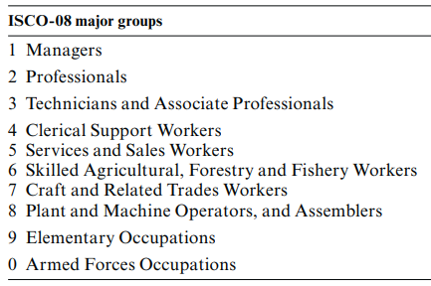
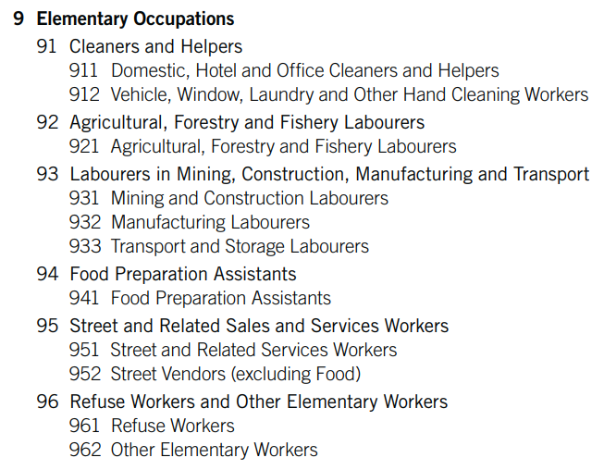
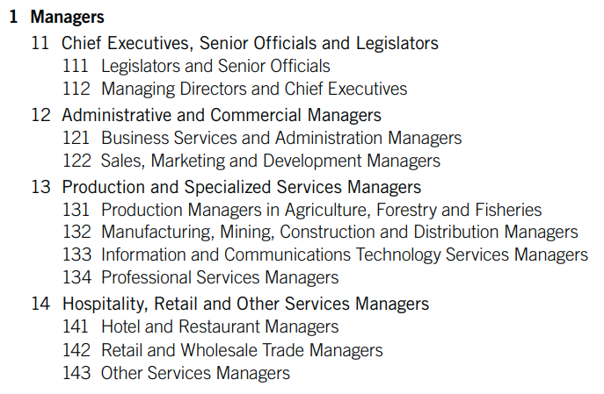
ISCO – International Standard Classification of Occupations
ILO: International Labour Organization in Geneva
  original idea comes from 1921, the need for an ISCO
  the first elementary version of ISCO has been proposed in 1958
  ISCO68 -ISCO88 -ISCO08
ISCO – 4 digits

Slide 4
Categorical approach to occupation stratification
Class approach
Limited number of discrete categories
External heterogeneity (members differ from other members)
Internal homogeneity (similarity to other members of the same category)
Criteria that define heterogeneity and homogeneity are tested in empirical research
  Conditions (income, working time, vacation time, type of contract)
  Opportunities (mobility odds, financial bonuses, promotions)
How social classes are relevant for description and explanation of social phenomena
Social classes = social mobility
  Multidimensionality, social mobility patterns differ
Social classes are theoretical concept that is empirically tested

Slide 5
Continuous approach to occupation stratification
Hierarchical approach
Indexes are similar to prestige scales, but differences in construction
Unlimited number of distinctions among occupational groups
Differences in occupations can be captured in one dimension
  Represented by one parameter is statistical modeling
  Advantage when external heterogeneity and internal homogeneity do not work in the case of social classes
Can solve the problem of “intervening” variable in mobility analysis (gender, age, ethnicity)
Indexes (ISEI) = status attainment process
Reproduction is part of attainment process, social mobility is not directly measured

Slide 6
Social classes: categorical approach
Generally: social classes are connected to modern society
The labour market is the axis of modern life
Job = money that are necessary for life in society = the level of quality of life
  living conditions
Jobs (and labour markets in nation states) mean the organization of life, time and individual biographies

Slide 7
Fathers of social classes: Karl Marx and Max Weber
Karl Marx (1818–1883), German philosopher, economist, sociologist.
Two classes in modern society: class antagonisms under capitalism between the bourgeoisie and proletariat
Classes are defined by the relationship to production
  Bourgeoisie owns means of production
  Proletariat owns just labour power
Structural specification of social classes
Max Weber (1864–1920), German sociologist, philosopher, and political economist
Class position means the labour market position
Jobs
Many classes and specific cultural behaviour (explanation!)
Cultural specification of social classes

Slide 8
Social classes in modern societies
Social classes are groups of people in the same labour market position
People with the same labour market chances
  The same odds to get certain type of work
  The same odds to get the similar salary
  The same odds to do certain type of paid activity
Are social classes the social groups today?
  Is job/employment so important that makes social class?

Slide 9
Theory of social classes
Theory of social classes must answer two key questions:
What criteria and why these criteria differentiate positions in the labour market?
  How many social classes?
Who belongs to which social class?
  Does the social class exist as a social group? What have social class representants similar?

Slide 10
Empirical measurement of social classes
Up to 1980’s huge distance between class theory and empirical indication of class differences
A lot of authors wrote about class differences in the modern labour markets but the problem was how to indicate them
Empirical indication of class differences = operational definition
  operationalization
Theory is a base of concept of social classes
Why social classes cannot be derived from empirical reality?

Slide 11
EGP, ESeC => ESeG
EGP and ESeC => ESeG
  The most popular social class empirical indications today
EGP (Erikson, Goldthorpe and Portocarero)
  Origins in 1980s
  It was developed for occupational structure for Great Britain in 1980s.
ESeC is updated EGP
ESeC is developed for contemporary european countries

Slide 12
What is the ESeC?
A statistical tool for for understanding the differences in social structures and socioeconomic inequalities across the EU
Completed in 2006 by Eurostat
Consortium of academics from six different EU countries
Goal of ESeC
  to arrange a set of entities into groups, so that each group is:
    as different as possible from all other groups
    but each group is as internally homogenous as possible.

Slide 13
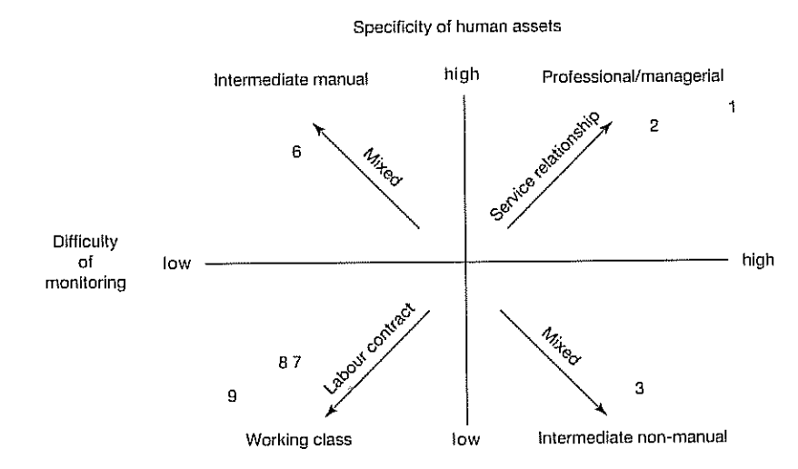
Primary distinctions in ESeC (derived from EGP)
Employers – who buy the labour of others and assume so level of authority and control over them
Self-employed – neither buy labour nor sell their own labour to an employer
Employee – who sell their labour thus placing themselves under control of an employer
Excluded – involuntary unemployed, long-term disability

Slide 14
ESeC
classs scheme I

Slide 15
ESeC
classs scheme II

Slide 16
Why is the ESeC needed?
A way to compare economic prosperity internationally
Monitor social structure change
Observe the pace of “climbing the social hierarchy”
  Relevant to governments and politicians
Determine if there are factors such as age, race or sex that make an individual more disposed to be in a certain socioeconomic classification
Harmonization makes comparison easier and more statistically significant

Slide 17
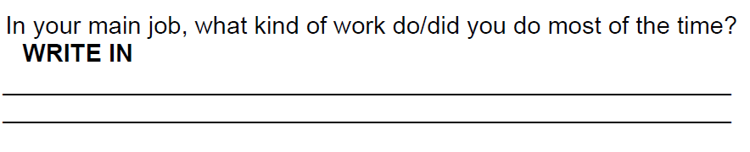
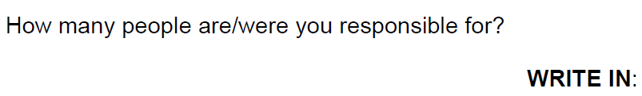
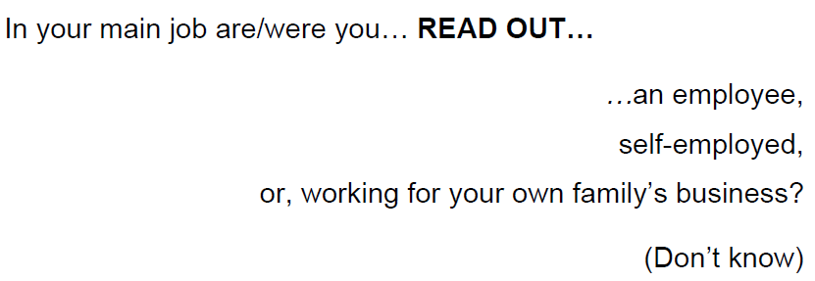
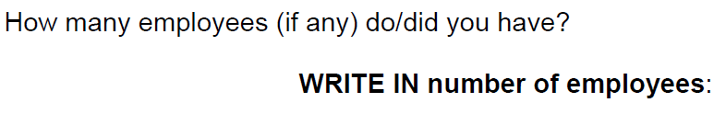
Empirical variables for identification of ESeC positions
Questions for questionnaire
ISCO
Additional questions:

Slide 18
Proportion of ESeC and EGP in the Czech Republic (6 class version, 2012)

Slide 19
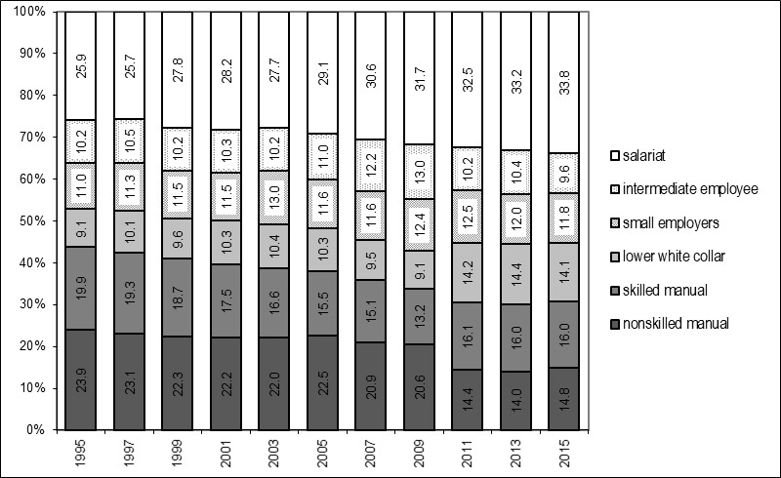
Trends in ESeC in the Czech Republic (6 class version)

Slide 20
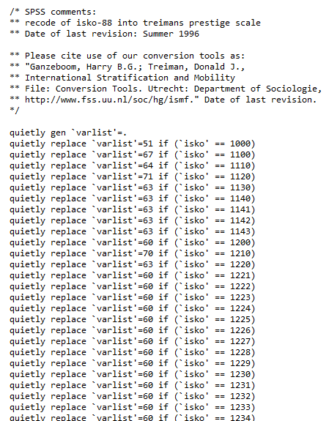

Prestige ratings - SIOPS
SIOPS - Standard International Occupational Prestige Scale (SIOPS) scores
constructed by Donald J. Treiman: Occupational Prestige in Comparative Perspective (1977)
averaging the results of prestige evaluations from 60 countries
  evaluative judgments
  sample of population or experts
  prestige judgments of occupations
  general desirability of occupations
ISCO code = prestige rating code

Slide 21
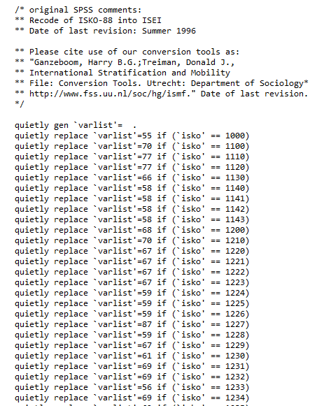
ISEI: International Socio-economic Index of Occupational Status
ISEI is generated on the base of optimal scaling procedure
EDUCATION -> occupation -> INCOME
EDUCATION -> ISEI -> INCOME
Zero correlation EDU-INCOME
ISEI is empirical concept without theoretical support

Slide 22
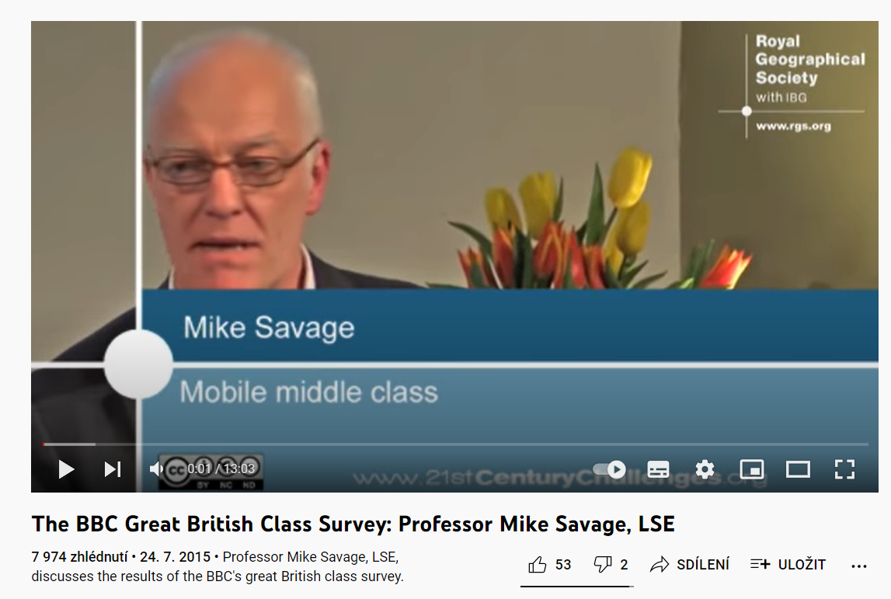
New class scheme?
YT video with Mike Savage about research of social classes in Britain: https://youtu.be/m1rSJedkoQ4

