Slide 1
Theory of social mobility I
Social mobility is the movement of people up or down the stratification system.
Class systems allow for more movement than slave or caste systems.
Intragenerational and intergenerational social mobility.
While class systems do allow for social mobility, opportunities are not evenly distributed across social groups
Social origin class/actual social class position have a significant impact on many aspects of life, including education, occupation, place of residence, marriage partner, and more
Against to economic liberal view of social world
1
Notes:
An important characteristic of class systems, as opposed to slave or caste systems, is that in class-based systems of stratification, there is the opportunity for social mobility. This means that people and groups can, potentially, move up or down in the rankings, and this is seen by many as a significant benefit of class systems.
In reality, however, such mobility is less common than our national mythology suggests. Typically, those who arrive at high positions have families who either had high positions themselves or the resources to provide the appropriate education for advancement. Achieving upward mobility is very difficult, and the wonderful stories we’ve all heard and seen (think, for example, of the movie The Pursuit of Happyness) are so very moving because they are the exception, not the norm. If such stories were common, they would not get our attention in nearly the same way.

Slide 2
Theory of social mobility II
Loss aversion - psychological concept
Those who now occupy managerial and professional positions will do all they can to protect their children from falling down the social ladder.
To pay for the best pre-school provision
To buy houses in areas with high-performing state schools
To hire private tutors, and arrange educationally enriching experiences
All human behavior can be interpreted from the point of social position reproduction in time

Slide 3
Theory of social mobility III
People may move up or down the social ladder within their lifetime or from one generation to the next.
Everyone has the same chance of moving up is what lies behind the idea of equality of opportunity.
Social mobility can relate to an individual’s life opportunities or opportunities in relation to parents (intergenerational)
ISO – inequality of social opportunity - definition
IEO – inequality of educational opportunity - definition

Slide 4
Inequality of opportunity
Indicated by social mobility
Trends in European countries
From agriculture to industry: industrial societies
From industry to services: post-industrial societies
These trends are reflected in structural social mobility trends
But no changes in social fluidity (relative social mobility)
Odds ratios are the same
Three factors that influence pattern of social fluidity
desirability
bariers
resources
4
Notes:
An important characteristic of class systems, as opposed to slave or caste systems, is that in class-based systems of stratification, there is the opportunity for social mobility. This means that people and groups can, potentially, move up or down in the rankings, and this is seen by many as a significant benefit of class systems.
In reality, however, such mobility is less common than our national mythology suggests. Typically, those who arrive at high positions have families who either had high positions themselves or the resources to provide the appropriate education for advancement. Achieving upward mobility is very difficult, and the wonderful stories we’ve all heard and seen (think, for example, of the movie The Pursuit of Happyness) are so very moving because they are the exception, not the norm. If such stories were common, they would not get our attention in nearly the same way.

Slide 5
Skleněný strop (Glass ceiling) | X | Lepivá podlaha (Sticky Floor)
omezení, bariéry | X | hodnoty, motivace
stejné úsilí | X | rozdílné úsilí
problém na straně systému | X | problém na straně rodiny/jedince
systémové/sociální vysvětlení | X | kulturalistické vysvětlení
Emile Durkheim | X | Max Weber
sociální fakta | X | sociální jednání
metodologický holismus | X | metodologický individualismus
Strukturní, systémové teorie | X | Teorie individuální
Strukturní změna/změna v omezeních | X | Teorie racionlání volby
Teorie kohortní výměny (v nejvyšších stupních vzdělání nejnižší OD asociace) | X | Mobilitní strategie (shora, zdola), Teorie averze k riziku
Age, Period, Cohort efekty v mobilitním výzkumu
5
Notes:
An important characteristic of class systems, as opposed to slave or caste systems, is that in class-based systems of stratification, there is the opportunity for social mobility. This means that people and groups can, potentially, move up or down in the rankings, and this is seen by many as a significant benefit of class systems.
In reality, however, such mobility is less common than our national mythology suggests. Typically, those who arrive at high positions have families who either had high positions themselves or the resources to provide the appropriate education for advancement. Achieving upward mobility is very difficult, and the wonderful stories we’ve all heard and seen (think, for example, of the movie The Pursuit of Happyness) are so very moving because they are the exception, not the norm. If such stories were common, they would not get our attention in nearly the same way.

Slide 6
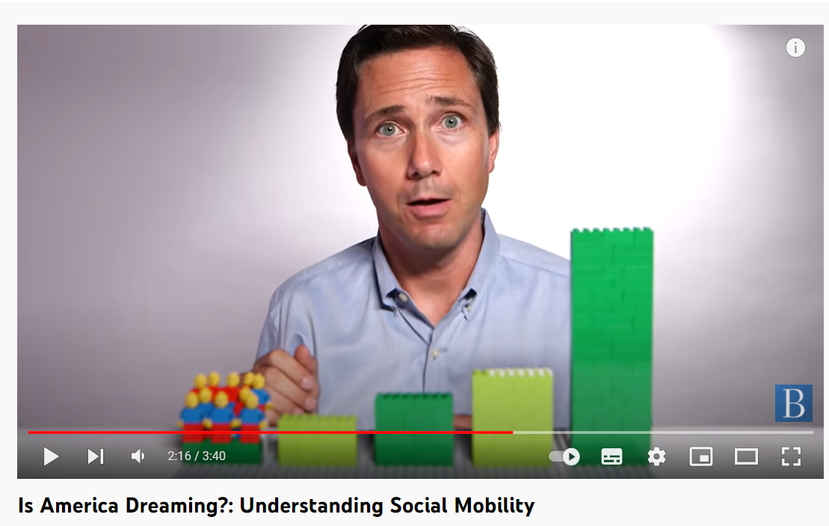
Is America Dreaming?: Understanding Social Mobility
YT: https://www.youtube.com/watch?v=t2XFh_tD2RA

Slide 7
Social mobility - politicians
“I want to see social mobility rising once again,” said prime minister Tony Blair in 2004
“We can unleash the biggest wave of social mobility since the second world war,” said prime minister Gordon Brown in 2010.
“I want to see a more socially mobile Britain,” said David Cameron in 2013.
“I want Britain to be the world’s great meritocracy,” said Theresa May in 2016.
Why does social mobility happen?
Two general factors that influence social mobility
Level of inequality
Exogenous and endogenous factors
Exogenous, structural factors, absolute mobility
Endogenous, individual factors, relative mobility

Slide 8
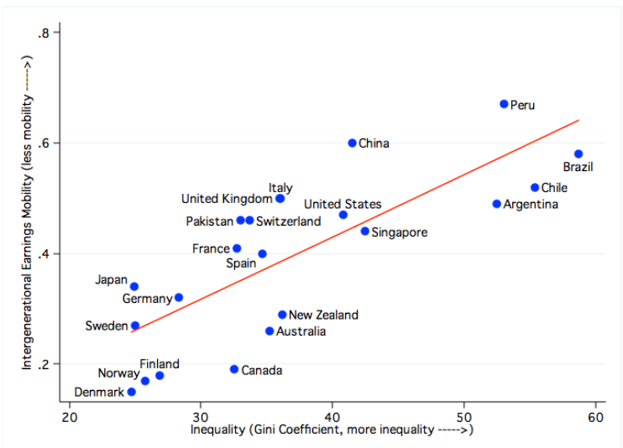
Level of inequality I - GGC
What is the relatioship between inequality and social mobilty?
Aggregated level – Great Gatsby Curve
Higer economic inequality means lower social mobility and vice versa
Inequality generates less opportunities, low social mobility
GGC: Great Gatsby Curve
8
Notes:
An important characteristic of class systems, as opposed to slave or caste systems, is that in class-based systems of stratification, there is the opportunity for social mobility. This means that people and groups can, potentially, move up or down in the rankings, and this is seen by many as a significant benefit of class systems.
In reality, however, such mobility is less common than our national mythology suggests. Typically, those who arrive at high positions have families who either had high positions themselves or the resources to provide the appropriate education for advancement. Achieving upward mobility is very difficult, and the wonderful stories we’ve all heard and seen (think, for example, of the movie The Pursuit of Happyness) are so very moving because they are the exception, not the norm. If such stories were common, they would not get our attention in nearly the same way.

Slide 9
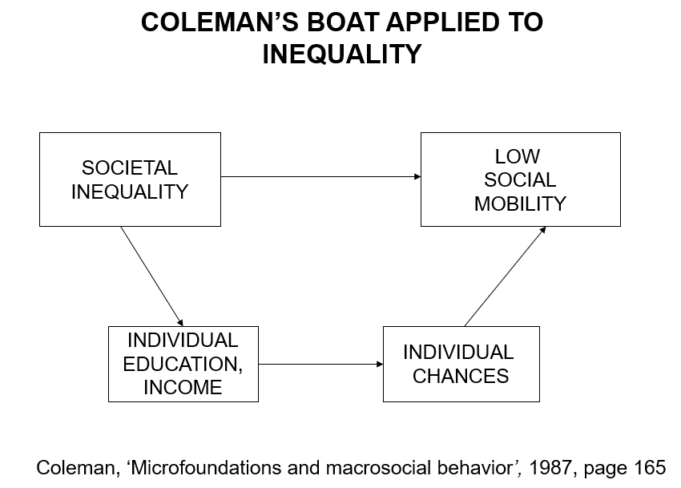
Level of inequality II - GGC
How does GGC work in individual level?

Slide 10
Exogenous factors I
Demographic, economic, political factors
Contextual dependent
Differences between countries
level of industrialization
technological and economic trends
Changes in social class structure
Changes in the proportions of social classes
Changes in numbers of people in classes vs changes in class positions of people
Changes in classholders vs changes in social mobility

Slide 11
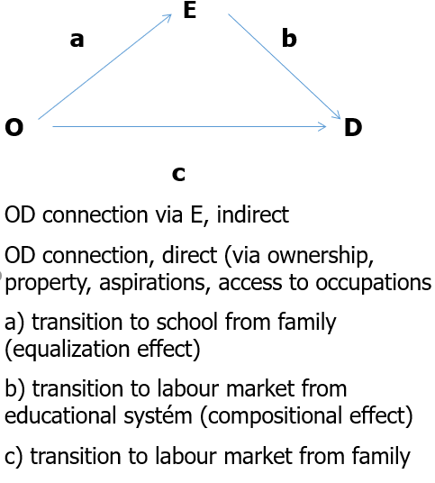
Example of exogenous factors
Birth cohort replacement, education, equalization and compositional effect in social mobility (Breen, Johnson, 2007)
Labour market = birth cohorts (APC differences)
Cohort replacement
Argument: in each younger cohort we can measure higher social fluidity (lower OD association)
Why? Connections: O - E – D triangle
Equalization effect
Compositional effect
This argument is relevant for stable democratic society „under normal circumstances“
11

Slide 12
Endogenous factors
Inner mobility regime
Contextual independent
Similar in all countries
Level of social fluidity is the same over countries – red queen effect
Similar factors that influence social fluidity
Sociological theories
Social vs. cultural reproduction (glass ceiling vs. sticky floor)
Theory of rational action (Goldthorpe, 1996; 2000), the aim is to avoid of social decrease, because of that strong orientation for social reproduction, especially in educational aspiration that are stratified according to social origin
Theory of cultural capital is a tool for reproduction of class position via educational system (Bourdieu, Passeron, 1964; 1977)

