Slide 1
Inequality of educational opportunity empirical measuring
(and educational expansion)

Slide 2
IEO and educational expansion
IEO: chances to attain certain level of education by social origin (SO) - family background
Educational expansion (EE) is seen as a social-political provision for change of IEO (inequality of educational opportunity)
EE via IEO helps to increase social justice, equality and meritocracy
The relationship between IEO and EE has higher relevance for academic research as well as for social policy and it is the source of legitimization of social systems.

Slide 3
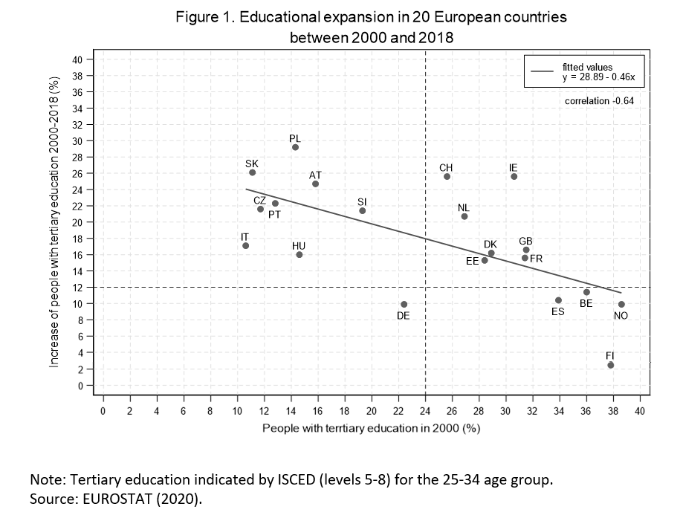
Educational expansion in European countries 2000+
Bologna process, declaration of European countries and the beginning of educational expansion in a year 2000
EE is defined as: the growth of the educational system. It means the increase of places in the educational system that is connected with increased rates of enrolment (Craig, 1981).
Notes:
In 1999, the Bologna declaration was signed. This can be seen as the beginning of the most recent wave of educational expansion in Europe. All these changes were encouraged by the need for highly educated people on the European labour markets and by further economic developments (Kogan, 2012).
The X axis shows the proportion of people with tertiary education in 2000 in each country. The Y axis shows how much this proportion increased between 2000 and 2018 (all year trends cf. Table A1, in the Appendix). The average proportion of people with tertiary education across countries was 24.1% in 2000 and 42.0% in 2018.
The educational expansion between 2000 and 2018 is negatively path dependent. The increase is lower in countries where the proportion with tertiary education was already high in 2000, and vice versa (the Pearson correlation is -0.64)

Slide 4
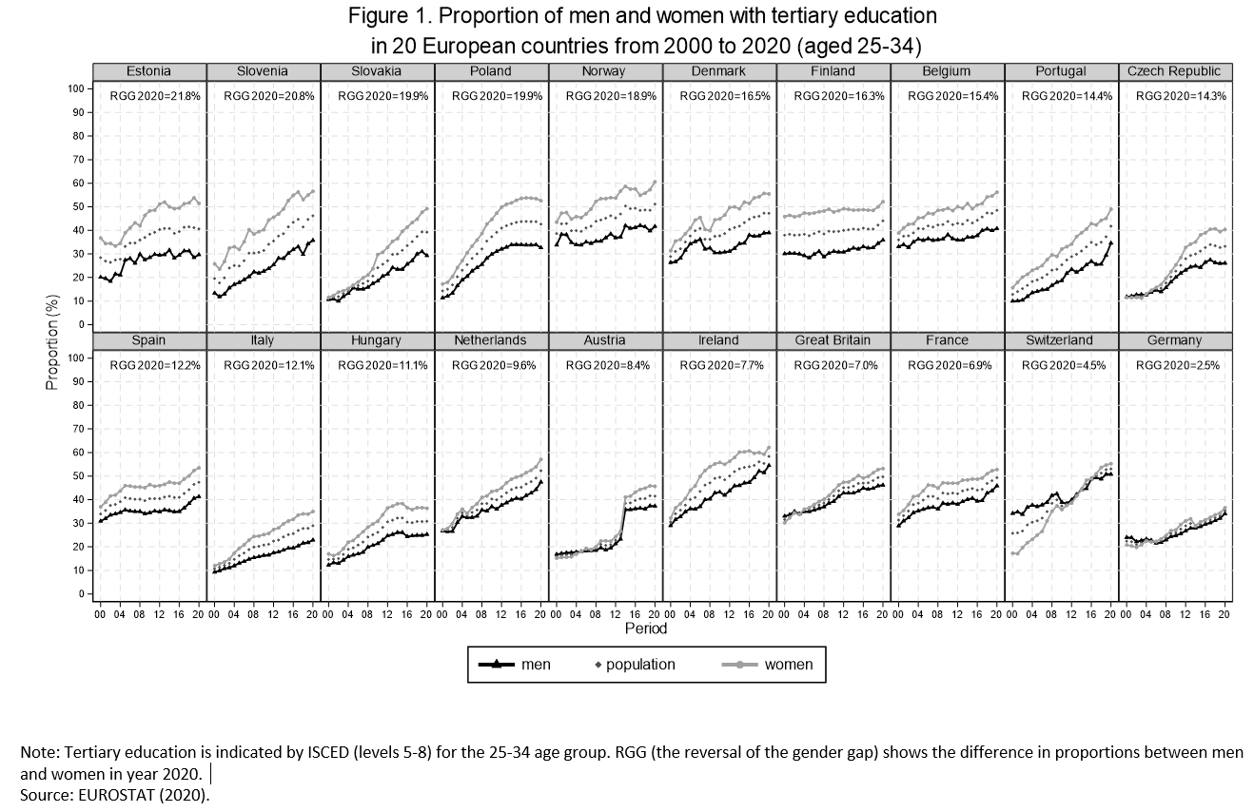
Educational expansion in European countries 2000+

Slide 5
Educational expansion and the reversal of gender gap (RGG)
Why RGG happens?
changes in the labour markets, marriages and in family lives (DiPrete and Buchman, 2013) = more incentives for women to obtain more education
economic and social returns to higher education
the labour force participation of women increases, because the labour markets demand specific occupations requiring higher education.
higher education means a greater insurance against poverty, high standard of living
parents’ incentives into children by gender have been equalized inside families
girls perform better than boys in colleges (higher level of their preparedness, differences in school-related attitudes and lower dropout rate)
Notes:
In 1999, the Bologna declaration was signed. This can be seen as the beginning of the most recent wave of educational expansion in Europe. All these changes were encouraged by the need for highly educated people on the European labour markets and by further economic developments (Kogan, 2012).
The X axis shows the proportion of people with tertiary education in 2000 in each country. The Y axis shows how much this proportion increased between 2000 and 2018 (all year trends cf. Table A1, in the Appendix). The average proportion of people with tertiary education across countries was 24.1% in 2000 and 42.0% in 2018.
The educational expansion between 2000 and 2018 is negatively path dependent. The increase is lower in countries where the proportion with tertiary education was already high in 2000, and vice versa (the Pearson correlation is -0.64)

Slide 6
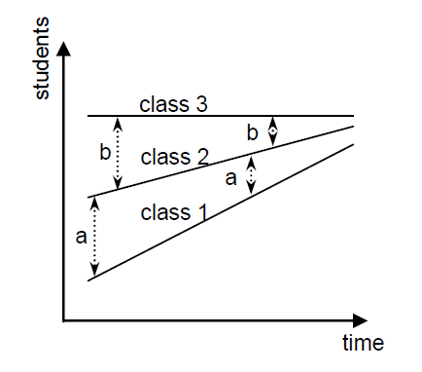
Distribution of education
Raymond Boudon in Education, Opportunity and Social Inequality (1974) says: If school attendance rates increase over time, then inequalities in educational opportunity will steadily decline, because the lower socioeconomic classes can increase their attendance rates by more proportions than the upper classes whose proportions are already high and constrained by ceiling effects.

Slide 7
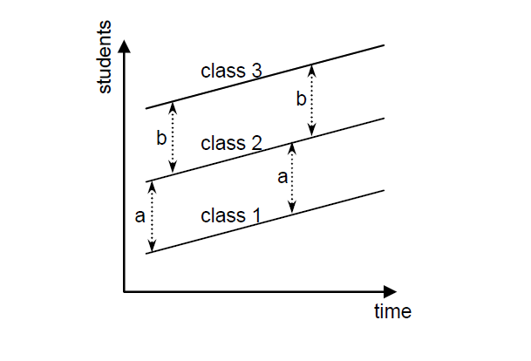
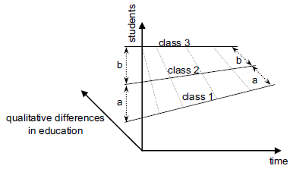
Empirical anti-evidence to Boudon
MMI (Raftery, Hout, 1993): differences in social origin effects on educational attainments do not change during EE
Persistent inequality (Blossfeld, Shavit, 1993) – no change in IEO
EMI (Lucas, 2001)
Why? Problem in measurement of IEO
Boudon
Empirical evidence - MMI
Empirical evidence - EMI

Slide 8
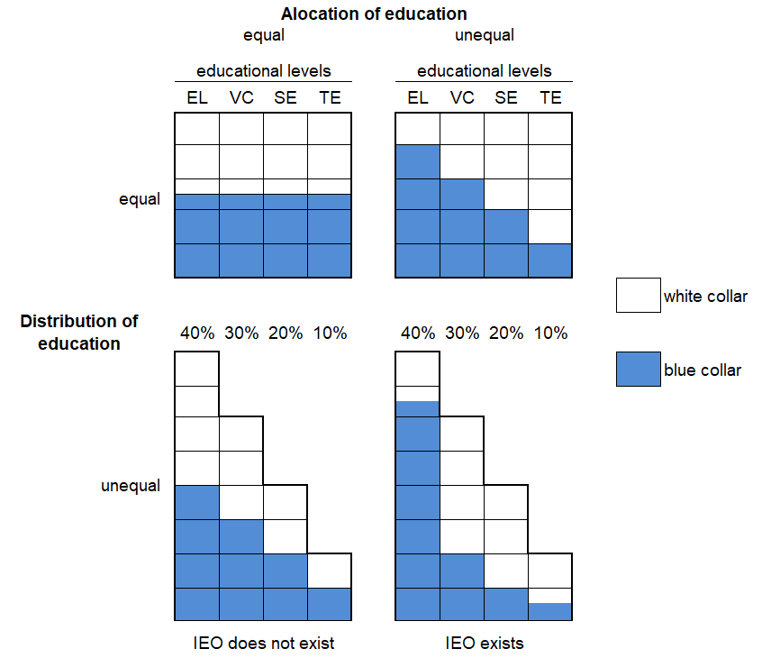
Distribution and alocation of education
Robert Mare (1980, 1981): the concept of distribution of education has to be completed by the concept of alocation of education
Changes in distribution of education does not mean the changes in alocation of education

Slide 9
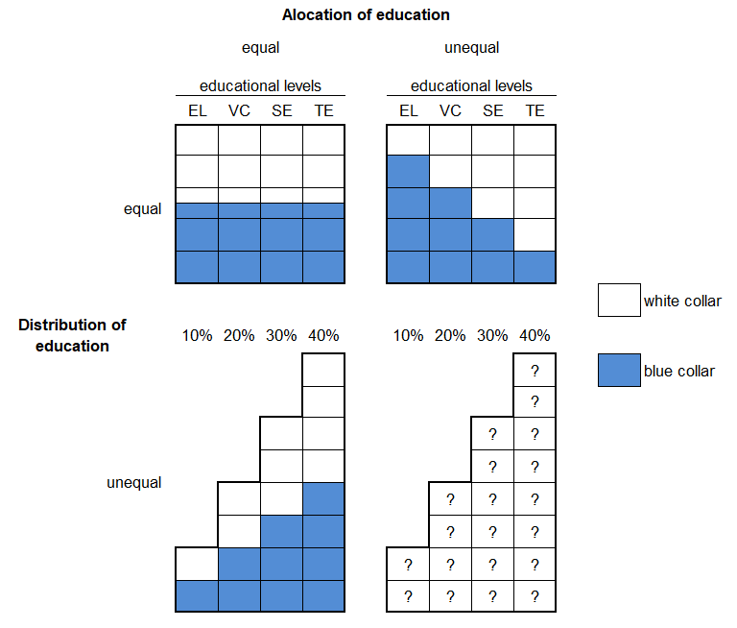
Distribuce a alokace vzdělání – výzkumná otázka
How does the chage in distribution of education influence the alocation of education?
How does educational expansion influence IEO?
Is the educational expansion the social politcal provision for the change of IEO?

Slide 10
Empirical measurement of IEO in SSR
Two ways of measurement of IEO
  IEO in educational attainment
    differences in completed (final) education levels by social origins (Blau and Duncan, 1967; Hauser and Featherman, 1976)
    linear models
    problem: SO effects and effects of changes in educational distributions are mixed
  IEO in educational transitions, that lead to final education levels (Mare, 1980, 1981)
    final education is disaggregated into individual educational transitions between educational stages
    differences in completed individual transitions by social origin
    sequential logit models - “true“ transitional SO effects based on the odds ratios, not influenced by changes in marginal distributions
    problem: connection between “true“ transitional SO effects and SO effects on final education level (these effects are usual different in empirical analyses)
Notes:
Mare’s approach can be understand as a decomposition of first approach.

Slide 11
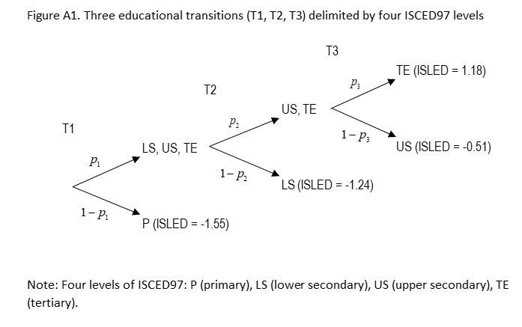
  Completed education E(L_{i}) can be measured as the sum of the conditional probabilities of attaining each educational grade (Mare, 1981)
Notes:
The transitions do not characterize the structures of European educational systems. They are sequences that reflect common barriers in these systems, and they should not be understood as real decisions about school continuation or discontinuation. They primarily indicate who drops out of the educational system and in which phase of the schooling process. We therefore use these sequences only for identifying IEO in European countries, and not for describing the educational systems, although in reference to the tradition of educational transitional analysis in sociology we still use the term ‘transition’

Slide 12
Connection between two approaches of IEO measurement
SO effect on completed education (IEO) is a weighted sum of SO effects on passing each educational transition (Mare, 1981, Buis, 2010, 2017)
  Completed education by SO is disagregated into (conditional) probabilities to pass educational transitions by SO
  Conditional probabilities are decomposed into:
    weights of transitions
    effects on passing educational transitions
  Weights of transitions = changes in transitional distributions given by educational expansions
  Both the social stratification and the structural features of IEO are considered
Notes:
What is the relationship between IEO measured by differences in completed education and IEO measured at the level of educational transitions?
Weights are given by
1] the probability of transitional passing
2) by proportions of people that are influence by transitions
3) by vertical differences between transitions.
If the weight is 0, there is no contribution of transition to IEO in completed education
If the weight increases from 0 over time or over educational expansion levels, the importance of transition grows (SO ‘true’ effect is less adjusted by weight).
Each educational transition then contributes in some specific part – as a weighted origin effect – to IEO in completed education. This means that the weights are factors that give ‘meaning’ to the ‘true’ origin effects in the process of IEO formation.
To use the conditional probabilities p for identifying educational outcome, it is necessary to assign meaningful numerical values to all education levels of respondents (Buis, 2010, 2017). These values define how the attained education is measured. We use the average values of standardized ISLED by ISCED97 categories.

Slide 13
Conclusion
Three empirical measures in IEO:
  the ‘true’ origin effect on passing educational transitions
  the weight of educational transitions
  the contribution of transitions to IEO in completed education (weighted origin effects)
  SO effect on completed education = linear models
  is a weighted sum of SO effects on passing
  each educational transition = transitional models.
Notes:
To understand the mechanism behind the relationship between educational expansion and IEO, it is important to make a distinction among three empirical measures:

Slide 14
Educational expansion in the CR in last 20 years II
What does educational expansion mean for transition to labour market?
  Can we talk about the inflation of diploma/certificates?
  If yes, is it good strategy to invest to education and increase number of young people in universities?
What happens with returns to higher education?
  In status consistency society they should be higher and increase
  Yes, returns to higher education increase
14

