Slide 1
Gender, Sex, Identity, Power
Feminism and LBGTQia+
Lesbian, Gay, Bisexual, Transgender, Questioning/Queer, Intersex and Asexual/Aromantic
+ (allies, pansexual, androgynous, and polyamorous, etc)

Slide 2
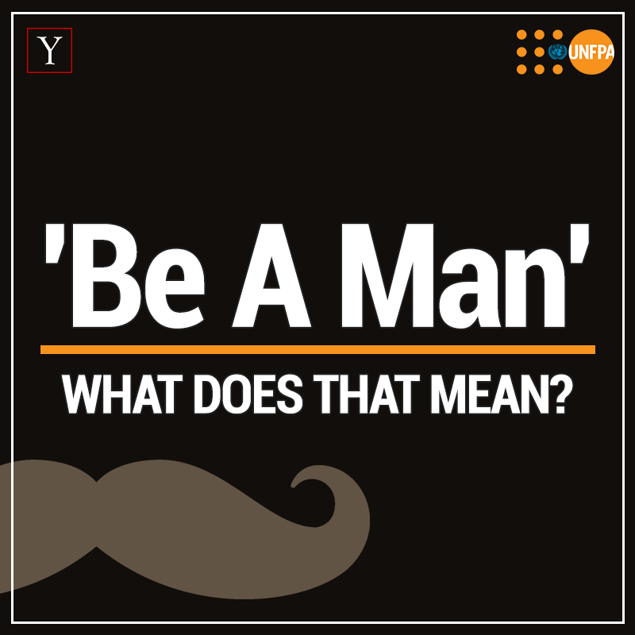
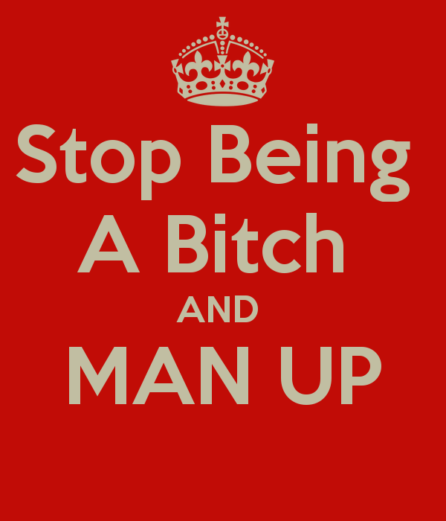
Framing Conceptions
Are you a feminist?
Why such strong reactions?
What are the (cultural) implications of using this label?
Can men be feminists?
What to make of these phrases →
How are they related to language and power?
Why isn’t there something called ‘masculinism’?
Men’s Studies

Slide 3
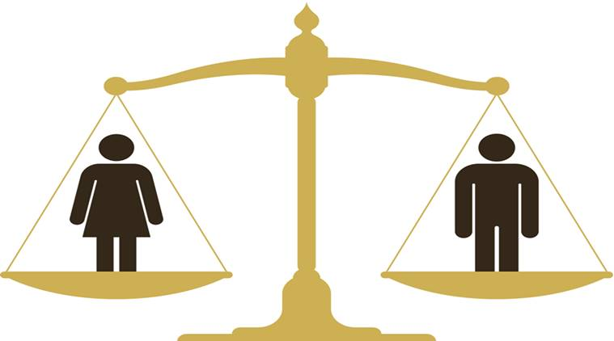
Feminism is About Equality for the both genders
Feminism is a range of political movements, ideologies, and social movements that share a common goal: to define, establish, and achieve political, economic, personal, and social equality of sexes

Slide 4
Waves of Feminism
First-wave: (roughly -19th century- beginning of the 20th century)
Second-wave: (roughly 1960-80s)
Third-wave: (early 1990s)
Fourth-wave: (from 2012 to today)

Slide 5
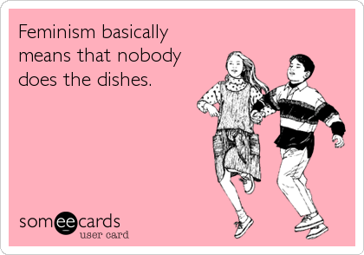
First- wave
19th Century to beginning of 20th Century
The aim of the first wave of feminism was to grant the right to vote, the right to education and property ownership

Slide 6
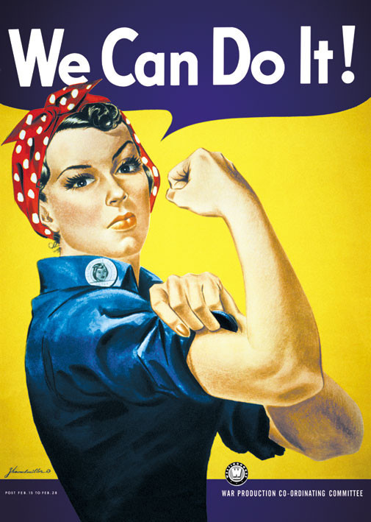
Second-wave
Second-wave feminism is a period of feminist activity and thought that began in the United States in the early 1960s and lasted roughly two decades (1980s)
The main theme of this wave is the position of a woman in society, disagreement with their exclusion from public life and disagreement with their position in the “home”
Betty Friedan - wrote the bestselling book The Feminine Mystique. She explicitly objected to how women were depicted in the mainstream media, and how they placed them at home limited their possibilities and wasted potential
Women began to gain access to virtually all professions

Slide 7
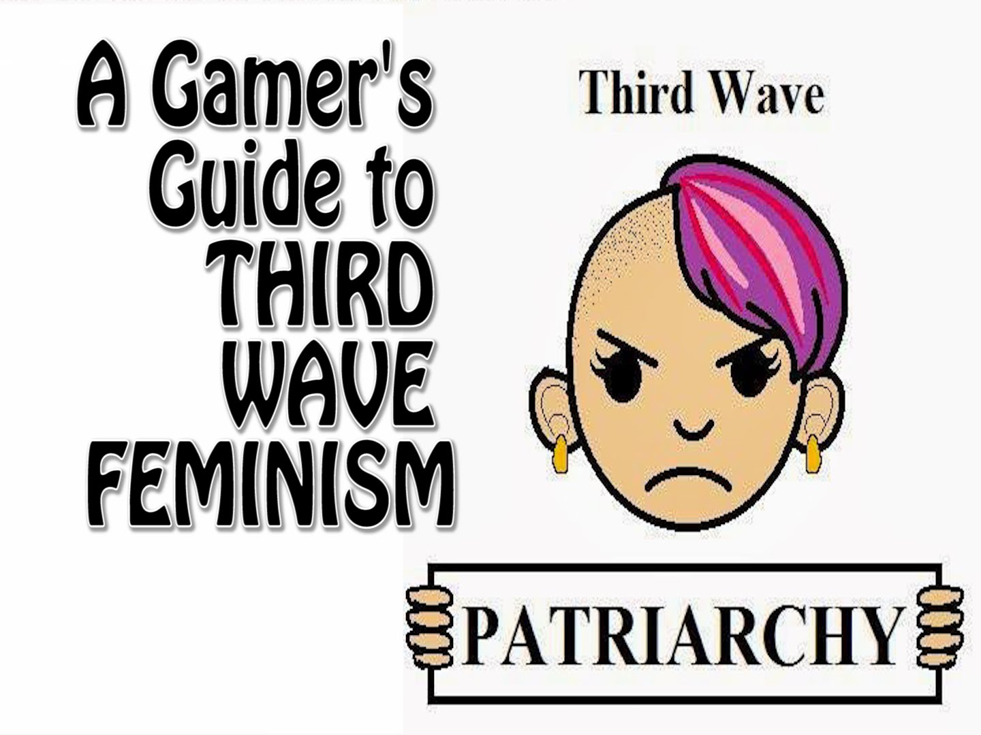
Third-wave
Arose as response to the failure of the second wave (1990s)
multiple feminisms
heavily influenced by academic investigations of queer theory
→ gender and sexuality are fluid categories, do not easily map into “men” and “female”
increased understanding of bisexuals and transgender identities
Consider issues of domestic violence, maternity leave, equal pay, women's suffrage, sexual harassment, and sexual violence
has been critiqued for its focus on individual emancipation; “individualism” (Identity Politics)

Slide 8
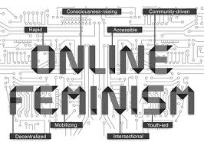
Fourth-wave
due to the Internet, there us a shift from third wave – to mainly social media
internet has created a “call-out” culture
Still influenced by the third wave
internet has facilitated the creation of a global community of feminists - discussion and activism
feminism is being reinvigorated by the Internet

Slide 9
Contested feminism
Simona fojtová

Slide 10
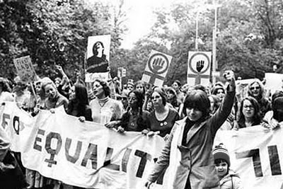
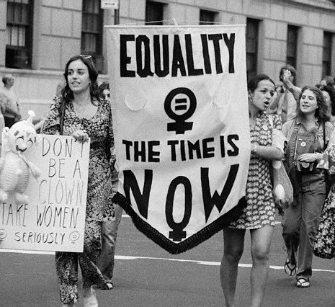
the Western feminism

Slide 11
The east/west feminist Encounters in the 1990s
Political program
Accept it or reject it
Do you agree that culture makes a difference in how we experience the world?
National Organization for Women sponsors a protest in front of the US capitol, October 7, 1985

Slide 12
“Now it has become fashionable in the West to talk of “race, class and gender” as intersection lines of oppression, but this doesn’t offer a framework for East European women’s experience“
Laura Busheikin (1993)

Slide 13
Structuralism/Post-Structuralism
The power of the binary/the uncertainty of the slipping signifier
Words, Discourse, language, identity and power
Rights, access, and the anxieties around identity/sex?

Slide 14
Fluidity
THE HISTORY AND SCIENCE OF GENDER FLUIDITY
gender fluidity and trans identity in context (socially-constructed “definitions”)
What do you make of their argument?

Slide 15
Identity politics as they intersect Gender and Sex
Sex - The characteristics that identify a person as male, female or intersex (people born with physical features, especially genitals or chromosomes, that are neither clearly male nor clearly female or are a combination of female and male).
Gender - The set of behaviors and activities that are culturally identified as "masculine" or "feminine." These include clothing, hairstyles, body language, occupations, hobbies and so on.
Sex is a biological characteristic based on chromosomal factors and sex characteristics such as genitals. Gender is a social construct and refers to how an individual navigates the world through identity (pronouns, names, etc.), how we dress and our mannerisms (feminine, masculine), and how we see ourselves. Often, these two get mixed up, resulting in the misconception that our body parts decide our gender.
Intersex statistics (approximations)

Slide 16
Questions to Consider
What is at stake for society by instituting conceptions of non-binary identities?
How is this issue related to power and language?
Can cultural change be judicially implemented (Does banning books, passing laws, implementing curriculum (CRT, sex education, etc.) bring about/stave off cultural change?)

Slide 17
Identity Politics
Stated simply, identity politics is the assertion that “the most profound and potentially most radical politics come directly out of our own identity, as opposed to working to end somebody else’s oppression.” The Combahee River Collective detailed how their experiences as Black women were different than those of white women, and this mattered because understanding the ways in which racial, economic, gender, and other oppressions were linked and shaped their lives helped to make sure that no one could be left behind.

Slide 18
Identity Politics
Progress and Power – for whom? What is at stake for speaking out/keeping quiet?
Racial identity is an invented series of social categories which have impacts on power and agency socially, economically, and politically. Though race is socially constructed, it has material and practical implications for the lives of those who have been assigned racial categories at the losing end of the spectrum of power.
Central/Eastern Europe – Is diversity an issue?
If whiteness is the standard, it also is the criteria used to determine whether ideas, actions, or experiences have worth, merit, or value. Whiteness attempts to determine what is valid. Too often, whiteness dismisses the experiences and worldviews of people who are not white, because the opinions, values, needs, and beliefs of people who are not white are not considered to have merit, particularly when compared to whiteness.
As a white (man), how should I respond?
Focusing on difference at the expense of the “collective”?
a fixation on diversity renders people incapable of seeing outside of their own experience, preventing them from being able to build relationships with those who do not share their experiences. And, in the political realm, they argue that a focus on differences, rather than what we share in common, is a strategic mistake in elections. Another fallacy from critics of identity politics is that identifying and addressing differences somehow prevent people with different histories, backgrounds, ethnicities, identities, or experiences from finding commonality.

Slide 19
Identity Politics – has it gone too far?
The most vocal activists use Identity as the reason why everyone must listen to them, instead of trying to convince people why they must be listened to. They make as many sweeping generalizations about identity—who can speak, who can ask questions, who can understand, who must try to understand but will never understand anyway—as they accuse others of making. So, they shouldn’t be surprised when, instead of effecting change, they are now mired in cultural wars—the product of dissenters turning identity politics against them.
Identity politics makes people feel better about themselves at the expense of productive discourse. A person’s lived experience should never be invalidated. But no identity makes the beliefs that someone derives from their lived experience automatically more correct. In a time of such polarization, identity politics makes us close ranks with the like-minded when we need to reach out.
Consider: https://www.facebook.com/GLBLCTZN/videos/265091260697013/

Slide 20
Cancel Culture: Responses and their Logic
Cancel culture allows marginalized people to seek accountability where the justice system fails. Cancel culture amounts to online bullying, and can incite violence and threats even worse than the original offense being called out
Cancel culture gives a voice to disenfranchised or less powerful people. Cancel culture is not productive and does not bring about social change.
Cancel culture is simply a new form of boycott, a cherished tactic in the civil rights movement, to bring about social change. Cancel culture is a slippery slope and leads to intolerance in democratic societies as people systematically exclude anyone who disagrees with their views.

Slide 21
The way forward?

Slide 22
https://www.weforum.org/agenda/2018/08/chart-of-the-week-equal-pay-remains-a-global-issue
https://esldiscussions.com/f/feminism.pdf

