Slide 1

Female and male genres

Slide 2
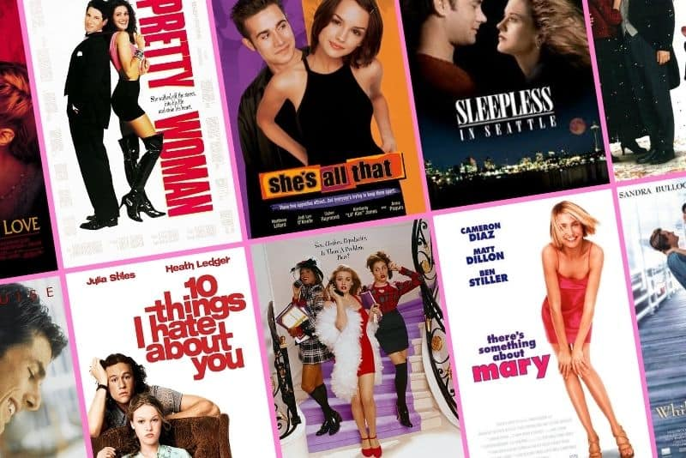
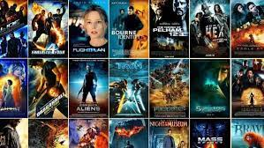
What are female and male genres?

Slide 3

Genres in general
Genre – a construction that can differ among producers, audiences, advertisers etc. Simply – an expectation of some formal, structural and content fulfillment.
Female genres: soap operas, melodrama, romance, telenovela, reality show
Male genres: action, adventure, sci-fi, fantasy + news!
Why?

Slide 4

Reading the Romance (J. Radway)
Ethnographic study – how women read romance (why do they read it)
Explicitly political – recruiting women for feminism (and away from romance)
Important study – the act of reading (reading is more important than text)
Reading is
  Relaxing
  Escaping
  Guilty pleasure (guilty about time spent with books, money spent and pleasurable feeling)
  Compensatory literature
  Collective fantasy (constructed by Radway!)
  The books – ideal men seeing the true value of the heroine, emotional realism

Slide 5

Watching Dallas (I. Ang)
„active audience“ paradigm – study of pleasure from watching soap opera
Netherlands, 1982, ad in magazine Viva – 42 responses
A need to read the letters symptomatically („with suspicion“)
What soap operas bring to their audiences: relaxation, fun, emotional realism – tragic structure of feeling (main reason for liking Dallas)
  „World is a sad place no matter your social status“
Other works on Dallas – The Export of Meaning: Cross-Cultural Readings of Dallas (Liebes, Katz)

Slide 6

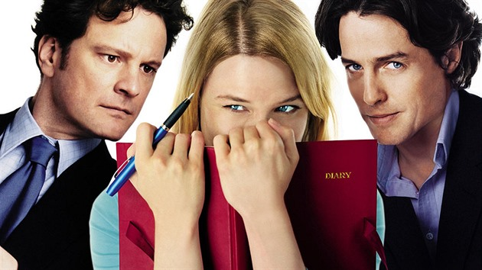
Bridget Jones Diaries (A. McRobbie)
Bridget as an exemplar heroine
  product of modernity (education, free agent, single, childless, enjoying herself vs. anxiety about loneliness)
  self-monitoring subject (diary, confiding in friends…)
  invoking feminism and relegating it to the past
The infectious girlishness of Bridget Jones produces a generational logic which is distinctly post-feminist. Despite feminism, Bridget wants to pursue dreams of romance, find a suitable husband, get married and have children.
Post-feminism in this context seems to mean gently chiding the feminist past, while also retrieving and reinstating some palatable elements, in this case sexual freedom, the right to drink, smoke, have fun in the city, and be economically independent.

Slide 7
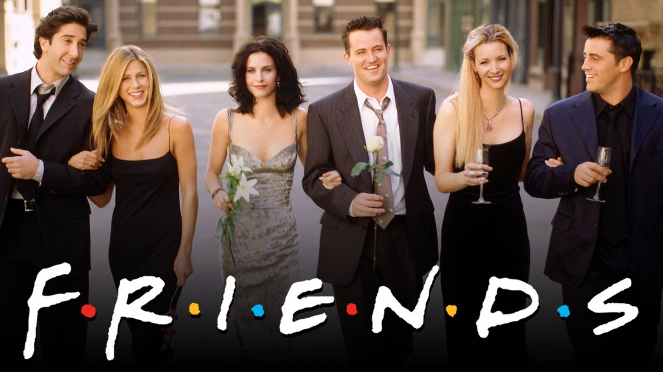
Post-feminist series (Friends, Ally McBeal, Sex and the City, Desperate Housewives)
90‘s and early 2000
McCabe and Akass label Friends as explicitly post-feminist series along with the other mentioned in the title
Monica is the figure of the „postfeminist singleton“ – embodies and articulates a discourse that is centered on white, heteronormative romantic love, and the fetishization of the domestic sphere, encompassing both domestic labor and the inhabitation of domestic space.

Slide 8
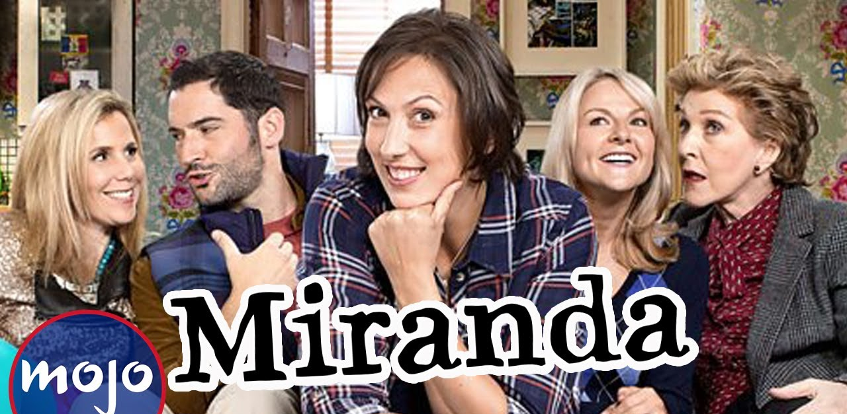
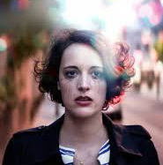


What about now?
The Bold Type
Miranda
Why Women Kill
Fleabag
Emily in Paris
…

Slide 9
