Slide 1
East Africa
Lucie Konečná
BSSn4457 Regional Security Complexes
12/10/2023

Slide 2
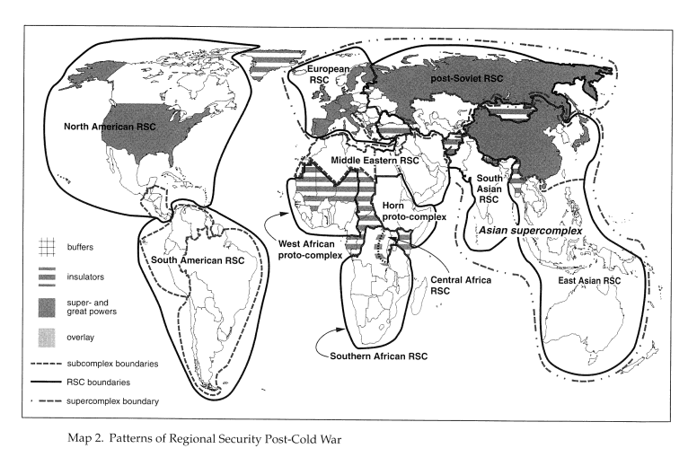
Regional Security Complexes

Slide 3
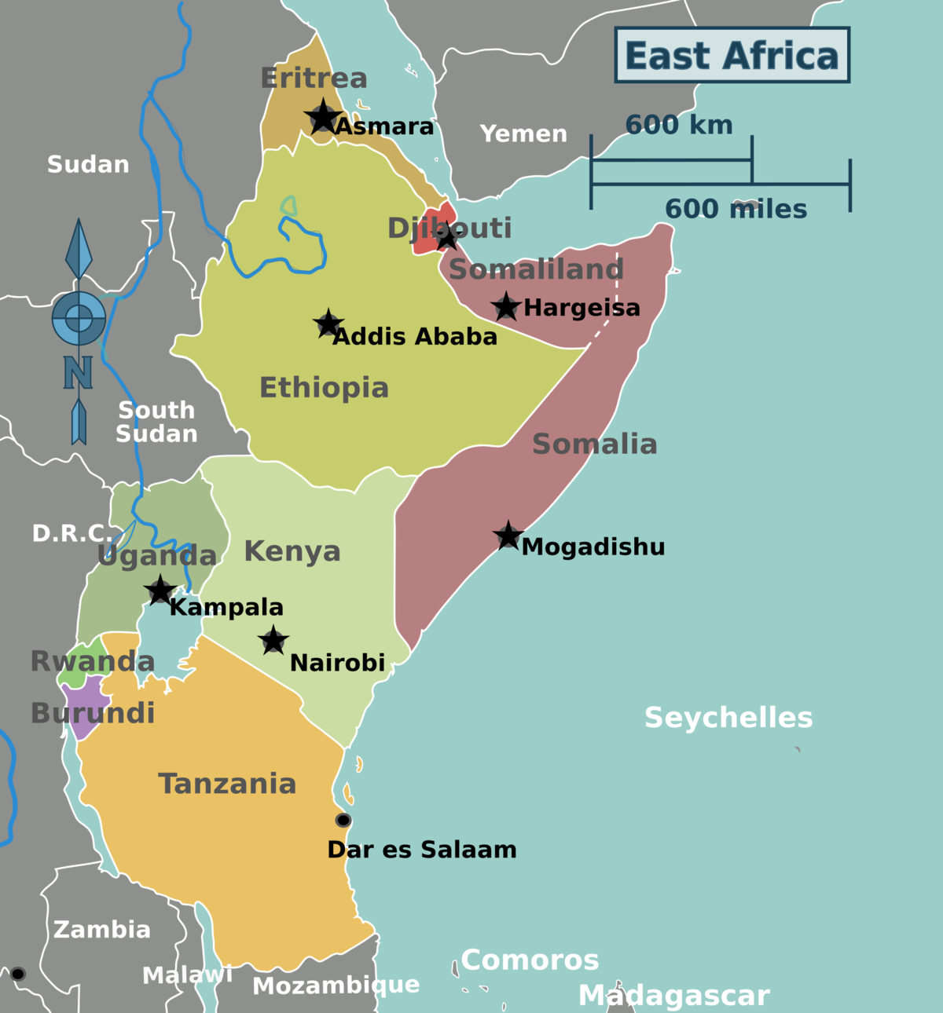
East Africa
Eritrea, Ethiopia, Kenya, Somalia, Djibouti.
Great Lakes Region: Uganda, Burundi, Rwanda, Tanzania, DRC, Malawi?

Slide 4
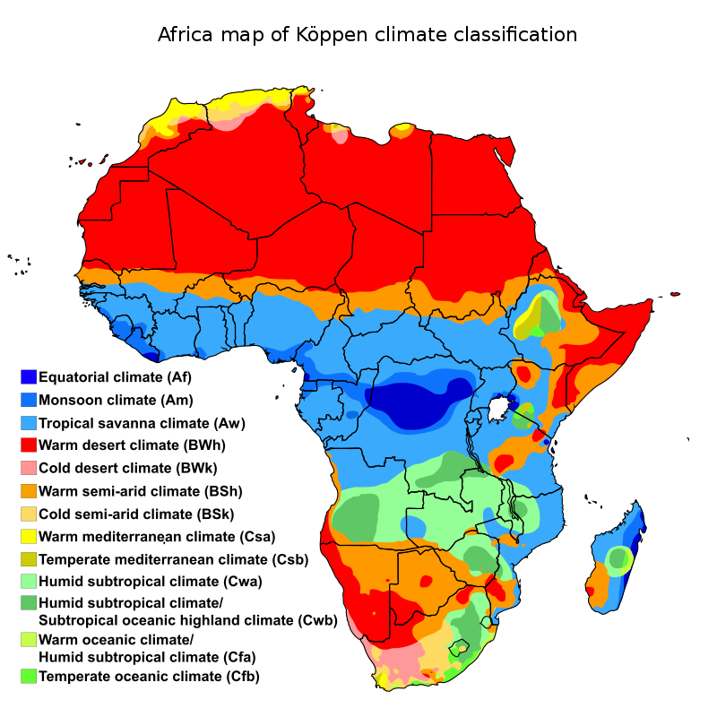
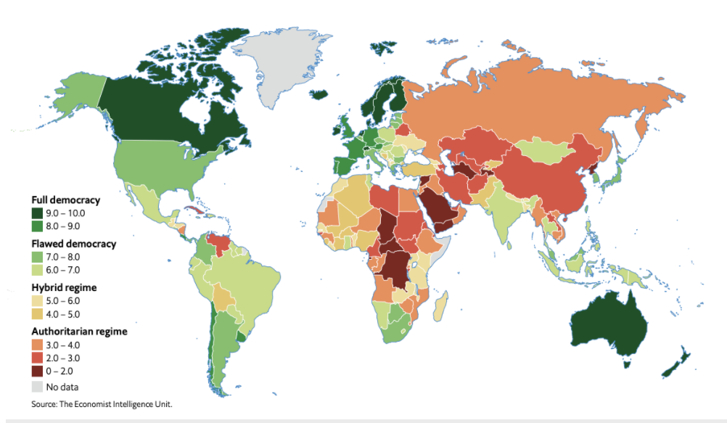
Facts about EA
Around 196 million inhabitants
Geography - African Great Lakes - Victoria and Tanganyika, Mount Kilimanjaro (4,900 metres), high concentrations of wild animals (big five), Rwenzoris, Eastern Rift mountains and Ethiopian Highlands.
FSI (FFP) – Somalia (1st), Djibouti (45th), Eritrea (19th), Kenya (35^{th)} Ethiopia (11th)

Slide 5
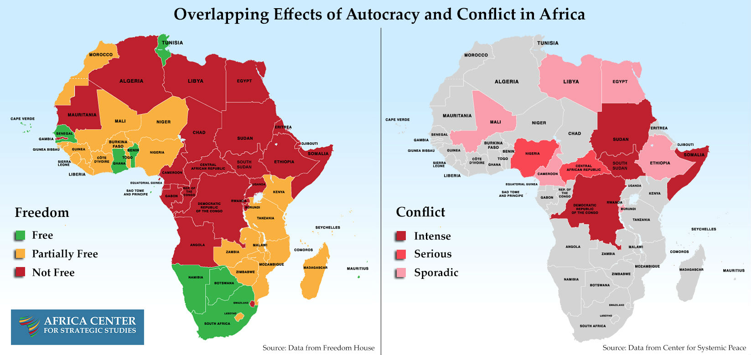

Slide 6
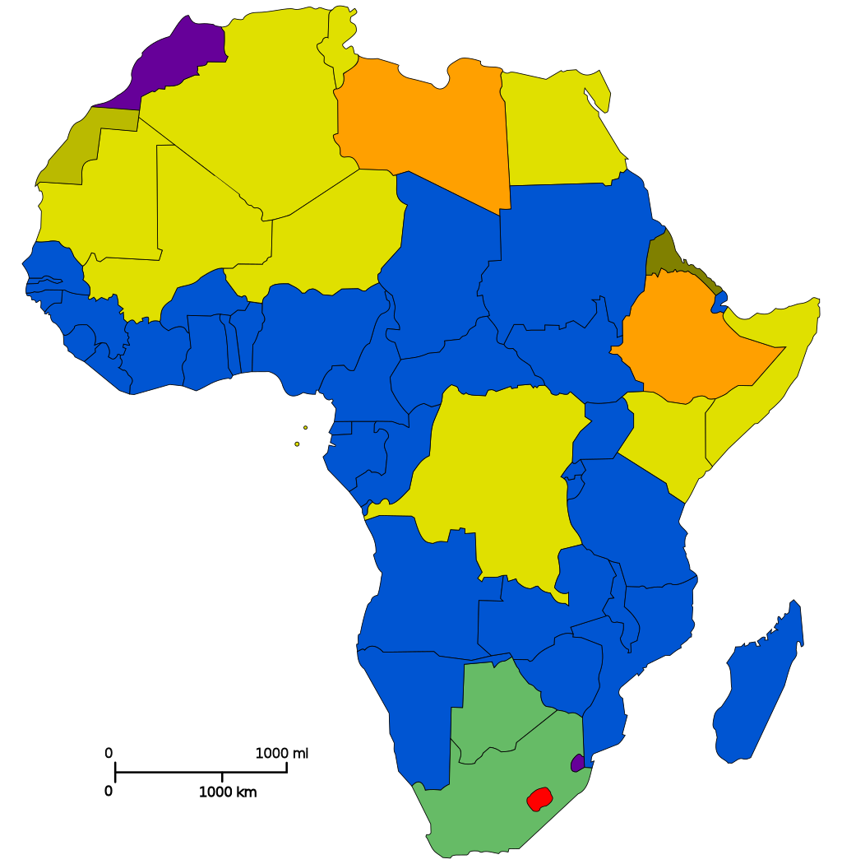
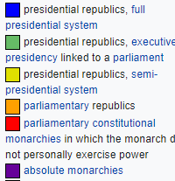
EA – Form of Government

Slide 7
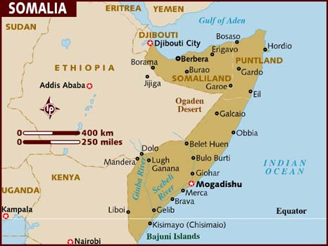
Somalia
17 mil inhabitants, Sunni Muslim (Islam)
Independence 1960
Ogaden war 1977-1978
The fall of the Barre regime
and the beginning of the Civil War 1991
The Islamic Courts Union – Al-Shabaab

Slide 8
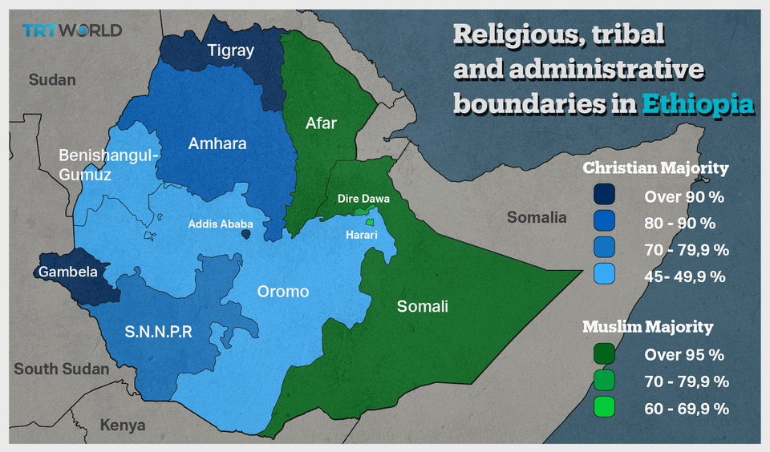
Ethiopia
120 mil inhabitants, Ethiopian Orthodox 43.8%, Muslim 31.3%, Protestant 22.8%
Oromo 34.4%, Amhara 27%, Somali 6.2%, Tigray (Tigrinya) 6.1%
Ethiopian-Italian War (1935-36), occupation of Italy until 1941
The overthrow of the emperor, the new regime 1974
Ogaden war 1977-1978
Civil War 1974-1991
EPRDF - Oromo Democratic Party (ODP), Amhara Democratic Party (ADP)Southern Ethiopian People's Democratic Movement (SEPDM) and Tigray People's Liberation Front (TPLF)
Ogaden National Liberation Front
Oromo Liberation Front
Eritrean-Ethiopian War 1998-2000
Tigrayan People's Liberation Front
(Conflict 2020-2022)

Slide 9
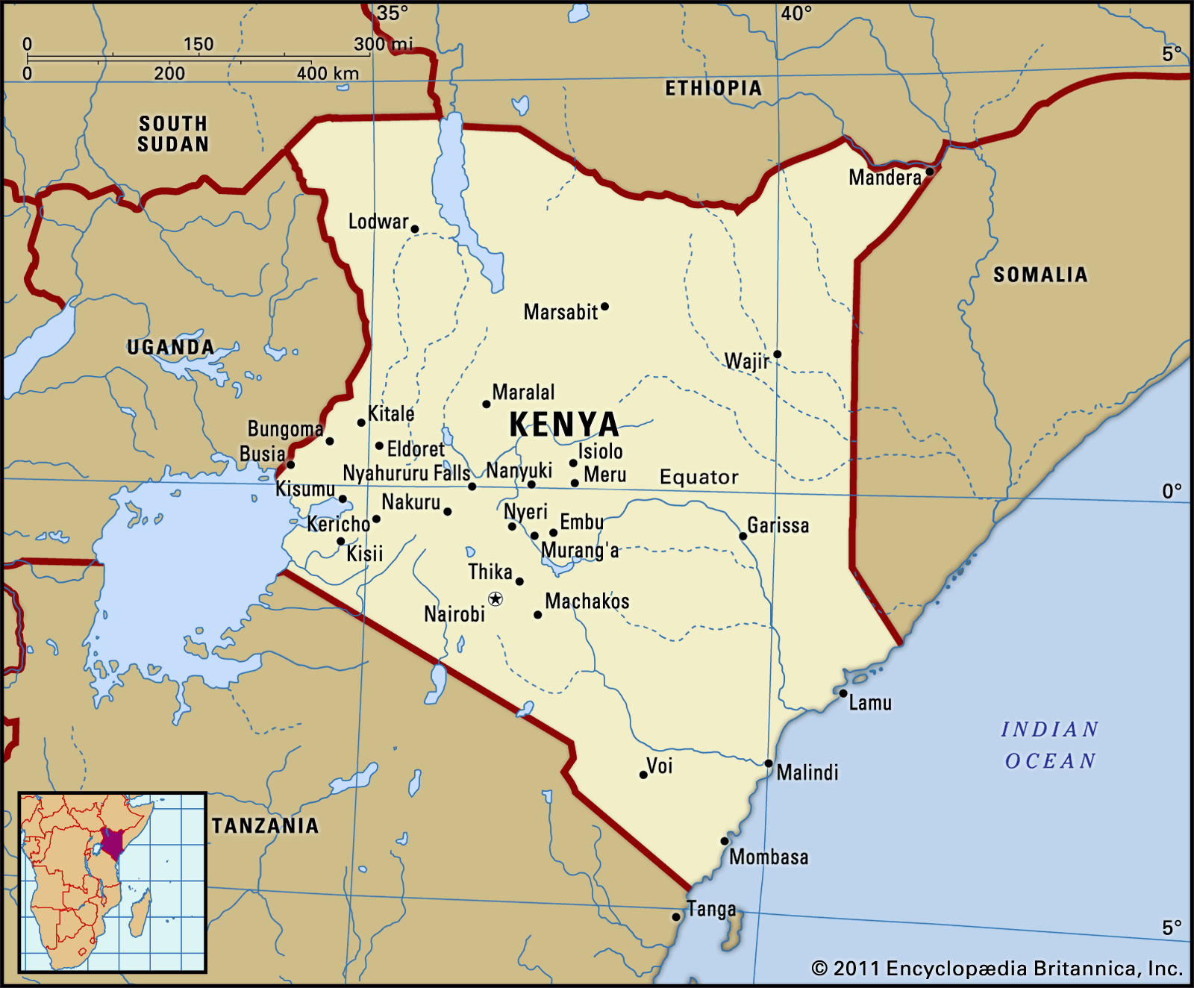
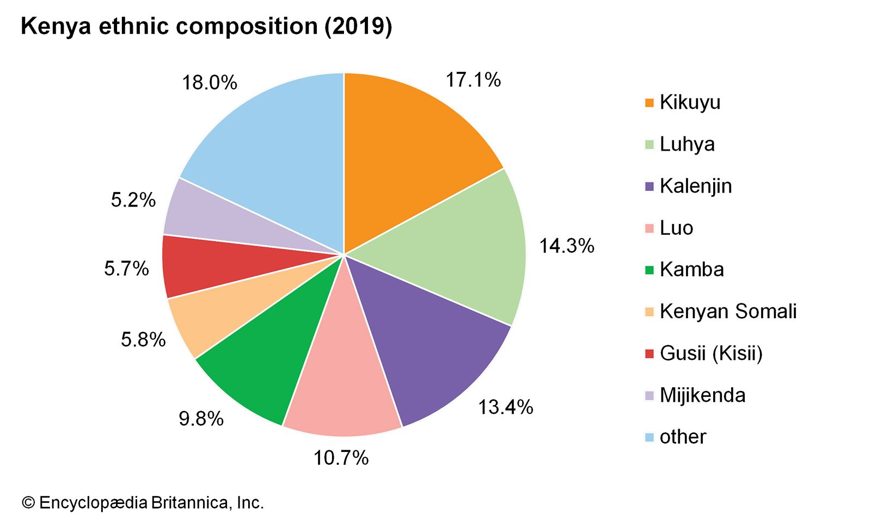
Kenya
53 mil inhabitants, Christian 85.5%, Muslim 10.9%
Mau Mau rebellion, 1963 Independence
Post-election violence 2007-2008
Post-election violence 2017
Elections 2022 – William Ruto

Slide 10
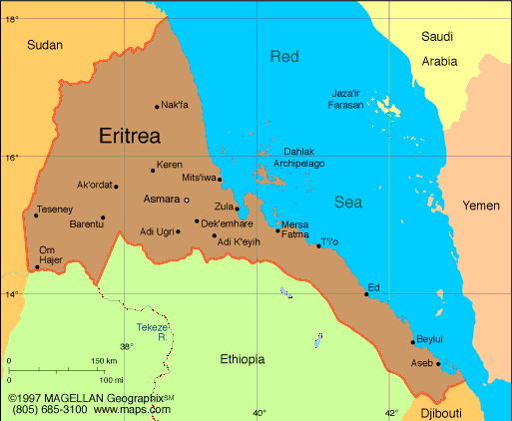
Eritrea
4 mil inhabitants, Christians 50%, Sunni Muslim 48%
Ethiopian-Eritrean Federation 1952
Independence 1993
Conflicts with neighboring states
There have never been national elections in Eritrea since independence in 1993
People's Front for Democracy and Justice (PFDJ), Isaias Afewerki
Eritrean-Ethiopian War 1998-2000/2018

Slide 11
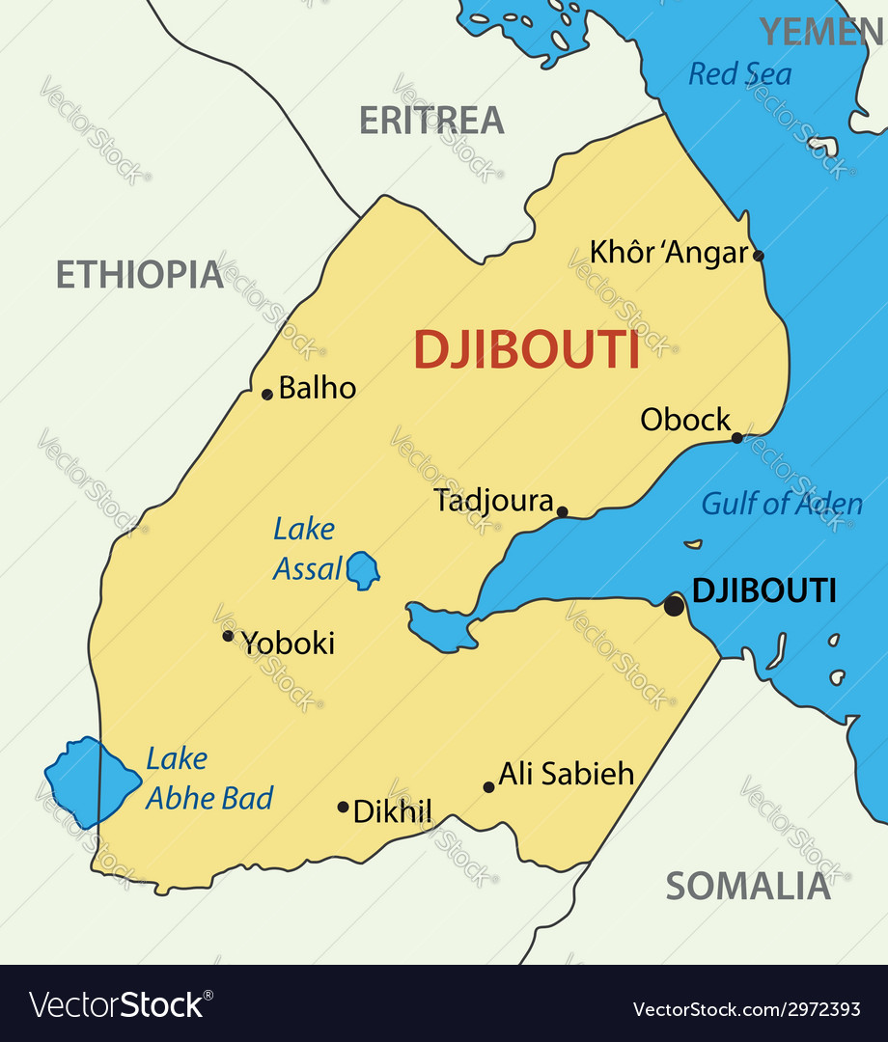
Djibouti
1 mil inhabitants, Sunni Muslim 94%, Christian 6% (mainly foreign-born residents)
Somali (Issa) 60%, Afar 35%, other 5% (mostly Yemeni Arab, also French, Ethiopian, and Italian)
Independence 1977
Civil War 1991-1994, People's Rally for Progress x Front for the Restoration of Unity and Democracy (FRUD)
Ismaïl Omar Guelleh 1999-2023

Slide 12
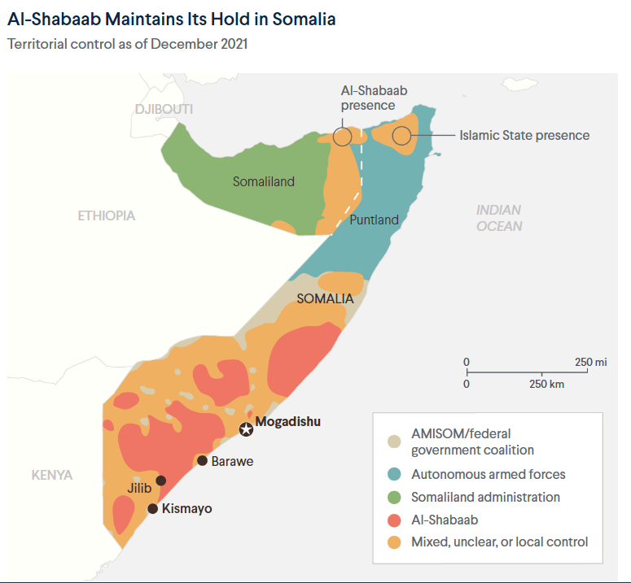
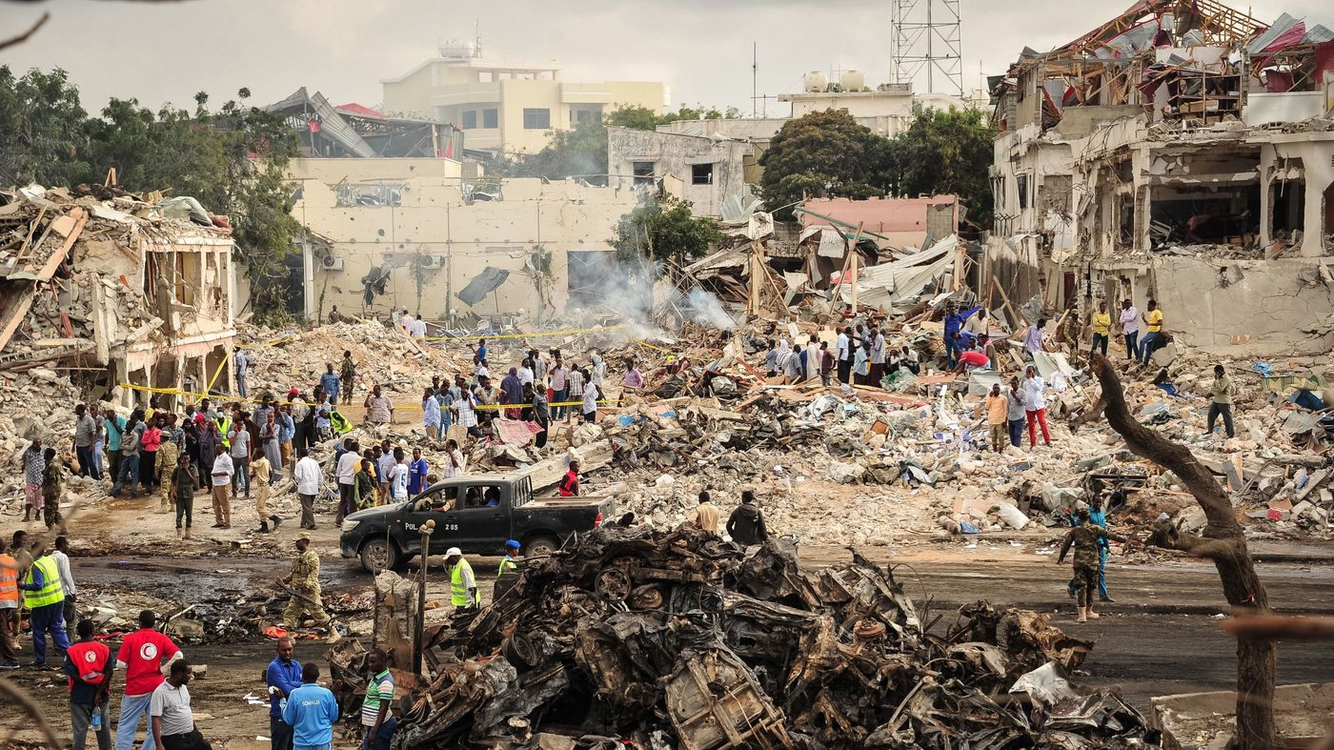
Terrorism in East Africa
Jabha East Africa/Islamic State in East Africa
Al-Shabaab
Ansar al-Sunna
Eritrean Islamic Jihad (EIJ) /Eritrean Islamic Salvation Movement
Ginbot 7, Ogaden National Liberation Front, Oromo Liberation Front (end in 2018)
Allied Democratic Forces

Slide 13
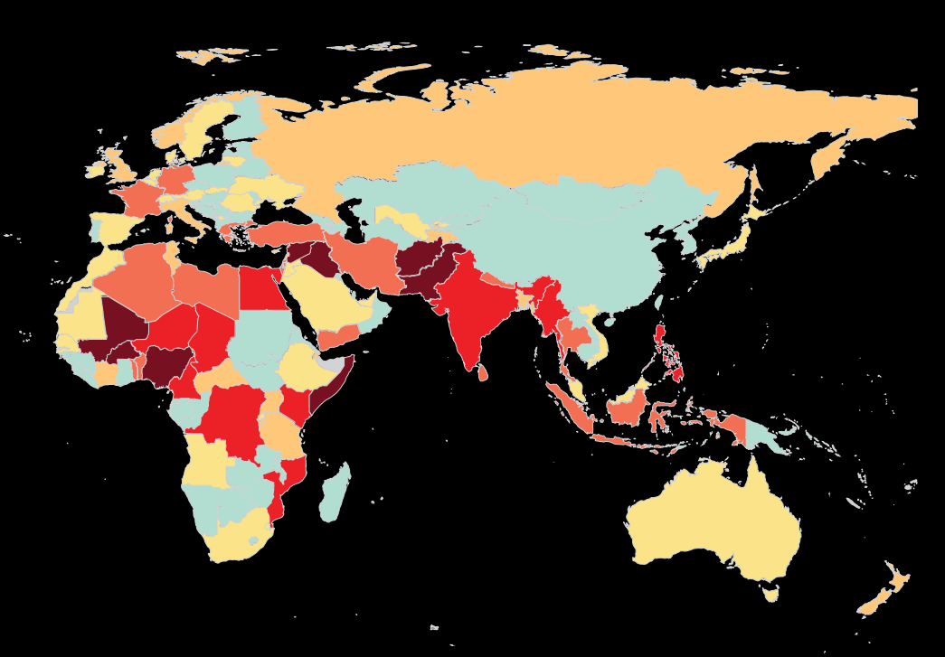
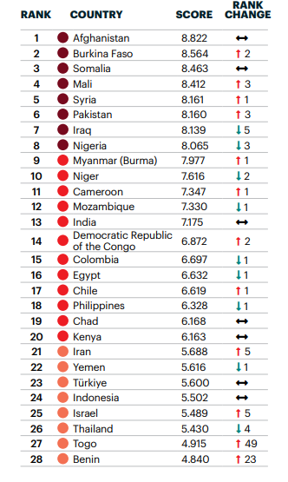
Terrorism

Slide 14
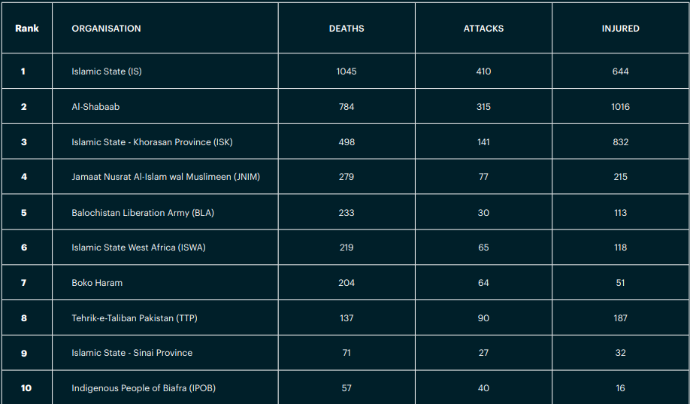
Deadliest Groups of 2022

Slide 15
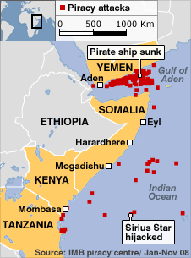
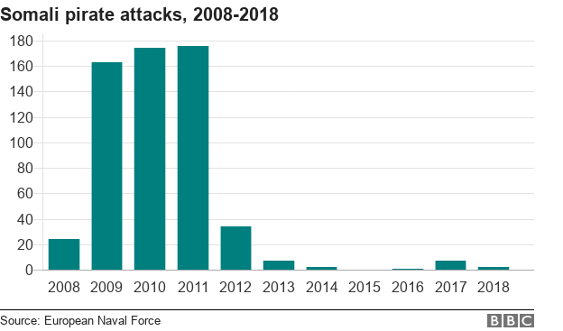
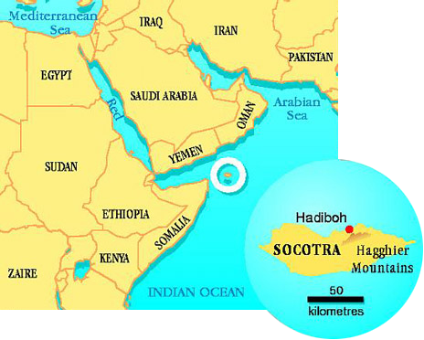
Piracy in Horn of Africa
Gulf of Aden, Guardafui Channel and Somali Sea.
Civil war in Somalia - illegally fishing on the Somali seaboard and ships began dumping industrial.
Most of the attacks in the Horn of Africa took place outside territorial waters.
Expiry of the United Nations Security Council's (UNSC) counter-piracy Resolution 2608 (2022).
IGAD – Intergovernmental Authority on Development – CEWARN.
Djibouti Code of Conduct 2009.

Slide 16
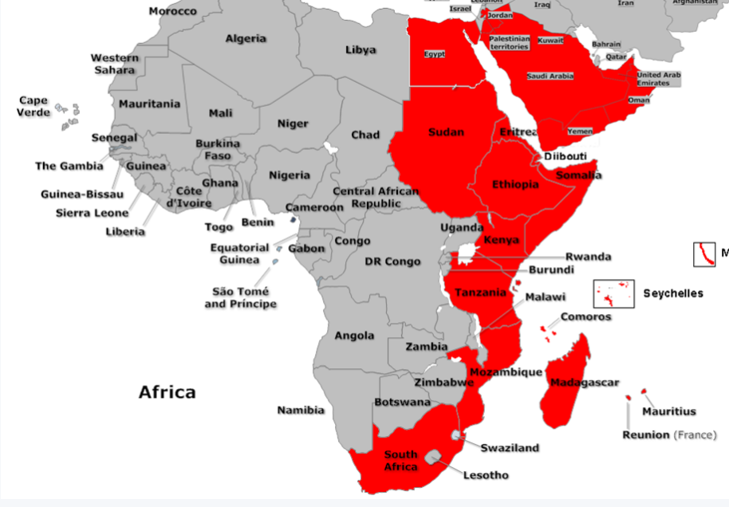
Djibouti Code of Conduct

Slide 17
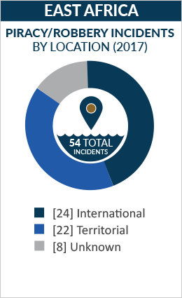
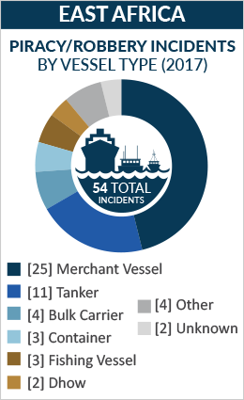
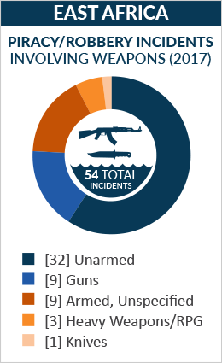
Piracy

Slide 18
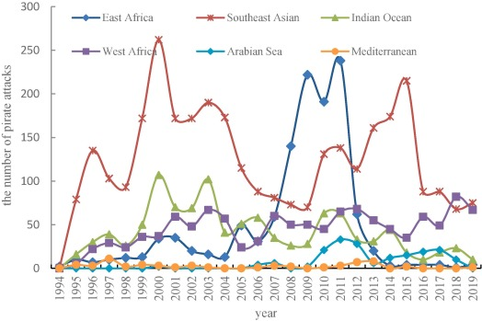
Piracy Worldwide

Slide 19
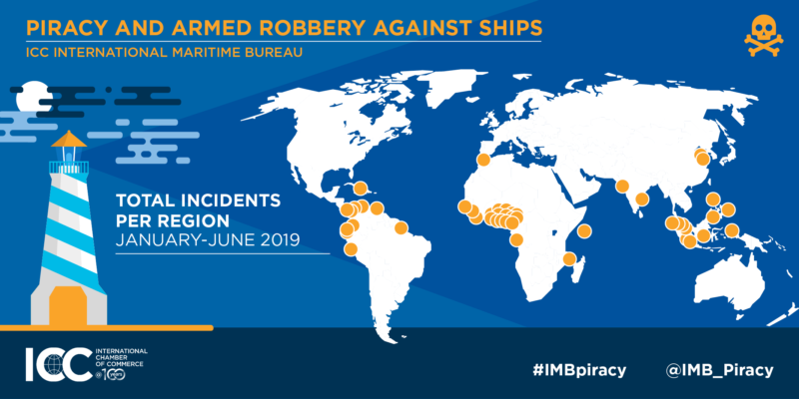
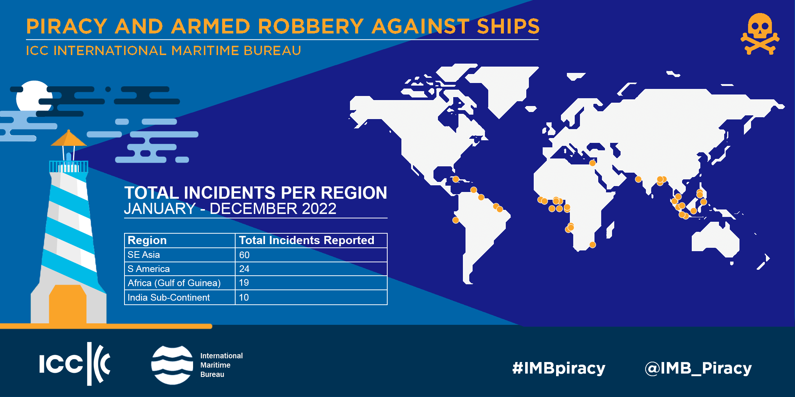
Piracy

Slide 20
Operation Atalanta and Ocean Shield
Other operations in EA - Combined Task Force 150, Combined Task Force 151, Chinese People's Liberation Army Navy participation, Operation Copper.
Operation Atalanta, formally European Union Naval Force (EU NAVFOR) Somalia (2008-present).
Atalanta tasks:
•Protects vessels of the World Food Programme (WFP), African Union Mission in Somalia (AMISOM) and other vulnerable shipping;
•Deters and disrupts piracy and armed robbery at sea;
•Monitors fishing activities off the coast of Somalia;
•Supports other EU missions and international organizations working to strengthen maritime security and capacity in the region.
Operation Ocean Shield (2009-2016).

Slide 21
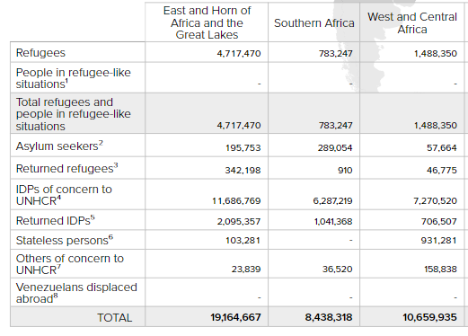
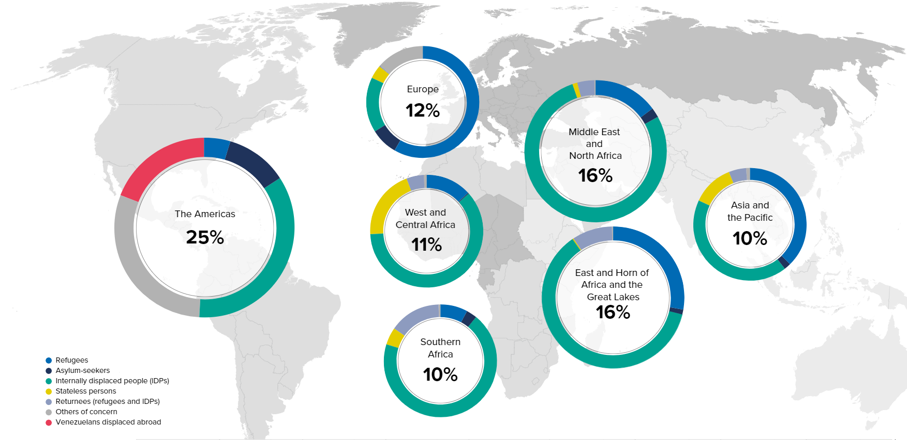
Influx of Refugees

Slide 22
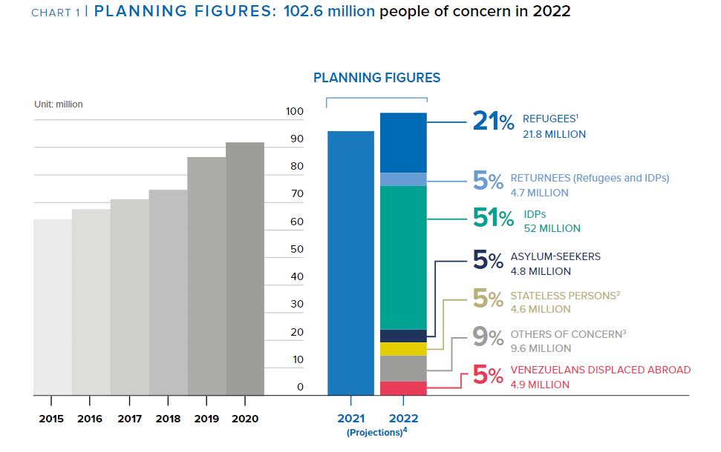
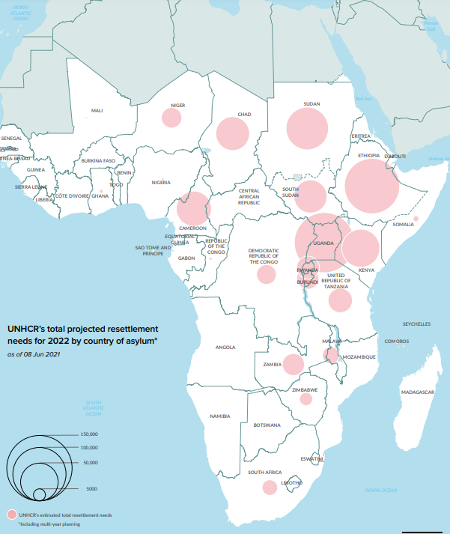
Influx of Refugees
Host country – Uganda (1,4 mil), Sudan (1,1 mil), Ethiopia (850 thousand),Kenya (600 thousand), Tanzania (250 thousand)

Slide 23
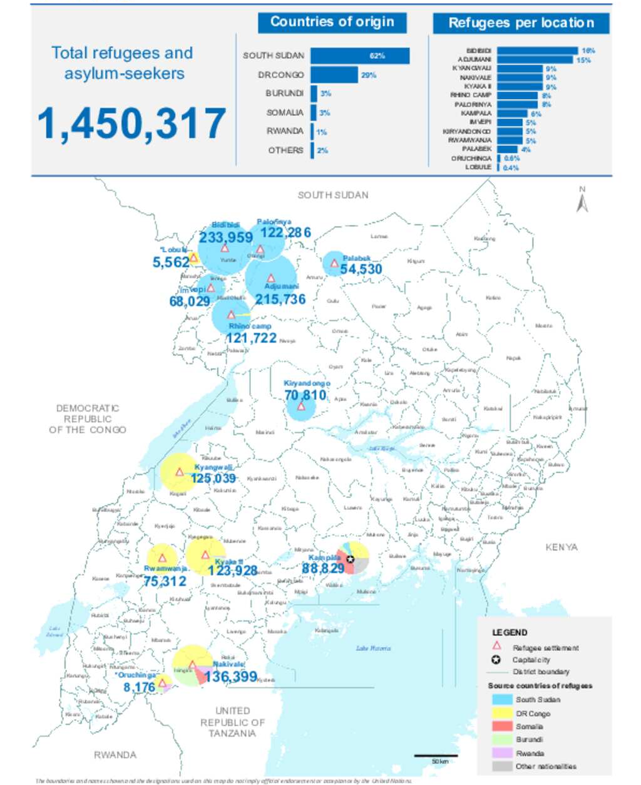
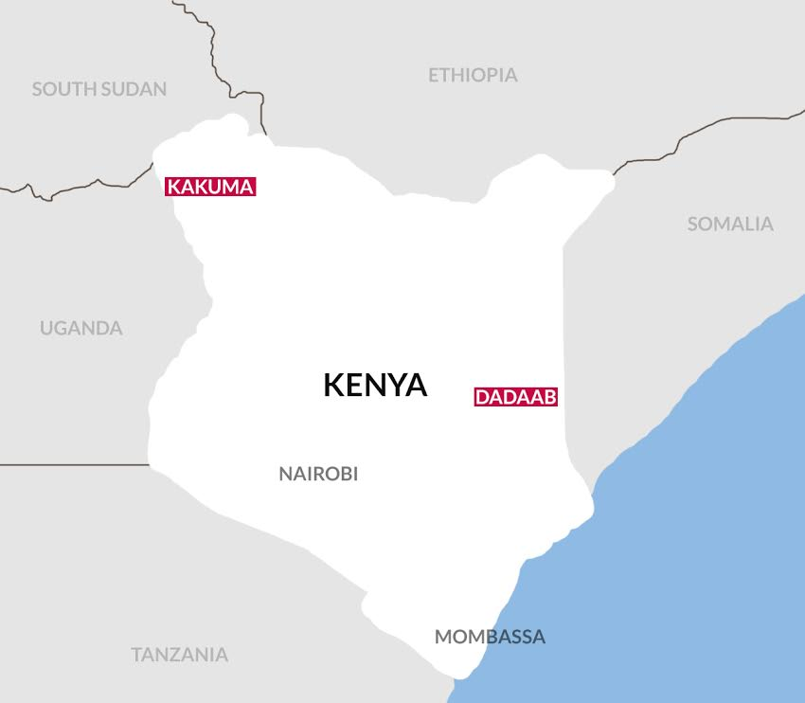
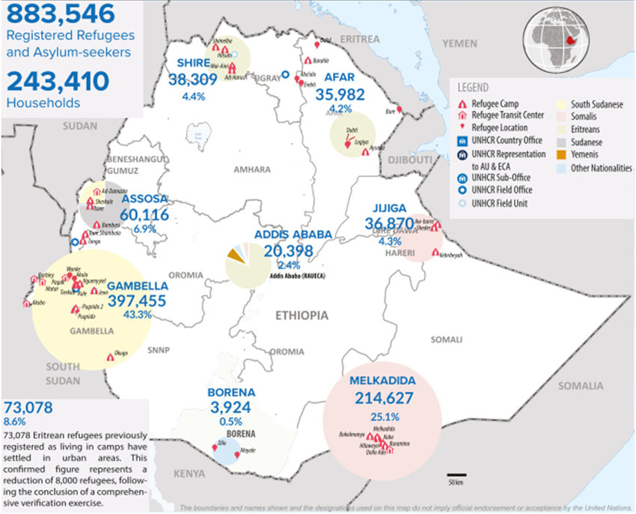
Influx of Refugees

Slide 24
Negative Impacts of Refugeeism
Economical impacts – influence on food prices, influence on the reduction of wages of local residents, Influence on the rise in housing and rental prices and direct state expenditure on refugees.
Social impacts – internal displacement of persons, social inequalities between refugees and local people, ethnic tension.
Environmental impacts – increase in the slums, pollution or depletion of water, deforestation, soil degradation.
Political-security impacts - increase in terrorism, increase in trafficking and crime, bilateral tensions between neighboring countries.

Slide 25
Refugee-Related Political Violence
a) Attacks between sending state and refugees (The violence occurs between refugees and government of sending state)
b) Attacks between receiving state and refugees (The violence occurs between refugees and government of receiving state)
c) Ethnic or factual violence among refugees (The violence occurs between groups of refugees)
d) Internal violence within receiving state (The violence occurs between refugees and local population of receiving state)
e) Interstate war or unilateral intervention (Refugees and the government of more than one state are involved in violence)
f) Attacks between refugees and transnational VNSA (The violence occurs between refugees and transnational VNSA (( non-state armed groups operating across several countries))

Slide 26
Refugee-Related Political Violence

Slide 27
Thank you for your attention

