Slide 1
Great Lakes Region
Lucie Konečná
BSSn4457 Regional Security Complexes
26/10/2023

Slide 2
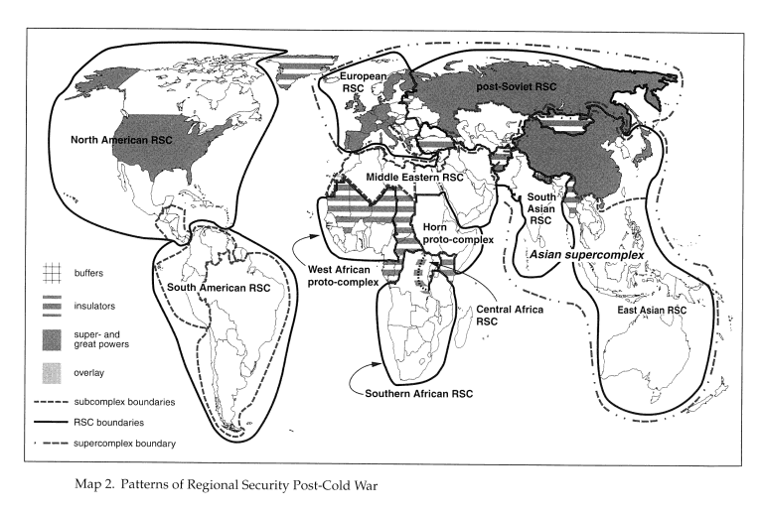
Regional Security Complexes

Slide 3
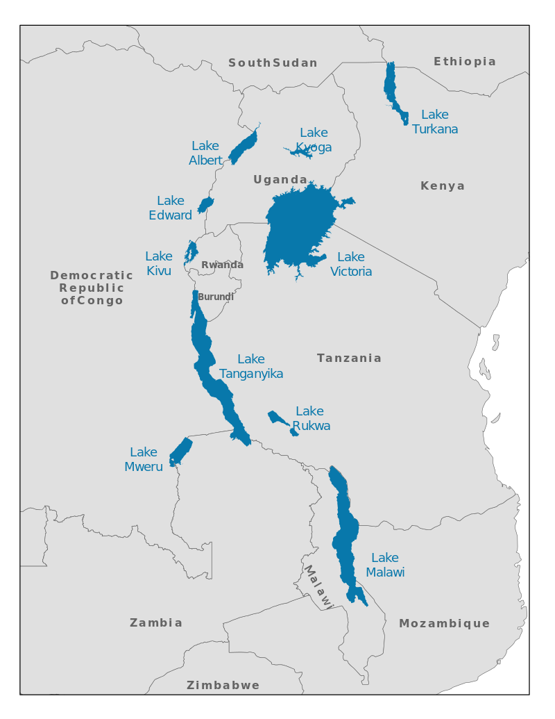
Great Lakes Region
Uganda, Burundi, Rwanda, Tanzania, DRC (Malawi, Kenya and Mozambique).

Slide 4
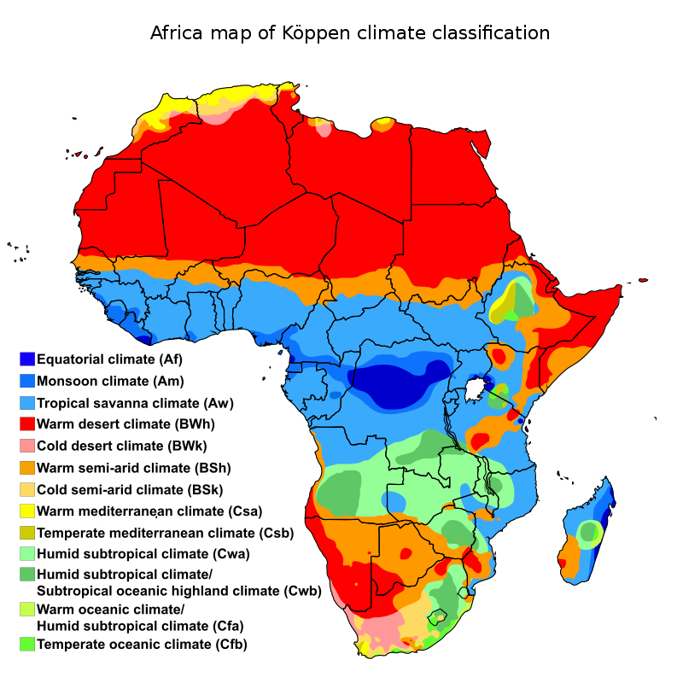
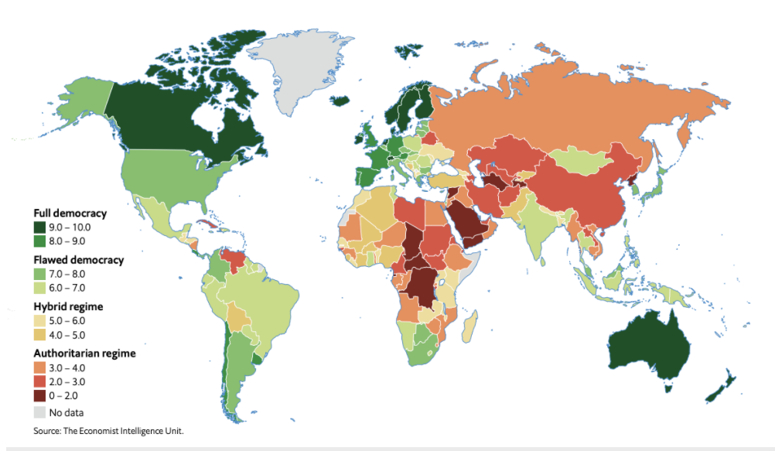
Facts about GLR
Around 230 million inhabitants
Geography - African Great Lakes - Victoria and Tanganyika, Mount Kilimanjaro (4,900 metres), high concentrations of wild animals (big five), Rwenzoris, Eastern Rift Mountains and Ethiopian Highlands.
FSI (FFP) – Burundi (20), Uganda (26), Rwanda (44), Tanzania (65), DRC (4).
(, DRC(

Slide 5
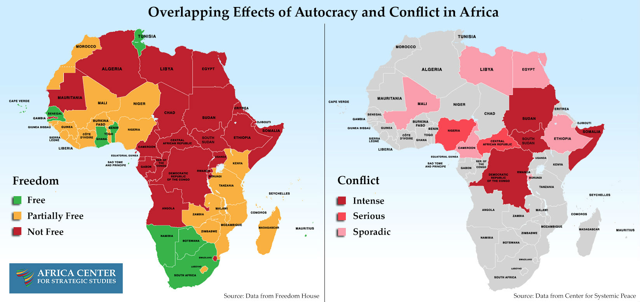

Slide 6
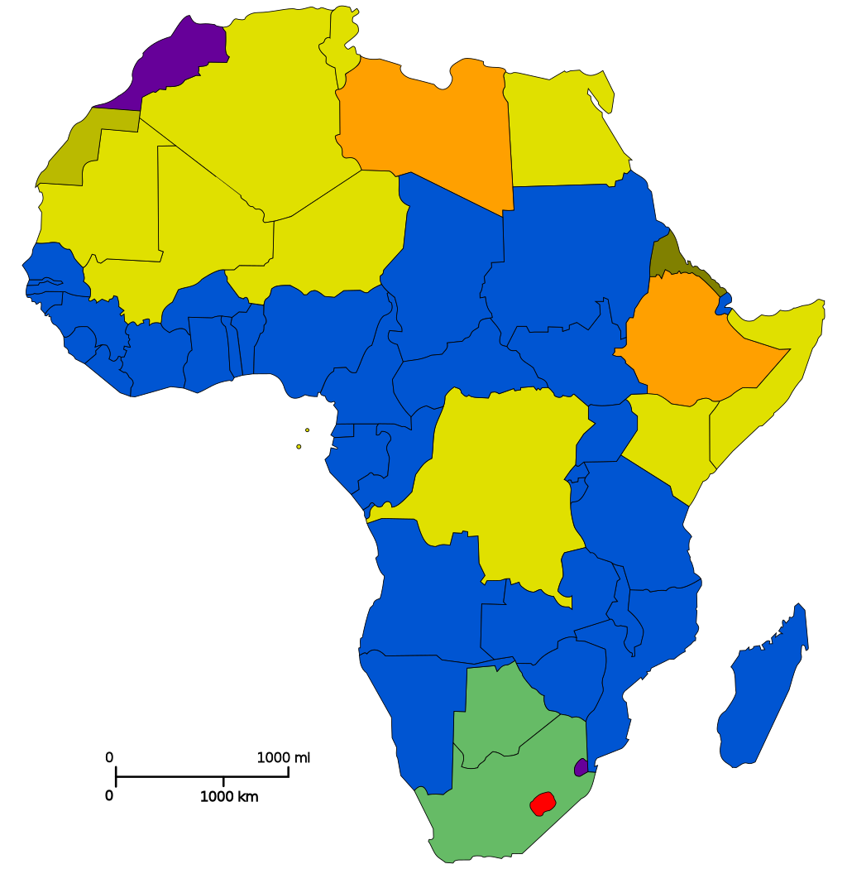
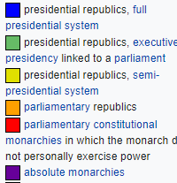
EA – Form of Government

Slide 7
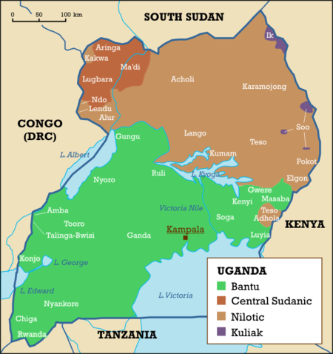
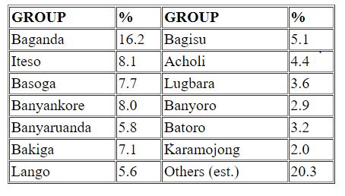
Uganda
47 mil inhabitants, Protestant 45.1%, Roman Catholic 39.3%, Muslim 13.7%
Independence 1962
Apollo Milton Obote x Idi Amin
Kagera war
Civil war 1980-1986 (Bush war)
Lord’s Resistance Army
Involvement in the first
and second civil wars in the DRC

Slide 8
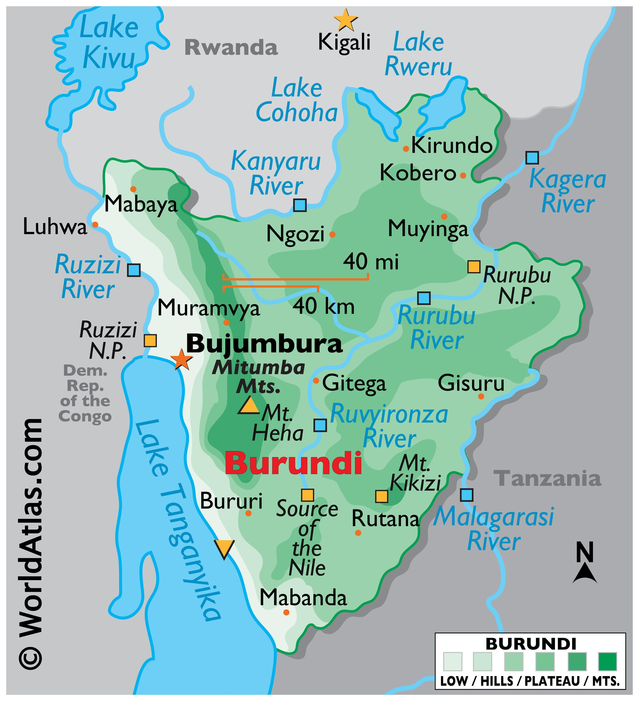
Burundi
12 mil inhabintants, Roman Catholic 62.1%, Protestant 23.9%, Muslim 2.5%
Ruanda-Urundi 1919-1962
Independence 1962
UPRONA – Union for National Progress
Civil war 1993-2005/08
National Council for the Defense of Democracy–Forces for the Defense of Democracy (CNDD-FDD).
Crisis 2015 - Pierre Nkurunziza x general Niyombare; Popular Forces of Burundi, RED-Tabara x Imbonerakure.
2020 new president Évariste Ndayishimiye (CNDD-FDD)
Gitega (New capital city)

Slide 9
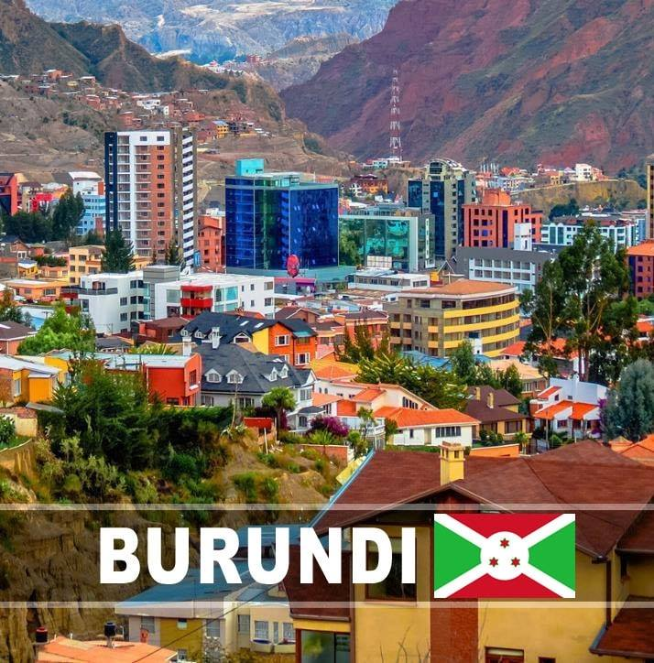
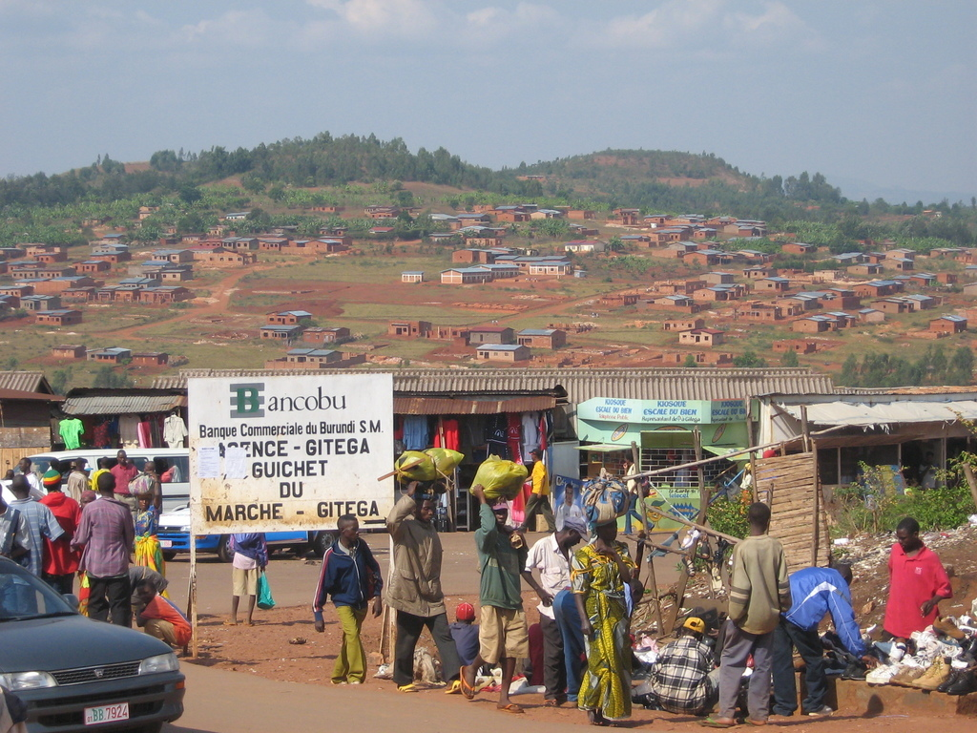
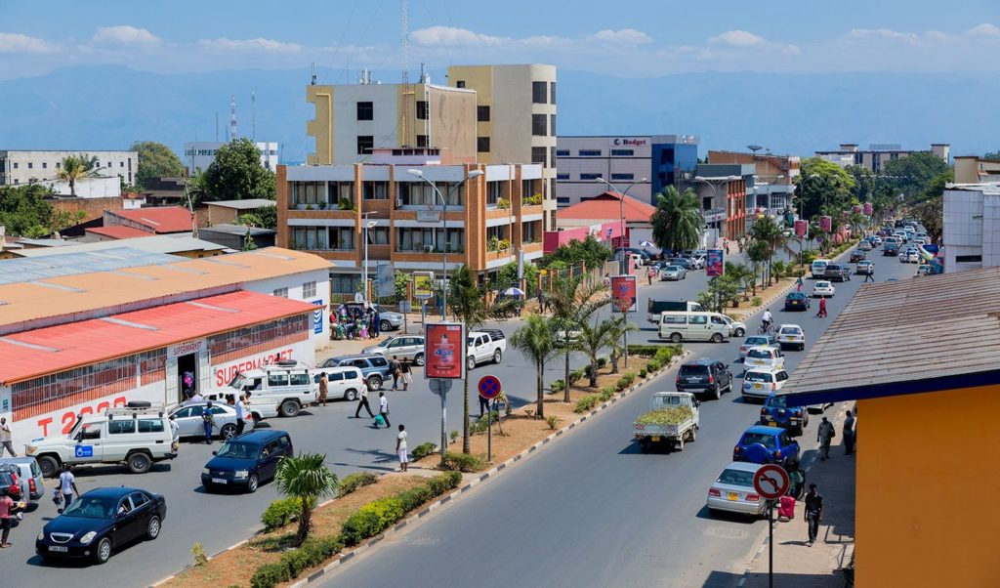
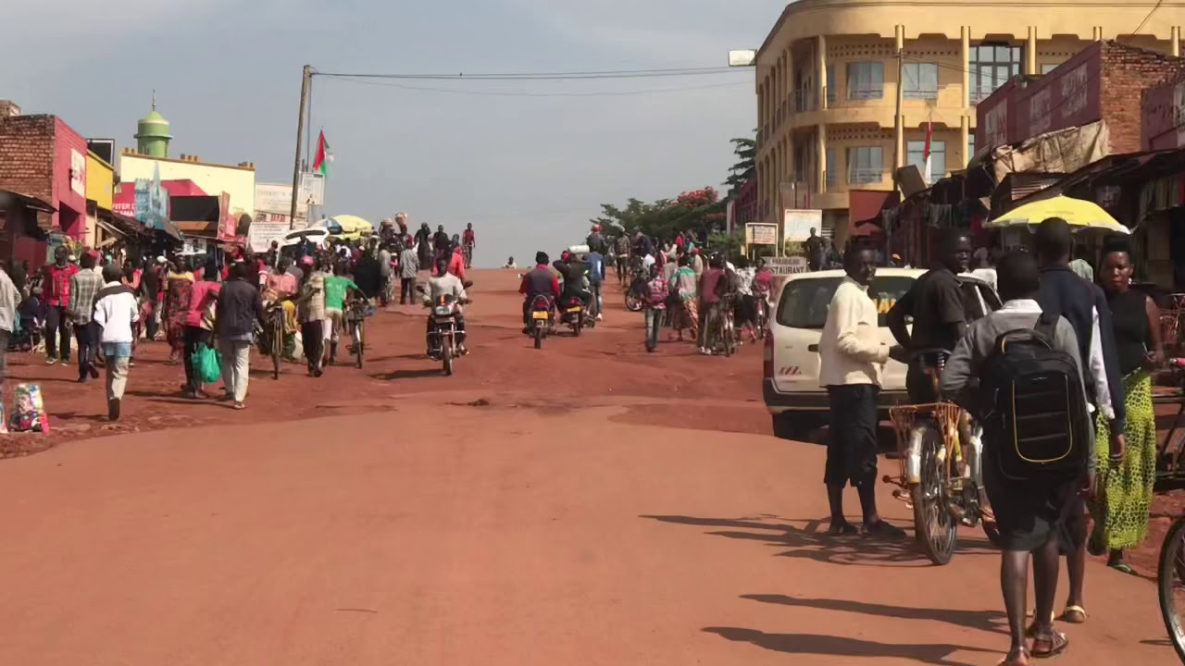
Bujumbura vs.
Gitega

Slide 10
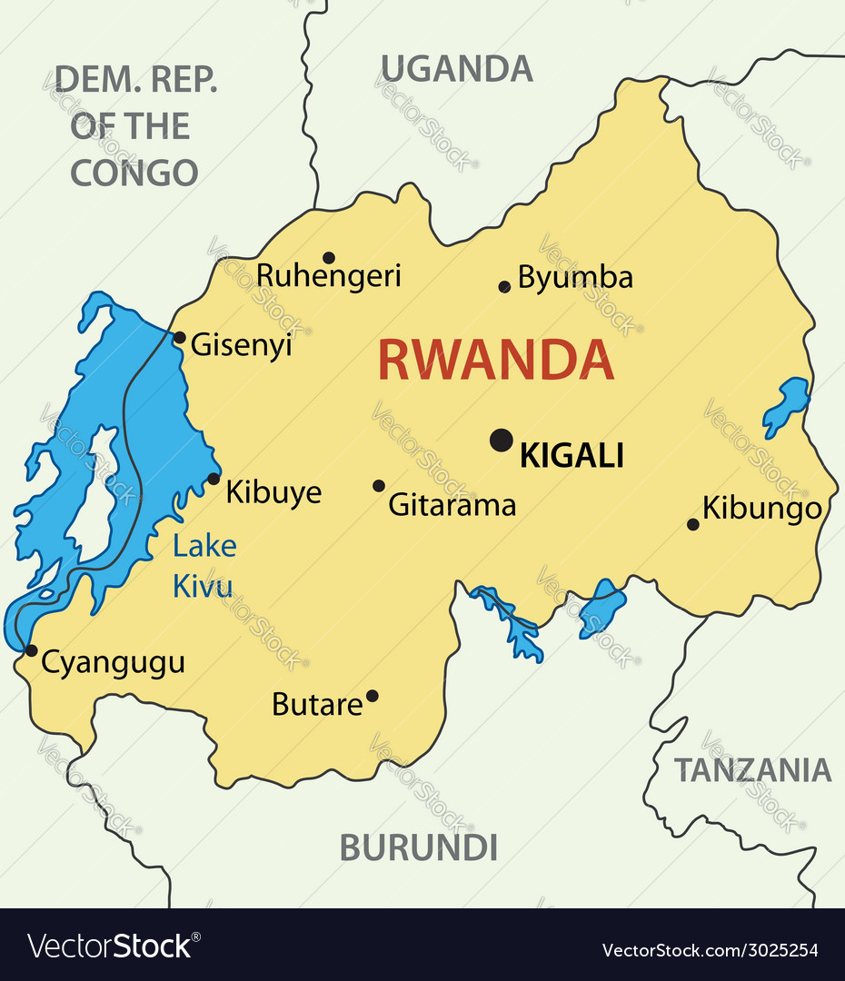
Rwanda
13 mil inhabitants, Protestant 49.5%,Roman Catholic 43.7%, Muslim 2%
Independence 1962, MDR-Parmehutu
The National Revolutionary Movement for Development (MRND) was the ruling political party of Rwanda from 1975 to 1994 under President Juvénal Habyarimana
Civil war 1990-1994 (RPF – Rwandan Patriotic Front)
Genocide 1994 (Interahamwe, Impuzamugambi x Inkotanyi)
Involvement in the first and second civil wars in the DRC

Slide 11
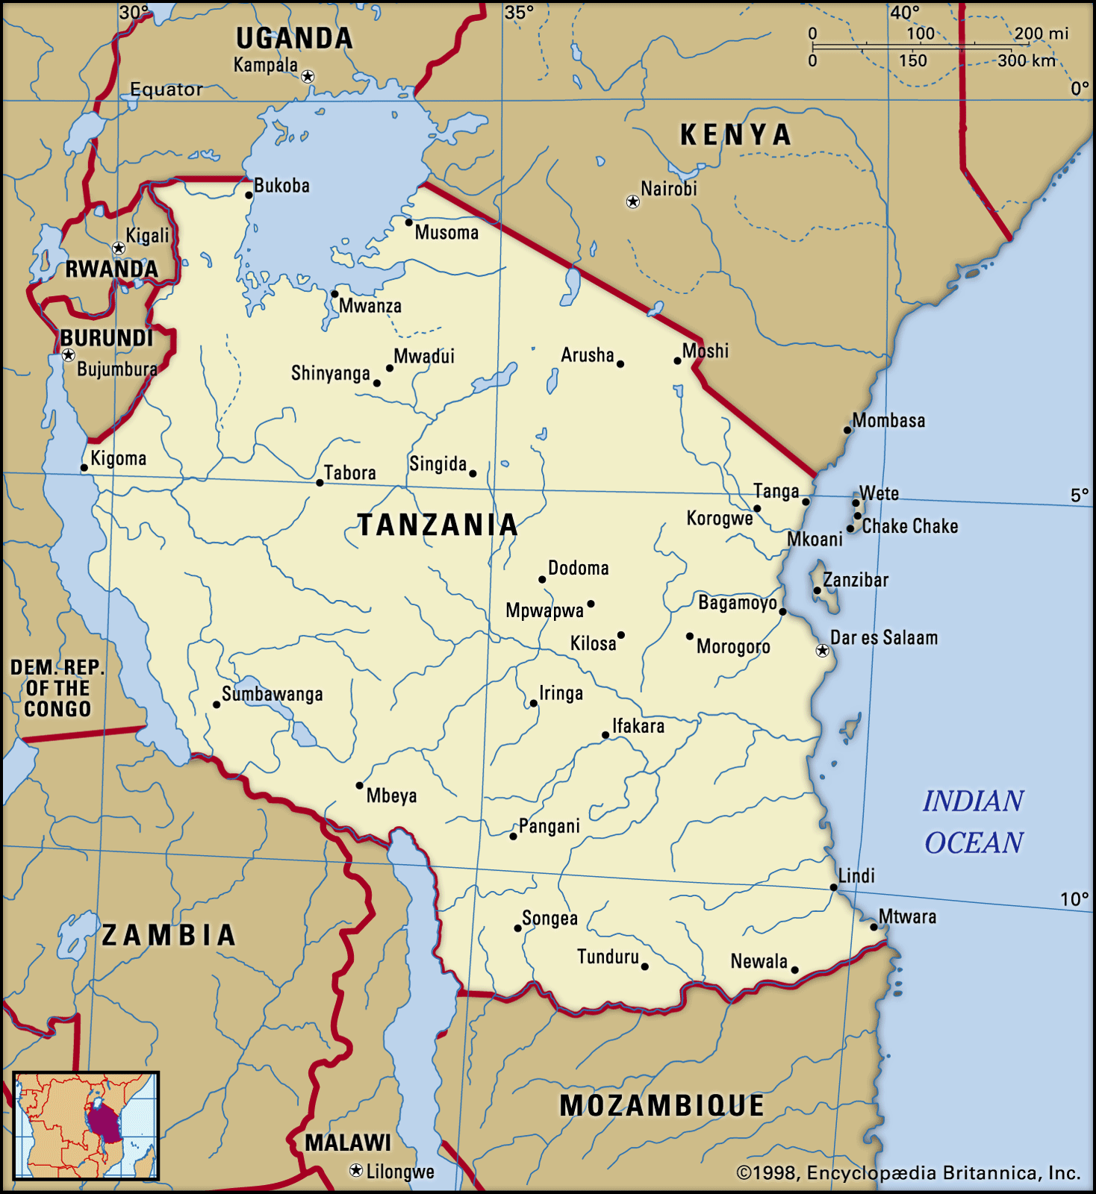
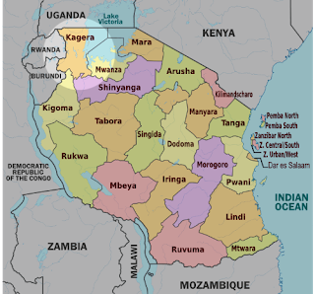
Tanzania
64 mil inhabitants, Christian 61.4%, Muslim 35.2%
Creation of Tanzania 1964
Kagera war 1978-1979
New capital city Dodoma

Slide 12
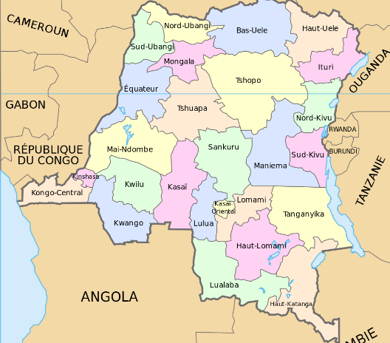
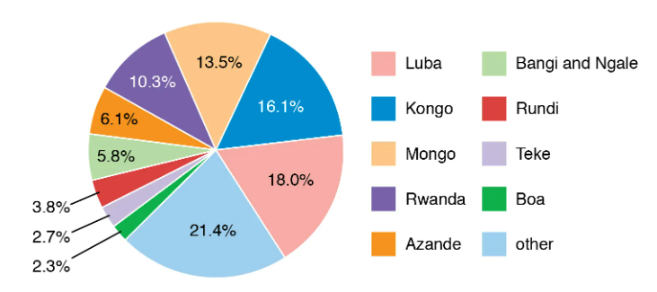
DRC
96 – 108? mil inhabitants, Christians constituted 93.7%
Independence 1960
First civil war 1996-1997
Second civil war 1998-2003
Alliance of Democratic Forces for the Liberation of Congo-Zaire (AFDLC)
M23, Mai-Mai, CODECO
Félix Tshisekedi

Slide 13
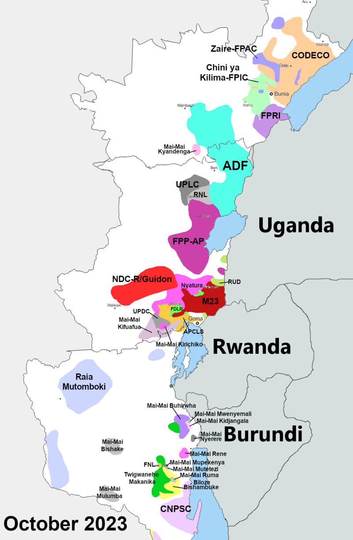
DRC - Division between VNSAs

Slide 14
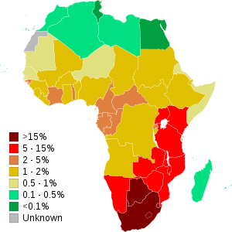
HIV in Africa
State | % in the population
Eswatini | 26%
Botswana | 23,4%
South Africa | 17%
Tanzania | 5%
Rwanda | 3%
Burundi | 3%
Uganda | 7%

Slide 15
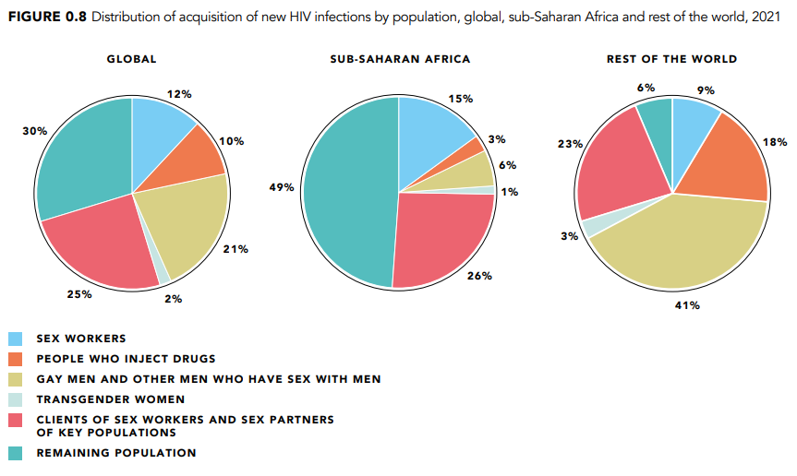
HIV/AIDS

Slide 16
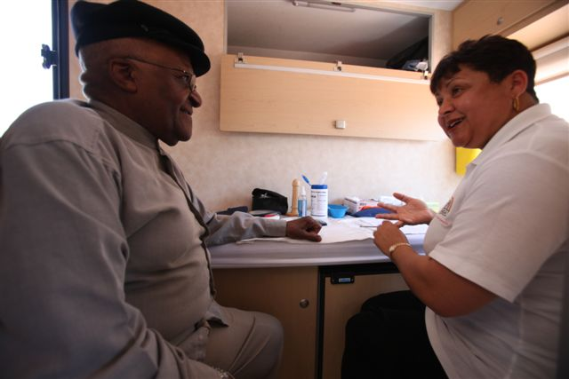
HIV in Africa
Bushmeat theory – Cameroon.
71% of the total HIV population lives in Sub-Africa.
Desmond Tutu HIV Foundation .
UNAIDS - Joint United Nations Programme on HIV/AIDS.
Causes of expansion in Africa: behavioral factors, lack of money, natural disasters and conflicts, health industry, medical suspicion, circumcision?, religious factors, educational level, poverty.
Uganda – AIDS Information Centers

Slide 17
HIV in Africa
Justus Amuche Nweze - HIV/AIDS in sub-Saharan Africa: Current status, challenges and prospects.
Reasons for the high prevalence of HIV/AIDS in sub-Saharan Africa:
The initial responses to HIV in Africa and the West
b) Cultural behaviors and beliefs (Widow inheritance, Postpartum sexual abstinence, Sexual cleansing, Virgin cleansing fable, Ritualised non-marital sexual intercourse)
c) Multiple sexual partners
d) Poverty, conflict/war, migration, and HIV/AIDS
e) Blood transfusion and HIV
f) HIV/AIDS-associated stigma and discrimination

Slide 18
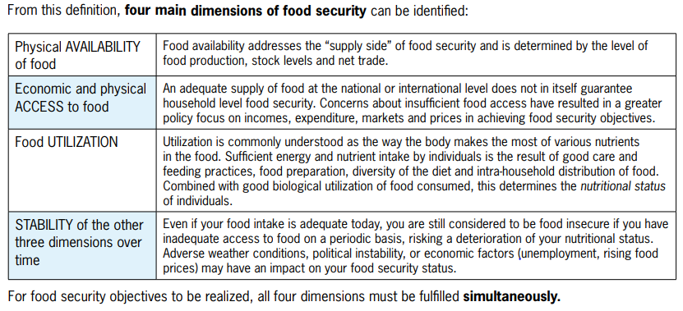
Food Security - Definition
“Food security exists when all people, at all times, have physical and economic access to sufficient safe and nutritious food that meets their dietary needs and food preferences for an active and healthy life.” 1996 World Food Summit.
“Food insecurity, on the other hand, is defined by the United States Department of Agriculture (USDA) as a situation of "limited or uncertain availability of nutritionally adequate and safe foods or limited or uncertain ability to acquire acceptable foods in socially acceptable ways.“
4 Dimensions + 2 new dimensions (Agency and Sustainability).

Slide 19
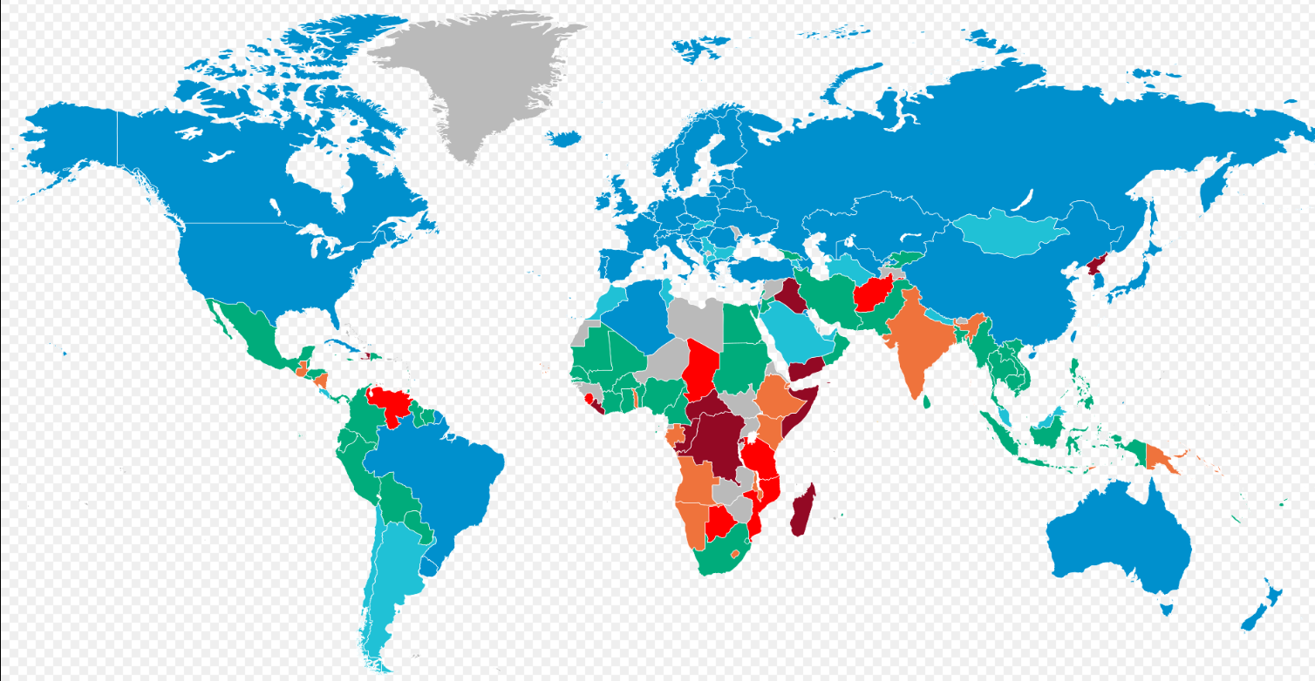
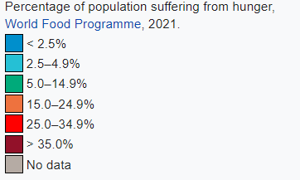
Hunger in the World

Slide 20
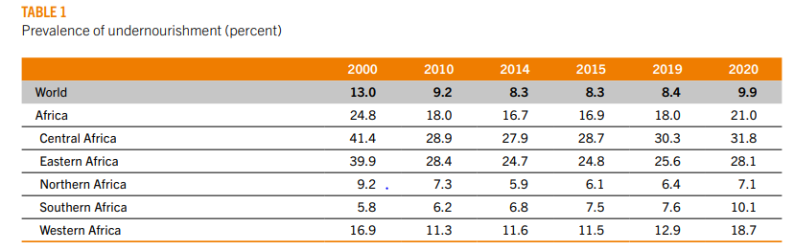
Food Security
281.6 million people in Africa face hunger (2021).
Food security situation is determined by several drivers including conflicts, climate variability and extremes, economic slowdowns and downturns, and the unaffordability of healthy diets.
Food and Agriculture Organization of the United Nations, FAO (1945).
The biggest deterioration occurred between 2019 and 2020.
125.1 million people live in Eastern Africa, followed by Western Africa (75.2 million), Central Africa (57.1 million), Northern Africa (17.4 million) and Southern Africa (6.8 million).

Slide 21
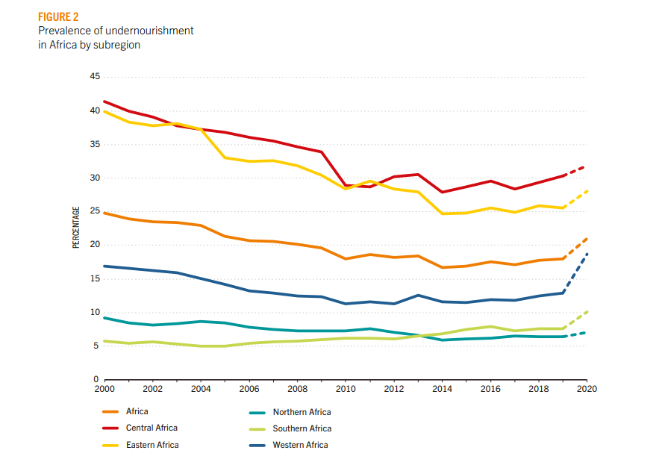
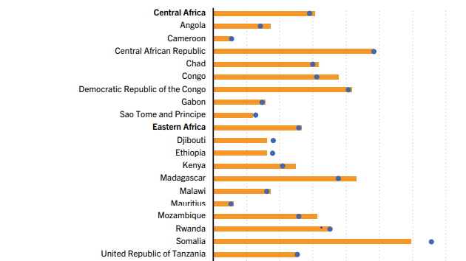
Food Security

Slide 22
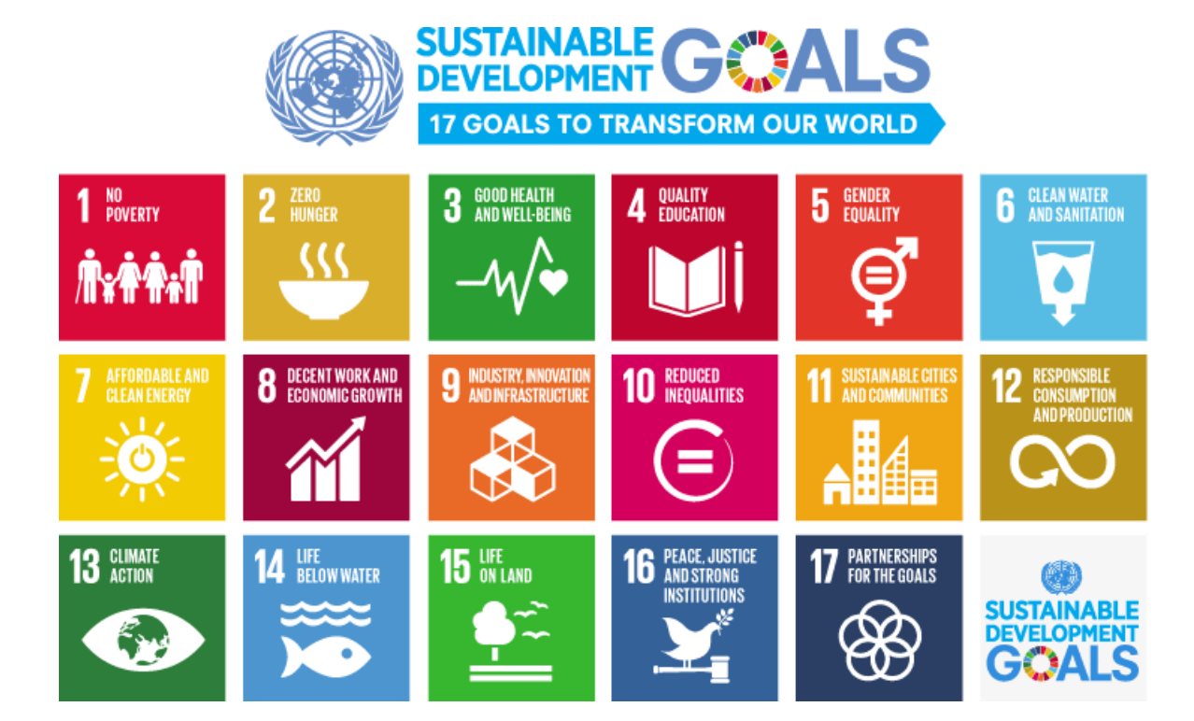
Food Security
Shared vision of humanity and a social contract between the world’s leaders.

Slide 23
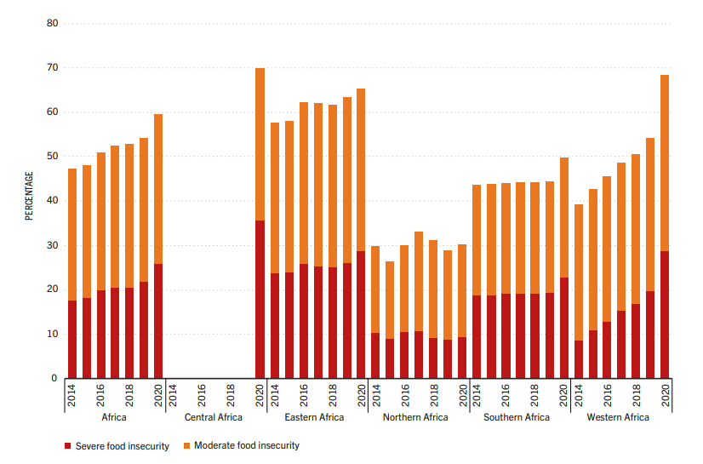
Food Security
The Food Insecurity Experience Scale - (FIES) :
a) Moderate food insecurity (uncertain ability to obtain food and have been forced to reduce, at times over the year, the quality and/or quantity of food they consume due to lack of money or other resources.
b) Severe food insecurity (run out of food, experienced hunger and, at the most extreme, have gone for days without eating)

Slide 24
Food Security
Food security and nutrition indicators:
Undernourishment
Food Insecurity Experience Scale
Stunting, wasting and overweight in children under five years of age
Low birthweight
Adult obesity
Anaemia in women of reproductive age
Exclusive breastfeeding
https://www.youtube.com/watch?v=ZxPLxU8-Hxg
https://www.youtube.com/watch?v=5YcvKvxWaCE

Slide 25
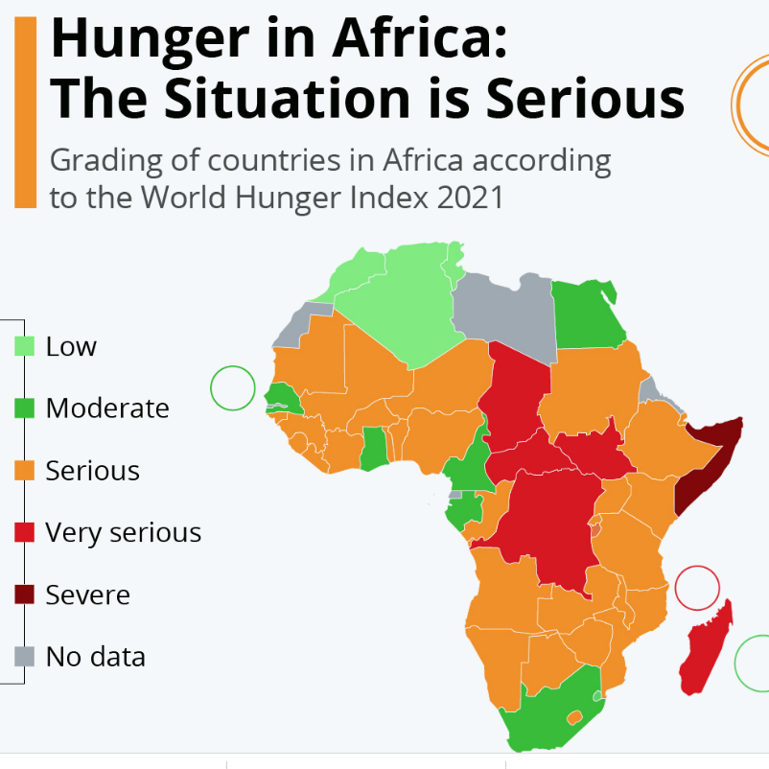
Global Hunger Index
Around 20% of people in Africa are facing chronic hunger, compared with only 10% globally.
Russia's war on Ukraine has exacerbated food supply problems, while climate change and the pandemic have also contributed.

Slide 26
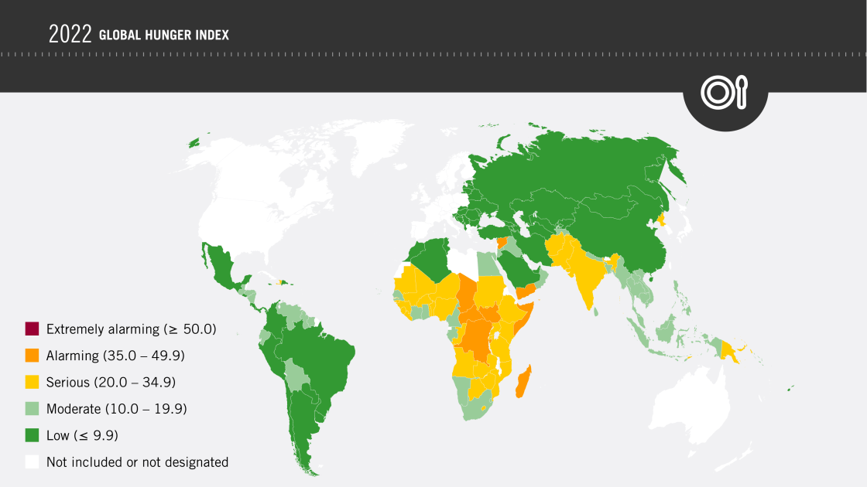
Global Hunger Index

Slide 27
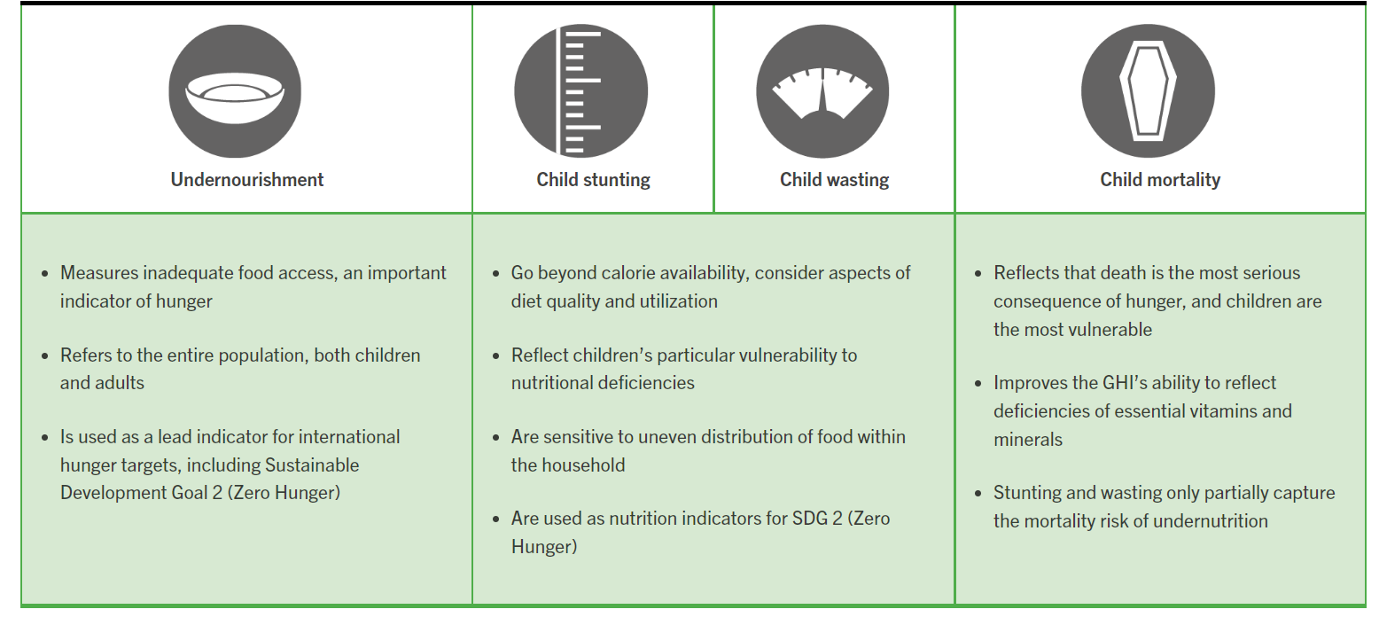
Global Hunger Index

Slide 28
Thank you for your attention

