Slide 1
Region of Southern Africa (Land issues)
Lucie Konečná
BSSn4457 Regional Security Complexes
09/11/2023

Slide 2
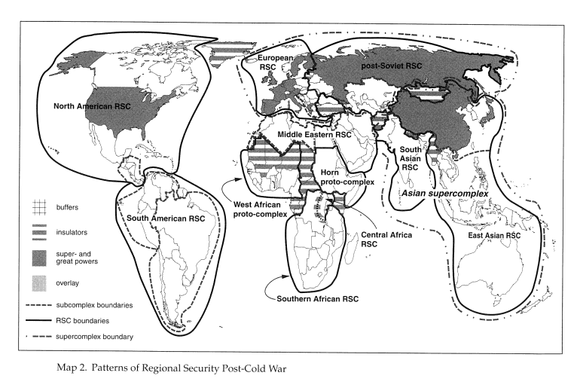

Slide 3
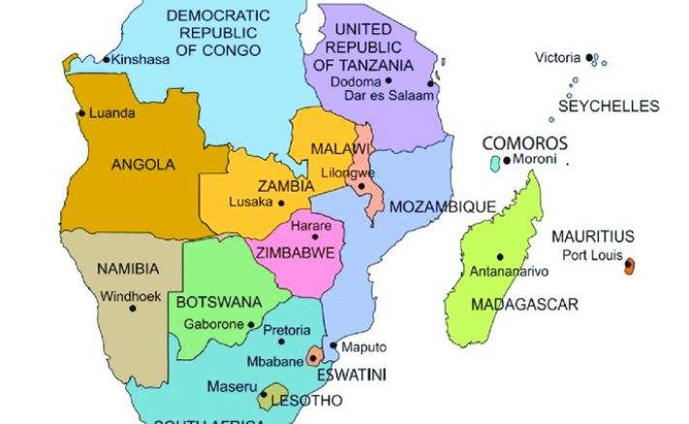
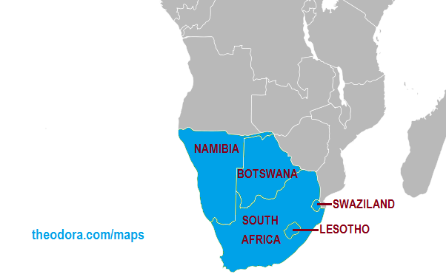
Southern African Region
SADC vs. SACU

Slide 4
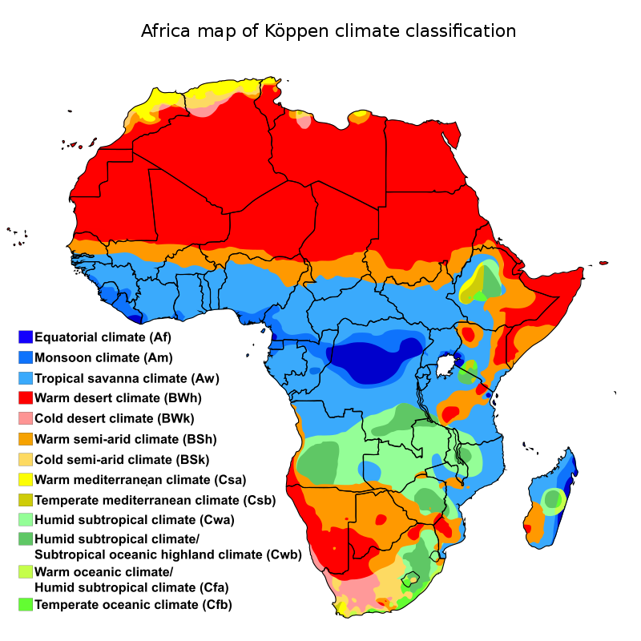
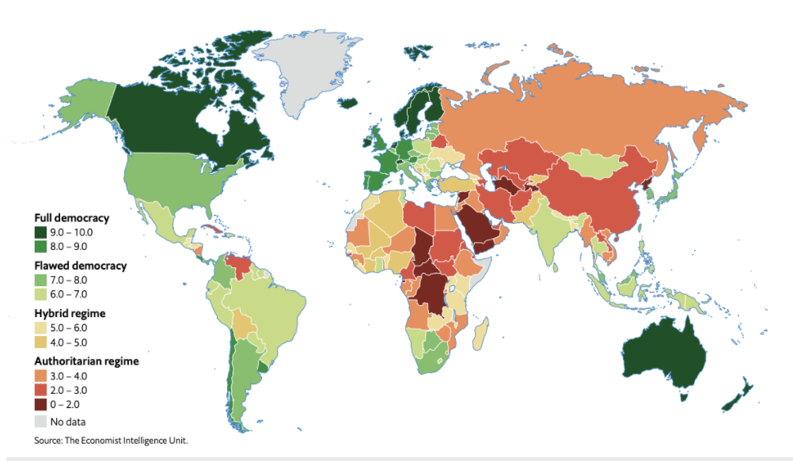
Facts about SAR
NG – South Africa, Malawi, Botswana, Namibia, Zimbabwe, Zambia, Mozambique, Angola, Lesotho and Eswatini.
Population - 187 mil (SA 60 mil)
https://fragilestatesindex.org/analytics/fsi-heat-map/
FSI (FFP) – Zimbabwe (16), Mozambique (21), Angola (39), Zambia (48), Malawi (43).

Slide 6
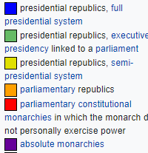
SA – Form of Government

Slide 7
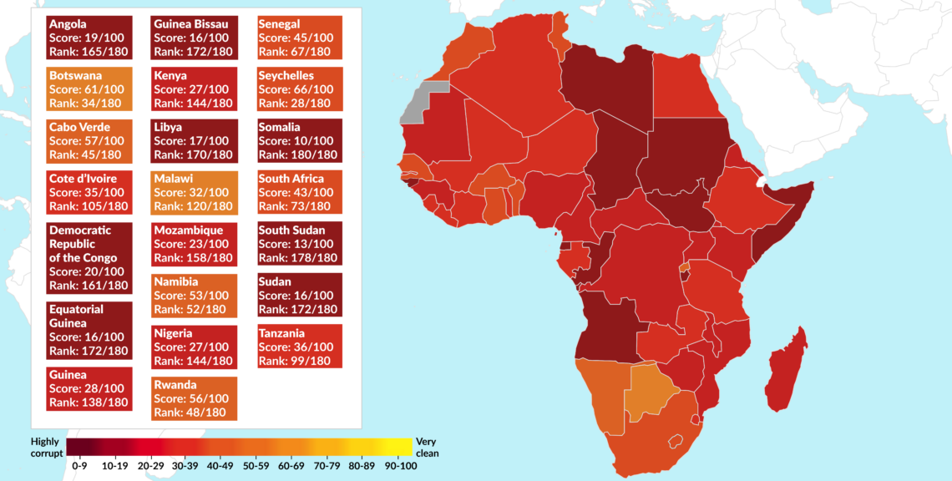

Slide 8
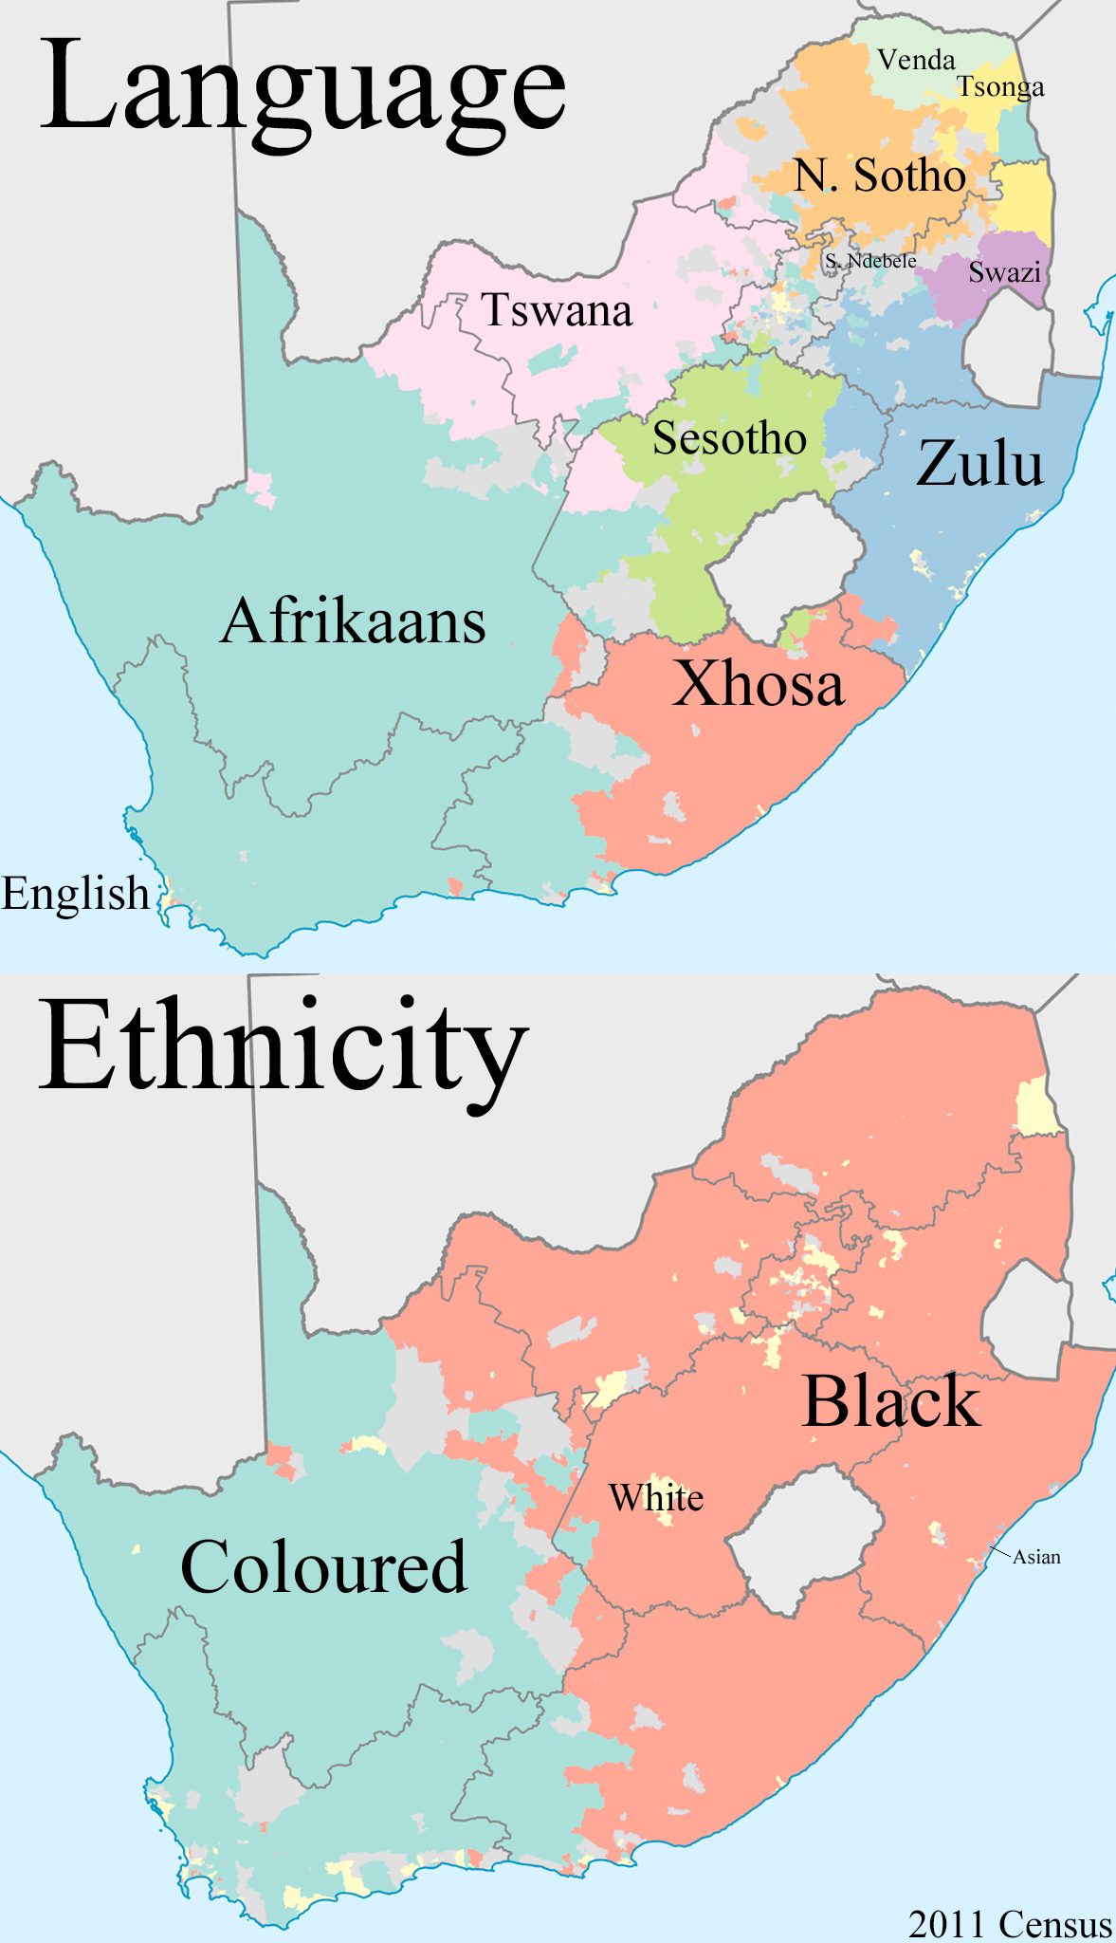
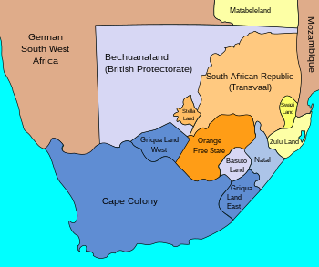
South Africa
60 mil inhabitants, Christianity 78%
Anglo-Zulu war, Boer wars.
Union of South Africa 1910, Apartheid 1948, RSA 1961.
African National Congress (ANC).
South African Border War.

Slide 9
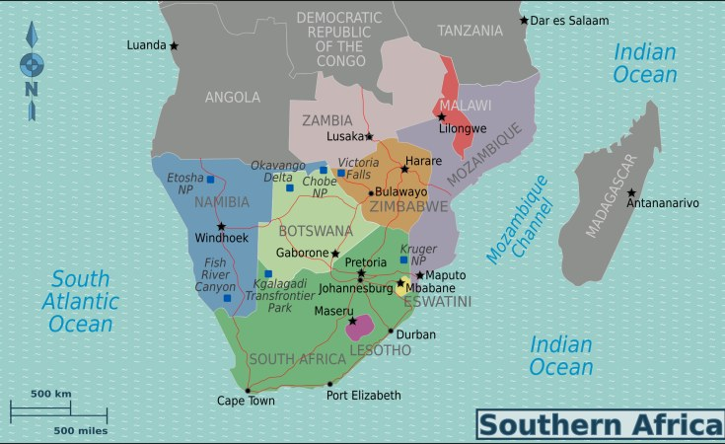
Eswatini and Lesotho
Kingdom, absolute monarchy
1,2 mil inhabitants, Christianity 90%.
Independence 1968.
Constitutional monarchy.
2,2 mil inhabitants, Christianity 95%.
Independence 1966.

Slide 10
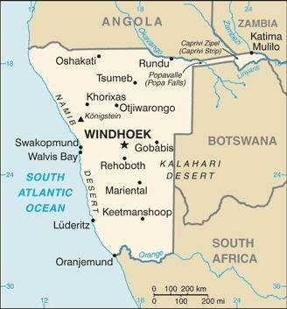
Namibia
2,5 mil inhabitants, Christianity 90%.
South African Border War (1966-1990)
Independence 1990.
Caprivi War 1999 - CLA Caprivi Liberation Army.
SWAPO - South-West African People's Organization

Slide 11
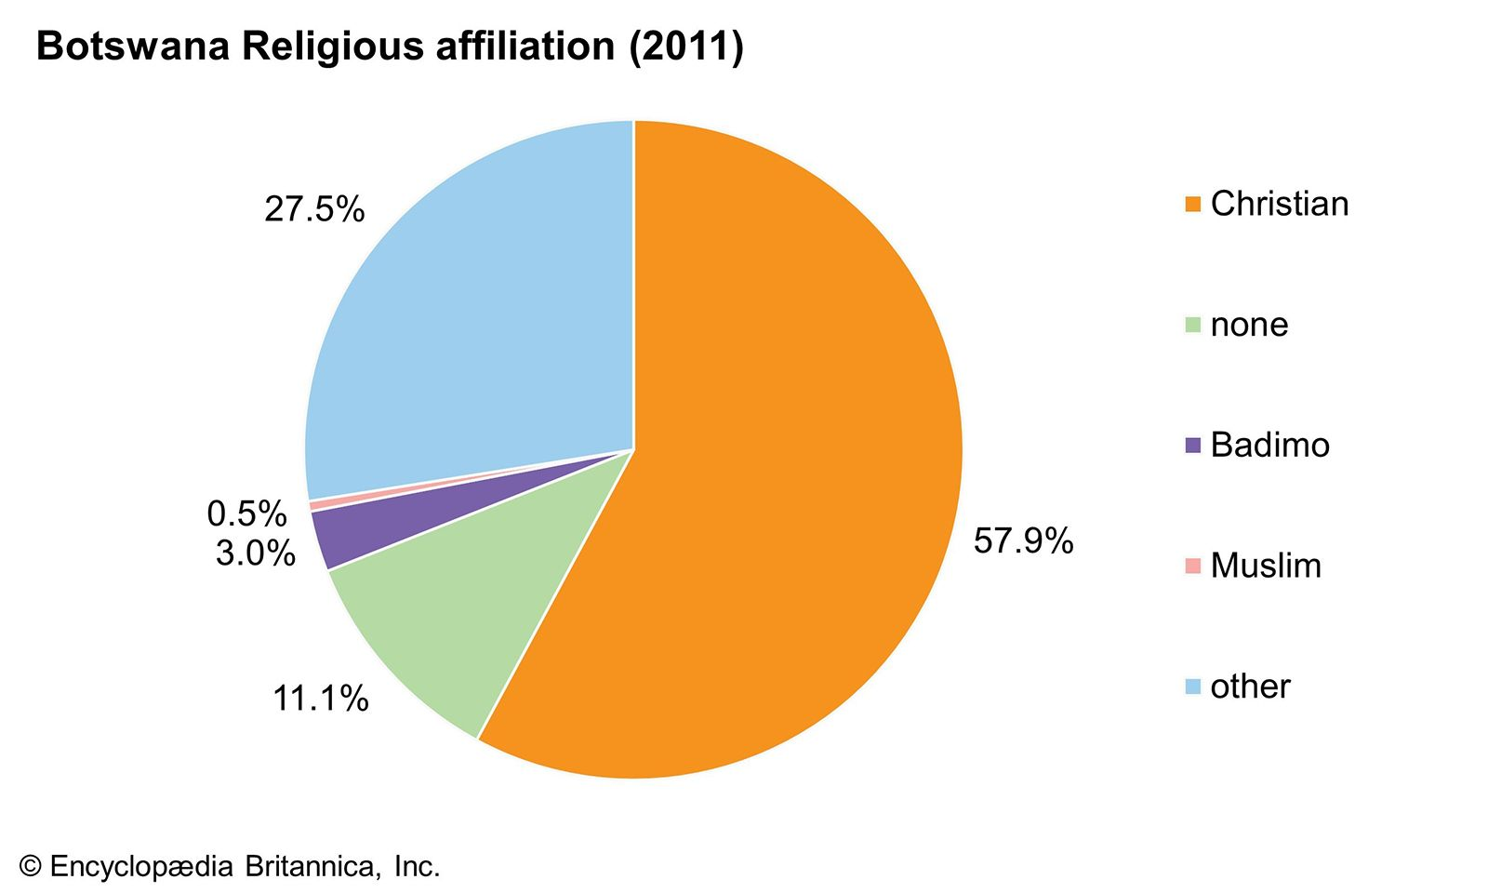
Botswana
2,5 mil inhabitants, Christianity 58%
1885 Bechuanaland.
Independcence 1966.
Botswana Democratic Party (BDS).
The lowest perceived corruption ranking and the highest level of democracy.
Tswana 79%, Kalanga 11%, San 3%.

Slide 12
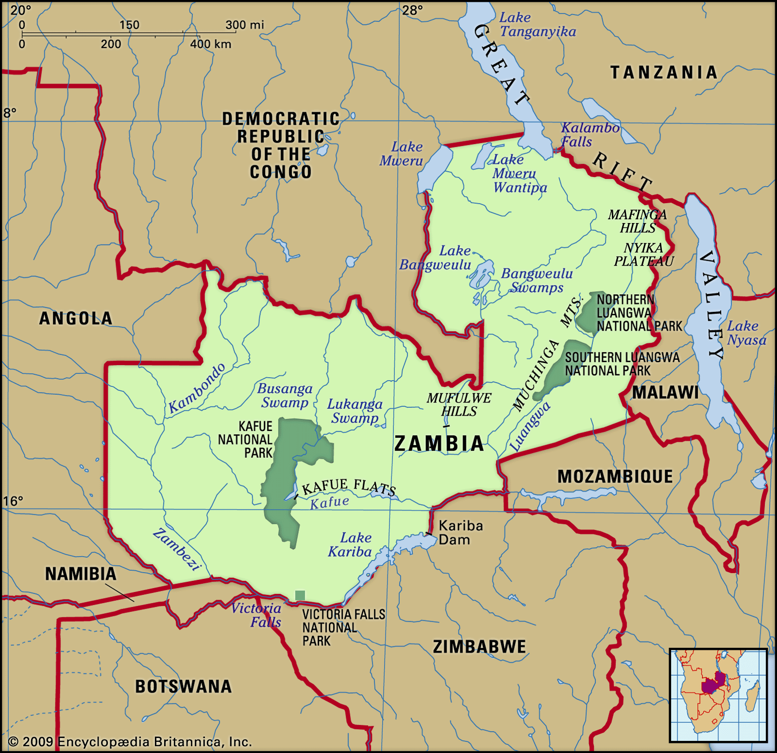
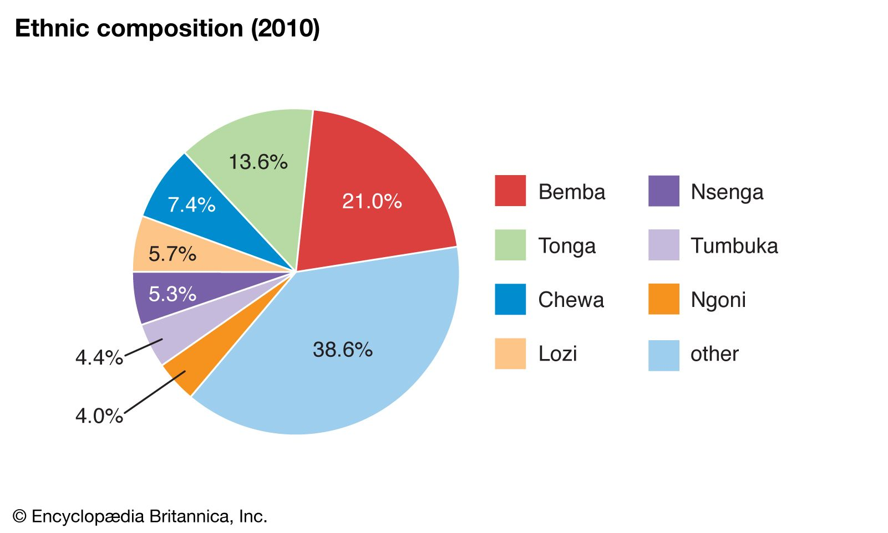
Zambia
18,5 mil inhabitants, Christianity 95,5%.
Barotseland-North-Western Rhodesia and North-Eastern Rhodes 1911 Northern Rhodesia, 1953-1963 the Federation of Rhodesia and Nyasaland.
Independence 1964.
United National Independence Party (UNIP), Kenneth Kaunda, 1964-1991.
Change of political regime 1991.
Movement for Multi-Party Democracy (1991-2011), Patriotic Front (2011-2021), United Party for National Development (2021-).

Slide 13
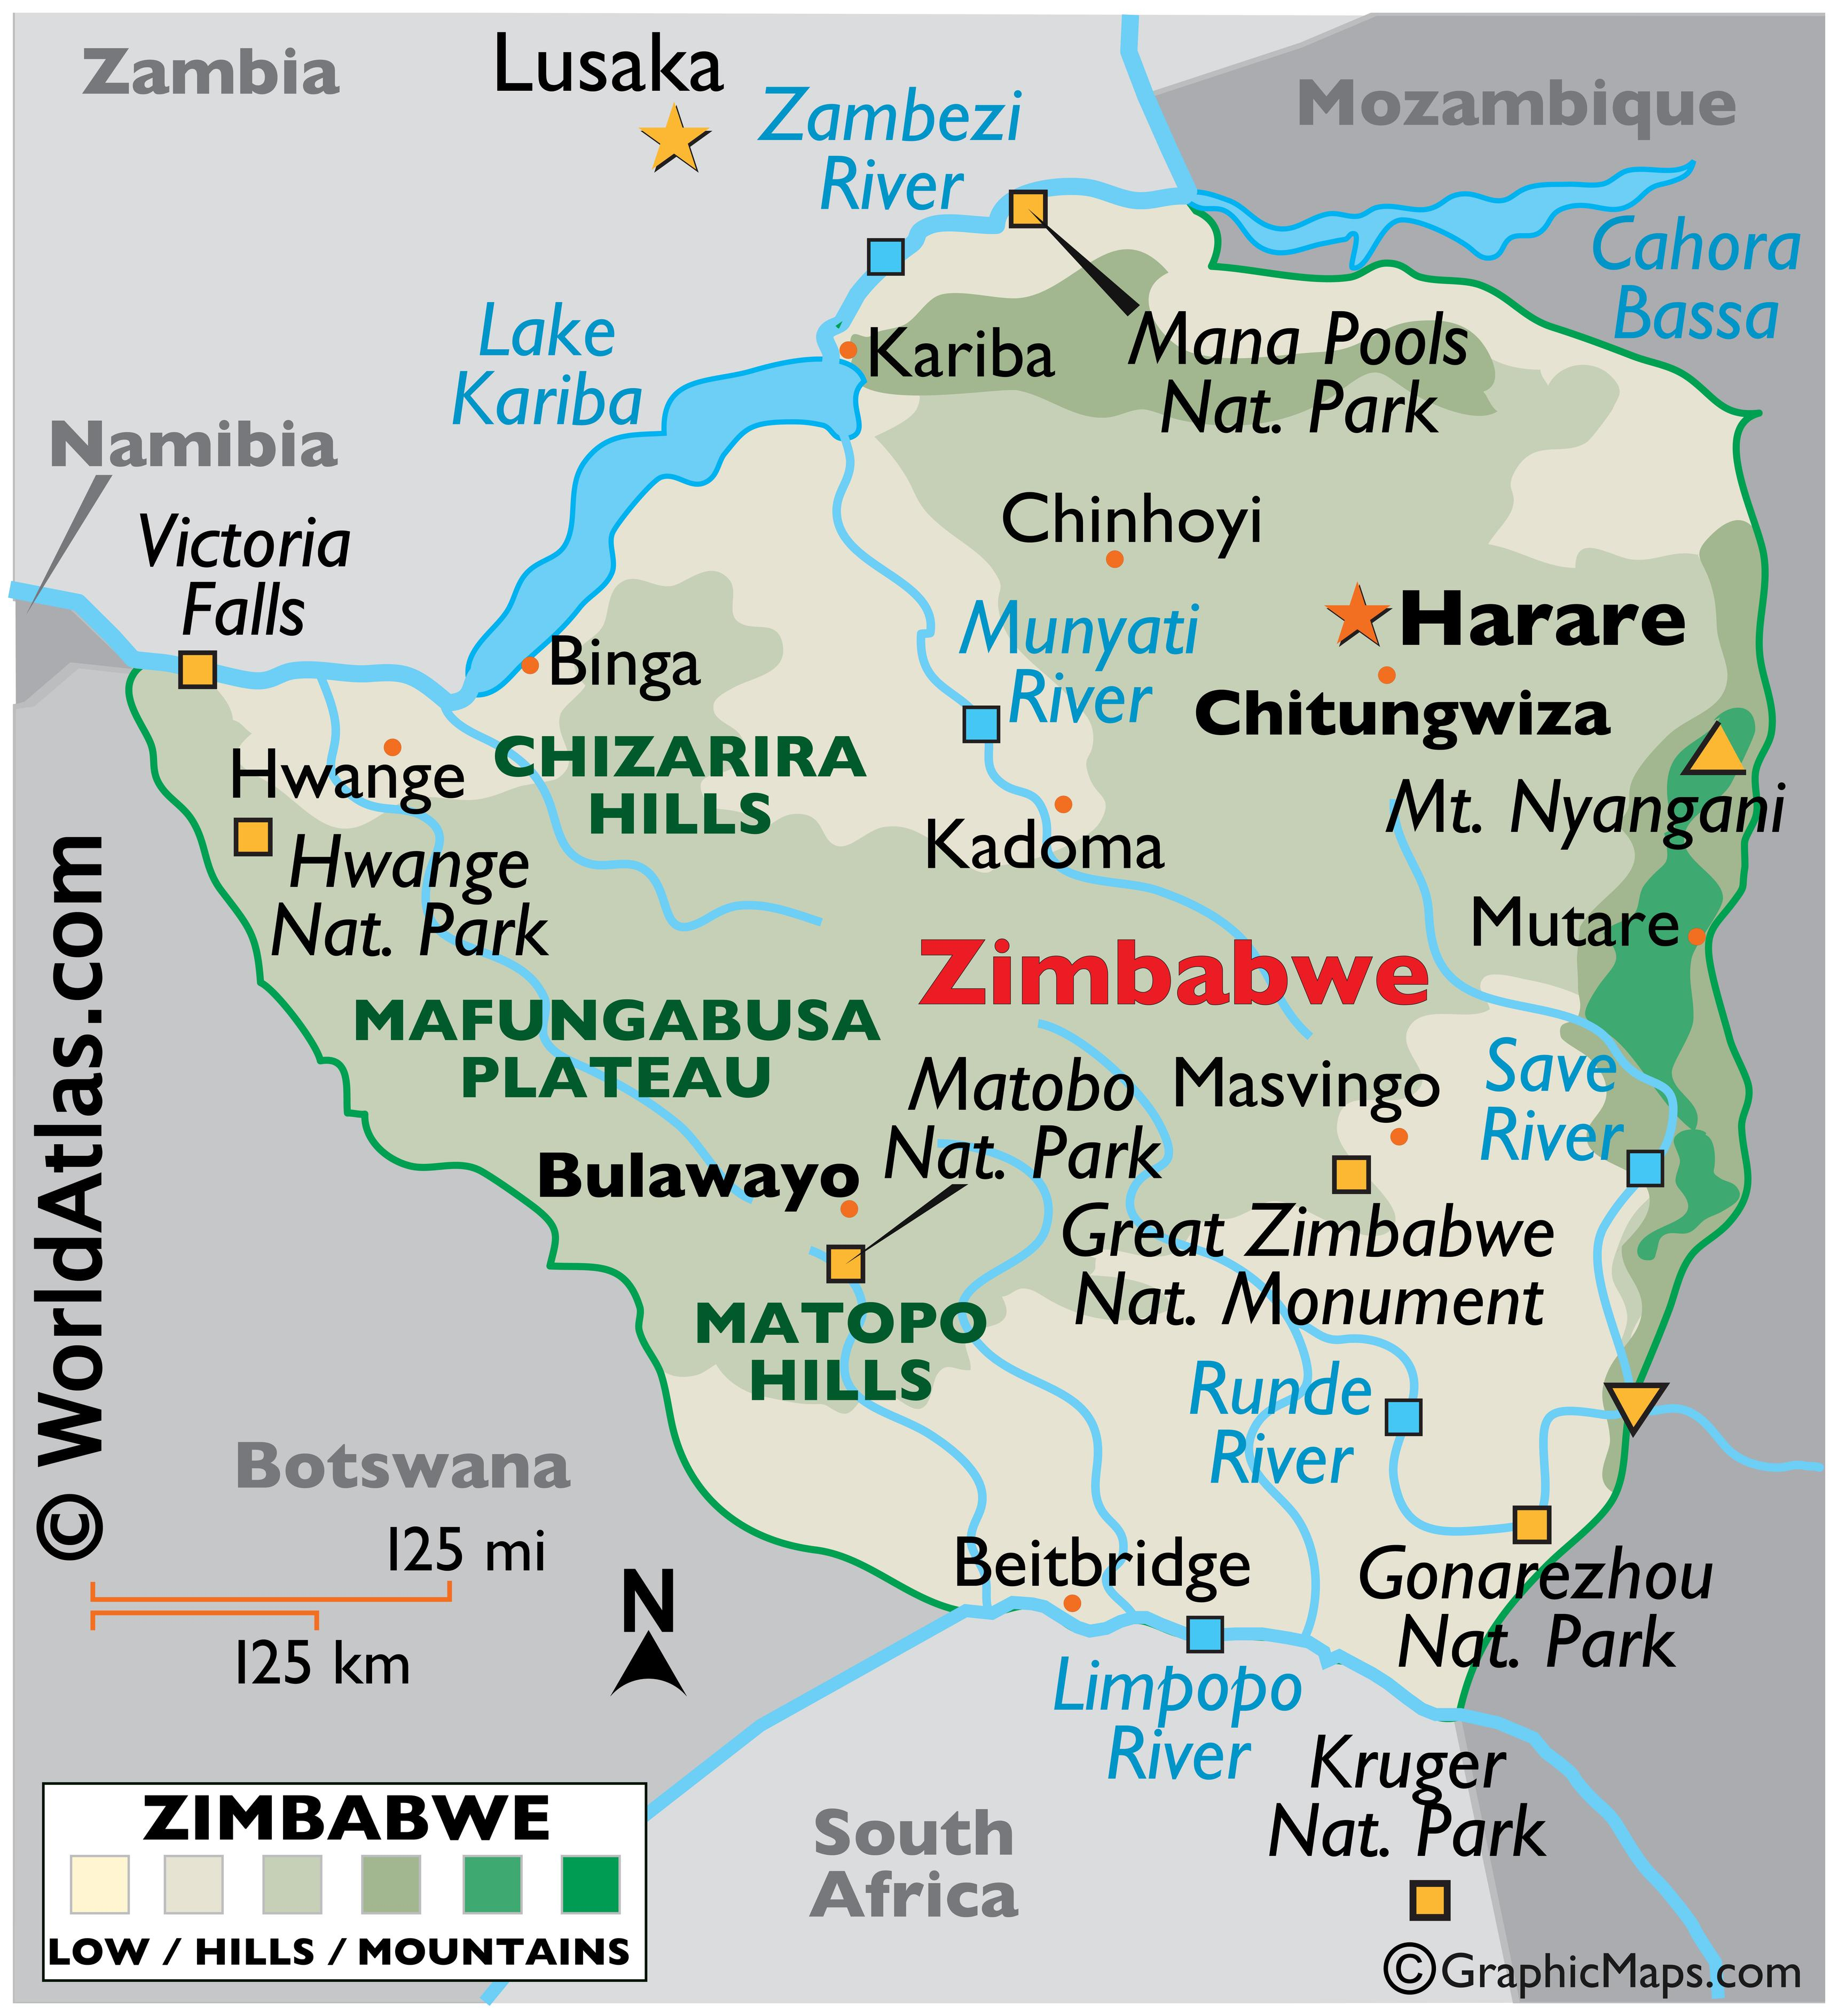
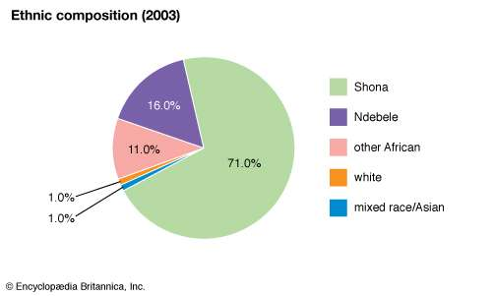
Zimbabwe
15 mil inhabitants, Christians constituted 86%
1923 Southern Rhodesia.
Rhodesian Bush War 1964-1979 (ZANU, government forces – Rhodesian Front led Ian Smith/Abela Muzorewa, ZAPU-Zimbabwe African People‘s Union).
Independence 1965/1980 (In 1965, the white separatist minority government unilaterally declared independence).
Riots in Matabele (1980-1988), Gukurahundi genocide, ZAPU (Michael Nkomo) + ZANU.
Zimbabwe African National Union – Patriotic Front (ZANU-PF) Robert Mugabe 1987-2017, Emmerson Mnangagwa.

Slide 14
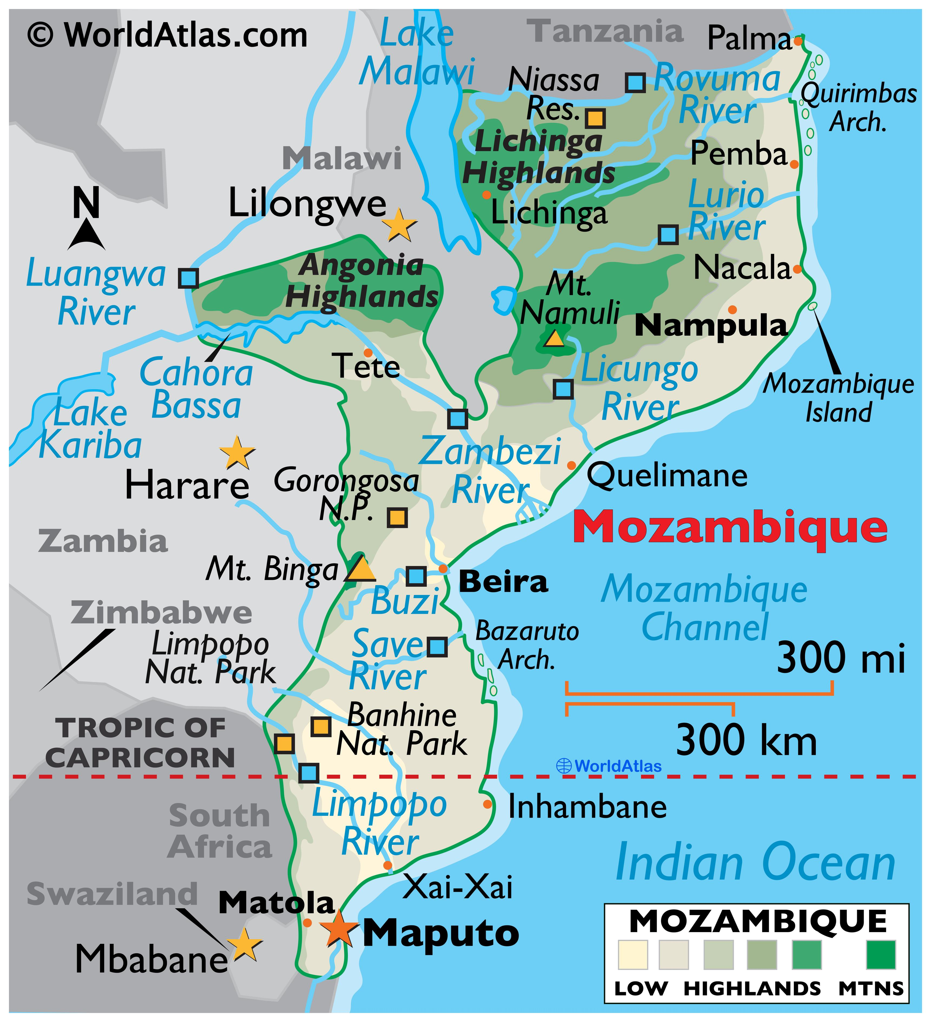
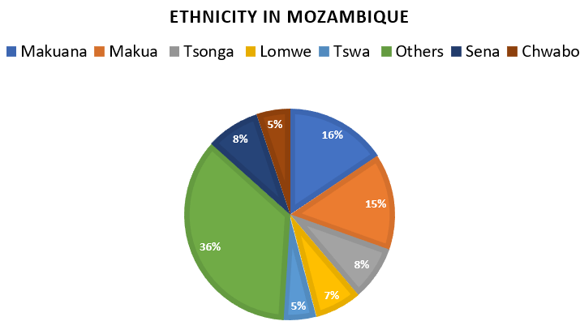
Mozambique
32 mil inhabitants, Christianity 60%, Islam 19%,
Independence 1975 - FRELIMO - Liberation Front of Mozambique.
Civil war 1977-1992 (RENAMO - Mozambican National Resistance vs. FRELIMO).
1994 – first multiparty elections.
RENAMO insurgency (2013–2021).
Conflict in Cabo Delgado (2017 -).

Slide 15
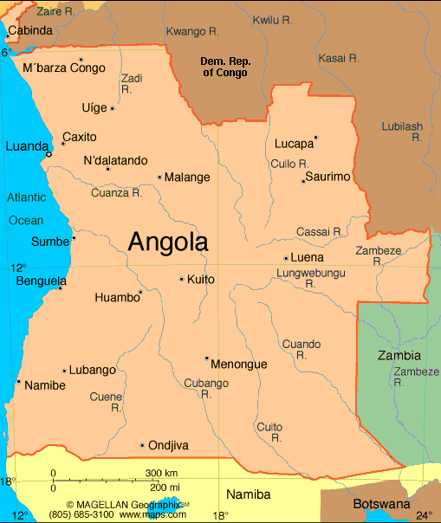
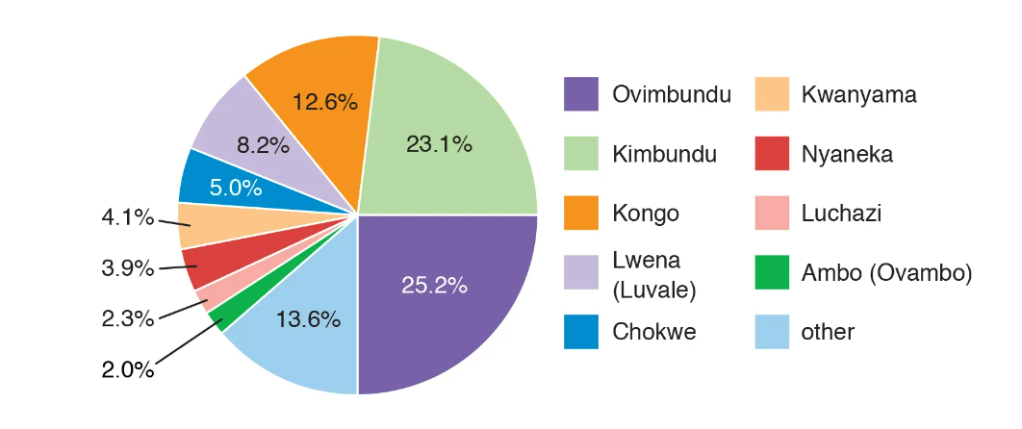
Angola
33 mil inhabitants, Christians constituted 92 %.
Angolan War of Independence 1961-1974.
Independence 1975.
Civil war 1975 – 2002 (People's Movement for the Liberation of Angola MPLA, National Union for the Total Independence of Angola UNITA, National Front for the Liberation of Angola FNLA).
Cabinda War (Front for the Liberation of the Enclave of Cabinda FLEC).
José Eduardo dos Santos (MPLA) 1979 – 2017, João Lourenço.

Slide 16
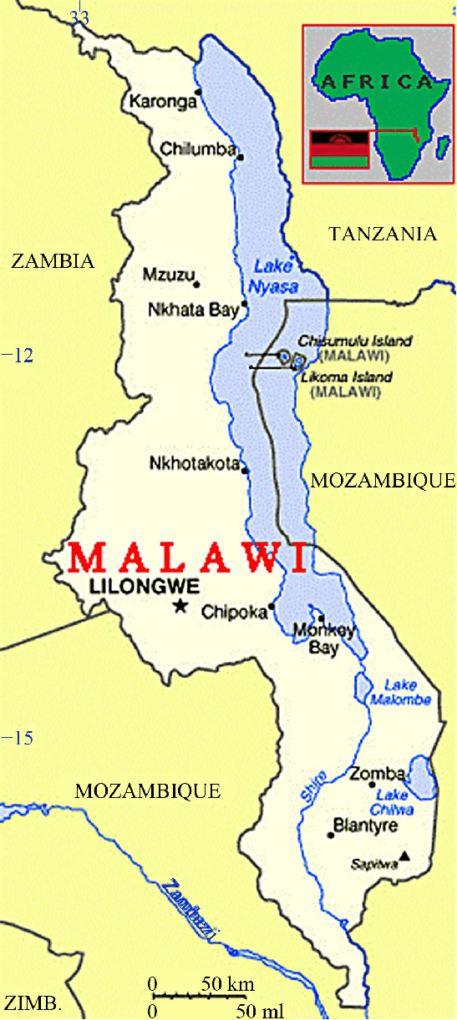
Malawi
19,9 mil inhabitants, Christians constituted 77 %, Muslims 14%.
1907 British protectorate Nyasaland, 1953 Federation of Rhodesia and Nyasaland.
1964 independence, Malawi Congress Party (MCP) – one-party system until 1993.
United Democratic Front 1994 – 2009, Democratic Progressive Party 2009 -?
Tanzania–Malawi dispute over Nyasa/Malawi lake.

Slide 17
Territorial Disputes among States

Slide 18
White Genocide/Land Reforms
Land reforms in SA – 1996 (87% owned by White), 2012 (67% owned by White), 1997 White Paper on Land Reform, 2011 Green Paper on Land Reform, since 2017 attempts of Land Expropriation without Compensation (LEWC).
Land reforms in Namibia - "Willing buyer, willing seller" principle applies, Land Reform Act of 1995 – three pillars, 2004 land value tax.
Land reforms in Zimbabwe – Lancaster House Agreement 1980, Zimbabwean Land Acquisition Act of 1992, Zimbabwe National Liberation War Veterans Association (ZNLWVA), 2005 – Constitutional amendment Fast Track.
Situation in Zambia and Botswana.
SA police definition on Farm attack: „Attacks on farms and smallholdings refer to acts aimed on the persons of residents, workers and visitors to farms and smallholdings, whether with the intent to murder, rape, rob or inflict bodily harm. In addition, all actions aimed at disrupting farming activities as a commercial concern, whether for motives related to ideology, labour disputes, land issues, revenge, grievances or intimidation, should be included.“

Slide 19
White Genocide
2001 - Committee of Inquiry into Farm Attacks.
The number of farmers of European descent had decreased by one third since 1997.
Creation of private armed patrols - „Farmwatch“
Protests Cape Town and Prayer meeting in Bloemfontein 2017, murder of Klapmuts farmer Joubert Conradie, #BlackMonday convoy, 2020 Senekal, 2022 Kirkwood
Motives for farm attacks: pervasiveness of violence, increasing poverty, unemployment and socio-economic crisis, retaliation, history of land dispossession and forceful evictions, untenable labour practices and labour-employers power relations, free access to armament, failed land reform schemes, breakdown of community policing, and ineffective security apparatus.

Slide 20
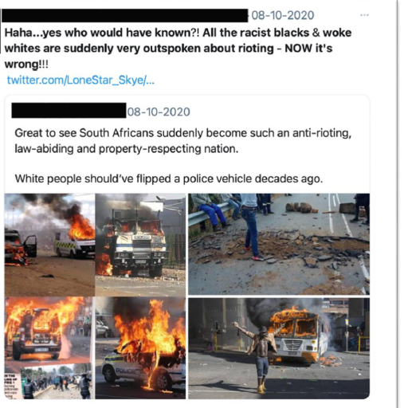
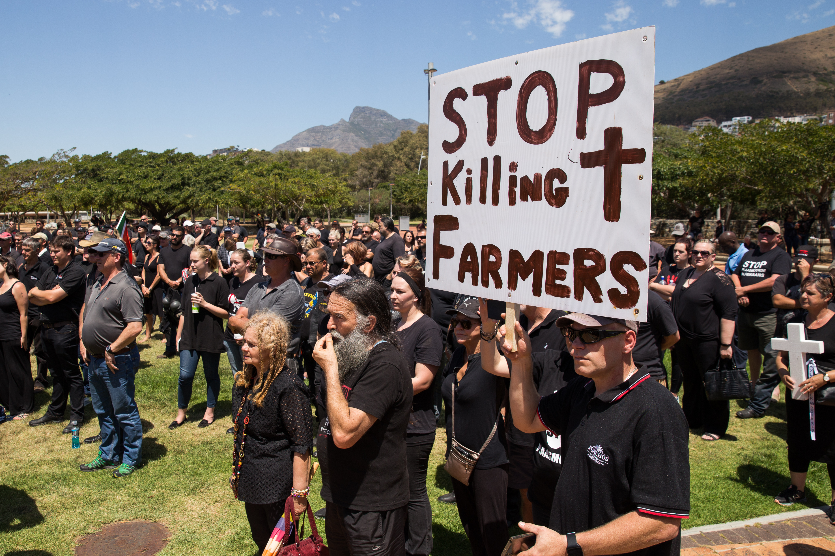
White Genocide

Slide 21
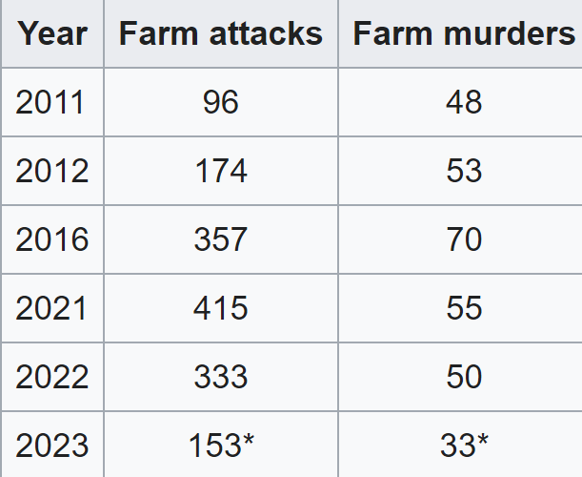
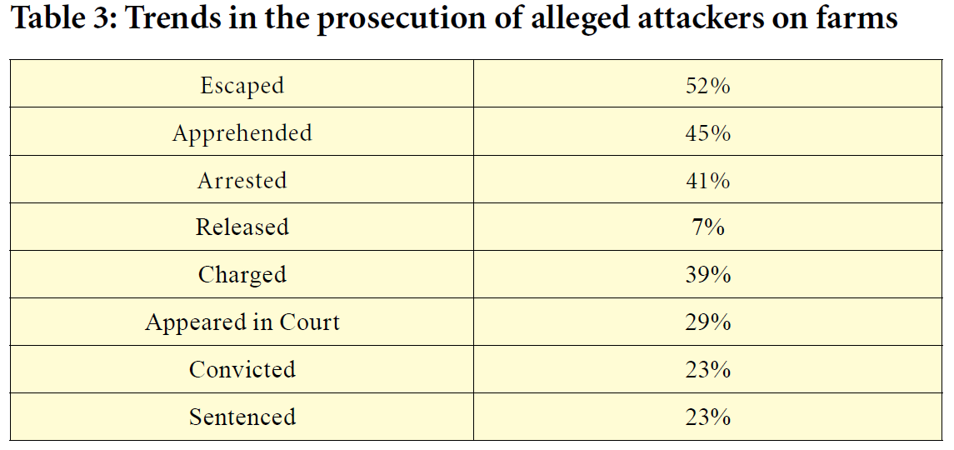

Slide 22
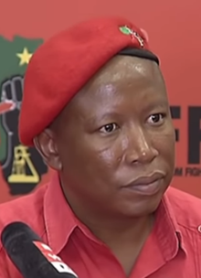
Julius Malema
Economic Freedom Fighters (EFF) – 2013
Was elected to a seat in the National Assembly in 2014, re-elected in 2019
"Kill the Boer, Kill the Farmer„
Hate speech, threats to journalists
Charged with fraud, money-laundering and racketeering (case was dismissed by the courts in 2015 due to excessive delays by the National Prosecuting Authority)

Slide 23
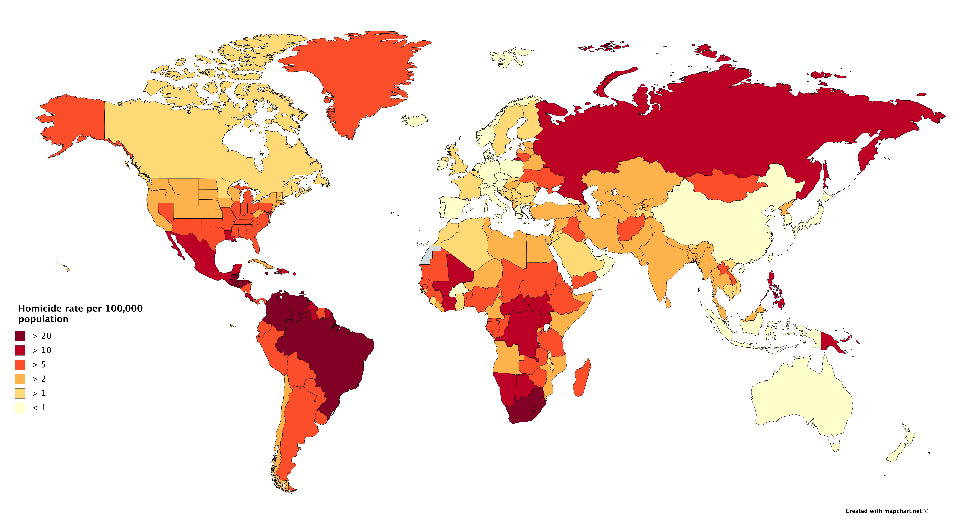
High Level of Criminality
Crime rate: SA 76,80 (3rd), Namibia 65,2 (15th), Angola 66,4 (13th), Botswana 52 (42nd), Zimbabwe 59 (25th), Zambia 43 (74th).
1 919 495 serious crimes were reported in SA in 2020.

Slide 24
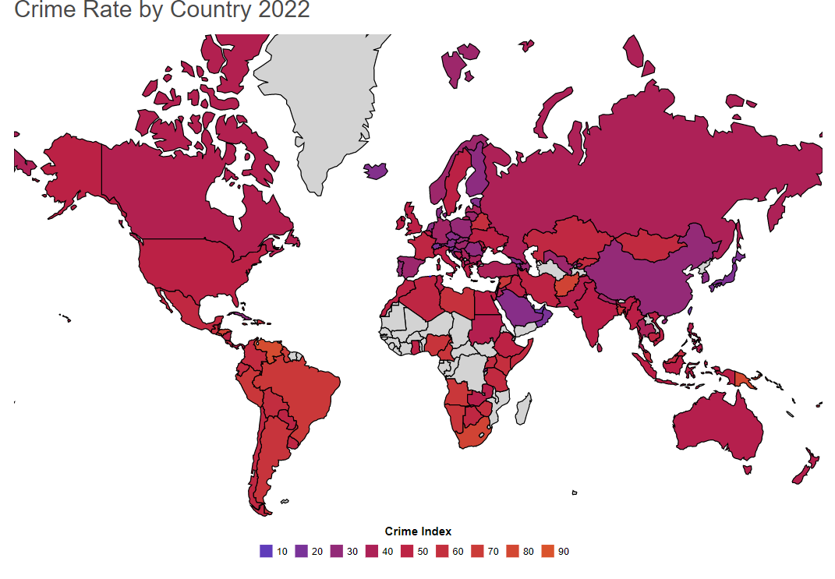
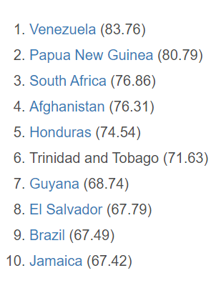
High Level of Criminality

Slide 25
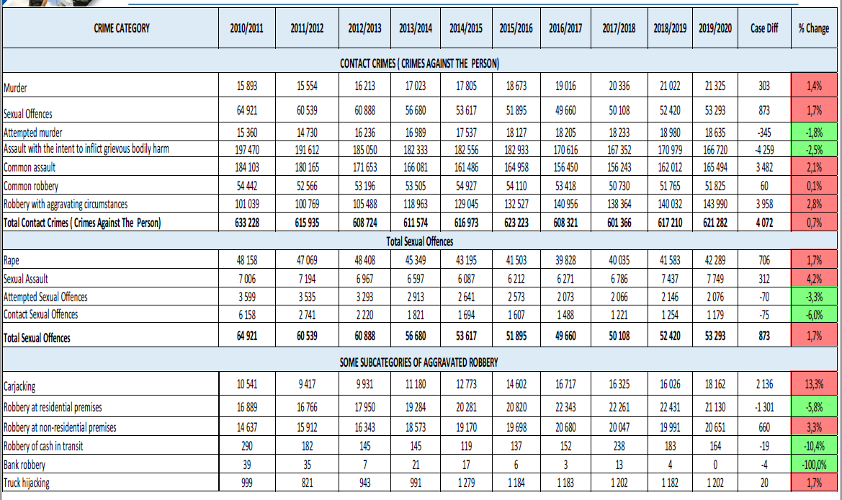
High Level of Criminality

Slide 26
Urbanisation in African regions

Slide 27
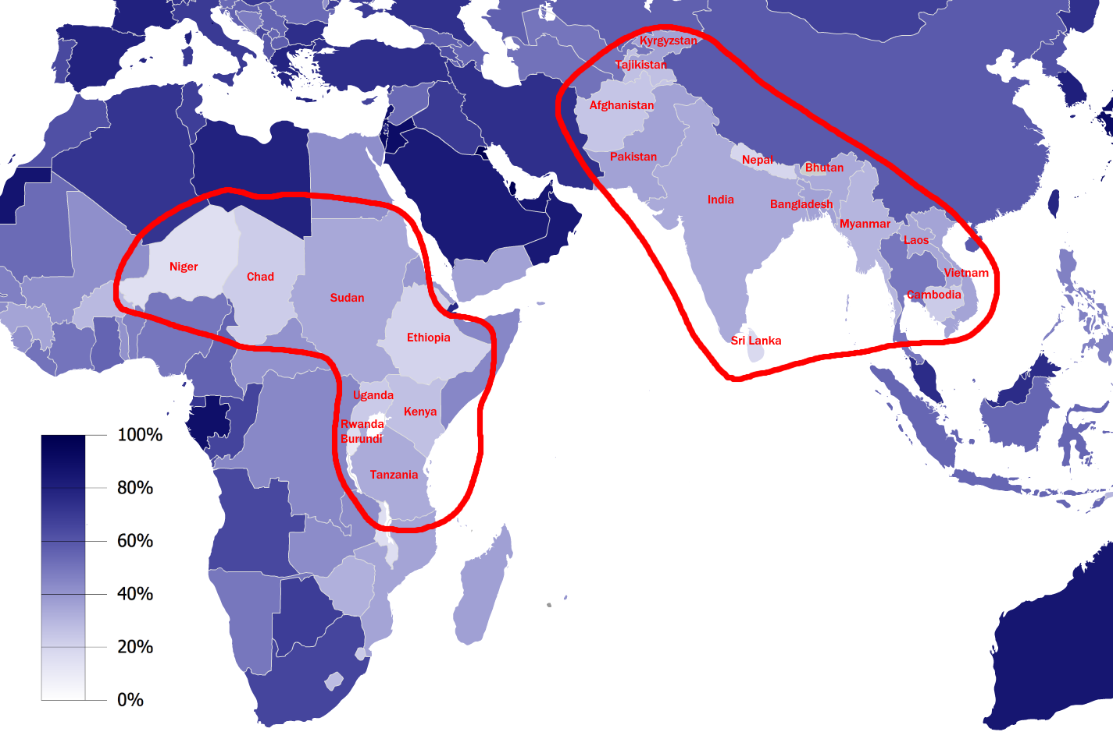
Urbanisation

Slide 28
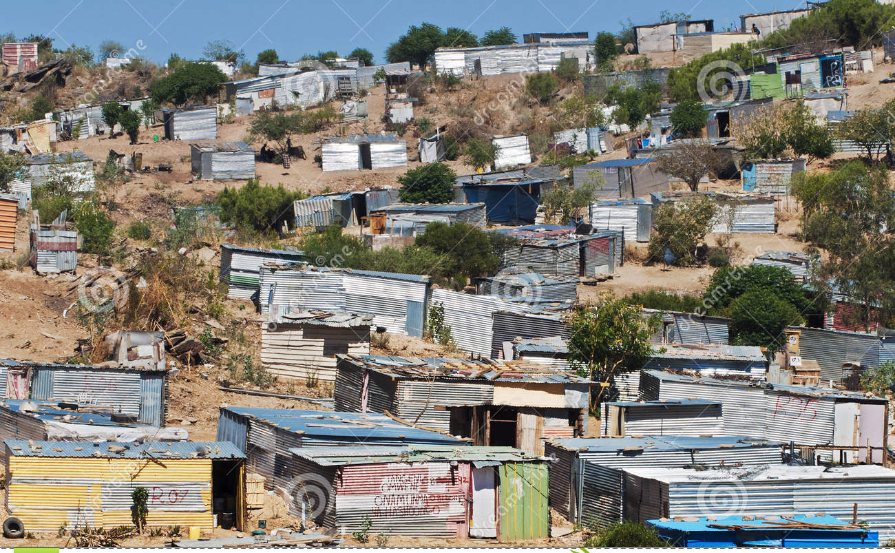
Slums in SA and Namibia
https://en.wikipedia.org/wiki/List_of_slums_in_South_Africa

Slide 29
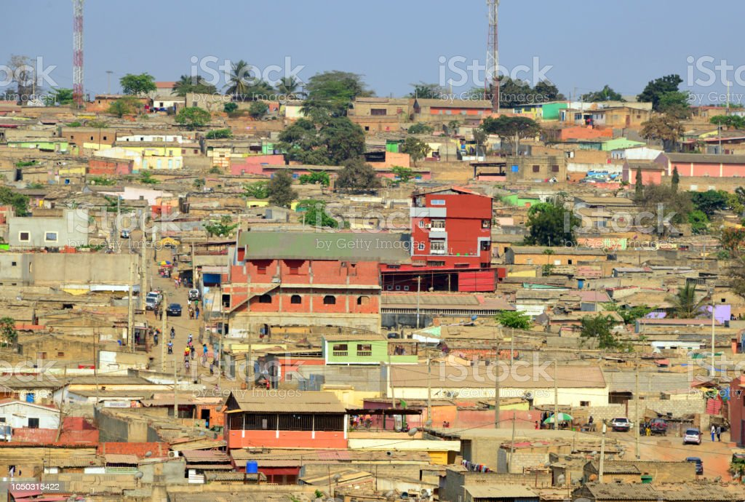
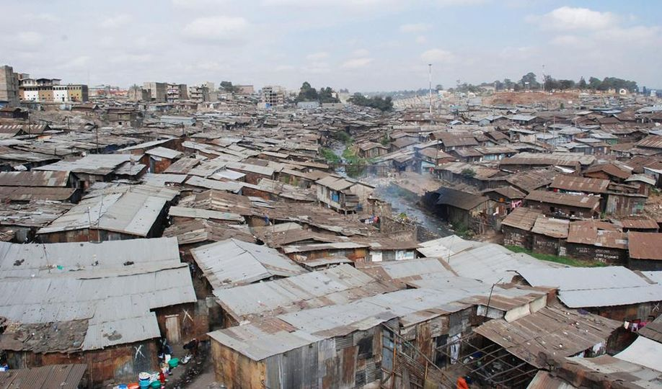
Slums in Angola and Zambia

Slide 30
Thank you for your attention

