Slide 1
Policy Intelligence
7.11.2023
GLCb2028 Artificial Intelligence in Political Science and Security Studies
Jan KLEINER
jkleiner@mail.muni.cz

Slide 2
Presentation outline
Intelligence studies introduction.
Particular methods (Center for the Study of Intelligence (U.S.). , 2009):
Diagnostic techniques.
Contrarian techniques.
Imaginative thinking techniques.
Aim
To gain knowledge of methods used for forecasting – goes hand in hand with simulations.
AI meets forecasting theory and methods.
We will form atuthor teams at the end of the lesson.

Slide 3
Intelligence studies I (Johnson, 2006)
Secretive nature – mostly studied from the outside (insiders need security clearance and are not allowed to publish).
Interdisciplinary academic field devoted to analyzing intelligence activities, agencies, and processes.
It examines issues like intelligence collection, analysis, counterintelligence, covert action, and accountability.
Key topics include the structure/organization of intelligence agencies, the intelligence cycle, and intelligence oversight.

Slide 4
Intelligence studies II (Johnson, 2006)
Forecasting techniques predict future events and trends. This can involve statistical models, simulations, and expert analysis.
E.g., forecasts on geopolitical developments, conflicts, weapons proliferation, terrorism threats, and cybersecurity.
Simulations allow intelligence analysts to model complex situations under different scenarios. This helps test assumptions and identify key variables/uncertainties.
An "anticipatory" vs. reactive approach.
However, forecasting faces challenges like cognitive biases, uncertainty, and the difficulty of modelling human behavior.

Slide 5
Claude (2023):
Business - Forecasting sales, market trends, new product adoption, competitor moves. Competitive intelligence.
Economics - Forecasting economic growth, inflation, unemployment, recessions. Monitoring systemic risks.
Science/Technology - Anticipating new innovations and diffusion patterns. Technology forecasting.
Public Health - Disease outbreak modeling and surveillance. Tracking population health patterns.
Climate/Environment - Projecting impacts of climate change. Modeling environmental risks/catastrophes.
Politics - Election forecasting models. Predicting political instability and regime changes.
Humanitarian - Early warning models for famine, natural disasters, refugee flows.
Crime - Statistical crime prediction models. Pattern analysis of criminal networks.

Slide 6
Diagnostic techniques:
Key Assumptions Check.
Quality of Information Check.
Indicators of Signposts of Change.
Analysis of Competing Hypotheses (ACH).

Slide 7
Analysis of Competing Hypotheses (ACH):
Alternative explanations (hypotheses) and evidence that will disconfirm rather than support hypotheses.
Absorbs large ammount of data.
Mitigates deception and denial, first impression and confirmation biases.
Prevents picking on first satisfactory solution and steers analysts to go through all options.
All the information and argumentation must be evaluated and given equal treatment.

Slide 8
ACH steps I:
Brainstorm to identify all possible hypotheses.
List all significant evidence relevant to all the hypotheses.
Prepare a matrix with hypotheses.
Determine whether each piece of evidence is consistent, inconsistent, or not applicable to each hypothesis.
Refine the matrix and reconsider (add) the hypotheses (focus on disproving hypotheses rather than retaining).
Analyze how sensitive the ACH results are to a few critical items of evidence; should those pieces prove to be wrong, misleading, or subject to deception, how would it impact an explanation’s validity?

Slide 9
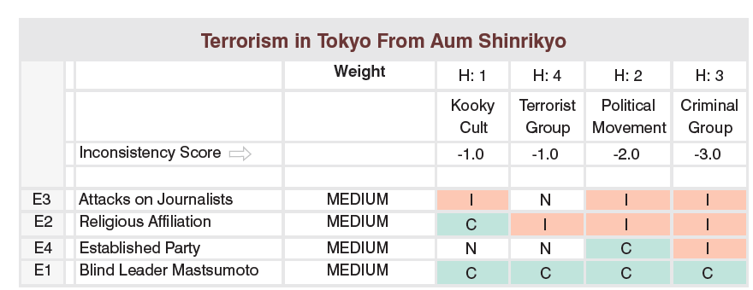
ACH steps II:
• Ask what evidence is not being seen but would be expected for a given hypothesis to be true. Is denial and deception a possibility?
• Establish the relative likelihood for the hypotheses and report all the conclusions.

Slide 10
Contrarian techniques:
Devil’s Advocacy
Team A/Team B
High-Impact/Low-Probability Analysis
“What If?” Analysis

Slide 11
Devil´s Advocacy
„Challenging a single, strongly held view or consensus by building the best possible case for an alternative explanation.“
Identifying faulty logic.
Challenging key assumptions – can make them stronger through discussion or can discard them.
Identification of alternative explanations.
World War Z.

Slide 12
Devil´s Advocacy Steps:
• Outline the mainline judgment and key assumptions and characterize the evidence supporting that current analytic view.
• Select one or more assumptions—stated
or not—that appear the most susceptible to challenge.
• Review the information used to determine
whether any is of questionable validity, whether deception is possibly indicated, or whether major gaps exist.
• Highlight the evidence that could support an alternative hypothesis or contradicts the current thinking.
• Present the findings that demonstrate there are flawed assumptions, poor quality evidence, or possible deception at work.

Slide 13
A/B Teaming
„Use of separate analytic teams that contrast two (or more) strongly held views or competing hypotheses.“
Methods: Analysis and debate phase – contrarian oppinions and discussion (moderated or not).

Slide 14
High Impact/Low Probability
„Highlights a seemingly unlikely event that would have major policy consequences if it happened.“
Allows for capturing unlikely scenario with factors at play that can have devastating impact.
Preparing for a black swan.
What if analysis
„Assumes that an event has occurred with potential (negative or positive) impact and explains how it might come about.“

Slide 15
HILP method:
Define the high-impact outcome first (justification).
Devise one or more plausible explanations for or “pathways” to the low probability outcome.
Insert possible triggers or changes in momentum if appropriate (e.g., natural disasters).
Brainstorm plausible but unpredictable triggers of sudden change.
Identify for each pathway a set of indicators or “observables” that would help you anticipate.
Identify factors that would prevent such scenario.

Slide 16
Imaginative techniques:
Brainstorming
Outside-in thinking
Red Team Analysis
Alternative Futures Analysis

Slide 17
Red team analysis
„Models the behavior of an individual or group by trying to replicate how an adversary would think about an issue.“
Mitigates the mirror-image bias (methods puts analysts into the shoes of the adversary).
The method:
Put themselves in the adversary’s circumstances.
Develop a set of “first-person” questions that the adversary would ask, such as: “How would I perceive incoming information; what would be my personal concerns; or to whom would I look for an opinion?”
Draft a set of policy papers or other simulated documents in which the adversary makes specifc decisions, proposes recommendations, or lays out courses of actions.

Slide 18
References I
Johnson, L. K. (ed.). (2006). Handbook of intelligence studies. London: Routledge.
Center for the Study of Intelligence (U.S.). (2009). A tradecraft primer: Structured analytic techniques for improving intelligence analysis. U.S. Central Intelligence Agency, Center for the Study of Intelligence.
Claude. (2023, November 6). Give me examples of areas in which forecasting and intelligence studies techniques can be beneficial beyond security. Here are some examples of how forecasting and intelligence studies techniques could provide value beyond security:
Business - Forecasting sales, market trends, new product adoption, competitor moves. Competitive intelligence.
Economics - Forecasting economic growth, inflation, unemployment, recessions. Monitoring systemic risks.
Science/Technology - Anticipating new innovations and diffusion patterns. Technology forecasting.
Public Health - Disease outbreak modeling and surveillance. Tracking population health patterns.
Climate/Environment - Projecting impacts of climate change. Modeling environmental risks/catastrophes.
Politics - Election forecasting models. Predicting political instability and regime changes.
Humanitarian - Early warning models for famine, natural disasters, refugee flows.
Crime - Statistical crime prediction models. Pattern analysis of criminal networks.
Education - Projecting future skills demands. Monitoring student outcomes.
The key is applying intelligence techniques like data gathering, rigorous analysis, modeling, tradecraft to create actionable foresight in new domains. This can improve planning and risk management beyond traditional security realms. Retrived from [https://claude.ai/chat/b5ca606a-860c-150-8d1e-dc933d13a01a]

Slide 19
Thank you for your attention.
Questions?
Jan KLEINER
jkleiner@mail.muni.cz

