Slide 1
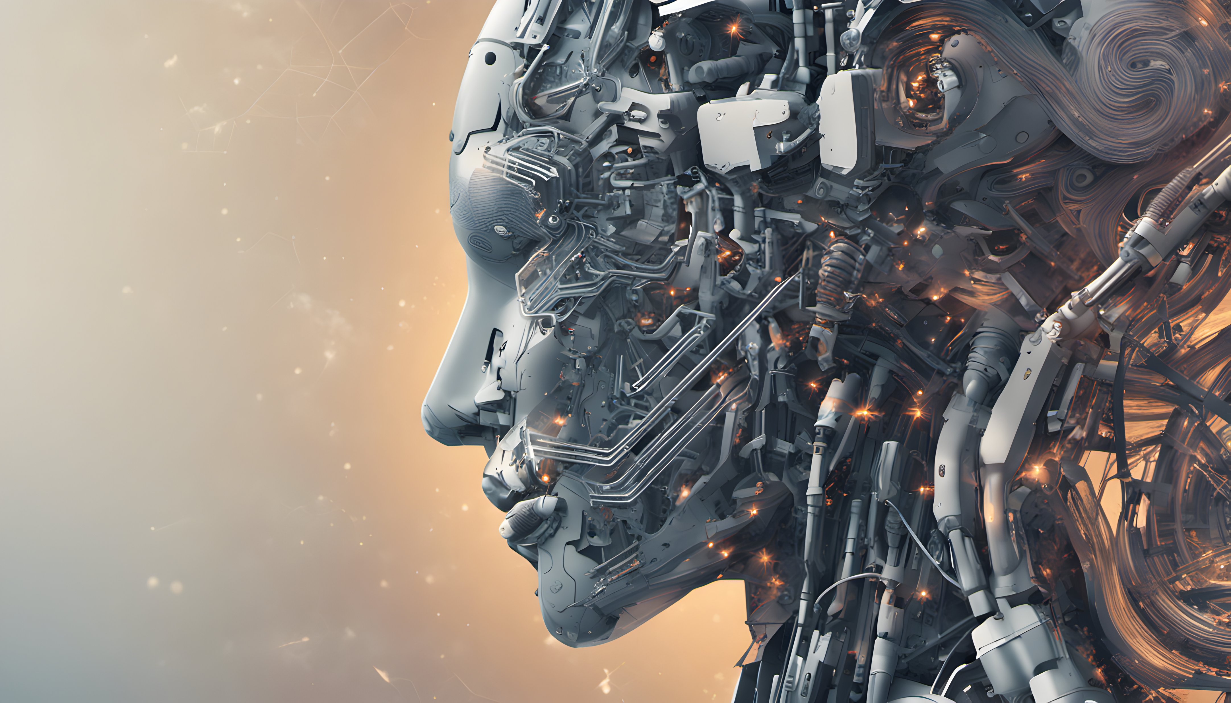
Introduction to AI in Social Sciences
26.09.2023
GLCb2028 Artificial Intelligence in Political Science and Security Studies
Jan KLEINER
jkleiner@mail.muni.cz

Slide 2
The Course´s Commons
https://docs.google.com/document/d/1wwI5iTifzOJbRBhU7AcoiUTF_qJKzpV7EKFphOeEToU/edit

Slide 3
Presentation outline
What is AI and its history?
Future markets´ predictions about AI.
Societal impacts of the AI´s development.
Will AI enslave the humanity or save it – the “big” debate and the ethics of it.
ChatGPT and LLMs (r)evolution.
More questions than answers.

Slide 4
What is AI? (Mueller & Massaron 2021)
AI has nothing to do with human intelligence → a simulation at best.
Seven kinds of human intelligence and how AI simulates them - next slide.
Four ways of AI´s categorization (the standard model):
Acting humanly (Turing test [see critique – e.g., Levasque (2014)] and its alternatives – Reverse Turing Test, Marcus Test, Winograd Schema Challenge etc.)
Thinking humanly (how to determine? → cognitive modelling approach → introspection, psychological testing, brain imaging).
Thinking rationally – do humans think rationally?
Acting rationally – do humans act rationally?
→ The standard model long-run problem: assumes that humans supply fully specified objective to the machine → we want machines to pursue OUR objectives, not THEIRS, but they have to be UNCERTAIN (we cannot predict black swans) (Russell & Norvig, 2021).
Notes:
Turing test alternatives: (1) REVERSE TURING TEST - A human tries to convince a computer that that the
human is not a computer (e.g., CAPTCHA button); (2) Minimum Intelligent Signal Test – only true/false and yes/no questions are given; (3) MARCUS TEST – comp watches TV shows and is then asked questions about it; (4) LOVELACE TEST 2.0 - A test detects AI through examining its ability to create art; (5) Winograd Schema Challenge - This test asks multiple-choice questions in a specific format (ambiguous pronouns, noun phrases etc. + no human judges)
Turing test critique summary (Levasque, 2014) –
Deception: The machine is forced to construct a false identity, which is not part of intelligence.
Conversation: A lot of interaction may qualify as "legitimate conversation"—jokes, clever asides, points of order—without requiring intelligent reasoning.
Evaluation: Humans make mistakes and judges often would disagree on the results.

Slide 5
Discussion: can AI simulate human intelligence?
Seven types of human intelligence and how AI simulates them (Mueller& Massaron 2021, 12-13):
Visual-spatial – need to understand dimensions and characteristics of the physical environment.
Bodily-kinesthetic – Repetitive tasks, higher precision than humans.
Creative – „A truly new kind of product is the result of creativity“ (p. 13).
Interpersonal – Computers do not understand the question, they provide answers based on statistics.
Intrapersonal – Inward insight, own interests, setting goals – human-only intelligence? Machines have no desires or interests.
Linguistic – „…understanding oral, aural, and written input, managing the input to develop an answer, and providing an understandable answer as output“ (p. 13).
Logical-mathematical – „Calculating a result, performing comparisons, exploring patterns, and considering relationships“ (p. 13).

Slide 6
What is AI? (Mueller& Massaron 2021)
AI has nothing to do with human intelligence → its simulation at best.
What is intelligence? → it is composed of activities:
Learning
Reasoning
Understanding
Grasping truths – validity of manipulated information
Seeing relationships
Considering meaning
Separating fact from belief
7 kinds of human intelligence and how AI simulates them – see pp. 12-13.
OECD (2019: 21): four elements of current AI vision: autonomous vehicles and robotics, natural language processing, computer vision, and language and learning.

Slide 7
The Foundations of AI I (Russell & Norvig, 2021)
(1) Philosophical: ethical principles; how does mind arise from physical brain?; where does knowledge come from? (ontological and epistemological prisms) etc.
Practical consequences: e.g., Kant´s deontological ethics → the „right thing“ determined not by outcomes (utilitarism), but by universal laws (don´t lie, don´t kill).
Important, among other things, in geopolitics → China as an emerging AI superpower (Chinese are guided by other principles then the West).

Slide 8
The Foundations of AI II (Russell & Norvig, 2021)
(2) Mathematical – what are the formal rules that grant valid conclusions?; what can be computed/operationalized?
Formal logic, probability, statistics
(3) Economics – how should we make decisions alongside our preferences?; what are our preferences?; what are the interests of all the stakeholders?
In practice: stakeholder theory; game theory etc, optimizing vs. satisficing (rationality vs. bounded rationality).
(3) Neuroscience – how do brains process information?
(4) Psychology – How do humans and animals think and act?
(5) Computer engineering + quantum computing
(6) Control theory (control engineering) and cybernetics – optimization of systems
(7) Linguistics – how does language relate to thought?; prompts and responses etc.

Slide 9
Types of AI
Strong („generalized intelligence that can adapt to a variety of situations“) vs. weak – („specific intelligence designed to perform a particular task well“) (Mueller& Massaron 2021: 16).
Seven types (Betz, 2023):
Narrow – specific task, no independent learning.
General – AI learns, thinks and performs similarly to humans.
Superintelligence – AI surpasses humankind´s knowledge.
Reactive Machines – AI responds to stimuli in real time, unable to store information.
Limited Memory – AI can store knowledge.
Theory of Mind – AI can sense and respond to human emotions (+ limited memory capabilities).
Self-aware – AI recognizes other´s emotions and has sense of self – AI´s final stage of evolution.

Slide 10
The Singularity (Mueller & Massaron, 2021)
There is a hype about this.
A master algorithm (7 kinds of intelligence + 5 tribes of learning).
Five tribes:
Symblogists – logic and philosophy; deduction solves problems
Connectionists – neuroscience; backpropagation (a backward process that adjusts neural network model) solves problems
Evolutionaries – evolutionary biology; genetic programming solves problems
Bayesians – statistics; probabilistic inference solves problems
Analogizers – psychology; kernel machines solves problems
Notes:
What is a kernel machine?
→ imagine you have a bunch of data points, and you want to figure out a way to separate them into groups.
→ Kernel machine draws a line or a curve on the paper to separate these dots into groups (line or curve doesn't have to be a straight line. It can be all wiggly and twisty if that's what works best for your data)
It does this by looking at how far apart the dots are and how similar they are to each other.
So, in simple terms, a kernel machine is like a magical drawing tool that helps you sort things into groups by drawing lines or curves on a piece of paper in the cleverest way possible.

Slide 11
Sources of AI hype
Corporations and their marketing, yet a lot of fails (e.g., Genderify – predicting person´s gender; public backlash due to built-in stereotypes and biases) (Mueller & Massaron, 2021).
Reliance on authorities and expert opinions = a big no-no! (ibid.).
→ User overestimation of and over-reliance on AI´s capabilities (new threats – sleeping in autopilot Tesla etc.) (ibid.).
AI is not „so much an advancement of technology, but rather the metamorphosis of all technology. This is what makes it so revolutionary“ (Elliot, 2021: 4).
Future markets.

Slide 12
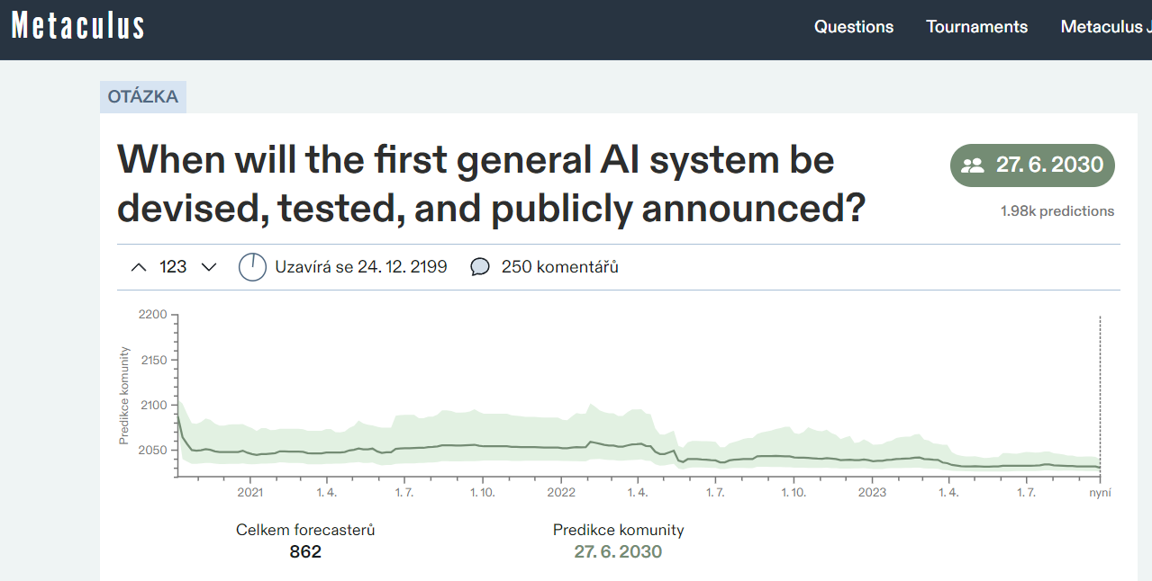
Future markets predictions
E.g., Metaculus; what about quantum computing?
Source: Metaculus

Slide 13
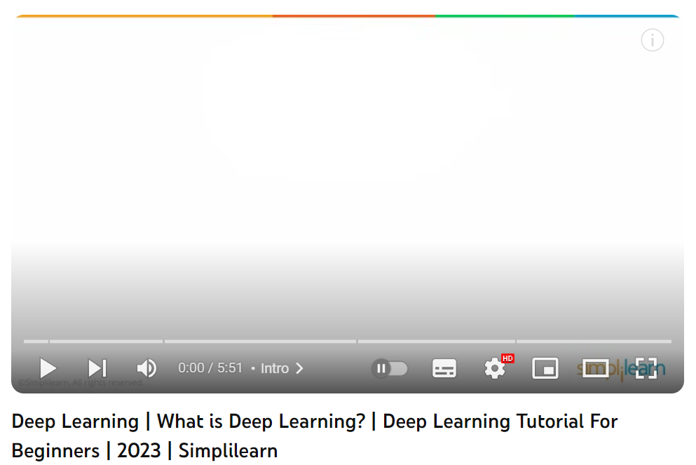
The brief history of AI (Russell & Norvig, 2021)
Inception in 1943 – model of artificial neurons.
<a long, but boring period of theoretical concepts>
2001 – Big data due to the advancements of the WWW.
2011-present – Deep learning
Source: YouTube

Slide 14
Societal impacts I
Tied to geography (e.g., mobility, geopolitice), workforce and economics, security… everything = cannot list everything ☺
Hard-to-imagine due to its unpredictability and anticipated black-swan-events (beware of predictions!).
Social theory of mobility justice – how inegalitarian aspects of mobility can be exacerbated by AI (e.g., autopilot vehicles) (Birtchnell, 2021: 19).
Increasing efficiency of traffic flows; could change people´s willingness to travel bigger distances (generally digital technologies + phenomena like pandemics).

Slide 15
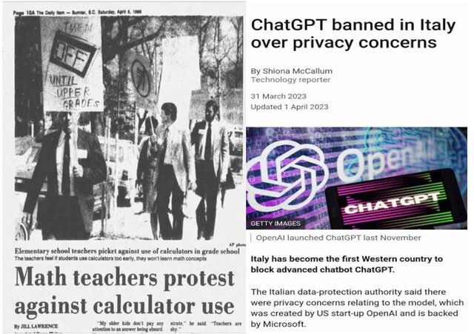
Societal impacts II – Work (Boyd, 2021)
1738 – Jacques Vaucanson – stoned for the flute player automata.
1779 – Lancashire machine-breakers.
1793 – cotton gin → concerns about the cost of slaves.
Source: Mijwil et al., 2023

Slide 16
Societal impacts II – Work (Boyd, 2021)
Tied to geography (e.g., mobility, geopolitice), workforce and economics, security… everything = cannot list everything ☺
Hard-to-imagine due to its unpredictability and anticipated black-swan-events (beware of predictions!).
Social theory of mobility justice – how inegalitarian aspects of mobility can be exacerbated by AI (e.g., autopilot vehicles) (Birtchnell, 2021: 19).
Increasing efficiency of traffic flows; could change people´s willingness to travel bigger distances (generally digital technologies + phenomena like pandemics).

Slide 17
Let´s have a break…
Find interesting predictions regarding the AI related societal impacts on Metaculus or any other future-markets-prediction site.

Slide 18
Ethics (Birtchnell, 2021)
The snowman problem – AI-driven vehicle has no way of knowing whether the snowman is alive or not; alteration of the trolley problem.
Autonomous weapon systems (UAVs, clever munitions, UGVs, autonomous vessels etc.) → combatant/non-combatant? (even humans have troubles distinguishing – contested ROEs); what error (collateral damage) is acceptable? → AI quantifies decision-making; UAV pilots suffer PTSD too etc.
Landmines parallel → Banned by the Ottawa Treaty (Russel & Norvig, 2021).
Convention on Certain Conventional Weapons (CCW) – legal aspects (China yes / Israel, USA no); stems from IHL (e.g., the principle of proportionality).
Surveillance and dataflows increase after COVID-19 → AI and smart cities → privacy concerns (state/corps. – surveillance capitalism).
+ Robot rights, trust and transparency, fairness and bias etc. (see Russel & Norvig, 2021).

Slide 19
Ethics II (Russell & Norvig, 2021)
Improved medical diagnosis, better predictions of extreme weather, safer driving…
BUT: unintended side effects, out-of-distribution, deception, legal aspects (authorship laws) etc.
→ Principles: ensure safety, fairness, respect privacy, promote collaboration (to prevent concentration of power), provide transparency (is it possible?), limit harmful uses of AI (e.g., employment ramifications).

Slide 20
How to gauge AI´s performance? (Lynch, 2023)
Usually via benchmarks („…a goal fir the AI system to hit“).
Artificial Intelligence Index Report 2023 (Maslej et al., 2023) – includes publicly available data.
Image classification – 91 %.
Human Pose estimation – 94.3 %.
Etc.
Overcame human baseline → The need for new and new benchmarks.
HELM – Holistic Evaluation of Language Models.
Results of the HELM core scenarios.
Multi-task Language Understanding (MMLU).
Non-specialist human baseline – 34.5 % (Nikkel, 2023).
The more parameters, the better performance?

Slide 21
Parameters (Deepchecks, 2023)
More parameters → better performance (Google PaLM (540 bil.) vs. Google Chinchilla (75 bil.) – almost same MMLU score).
Define AI´s model behaviour (how it processes input to produce output) and shape its understanding of language.
Hyperparameter: LLM´s temperature.
Regulates randomness or creativity of AI´s responses.
Higher – diverse and creative output, but risk of straying.
Lower – deterministic, sticking to the most-likely prediction.
Parameters are just probabilistic constructs – function on statistics and do not hold any inherent meaning.
E.g., Birds of feather → flock together (0.7) OR lay eggs (0.2).
→ Can hallucinate!

Slide 22
The Future of Life Institute Open Letter (FLI, 2023)
A six-months halt on training AI systems more powerful than GPT-4 bc.:
Spread of disinfo and propaganda.
Automate away even fulfilling jobs.
AI can become uncontrollable.
AI can be used to develop autonomous weapons.
Humankind is not prepared to deal with threats such as these (Maslej et al., 2023 concur).
Creation of regulatory authorities.
AI systems should be „accurate, safe, interpretable, transparent, robust, aligned, trustworthy, and loyal“.
→ Enjoy „AI Summer“ before fall and winter.
+ Fear of China and other parties → technological race – a new security dilemma?

Slide 23
References I
Betz, S. (2023). 7 Types of Artificial Intelligence. Built in. https://builtin.com/artificial-intelligence/types-of-artificial-intelligence.
Birtchnell, T. (2021). Geographies of AI. In: Elliott, A. (Ed.). (2021). The Routledge Social Science Handbook of AI (1st ed.). Routledge. https://doi.org/10.4324/9780429198533.
Boyd, R. (2021). Work, employment and unemployment after AI. In: Elliott, A. (Ed.). (2021). The Routledge Social Science Handbook of AI (1st ed.). Routledge. https://doi.org/10.4324/9780429198533.
Deepchecks. (2023). Deepchecks Glossary: LLM Parameters. Deepchecks. Available from: https://deepchecks.com/glossary/llm-parameters/.
Elliott, A. (Ed.). (2021). The Routledge Social Science Handbook of AI (1st ed.). Routledge. https://doi.org/10.4324/9780429198533.
FLI. (2023). Pause Giant AI Experiments: An Open Letter. Future of Life Institute. Available from: https://futureoflife.org/open-letter/pause-giant-ai-experiments/.
Levesque, H. J. (2014). On our best behaviour. Artificial Intelligence. 212: 27–35. doi:10.1016/j.artint.2014.03.007.

Slide 24
References II
Lynch, Shana. (2023). AI Benchmarks Hit Saturation. Stanford University Human-Centered Artificial Intelligence. Available from: https://hai.stanford.edu/news/ai-benchmarks-hit-saturation.
Mijwil, M. M., Hiran, K. K., Doshi, R., Dadhich, M., Al-Mistarehi, A.-H., & Bala, I. (2023). ChatGPT and the Future of Academic Integrity in the Artificial Intelligence Era: A New Frontier. Al-Salam Journal for Engineering and Technology, 116–127. https://doi.org/10.55145/ajest.2023.02.02.015
Mueller, J. P. & Massaron, L. (2021). Artificial Intelligence for Dummies. Hoboken: John Wiley and Sons, Inc.
Nestor Maslej, Loredana Fattorini, Erik Brynjolfsson, John Etchemendy, Katrina Ligett, Terah Lyons, James Manyika, Helen Ngo, Juan Carlos Niebles, Vanessa Parli, Yoav Shoham, Russell Wald, Jack Clark, and Raymond Perrault, (2023). The AI Index 2023 Annual Report, AI Index Steering Committee, Institute for Human-Centered AI, Stanford University, Stanford, CA.
Nikkel, B. (2023). MMLU: Better Benchmarking for LLM Language Understanding. Deepgram. Available from: https://deepgram.com/learn/mmlu-llm-benchmark-guide.
OECD 2019. Artificial Intelligence in Society. Paris: OECD Publishing.
Russel, S. J. & Norvig, P. (2021). Artificial Intelligence: A Modern Approach (4th ed.): Pearson Education Limited.

Slide 25
Thank you for your attention.
Questions?
Jan KLEINER
jkleiner@mail.muni.cz

