Slide 1
Intenational law
Core international law: a set of norms, rules, and practices created by states and other actors to facilitate diverse social goals

Slide 2
International law vs. domestic law
Nonbinding in traditional sense x binding
Long time states were subjects x individuals are subjects
Creation through multilateralism x creation thorugh strandard law-making proces (parliament,…)
Some issue-specific body responsible for enforcement (contractual) x state responsible for enforcement and using enforcement agencies

Slide 3
Evolution of international law
From natural law to positive
Natural law
Customary law (like a common law) – accrues over time and if it becomes entrenched, it gains the force of the law (the law of the sea)
Multilateral
Virtually all countries are members to UN Charter, but UN General Assembly's resolutions are not binding
Consent and legal obligation
Treaties are the backbone to international law
Their enforcement is difficult, because states bind themselves to abide by the rules (but "pacta sunt servanda")
Justification
International law is not logically applied top-down, but based on arguments and analogy
Argument is rhetorical
Institutional autonomy
Functional perception of different spehres – the political and the sphere of law (case of humanitarian intervention)

Slide 4
Approaches to International Law
Realism – they are outworking of the states‘ interests
Liberalism – they are the way how states cooperate and create a stable environment, means to mitigation of communication/coordination problems
Marxists – they are reflection of the ruling class/capitalist class

Slide 5
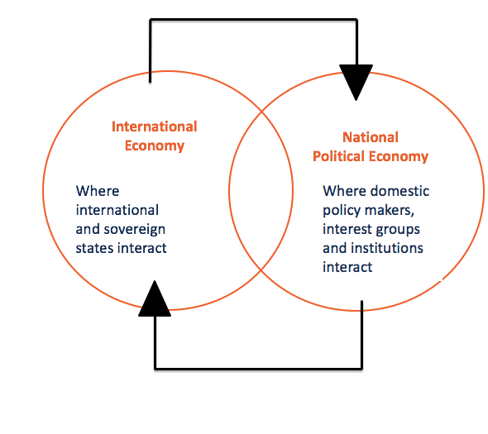
International Political Economy

Slide 6
Three dimensions to world affairs
Strategic – politics of state affairs (diplomatic, military)
Global market affairs – global production, consumption, finance, investment, work, and trade
Politics of the world's social (civic) affairs – world of civic society, NGOs

Slide 7
Post-war arrangement and emergence of IPE as a branch of study
Bretton Woods system (1945–1971):
IMF (International Monetary Fund) - to ensure a stable exchange rate and provision of emergency assistence
IBRD (The International Bank for Reconstruction and Development, later the World Bank) - created to facilitate private investment and reconstruction in Europe
GATT (General Agreement on Tariffs and Trade) -> WTO
Dismantling of the Bretton Woods system:
Oil shocks of 1970s, end of the gold standard
Economy becomes an important issue within the IR community – political scientists lead the way and economists are reluctant

Slide 8
IPE with regard to human nature
Materialist account to IPE: classical marxism
Marx and Engels – expectations of world-wide class struggle that would lead towards revolution (but not local – global)
Means of production determine everything else including norms, ideals, and values
Constructivism
Ideas are analytically central

Slide 9
Approaches to IPE: Mercantilism
economic nationalism (Thomas Mun, Frederick List)
17th to 18th century
Foreign trade as a way how to increase wealth: sell more each year than you buy + increase in exports with import substitution (import taxes, tariffs, non-tax barriers), use national transport, add value to primary producst
Remains strong even today – retional policies – European Union, Trump's tariffs
Language using promoting exports, inhibiting imports, controlling captial flows, keeping currency and foreign reserves in state hands

Slide 10
Approaches to IPE: economic liberalism
(Adam Smith, David Ricardo, Milton Friedman, Friedrich A. von Hayek)
Adam Smith – highly critical of economic nationalism, because of the way it exalted the significance of a favourable balance of trade; did not believe in restricting imports, fostering exports and using subsidies for infant industries could make a state wealthy
Free trade as most effective way to pursue wealth
Absolute advantage, then Ricardo's comparative advantage – even the states that were more productive in every way still have an incentive to trade
Calculating human nature; state control over markets distorts them
"Washington Consensus" - balanced budgets, small or no budget deficits, reduced state expenditure, tax reforms to broaden the tax base, reduce tax burden, interest rates and exchange rates determined by the market and not by the bureaucrats
Governments necessary to act as umpires and maintain the integrity of the system.

Slide 11
Approaches to IPE: socialism
Reformist socialism: Distribution of wealth should succeed – people are good enough to distribute the fruits of the economy
Optimists like Robert Owern and Henri de Saint-Simon
Reforms in workers' pay, participation, and education
Human capacity for personal improvement, people basically good if treated well
Revolutionary socialism of Karl Marx – socialism as the next stage in humanity's history
History seen in terms of raising proletariat to verthrow the boureoisie and dismantle the state in order to establish advanced communism
More contemporary – neo-marxist theories of dependence, structural features of the capitalist world economy (centre, periphery, and semiperiphery)

