Slide 1
Power, hegemony, regimes

Slide 2
Types of Goods provided in the system
 | RIVAL | NON-RIVAL (person, group, government, etc. cannot adequately deny a person access to it)
EXCLUDABLE | Private good My bottle of coke | Club good Movie tickets Security in alliances
NON-EXCLUDABLE one person’s consumption of the good does not interfere with another’s consumption of it are prone to over-consumption and underproduction | Common good Fishery | Public good Clean air Safe seas

Slide 3
Power
Measuring power?
Ability to make someone do something he wouldn't have otherwise done.
Potential to influence others (tangible and intangible possesions of state - capability)
Long term sources: total GDP, population, territory, geography, nautral resources; political culture, education, patriotism, strength of technological base
Short term sources: military forces (capability), military-industrial capacity, type and efficiency of state bureaucracy, support and legitimacy, loyalty of the army
Security dilemma
Balance of power
Deterrence – compellence – escalaton – arms race
“Being powerful is like being a lady. If you have to tell people you are, you aren't.”
Margaret Thachter

Slide 4
Regime
Principles represented in coherent statements about how world works (global welfare is based on free trade)
Norms – general standards of behaviour
Rules – lower level than principles and norms
Decision-making procedures

Slide 5
Possible solutions to the collective goods problems
Principle | Advantages | Drawbacks
Dominance | Order, Stability, Predictability | Opression, Resentment, occasional fighting to get to the top
Reciprocity | Incentives for Mutual Cooperation | Incentives for Downward Spirals Complex Accounting and need for monitoring
Identity | Sacrifice for Group, Redefine interests | Demonizing an out-group

Slide 6
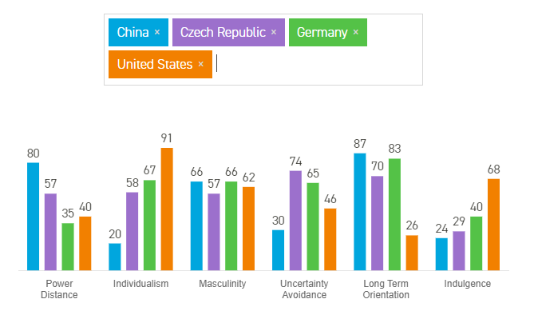
Hofstede insights
Different cultures than solve the various dilemmas differently.

Slide 7
Hegemonic Stability theory
Talked about in the context of US dominance over international system after 1945 and the subsequent breakdown of the Bretton-Woods institutions in 1970s
Hegemonic power emerges from fundamental realignment of material power in the international system (often out of systemic wars; Pax Britannica, Pax Americana)

Slide 8
Neorealist reading of HST
Connected with names like Charles Kindelberger or Robert Gilpin, Stephen Krasner, critique: Susan Strange
- hegemon is the provider of the public good and his position also flows out of this provision (x Britain had internally imperial trading system and was able to bear the non-reciprocity of its rivals/other states in the system)
Power to punish free-riders, deter agression, function as a lender of last resort (provider of hard currency)
Provide goods that the other states want and aceed to it (current situation)
1971 – US starts acting unilaterally (burdern of Vietnam war, economic decline, but the system continues working (although there had been a lot of talk about decline)
Susan Strange: sturctual power of USA (security, credit, knowledge, and production)

Slide 9
Neoliberal variant
Robert Keohane, Joseph Nye, Ikenberry, Kupchan
How come do the forms of cooperation introduced by United States still work?
Cooperative relationship do not require a hegemon
There is not a necessary relationship between uneven distribution of power and internal liberal order of the state
Cooperative, regime-based behaviour is the outcome of the liberal domestic character of the major states
Diminishes the comparison between Britain and USA by stressing "complex interdependence" between states and other actors (not just formalized treaties based on uneven power relationship)
The continuing usefulness of such arrangements (institutions and regimes) then account for their prevalence
Ikenberry – stresses the constitutional establishment

