Slide 1
Discussion

Slide 2
Costs of inaction
The cost of inaction in the future regarding transition to renewable energy seems to be less discussed that current investments needed into renewable energy sources. Could you perhaps explain what are the specific arguments supporting the increasing cost of inaction?

Slide 3
Source: Nature

Slide 4
Source: Way 2022, see also Stern 2022

Slide 5
Framing climate change
It seems to me that the discussion in the media surrounding climate change and fossil fuels takes the position that only a complete and total elimination of fossil fuels will come close to possibly saving the environment. At the same time, as a practical matter, some fossil fuels will be needed for the foreseeable future.
Similarly, the most vocal renewable energy proponents discuss climate change as being an existential crisis, but often their actions do not reflect their words (ranging from individual actor’s hypocritical travel habits, to countries re-embracing fossil fuels when “times get tough”).
Is this extremist language/approach wise, or might it embolden climate-skeptics?

Slide 6
Nuclear power
Levelized cost of electricity per megawatt-hour: why the cost of nuclear energy rises and why the RES like wind and solar tend to decrease in their costs?
***
Is building up new nuclear power plants really necessary to achieve emission reduction? Isn’t it waisting money, which could be used for research on storage technologies and more efficient renewable technologies?
***
My understanding is that, while continual improvement is needed, modern nuclear plants are relatively safe. No method of energy production is entirely without cost/risk. Given that humans are not good at weighing probabilities and risk, shouldn’t we be careful not to overreact to these isolated incidents given nuclear’ s potential? (I understand that the urgency of the climate crisis weighs against further investment in nuclear - which takes a long time to build – but this still seems like a worthwhile discussion.)

Slide 7
Nuclear power
IEA WEO 2022: to meet the 1.5 target, we need to add:
1,120 TWh by 2030
Additional 1,517 TWh by 2050
That translates to:
150 new reactors by 2030
350 new reactors by 2050
No shutdowns of the existing reactors
Reactors in use (2022): 437

Slide 8
Costs!
How do the energy-storage technologies influence the cost of electricity? Why can the total cost increase?

Slide 9
The paradigm
Do you see any relevant point in Degrowth ideology, scientific work of ecological economist and localization tendencies?
***
Is there any constructive what is our goal as a human civilization and individuals? Is it material welfare or deeper meaning of our existence on the Earth?

Slide 10
Circular economy and waste
Can the circular economy contribute to addressing the pressure on the environment caused by the proliferation of renewable technologies, such as solar panels, wind turbines, and batteries, and ensure more sustainable resource extraction and end-of-life planning for these technologies?
***
How big of an environmental impact have the disposal of PV panels after the end of their life? How to minimize it in the future?

Slide 11
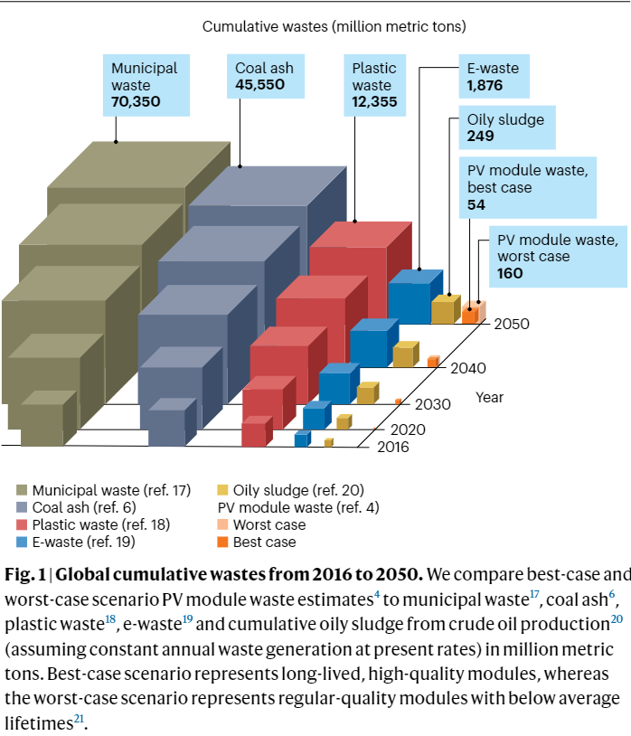
Source: Mirletz 2023

Slide 12
Source: Ritchie 2023

Slide 13
This question is somewhat skeptical. If the energy transition does not succeed, could it potentially discredit the EU's position both at the member state level and internationally?

