Slide 1
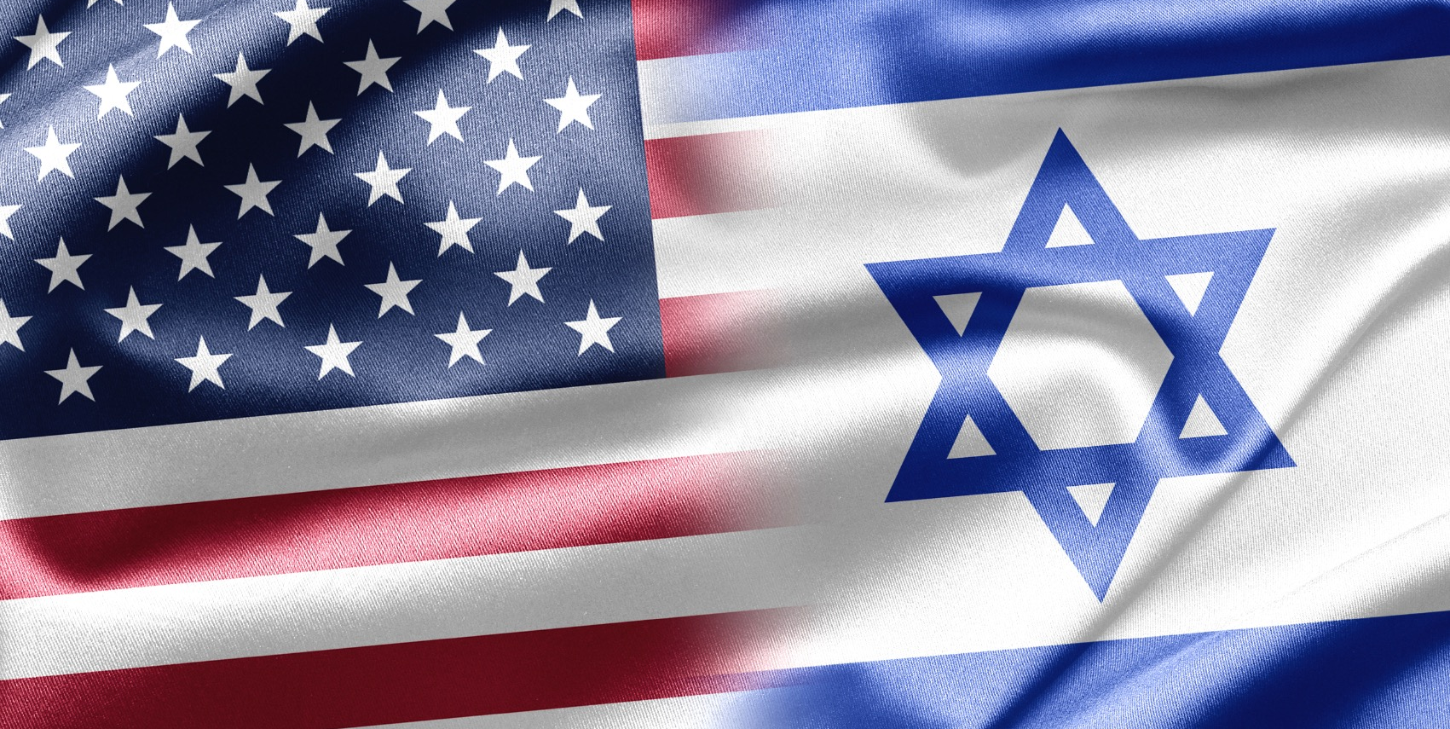
U.S. Foreign Policy Towards Israel
MVZ244
Dr. Aaron T. Walter

Slide 2
Course overview
Examine the continuity and change of U.S. foreign relations with Israel
  tight bonds with inherent tension
An overview of change from President Truman to President Trump
Examine key milestones in the relationship of the two nations
Impact of U.S. presidential decision making on foreign policy
Impact of foreign policy crisis on relationship with Israel

Slide 3
Course objectives
Explore major themes, historical events, and personalities in U.S.-Israeli relations
  before 1948
  after 1948
Discuss the nature of America’s ‘special’ and ‘strategic’ relationship with Israel
Role, if any, of lobbies
Familiarity of key players and issues and complexities of U.S. diplomatic efforts in the Middle East
Provide critical thinking tools necessary to examine with a critical eye the day-to-day happenings in Israel, the broader Middle East, and America’s relationship within.

Slide 4
Structure of Classes
Overview of topic
Case study on key episode(s) of U.S.-Israeli relations
Review and commentary
Discussion on contemporary aspects, as necessary
This is NOT a class on the Arab-Israeli conflict
This is NOT a class on the Israeli-Palestinian peace process

Slide 5
Expectations
Arrive prepared and ready to participate
  weekly readings
  awake
  not preoccupied
    this is a 90 minute class
Ask questions
Respect for classmates and instructor

Slide 6
Exam Schedule
Midterm Exam via Information System (IS)
  questions from first 5 weeks
  Final paper upload to IS (Thursday.FinalWeek)
  analysis of case study
    choice of topic (Week2)
    list of topics provided (StudyMaterialFolder)

Slide 7
Grading
15 % classroom participation
20 % midterm exam
65 % final paper

Slide 8
Readings
Relate contemporary and historical issues
  stay current with relevant online news
  Times of Israel: http://www.timesofisrael.com
  Jerusalem Post: http://www.jpost.com
  New York Times: http://www.nytimes.com
  Wall Street Journal: http://www.wsj.com
  Fathom: http://fathomjournal.org
  Tablet: http://tabletmag.com

Slide 9
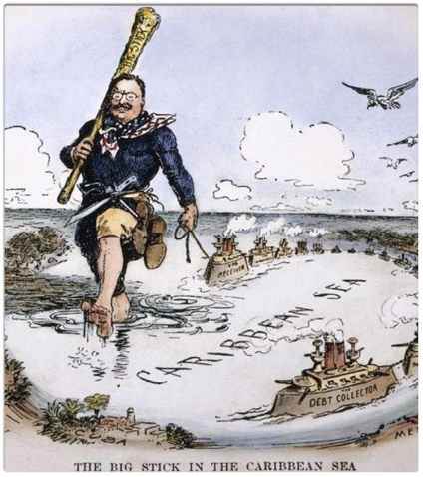
What is Foreign Policy?
Self-interest strategies
  trade
  national security
  common or shared “values”
Strategically employed to interact with other countries
Foreign policies of U.S. have varying rates of change and scopes of intent, affected by factors that change the national interests.
  Cuba 1959, 2013-15
  Iran 1979, 2014-15
  Israel

Slide 10
Foreign Policy
Realist
  Hans Morganthau
    Realism in International Politics
    Political realism. Realism that is objective. Rational.
      Politics Amongst Nations: Struggle for Power and Peace (1985)
Neorealist
  Waltz, Theory of International Politics (1978)
    Power is most important in International politics
Neoclassical
  Classical realist and neorealist plus defensive realist theories.
  mistrust and perception leads to underexpansion or underbalancing behavior = imbalances within the international system
  Rose World Politics (1998)
Constructivist
  significant aspects of IR are historically and socially constructed, rather than inevitable consequences of human nature or other essential characteristics of world politics
  Wendt (2004), Ruggie

Slide 11
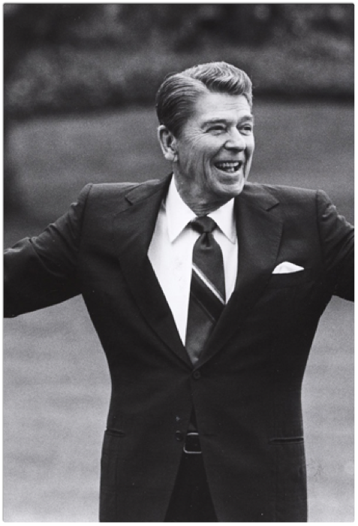
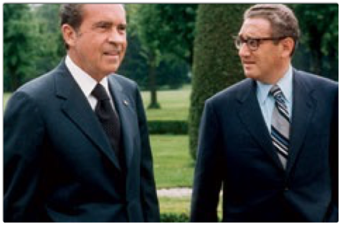
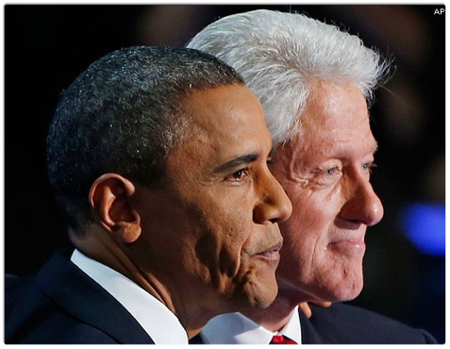

Slide 12
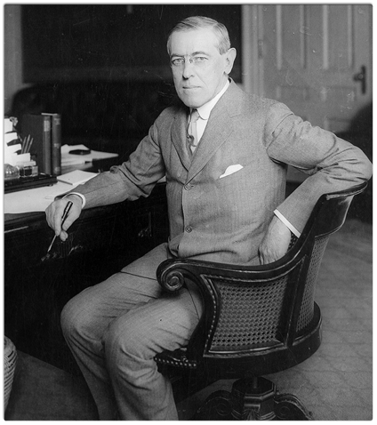
Wilson Legacy
Wilsonian Idealism
Roosevltian (TR) realism
Marriage of domestic policy to foreign policy that enables liberal internationalism
element in the never-ending debate between International Relations theory and practice: the ideological tug-of-war between the Wilsonian and Rooseveltian worldview. liberal internationalism’s “multilaterist” element of Wilsonianism and the “democratization” element, a euphemism for American primacy.
A difficult question is raised: what happens if the liberal internationalism and the concept of assertive multilateralism slide into liberal imperialism?

Slide 13
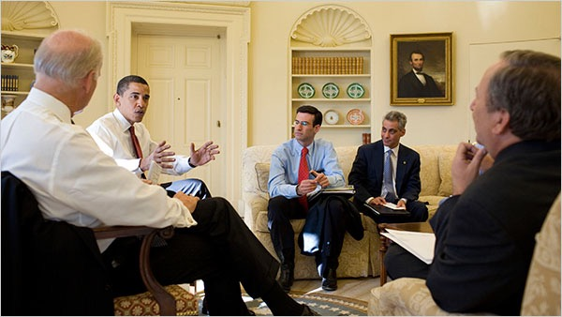
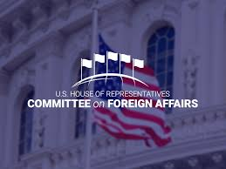
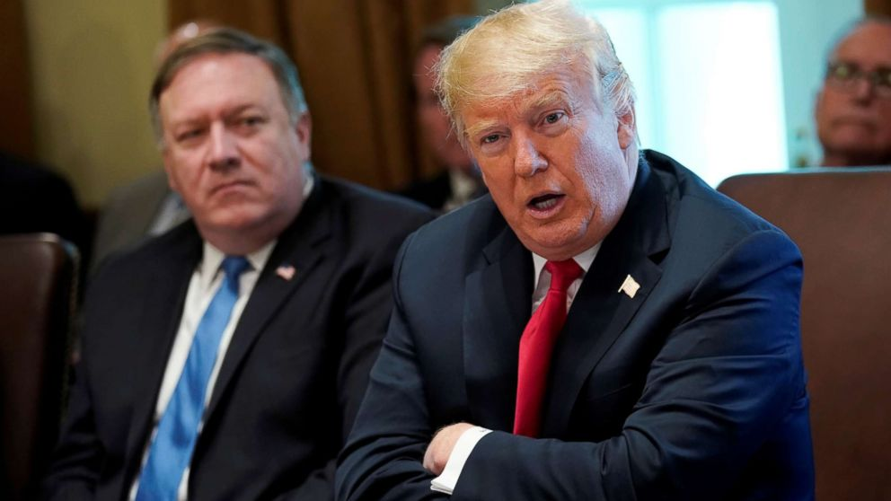
Who Makes foreign policy?
The President
The Cabinet
Congress
Bureaucracy
Interest Groups
The Media

Slide 14
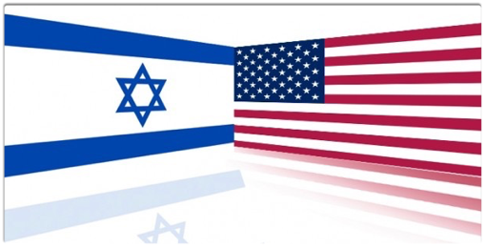
Case Study: The creation of Foreign Policy towards Israel
U.S. relationship with Israel was genesis of national interests in the Middle East both of military and cultural value
It was also a crucible for U.S. President Harry Truman and early post-WWII foreign policy.

Slide 15
From 1946-1948 rapidly changing geopolitical circumstances, i.e. Cold War confronted the U.S. as new superpower
US policy in the Middle East was focused on supporting Arab states' independence; aiding the development of oil-producing countries; preventing Soviet influence from Greece, Turkey and Iran;
Also, attempts were made to prevent an arms race and maintaining a neutral stance in the infant Arab-Israeli conflict.

Slide 16
Genesis
The development of Arab-American relations under FDR,
  the 1945 Bitter Lake meeting between Roosevelt and Saudi King Ibn Saud.
This is a critically important event, which would set the tone for Arab intransigence regarding the idea of a Jewish State in Palestine.
Importantly, it also reveals at least part of the motivation behind U.S. State Department reluctance to move ahead with the proposal and gives the context for the adversarial relationship that would develop between State and the White House over Israel.
The authors go on to relate the most relevant developments between 1942 and 1948, including
  Biltmore Declaration in support of a Jewish Home in Palestine,
  the Harrison Report, which revealed the deplorable conditions of postwar Jews (which probably influenced Truman more than any other single event),
  and the Anglo-American Committee, formed subsequently to study the feasibility of admitting 100,000 European Jews into Palestine.
These 100,000 is extremely helpful, as an understanding of the U.S., British, Soviet and Arab political maneuverings over it explains why the British eventually referred the issue to the U.N. (although there were economic considerations as well), the growing chasm between the U.S. and many other U.N. member nations, and the eventual general disappointment many of them expressed when the U.S. recognized Israel, essentially unilaterally.

Slide 17
Genesis
The U.S. has been the principle power outside the region since the end of WWII
  Therefore any efforts in the Middle East imposed by outside powers and then enforced until both Jews and Arabs agreed to abide by it.
    British Mandate principle and policy
  The two peoples’ national aims were irreconcilable.
    British gave UN the “problem” of Jews and Arabs
    Anglo-­American Morrison-Grady plan,
      a federated Palestine with autonomous Jewish and Arab provinces
  Before 1948, sentiment as well as policy was aligned with Arabist mentality
    anti-Zionist U.S. State Department
    The ‘Arabists’ exerted considerable influence both as career diplomats and as bureaucrats within the State Department. But over time, group became insular and headstrong and showing a marked tendency to assert the Arab point of view. Nevertheless this Arabist elite, demonstrated their profound influence on American attitudes toward the Middle East.
President Truman had conflicted attitudes toward establishment of the State of Israel.
  ethical paradoxes
  moral ambiguities
  deeply flawed region

Slide 18
Genesis
Pre-1948 existed the “prevailing standards of self-determination” that led to the 1922 League of Nations Mandate, which formally recognized “the historical connection of the Jewish people with Palestine” and endorsed their “reconstituting their national home” in that land.
  offered legitimacy to the Balfour Declaration
  infuriated the Arabs and Arabists (Orientalist's)
    CIA’s pro-Arab operations in the 1940s and 50s by the agency’s three most influential—and colorful—officers in the Middle East. Kermit “Kim” Roosevelt was the grandson of Theodore Roosevelt and the first head of CIA covert action in the region; his cousin, Archie Roosevelt, was a Middle East scholar and chief of the Beirut station and Miles Copeland, a maverick covert operations specialist.
The Mandate was a recognition that the number of stateless and endangered Jews in the world at that time far exceeded the number of Arabs living in the backwater of a defeated Ottoman Empire.
  Also, The Mandate indicated belief that self-determination for the Jewish people was not possible without a Jewish state.
Truman when he became president had extensive experience in Midwestern machine politics, but was a relative neophyte in the realm of foreign policy.
  He had been largely excluded the circles of power as Roosevelt’s vice president; had to work against a tremendous information deficit

Slide 19
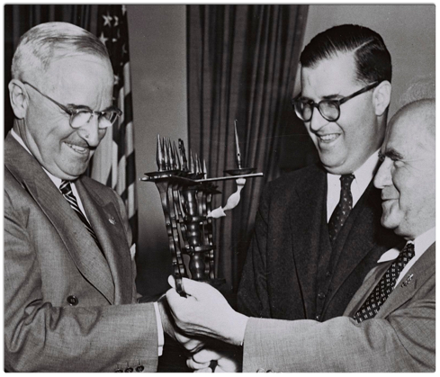
The Crucible
By 1946 (first full year of Truman’s presidency), thousands of Jewish refugees were stranded, caught between an unwillingness to remain in Europe, and displaced otherwise.
Wish to join fellow Jews in British-Mandate Palestine.
To Palestine’s Arab population these Jews represented an enormous threat to their own desire for self-determination.
A huge new influx of Jewish refugees from Europe endangered both their majority and their land.
“There was probably never a time after December 1917” — in the wake of the Balfour Declaration supporting a Jewish homeland in Palestine — “that the Jews and Arabs in Palestine could have agreed on their own to share or divide the country,”
-‘Genesis: Truman, American Jews, and the Origins of the Arab/Israeli Conflict,’ by John B. Judis (2014)

Slide 20
Allis and Ronald Radosh in their 2009 book, A Safe Haven: Harry S. Truman and the Founding of Israel offers a most complete blow-by-blow account of what happened in Truman’s recognition of Israel
  Key to Radosh is Truman’s Christian Zionism
    coincidentally this is offered as evidence as to earlier support from British Foreign Minister Balfour to U.S. President Wilson.
Verbal and archival evidence indicates that Truman often quoted Deuteronomy (“Go in and take possession of the land to which the Lord has sworn unto your fathers”)
  Alfred Lilienthal, a State Department Arabist, said Truman “was a Biblical fundamentalist who constantly pointed” to those words;
  Truman and his chief White House aide, Clark Clifford, exchanged biblical passages on the boundaries of Israel; and
  Six months after recognizing Israel, Truman wrote Chaim Weizmann that “[w]hat you have received at the hands of the world has been far less than was your due.”

Slide 21
The Crucible
President Truman’s relationship with the burgeoning Zionist lobby was strained.
  Truman exhibited a casual anti-Semitism that was certainly not out of place in his day, but also counted Jews among his close friends and advisers.
He felt put-upon by Zionist groups clamoring for his administration’s support and comes across as whiny — the “one constant in his reproaches were the ‘emotional Jews’ of the United States,’
  Truman was also aware of the political risks of taking sides.
On the one hand, to support Israel might be to involve the United States in a new world conflict after having just emerged from World War II.
On the other, domestic political pressure mitigated strongly against remaining neutral.
  “I’m sorry, gentlemen,’’ the president said, “but I have to answer to hundreds of thousands who are anxious for the success of Zionism; I do not have hundreds of thousands of Arabs among my constituents.”
-‘Genesis,’ by John B. Judis (2014)

Slide 22
Binationalism, the Zionist movement associated with Judah Magnes, Martin Buber, and Henrietta Szold: support a Jewish presence but recognized Arab rights in British Mandate Palestine.
  Important to note that Zionist binationalism, never a potent force.
  When discussing the period 1947–48, a revised partition plan would have given Palestinians more territory than allotted by the 1947 United Nations (UN) plan.
Although various Arab League countries and some Palestinian leaders were willing to entertain such ideas, Grand Mufti Haj Amin al-Husayni’s influence still prevailed among Palestinians, and Arab leaders mistrusted each other’s intentions; thus they rejected any compromise.
Also of importance is to recognize the differences between liberal Zionism, as embodied by Justice Brandeis and Rabbi Stephen Wise, and militant American Zionism, with each varying approaches to the American public and politicians.
  Important to note: neither camp considered the Palestinians as having any rights; Palestinians were equivalent to American Indians, inferior peoples whose concerns were minimal when compared to those of whites.
  This is an indictment of American liberal Zionists, a double standard, where concern for the less fortunate could apply in Western countries but not to non-Westerners.

Slide 23
Zionist and Palestinian were often unreconcilable during the pre-1948 statehood.
Important to acknowledge the political realities behind American decision-making that often disregarded Palestinian needs.
Due to the Balfour Declaration, “The British and the Zionists had conspired to screw the Arabs out of a country that by the prevailing standards of self-determination should have been theirs.” (Genesis, p.251)
  view of Arabists in U.S. State Department
  view of T.E. Lawrence (British military commander, author)
  arguably the revisionist view of some contemporary historians and authors
However, contemporary policy decisions override past events.

Slide 24
THe Crucible
Argument that Truman acted largely for humanitarian purposes, and that domestic politics played only a small role in the president’s decision-making process.
Truman wrote that his challenge was to create neither an Arab nor a Jewish policy, but an American policy [that] ‘…aimed at the peaceful solution of a world trouble spot…based on the desire to see promises kept and human misery relieved.’” (xiii)
Truman also stated in a letter to Senator Walter F. George (R-GA) that “[he was] not interested in the politics of the situation, or what effect it will have on votes in the United States. [He was] interested in relieving a half million people of the most distressful situation that has happened in the world since A. Hitler made his invasion of Europe.” (p.192)
Truman’s well-known response to Defense Secretary James Forrestal’s advice to move cautiously so as not to endanger U.S. access to Arab oil: “Truman had heard enough and answered that he didn’t want to handle this from the standpoint of oil, ‘but from the standpoint of what is right’.” (p.178)
This depiction of Truman as an essentially moral person, confirms what biographer David McCullough’s wrote in his award-winning biography of Truman.
-Allis Radosh and Ronald Radosh, A Safe Haven (2010)
-David McCullough, Truman (1992)

Slide 25
Britain and the United States, in a joint effort to examine the dilemma, established the "Anglo-American Committee of Inquiry." In April 1946, the committee submitted ten recommendations covering topics such as "The European Problem," "Refugee Immigration Into Palestine," "Principals of Government," "United Nations Trusteeship," "Equality of Standards," "Land Policy," "Economic Development," "Education," and "The Need for Peace in Palestine.”
British, Arab, and Jewish reactions to the recommendations were not favorable. Jewish terrorism in Palestine antagonized the British, and by February 1947 Arab-Jewish communications had collapsed.
Britain, anxious to rid itself of the problem, set the United Nations in motion, formally requesting on April 2, 1947, that the U.N. General Assembly set up the Special Committee on Palestine (UNSCOP).
  This committee recommended that the British mandate over Palestine be ended and that the territory be partitioned into two states.

Slide 26
Jewish reaction was mixed--some wanted control of all of Palestine; others realized that partition spelled hope for their dream of a homeland. The Arabs were not at all agreeable to the UNSCOP plan.
In October the Arab League Council directed the governments of its member states to move troops to the Palestine border.
President Truman instructed the State Department to support the U.N. plan, and, with protest it did so.
On November 29, 1947, the partition plan was passed by the U.N. General Assembly.
At midnight on May 14, 1948, the Provisional Government of Israel proclaimed a new State of Israel.
On that same date, the United States, in the person of President Truman, recognized the provisional Jewish government as de facto authority of the Jewish state (de jure recognition was extended on January 31, 1949).
The U.S. delegates to the U.N. and top-ranking State Department officials were angered that Truman released his recognition statement to the press without notifying them first.
On May 15, 1948, the first day of Israeli Independence and exactly one year after UNSCOP was established, Arab armies invaded Israel and the first Arab-Israeli war began.

Slide 27
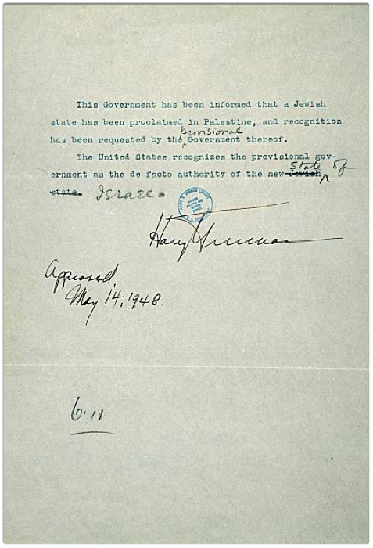
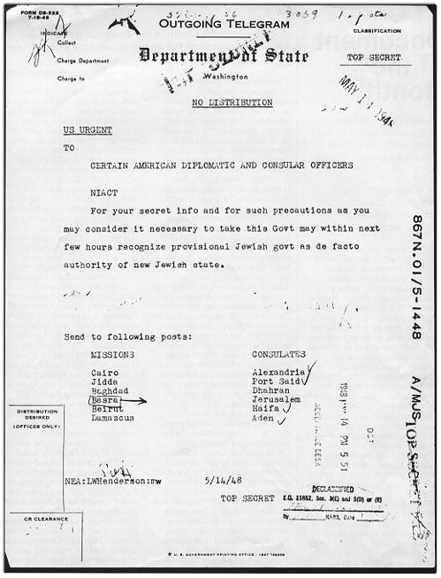

Slide 28
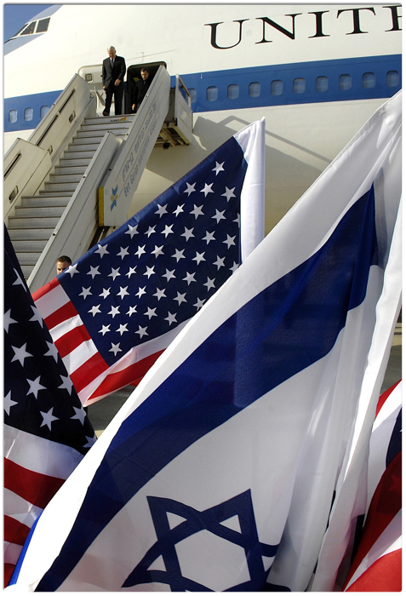
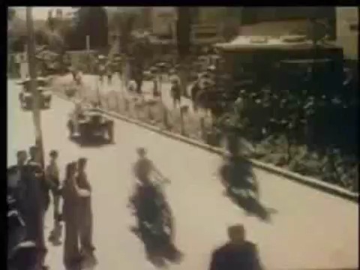


Slide 29
sources
The telegram reproduced here is from decimal file 867n.01/5-1448, Records of the Department of State, Record Group 59, National Archives and Records Administration, Washington, DC.
The press release is from the records of Charles G. Ross, Alphabetical File, Handwriting of the President at the Harry S. Truman Presidential Library, Independence, MO.
The Library is part of the Presidential Libraries system of the National Archives and Records Administration.
Recognition of Israel. http://jcpa.org/article/president-truman’s-decision-to-recognize-israel/

Slide 30
For a thorough treatment of the issues surrounding Israeli statehood see
Gudrun Kramer, A History of Palestine (New Jersey: Princeton University Press, 2002);
Ilan Pappe, The Forgotten Palestians (New Haven: Yale University Press, 2011);
Paul C. Merkley, The Politics of Christian Zionism, 1891–1948, (Portland: Frank Cass Publishers, 1992);
Lawrence Davidson. “Truman the Politician and the Establishment of Israel,” Journal of Palestine Studies XXXIX, no. 4 (Summer 2010) 29–42;
Earl D. Huff, “A Study of a Successful Interest Group: The American Zionist Movement,” The Western Political Quarterly 25, no. 1 (March 1972): 109–24;
Walter Russel Mead, “The New Israel and the Old,” Foreign Affairs 87, no.4 (July 2008): 1–15
Hugh Wilford, America’s Great Game: The CIA’s Secret Arabists and the Shaping of the Modern Middle East (Basic Books, 2013)
Robert D. Kaplan, The Arabists: The Romance of an American Elite (First Press, 1995)

Slide 31
The Crucible
National interests?
Shared values or traditions?
Lobby?

