Slide 1
Islamic Republic of Iran sanctions, environmental degradation, liberal movement
Mgr. Lenka Martínková

Slide 2
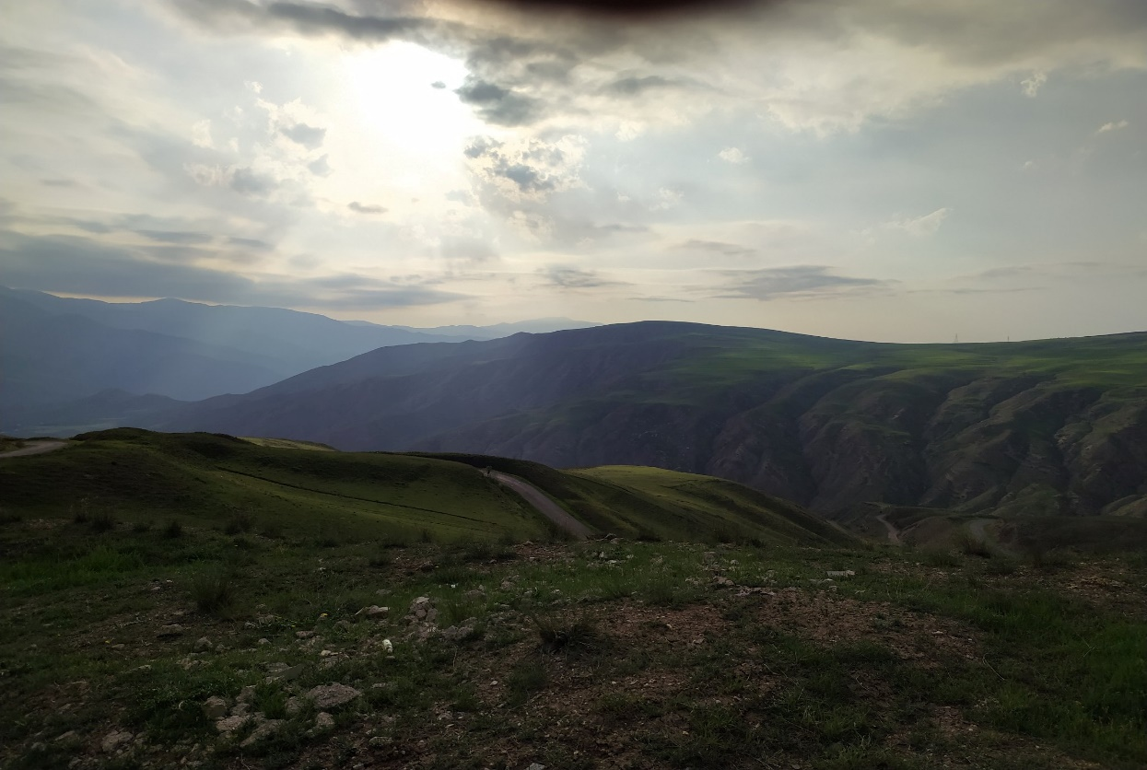
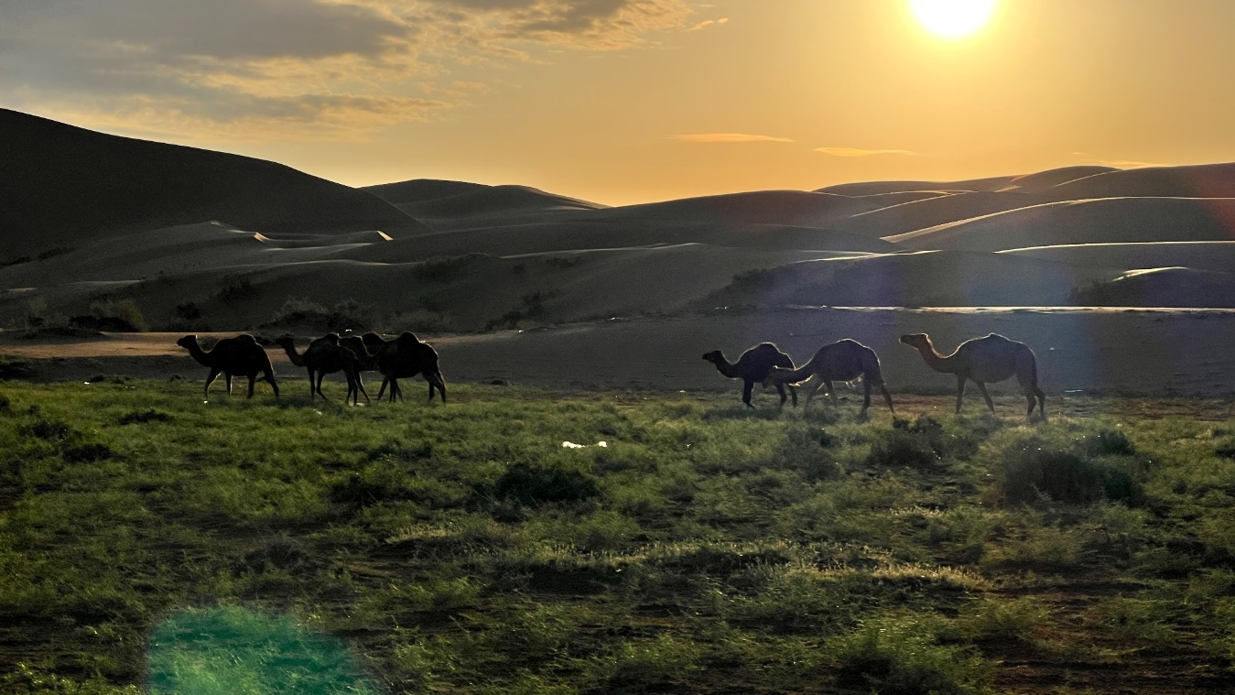
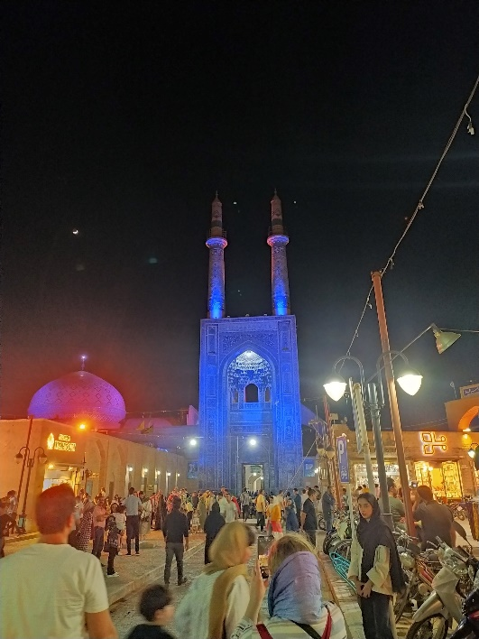
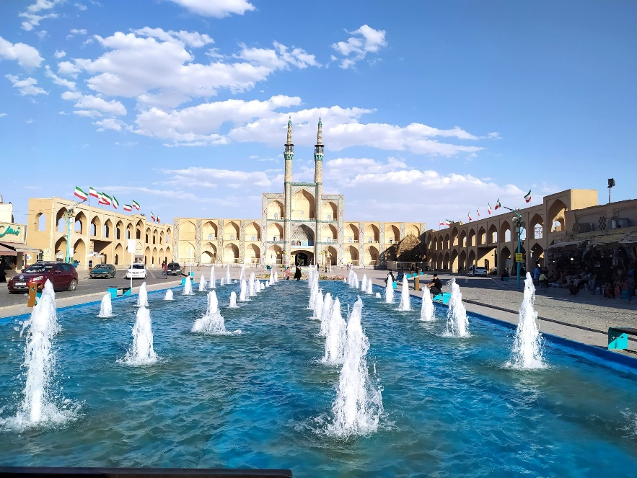
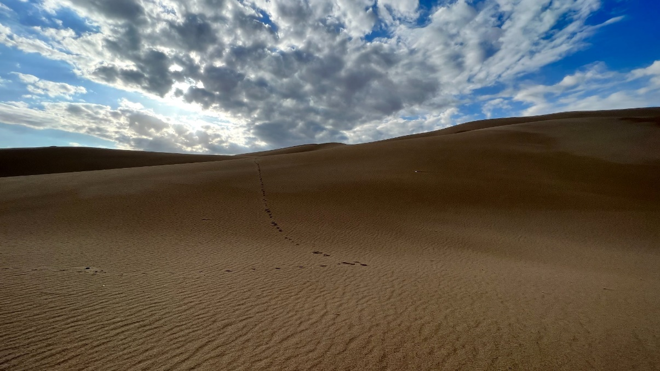

Slide 3
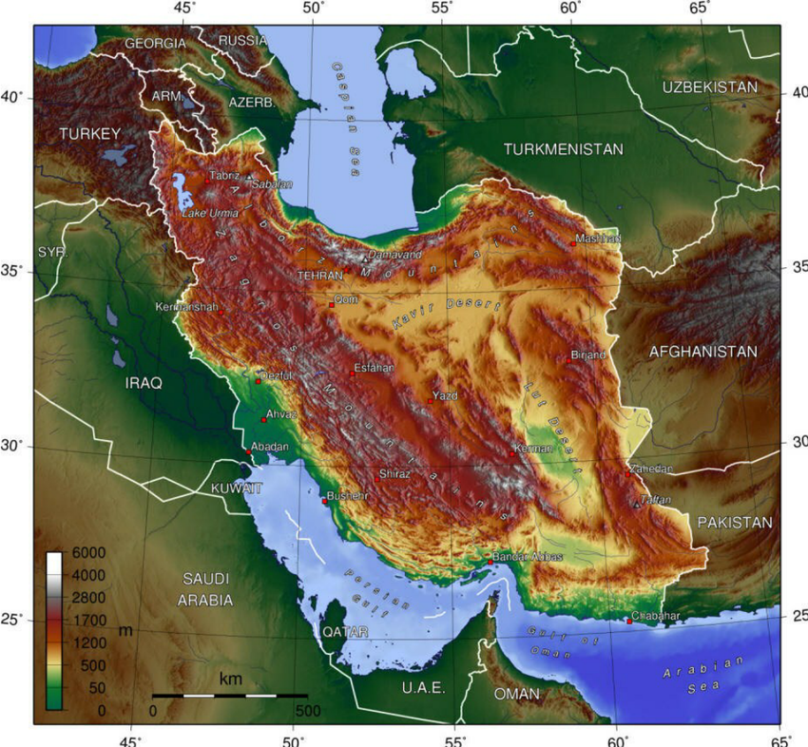
Geography, climate and population
Iran is the place on Earth the closest to the Mars
Mountains
Deserts
Shores
Forests

Slide 4
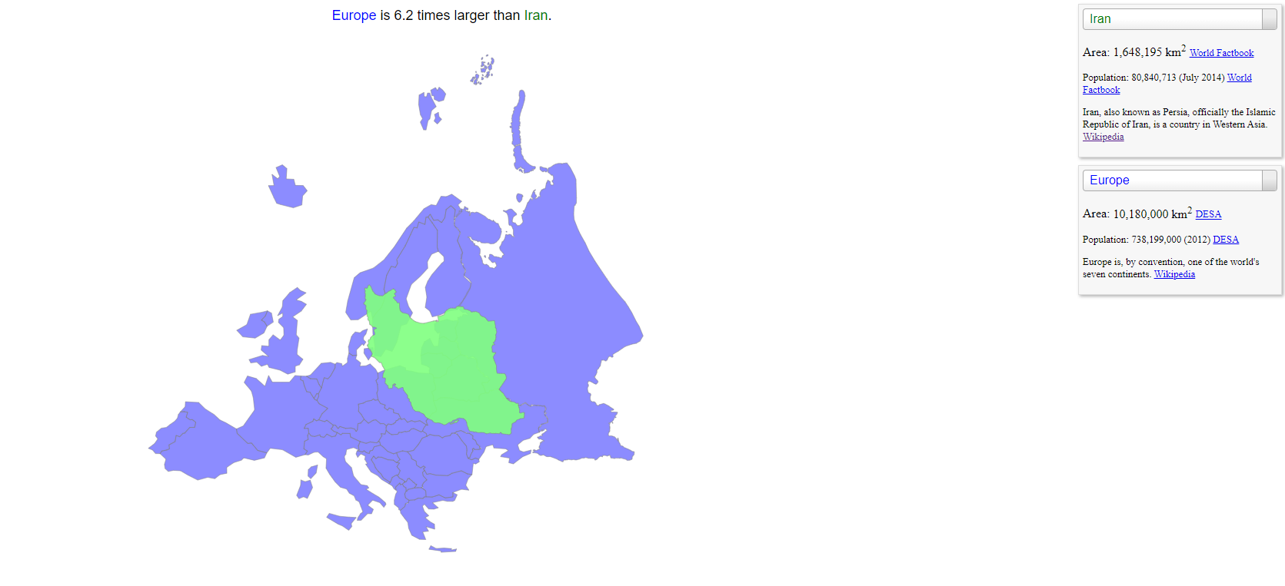
Population over 85 million
17th largest country in the world
Large as 20 Czech Republics or half of EU.

Slide 5
History
From Persian Empire to Islamic Republic
550 BC The first Persian Empire under Cyrus the Great soon became the world's first superpower (defeat nearby kingdoms, including Media, Lydia and Babylon)
The Persian Empire began to decline under the reign Xerxes and was eventually conquered by Alexander the Great in 334 B.C.E
The Muslim conquest of Persia (633–654) ended the Sasanian Empire part of Ummayyad Caliphate
Part of Abbasid Caliphate (Islamization, Arabic alphabet)
Iran was reunified as an independent state in 1501 by the Safavid dynasty (Shia Islam)
Qajar dynasty (1796–1925)
Pahlavi era (1925–1979)
Revolution and the Islamic Republic (1979 to present)

Slide 6
Modern History
Political Milestones in Islamic Republic
Khomeini (1979–1989)
Iran hostage crisis (1979–1981)
Iran–Iraq War (1980–1988)
Khamenei (1989–present)
Rafsanjani: pragmatic conservativism (1989–1997)
Khatami: reformers and conservatives struggle (1997–2005)
Ahmadinejad: hardline conservatism (2005–2009)
Rouhani: pragmatism (2013–2021)
Ebrahim Raisi (2021–)

Slide 7
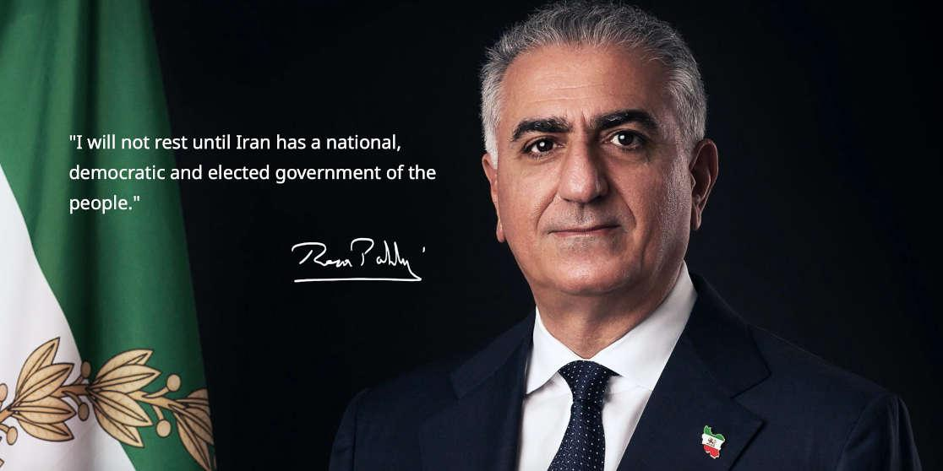
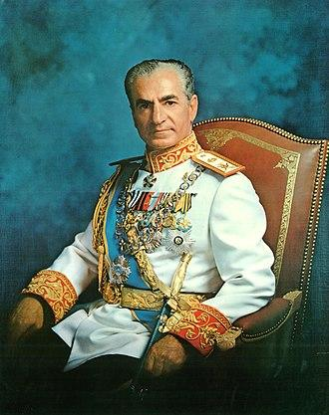

Slide 8
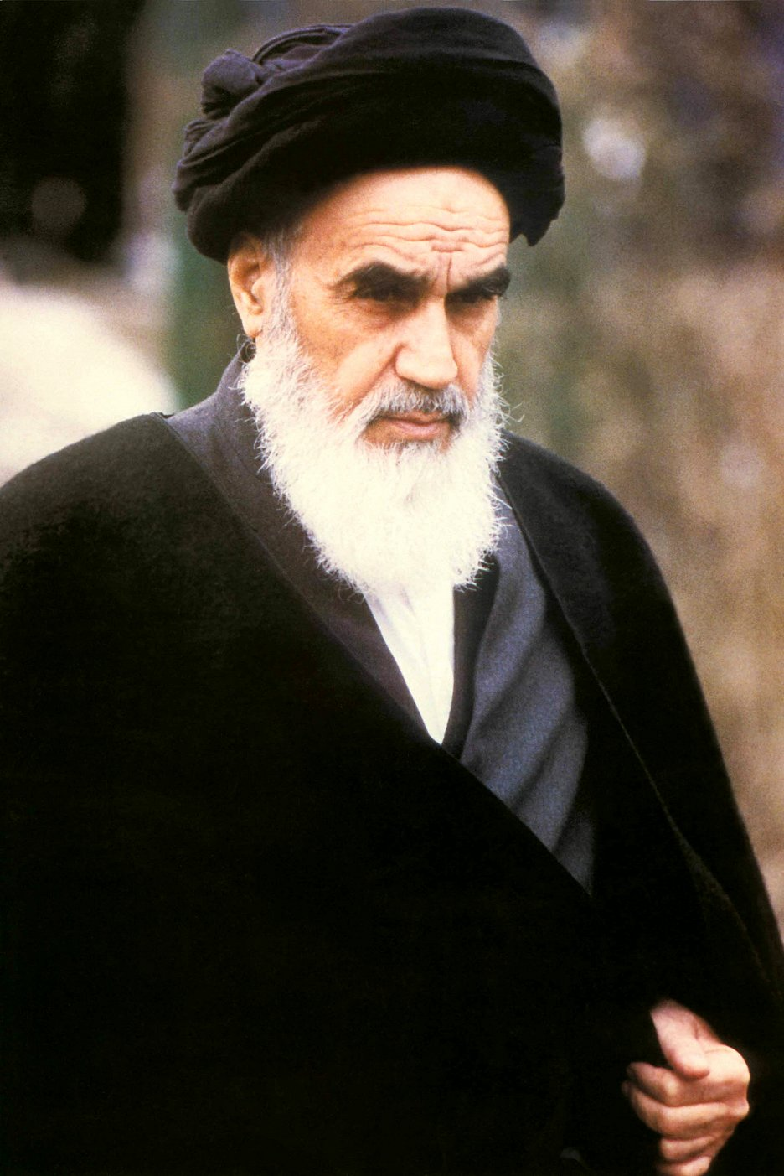
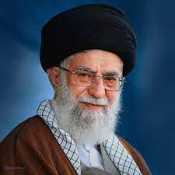
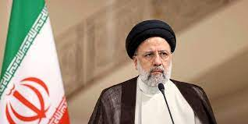
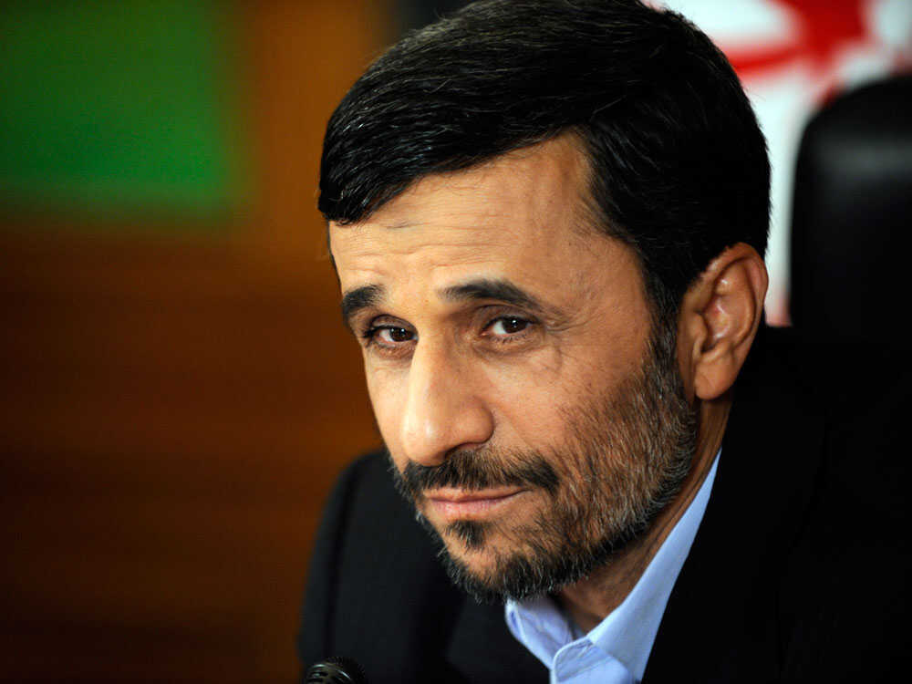
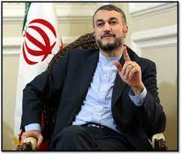

Slide 10
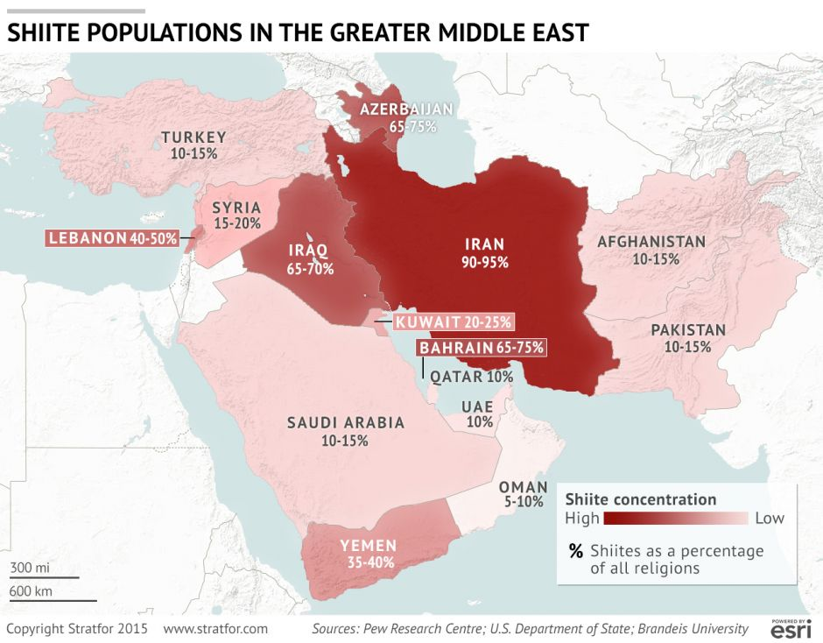
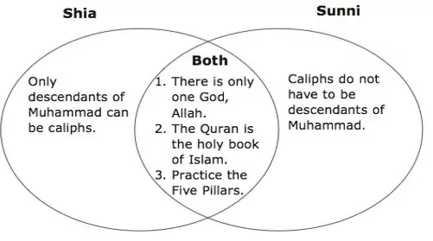

Slide 11
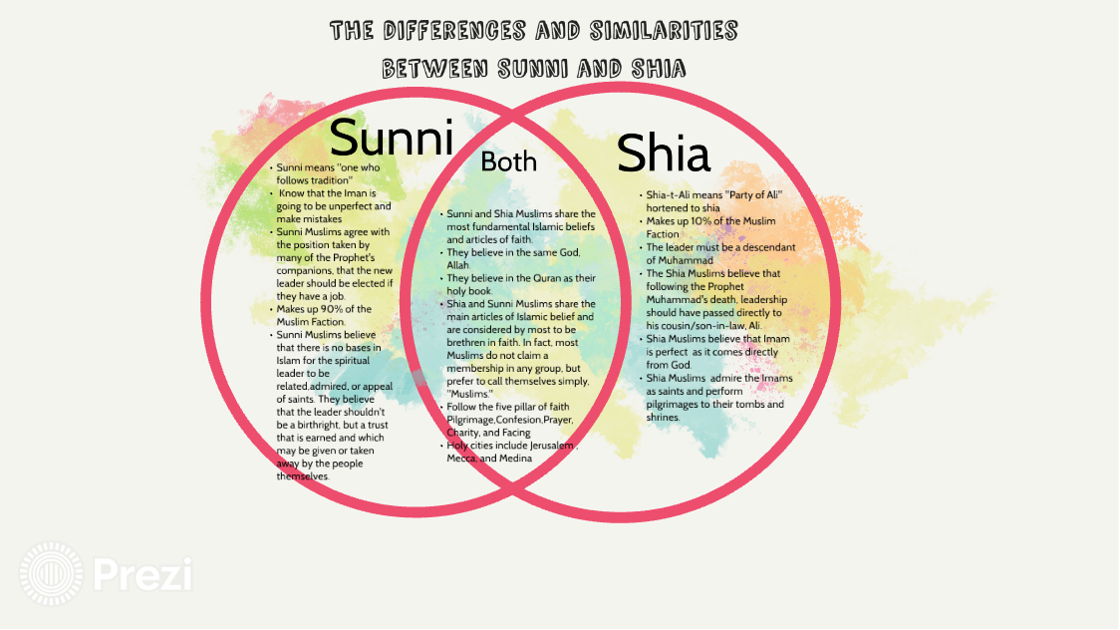

Slide 12
Political structure
Government |  | Unitary theocratic presidential Islamic republic
• Supreme Leader | Ali Khamenei (IRGC, QUDS) | Assembly of Experts (elects Supreme Leader)
 |  | Guardian Council (formed from IRGC, Religious and Military, Political experts) – under Supreme Leader oversight
• President |  | Ebrahim Raisi
• Vice President |  | Mohammad Mokhber
• Speaker of the Parliament |  | Mohammad Bagher Ghalibaf Government Unitary theocratic presidential Islamic republic • Supreme Leader Ali Khamenei • President Ebrahim Raisi • Vice President Mohammad Mokhber • Speaker of the Parliament Mohammad Bagher Ghalibaf • Chief Justice Gholam-Hossein Mohseni-Eje'i

Slide 13
IRGC, QUDS, and the cult of martyrdom
IRGC (SEPA) Internal governing force, responsible to the supreme leader only (above government, above army, intelligence)
AL QUDS (military and intelligence services, mostly working abroad – promoting agenda with allies and non-state actors in the region)
The cult of martyrdom, omnipresent, belief that death in the service of the Islamic Republic automatically makes you a martyr

Slide 14
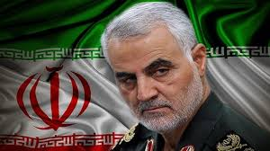
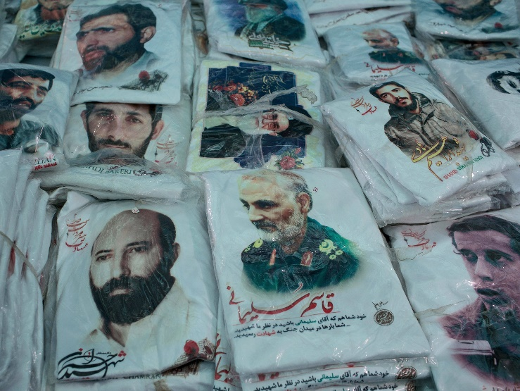
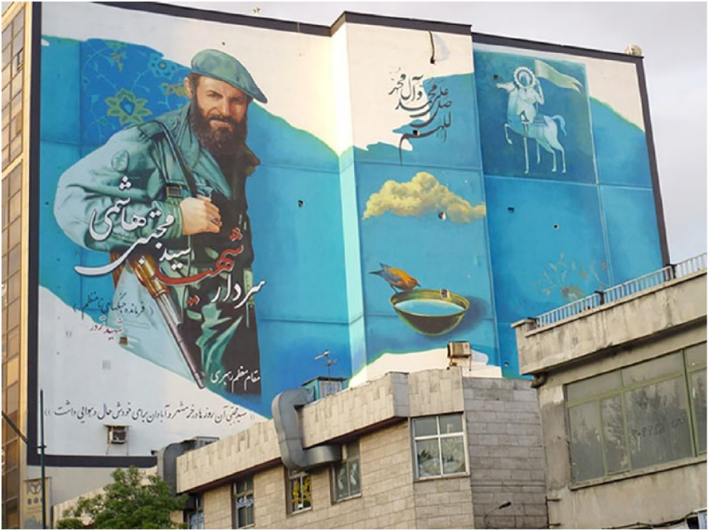
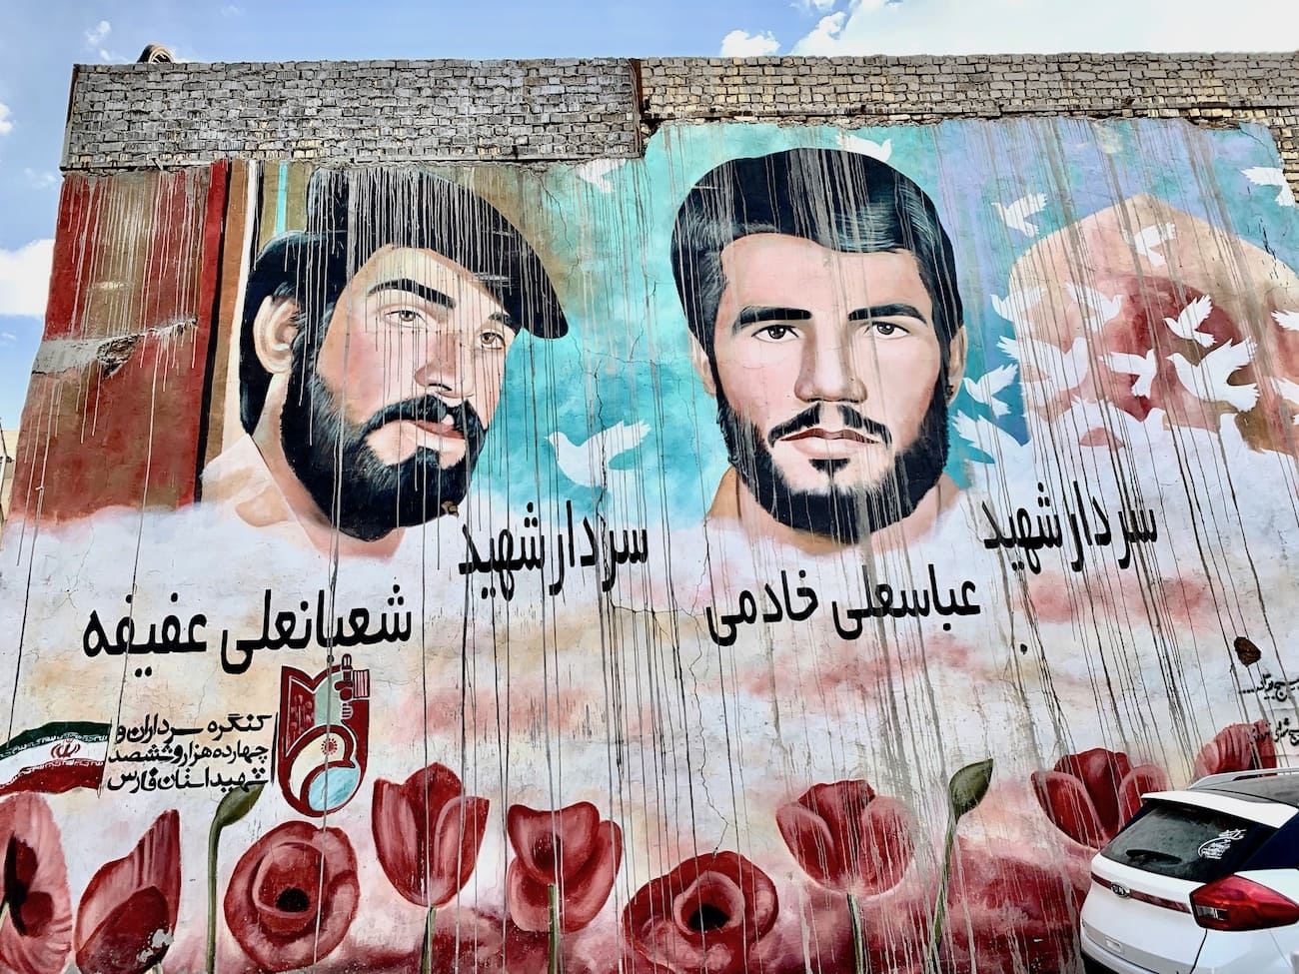
Shahed Qasim Suleymani
https://www.bbc.com/news/world-middle-east-50979463
US drone strike in Baghdad
Threats of retaliation
National martyr

Slide 15
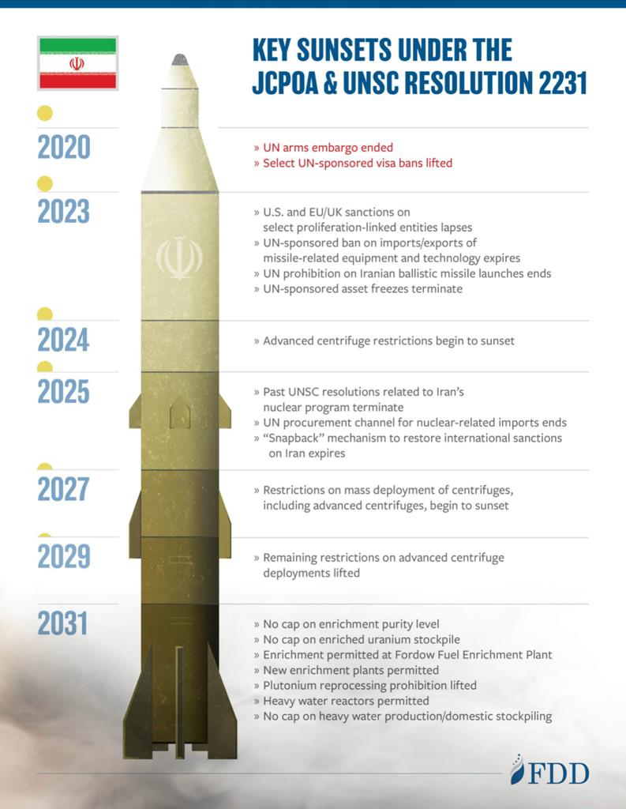
Sanctions
Sanction economy
sanctions since 1979 (USA)
2012 EU sanctions on import of oil and investments, ban on financial transactions
2015 JCPOA – sanctions lifted under simple conditions
2018 USA unilaterally re-imposed the sanctions (+ extraterritorial)
FTA
FATF
FTO

Slide 16
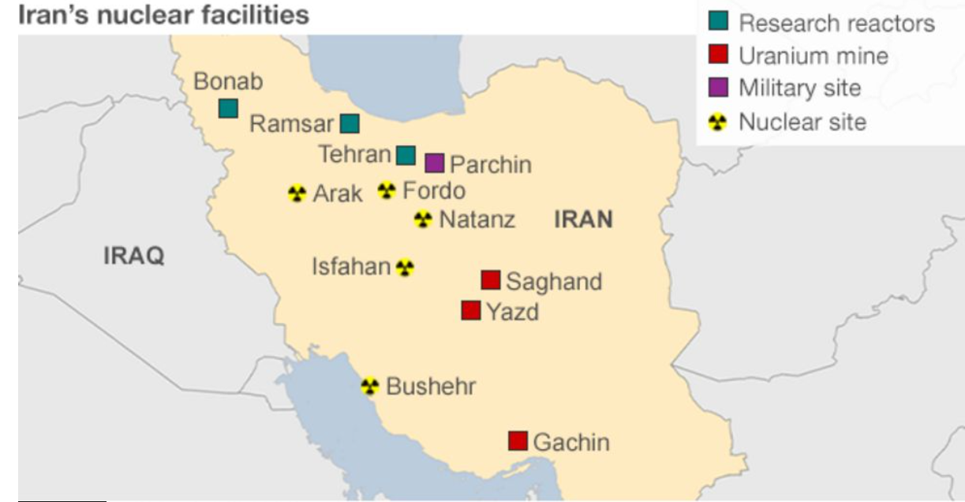
JCPOA
2015 Vienna (P5+1) and Iran
„Nuclear deal“ - only peaceful purpose
IAEA control of the nuclear program and the sites
Sanctions lifted: financial transfers, insurance, banking service, financial support for Iran, loans, grants, import of gas and oil, petrochemicals, export and equipment for petrol and gas industry, investment in the industry, shipping, building logistical infrastructure, metals, gold, diamonds, money, software, arms, individual lists and bans
2018 Trump withdrawal from JCPOA, renewal of the sanctions on oil export (total production and export went from 4.8 million b/d to 2 million only)

Slide 17
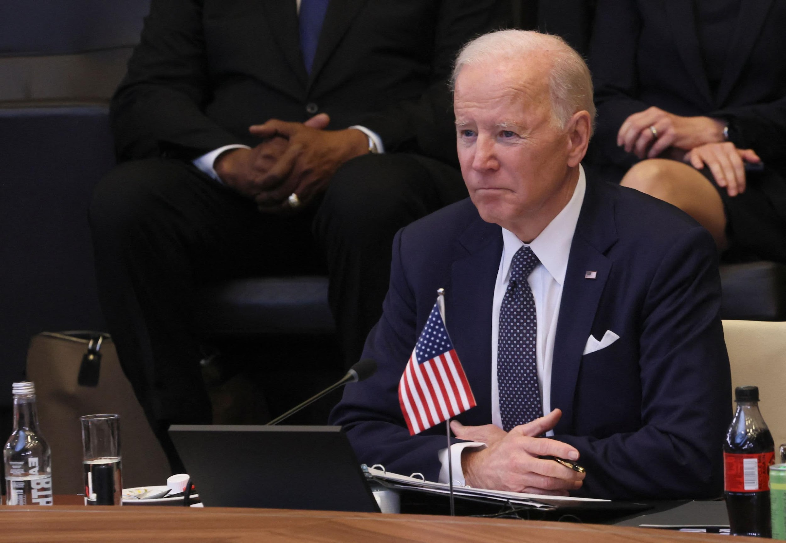
JCPOA Renewal - „Vienna talks“
Hard negotiations (over a year now)
The JCPOA sanctions were replaced with another measures
EU itself did not re-impose sanctions in 2018, but US secondary and FATF impacts
EU diminished, Russia distracted, US hardliners and Iran conservative government
Economically time sensitive – neither side can achieve everything
FTO, ballistic program, FATF, financial flows,…

Slide 18
EU and Blocking statute
EU law does not allow actors under the EU jurisdiction to comply with the extraterritorial laws
EU is still a part of JCPOA and US sanctions can not limit EU countries in the trade and cooperation with Iran in the certain fields
If the actor from EU complies to the US sanctions should be penalized for it
If actor has been penalized or limited by US sanctions it has to be reported to EC and authorized
Deutshe Telekom vs. Iran Melli Bank

Slide 19
FTO
US list of terrorist organizations
Prohibits US subjects from providing material, service, money, or training activities to the individuals or organizations connected to the terrorism
Obligation to report the breach of FTO rules, the financial institution will seize the funds,…
Subjects connected to anyone on the list have prohibited access on US territory and would be deported

Slide 20
FATF
Financial Action Task Force (2001 terr. funding) in OECD in Paris
Focus on organized crime, human trafficking, terrorism, money laundering, corruption
Blacklist (Iran, North Corea)
Iran was supposed to comply with it from 2015 till 2020 – did not approve and accept the AML/CFA legislative

Slide 21
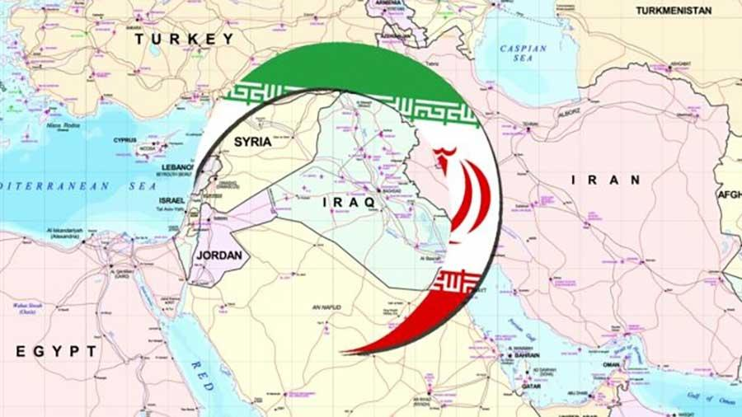

Slide 22
Political optics
“Axes of Resistance”
The political isolation and lack of regular political alliances led Iran to establish and cooperate with non-state actors based on the same military and radical politics. These alliances were formed under the pressure and insecurity caused by economic isolation.
Hizballah, Hamas, Houthis, Syrian government forces, Pro-Iranian powers in Iraq
The “evil West” excuse

Slide 23
Government shortcuts
Deflection (Asia, Africa) – very active recently
Modification in the export products, grey zone solutions (shell companies in another state),
Repressions, censorships, propaganda, inner economic restrictions
Copy of the designs of the foreign product (absence of intellectual property law or patents)
Proxies and NSAs (terrorist organizations) – funding of wars in the region
Proliferation (high developer missile program, space program, „civil“ nuclear program)
Abduction-seizing of ships in Hormuz, targeting enemies (IZ in Syria, SA in Yemen)

Slide 24
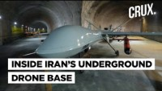
Military
Nuclear, ballistic and space program

Slide 25
Military strategy
Development of missiles with long-range (2000 km +). Such missiles will not serve as carriers of conventional warheads - these missiles will be developed to deter the US and Europe and, therefore, will carry nuclear warheads.
Creation of high-precision missiles is a priority of the program. Such missiles are helpful in combat, not only as a deterrent but also as an effective war capacity. Via a combination of improving accuracy and increasing range, they demonstrate a willingness to use them, which impacts the region’s stability. Iran improves its military capacities quantitatively and qualitatively. Thus, other states may need to improve their defense capabilities, especially against remotely guided missiles and remotely piloted objects (UAVs) such as drones and unmanned aerial vehicles. This capacity has been recently seen as an effective tool used by Russian forces in the war in Ukraine . Neighboring countries lack these capacities. In addition, these regional powers are prone to pre-emptive attacks in times of crisis. This tension and growing arsenals can lead to misjudgment, misunderstanding and unintended escalation of conflict.
Iran has a documented history of the proliferation of ballistic missiles, guided missiles, and UAV technology to non-state actors. Even to aggressive states such as Russia, recently. This disrupts the balance of power and regional security, destabilizing the region and fueling an arms race

Slide 26
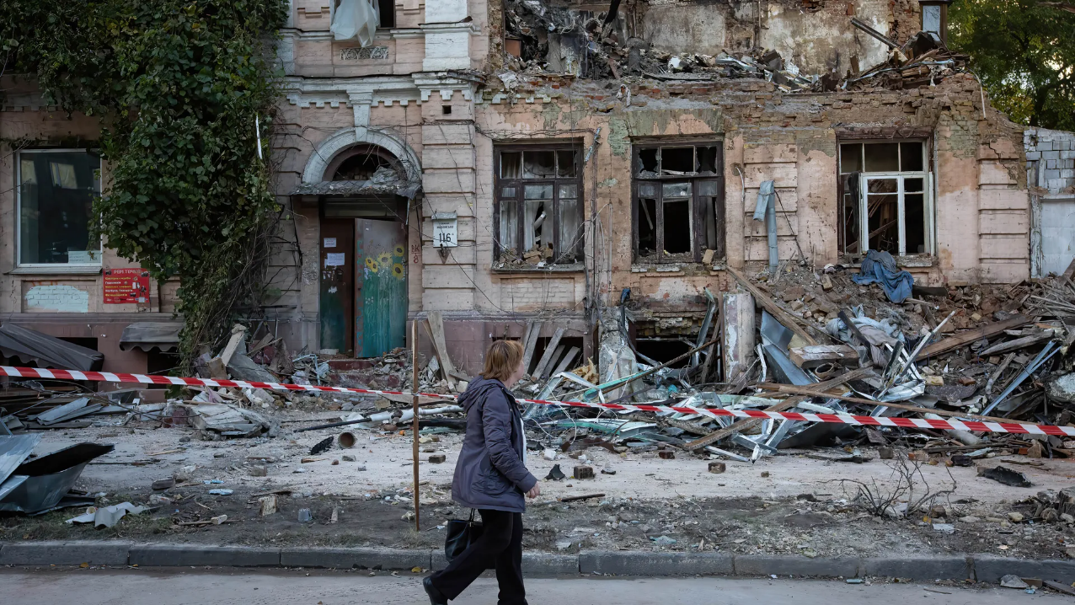
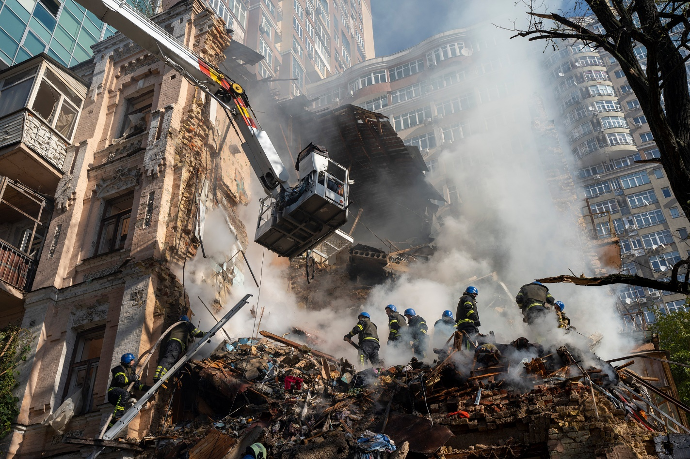
Firefighters work after a drone attack on buildings in Kyiv, Ukraine on Oct. 17. 2022
Waves of explosive-laden suicide drones struck Ukraine's capital as families were preparing to start their week early Monday, the blasts echoing across Kyiv, setting buildings ablaze and sending people scurrying to shelters.
https://time.com/6223204/iran-kamikaze-drones-russia-ukraine/

Slide 27
Economics
Sanctions, misadministration, corruption, clientelism “Economy of Resistance”
Infrastrucutre
Investments
Laws and security (HR)
Byrocracy
Education
Logistics
Central planning (Corruption, Misadministration)
1 Euro cca 45 000 IRR

Slide 28
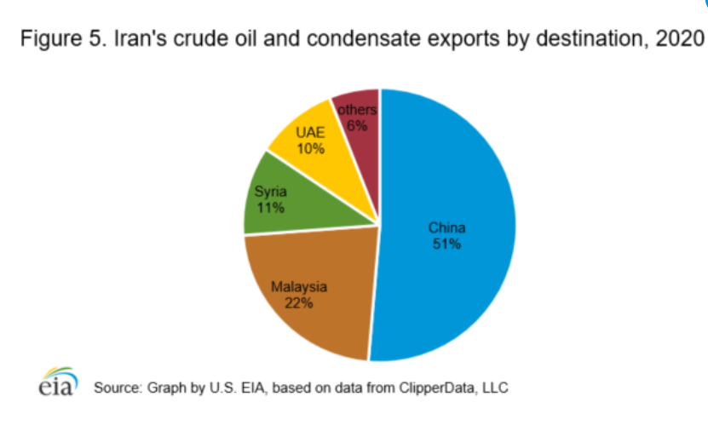
Iran as a supplier
Petrochemicals and plastics
Diversification
Deflection of exports
Underdeveloped
Missing infrastructure
Missing investments

Slide 29
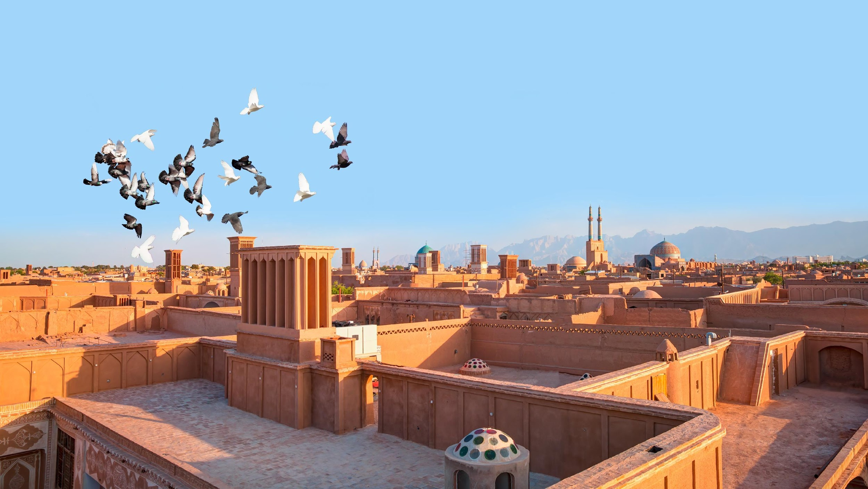
Iranian sources
Oil
Gas
Minerals
Construction material
Metals
Marble
Agriculture (tea, rice, olives, nuts, oranges, pistachios, jasmine, rose, herbs,…)

Slide 30
Energy
In 2012 Iranian oil production was (4 million b/d). This is a high share in OPEC (2.5 million b/d).
Iran supplies gas to Iraq, Azerbajdan, Armenia, Turkey.
Before 2019 Iran imported gas from Turkmenistan – to cover its own consumption and due to under-developed technology.
Crude oil production – 5th largest in OPEC
Gas production – 3rd largest in the World
Oil reserves – 3rd largest world reserve (20% of ME, 12% worldwide)
Gas reserves – 2nd largest world reserve
Oil export 40% of Iran’s total government revenues (IMF) in 2016

Slide 31
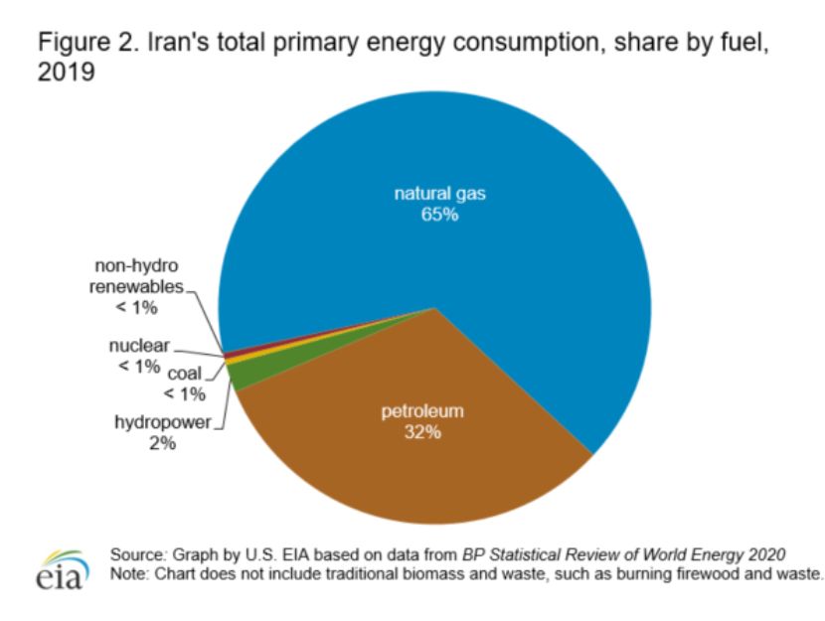
Energy consumption
Rentier state – subsidies in energy, fuel and water until 2019
Insufficient use of sources, distribution and export/import ratio
Socioeconomic issues (Poverty, Unemployment, Inequity, Corruption)
State policy has implications for sustainability, environmental state of the country

Slide 32
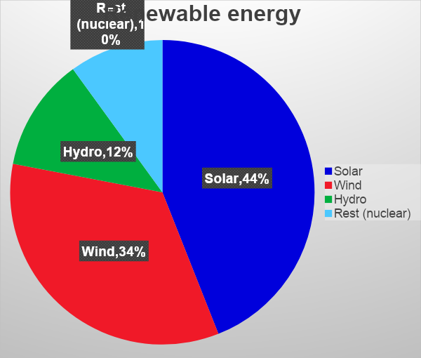
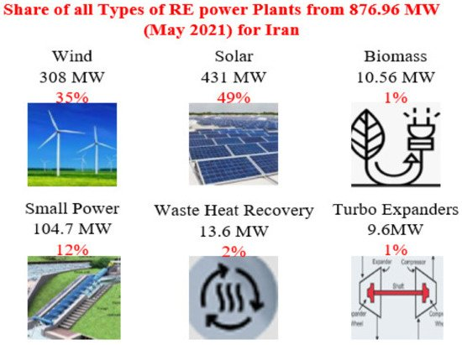
Renewable energy
Renewables 7% country’s total energy generation
natural gas’ 90%
https://www.youtube.com/watch?v=Ex1yDciznr8&ab_channel=WION

Slide 33
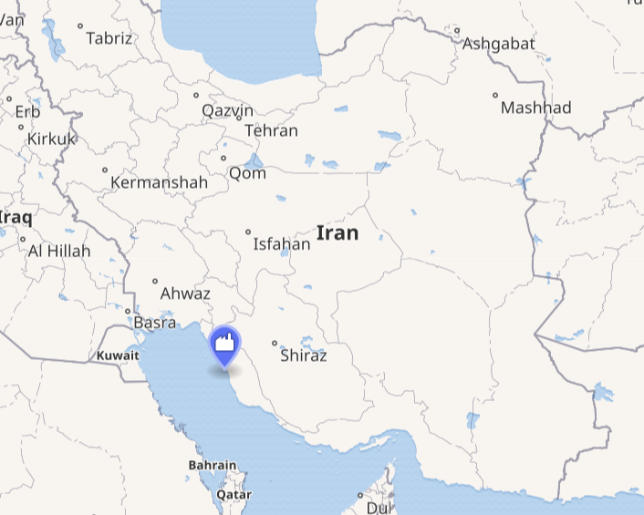
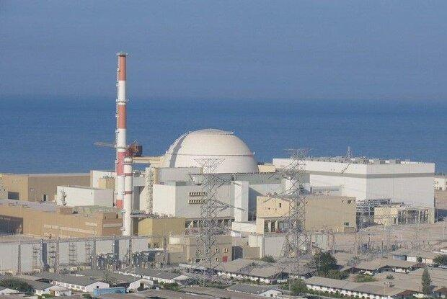
Nuclear energy
one operating nuclear power reactor, Bushehr Nuclear Power Plant
total of 42 199 million kW. h electricity generated from March 2011 to March 2020
BNPP-1 provided 1.84% of national electricity production in 2019
Halileh, 12km south of Bushehr
1 reactor operational, 2 new reactors planned
https://www.youtube.com/watch?time_continue=5&v=N1yjp4BbGuc&feature=emb_logo

Slide 34
Social issues
Middle Eastern issue and the reality of the impact of Iranian governmental planning
Inequity
Unemployment
Poverty
Immigration (Afghani, Pakistani,…)
Emigration (Brain Drain)
Minorities (Kurds, Baluchi, Hazar, Pakistani, Afghani, etc.)
Specifics:
Urbanization
Aging population
Decreasing nativity
Territorial differences (culture, habits, climate, ….)
Access to education
Amount of highly educated women

Slide 35
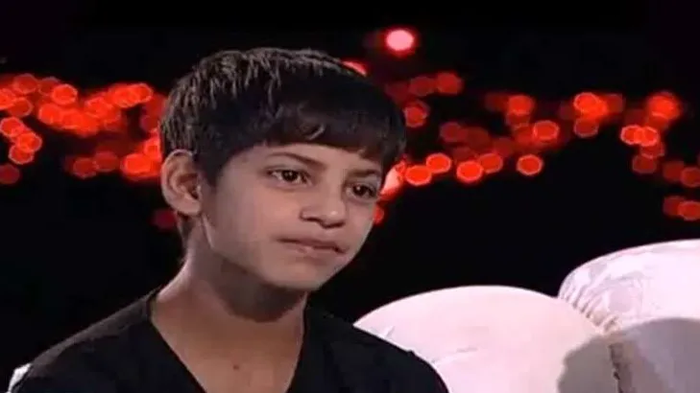
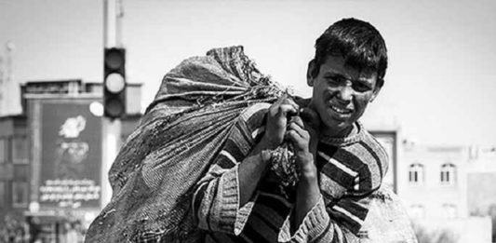
"I have no wishes, because I work from morning to night; I don’t have time to dream."
https://www.youtube.com/shorts/d8qZIQtiz_4
5-8 millions of child laborer in Iran, working 10 to 12 hours per day

Slide 36
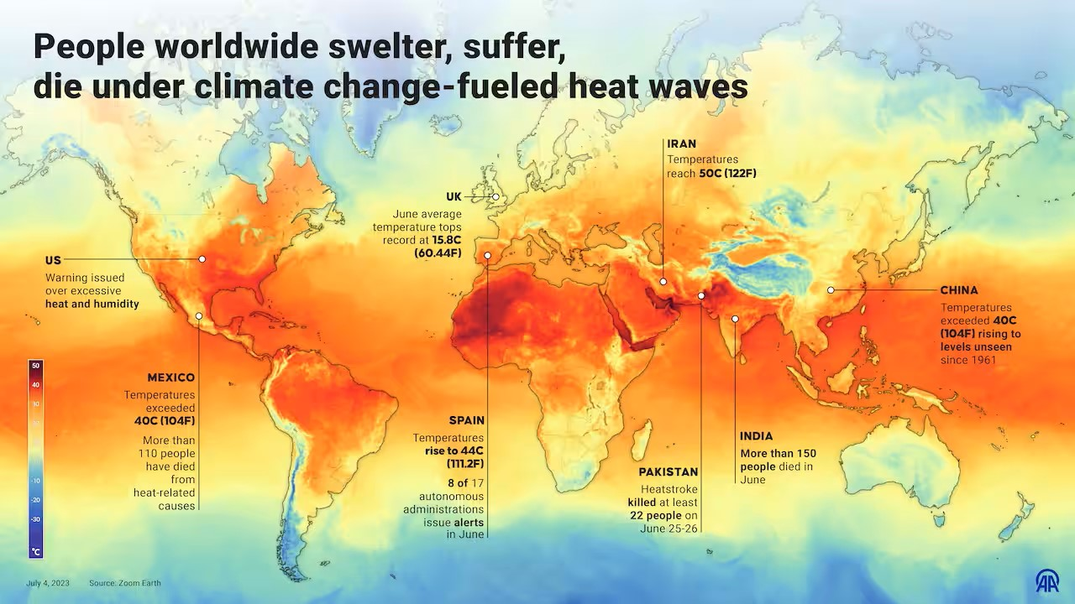

Slide 37
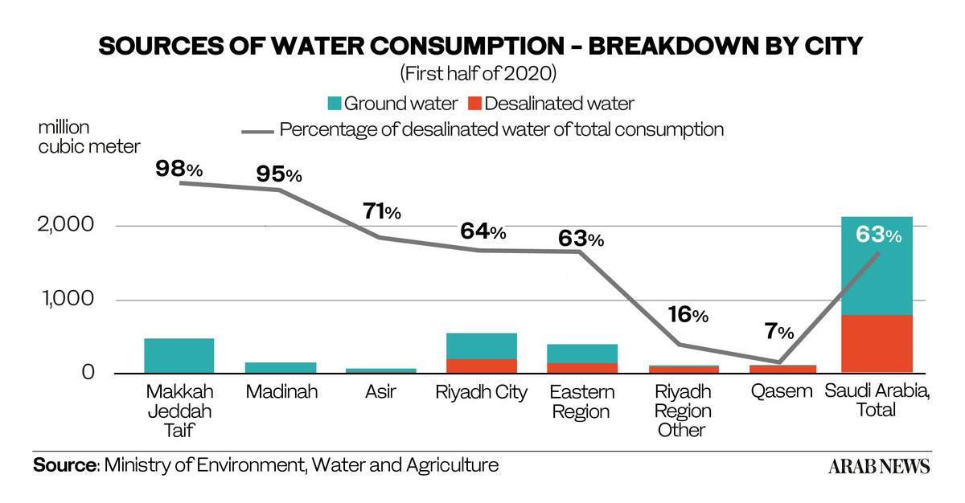
Enviroment
Deforestation, Water scarcity, Environmental degradation, Extinction of rare species, Decline of agriculture
Enviromental degradation – lower precipitation, sea level rise
Big weather diferences/blips
High temperatures
Desertification
Sandstorms
Drought
Smog

Slide 38
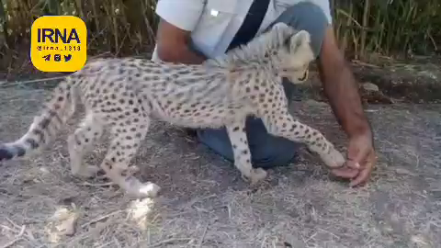
Piruz (Victor)
Symbol of Hope

Slide 39
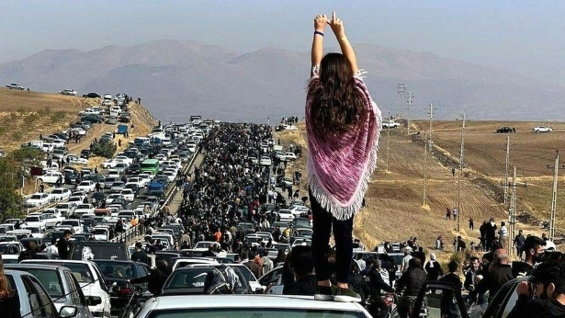
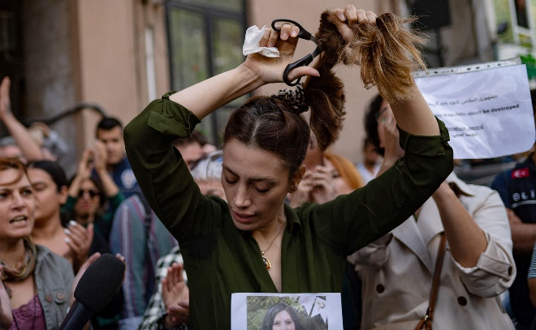
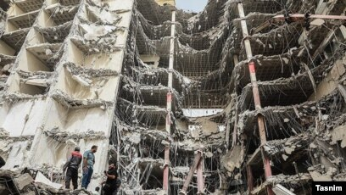
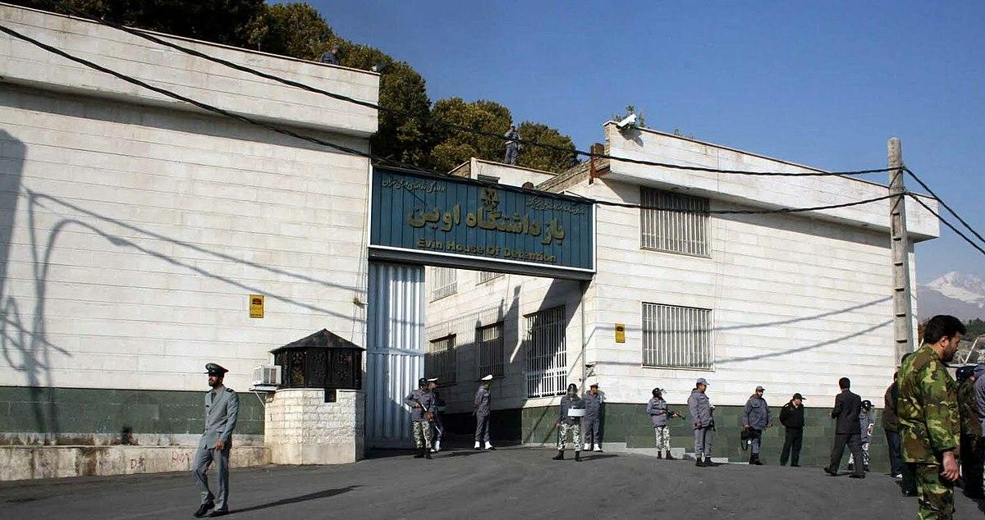
Liberal movements
Protests and Evin prison….
Green Movement 2009/2010 (Removal of Ahmadinejad,2nd term)
Blue Girl 2091
Economic protest 2020/2022
Abadan crushed building – "death to incompetent officials"

Slide 40
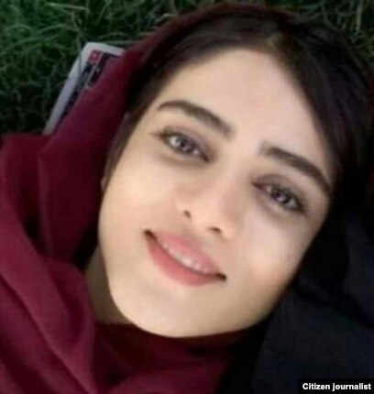
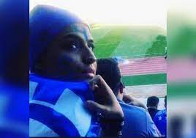
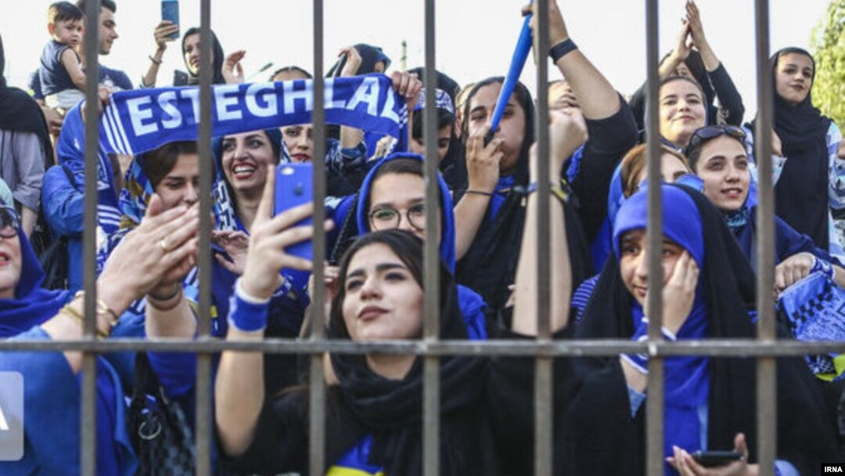
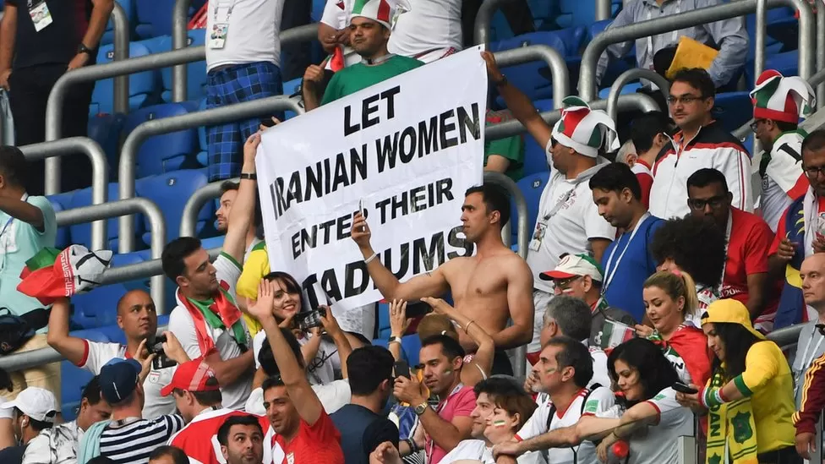
For the love of sport
Blue Girl – Sahar Khodayari

Slide 41
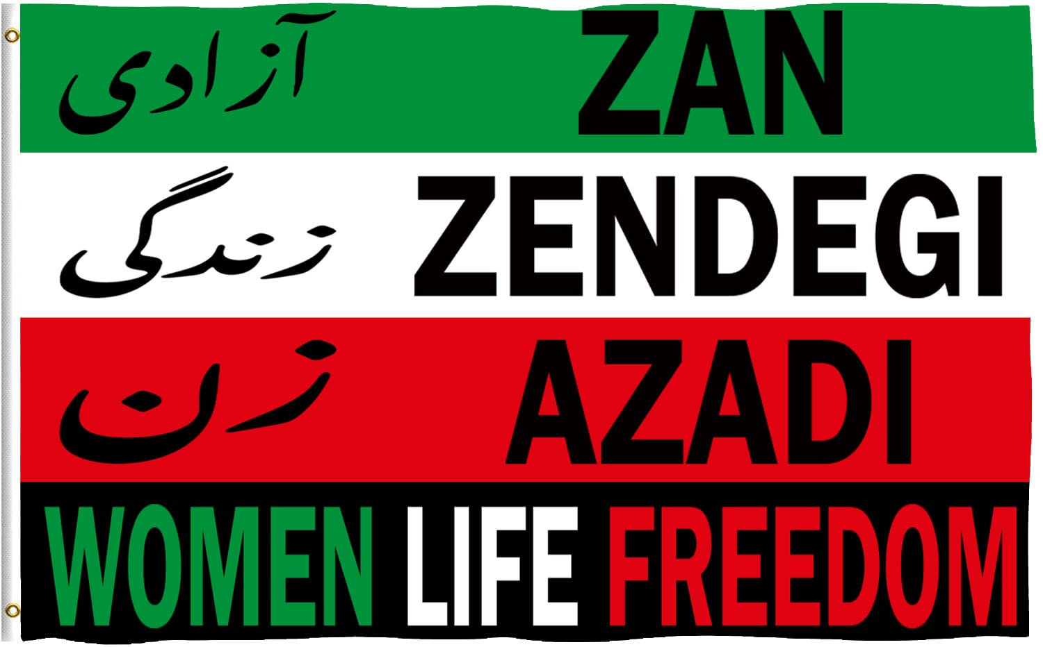
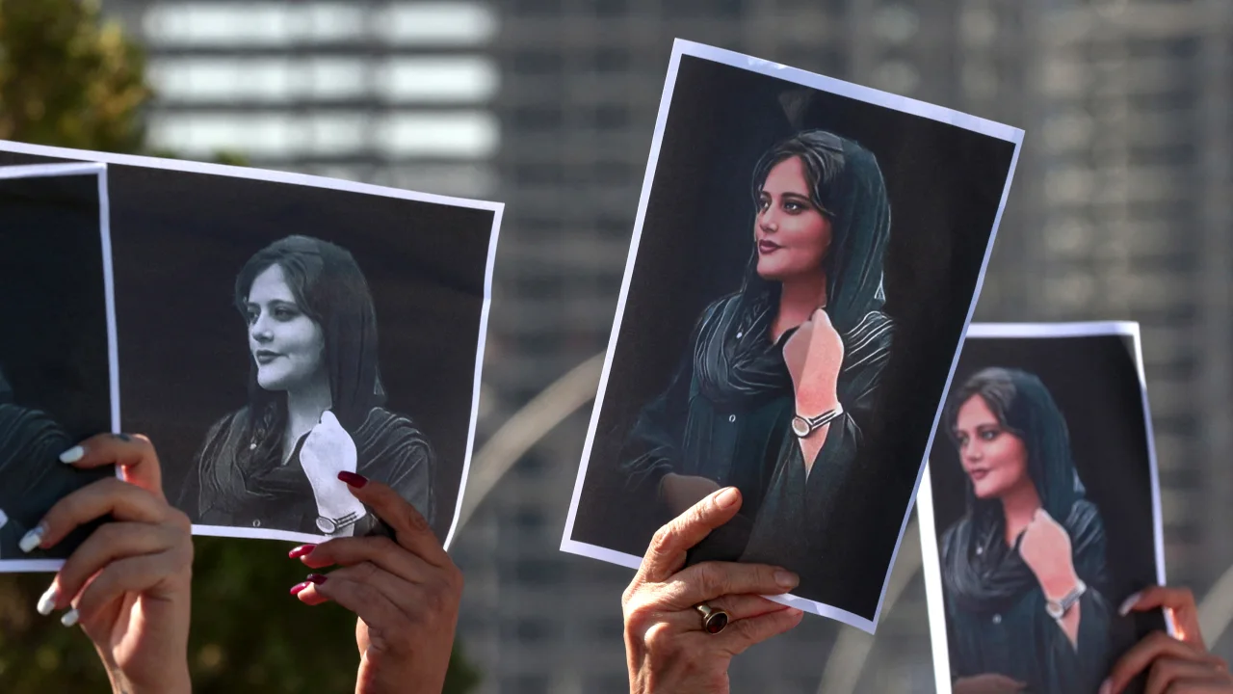
زن، زندگی، آزادی Women, Life, Freedom
Masha Amini, and the clothing restrictions
Morality police
Hijab
Limits to the women in public, and in private
A year after Masha Amini’s death – any change?

Slide 42
Baraye…
A Grammy for the protestors
Social
Gender
Environment
Economics
Immigration
Education
Perspectives
https://www.youtube.com/watch?v=HCUfgHHkLcA&ab_channel=RanaMansour
English version – read the words

Slide 43
In the news
Do you follow…
Prisoners swap
Détente with Saudi Arabia
Direct talks with USA
Modernisation of the restriction tools, use AI to monitor and issue fatwas

Slide 44
Questions?
Thank you for your attention!

