Slide 1
Data processing

Slide 2
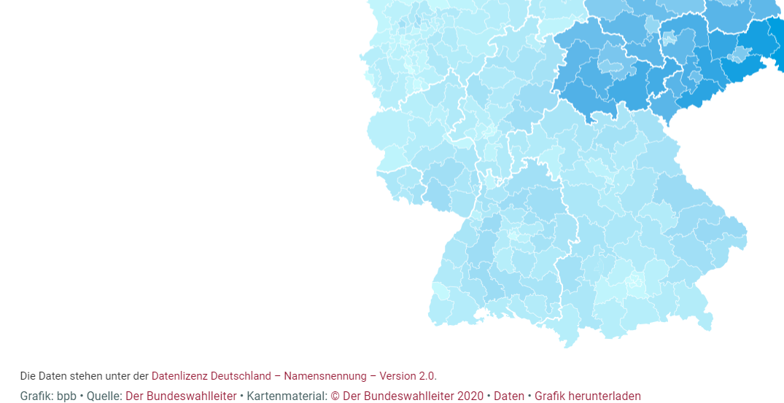
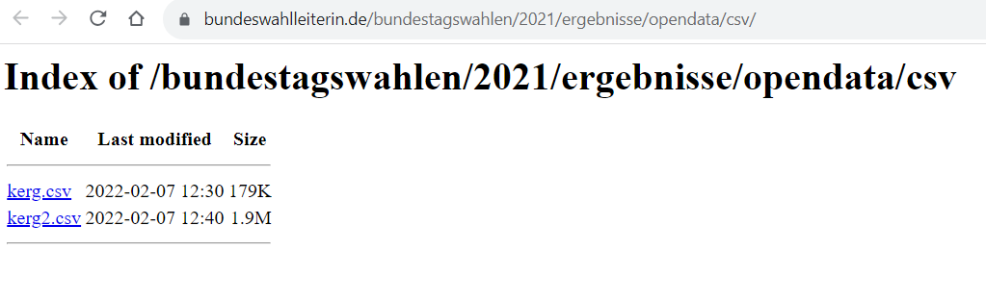
News articles

Slide 3
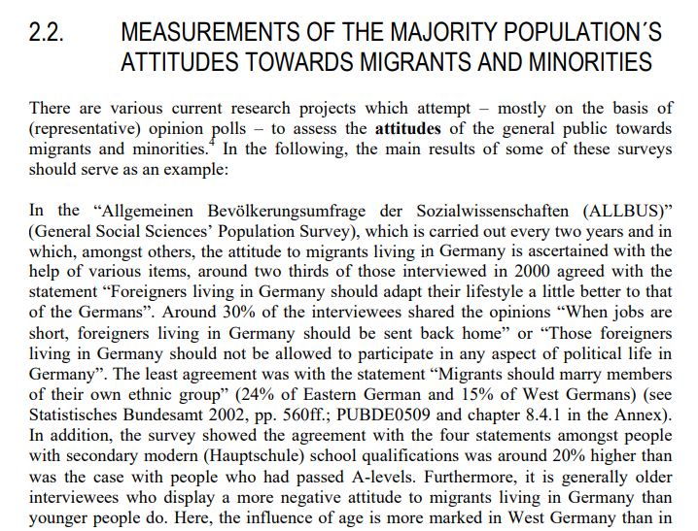
Data in acadamic articles and books

Slide 4

Real Data

Slide 5
Data linked to research articles
Processed data
Edited data
Original variables not used for article are deleted
Indication of source of data
data.mendeley.com
https://dataverse.harvard.edu/

Slide 6
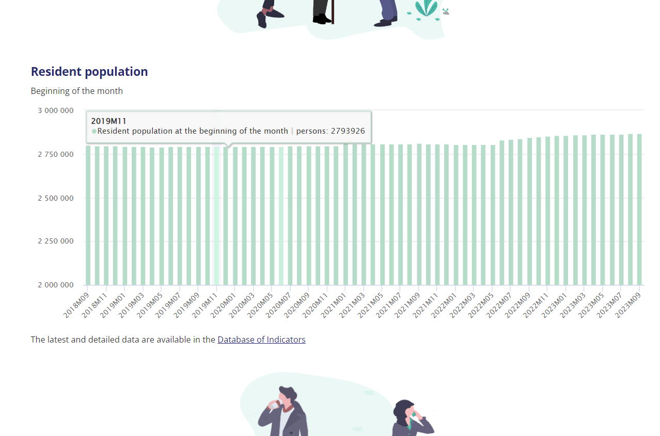
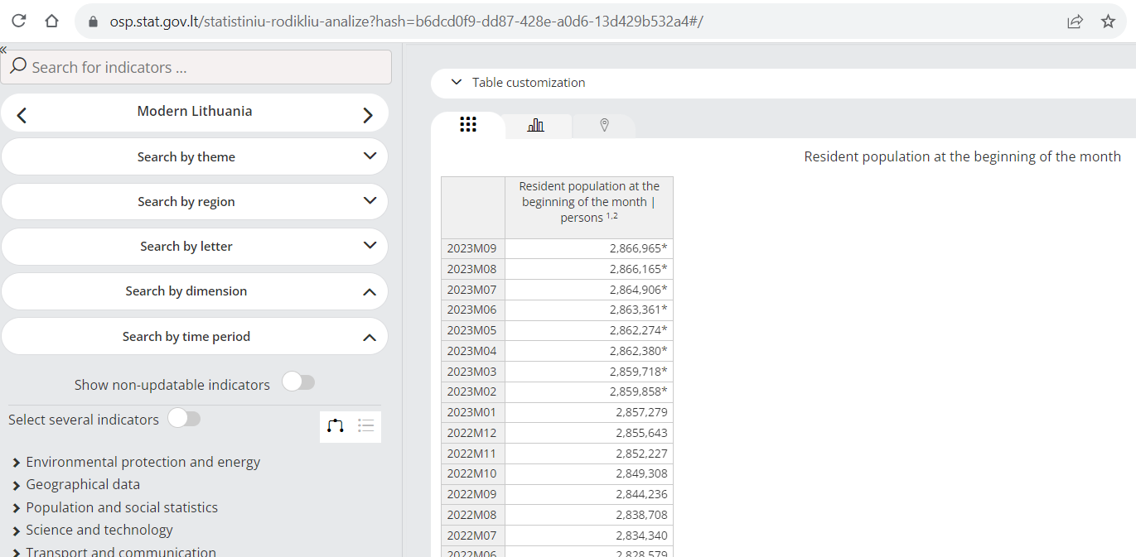
Information webpage using some data
https://osp.stat.gov.lt/en/lietuvos-ekonomikos-raida/gyventojai-ir-socialine-statistika
https://osp.stat.gov.lt/statistiniu-rodikliu-analize?hash=b6dcd0f9-dd87-428e-a0d6-13d429b532a4#/
Real Data

Slide 7

Open data repositories
https://datahub.brno.cz/

Slide 8
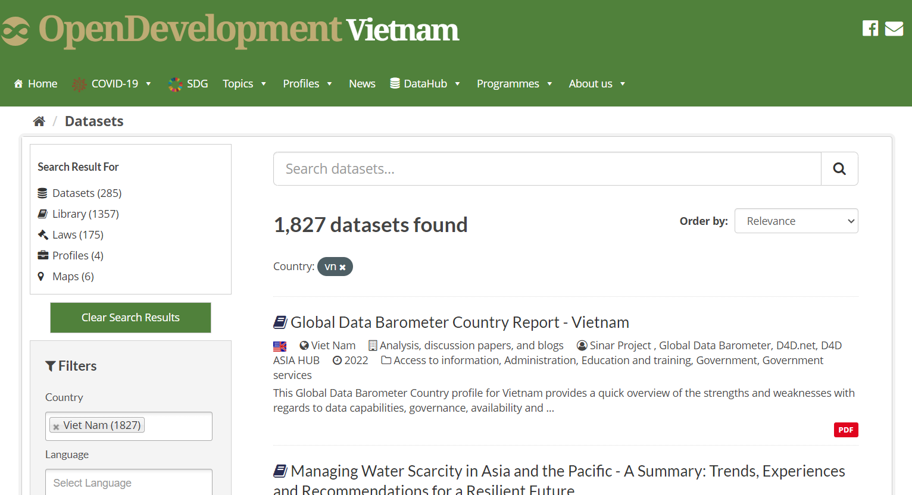
Vykopirovat vietnam

Slide 9
You can use AI !!!
Google search is obviously AI too
E.g. ChatGPT
https://chat.openai.com/
tell me about some sources about social and political data in Nigeria?
It is neccessary to check the results

Slide 10
Typical scenarios
Excel (xls, xlsx)
SPSS (sav), Stata (dta), R (rdata)
CSV, TXT
XML
JSON

Slide 11
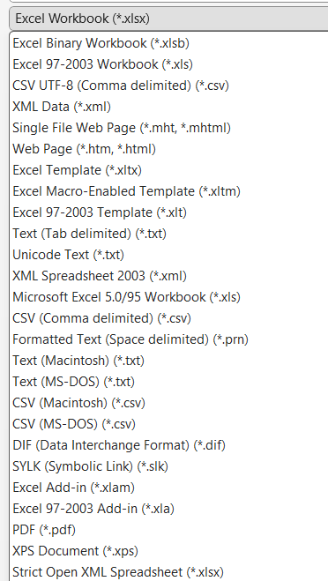
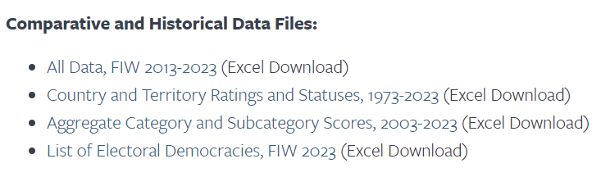
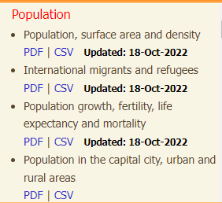
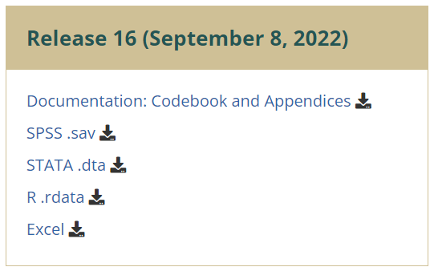
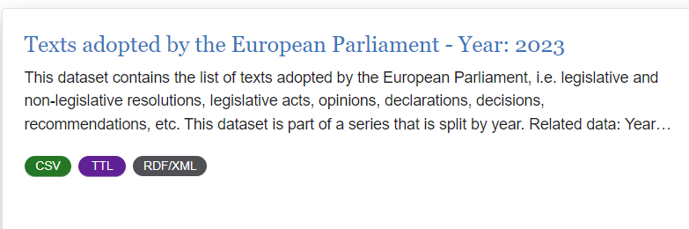
Examples

Slide 12
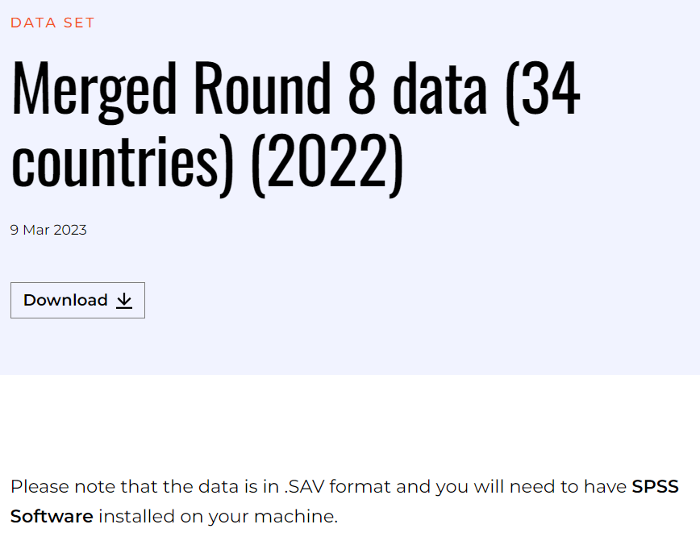
SPSS
SPSS is available at the MU website (see next page)
SPSS to excel online conversion: https://secure.ncounter.de/spssconverter

Slide 13

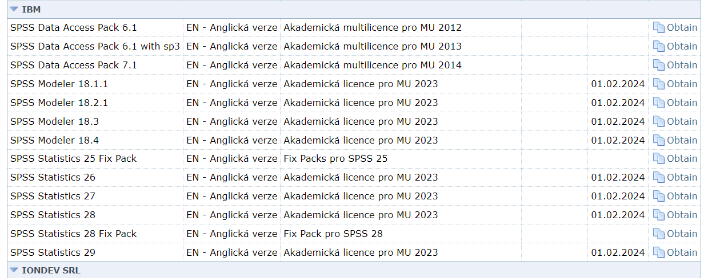
https://inet.muni.cz/?idr=ict.soft&pk=u&x=0&y=500

Slide 14
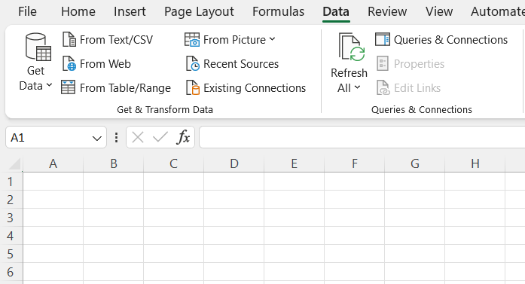
CSV
Our example of csv data: https://data.europarl.europa.eu/en/datasets/texts-adopted-by-the-european-parliament-year2023/26

Slide 15
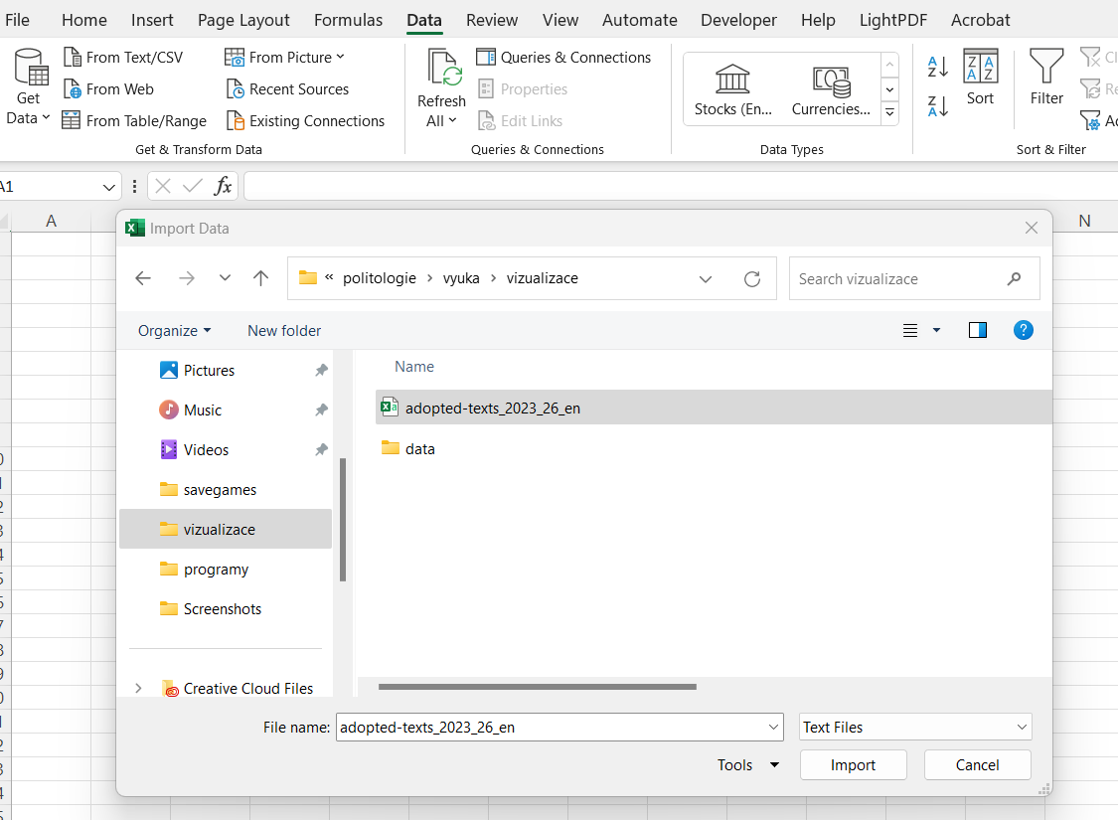

Slide 16
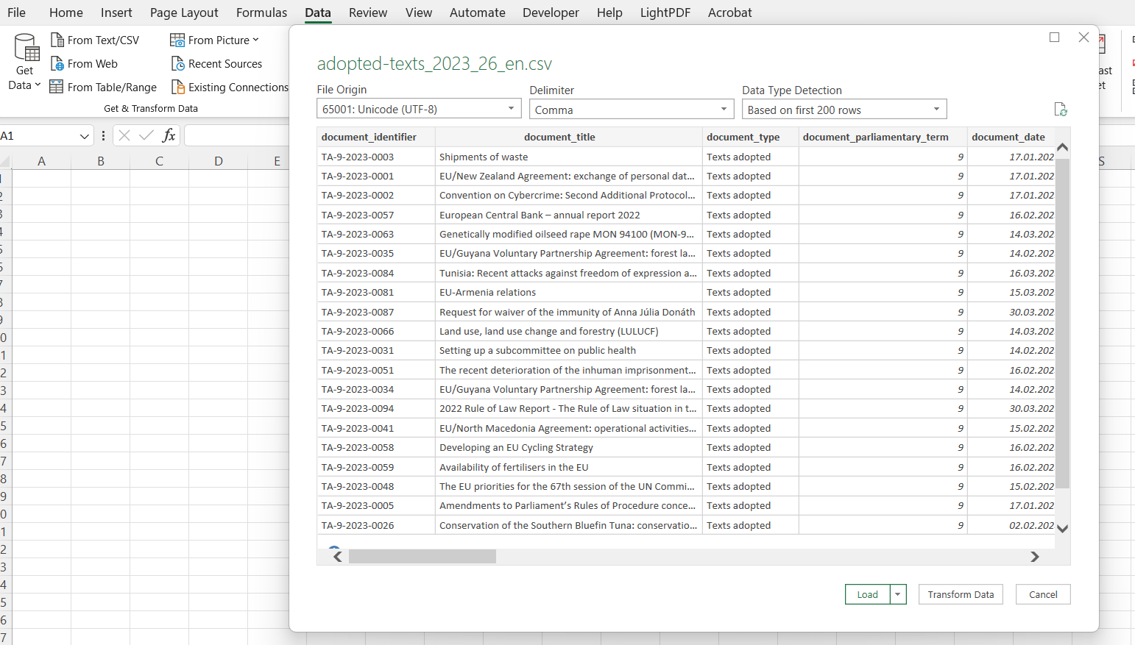
This is important for tables containing text in other language than English
TT

Slide 17
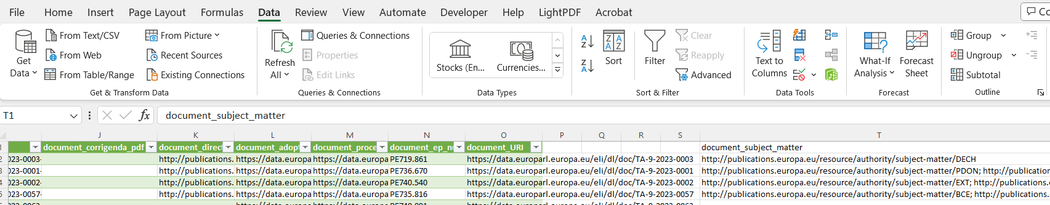
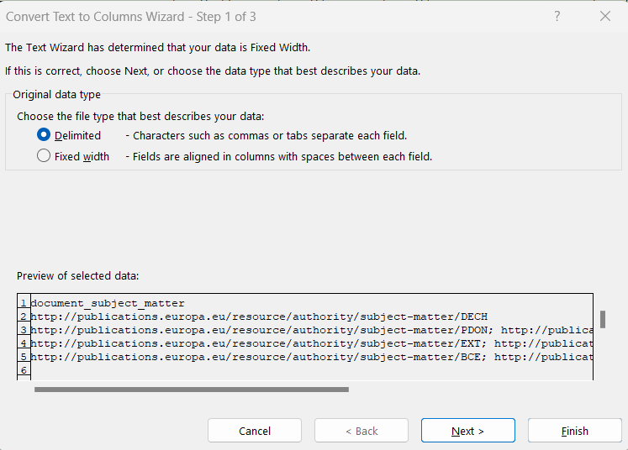
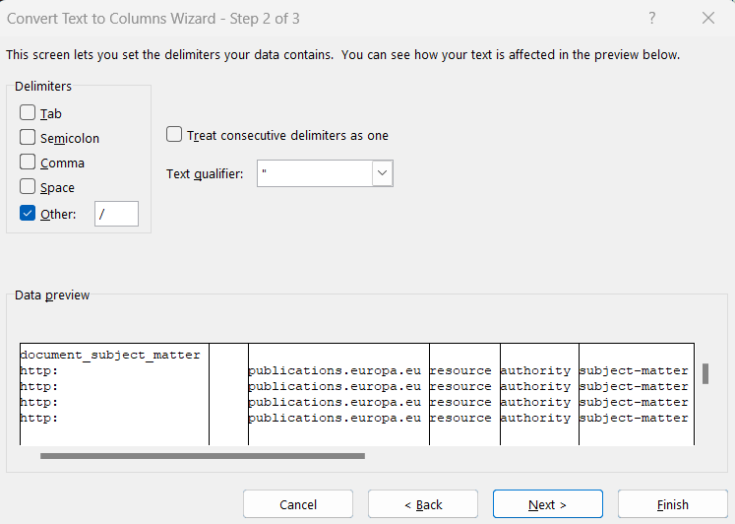
Split column into more columns

Slide 18
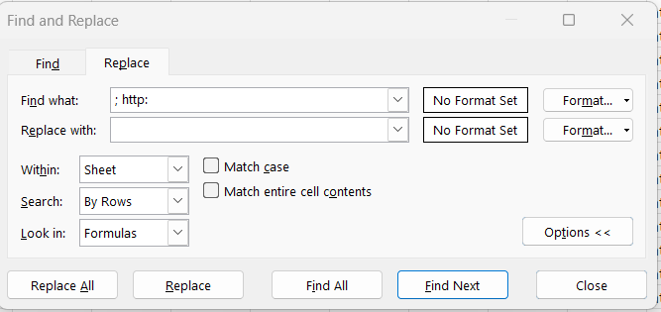
Cleaning (ctr+h)

Slide 19
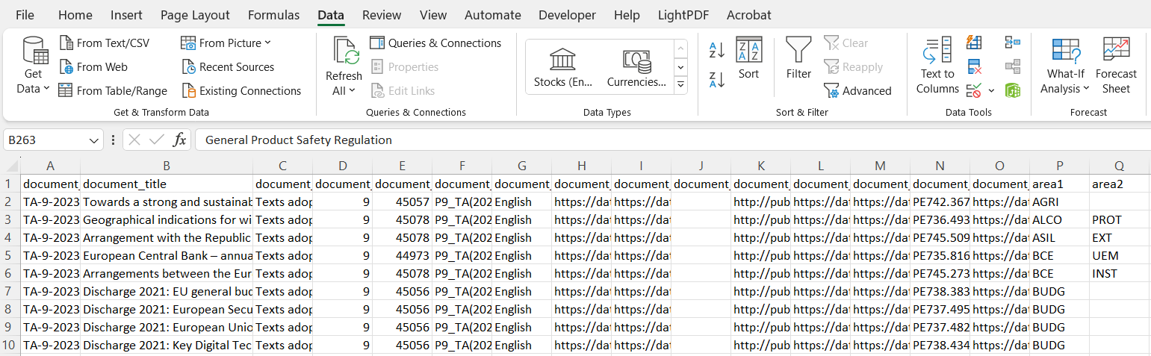
Sorting

Slide 20
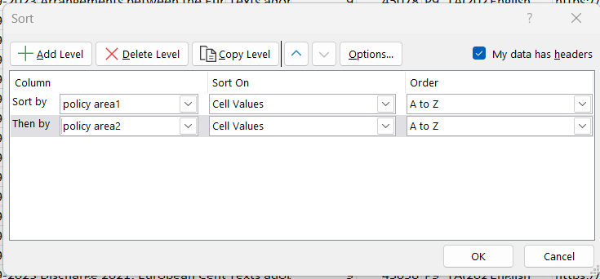
Here you can add one more box for choosing sorting variable
This box has to be marked to see variable names in „sort by“

Slide 21
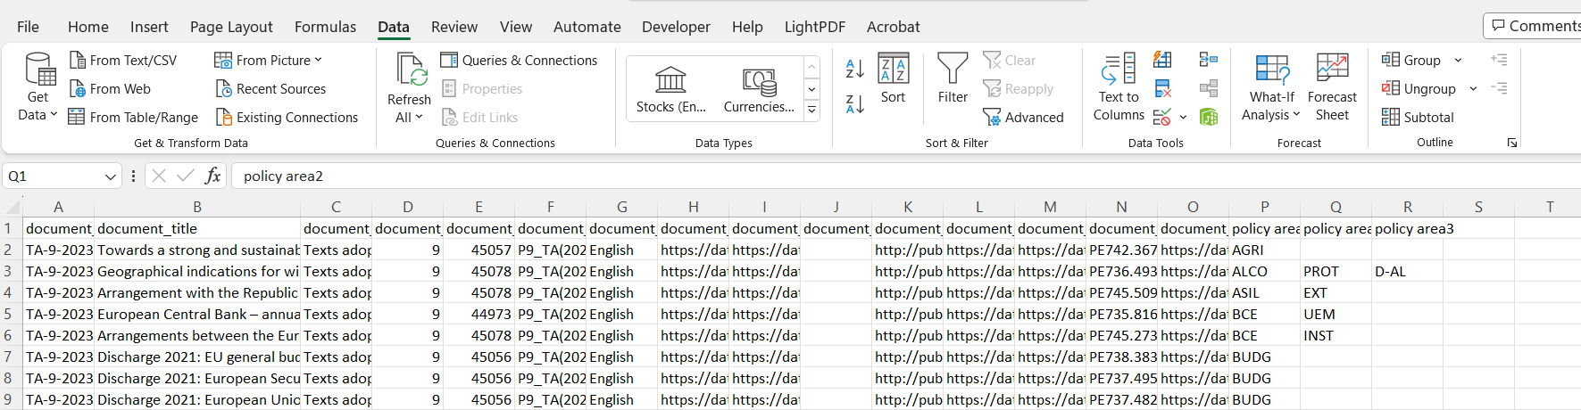
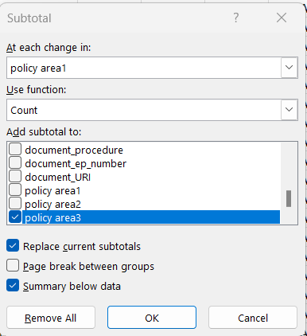
Computation
Grouping variable: for what categories we want to make the computation
Way of computation: what kind of number we want (sum, count, mean, min, max, SD)
Sum: the ammount which you have to pay in shop is sum of prices of pieces in your shopingcart
Count: number of pieces in your shopingcart
Mean: average price of pieces (e.g. 20, 30, 50, 100 mean is (20+30+50+100/4 = 50)
SD: mean deviation of values around the mean (50-20) + (50-30) + (50-50) +(100-50)/4 = 25
(real calculation works with squareroot of exposed numbers
What you want to count

Slide 22
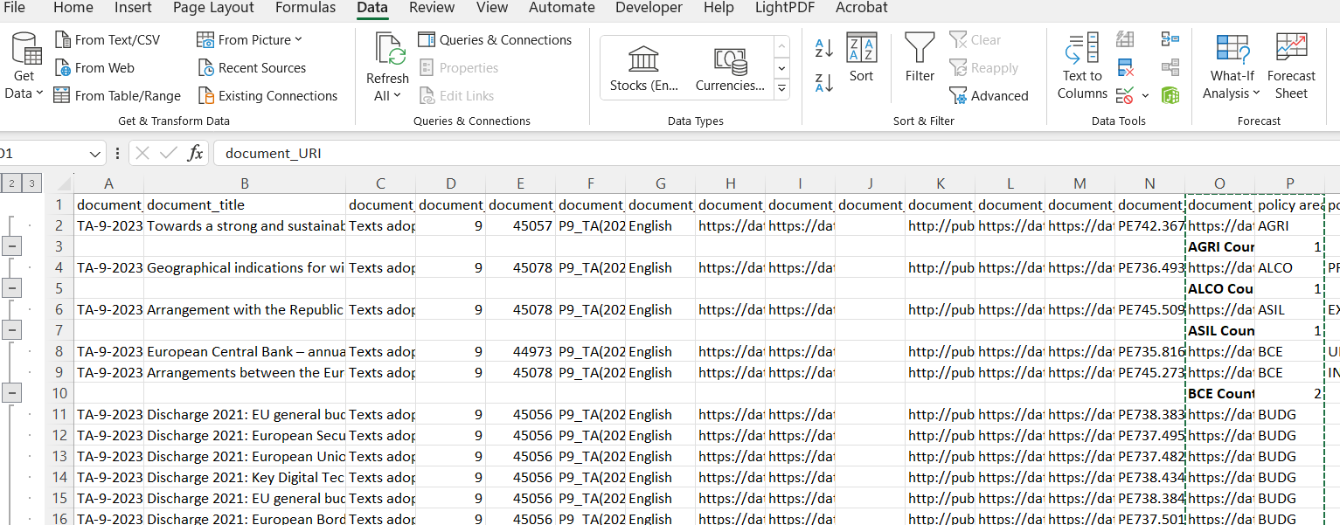
Result
It is not over yet

Slide 23
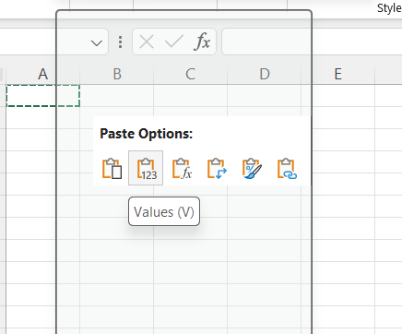
Copy the results to new sheet and insert them as values
  Click with right button of mouse
Select only rows wit result
  Add new empty column
  Use text to column wit „space“ as delimitor
  Sort data by new column
  Delete everything without word count (in new column)

Slide 24
Compute percentages
=C2/$C$70*100
$ allows to calculate values for whole column, but the value in denominator remains the sam

