Slide 1
Scatter plot

Slide 2
Relationship of two interval variables
Correlation
Weight x height
Unemployment rate x purchase power

Slide 3
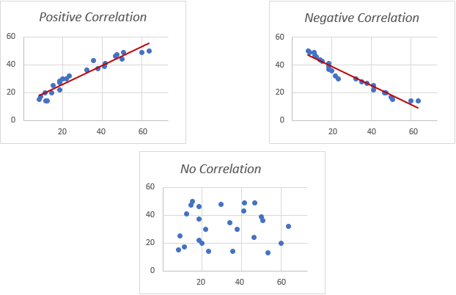
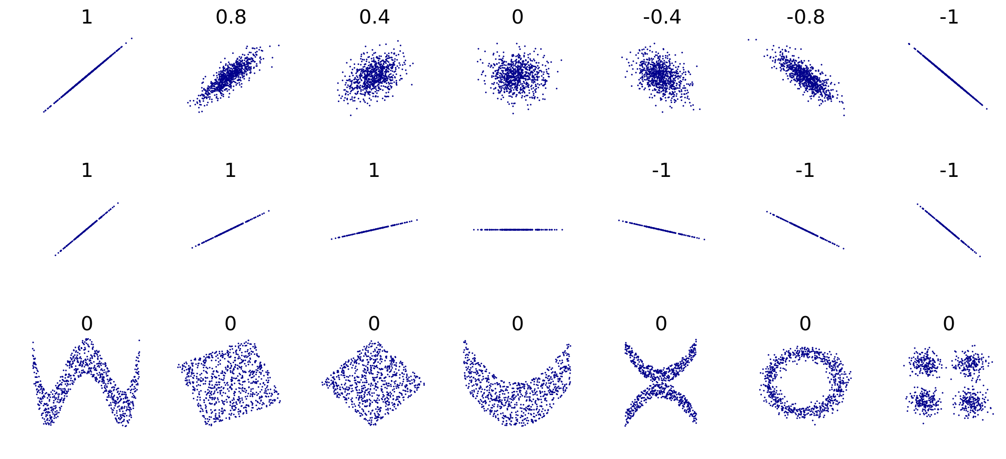

Slide 4
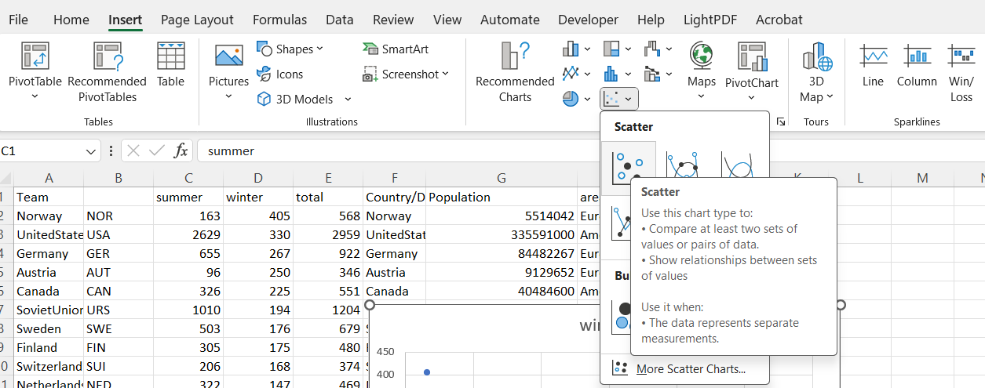
Scatterplot

Slide 5
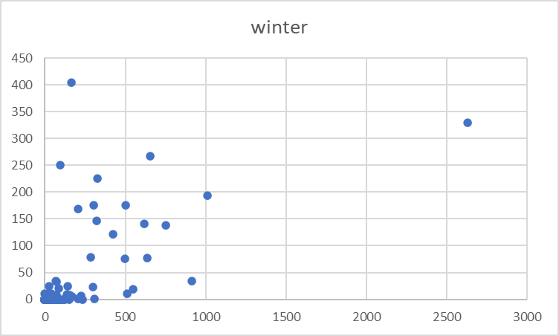
outliers
overplotting

Slide 6
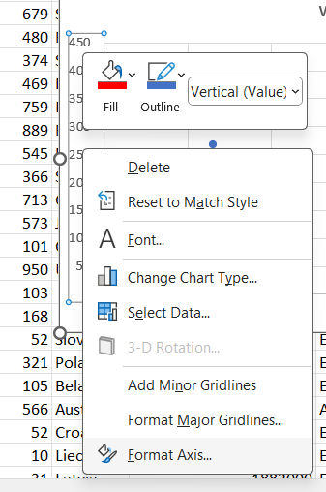
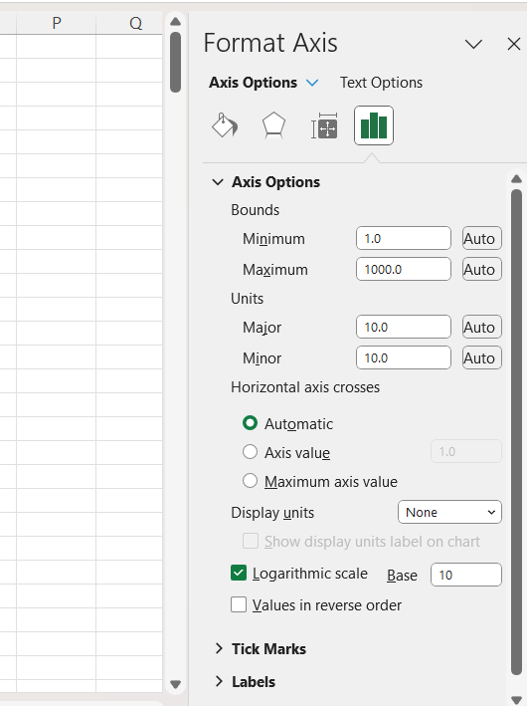
Log axis
Solution when there is a lot of small values and a few high values
  Typical situation: population
Problem: it does not work for 0 and negative numbers
Right click here
a quantity representing the power to which a fixed number (the base) must be raised to produce a given number (eg for 100 it is 2 because 10power2 is 100)
Excel leaves the labels as not transformed, but it change look of axis

Slide 7
Both axes logged

Slide 8
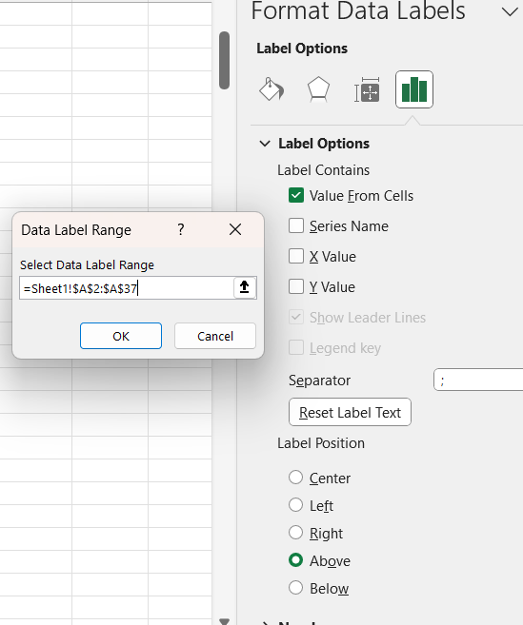
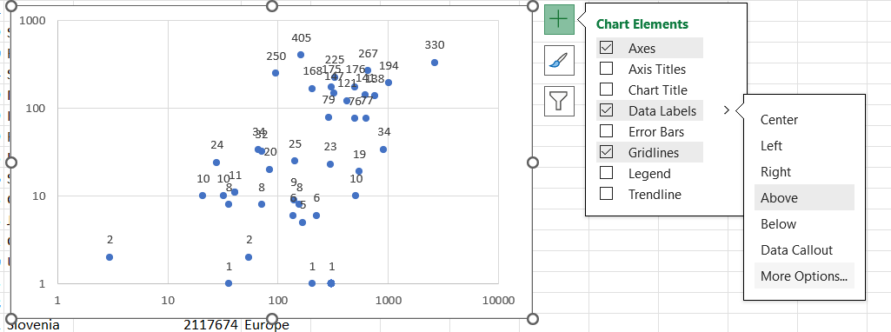
Add point labels

Slide 9
Overlays need to be managed manuály
Use short names or abbreviations

Slide 10
Add lines
Trend line
  Linear
  Exponential
  logarithmic
Quartals

Slide 11
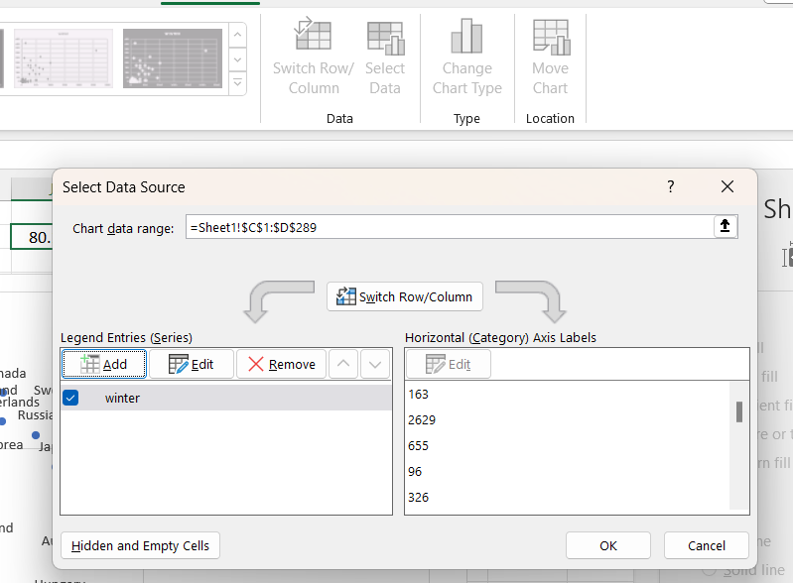
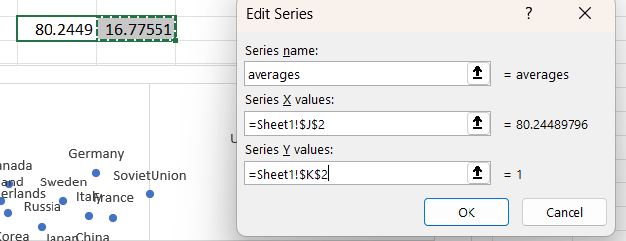

Slide 12
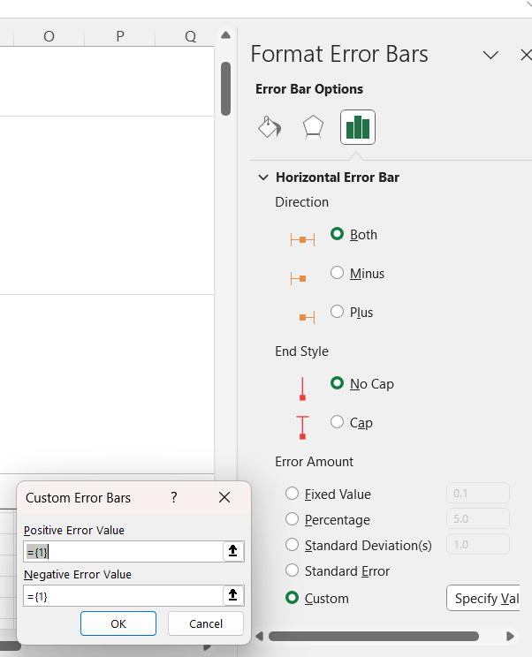
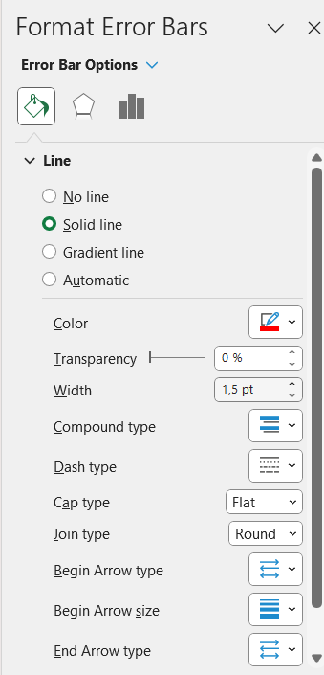
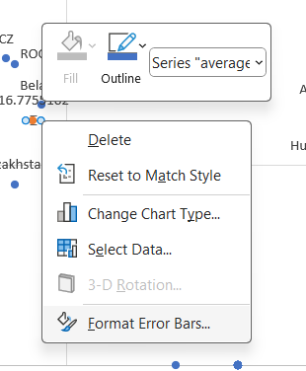
Right click here
From minimum to average
From average to maximum

Slide 14
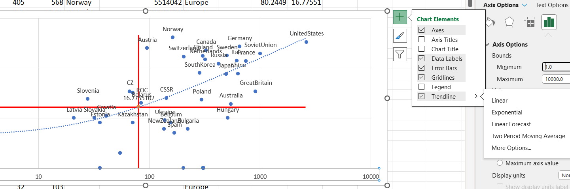
Trend line

Slide 15
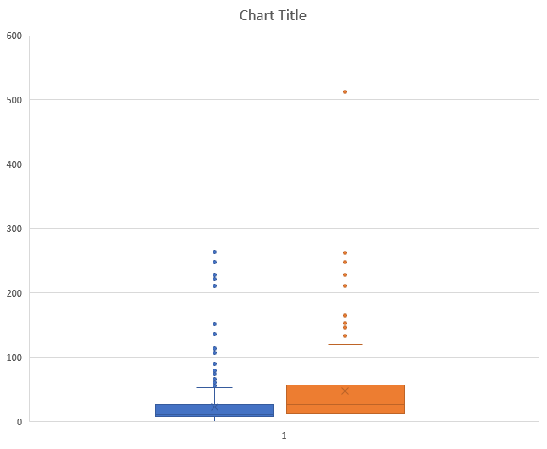
Set of boxplots

