Slide 1
Data visualization –
Text

Slide 2
The first step
Text has to be turned into data
Quantitative coding
  Human coding
  „automatic“ (machine processed) coding
    Almost always inclde some decision of human
    Frequency analysis (Wordclouds)
    Sentiment analysis - Is the text positive or negative?
    Topic models - what topics are in the text(s)
    Analysis of readability (how complex the text is?)
    Analysis of „positions“

Slide 3
Allocating recording units to substantial categories
  Classifying each coded unit of text from the sample according to the category scheme
    Coding scheme
      Before coding (deductive)
      During coding (inductive)
    Unit: page, paragraph, sentence, quasisentence

Slide 4
Quasi-sentence
an argument or phrase which is the verbal expression of one idea or issue
One sentence may include more ideas, one idea may be divided into more sentences.
I am going to buy bread, milk and apple.
I am going to buy bread.
I am going to buy milk.
I am going to buy apple.

Slide 5
Text elements
Paragraphs
  Sentences
    N-grams
      Words
        Lemma
        token

Slide 6
Problems
Language
Tenses, adjective, male/female
Common words (stopwords)
Reliability of human coding
Different understaning by different coders
Noise in automatic coding

Slide 7
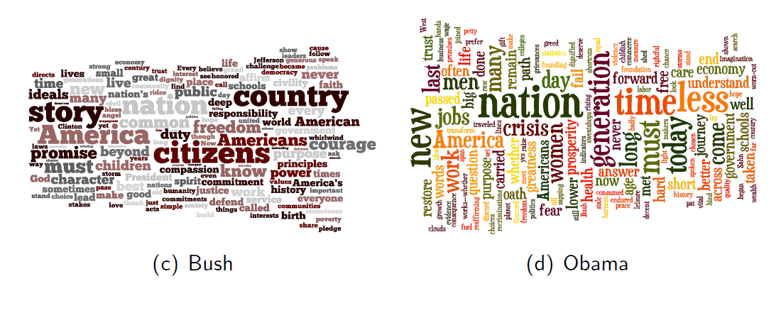
Wordcloud

