Slide 1
Visualization of spatial data

Slide 4
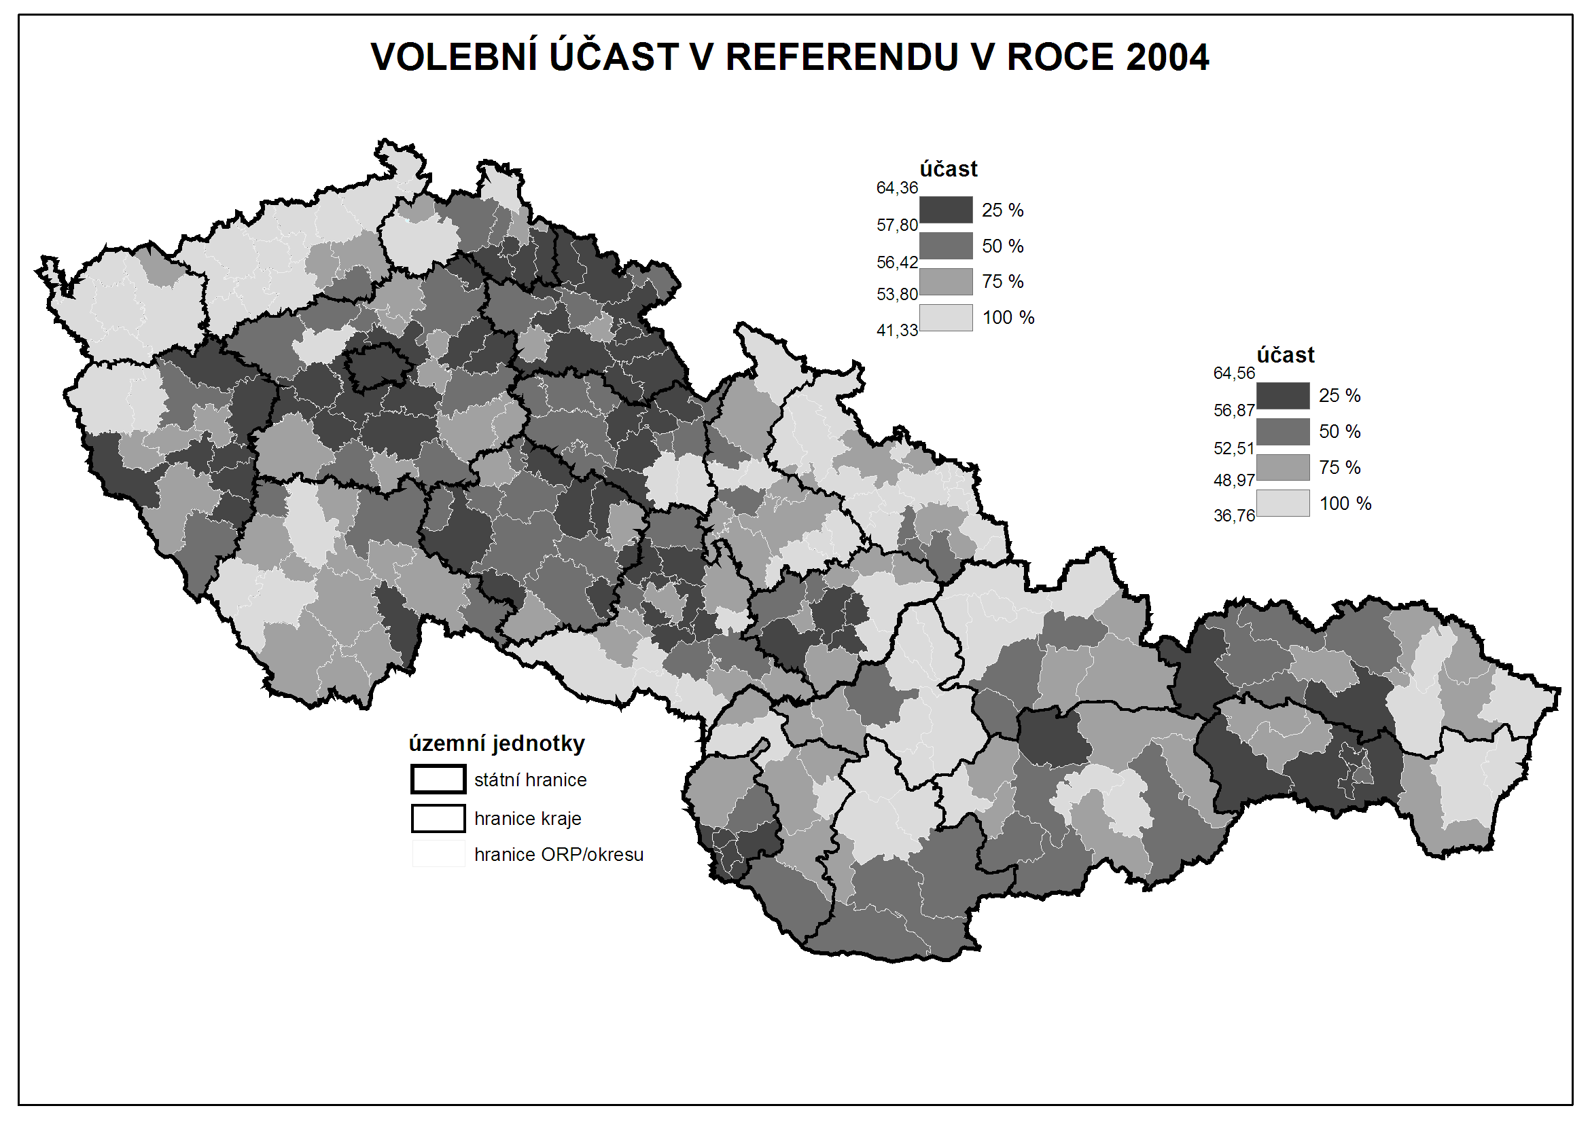

Slide 5
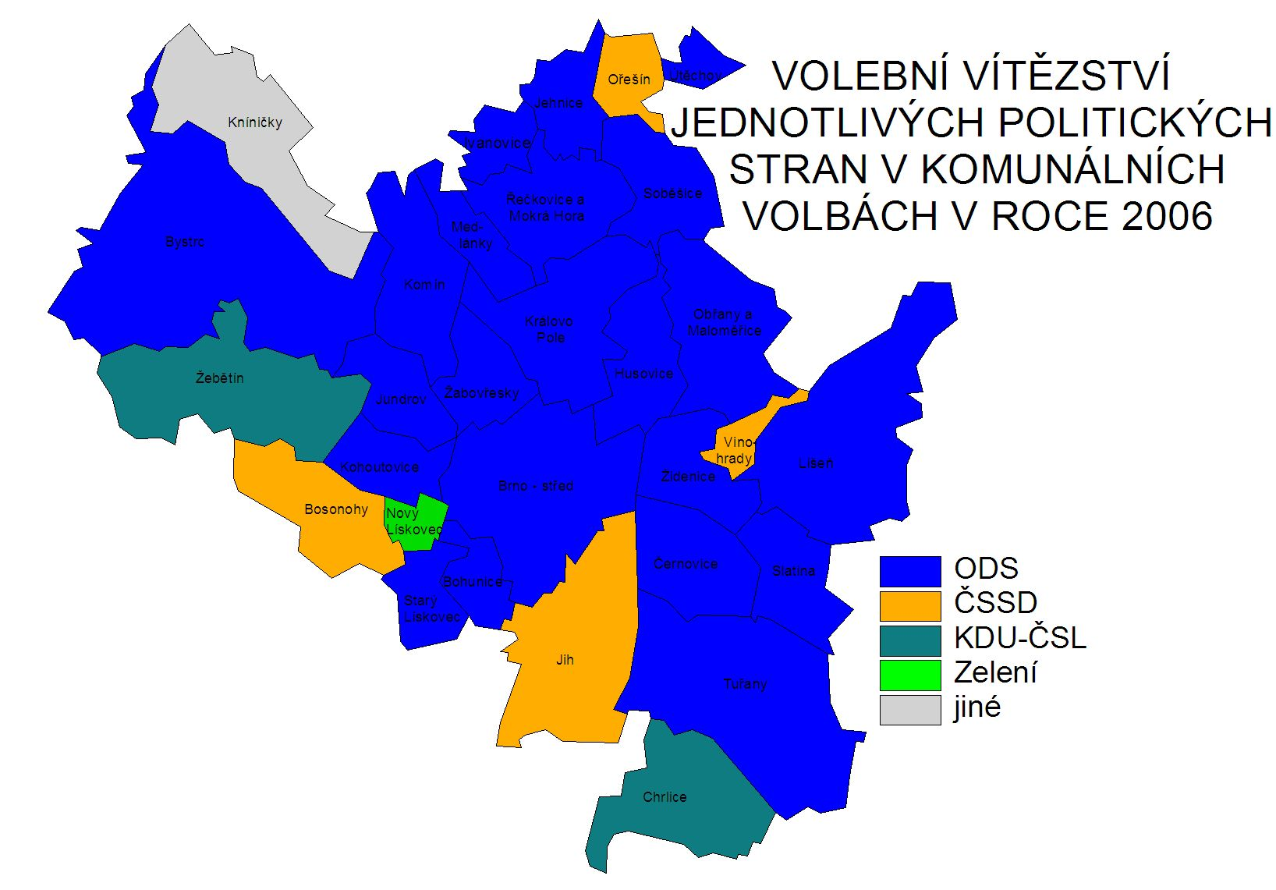

Slide 6
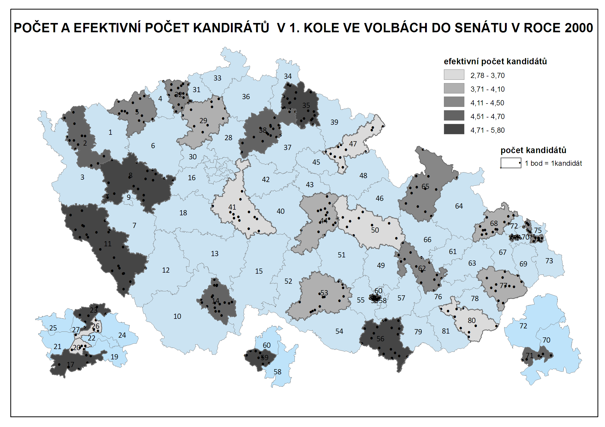

Slide 7
Two types of variables (spatially)
Just related to some space
GDP by country - it is not equally produced on whole teritory
It is just related to teritory
Choropleth maps
Truly spatial
The data are describing some exact location
Dot maps
The difference between categorical and cardinal variables are also important

Slide 8
Rules of using colors
Different categories (e.g. Winnig party)
Different colors (e.g. blue, red, green, etc.)
Different quantity (e.g. Electoral turnout)
Different shades of the same color (e.g from light blue to dark blue)
The higher intensity of variable, the darker the color is

Slide 10
Rules of creating intervals
Equal interval (eg. 0-10,10-20, 20-30,…)
Quantile – in all intervals, number of cases is the same
Natural breaks – unclear meaning

Slide 11
It is possible to combine cartographic visualization with piechart or barchart

Slide 12
What is needed
Data related to some spatial structure
Level of democracy in countries
Unemployment in municipalities
Number of parking places in streets
Or to places itselfs
Location of candidates homes
Location of armed clashes during conflict
Location of powerplants
How tall trees growing on their exact places are?
…

Slide 13
An empty map
The cartographic fature representig given spatial structure
Shapefiles
Contain information about coordinates
Contain information related to coordinates
Contain information about how the map should look
Practically: it consists of about 6 different files, all of them must remain in the same folder

Slide 14
Where to find empty maps?
https://www.diva-gis.org/Data
https://geodata.lib.utexas.edu/
https://datacatalog.worldbank.org/search/dataset/0039368
Open street map

Slide 15
Important things about empty maps
Geographic projection
The same country looks very diferently in different projections
The proper projection has to be selected
It is possible to set it in software

Slide 16
A key between map and data
Something which tells us that the data belongs to units drawn in map
It has to be exactly the same in map and in data
Full names are not best options (e.g. United Kingdom x Great Britain, Czech Republic x Czechia)
Standardized Ids
Usually available for any level of administrative units
Municipalities, counties, regions, states
Often available in official statistics

Slide 17
Spatial key
The data can be connected by the location
The coordinates of data has to be available
Or it must be data already in form of shapefile
How many candidates live in certain area
The map of mentions of places within book (check dubliners by james joyce)

Slide 18
Example of pledges from local electoral manifesto
Parties in local elections often promise the change of ceratain locations
repair of streets or pawments
Building of playgrounds
Reconstructions of public buildings
These locations can be drawn in map

Slide 19
software
ArcMap
QGis

Slide 20
What to do in software – add empty map

Slide 21
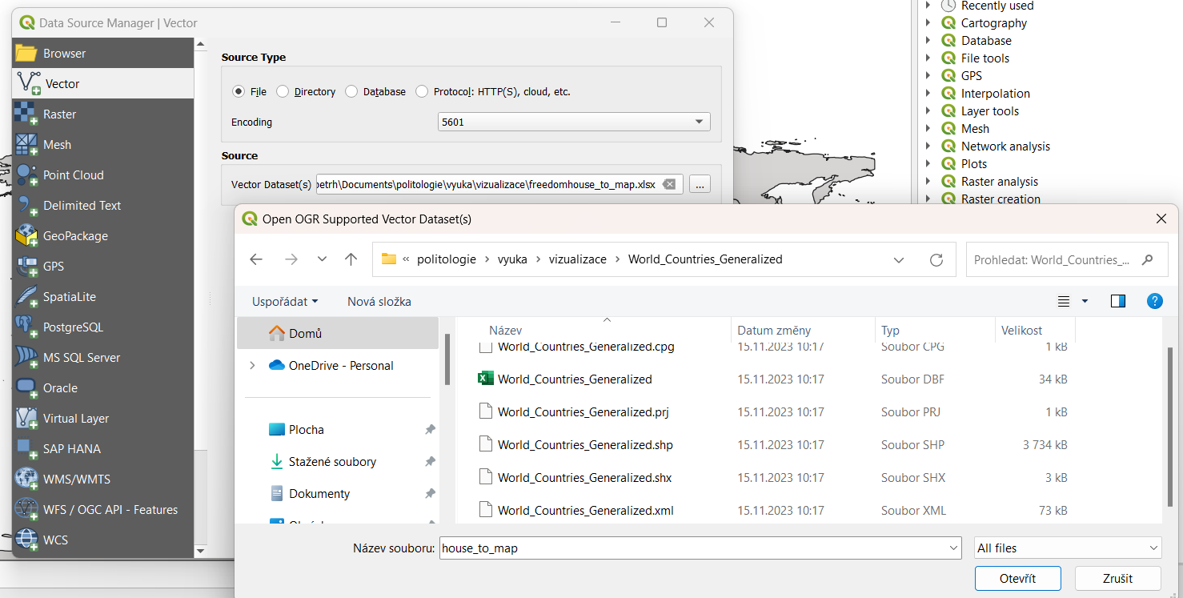

Slide 22
The same procedure to add excel table with data

Slide 23
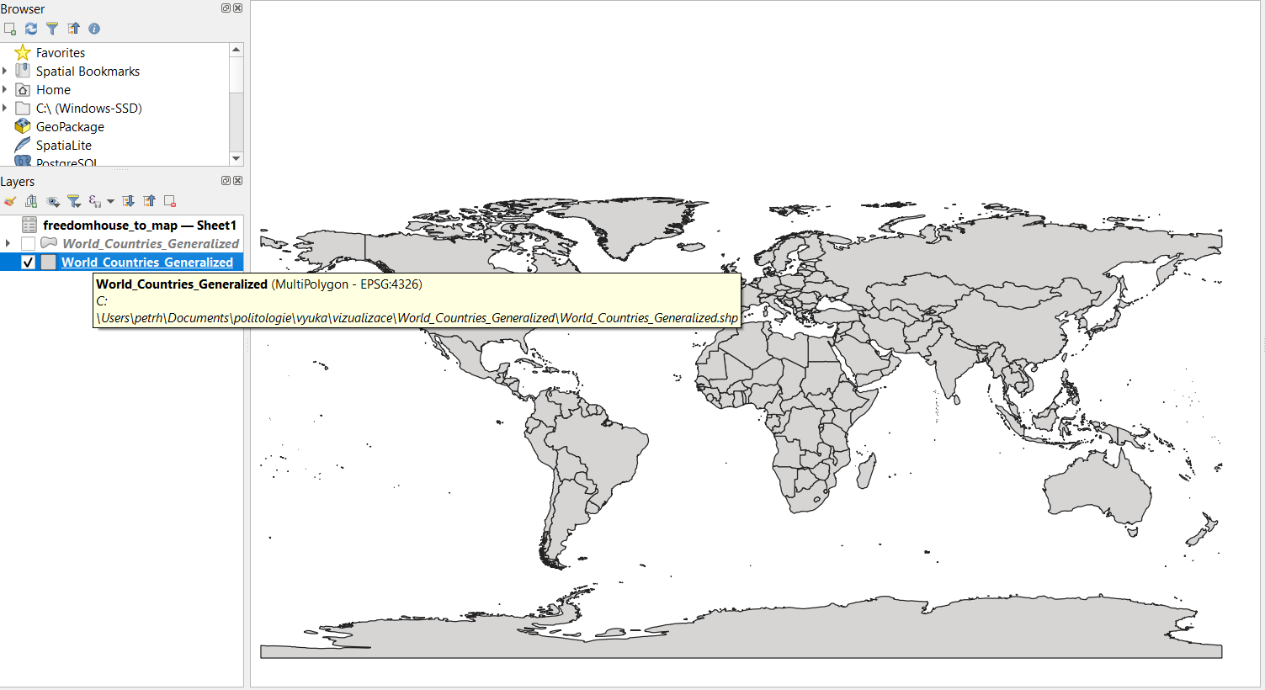

Slide 24
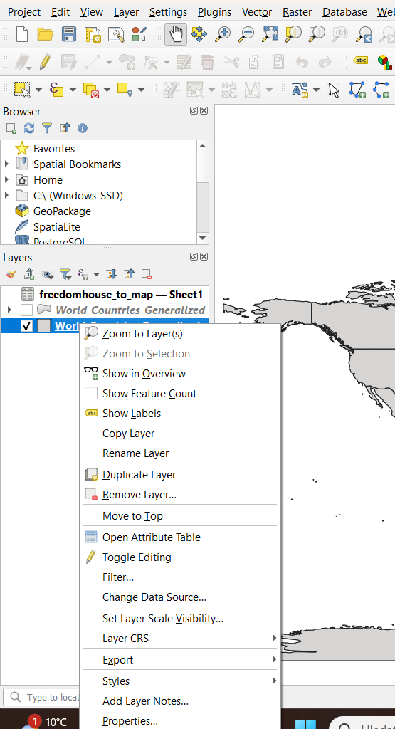
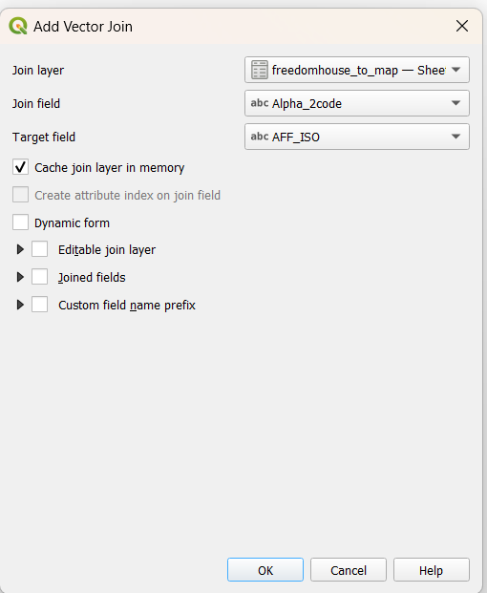
Join data from table to map
Right click on name of layer

Slide 25
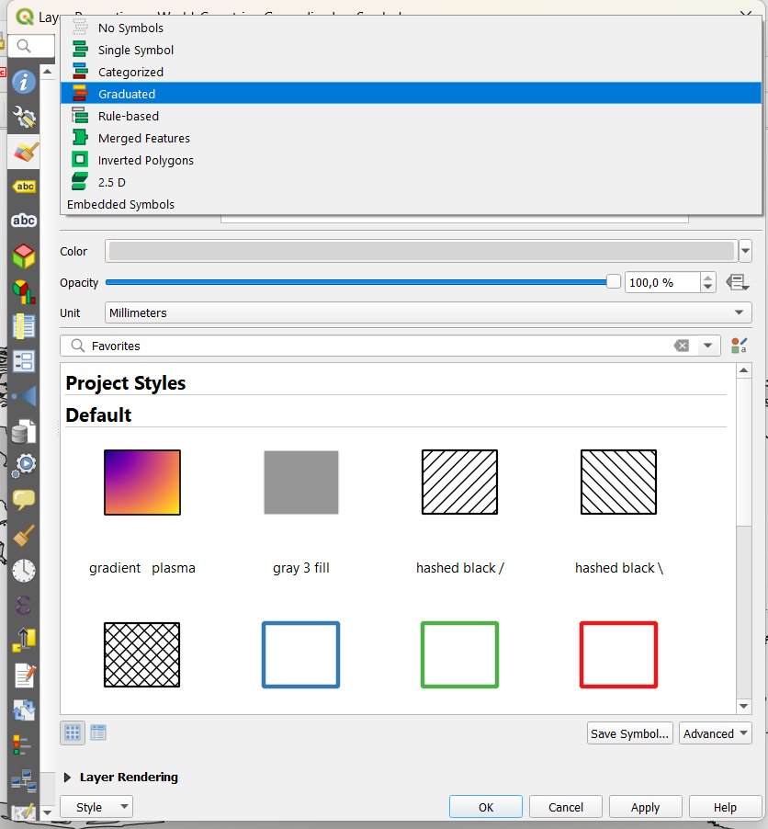
Make a map
Right click on name of layer

Slide 26
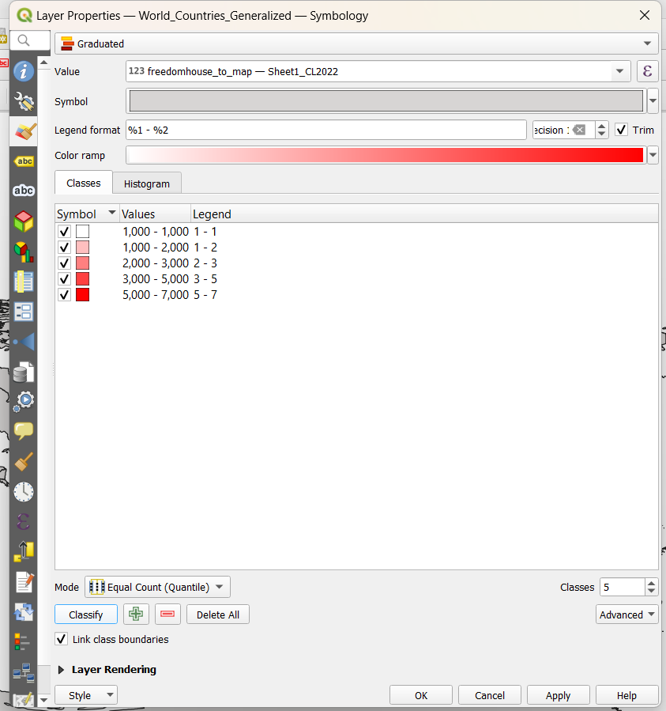
Variable to show
Color scale
intervals
Number of intervals
Way of making intervals

Slide 27
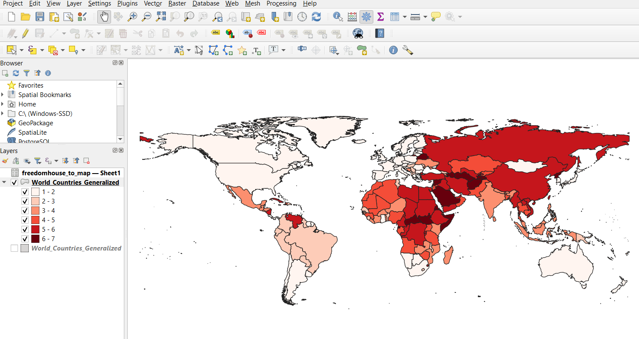

Slide 28
Add map elements (legend, scale, title, etc)

Slide 29
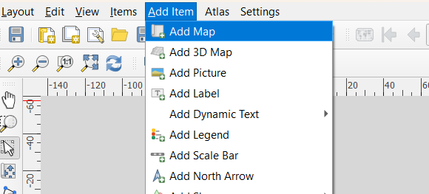
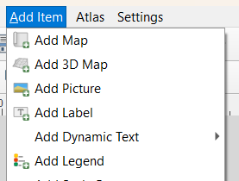
Draw with mouse over white board

Slide 31
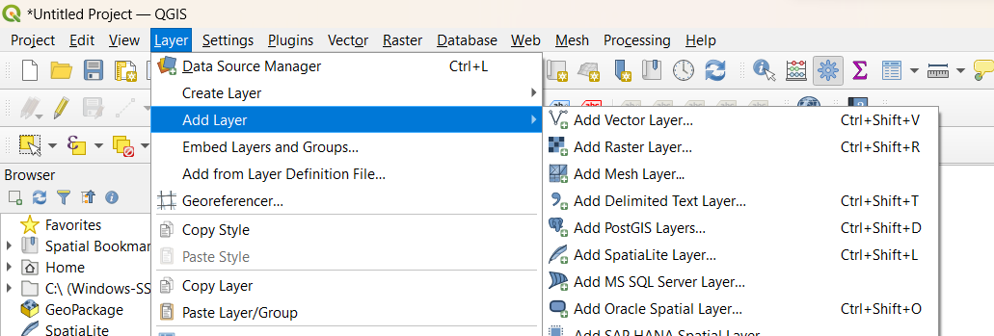
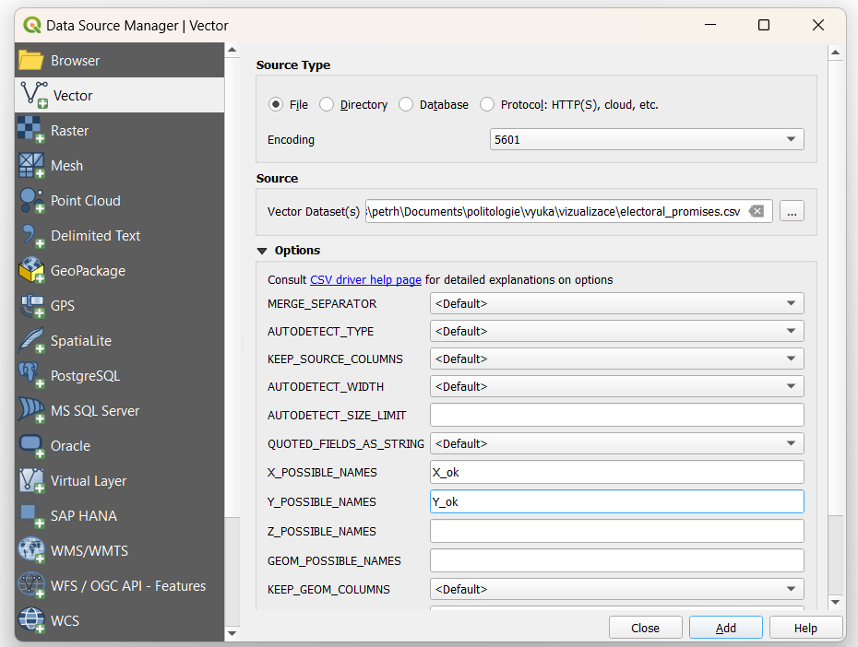
longitude
latitude

Slide 32
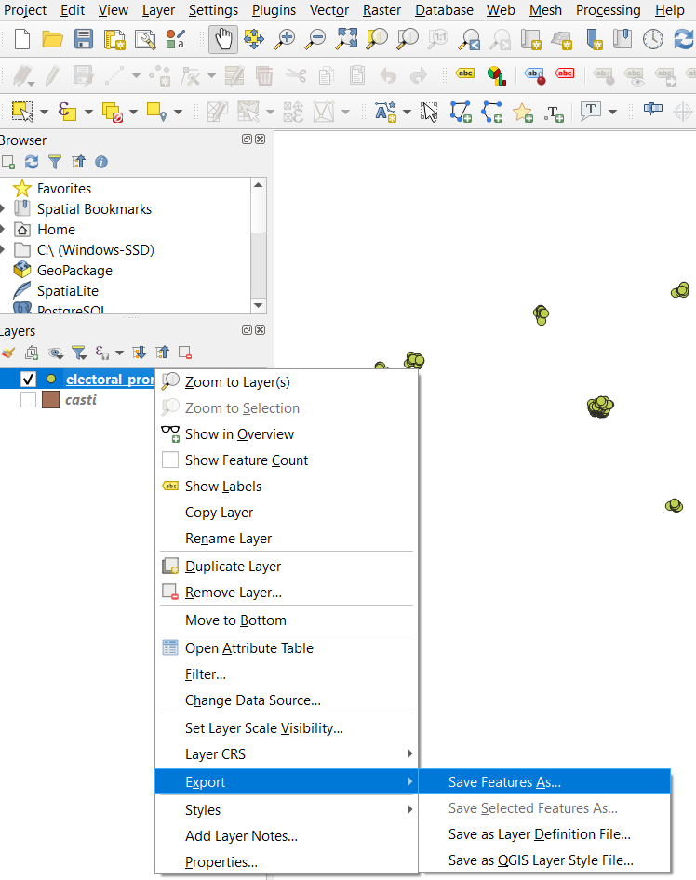
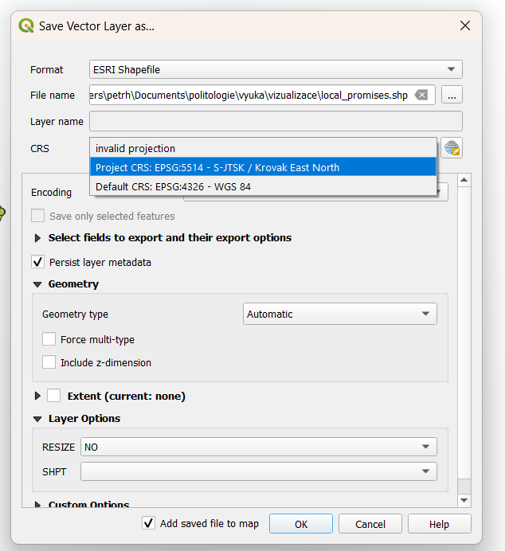
Right click on name of layer

Slide 33
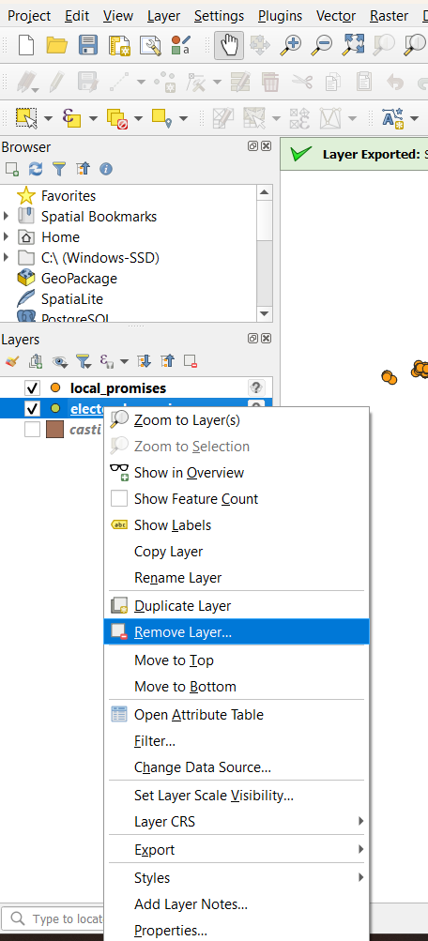
Right click on name of layer

Slide 34
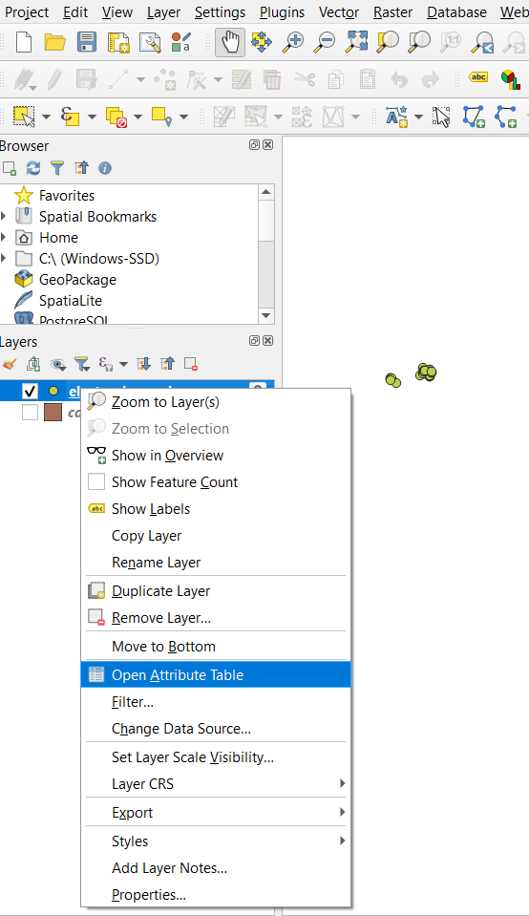
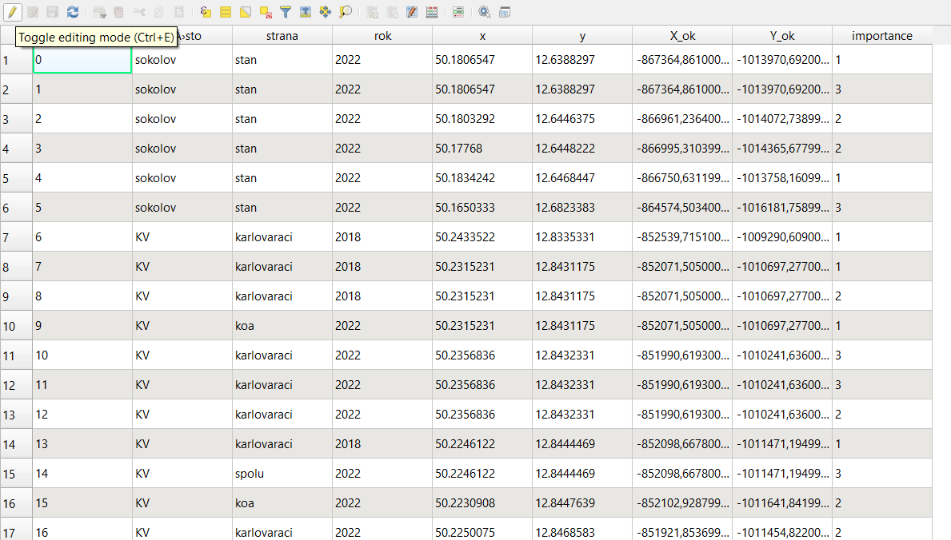
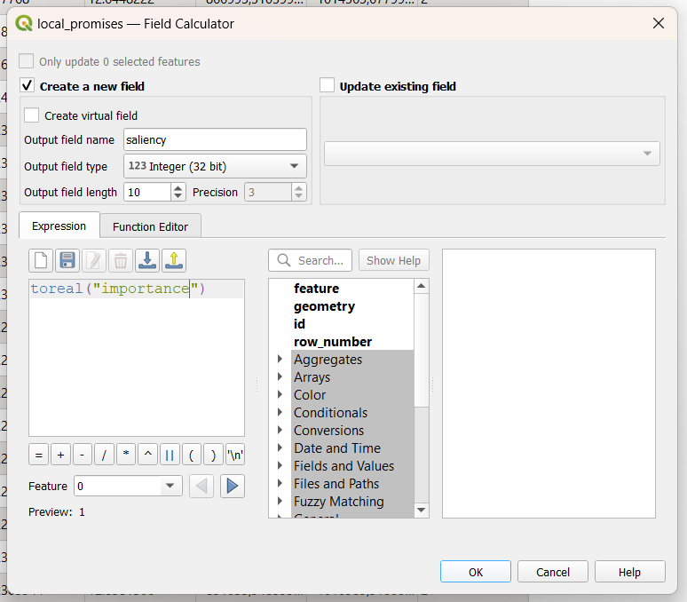
Right click on name of layer

Slide 35
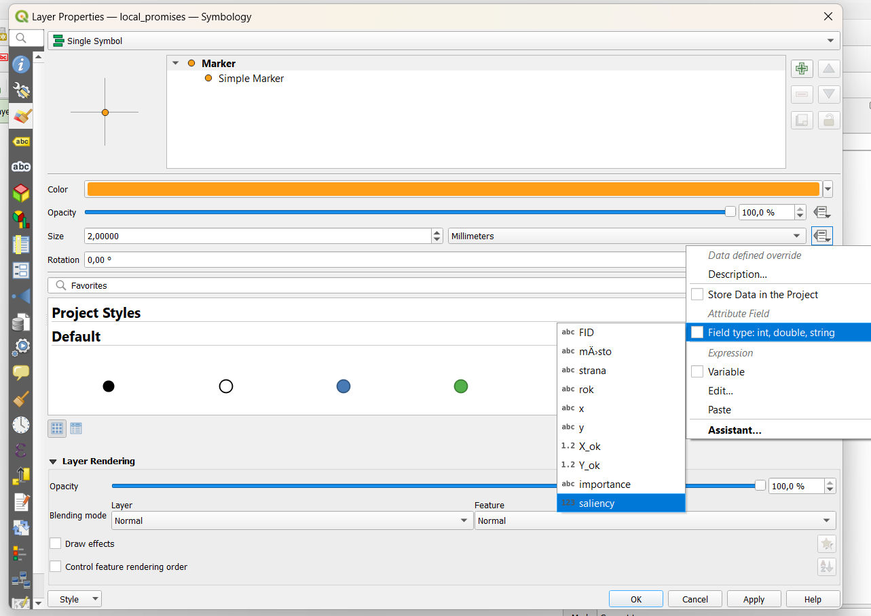
Right click on name of layer

Slide 36
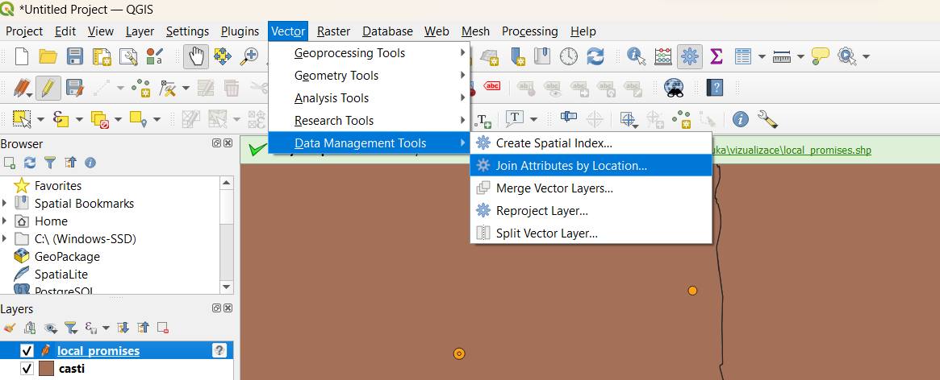
Spatial join

Slide 37
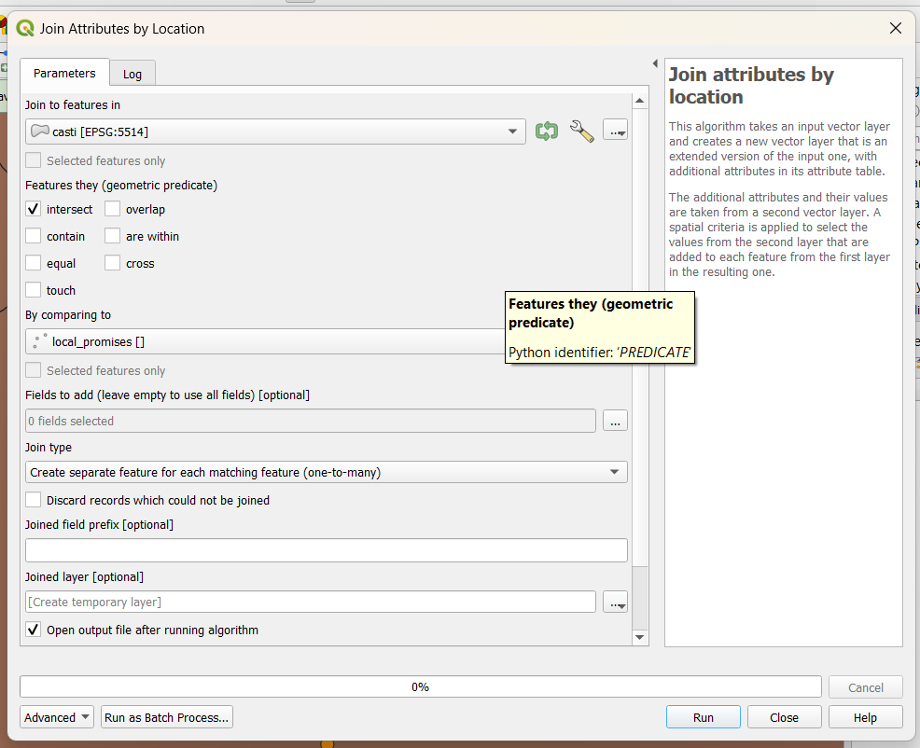
Layer to which the information is added
From this layer the information is taken

