Slide 1
Visualization of spatial data

Slide 4
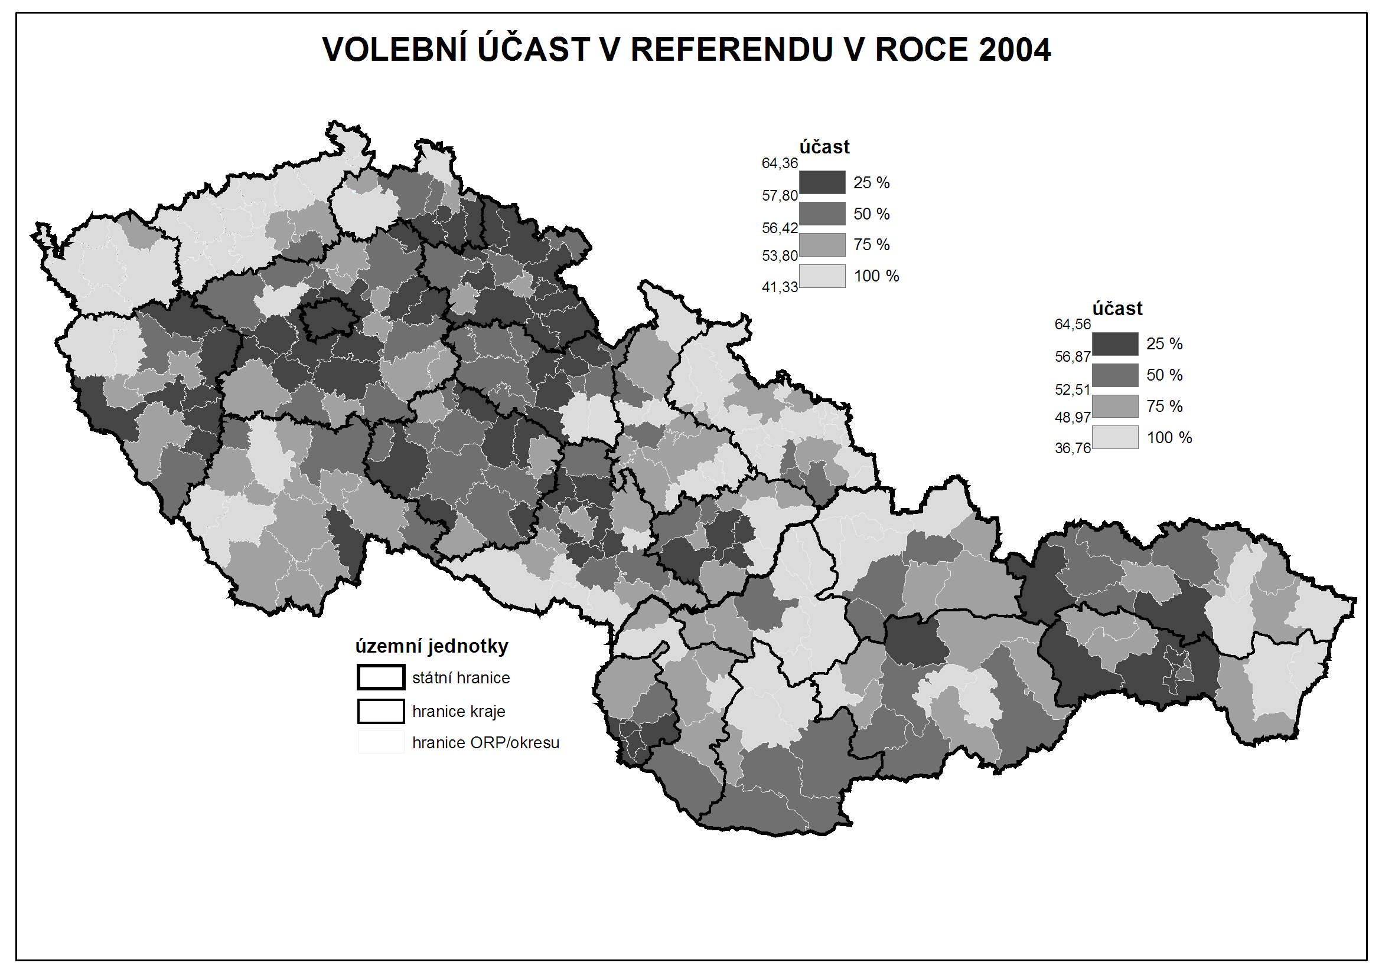

Slide 5
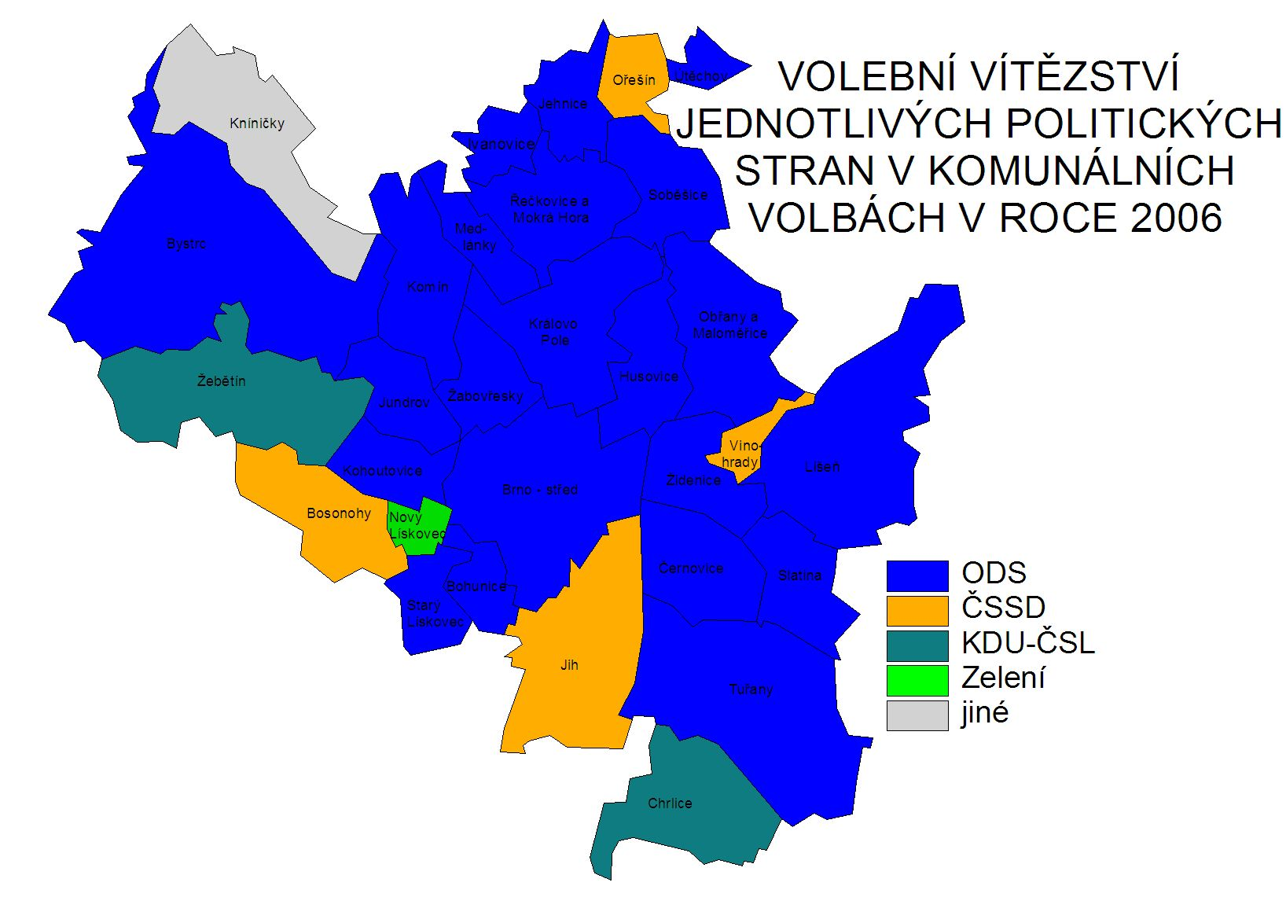

Slide 6
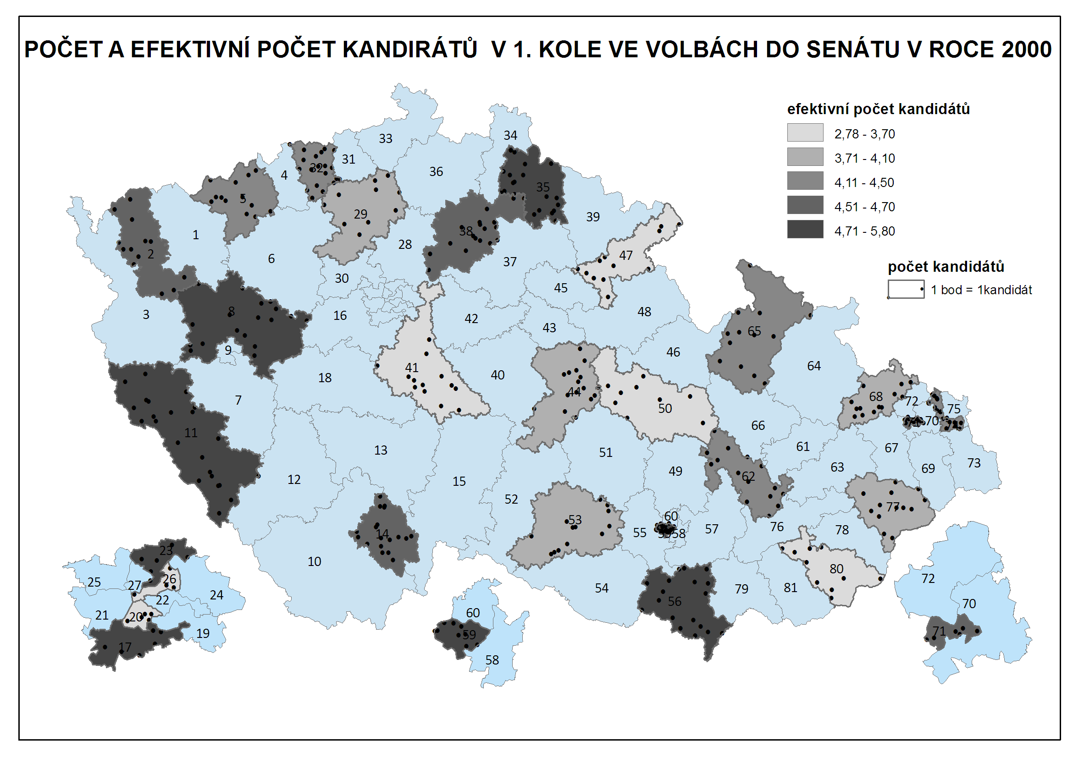

Slide 7
Two types of variables (spatially)
Just related to some space
  GDP by country - it is not equally produced on whole teritory
  It is just related to teritory
  Choropleth maps
Truly spatial
  The data are describing some exact location
  Dot maps
  The difference between categorical and cardinal variables are also important

Slide 8
Rules of using colors
Different categories (e.g. Winnig party)
  Different colors (e.g. blue, red, green, etc.)
Different quantity (e.g. Electoral turnout)
  Different shades of the same color (e.g from light blue to dark blue)
  The higher intensity of variable, the darker the color is

Slide 10
Rules of creating intervals
Equal interval (eg. 0-10,10-20, 20-30,…)
Quantile – in all intervals, number of cases is the same
Natural breaks – unclear meaning

Slide 11
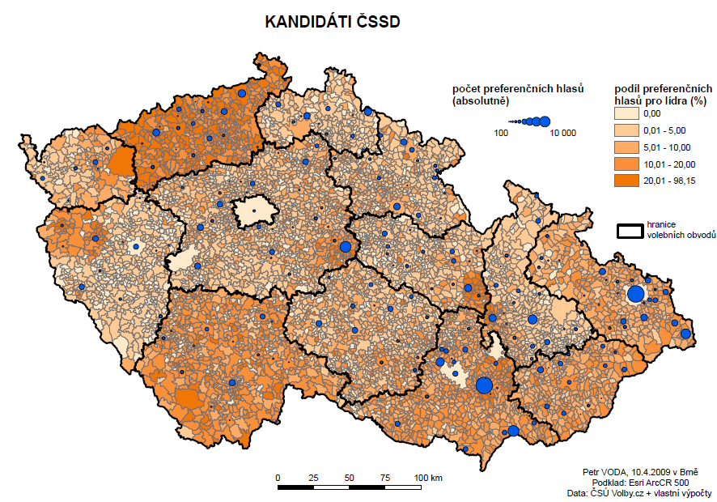
It is possible to combine cartographic visualization with piechart or barchart

Slide 12
What is needed
Data related to some spatial structure
  Level of democracy in countries
  Unemployment in municipalities
  Number of parking places in streets
Or to places itselfs
  Location of candidates homes
  Location of armed clashes during conflict
  Location of powerplants
  How tall trees growing on their exact places are?
  …

Slide 13
An empty map
The cartographic fature representig given spatial structure
Shapefiles
Contain information about coordinates
Contain information related to coordinates
Contain information about how the map should look
Practically: it consists of about 6 different files, all of them must remain in the same folder

Slide 14
Where to find empty maps?
https://www.diva-gis.org/Data
https://geodata.lib.utexas.edu/
https://datacatalog.worldbank.org/search/dataset/0039368
Open street map

Slide 15
Important things about empty maps
Geographic projection
The same country looks very diferently in different projections
The proper projection has to be selected
It is possible to set it in software

Slide 16
A key between map and data
Something which tells us that the data belongs to units drawn in map
It has to be exactly the same in map and in data
Full names are not best options (e.g. United Kingdom x Great Britain, Czech Republic x Czechia)
Standardized Ids
Usually available for any level of administrative units
Municipalities, counties, regions, states
Often available in official statistics

Slide 17
Spatial key
The data can be connected by the location
The coordinates of data has to be available
  Or it must be data already in form of shapefile
How many candidates live in certain area
The map of mentions of places within book (check dubliners by james joyce)

Slide 18
Example of pledges from local electoral manifesto
Parties in local elections often promise the change of ceratain locations
repair of streets or pawments
Building of playgrounds
Reconstructions of public buildings
These locations can be drawn in map

Slide 19
software
ArcMap
QGis

Slide 20
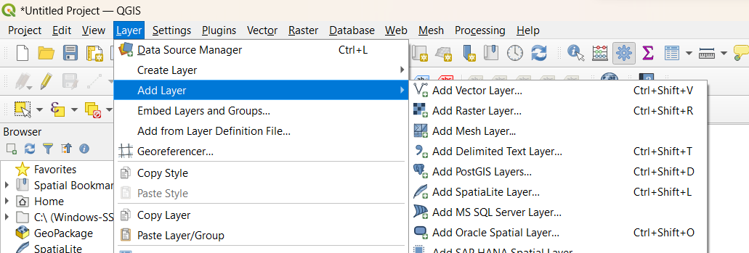
What to do in software – add empty map

Slide 21
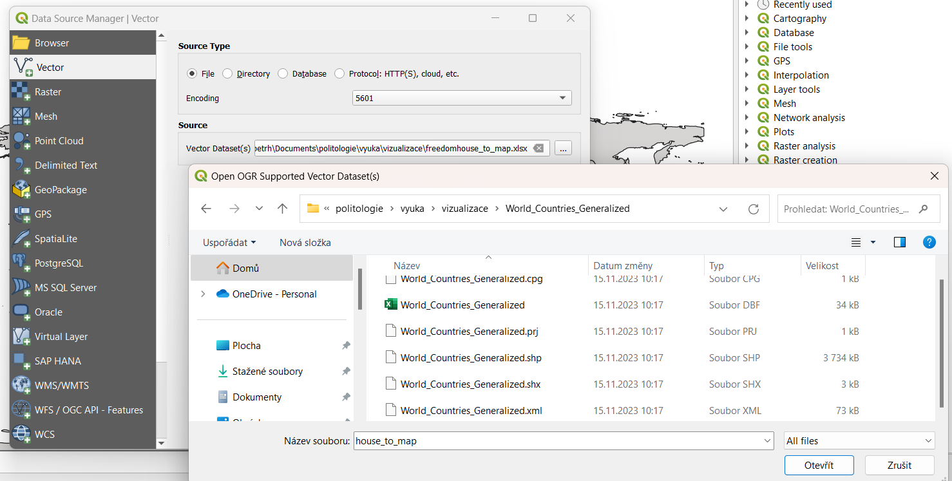

Slide 22
The same procedure to add excel table with data
(Layer - > Add layer -> Add vector layer
in row „Source“ click on three dots at the end of row and find the table in computer)

Slide 23
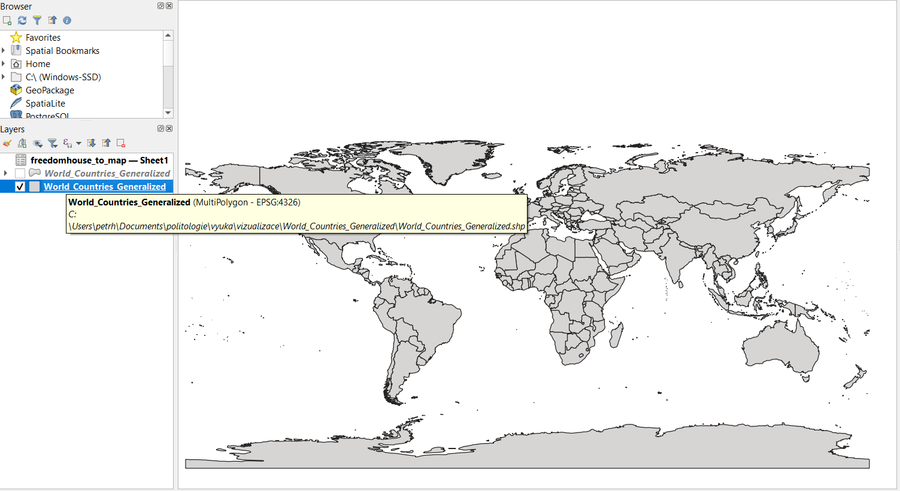
The qgis environment with added layers

Slide 24
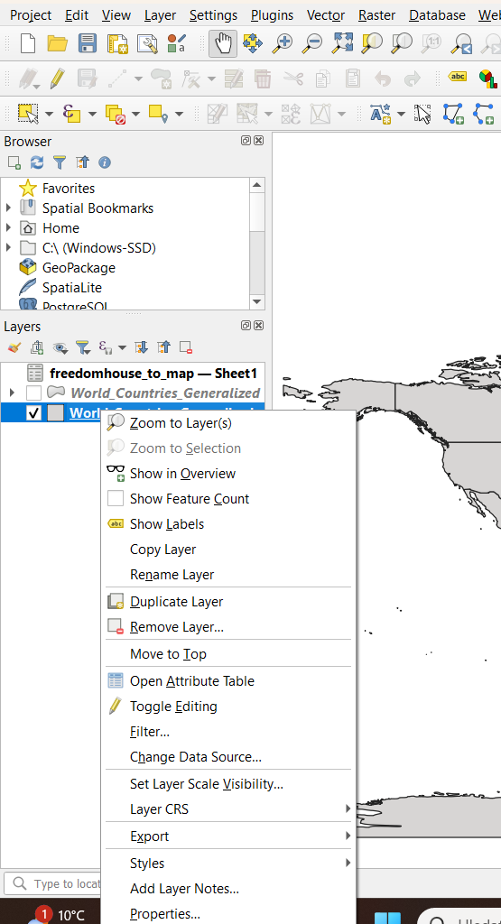
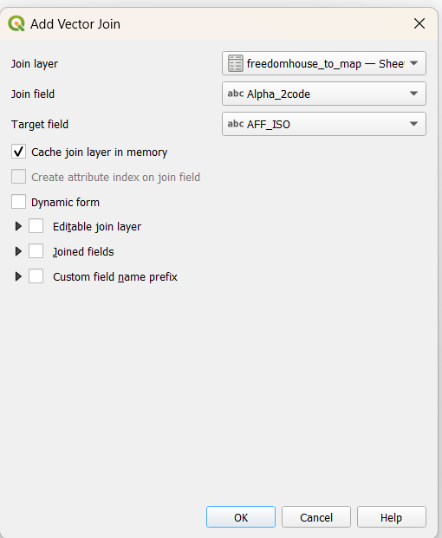
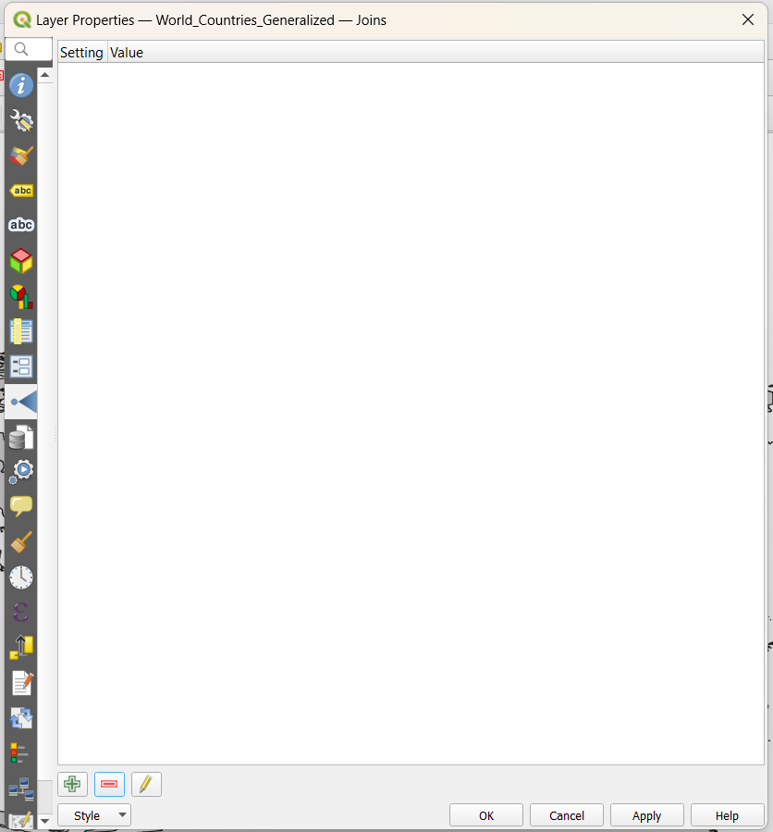
Join data from table to map
3. Select „joins“ from left ribbon
4. click on green plus
6. Select layer to join to map (table)
7. Select column in table serving as key
2. click on properties
1. Right click on name of layer
7. Select column in map serving as key, names can be different but the map and table has to contain same codes for same territories (but their number can differ)
5. After the click, new window is open
9. Click on OK
8. Click on OK

Slide 25
2. click on open attribute table
1. Right click on name of layer
You can check the join by checking attribute table
New columns are at the end of table
Their names contains name of table (in this case freedomhouse_to_map – sheet1 and original names of columns
There is no new layer, everything is in current map

Slide 26
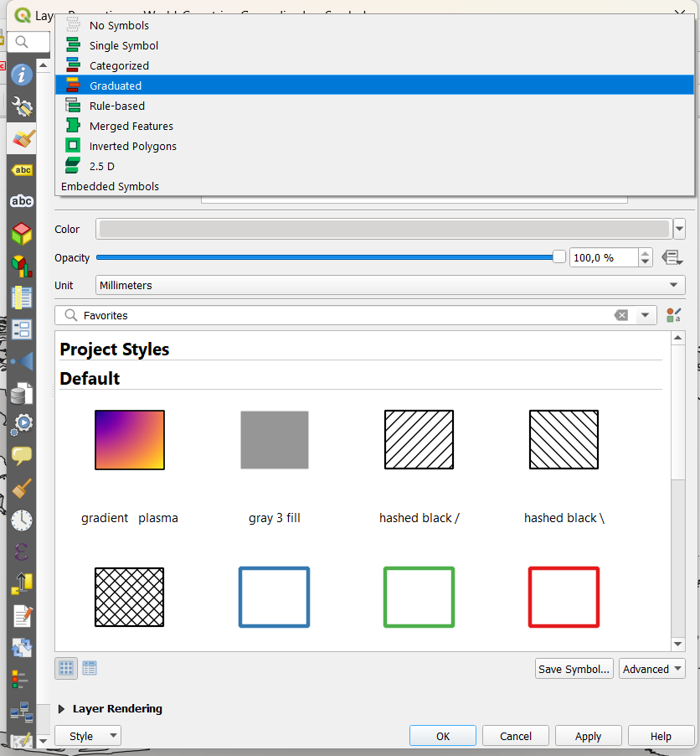
Make a map
4. Click on row where is currently written „single symbol“ and select „graduated“
3. Select „symbology“ from left ribbon
1. Right click on name of layer
2. click on properties
5. Continue on next slide

Slide 27
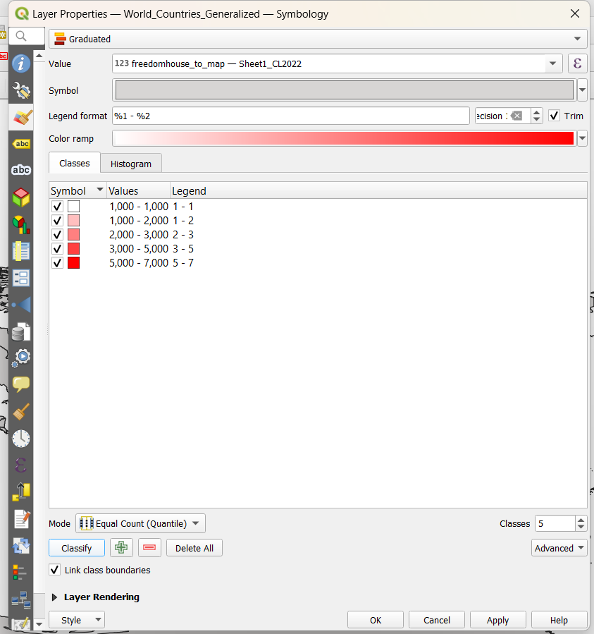
1. Select Variable to show by clickining on triangle here
2. You can set number of decimal places in numbers here
3. Select Color scale
7. After click on classify, intervals appears here
5. Select Way of making intervals (quantile is usually good option)
4. Select Number of intervals
6. Click on classify
8. Click on OK

Slide 28
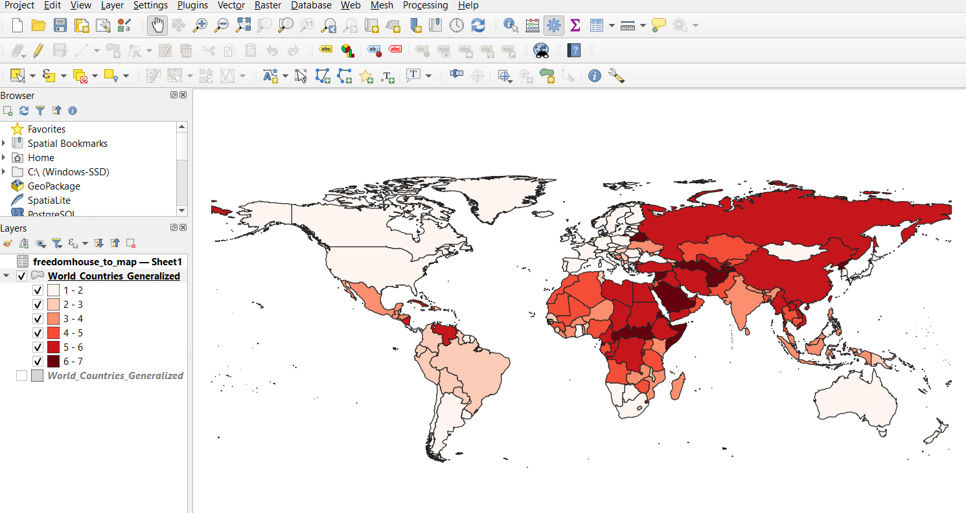
Almost final map

Slide 29
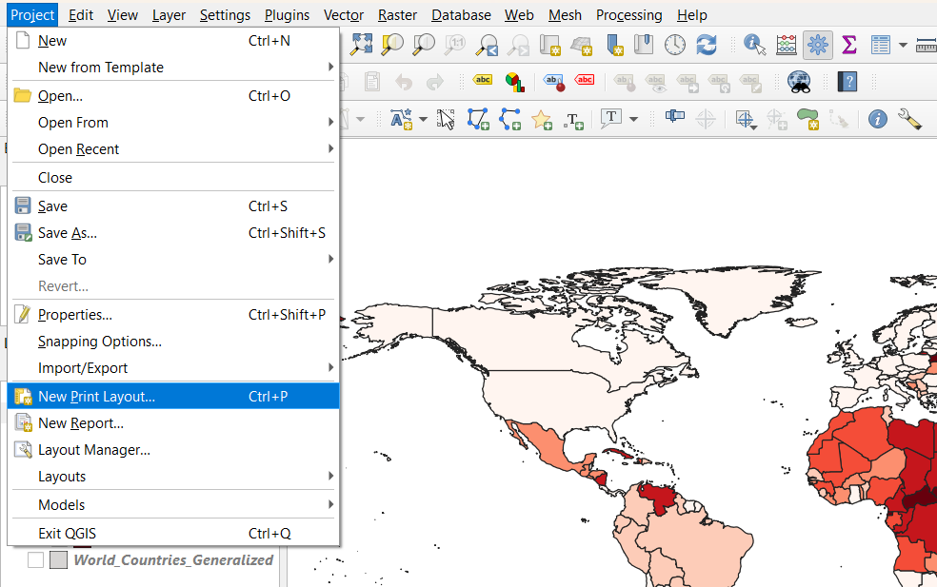
Add map elements (legend, scale, title, etc)
- it is done in New Print Layout
-after the clic it asks for name, it can be anything

Slide 30
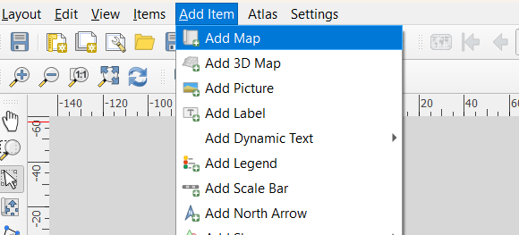
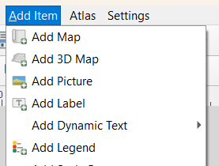
3. select Add Legend from Add item on upper ribbon
1. select Add Map from Add item on upper ribbon
2. and 4.
Draw with mouse over white board

Slide 31
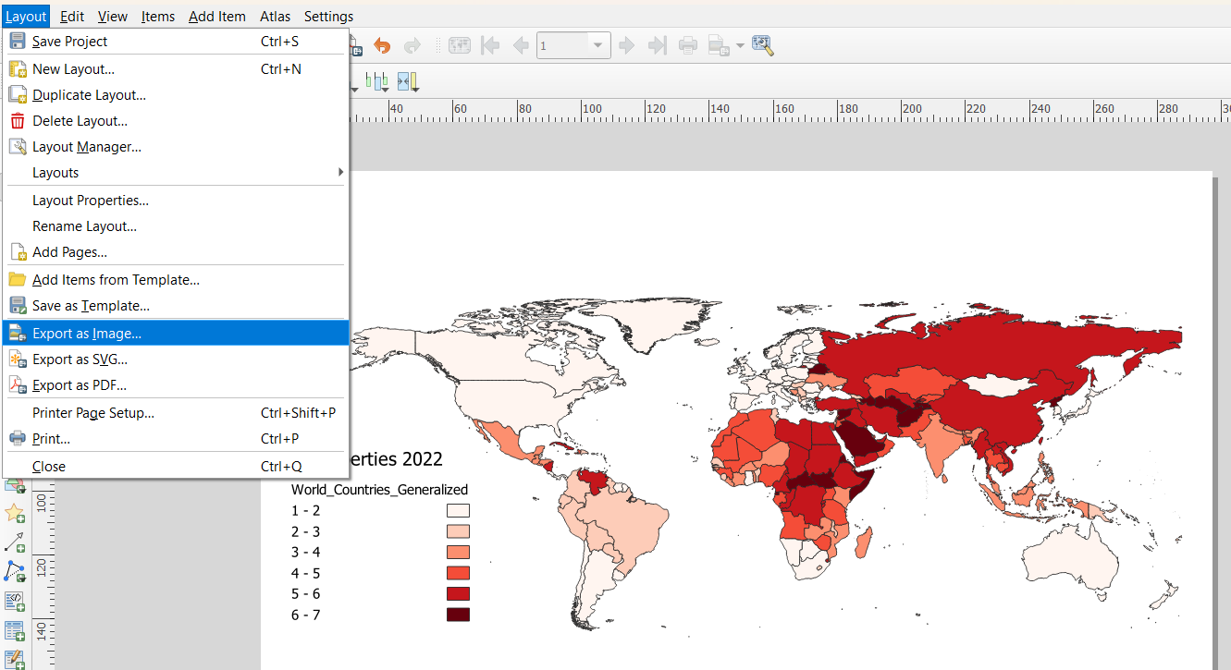
This is the final map, now it is possible to export it into pdf or image (PNG as best option)

Slide 32
Another example
Make a map from coordinates
Coordinates have to be stored in csv table
  You can make it in excel from any table by „Save as“
It is good to add coordinates after adding map with already defined projection system

Slide 33
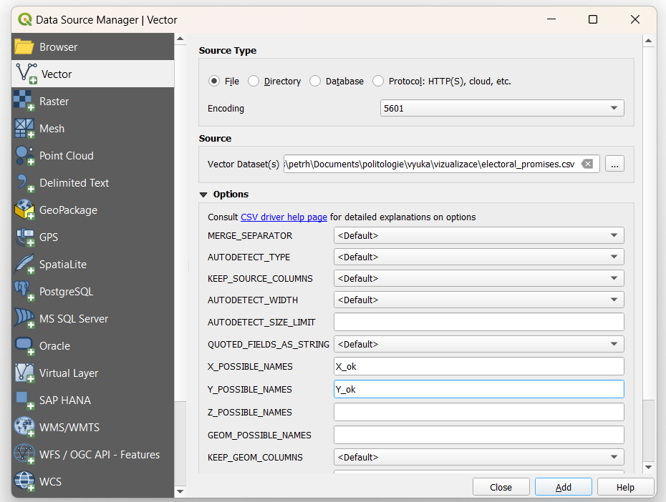
1. The procedure is almost the same as adding map or excel table
2. The only difference is in setting coordinates, the names are written as they are in our CSV file
longitude
latitude

Slide 34
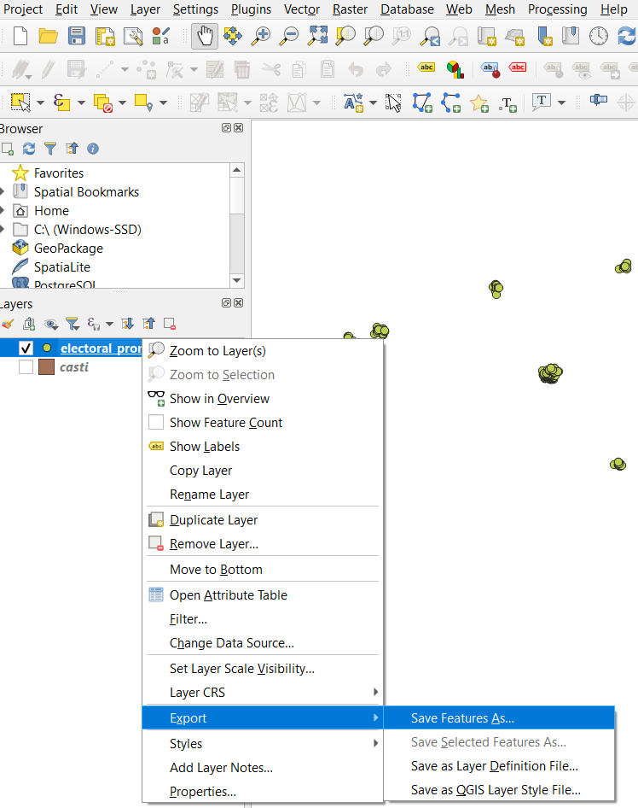
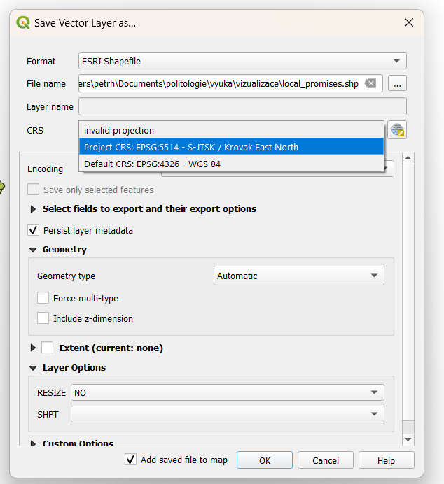
The layer is only temporary file, to make it fully editable, it has to be exported into computer
4. It has to be ESRI shapefile selected here
1. Right click on name of layer
5. You set the name for exported layer and place in your computer where to store it
6. Projection system is selected here, for most countries it is WGS-84, but some countries have something different
2. Select export and then click on Save features as
3. New window is open
7. Click on OK

Slide 35
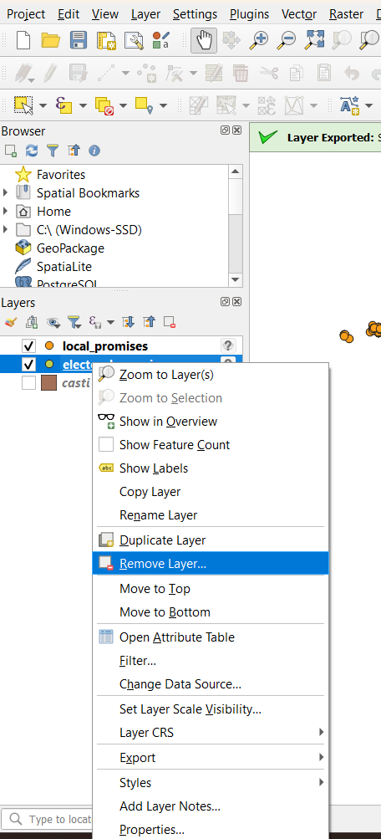
Right click on name of layer
Now the temporary layer can be removed
Be cautius and do not remove the new one
In new table, all numbers except coordinates are classified as text and it is good to make them numbers again, the procedure is on next slide

Slide 36
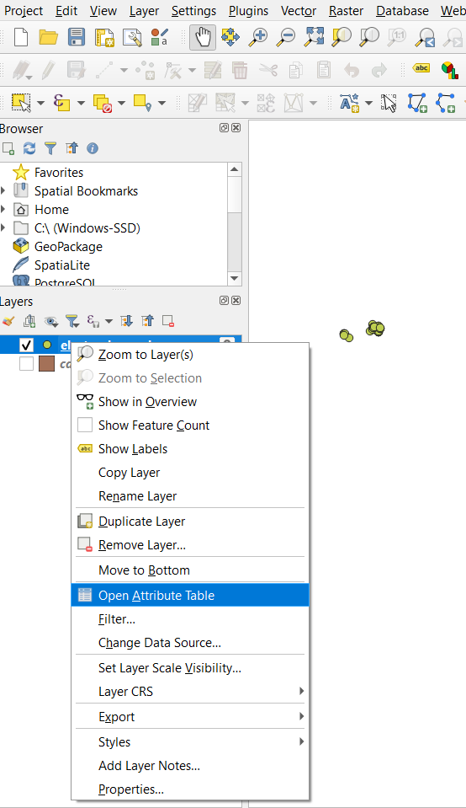

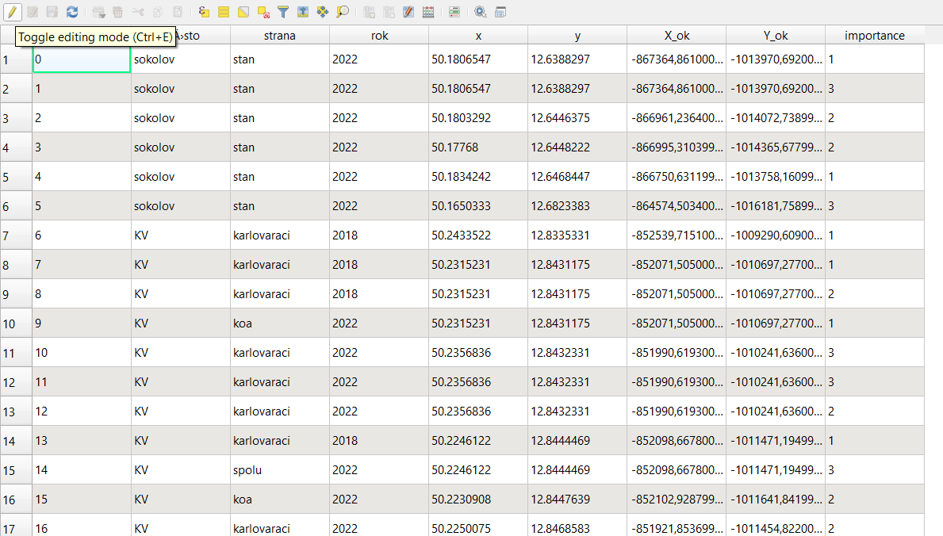
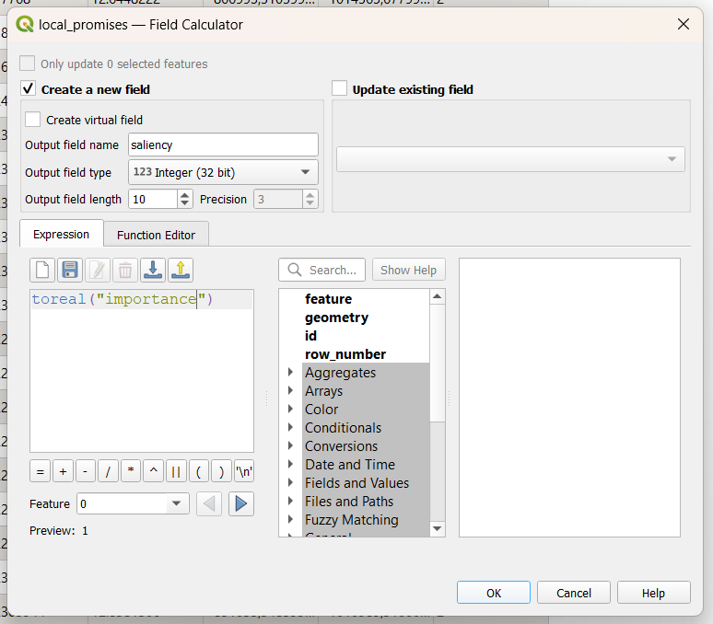
9. Click on save
4. click on calculator
5. New window is open
3. click on edit
1. Right click on name of layer
6. Set a name for new column here
2. click on open attribute table
7. Here is the place to write expression, toreal or toint are for turning text into number
8. Click on OK

Slide 37
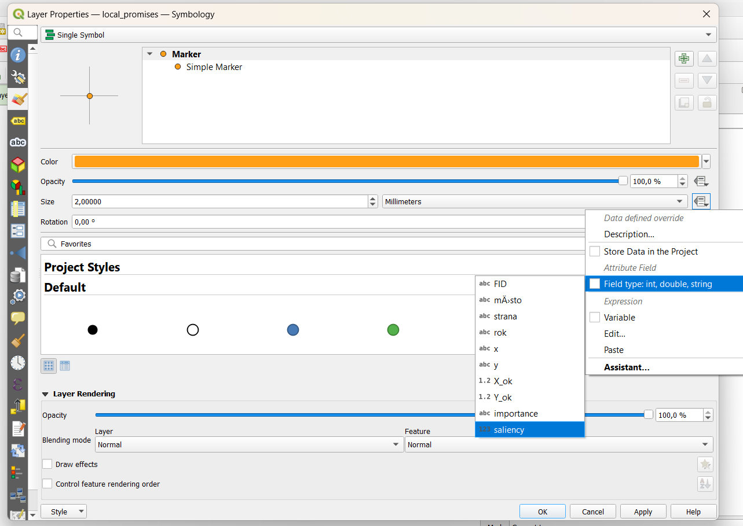
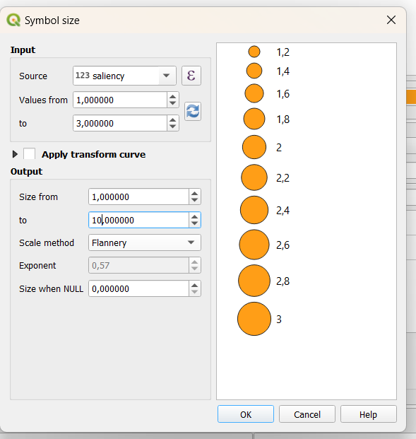
4. Leave single symbol here
3. Select „symbology“ from left ribbon
10. Here set minimum and maximum of the variable
1. Right click on name of layer
5. and 8. click here
2. click on properties
10. Here set minimum and maximum size of dots
9. Click ok assistant and new window opens
11. Click on OK
7. Thick this box and then select variable for making different sizes of dots
12. Click on OK

Slide 38
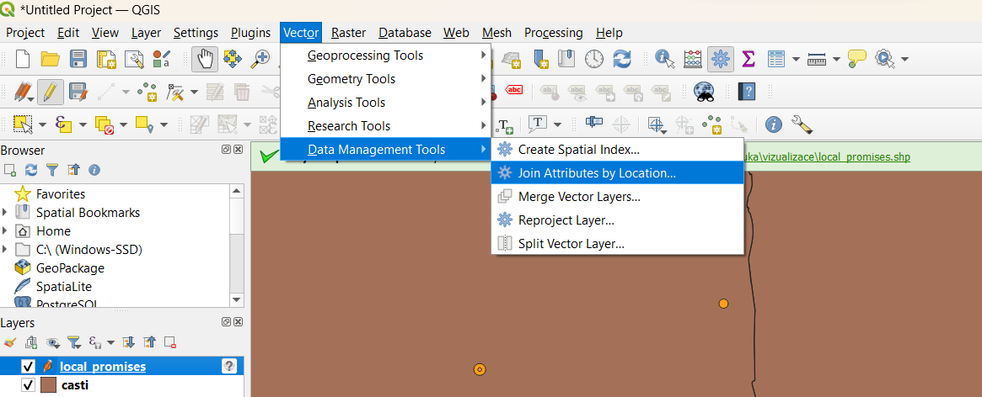
Spatial join – seves to add information from one layer to another layers

Slide 39
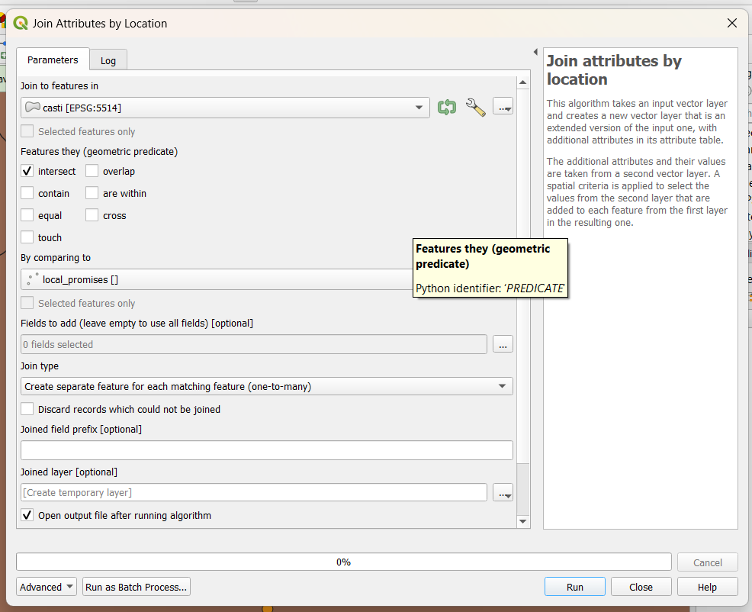
Layer to which the information is added
The way how layers are related
From this layer the information is taken

