Slide 1
Why don’t women run?
PMCb1121 WOMEN, POLITICS, AND MEDIA
Fall 2023

Slide 2
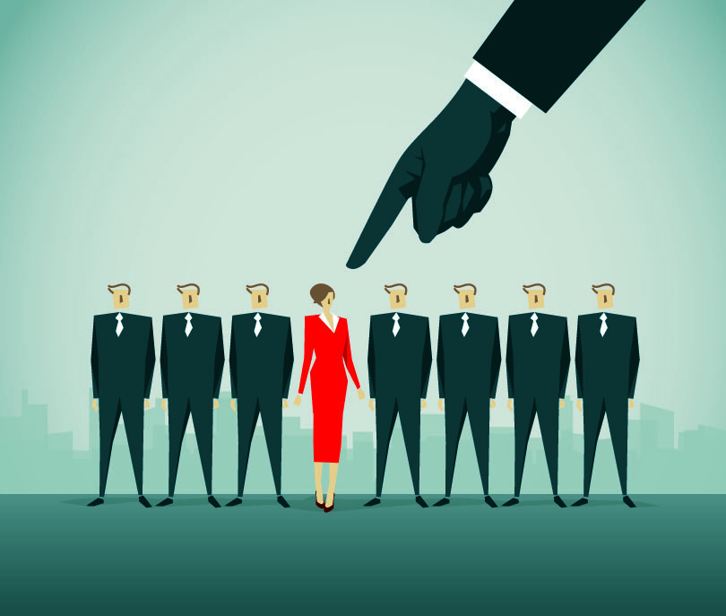
Women less likely to participate in electoral politics… (remember lecture 2?)
“We would like more women in politics but they are not interested.”
Why don’t women run for office as much as men do?
What are the main barriers??? (good topic for interviews)
Social structure
Psychological barriers

Slide 3
The supply side of political representation
Supply side = a pool of political aspirants with the will and capacities to run
What is the demand side??

Slide 4
Social structure

Slide 5
Structural factors (Paxton et al. 2020)
1) Money
2) Time
3) Civic skills and community participation
4) Education
5) Work and Economic power
6) Informal networks
7) Media and pop culture

Slide 6
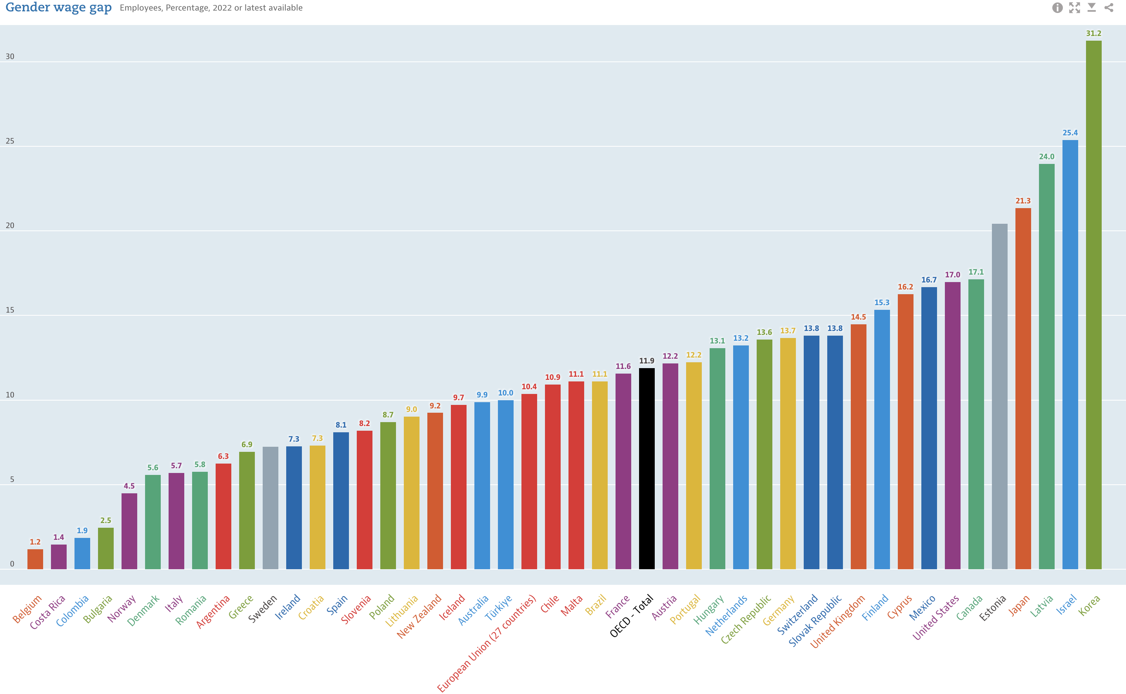
Money: gender pay gap
OCED pay gap 2022
Difference in median wages of employees
OEDC average:
A woman earns 0,88 cents for every EURO a man earns

Slide 7
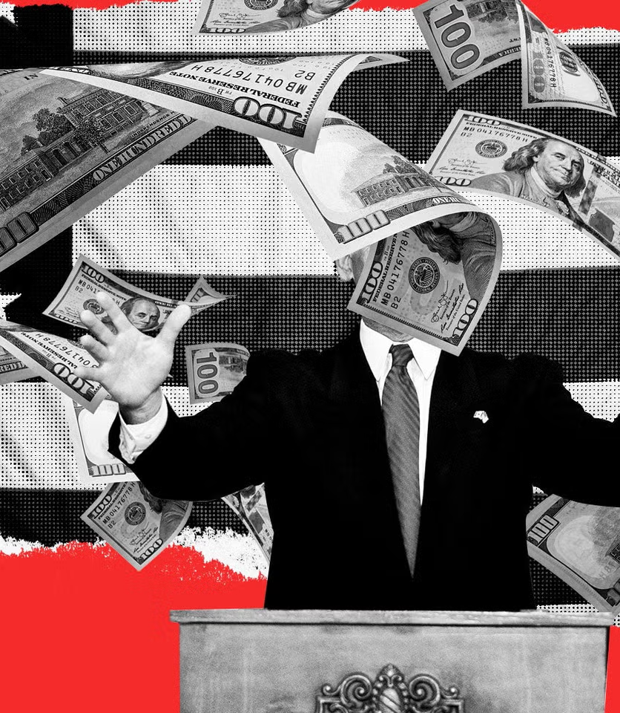
Why money matters?
Campaigns costly
Running for office requires material security
Politicians: wealthy, good networks
Pinto-Duschinsky 2002: 104 countries, 59% no limits on campaign spending, 72% no limits on financial contributions by individuals
Campaign limits: increase competition, more less wealthy candidates
“The best way to make a small fortune from politics is to start with a large one“

Slide 8
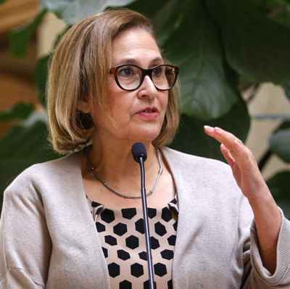
Adriana Munoz (President of the Senate, Chile)
“Being a candidate is difficult for a woman because you need to have a lot of money. We have little help economically. Men have access to circles or networks where money is let – they are friends with bank managers. But we are not supported this way. For us, it’s pretty complicated, this arena of power and money.“
(quoted in Franceschet 2001)

Slide 9
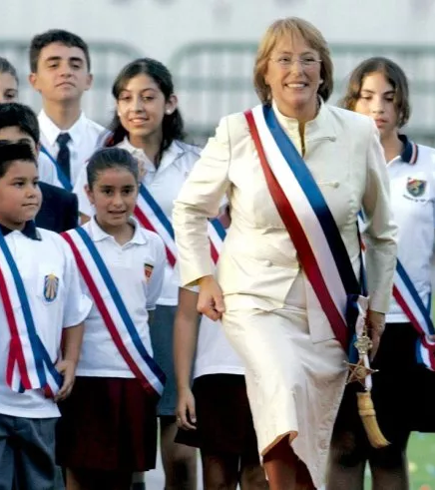
Case studies: Chile 2017 legislative election (Piscopo et al. 2021)
Gender electoral financing scheme
Electoral reform 2015-16
Candidate money
From parties
From banks
From private donors
Their own money
Candidate expenditure reimbursed by state
40% quota – state money for every women elected
Women reported less financial support from parties then men

Slide 10
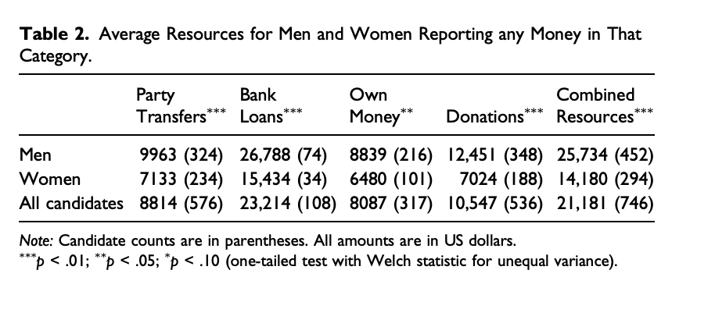
Chile 2017
“a successful woman candidate recalled how men candidates in her party requested and received more money, even though the party previously pledged equal financial support to all candidates..“ (p. 230)

Slide 11
Women less overall funding
The gap applies for new-comers
Incumbents = no gender gap
Disadvantage for women without pre

Slide 12
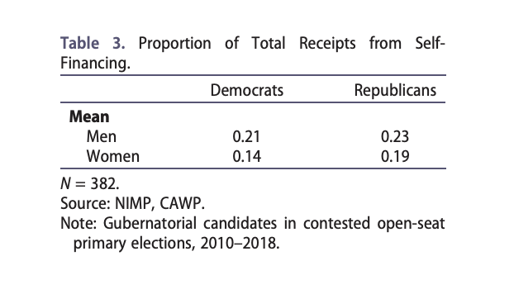
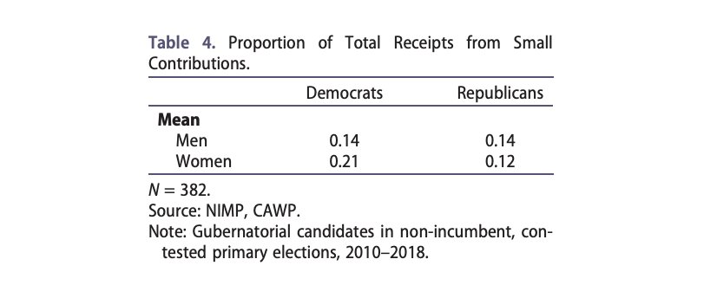
Case study: USA governor races (Sanbonmatsu and Rogers 2020)

Slide 13
Case study: the UK (Murray 2023)
Candidates reported selection costs (before being selected)
Money = significant advantage
Especially for Conservatives
Time investment
Lost economic opportunity, loss of income (reduced hours at work)
Family lives, relationships, friendships, health and wellbeing
Length of campaign matters
Women struggling financially more
Outsourcing childcare increases financial burden

Slide 14
Resources and household composition
Political economy of the household may prevent ambitious women from running
Income constraint
Lower income prevents poorer women from political ambition
Breadwinner constraint
Women responsible for household income
Household composition
Women without no support from other earners

Slide 16
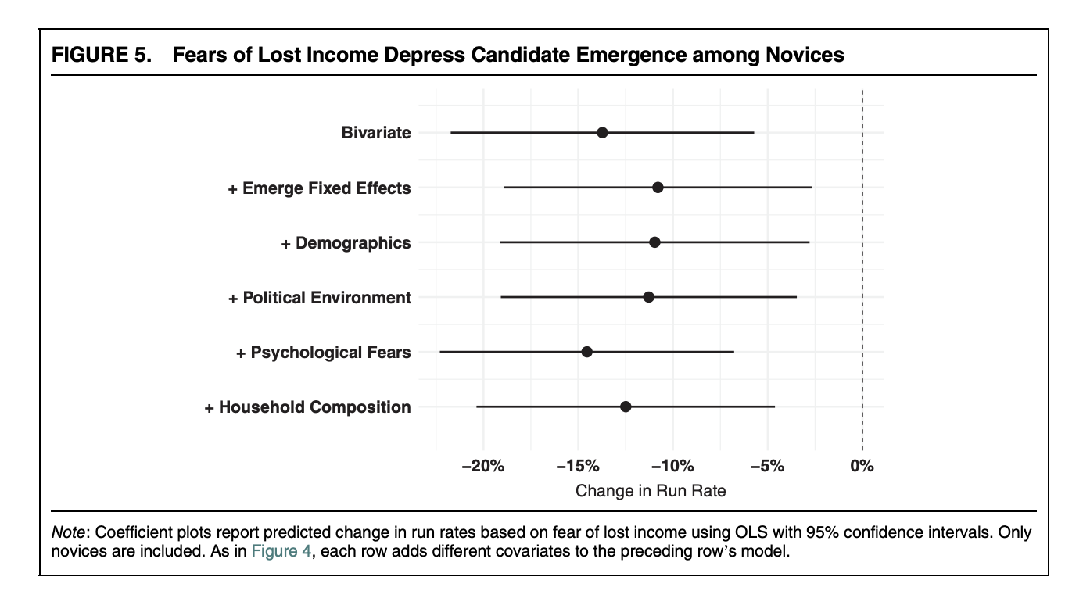

Slide 18
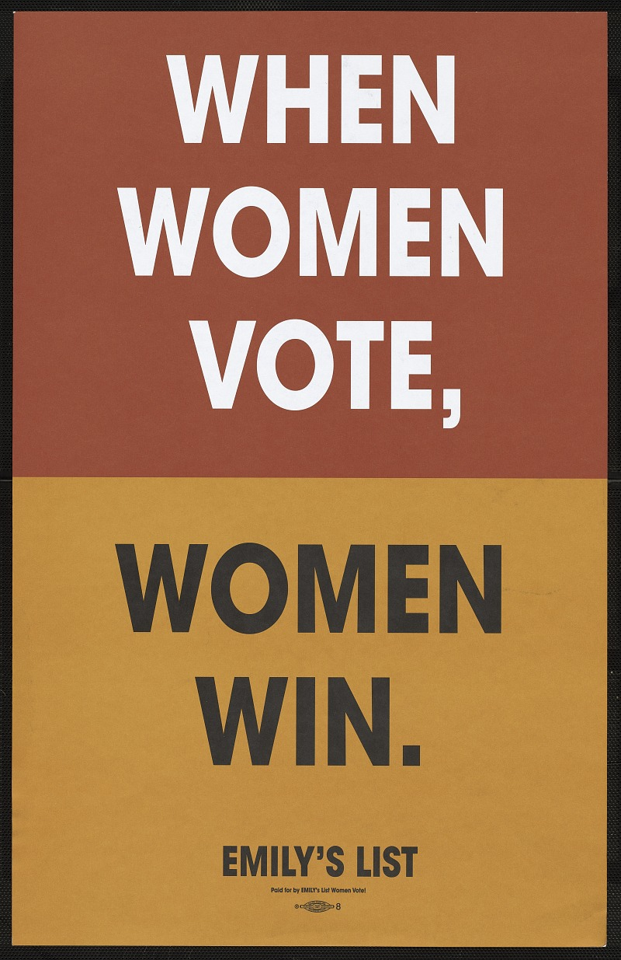
Positive impact of:
Public financing of elections
Campaign founding regulation
Free allocated broadcast time
NGOs
State incentives to parties
Most famous organization: EMILY‘s list (Early Money Is Like Yeast )
https://www.emilyslist.org/pages/entry/women-we-helped-elect
Shifts in strategies, nowadays they choose already viable candidates

Slide 19
Time
Valuable resource
Political involvement is time demanding
Women‘s burden: care, child bearing, housework, family responsibilities
Second shift (Arlie Hochschild 1989)
Is politics a third shift?
https://ourworldindata.org/grapher/minutes-spent-on-leisure
Women politicians less often married, more often childless
It is a structural problem. Because there are differences in female participation in electoral politics across countries with different social welfare and culture

Slide 20
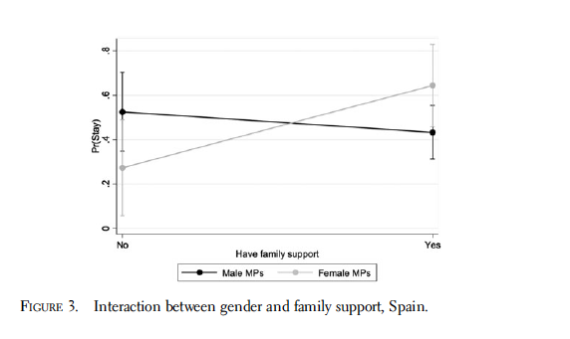
Family support/resources and ambition
Family patterns, gender roles
Differences between the Nordic and the Mediterranean model
Women in politics in Spain need more family support!

Slide 21
Psychological barriers

Slide 22
Lack of political ambition?
Gaps in confidence
Gaps in political ambition
Gaps in electoral/risk aversion, conflict avoidance etc.
Gaps in political knowledge/interest
Role models in politics?

Slide 23
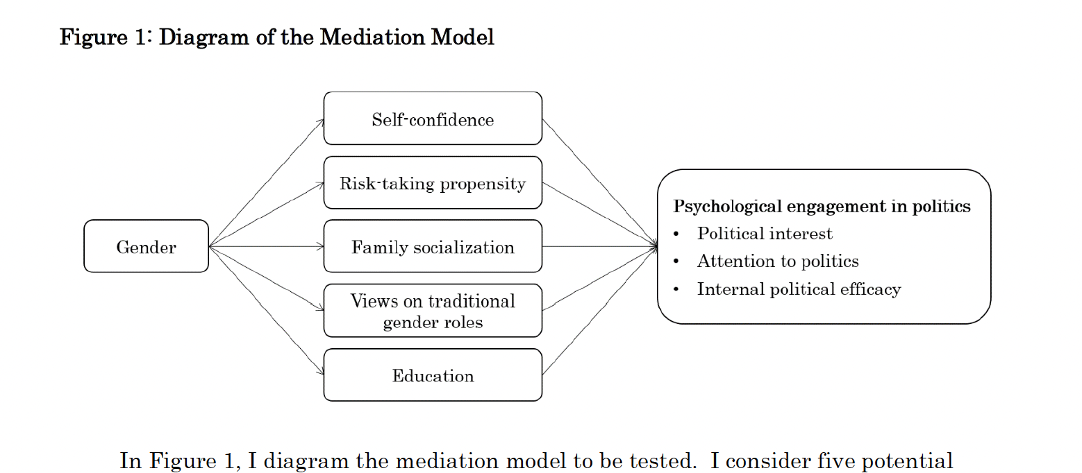
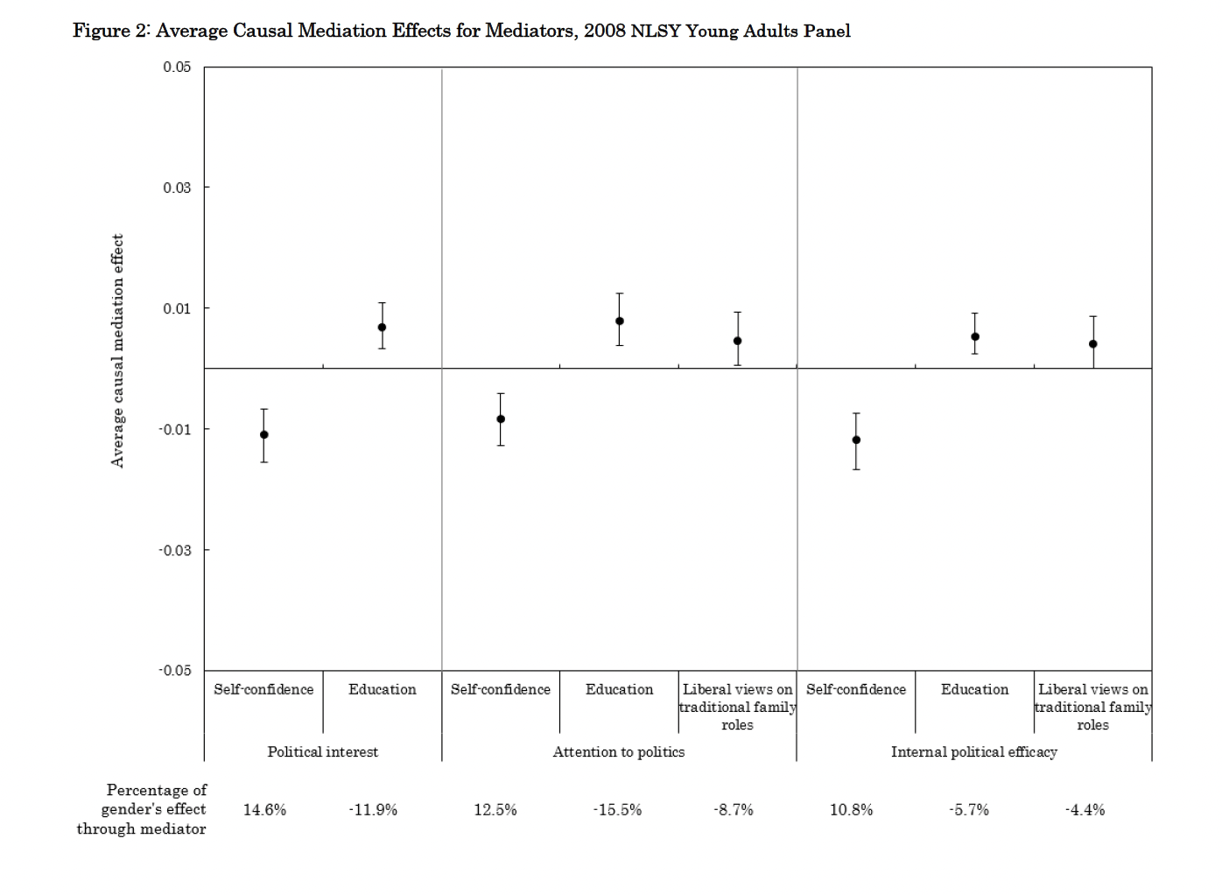
Self-confidence
Women less confident
Undervalue achievements
Less confident in their skills
Socialization effect
Lower self-confidence decreases
Interest in politics
Political efficacy

Slide 24
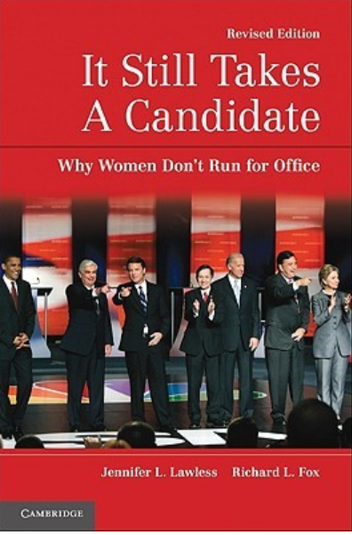
Political ambition
Politics as a reasonable career mostly for men not for women
Eligible women consider political career far less often
Lots of research with consistent results
Most famous research: Fox and Lawless
Interviews and survey (pipeline job professionals)
Lawers, Educators, Business leaders, Political activists, Local officials
Gaps in ambition consistent across geneerations

Slide 25
Gaps in pol. ambitions
Political socialization
Traditional gender roles/ Family dynamic
Self-Perception and candidate viability
Perception of the environment
Party recruitment dynamics
External. Factors more impactful. (Lawless and Fox 2004)

Slide 26
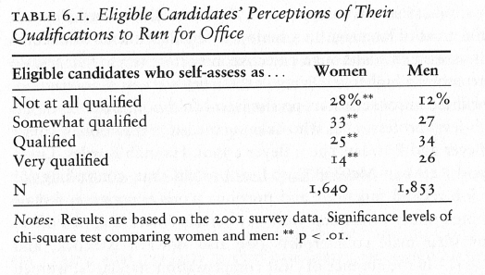
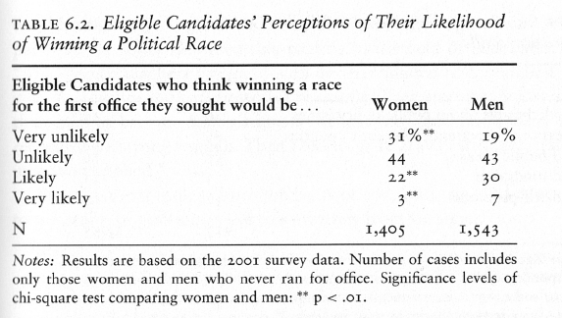
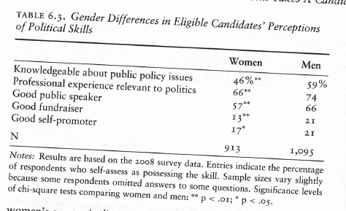

Slide 28
Ambition among ordinary men and women?
Self-confidence
Encouragement
Much more important for women
(Crowder-Meyer 2020)

Slide 29
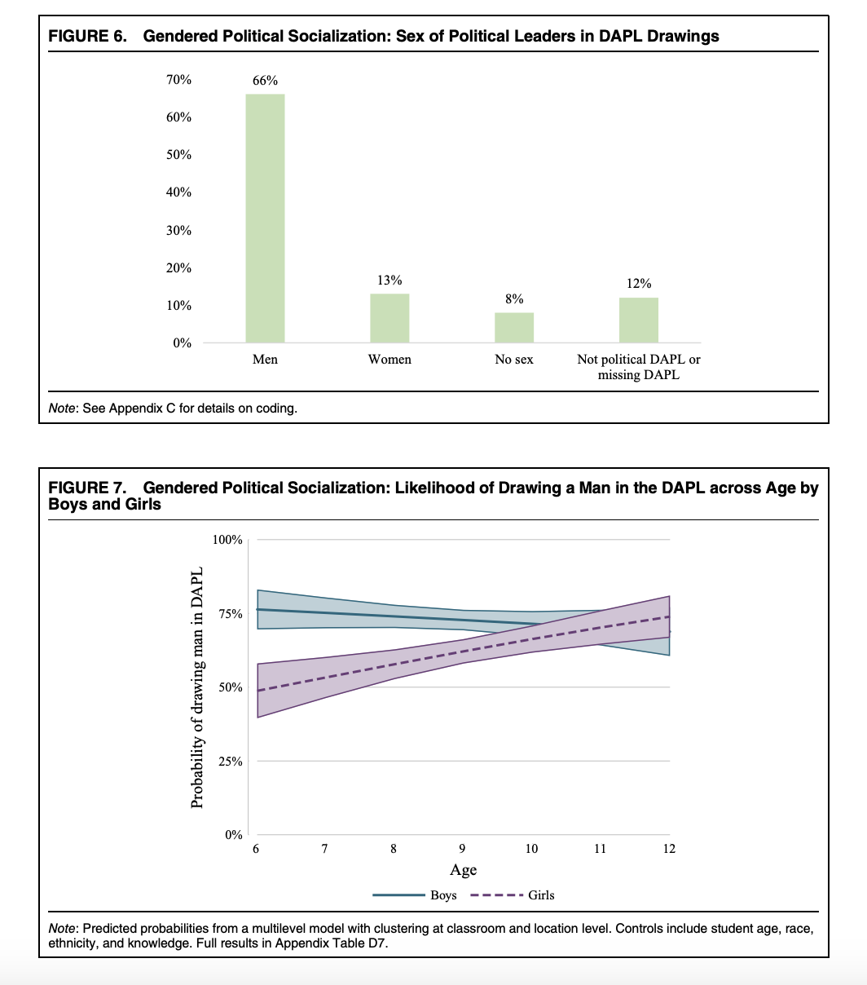
The role of gendered political socialization!
Children internalize gender stereotypes
Leaders typically male
Girls less likely to imagine political leaders as women with age
Girls less politically interested and ambitious with age

Slide 30
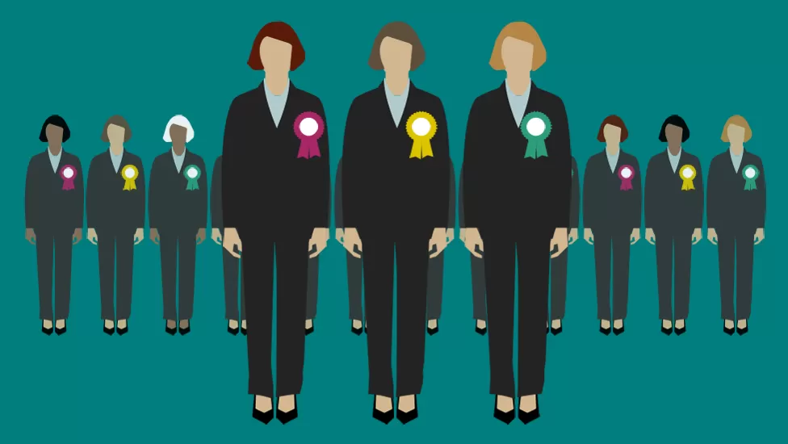
Symbolic representation matters?
Impact of role models!
Descriptive representation
Substantive representation
Feedback to voter that women can win
Descriptive underrepresentation creates psychological barriers
Signals uneven status

Slide 31
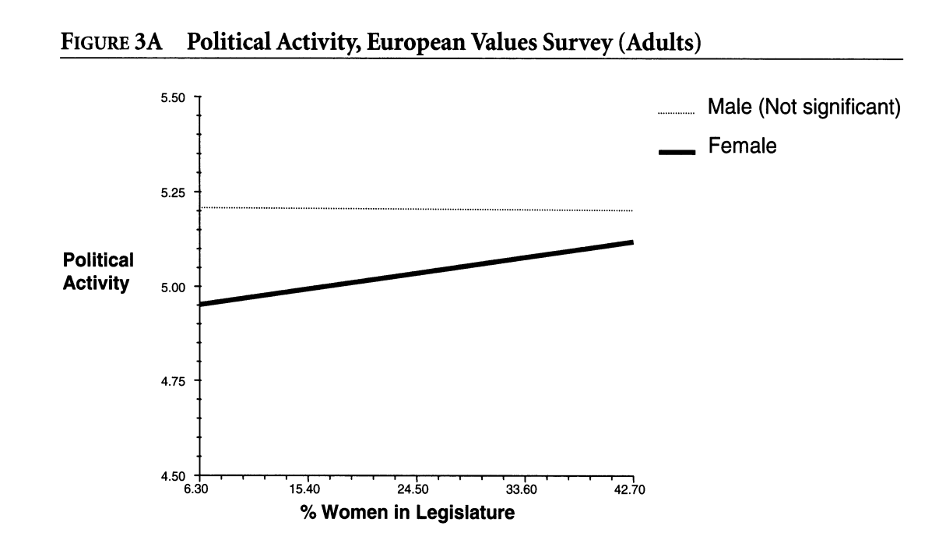
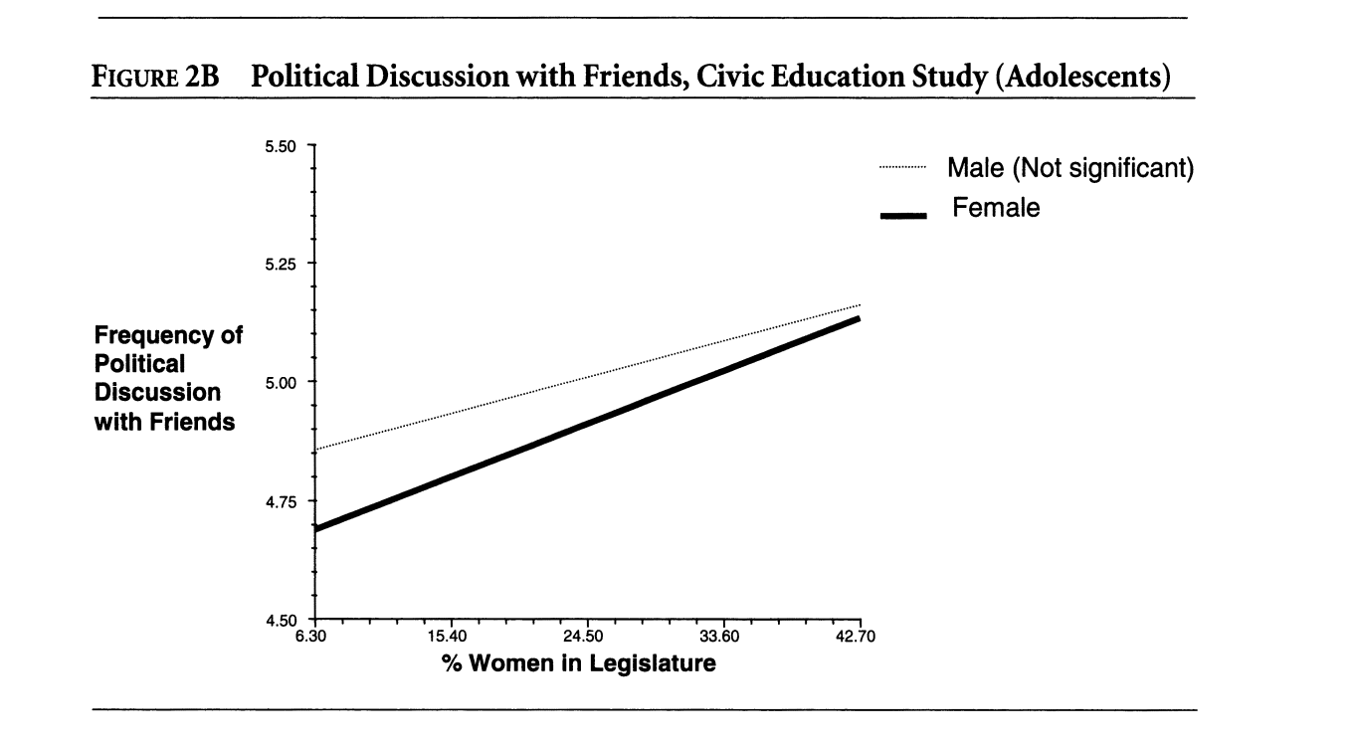
Wolbrecht and Campbell 2007
Comparative data (Europe plus USA)
The effect moderated also by age (socialization hypothesis)
Also effects on anticipated involvement of girls (through increased discussions of politics with parents)

Slide 32
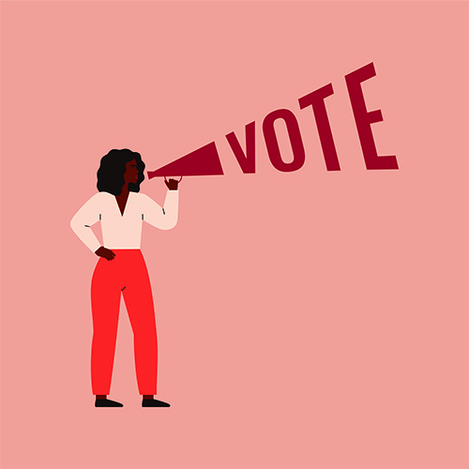
Research also suggests:
Women motivated to run by the costs of non-running
Reported feelings of urgency and threat
US 2018 midterm

