Slide 1
Session 6 Digital public diplomacy
Monika Metykova
m.metykova@sussex.ac.uk
32153@mail.muni.cz

Slide 2
Public diplomacy and soft power
Public diplomacy and soft power – Cull on their relationship:
https://www.youtube.com/watch?v=4bcXyxAlV4Y&ab_channel=BYUKennedyCenter (from 30:00)

Slide 3
Digital Public Diplomacy
A university take on it:
https://www.youtube.com/watch?v=e-KHxOpM7sk&ab_channel=LeeKuanYewSchoolofPublicPolicy
The UK Foreign Office’s take on it:
https://www.youtube.com/watch?v=wD0FdpMK70Q&ab_channel=Foreign%2CCommonwealthandDevelopmentOffice (UK’s Ambassador in Egypt)

Slide 4
Mediated public diplomacy – from news to Twitter
Golan, G. J., Manor, I. and Arceneaux, P. “Mediated Public Diplomacy Redefined: Foreign Stakeholder Engagement via Paid, Earned, Shared, and Owned Media” (2019) American Behavioral Scientist 63(12), pp. 1665-1683.
As originally conceptualized by Entman (2008), mediated public diplomacy is “the organized attempts by a president and his foreign policy apparatus to exert as much control as possible over the framing of U.S. policy in foreign media” (p. 89). As put by Entman (1993), To frame is to select some aspects of perceived reality and make them more salient in a communicating text, in such a way as to promote a particular problem definition, causal interpretation, moral evaluation, and/or treatment recommendation for the item described. (p. 52).
Thus, to research public diplomacy via framing is to approach the framework with more theoretical rigor. This is achieved by incorporating the anarchic power dynamics of the international system into determining not only if frames are selected and salient but also by whom the frames are constructed, for what purpose they are constructed, and what effect they have on foreign audiences (Miskimmon & O’Laughlin, 2017).
While the literature has tended to research framing in static conditions—that is, one frame disseminated to a population—Chong and Druckman (2007) argue that to understand political communication it is necessary to investigate frame competition (Borah, 2011) or the extent to which two or more frames compete simultaneously for predominant acceptance in a population. Approaching the study of public diplomacy through framing is not only to optimize public diplomacy scholarship itself but also to contribute to the broader theoretical context of framing in political communication. As foreign citizens are exposed to news media coverage, they are offered “common sense” interpretations of foreign affairs.

Slide 5
A review of the growing literature on mediated public diplomacy indicates that scholars mostly focus on governmental news management as expressed by the ability of governments to affect media framing of foreign affairs (Arif et al., 2014; Cheng et al., 2015; Sheafer & Gabay, 2009). The research highlights the importance of cultural and political congruence between involved actors in government and media, suggesting that frame building lends particular advantage to international partners rather than rivals (Sheafer et al., 2018; Sheafer & Shenhav, 2009). While governments often use a variety of information subsidies to try and promote their foreign policy frames in foreign media, mediated public diplomacy efforts expand beyond this.
At the time it was published, Entman’s (2008) definition seemed all encompassing. However, the diffusion of social media platforms along with the prevalence of government-sponsored news media platforms, such as Russia’s RT, China’s CGTN, and Qatar’s Al Jazeera, have changed the assumptions related to governmental attempts to shape and influence coverage of foreign policies in foreign media. No longer focused exclusively on earned media strategies, governments include paid advertising, owned media such as government-sponsored media in most non-free states and shared media via social media channels in their media mix.
Framing on social media and in real time

Slide 6
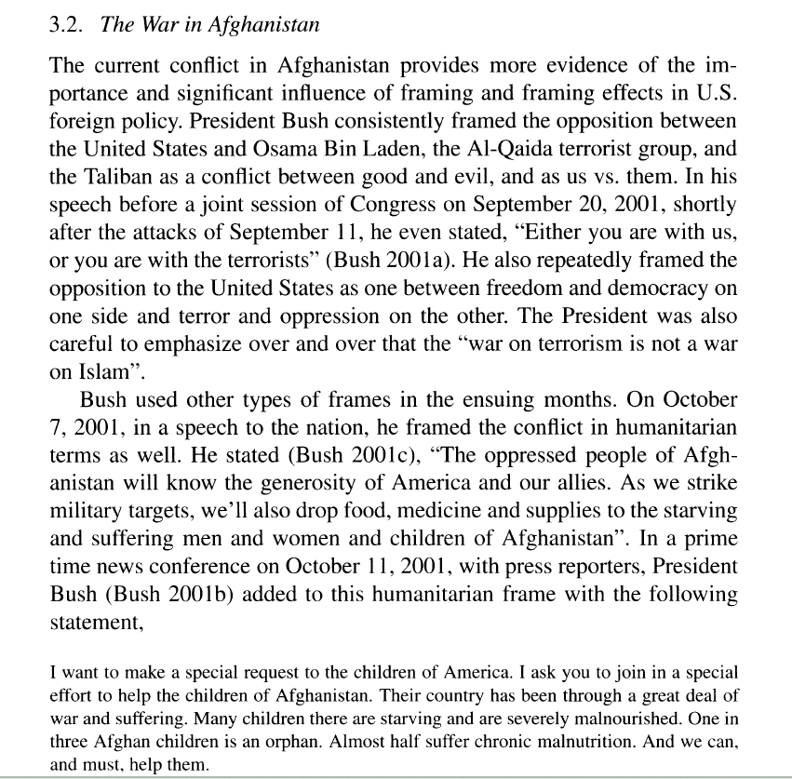
Framing Effects in International Relations Author(s): Alex Mintz and Steven B. Redd

Slide 7
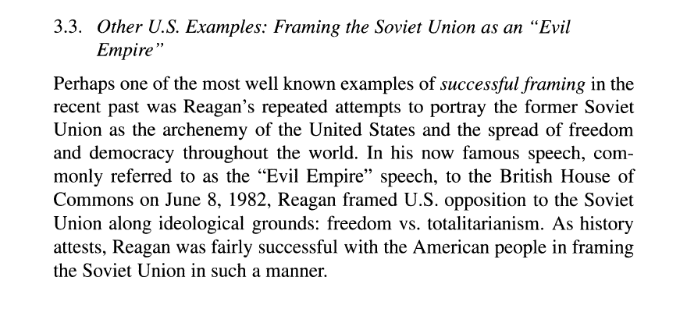

Slide 8
Twitter Diplomacy
Who tweeted this?
Xie Feng – China’s Ambassador to the US (2 tweets)
President Biden (2 tweets)
Pope Francis (2 tweets)
President Trump (2 tweets)
President Obama (2 tweets)
Madeleine Albright (1 tweet)
Olena Zelenska (1 tweet)
President Čaputová of Slovakia (1 tweet)

Slide 9
Tweet 1: Martin Luther King once said in Chicago, “The time is always right to do what is right.” Let’s embark on a new journey starting from San Francisco, move forward with no delay, and jointly usher in a better future for China-US relations and our two peoples!
Tweet 2: Donald Trump is running for president bragging about how he “killed Roe v. Wade.” Let’s be clear: The only reason a fundamental right has been stripped away from the American people for the first time in American history is because of Trump.
Tweet 3: The family is the greatest treasure of any country. Let us all work to protect and strengthen this, the cornerstone of society.
Tweet 4: PM Abe and I are also working to improve the trading relationship between the US and Japan, something we have to do. The US seeks a bilateral deal with Japan that is based on the principle of fairness and reciprocity.
Tweet 5: No one is born hating another person because of the colour of his skin or his background or his religion...
Tweet 6: I was raised Catholic, became Episcopalian & found out later my family was Jewish. I stand ready to register as Muslim in #solidarity.

Slide 10
Tweet 7: There are countries that never had to fight for freedom. There are people whose dignity was never infringed upon. But only those who fought for freedom and dignity know their value and won’t give it up. We won’t give it up.
Tweet 8: While we support our neighbor #Ukraine, we also get helped—by our neighbor #Czechia. Thanks to their police & army giving us a hand we can aid those fleeing Russia’s aggression. This is what “Slavic reciprocity” should look like, not the Russian version.
Tweet 9: Thank you for everything. My last ask is the same as my first. I'm asking you to believe—not in my ability to create change, but in yours.
Tweet 10: Presidents have been trying unsuccessfully for years to get Germany and other rich Nato Nations to pay more toward their protection from Russia. They pay only a fraction of their cost. The U.S. pays tens of Billions of Dollars too much to subsidize Europe, and loses Big on Trade!
Tweet 11: It is contrary to human dignity to cause animals to suffer or die needlessly.
Tweet 12: It was great to meet with you, @bts_bighit. Thanks for all you’re doing to raise awareness around the rise in anti-Asian hate crimes and discrimination. I look forward to sharing more of our conversation soon.
Tweet 13: On “political correctness”: It surprises me how “political correctness” has permeated American society. I can feel there are many supporters of the relationship, but they are becoming reticent under the chilling effect. I am one, but we are many. Let’s work together to encourage them to come out and speak up.

Slide 11
President Trump’s campaign and Twitter use
Joseph Nye: I still believe that the U.S. has lost soft power as a result of the campaign and the quality of the discourse in politics. And I think that continues when you look at the way Trump has continued to use Twitter for provocative statements designed to manipulate the press. Many of these don’t create attraction or admiration for the US.

Slide 12
Obama vs. Trump
Collins, S. and DeWitt, J. (2023) “WORDS MATTER: Presidents Obama and Trump, Twitter, and U.S. Soft Power” World Affairs 186(3), pp. 530-571.
Twitter is regarded today as an essential communication platform of U.S. diplomacy. Of all diplomatic tweets, those published by U.S. presidents carry the greatest weight and hold great potential to influence perceptions of the country. In this study, we conduct cross-presidential comparative analyses on an original dataset of over 2,000 tweets published by the first two presidents of the Twitter era. In particular, we test the commonly held notion that the substance and tone of Barack Obama’s communication reflected positively on America’s image abroad, with the potential to expand soft power—a vital foreign policy asset—while Donald Trump’s communication reflected negatively on America’s image, potentially eroding the nation’s image and its soft power. Findings demonstrate that what and how presidents communicate on Twitter may produce profound and disparate impacts on America’s image abroad and on U.S. soft power.

Slide 13
Soft Power Supporting Tweets
Soft power supporting tweets are those which promote the benevolence of the United States and/or highlight positive political, social, economic, or natural attributes. Tweets which honor, charm, congratulate, empathize, champion, and pledge solidarity with foreign publics and states or advocate for actions that support universal values, such as peace, security, justice, health, and prosperity also support soft power.
Soft Power Jeopardizing Tweets
Just as messages which inspire or attract others are prone to support soft power, those which alienate external audiences from the United States jeopardize its soft power capacity and are coded as such. Soft power jeopardizing tweets are shrouded with anti-democratic values or unpopular policy positions, express hyper-nationalist attitudes, hostility toward foreign states or intolerance toward other cultures, or engage in ostentatious self-promotion.
Tone of Tweets: statesmanlinke or combative
Audience Engagement with Tweets

Slide 14
In Figure 1, we reveal the implications of presidential tweets on U.S. soft power.13 The differences between Presidents Obama and Trump could not be more evident. Obama’s tweets regularly projected positive soft power attributes. While this was expected based on his stated commitment to improving America’s global image, what was unexpected was the strength of the finding. Of all the tweets with potential impact on soft power, every single one (N=160) supported soft power; not a single one jeopardized it. In sharp contrast, nearly two-thirds of Trump’s (64.7 percent) tweets jeopardized soft power as opposed to 35.3 percent which supported it. We explore these dynamics in more detail below.
Table 2 presents a side-by-side comparison (and clear contrast) of the content of tweets published by Presidents Obama and Trump. With regard to the question of how Obama’s tweets supported soft power, data indicate that just over two-thirds (67.1 percent) of his soft power supporting tweets emphasized American attributes while only 18.9 percent highlighted American benevolence, and 14 percent projected both American benevolence and attributes. The majority of Obama’s soft power tweets emphasized American character as imbued with universally respected values and policy goals, such as peace and justice, environmentalism, equal rights, labor rights, and economic justice.
Trump was more likely to focus on American benevolence than attributes (46.6 percent to 41.0 percent). Tweets in the former category often reflected the transactional nature of President Trump’s relationships. For example, he retweeted the Danish Prime Minister which read “Thank you for a constructive meeting about strengthening the ties between our two countries.”

Slide 15
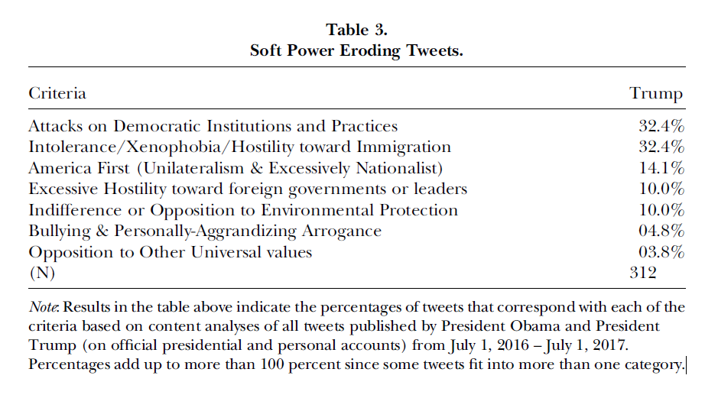

Slide 16
Tone:
We next move beyond the substance to an examination of the tonal quality of presidential tweets. Results are presented in Figure 5.Obama’s communication was universally “statesmanlike” (97.4 percent) except for one tweet which was “combative” and three which were coded as neutral. Again, while one would expect Obama’s communication to reflect a more diplomatic manner, the degree to which he was is unexpected.
Trump’s tweets were much more combative than his predecessor’s— roughly evenly divided between the two tonal categories (42.4 statesmanlike and 39.1 percent combative) with 18.5 percent coded as neutral. Statesmanlike messages were often announcements of events with foreign leaders and encouragement that others stand with the United States. President Trump’s tweets were only slightly more statesmanlike than combative, a finding that confirms expectations given his reputation for often provocative “straight talk.” Nevertheless, it is remarkable to consider that nearly half of the messages promulgated by a sitting U.S. president were hostile, departing sharply from standard protocol for presidential communication on publicly expressed matters impacting foreign policy.
Engagement:
The degree to which the public engaged with tweeted messages of the two presidents is presented in Table 4. If a given tweet is recognized (liked) or amplified (retweeted) more often, one could infer that it would generate greater impact on public perceptions. While Trump’s tweets were far more likely to be favorited than were Obama’s tweets (by an average of over 21k more times), there was virtually no difference between the two presidents in terms of the number of times, on average, their tweets were amplified with retweets (14,312 for Obama and 14,279 for Trump). Interestingly, soft power eroding tweets were more than twice as likely to be favorited and retweeted than were soft power building tweets (85,915 versus 38,496, respectively).

Slide 17
Obama and Twitter – a big shift in public diplomacy
Tsvetkova, N., Rushchin, D., Shiryaev, B., Yarygin, G. & Tsvetkov, I. (2020) “Sprawling in Cyberspace: Barack Obama’s Legacy in Public Diplomacy and Strategic Communication”, Journal of Political Marketing.
In response, this paper identifies and discusses new strategic imperatives, concepts, approaches, and comprehensive projects introduced in public diplomacy by the Obama administration during 2009–2016. By applying the methods of document analysis and discourse analysis for primary sources and official materials issued by the White House, Department of State, and US Congress, the paper offers interpretations of how the essence of public diplomacy, its definitions, and understandings by both officials and experts changed during Obama’s tenure.
The paper is divided into four sections that reflect the chief innovations proposed by the Obama administration. The first discusses a fundamental shift from soft power to strategic communication in public diplomacy strategy, after which the second reviews a new method introduced by the administration known as digital diplomacy. The third section describes a new way of confronting information that developed between the United States and Russia in order to win over the so-called Russian World, meaning the Russian-speaking population in the countries of East Europe and post-Soviet territory. Lastly, the fourth section examines Internet messaging and information campaigns against ISIL propaganda in social media.

Slide 18
After the end of the Cold War, when the necessity to influence Soviet citizens disappeared, and after the events of September 11, 2001, when the resources of US public diplomacy were almost entirely invested in Arab populations, the target audience of the Russian-speaking population in various countries worldwide lost priority among other targets of US information policy. The funding of international broadcasting programs in Russian diminished year after year, and channels such as the Voice of America, Radio Free Europe, and Radio Liberty lost their previous popularity among the Russian-speaking populations of post-Soviet territory and East European countries. By the same token, by 2013–2014, the United States had also lost its Russian audience in Europe, post-Soviet territory, Asia, and in Russia itself. That information vacuum was filled by Russian broadcasting agencies that allowed Moscow to communicate to people who with nostalgia for Russia’s Soviet past. As US channels lost reception, Russia remained the sole country to provide all Russian-speaking people with information in Russian, and in time, Russia would become a prominent source of information for the entire world. In a sense, Moscow has skillfully applied the achievements of Obama’s digital diplomacy in its information policy, as all newly established broadcasting agencies have transferred their programing online, notably on Facebook and Twitter. Roughly 90 percent of information distributed in Russian around the world now comes from Russia and is controlled by the Kremlin (US Congress 2015b). Such a turn of events has come to concern the political establishment of East Europe, which convinced the Obama administration of the rise of a new brand of Russian imperialism. The returning of Crimea, the proxy war in Ukraine, and other actions by Moscow became the premises for Moscow’s belligerent information policy in East Europe and post-Soviet territory.

Slide 19
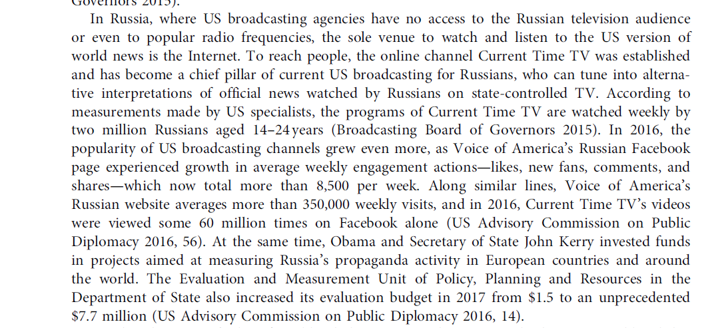

Slide 20
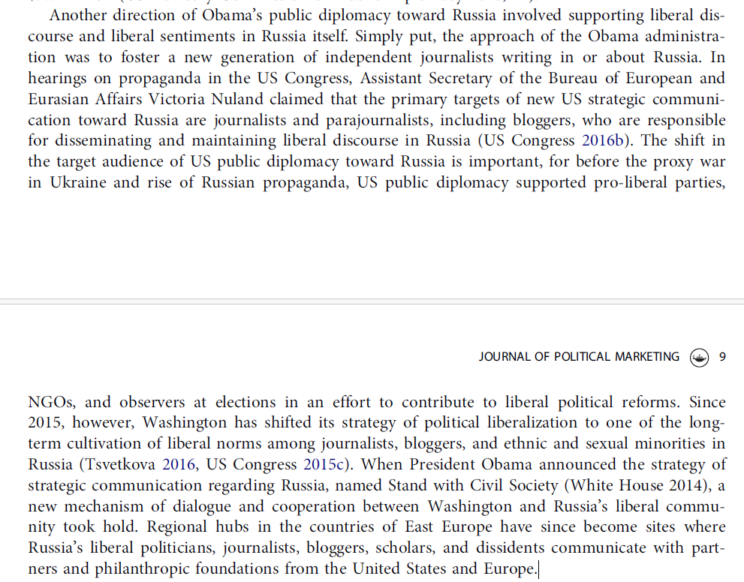

Slide 21
Appealing for public diplomacy support
Hong Kong - Appealing to foreign governments and the international community for support comprised one important strategy of the 2019 Anti-Extradition Law Amendment Bill (Anti-ELAB) Movement. Viewing Hong Kong as a cosmopolitan city, protesters recognized Hong Kong’s visibility in the international media and its global connections as significant resources. Attention and support from the international community were perceived as a key source of pressure on local and Chinese states. Thus, protesters talked about an “international front” that comprised rallies held in Hong Kong, but the movement targeted international media and the general public through various activities and rallies held in the international arena, mobilization in diasporic communities, and activists’ lobbying of foreign governments. Furthermore, activists and ordinary citizens’ efforts to appeal to foreign audiences via social media also comprised part of the international front. In fact, social media can be viewed as having lowered the threshold of participation for ordinary people to engage in public diplomacy (Seo, 2013). Through writing, tweeting, and retweeting protest-related posts, ordinary citizens could disseminate information worldwide, amplifying voices favorable to the Hong Kong movement and combatting pro-China commentators’ views, including the so-called fifty-cents party (Steger, 2019). Some activists believed that the sheer number of people participating in public diplomacy could enhance international lobbying’s efficacy (Lee, 2022).

