Slide 1
Session 8 Culture in soft power and public diplomacy
Monika Metykova
m.metykova@sussex.ac.uk
32153@mail.muni.cz

Slide 2
Not a new phenomenon
Leonard Bernstein presents Yo Yo Ma to President Kennedy:
https://www.youtube.com/watch?v=dNvAUobb1y4&ab_channel=SProkofieff

Slide 3
When I say Korea…
… it is everywhere:
https://www.youtube.com/watch?v=LiyPWH6Gm3U&ab_channel=TheLateShowwithStephenColbert

Slide 4
Everyone knows K-Pop but is this all there is?
Dafna Zur’s talk on Korea Gone Global
https://www.youtube.com/watch?v=HhysobmptAY&ab_channel=StanfordProgramonInternationalandCross-CulturalEducation%28SPICE%29 (from 9:30)
A view from Korea, the Academy of Korean Studies
https://www.youtube.com/watch?v=acpFxq52f1Q&ab_channel=SocietasKoreana

Slide 5
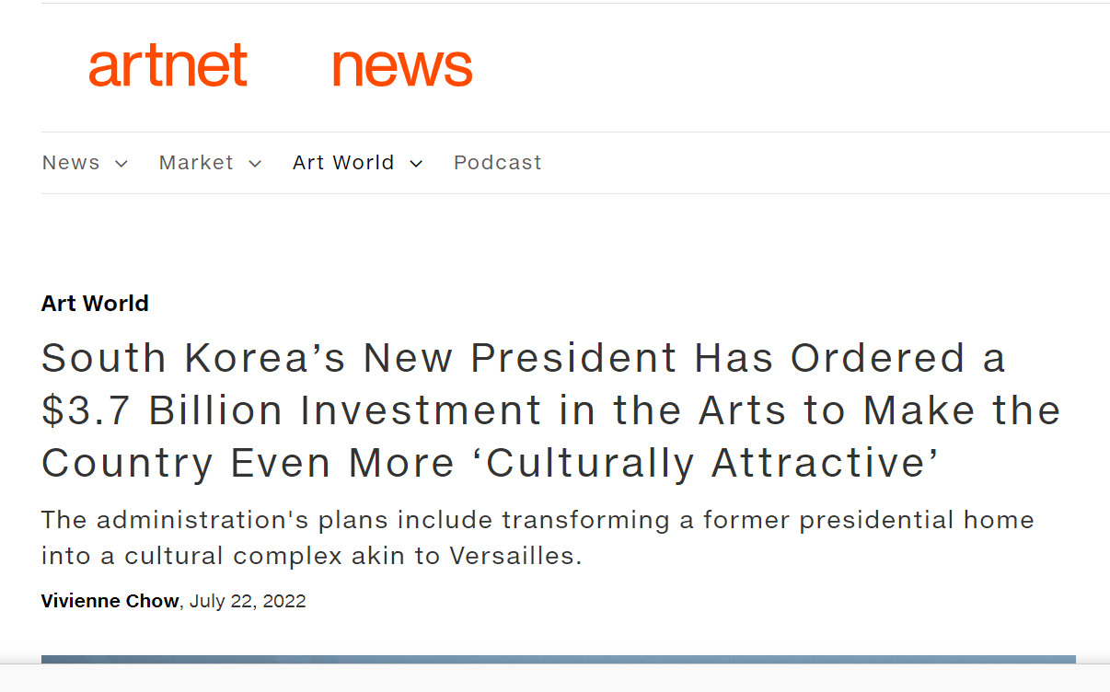
It does not happen overnight…
Cultural and economic policies are key
https://www.kocis.go.kr/eng/openInformation.do
https://www.investkorea.org/ik-en/cntnts/i-326/web.do
https://www.state.gov/reports/2022-investment-climate-statements/south-korea/

Slide 6
Some countries have Ministries of Culture
Who are their activities aimed at?
What kinds of programmes do they run?
Do they support cultural production? What kinds of cultural production?
An example from Europe – Council of Europe (not part of EU institutions):
https://www.coe.int/en/web/eurimages

Slide 7
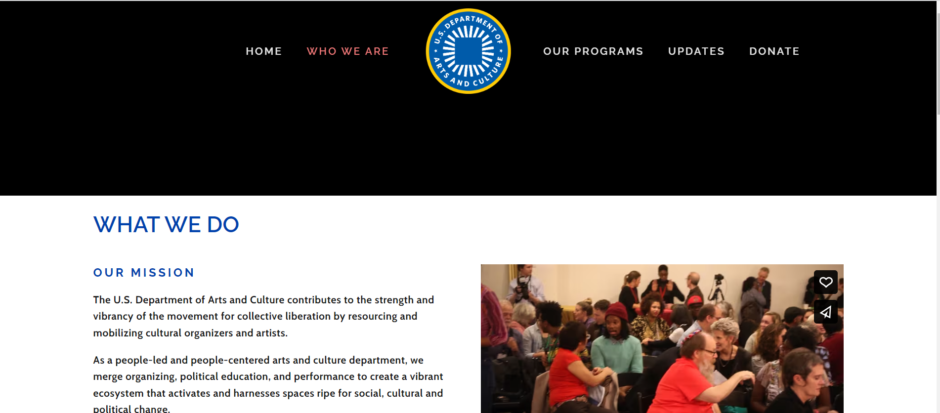
What about other countries?
US State Department
https://www.state.gov/department-of-state-organization-chart/

Slide 8
Cultural institutions aimed at foreign audiences
British Council, Alliance Francaise, Korean Cultural Centre…
Does your country have an institution like this?
Who pays its activities?
What are these activities?

Slide 9
Investment in cultural institutions
What do countries around the world do?

Slide 10
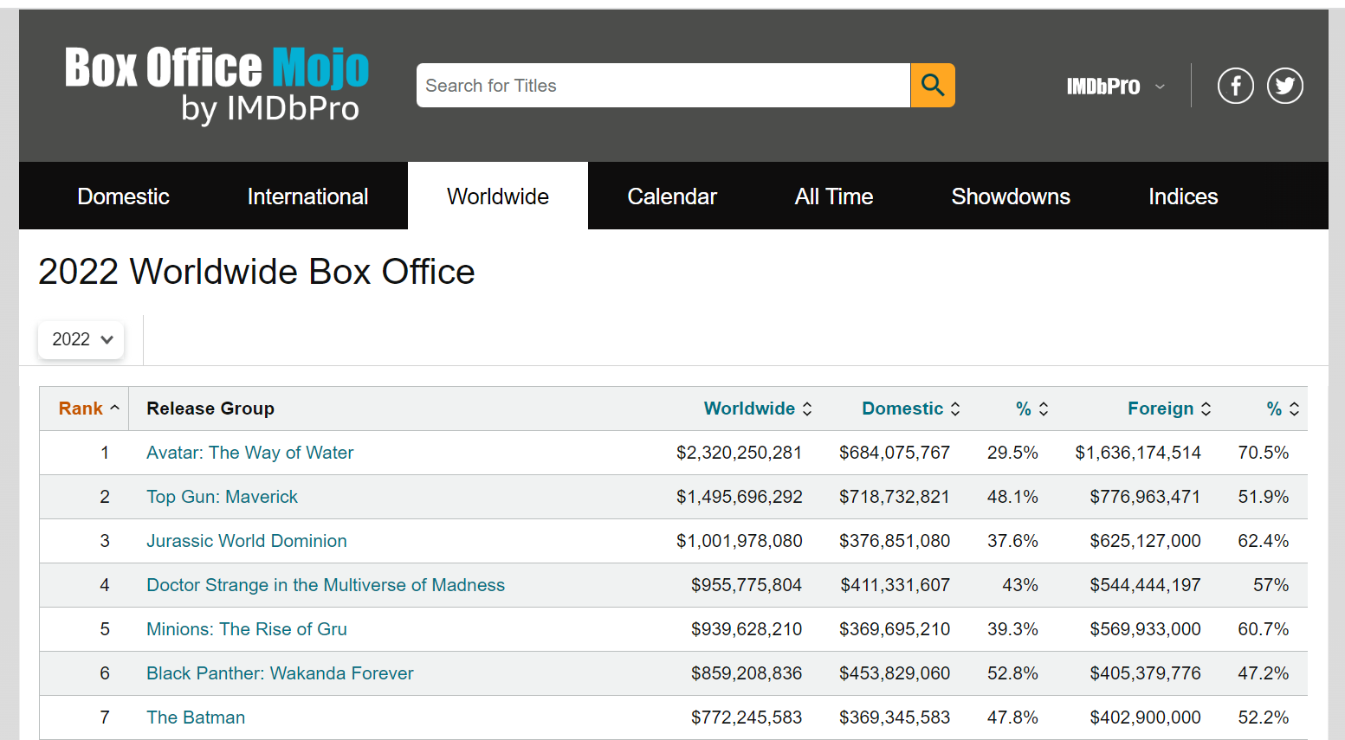
Other cultural products
Films – which were the highest grossing films globally in 2022?

Slide 11
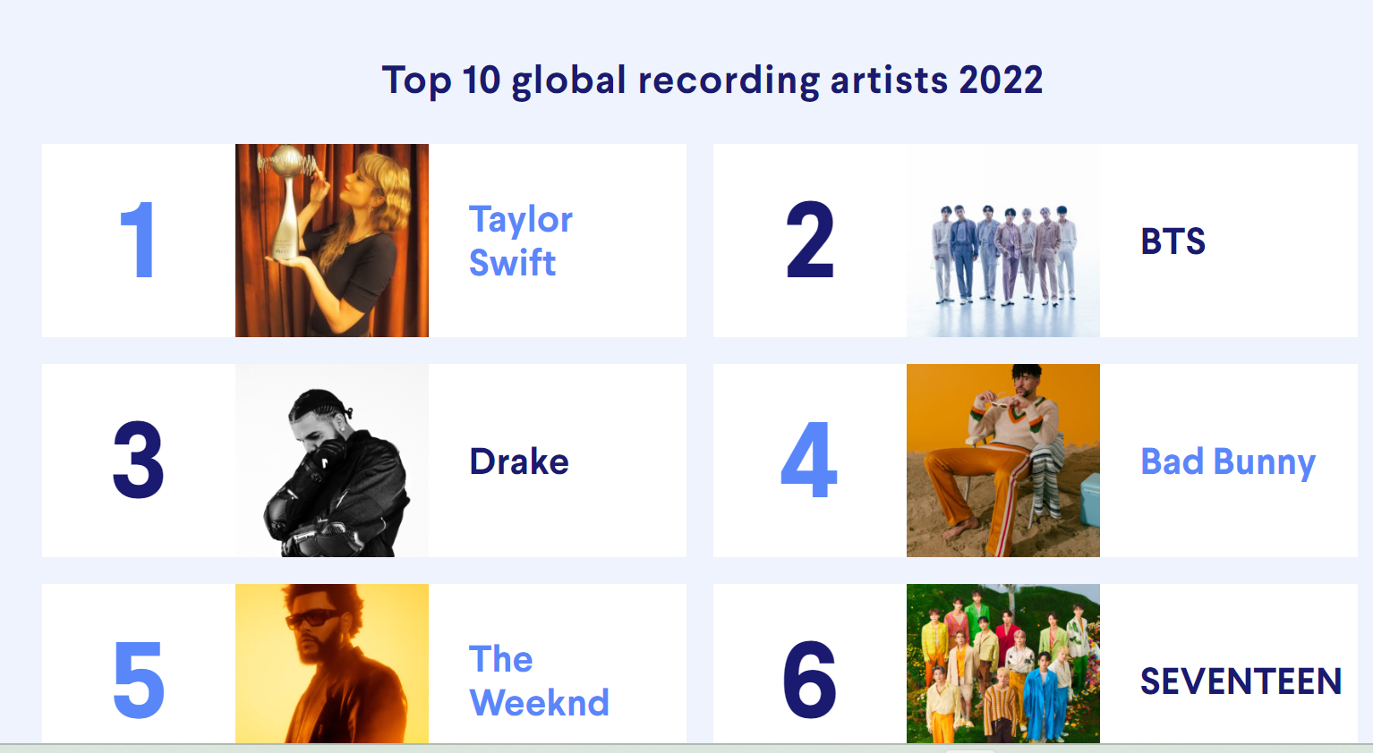
Music

Slide 12
Galleries and museums
Six of the top 10 visited museums are in Europe (four in the top 5), two are in the U.S., one is in Asia and one in Russia:
Musée de Louvre, Paris—7,726,321
Vatican Museums, Vatican City—5,080,866
British Museum, London—4,097,253
Tate Modern, London—3,883,160
National Museum of Korea, Seoul—3,411,381
Musée d'Orsay, Paris—3,270,182
National Gallery of Art, Washington, DC—3,256,433
Metropolitan Museum of Art, New York—3,208,832
Centre Pompidou, Paris—3,009,570
State Heritage Museum, St Petersburg—2,812,913

Slide 13
Sports diplomacy – goes way back
Ping Pong diplomacy
https://www.youtube.com/watch?v=lL2ruHvpLzE&ab_channel=SouthChinaMorningPost
A more in-depth look:
https://www.youtube.com/watch?v=ROJ-hkzBXfU&ab_channel=NationalCommitteeonU.S.-ChinaRelations

Slide 14
Sports 2022 FIFA World Cup
Lindsay Sarah Krasnoff talks about sports diplomacy and the FIFA World Cup
https://www.youtube.com/watch?v=G6nJUT6qfW0&ab_channel=InstitutefortheStudyofDiplomacy

Slide 15
Sports diplomacy – state, non-state actors, events, individuals
World Cups, Olympic Games, Goodwill Ambassadors, star athletes etc.

Slide 16
Exchange – a word we heard often …
… needs government support (entry and stay in a country)

Slide 17
And there is so much more…
Panda diplomacy
https://www.youtube.com/watch?v=ZR2GpiDE4FI&ab_channel=Vox
Food diplomacy
https://www.youtube.com/watch?v=CUaZ5IGL3AY&ab_channel=Quartz
Fashion diplomacy – Madeleine Albright
https://www.youtube.com/watch?v=EYoz-aCBJkk&ab_channel=PBSNewsHour
Michelle Obama’s dresses:
https://www.nytimes.com/2017/01/14/fashion/michelle-obama-first-lady-fashion.html

