Slide 1
Craniology and phrenology
The mystery of roots of academic racism
24. 11. 2023

Slide 2
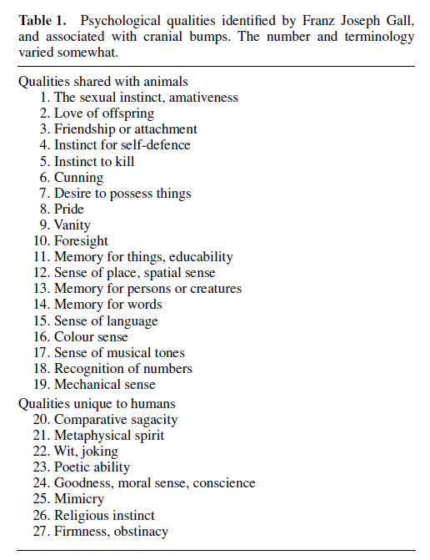
Phrenology
Gall (1758-1828) – there are organs in brain that control character, predict talents, and performance
These are traceable on the skull
Spurzheim (1776-1832)
Dissection of brain (hardened brain in alcohol; still used to this day but instead of alcohol, formaldehyde is used )
Nerve fibres in grey matter
Localization of the brain functions

Slide 3
Leaving Vienna due to censorship (bad moral influence on young ladies etc.)
Scientific circus all the way to Paris
Spurzheim leaving Gall 1813 (Britain and USA)
Gall accusing him of plagiarism (from 27 bumps to 35; Spurzheim´s book largely derives from Gall´s one)

Slide 4
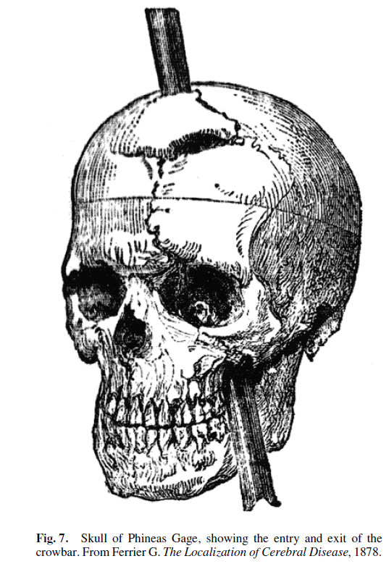
Contributions
Localization of brain functions
Broca´s discovery about language centres
Phinease Gage (1848) and damage in
prefrontal region of the brain

Slide 5
Sputzheim in USA – phrenology in 1840´s used to support segregation and represented a base for craniology
Maria Montessori – Pedagogical Anthropology (1913)

Slide 6
Craniology
Gobineau- („Broca questioned the conclusions of the ‘godfather of modern academic racism’, Arthur de Gobineau, who in his 1855 racist tract, Essay on the Inequality of Races, introduced the idea that the mixing of racial types led to racial degeneration. To the contrary, Broca (1864) argued, the mixing of racial types—what Broca called ‘hybridization’—could in many instances lead to racial improvements, an outlook Montessori shared. “ Fallace, 2023)
Measurement of cranium, skull, to make assumptions about differences in intelligence among human groups (race hierarchy)
Samuel G. Morton measured cranial capacity and made assumptions about brain size therefore intelligence.
Measurement by filling skulls with white pepper seeds, later lead shot
Bias: omitting subgrups, more female skulls in certain groups

Slide 7
Luchetti, 2022 – the mistake of carniology
Inference from individual instrument readings of volume to individual values of cranial capacity (cephalic index)
2. Inference from individual values of cranial capacity to average values of cranial capacity of the group samples
3. Inference from average values of cranial capacity of group samples to average values of cranial capacity of populations
4. Inference from average values of cranial capacity of populations to relative positions of a population on an ordinal scale of intelligence

Slide 8
most craniologists, had to presuppose the existence of a direct correlation between skull or brain size and mental abilities. However, craniologists never systematically investigated the relationship between values of cranial capacity and intelligence as a quantitative notion.
Elephant problem
Outliers in skull capacity
Different skull measures (facial vs. skull indexes) or claim, that the relationship holds in rough terms (Broca)
Intelligence testing – empirical was non-existing

Slide 9
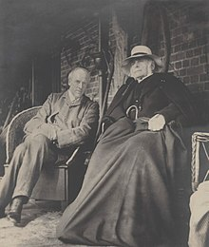
Alice Lee – female skulls of her grand colleagues were not supporting the craniological claim
Craniologists started to focus on different measures than just cranial capacity. They became obsessed with the physical measurement, but did not put attention to theory and statistics that was underlying it.
„The collapse of the craniological research program and its failure at quantifying intelligence by means of physical measures did not prevent the assumption of quantitativity of psychological attributes from making its way into the development of early psychological testing, most importantly intelligence testing (Boring, 1961; Carson, 2007, 2014; Gould, 1981). Even when measures of intelligence by means of standardized testing started to appear, independent evidence of its quantitative structure proved far from easy to obtain (Michell, 1997).“
(Karl Pearson- eugenic but not craniologist, his beef with his son); Eugenics (Francis Galton)

Slide 10
Current effort
to reject the very possibility of justifying any meaningful racial classification on biological grounds given our own contemporary standards of knowledge
What can we do?

