Slide 1
Social Stratification
What is social stratification?
  Systematic inequality between groups of people
Why social?
  SS concerns the groups of people
  Systems of inequality are organized around groups with a shared characteristic.
Criteria delimit the inequality
  wealth, income, prestige, power, gender, education, age
Rankings of groups change only very slowly
Contemporary European societies are stratified societies

Slide 2
Three basic models of social stratification
Slavery—ownership of certain people
Caste—status for life
Class—positions based on economics
2
Notes:
Historically speaking, there are three major types of systems of social stratification: slavery, caste, and class. Let me briefly describe each type.
1. In slave systems, some peoples are considered less than human and are owned as property. Their legal rights are limited, certain relationships are prohibited, and as you might imagine, and social power is essentially nonexistent.
2. In caste systems, societal groupings are based on deeply held cultural ideals and boundaries. The Indian caste system exemplifies this societal form of stratification, having both cultural and economic impacts. Caste systems are rigidly based. They are characterized by hereditary status, endogamy, and social barriers and are sanctioned by custom, law, and religion.
3. Class systems are the stratification system we are familiar with. People are divided according to economic markers such as income, wealth, ownership, and so on. There are many different characterizations of what constitutes class, and we will be talking about these characterizations today.

Slide 3
On what dimensions does stratification exist?
Assets, wealth, money (rich vs. poor people) = economic view
Occupations (labour market positions) = social class view
Prestige, respect = social status view
Power, influence, authority = power view
Income, occupation, education, power = socioeconomic status view
The debate is over which is the most important or most basic criteria
Three main dimensions of stratification are: economic capital (income, salary), education (prestige, respect), power (authority)

Slide 4
Social stratification cube
Three main dimensions
  economic capital (income, salary)
  education (prestige, respect)
  power (authority)
Fourth dimension
  time
Social mobility vs. social reproduction
Delimitation of social strata (no social classes)

Slide 5
Consequences of SSC
Reproduction of social strata
  In European countries children from the highest social classes have about 80% higher probability to attend university compare to children from the working class.
  Correlation between parents’ education and children education is about 0.44
  Correlation between parents’ income and income of children is about 0.35.
  Children from highest social class have 70% probability to get married with the same social class partner
  Marriage homogamy is about 55 %
    Structured by social class position
    marriage preferences vs. marriage remainders

Slide 6
Two reasons of reproduction
Social reproduction
  glass ceiling
  social barriers
  system
  everyone wants the same
Cultural reproduction
  sticky floor
  cultural values, attitudes
  behaviour
  people want different things

Slide 7
Two concepts of social stratification
Inequality of conditions
  unequal distribution of income to people
  differencens in wealth and material conditions
  different incomes means different chances to get different goods
Inequality of opportunity
  unequal start positions
  different start positions means different chances to get different levels of education, jobs and incomes
7
Notes:
Historically speaking, there are three major types of systems of social stratification: slavery, caste, and class. Let me briefly describe each type.
1. In slave systems, some peoples are considered less than human and are owned as property. Their legal rights are limited, certain relationships are prohibited, and as you might imagine, and social power is essentially nonexistent.
2. In caste systems, societal groupings are based on deeply held cultural ideals and boundaries. The Indian caste system exemplifies this societal form of stratification, having both cultural and economic impacts. Caste systems are rigidly based. They are characterized by hereditary status, endogamy, and social barriers and are sanctioned by custom, law, and religion.
3. Class systems are the stratification system we are familiar with. People are divided according to economic markers such as income, wealth, ownership, and so on. There are many different characterizations of what constitutes class, and we will be talking about these characterizations today.

Slide 8

Inequality of conditions vs. inequality of opportunity
Video YT: The problem of education inequality | CNBC Reports
https://youtu.be/T-JVpKku5SI

Slide 9
Basic principles social class reproduction
Cumulative advantage
  Matthew effect
  Advantages have tendency to strengthen itself
  The same can be applied to disadvantages.
Compensatory advantage
  Economic, cultural, social, family resources to face risks along the life course

Slide 10
Inequality of material conditions
indicated by Lorenz curve in empirical reality
  curve not number, it shows the shape of material inequality not the size
the size of material inequality is indicated by GINI coefficient
  it is number, it shows the size of material inequality

Slide 11
Inequality of opportunity
indicated by social mobility
  SM is the movement of people up or down the stratification system
trends in European countries
  from agriculture to industry: industrial societies
  from industry to services: post-industrial societies
    these trends are reflected in structural social mobility trends
but no changes in social fluidity (relative social mobility)
  odds ratios are the same
11
Notes:
An important characteristic of class systems, as opposed to slave or caste systems, is that in class-based systems of stratification, there is the opportunity for social mobility. This means that people and groups can, potentially, move up or down in the rankings, and this is seen by many as a significant benefit of class systems.
In reality, however, such mobility is less common than our national mythology suggests. Typically, those who arrive at high positions have families who either had high positions themselves or the resources to provide the appropriate education for advancement. Achieving upward mobility is very difficult, and the wonderful stories we’ve all heard and seen (think, for example, of the movie The Pursuit of Happyness) are so very moving because they are the exception, not the norm. If such stories were common, they would not get our attention in nearly the same way.

Slide 12
Ascription versus Achivement
What is ascription?
  How does acriptive society work?
What is achivement?
  How does meritocratic society work?
Why we should strive for meritocratic societies?
  Discussion

Slide 13
Standards of Equality – what should be the goal?
Ontological equality - everyone is created equal. Goal is equal respect and status within the culture.
Equality of Condition – “level playing field,” same starting point for everyone. Goals may include increasing diversity & using affirmative action.
Equality of Opportunity - inequality of condition is acceptable as long as everyone has the same opportunities for advancement and is judged by the same standards
  Fits most closely with modern capitalist society
Notes:
Photo Courtesy of AP Photo.

Slide 14
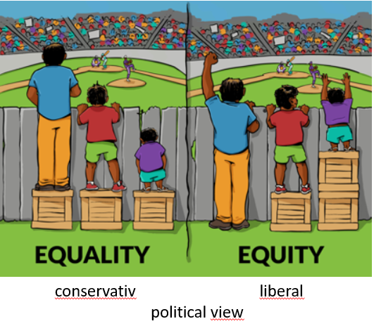
Equality vs Equity
Equality is the provision of equal access to resources and opportunities. Everyone gets the same thing, regardless of where they come from or what needs they might have.
Equity is the provision of personalized resources needed for all individuals to reach common goals. The goals and expectations are the same for all students, but the supports needed to achieve those goals depends on the students’ needs.
Notes:
Left: equal distribution of boxes, right = equal distribution of sightlines. So Equality is in both cases!!! But correct (from the case of watching a baseball game) is right panel! Sightline not boxes!
Equality is inferior to Equity! Equality does not need consider prevalence effect. E.g. The same one thing per household is equality but households differ by number of members. Equity is not equality of opportunity, conditions and so on.

