Slide 1
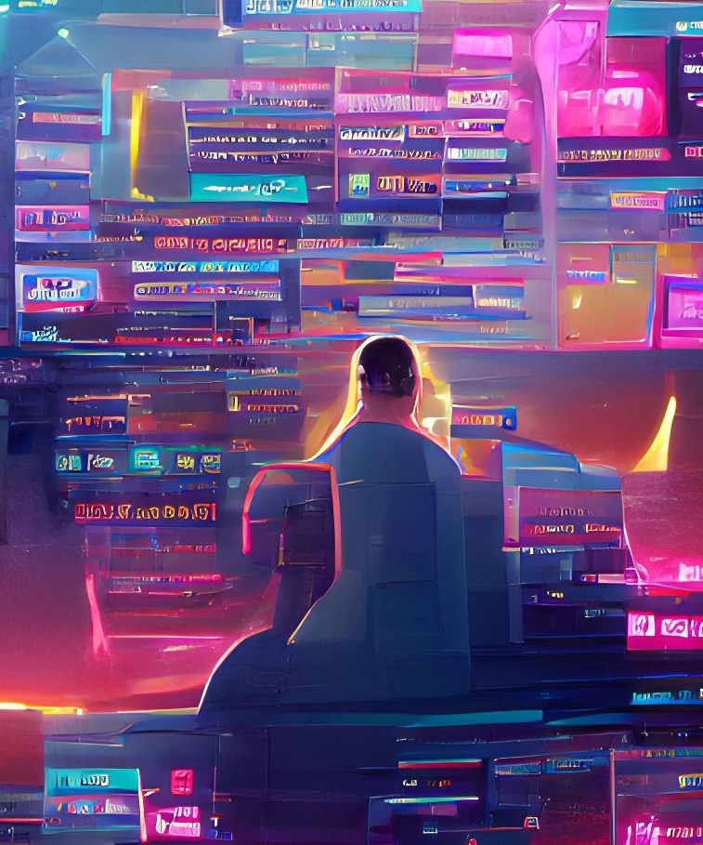
ZURb1614 / CMA17 Current issues in research of media and audiences
Closing session and feedback
Marie Jaroň Bedrošová marie.bedrosova@mail.muni.cz

Slide 2
Final assignment
Writing a popularisation text
Topic taught in the course selected by the student
Please, write the topic of the selected lecture on the title page of your popularisation text!
3 standard pages (1 standard page = 1,800 characters), including references
At least 2 academic sources
Deadline: January 5, 2024
Returned assignments need to be revised and submitted in a week
If you need to finish the course earlier or have a general question about the final task – write to Marie Jaroň Bedrošová
Questions about selected assignment topics – write to the teacher of the relevant lecture

Slide 3
Popularisation text
What is a popularisation text and what is the purpose?
For revision and specific information: presentation from the 1st lecture
Communicating science to the public
Interesting and relevant topic for public
Understandable language – explain and describe all terminology and concepts, do not unnecessarily use academic terms
Use visuals, interviews, quotes, …
Not academic paper, but also not a tabloid text
I.e., we do not want you to write and academic essay or a seminar paper
Imagine a blog post or an article in a popular magazine which is presenting science to normal people
Use references
Be aware of plagiarism (and self-plagiarism)
More info for example here: https://www.plagiarism.org/
https://www.muni.cz/en/about-us/official-notice-board/plagiarism

Slide 4
Plagiarism
Same rules for citations and paraphrases apply also for your popularisation texts.
How to avoid plagiarism: Student handbook (Foltýnek et al., 2020)
Three tips against plagiarism:
1. Distinguish other people’s ideas from your own
2. Reference the original source
3. Identify the original source so that it can be traced back
„Plagiarism is the use (of ideas, content or structures) of another work without appropriately acknowledging the source to benefit in a setting where originality is expected“ (Foltýnek et al. 2019).
Designed by starline / Freepik

Slide 5
Plagiarism
How to avoid plagiarism: Student handbook (Foltýnek et al., 2020)
Different types of plagiarism:
Word-for-word plagiarism
„Copying a whole text or a part of a text written by someone else without declaring its source and pretending that it is your own work […]. Plagiarism also occurs when the text is referenced, but it is unclear what is and isn’t your own idea. […] If we use a source in several places, the reference must be included in all places where we make use of the text.“

Slide 6
Plagiarism
How to avoid plagiarism: Student handbook (Foltýnek et al., 2020)
Different types of plagiarism:
Mosaic plagiarism
„This results from compiling several short segments of text from different sources, without stating a reference for each reproduced segment.
Always state all your sources, even if you’re only citing a portion of a sentence. It does not suffice to list all sources in the bibliography. We must also refer to each source within the text.“

Slide 7
Plagiarism
How to avoid plagiarism: Student handbook (Foltýnek et al., 2020)
Different types of plagiarism:
Paraphrase or translation without source
„The original idea is what counts. Even if we describe it in our own words – that is, we paraphrase – or we translate it from a different language, it is not our own idea. Accordingly, we must reference it.“

Slide 8
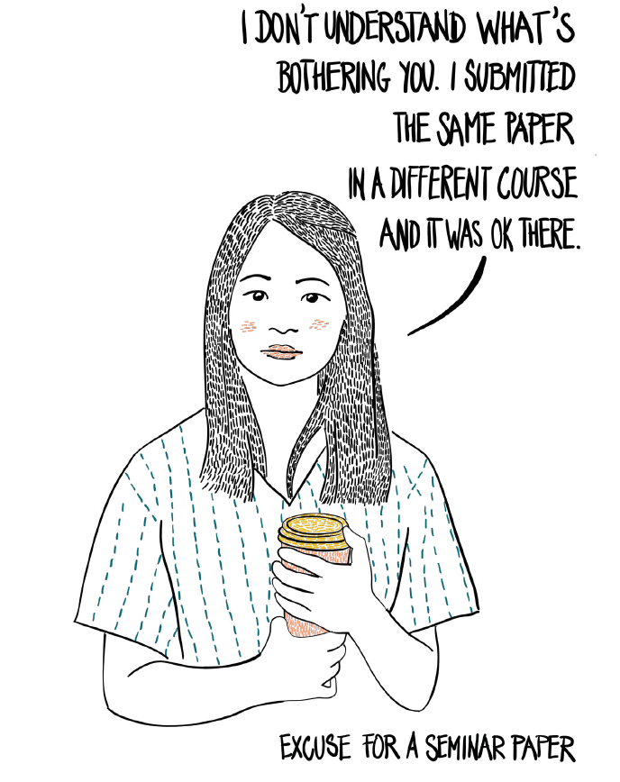
Plagiarism
How to avoid plagiarism: Student handbook (Foltýnek et al., 2020)
Different types of plagiarism:
Self-plagiarism
„When we reuse our own work that has already been published or that we have already submitted for a different course, and we don’t reference it, that constitutes self-plagiarism. That is because we repeatedly gain an advantage from the same work or its part, such as an educational grade or scientific recognition.“

Slide 9
How to cite?
Choose a referencing style and use it consistently in your text, e.g.:
ČSN ISO 690
https://www.citace.com/CSN-ISO-690
APA
https://owl.purdue.edu/owl/research_and_citation/apa_style/apa_formattingand_style_guide/index.html

Slide 10
How to cite? Examples…
In-text citations:
Direct quotation: „Plagiarism is the use (of ideas, content or structures) of another work without appropriately acknowledging the source to benefit in a setting where originality is expected“ (Foltýnek et al., 2019, p. 9).
Paraphrasing: In their guidebook, Foltýnek and his colleagues (2019) give students tips against plagiarism, such as differentiating our own thoughts and ideas from those of others and always refering to the original sources.
References / bibliography:
List all sources you used in your text.
Foltýnek, T., Černikovský, P., Fontana, J., Gojná, Z., Henek Dlabolová, D., Holeček, T., Hradecký, J., Kozmanová, I., Mach, J., Římanová, R., Tesaříková Čermáková, K., Válová, A., Vorel, F., & Vorlová, H. (2020). How to avoid plagiarism. Student handbook. Charles University, Karolinum Press.

Slide 11
Designed by starline / Freepik

Slide 12
Examples of popularisation texts
For inspiration only...
https://blogs.lse.ac.uk/parenting4digitalfuture/2020/06/24/euko-cyberhate/
https://irtis.muni.cz/for-media/why-do-czech-adolescents-meet-face-to-face-with-people-from-the-internet
https://yskills.eu/news-from-the-first-wave-of-the-yskills-school-survey/
https://yskills.eu/how-do-digital-skills-relate-to-cyberhate-exposure/
BUT: These examples generally introduced a single study/result
to the public – that is a specific format!
You need to introduce a bit broader topic and use at least two academic sources!
Do not forget to properly cite your references!
Do not feel constrained by these examples. You can be creative and approach the task originally.

Slide 13
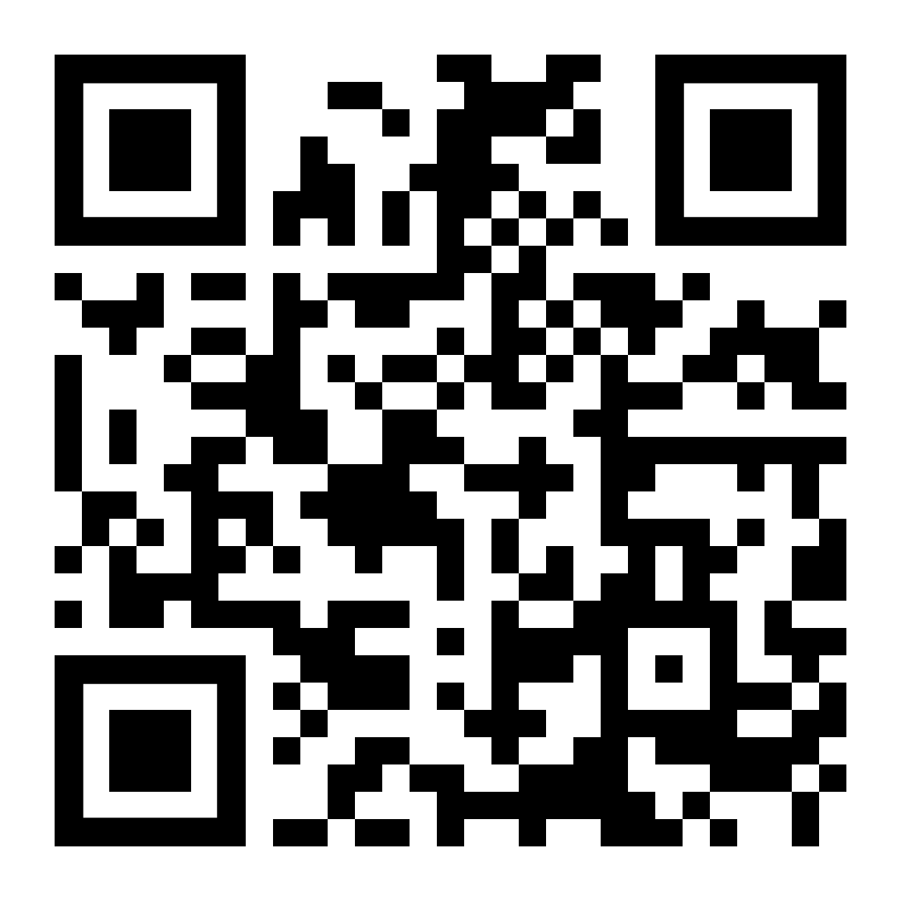
Course feedback
https://padlet.com/cyber_marie/feedback

Slide 14
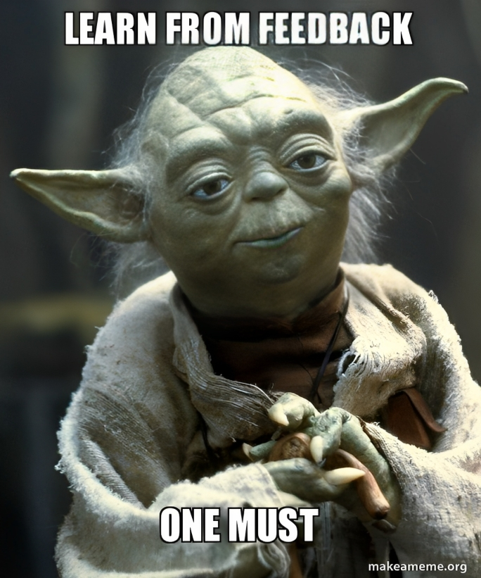
Course feedback
Individual task
Were my expectations about the course fulfilled? Did I learn what I wanted to learn?
What did I like the most?
What could have been better?
Was there anything that needs to be changed?
Do I have feedback for a specific lecture?
Is there anything else I would like to address?

Slide 15
flaticon

