Slide 1
Thesis I: Monster as a Cultural Body
The word“monster” takes its root from the Latin monstra meaning to “show forth,” “warn,” or “sign.”
It shares its root with“demonstrate”
What does the monster demonstrate or bring forth?
Monster always signifies something other than itself
Monster is a pure cultural body

Slide 2
Thesis II: The Monster always escapes
Why is that the case?
The Monster returns in slightly different shape, dictated by events or social conditions
Monstrous interpretation is an epiphany about social, cultural, and historical conditions

Slide 3
Thesis III: The monster as a category crisis
The Monster is dangerous because it threatens to smash distinctions
A kind of third term, the Monsters threatens binaries
Offers other ways to explore the world

Slide 4
Thesis Iv: The monster dwells at the gates of difference
The Monster is difference made flesh, come to dwell amongst us
Monsters are created from combining fragments from different forms and reassembled to create the Monster
Shows that difference is arbitrary and culturally constructed

Slide 5
Thesis v: The monster polices the boundaries of the possible
Monsters prevent mobility; to step outside the boundaries of the state is to risk becoming the Monstrous Other
Monster embodies those sexual practices, which can only be committed through the Monster body
Monster embodies fears of the racial, sexual, gendered Other

Slide 6
Thesis vI: Fear of the monster is really a kind of desire
We are terrified and attracted to the Monster
Experience the terrifying in the safety of theaters
Attracted by the promises of the forbidden
Monsters will always dangerously entice

Slide 7
Thesis vII: The monster stands on the threshold of becoming
Monsters are our children
They bear self-knowledge; human knowledge
They make us think of what makes a human
They ask us why we have created them

Slide 8
Approaches to monstrosity
Rapid cultural changes echo in the narratives of monstrosity
Monstrosity as a condition of the 21st century

Slide 9
Psychoanalytical approach to monsters
Uncanny – unfamiliar familiar
A repressed memory from childhood
That class of frightening that leads back to the old and the familiar
Something previously known in which repressed becomes recognizable

Slide 10
Representational Approach to monsters
Monsters as representation of collective nightmares
Represents that which we have repressed and as well as cultural desires and anxieties

Slide 11
Repression
Repression is a process though which the most disturbing parts of our psyche are pushed into the unconscious, away from the everyday conscious life
Freud = repression is a necessary condition of civilization
Basic Repression = what makes us human
Surplus Repression = makes us monogamous, heterosexual, bourgeois; deeply connected to our culture and society.

Slide 12
The Return of the Repressed
The process whereby repressed elements, preserved in the unconscious, tend to reappear in consciousness or in behavior.
In horror film, the return of the repressed means that the Other - representing that which we have repressed - returns though representations of the Monster

Slide 13
The Return of the Repressed
The true subject of horror genre is the struggle for recognition of all that our civilization represses or represses – the return of the repressed

Slide 14
Ontological approach to monsters
Ontology – the way of being
Something known is no longer a monster
To be a monster is to occupy the space of the unknown and the possible
What is that space?
The Future

Slide 15
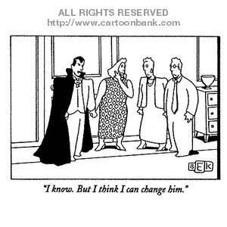

Slide 16
The Origin of the vampiric myth
The myth of the vampire, or the dead coming back to feed on the living, have found its strongest expression in Eastern Europe
Symbolized the fear of disease and the ignorance of science and medicine
Also served to police the boundaries of community
Came to represent a deviant member of a community who was guilty of violating norms and values
Within Bram Stocker universe became associated with anti-semitism

Slide 17
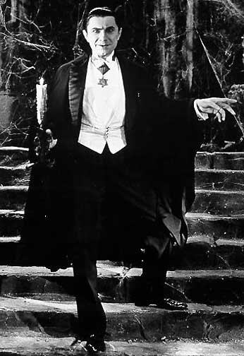
Bram Stocker’s Dracula (1897)

Slide 18
Vampires in the 1970s-2000s
Vampire has been secularized
Removed from associations with Satan
Subverts patriarchal family structure by forming families of their own
Vampire bite becomes an act of sexual intercourse
Demonstrate the desire and danger of transgression
Became associated with the HIV/AIDS epidemic

Slide 19
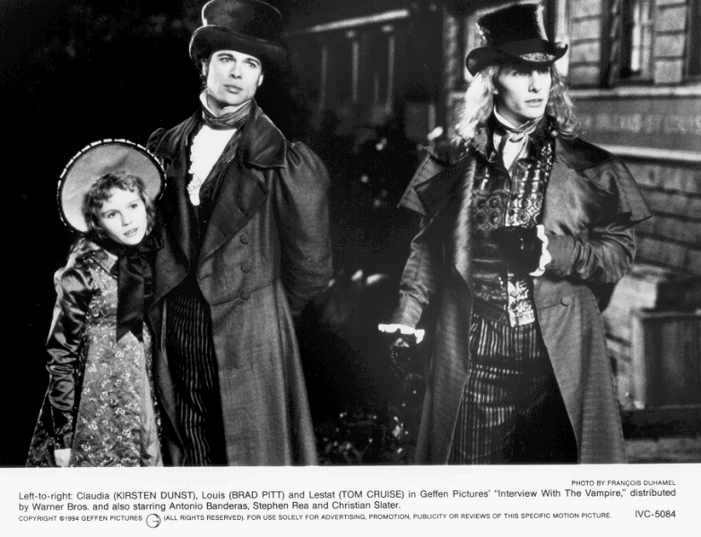

Slide 20
Vampires post-Twilight – 2000s
Rather than a story about deviance become stories about normalization
Existence of “good”/”bad” or “safe”/”unsafe” vampires
Teach a lesson in sexual mores
Become stories about taming sexual impulses
Vampire surveillance functions to tame female sexuality

Slide 21
