Slide 1
Great Lakes Region
Lucie Konečná
BSSn4457 Regional Security Complexes
5/12/2024

Slide 2
Regional Security Complexes

Slide 3
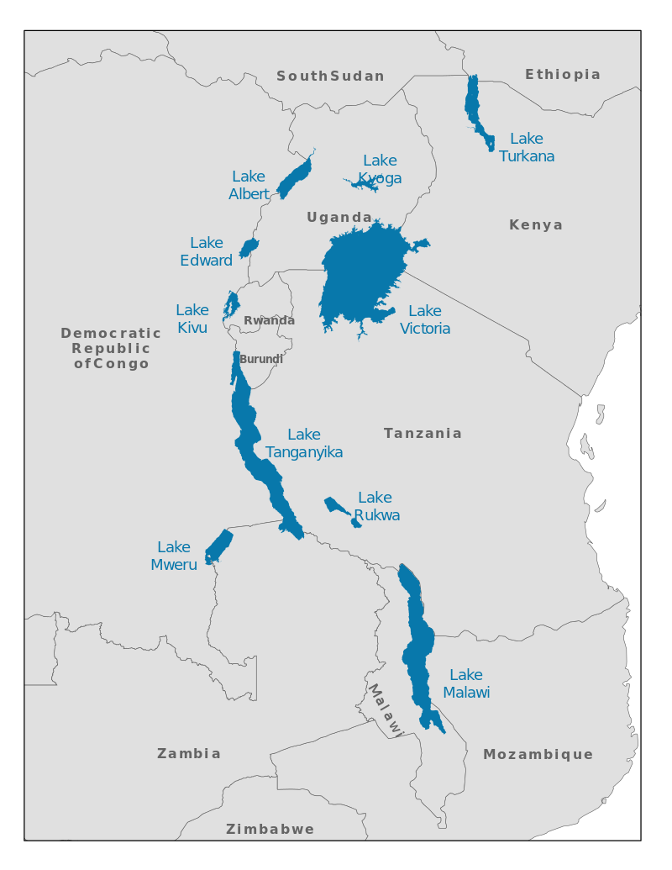
Great Lakes Region
Uganda, Burundi, Rwanda, Tanzania, DRC (Malawi, Kenya and Mozambique).
International Conference on the Great Lakes (ICGLR) - Its founding history began in 2000 when the United Nations Security Council, as stated in its resolutions 1291 and 1304, called for an International Conference on peace, security, democracy and development in the Great Lakes region.

Slide 4
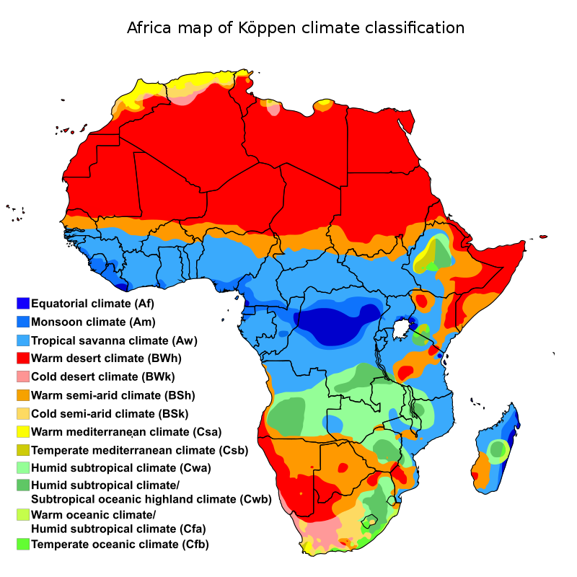
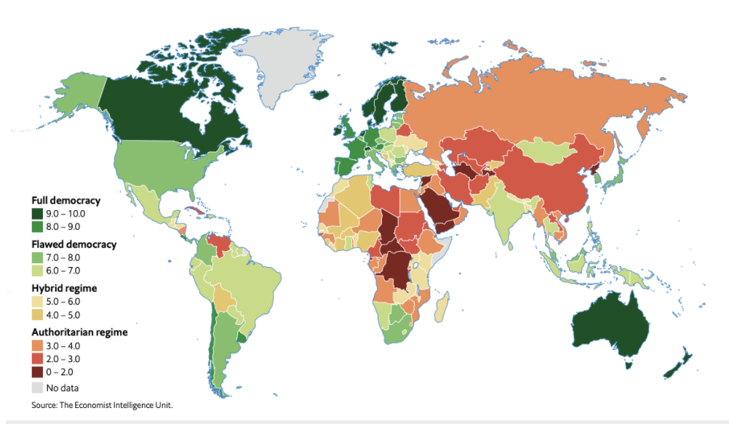
Facts about GLR
Around 240 million inhabitants
Geography - African Great Lakes - Victoria and Tanganyika, Mount Kilimanjaro (4,900 metres), high concentrations of wild animals (big five), Rwenzoris, Eastern Rift Mountains and Virunga Mountains
FSI (FFP) – Burundi (24), Uganda (28), Rwanda (46), Tanzania (62), DRC (5).
(, DRC(

Slide 5
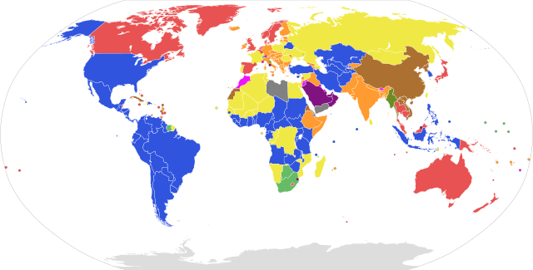
SA – Form of Government

Slide 6
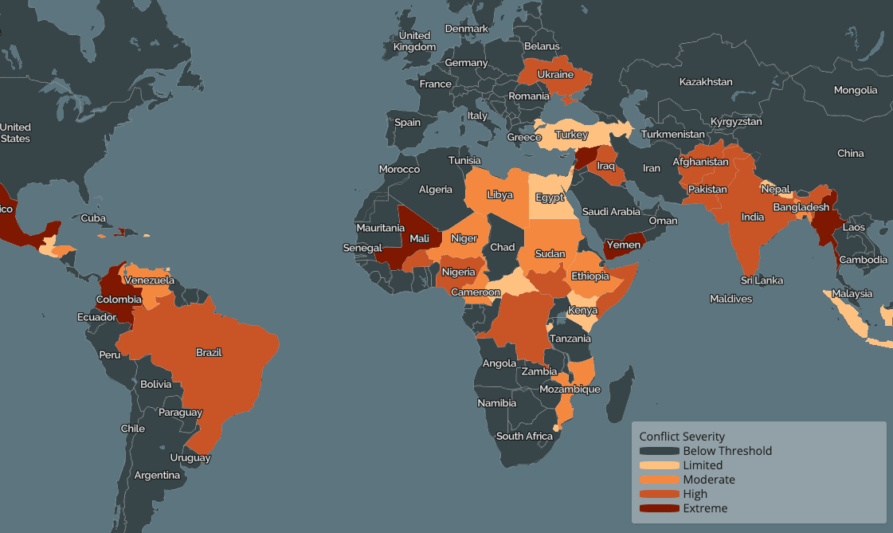
Conflict Map

Slide 7
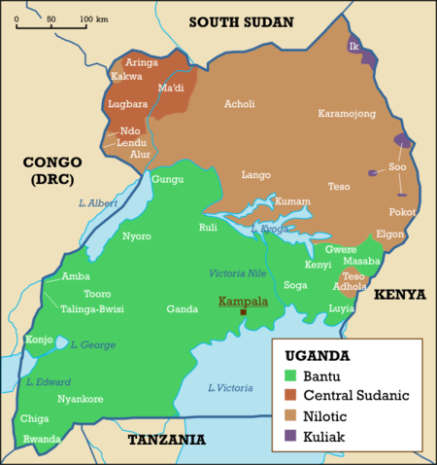
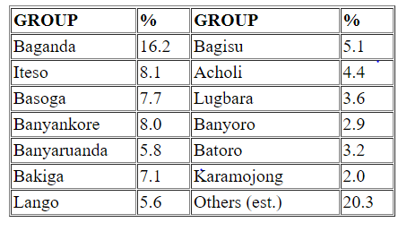
Uganda
48 mil inhabitants, Protestant 45.1%, Roman Catholic 39.3%, Muslim 13.7%
Independence 1962
Apollo Milton Obote x Idi Amin
Kagera war
Civil war 1980-1986 (Bush war)
Lord’s Resistance Army
Involvement in the first
and second civil wars in the DRC

Slide 8
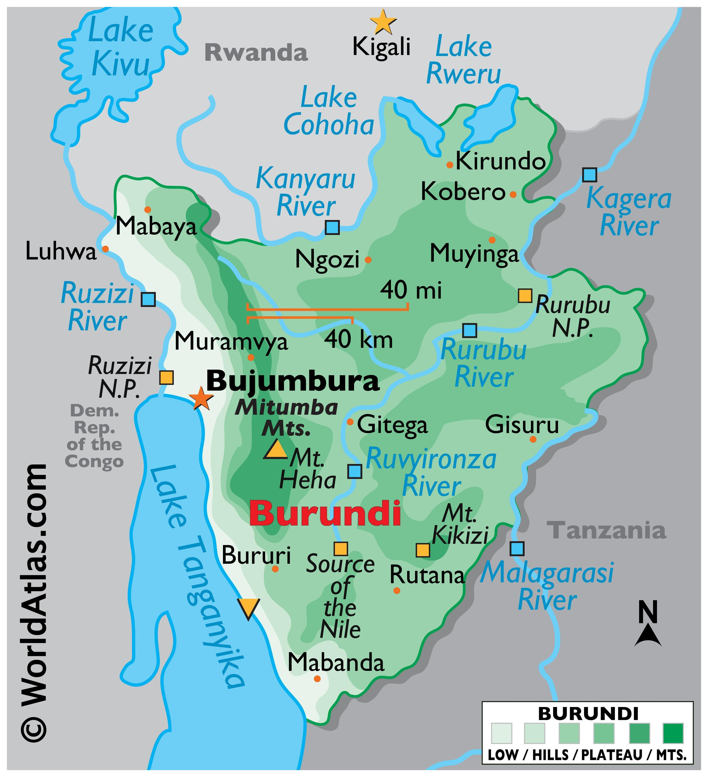
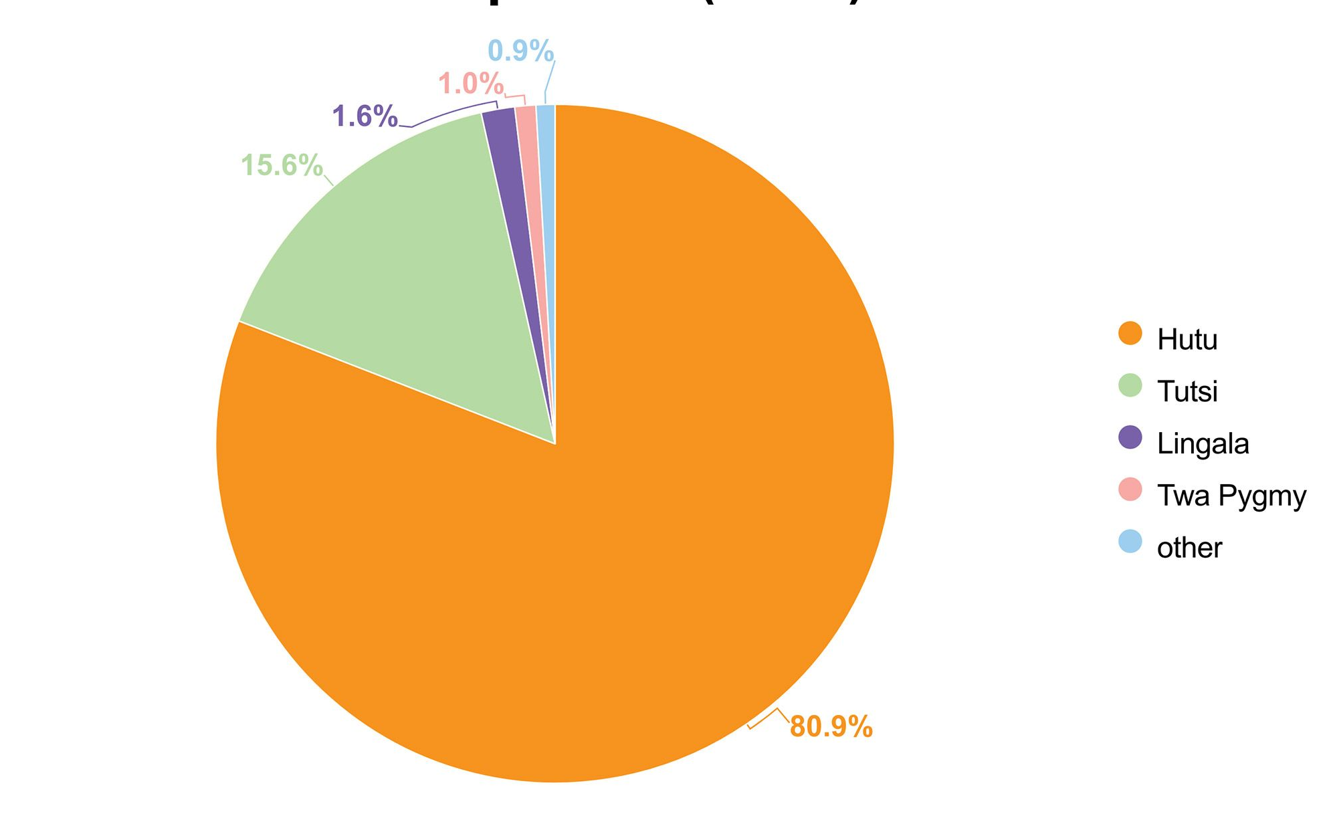
Burundi
13 mil inhabintants, Roman Catholic 62.1%, Protestant 23.9%, Muslim 2.5%
Ruanda-Urundi 1919-1962, Independence 1962
UPRONA – Union for National Progress
Civil war 1993-2005/08
National Council for the Defense of Democracy–Forces for the Defense of Democracy (CNDD-FDD).
Crisis 2015 - Pierre Nkurunziza x general Niyombare;Popular Forces of Burundi, RED-Tabara x Imbonerakure.
2020 new president Évariste Ndayishimiye (CNDD-FDD)
Gitega (New capital city)

Slide 9
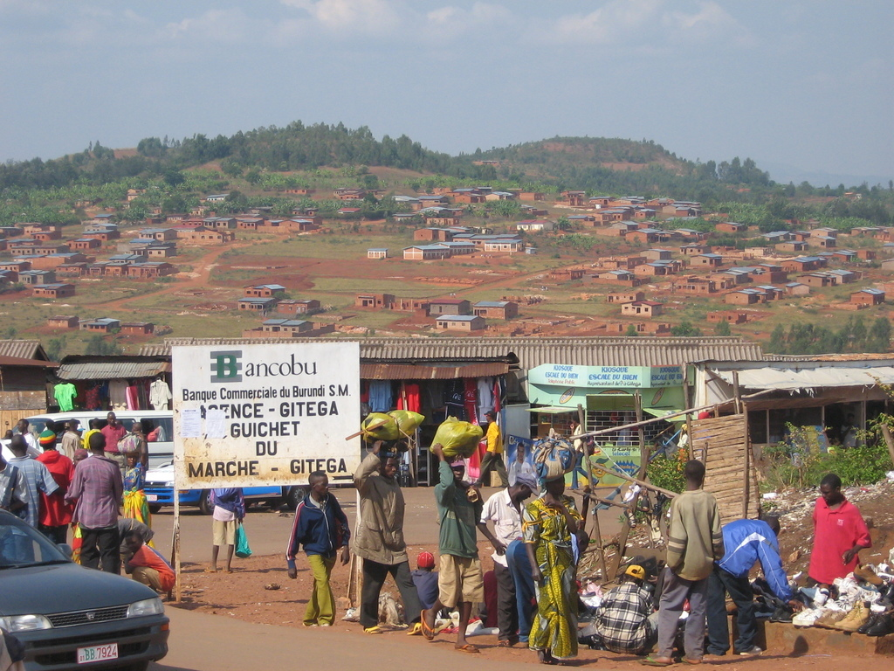
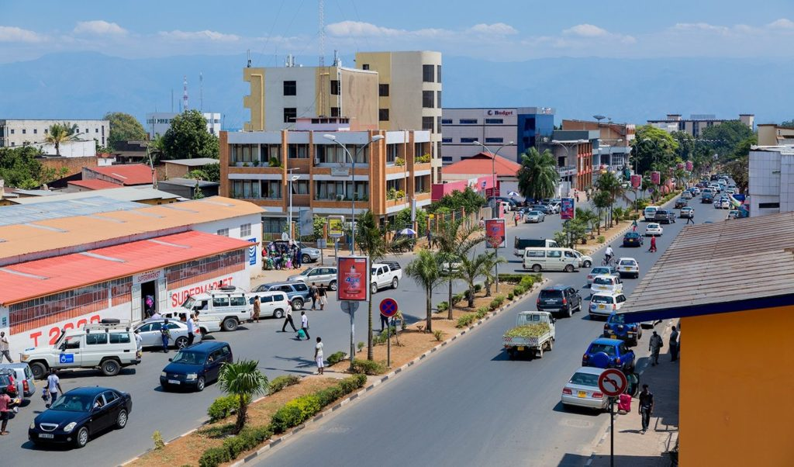
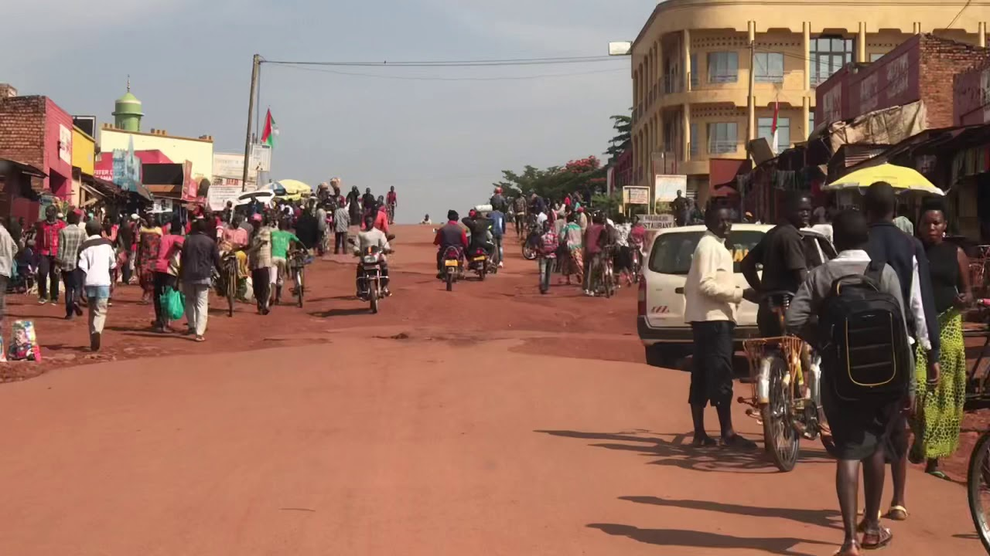
Bujumbura vs. Gitega

Slide 10
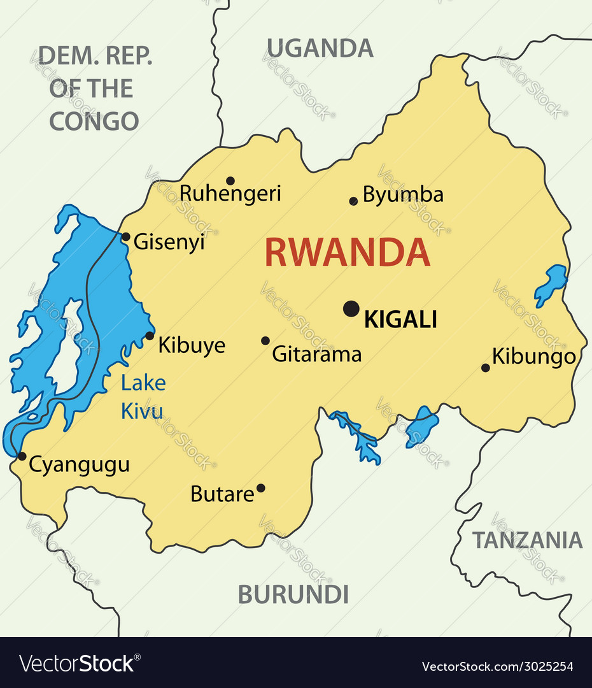
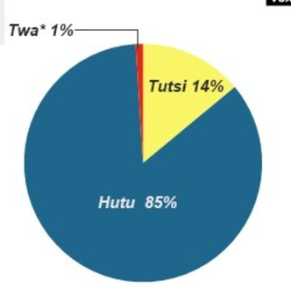
Rwanda
14 mil inhabitants, Protestant 49.5%,Roman Catholic 43.7%, Muslim 2%
Independence 1962, MDR-Parmehutu
The National Revolutionary Movement for Development (MRND) was the ruling political party of Rwanda from 1975 to 1994 under President Juvénal Habyarimana
Civil war 1990-1994 (RPF – Rwandan Patriotic Front)
Genocide 1994 (Interahamwe, Impuzamugambi x Inkotanyi)
Involvement in the first and second civil wars in the DRC

Slide 11
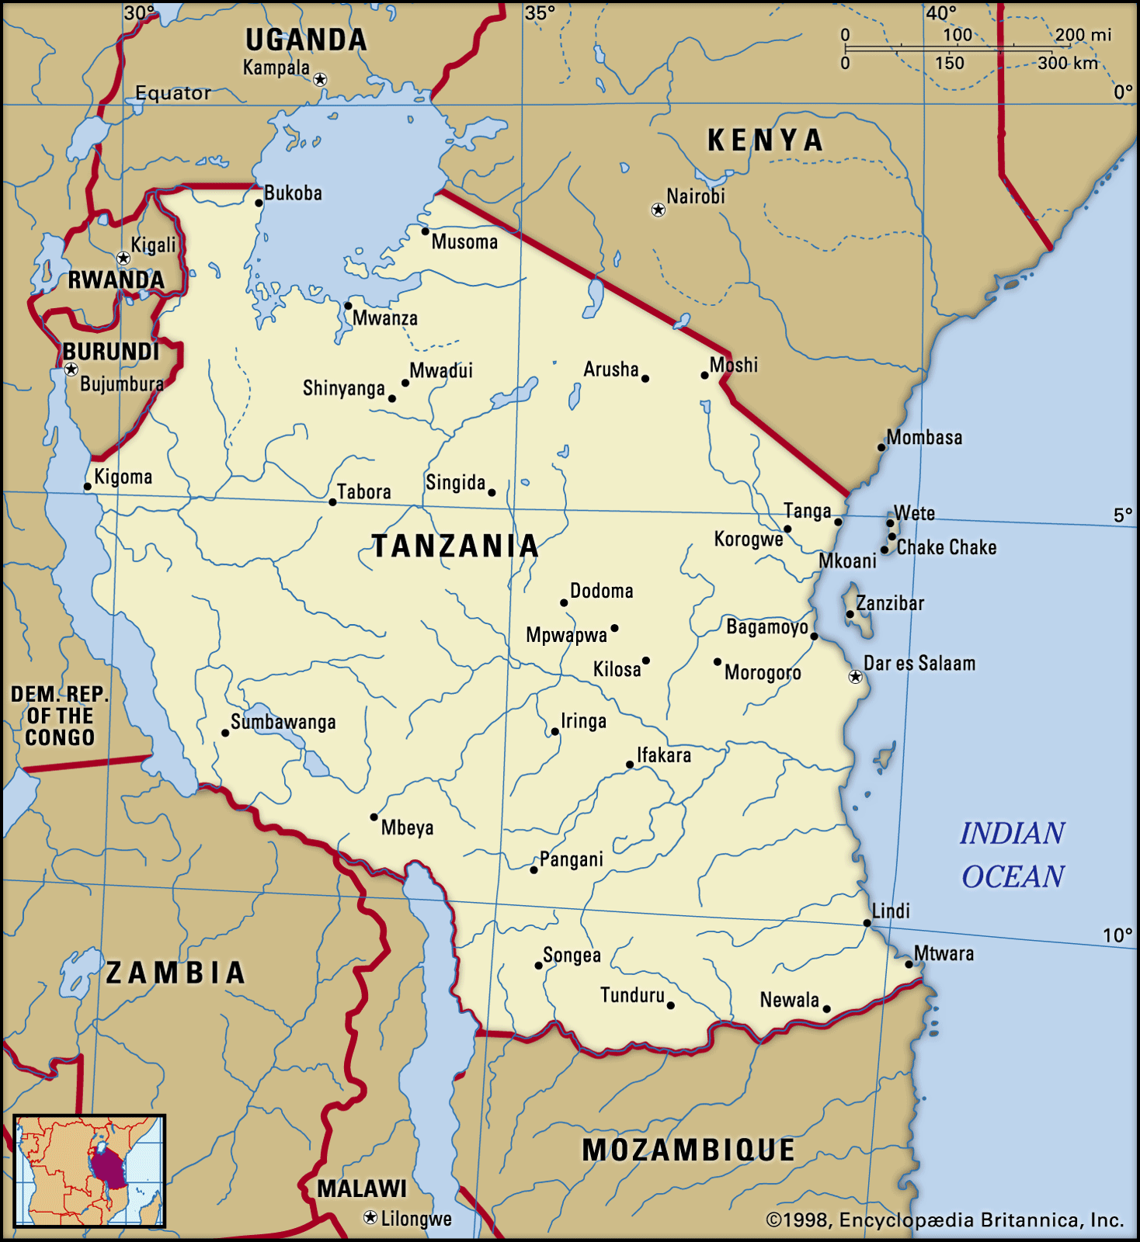
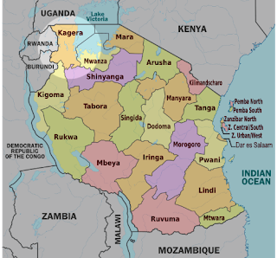
Tanzania
67 mil inhabitants, Christian 61.4%, Muslim 35.2%
Independence 1961, Creation of United Republic of Tanzania 1964
Kagera war 1978-1979
New capital city Dodoma
John Magufuli x Samia Saluhu Hassan
Chama Cha Mapinduzi (Tanganyika African National Union (TANU) + Afro-Shirazi Party)

Slide 12
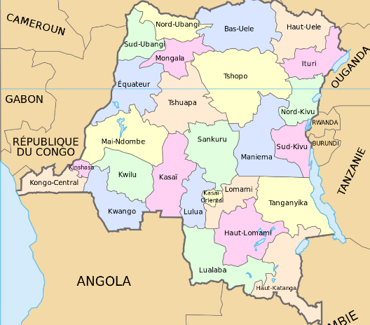
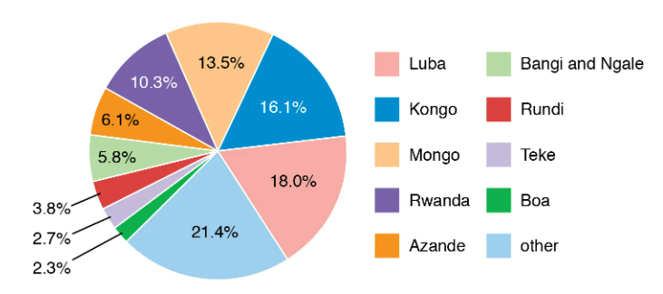
DRC
102 mil inhabitants, Christians constituted 93.7%
Independence 1960
First civil war 1996-1997
Second civil war 1998-2003
Alliance of Democratic Forces for the Liberation of Congo-Zaire (AFDLC)
RCD - Congolese Rally for Democracy, MLC -Movement for the Liberation of Congo
M23, Mai-Mai, CODECO
Félix Tshisekedi

Slide 13
DRC - Division between VNSAs
Popular Forces for Peace – People's Army – FPP-AP
NDC-R (Nduma Defense of Congo-Renovated)

Slide 14
HIV in Africa
State | % in the population
Eswatini | 26%
Botswana | 23,4%
South Africa | 17%
Tanzania | 5%
Rwanda | 3%
Burundi | 3%
Uganda | 7%

Slide 15
HIV/AIDS

Slide 16
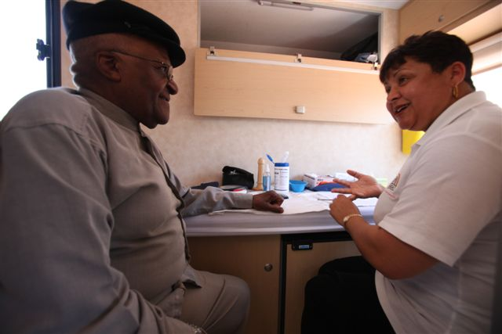
HIV in Africa
Bushmeat theory – Cameroon.
71% of the total HIV population lives in Sub-Africa.
Desmond Tutu HIV Foundation .
UNAIDS - Joint United Nations Programme on HIV/AIDS.
Causes of expansion in Africa: behavioral factors, lack of money, natural disasters and conflicts, health industry, medical suspicion, circumcision?, religious factors, educational level, poverty.
Armed conflict can increase the likelihood of exposure to HIV infection in several of the following ways: a) Population displacement b) Breakdown of traditional sexual norms c) Vulnerability of women and girls d) Rape as a weapon of war e) Collapse of health systems f) Increased substance use
Uganda – AIDS Information Centers, ABC Campaign

Slide 17
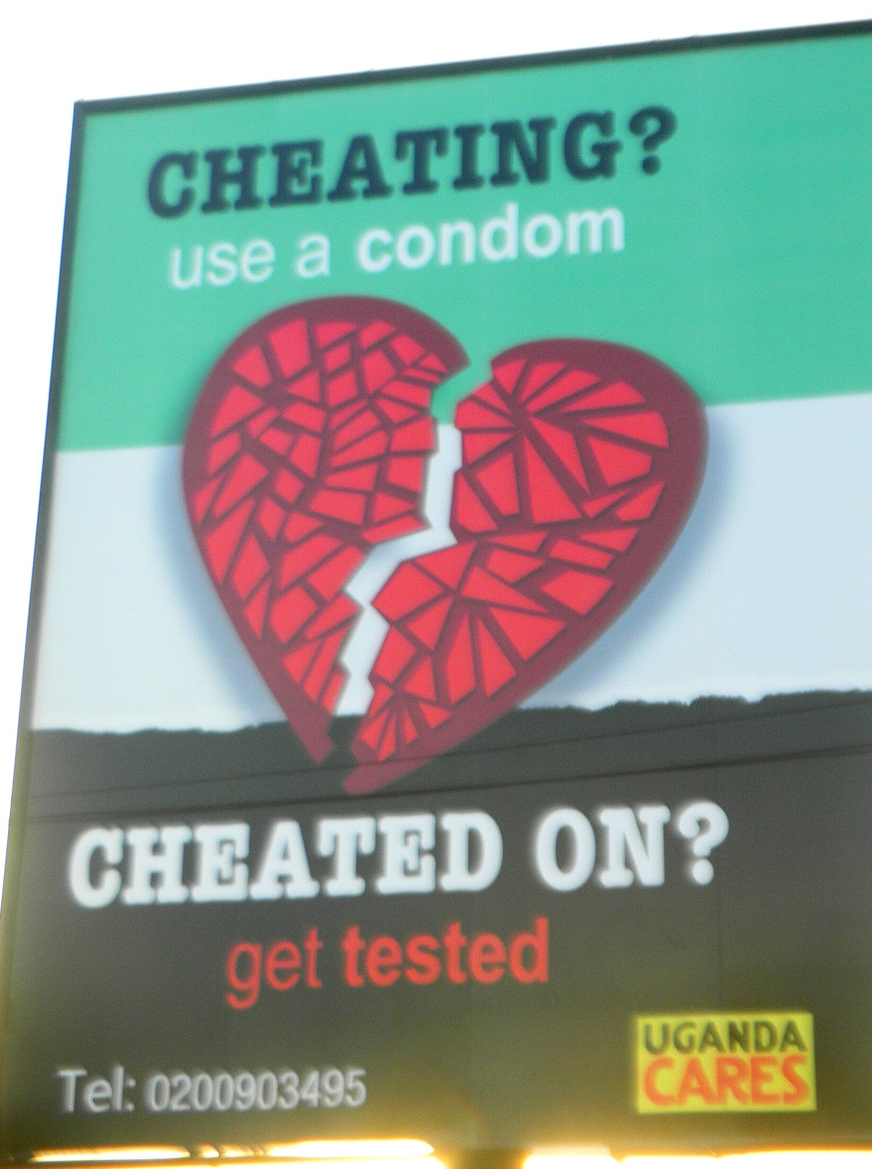
Uganda – ABC Campaign

Slide 18
HIV in Africa
Justus Amuche Nweze - HIV/AIDS in sub-Saharan Africa: Current status, challenges and prospects.
Reasons for the high prevalence of HIV/AIDS in sub-Saharan Africa:
The initial responses to HIV in Africa and the West
b) Cultural behaviors and beliefs (Postpartum sexual abstinence, Sexual cleansing, Virgin cleansing fable, Ritualised non-marital sexual intercourse)
c) Multiple sexual partners
d) Poverty, conflict/war, migration, and HIV/AIDS
e) Blood transfusion and HIV
f) HIV/AIDS-associated stigma and discrimination

Slide 19
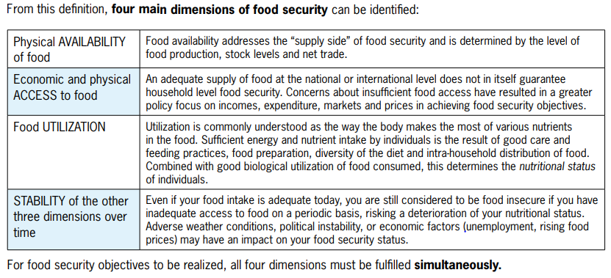
Food Security - Definition
“Food security exists when all people, at all times, have physical and economic access to sufficient safe and nutritious food that meets their dietary needs and food preferences for an active and healthy life.” 1996 World Food Summit.
“Food insecurity, on the other hand, is defined by the United States Department of Agriculture (USDA) as a situation of "limited or uncertain availability of nutritionally adequate and safe foods or limited or uncertain ability to acquire acceptable foods in socially acceptable ways.“
4 Dimensions + 2 new dimensions (Agency and Sustainability).

Slide 20
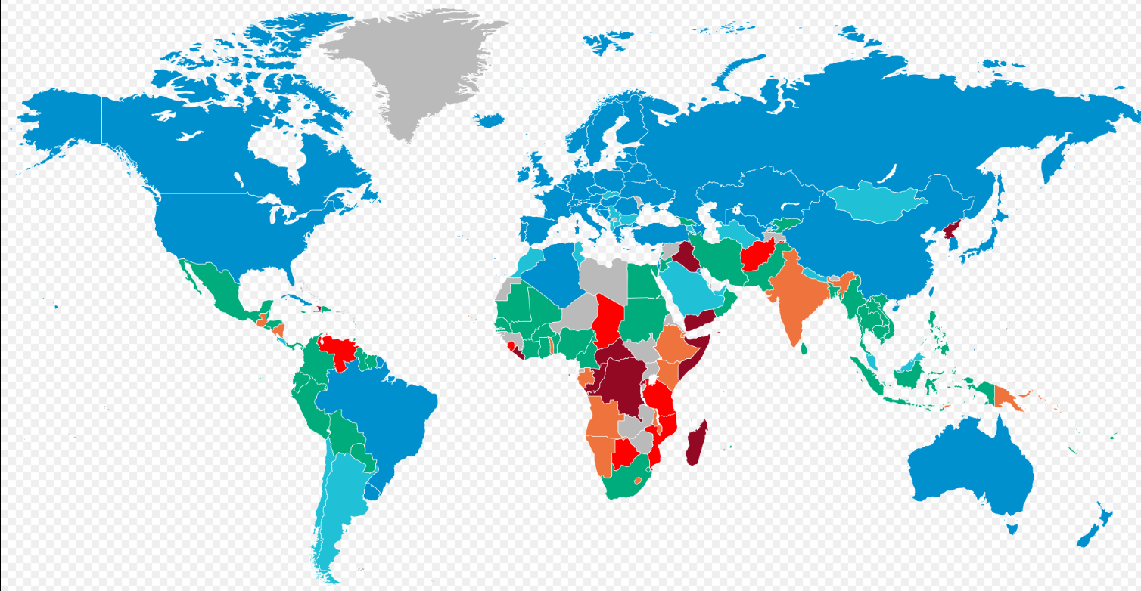
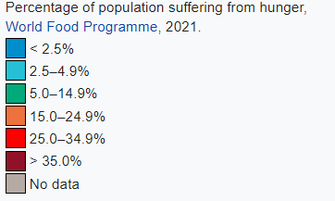
Hunger in the World

Slide 21
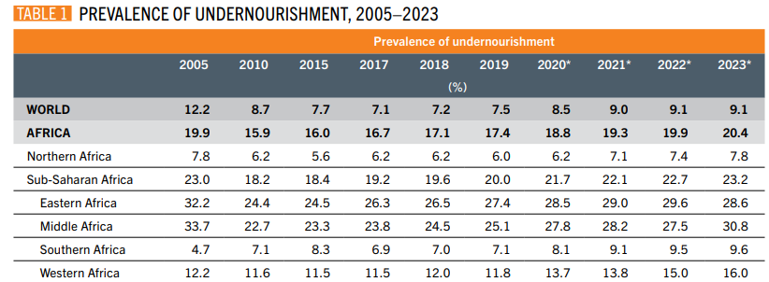
Food Security
298.6 (384 worldwide) million people in Africa face hunger (2023).
Food security situation is determined by several drivers including conflicts, climate variability and extremes, economic slowdowns and downturns, and the unaffordability of healthy diets.
Food and Agriculture Organization of the United Nations, FAO (1945).
The biggest deterioration occurred between 2019 and 2020.
138.5 million people live in Eastern Africa, followed by Western Africa (70.4 million), Middle Africa (62.2 million), Northern Africa (20.7 million) and Southern Africa (6.8 million).

Slide 22
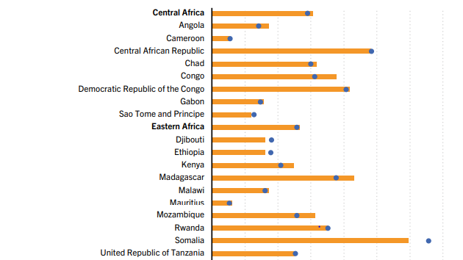
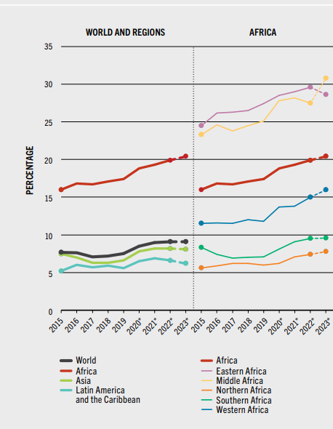
Food Security
FAO highlights four factors having a negative impact on food security in Africa:
a) Conflict: Prolonged or new conflicts disrupt food production, markets, and access, displacing millions and exacerbating hunger.
b) Climate variability and extremes: Changes in climate patterns, including droughts, floods, and extreme weather, reduce agricultural productivity and increase food insecurity.
c) Economic slowdowns and downturns: Global economic instability, exacerbated by events like COVID-19, has led to reduced income and employment opportunities, limiting access to nutritious food.
d) Structural challenges: These include ineffective governance, policies that fail to address systemic issues in agriculture and food distribution and entrenched social inequalities.

Slide 23
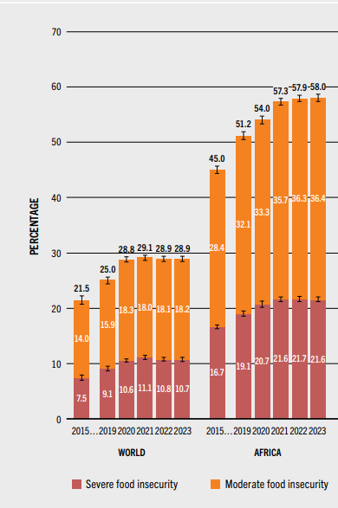
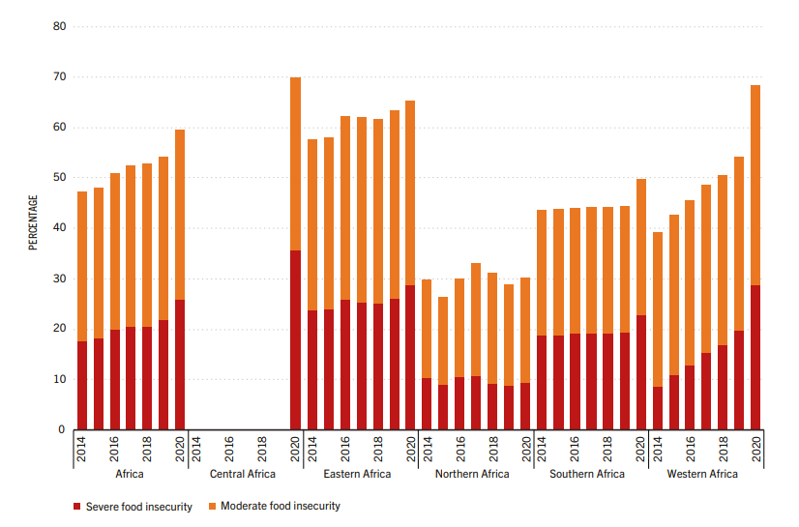
Food Security
The Food Insecurity Experience Scale - (FIES) :
a) Moderate food insecurity (uncertain ability to obtain food and have been forced to reduce, at times over the year, the quality and/or quantity of food they consume due to lack of money or other resources.
b) Severe food insecurity (run out of food, experienced hunger and, at the most extreme, have gone for days without eating)

Slide 24
Food Security
Food security and nutrition indicators:
Undernourishment
Food Insecurity Experience Scale
Stunting, wasting and overweight in children under five years of age (Data from WHO)
Low birthweight (under 2,5kg)
Adult obesity (BMI index,)
Anaemia in women of reproductive age (hemoglobin concentration less than 120 g/L)
Exclusive breastfeeding (Exclusive breastfeeding for infants under 6 months)

Slide 25
Food Security
Shared vision of humanity and a social contract between the world’s leaders.

Slide 26
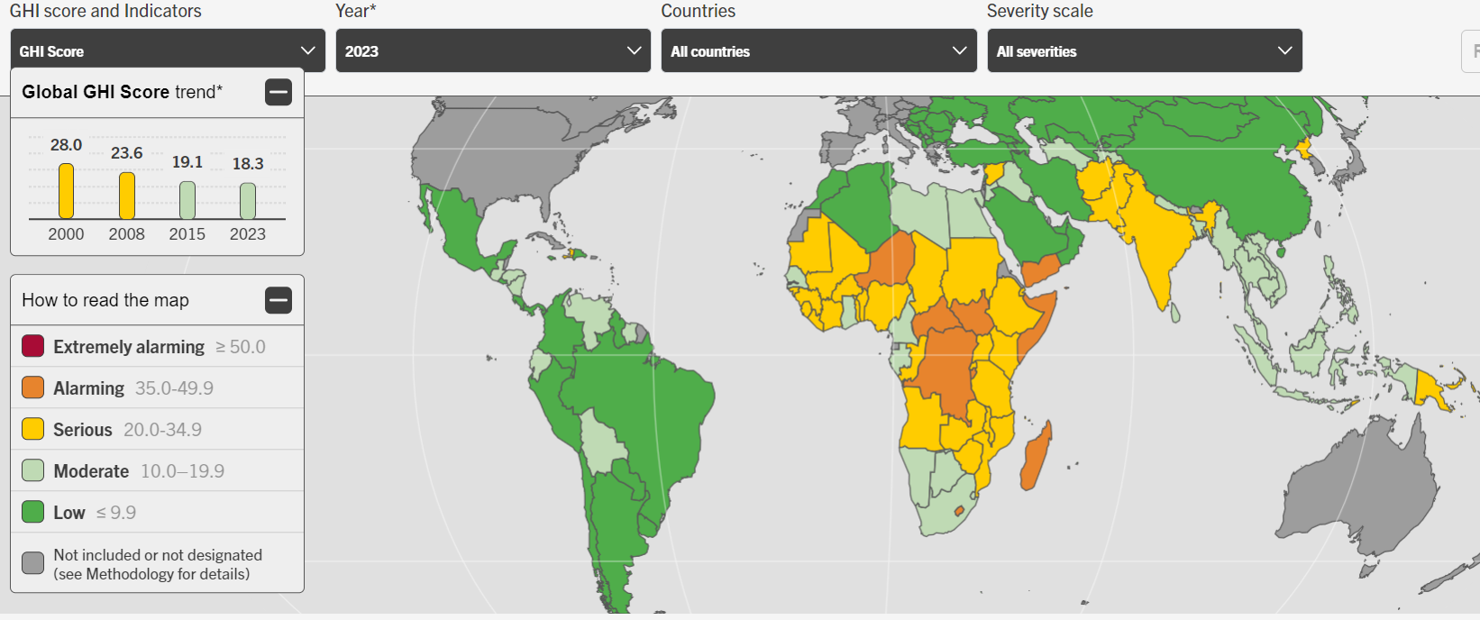
Global Hunger Index
Around 20% of people in Africa are facing chronic hunger, compared with only 10% globally.
Russia's war on Ukraine has exacerbated food supply problems, while climate change and the pandemic have also contributed.

Slide 27
Global Hunger Index

Slide 28
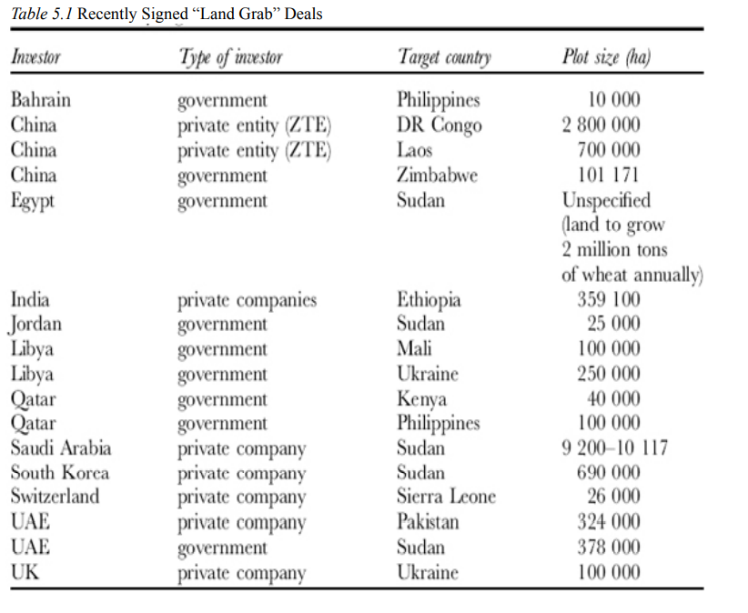
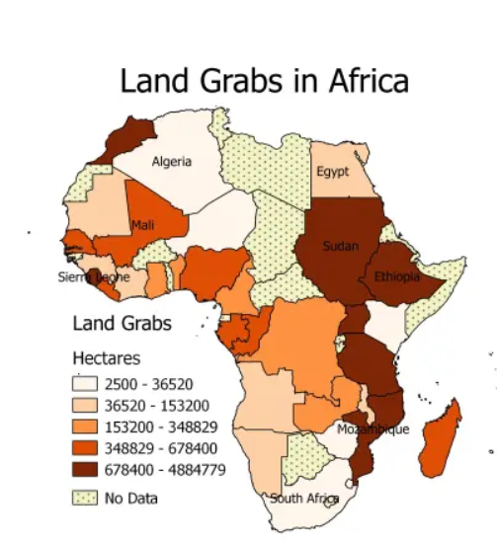
Land Grabbing: A New Challenge to Global Food Security

Slide 29
Thank you for your attention

