Slide 1
Hybrid Warfare
Jakub Drmola

Slide 2
What is hybrid warfare?
- is it conventional or irregular warfare?
- is it warfare in cyberspace or on the ground?
- is it warfare with weapons or information?
- is it new or old?
- there is no agreed definition

Slide 3
“… hybrid threat refers to an action conducted by state or non-state actors, whose goal is to undermine or harm a target by influencing its decision-making at the local, regional, state or institutional level. Such actions are coordinated and synchronized and deliberately target democratic states’ and institutions’ vulnerabilities. Activities can take place, for example, in the political, economic, military, civil or information domains. They are conducted using a wide range of means and designed to remain below the threshold of detection and attribution.”

Slide 4
Evolution of the concept
- first appearance in 1990s
western concept of parallel conventional and irregular operations
the concept gradually grew more and more vague and pointless
- resurgence in 2014
“hybrid warfare” became synonymous with the war in Ukraine
completely different understanding of the concept by RF – “nonlinear warfare”

Slide 5
Some traits
- hybrid war?…. just using any and all possible means to prevail
- but different from “total war”
- blurs the line between war and peace
- aims to be economical and efficient
- does not always seek immediate victory
- population-centric a political
- flexible and adaptive

Slide 6
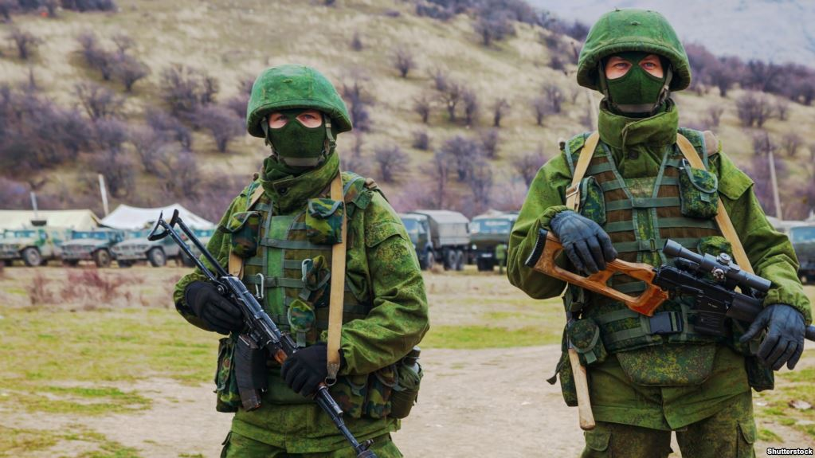

Slide 7
Tools used
- mobilizing sympathetic population
- arming and supporting proxy groups
- limited and clandestine deployment of regular forces
- “deregularization” of units
- cyber-attacks against the enemy and his infrastructure
- information warfare at both local and international level

Slide 8
So what is it again?
- it is just warfare in the broadest sense
- i.e. not limited to single type
- including non-military means
- avoiding escalation and full confrontation
- fluid, dynamic, adaptive

Slide 9
The recipe for “hybrid” warfare
Mix together: conventional warfare + irregular warfare + information warfare + political warfare + economic warfare + cyber warfare
- specific ratios of ingredients will differ case by case
- season to taste, shake and stir, and be ready modify
- also called “non-linear warfare” (RF, 2017) or “unrestricted warfare” (PRC, 1999)

Slide 10
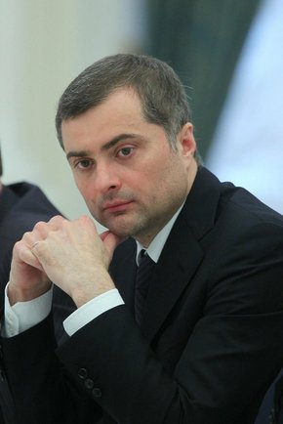
“Non-linear war”
concept by Vladislav Surkov (allegedly)
Putin’s advisor
shifting state of confusion
leveraging media
https://www.youtube.com/watch?v=tyop0d30UqQ

