Slide 1
Hungary and politics
Michal Pink

Slide 2
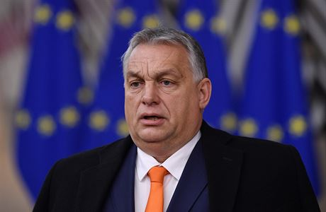
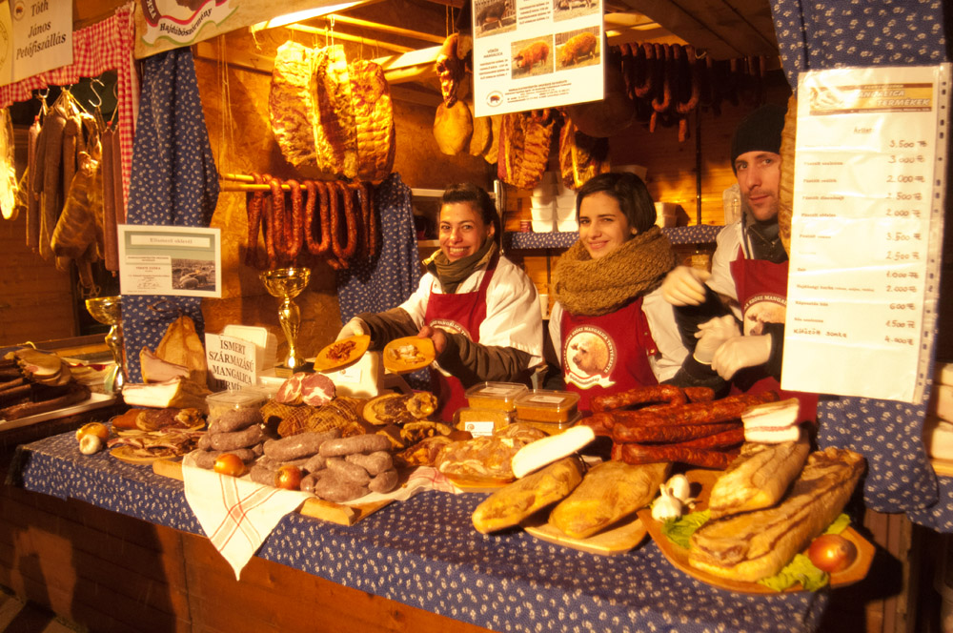
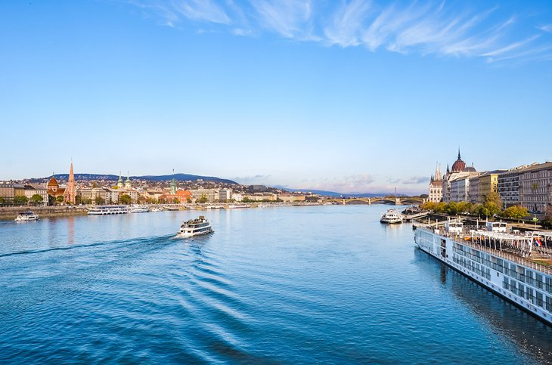
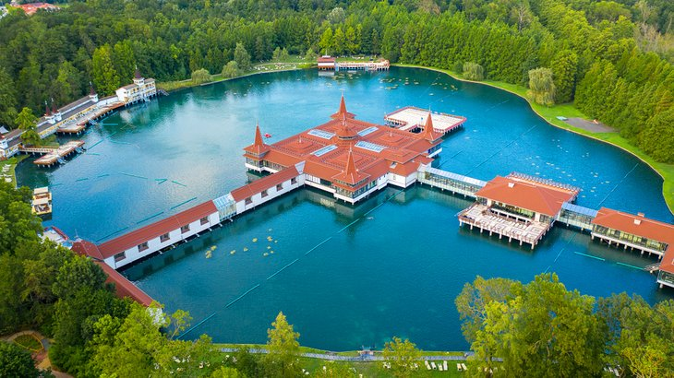
Hungary

Slide 3
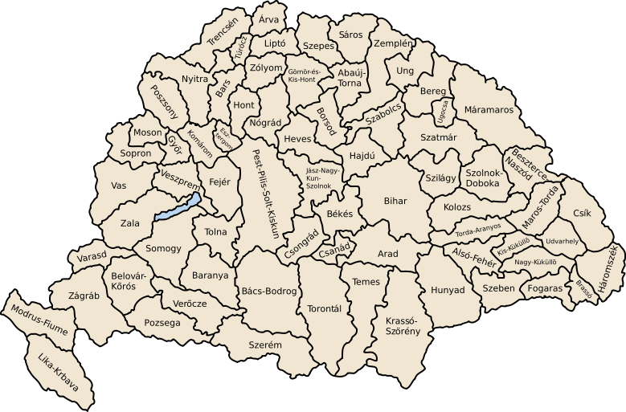
Hungary before 1918

Slide 4
Hungarian poliical parties 1866 - 1918
Függetlenségi és 48-as Párt – Party of Independence 48 (Liberalism)
Magyar Szociáldemokrata Párt – Social democracy
Katolikus Néppárt – Catholic People´s Party
Országos Alkotmánypárt – National Constitution Party (1867 – liberal)
Nemzeti Munkapárt - National Party of Work (Classical liberalism)
Polgári Radikális Párt - Radical Civic Party (Radicalism)
48-as Alkotmánypárt – 1848 Constitution Party (Liberalism)

Slide 5
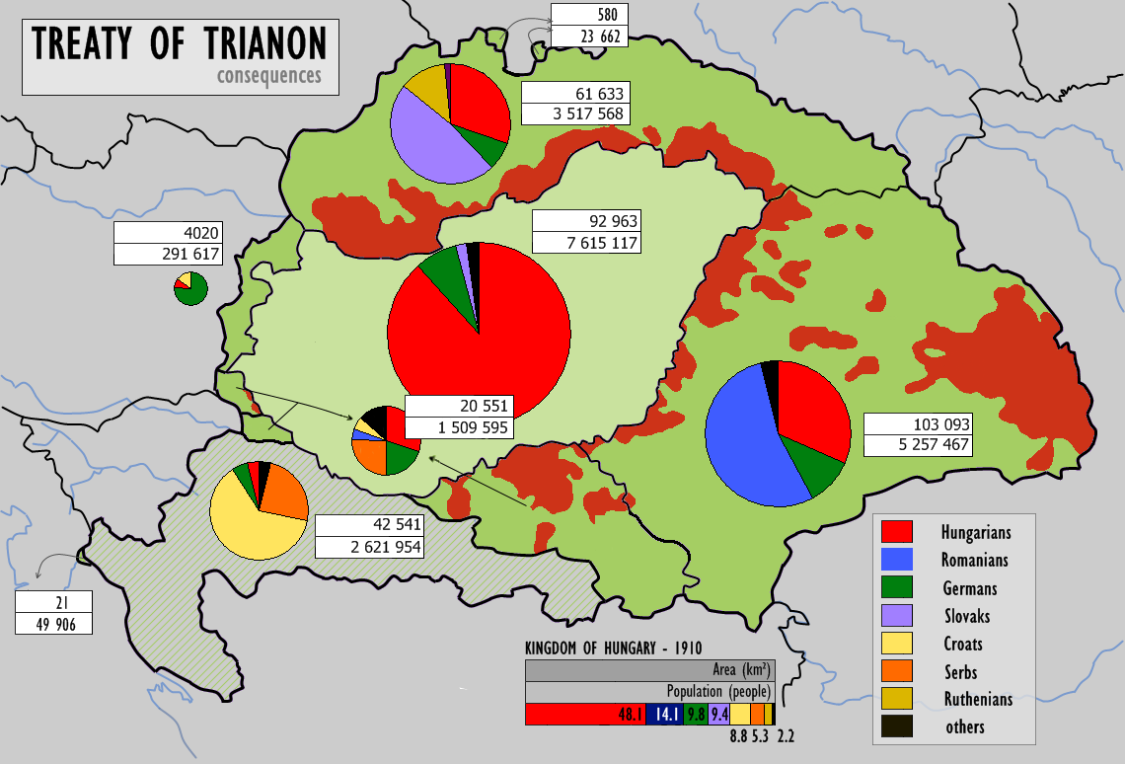
Trianon historical injustice

Slide 6
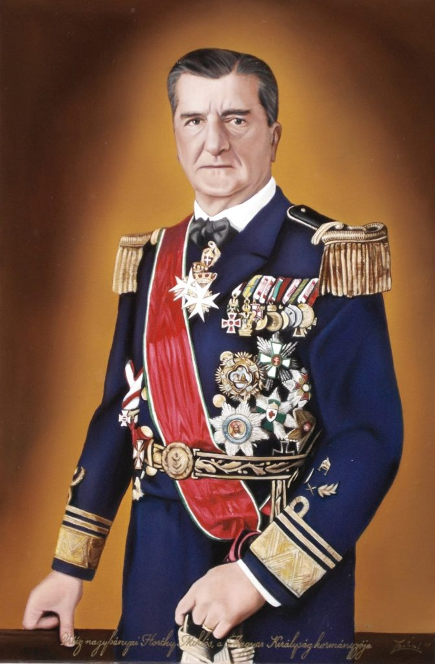
Hungary 1918 – 1920 and 1921 - 1940
First Hungarian Republic 1918 – 1920
MKP – Hungarian Communist Party
Béla Kun – Far left republic up to the Soviet model, „Red represions“
The end of the régime - external military act
Kingdom of Hungary – Kingdom without king
Miklós Horthy de Nagybánya – head of the Hungary 1920 – 1944
Head of the Habsburg NAVY during the WWI 1914 – 1918, soldier
National conservative leader, „Red represions cover by whitte represion“
March 1920 – restauration, but without House of Habsburg
Double restauration of Habsburg throne – without any positive reaction
Hungary and cooperation with Italy, Germany – active participation 1938/39

Slide 7
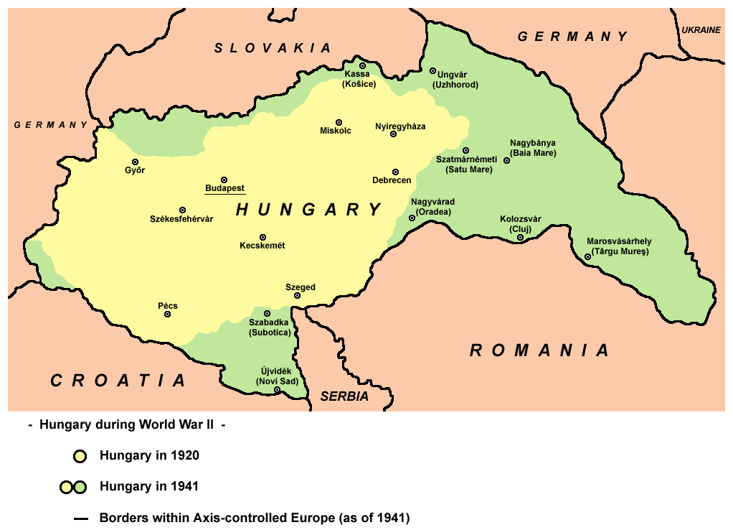
Hungary and WW II

Slide 8
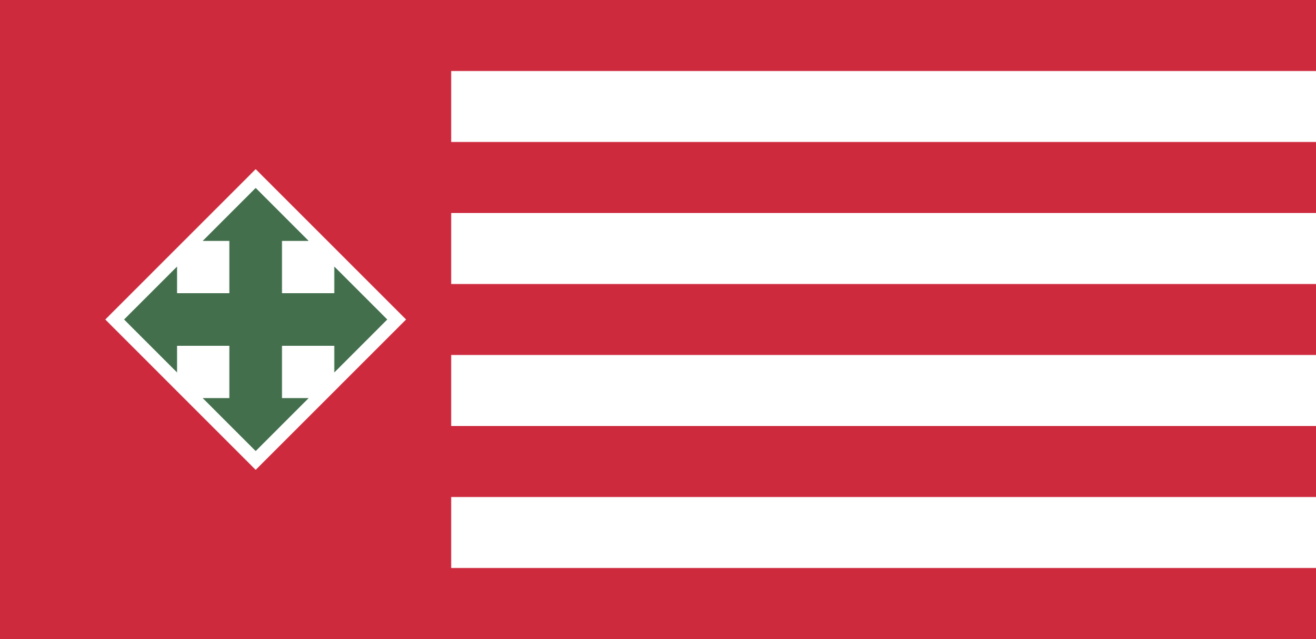
Hungary 1940 - 1944/45
1939 – 1940, step by step enlargement of borders
Czechoslovakia, Romania, Yugoslavia, „detrianonisation“
No military operation, foreign policy and cooperation with Germany
April 1941 Hungary member of Axis Power (Berlin – Rome)
1942, secret diplomatic negotiation with UK
Since 1944 represions of nondemocratic regime step by step in every day life
Until the 1944 – antisemitic laws, but better situation than in other countries
1944 – Germany occupy Hungary, Romania joined the Allies in August
Férenc Szálási 1944, replacement of Horthy, Arrow Cross Party leader
Horthy home isolation in Germany until the end of WWII.

Slide 9
1945 – 1956
Establishment of nondemocratic regime
Cooperation with Soviet army and Soviet advisors
Független Kisgazda Párt (Party of Independent farmers) 1945 winner
displacement of the German speaking population
No industrialisation – less workers, Hungary – rural, agrarian country
Step by step – instalation of totalitarian system up to the Soviet model
Magyar Dolgozók Pártja (Hungarian workres party 1947)
1949 – Constitution up to the Soviet model 1936
Hungarian peoples republic – violent represion aprox. 2000 victims (45 – 49)
Nationalisation - Agricultural cooperatives
State borders again according to Trianon

Slide 10
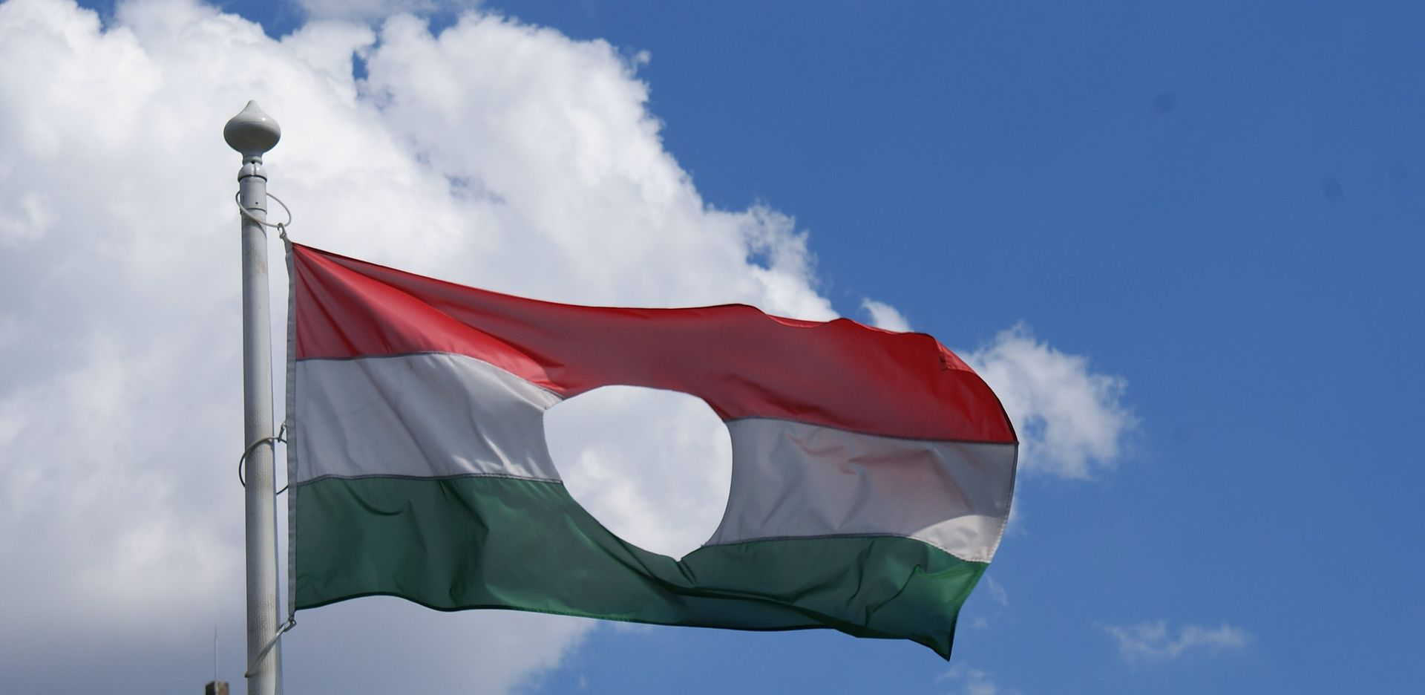
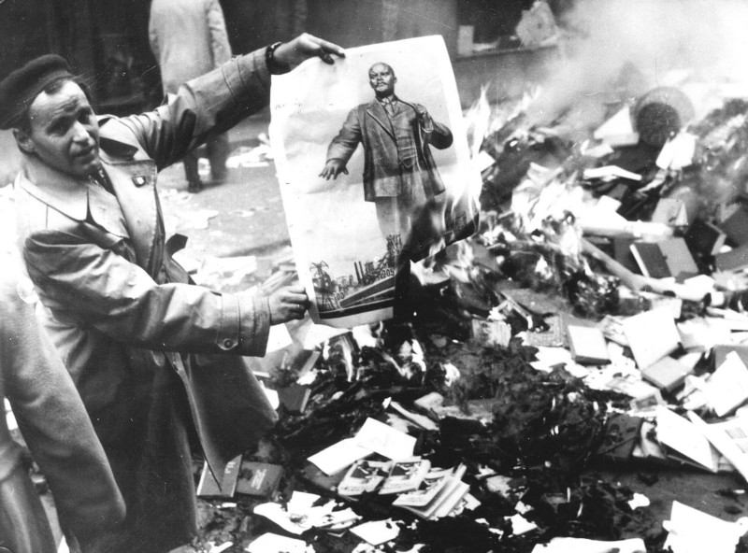
1956: 23.10. – 10.11.
Uprising, neutrality, exit of Warsaw pact and eastern block
nationwide resistence against the Stalinist dictatorship and Soviet control
Key name – Imre Nagy, prime minister of Hungary during two weeks
First, the Soviet army withdrew from the capital city and waited/Suez
October 31 the USSR decision – stop the revolution by military operation
November 4th – the offensive against the capital began
Six days of street war 5.500 victims
November 7th – János Kádar came to Budapest
Pro-Moscow revolutionary worker-peasant government
Imre Nagy was executed, "as a lesson to all other leaders
in socialist countries"

Slide 11
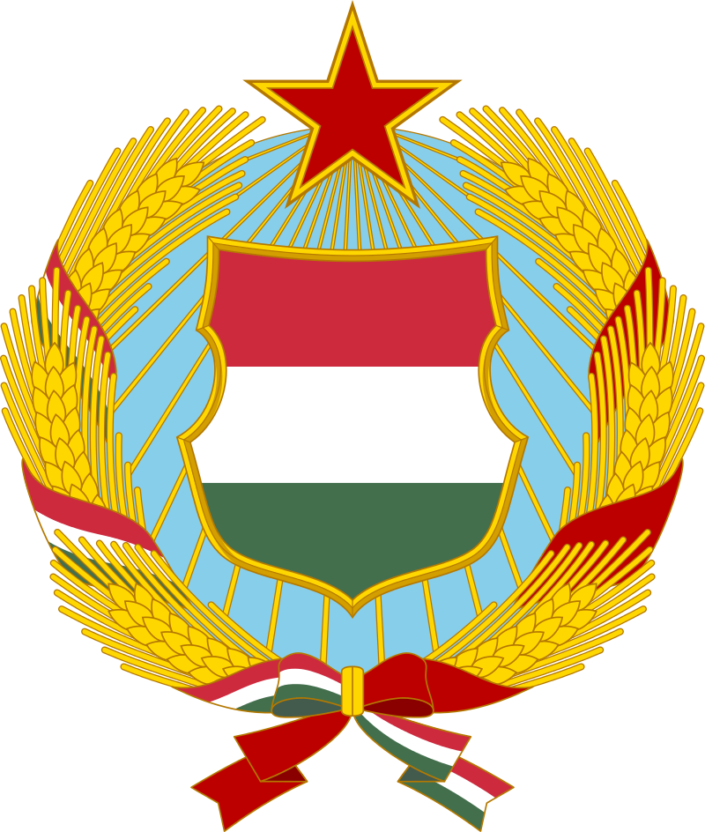
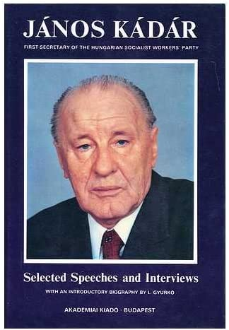
Gulyáskommunizmus – 1962 – 1989
Cadarism – a mix of different values and attitudes
The least repressive regime in Eastern Europe
Semi-freedom in private life, church, teaching AJ and NJ is not a problem
Limited free market - agricultural crops from own garden
Increasing living standards, numbers of cars, refrigerators, color TV

Slide 12
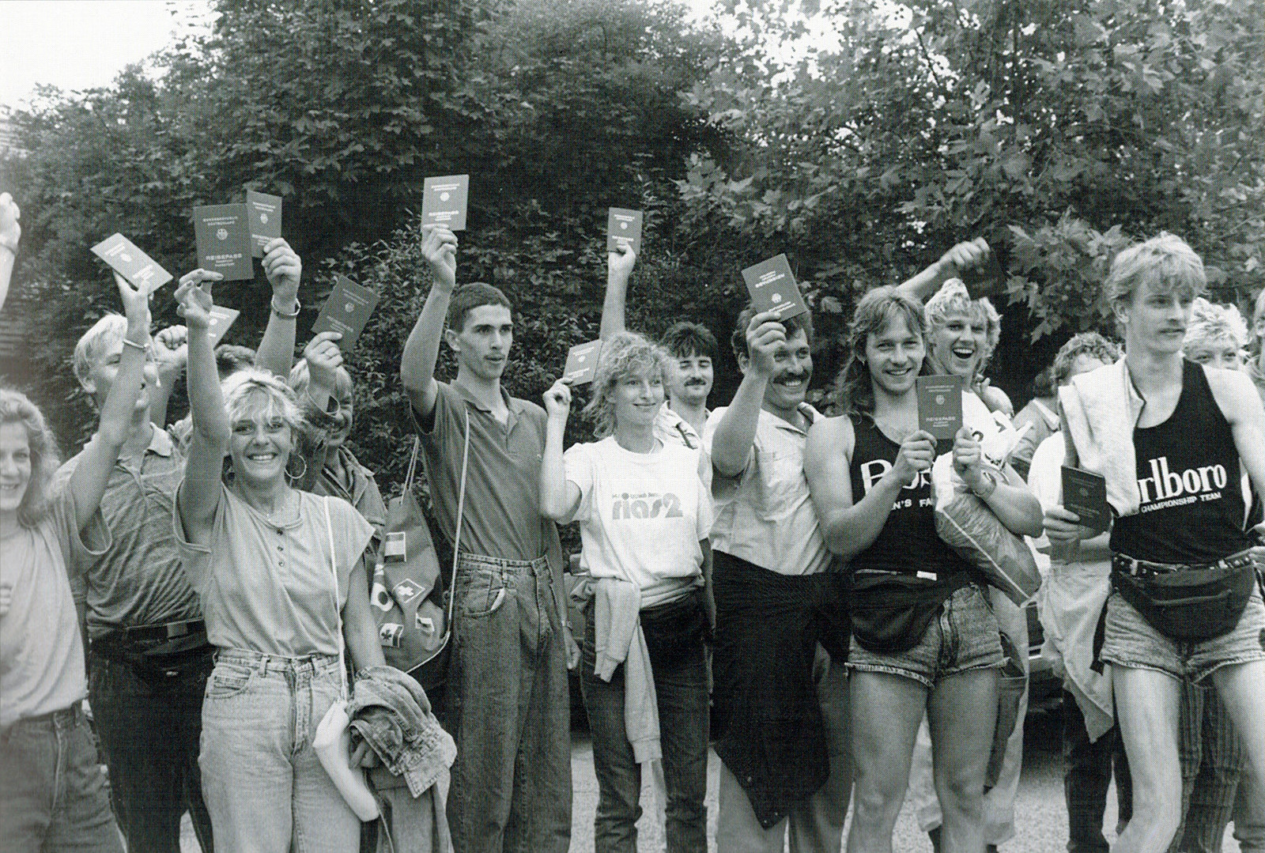
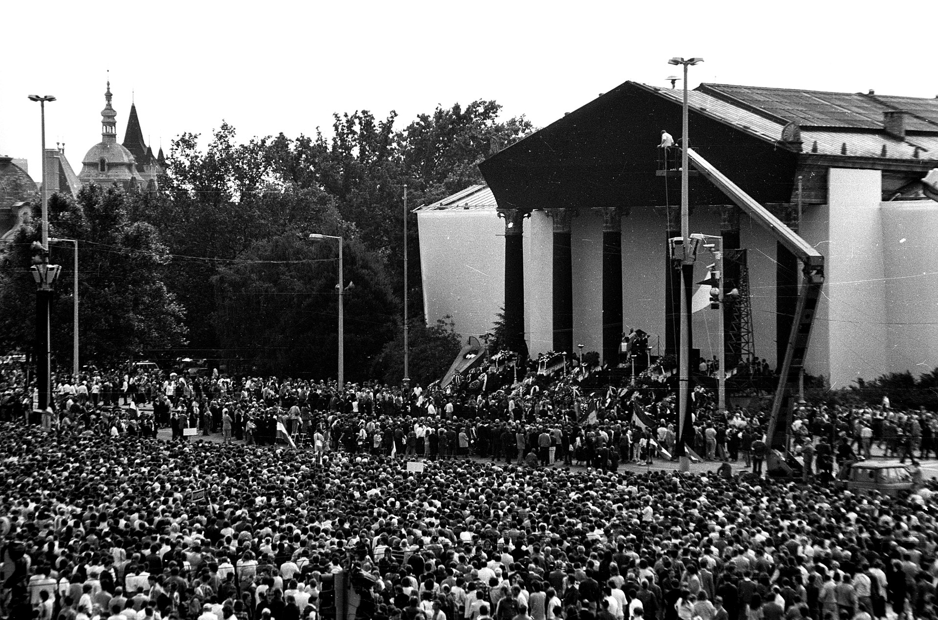
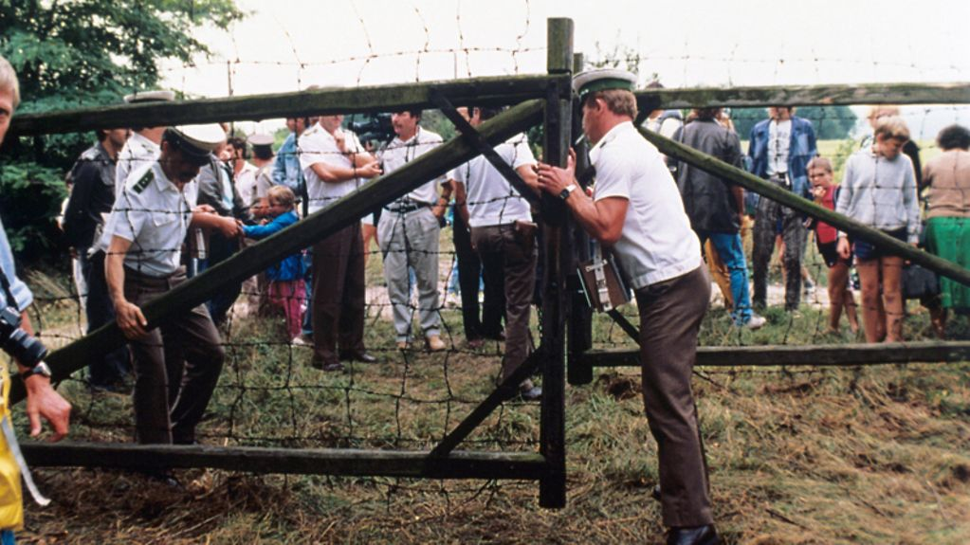
1989 – fall of comunnism

Slide 13
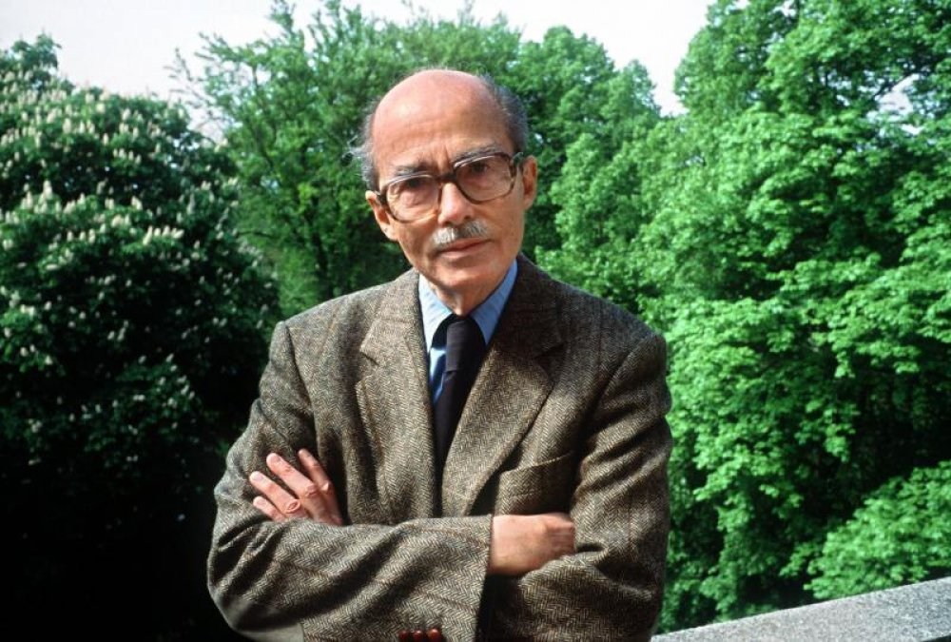
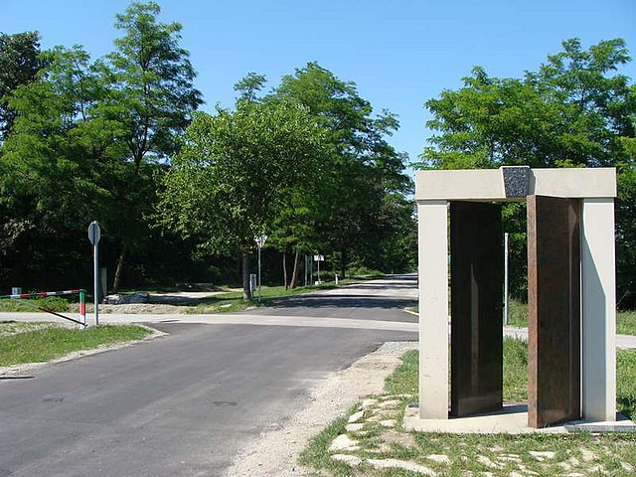
1989 – fall of comunnism
16.6. 1989 – funeral ceremony of Imre Nagy,
Victor Orbán speech
Pan-European picnic – 19.8. 1989
Opening the border for three hours - the end of the Iron Curtain
About 600 citizens of the GDR escape to the west
Negotiated transition - absence of a key turning point
No victims – other case Romania and neighboring Yugoslavia
March/April 1990 – first competitive election
During the fall 1989 negotiation – how to transform the regime
Constitution 23.10.1989 includes new rules of political power (symbolic day)
Role of MDF – Hungarian democratic forum

Slide 14
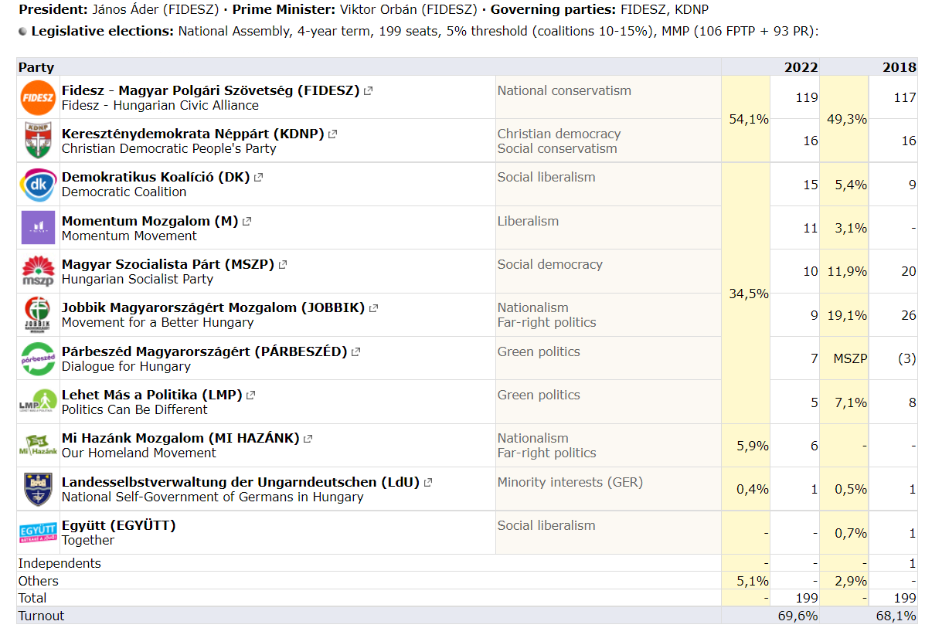

Slide 15
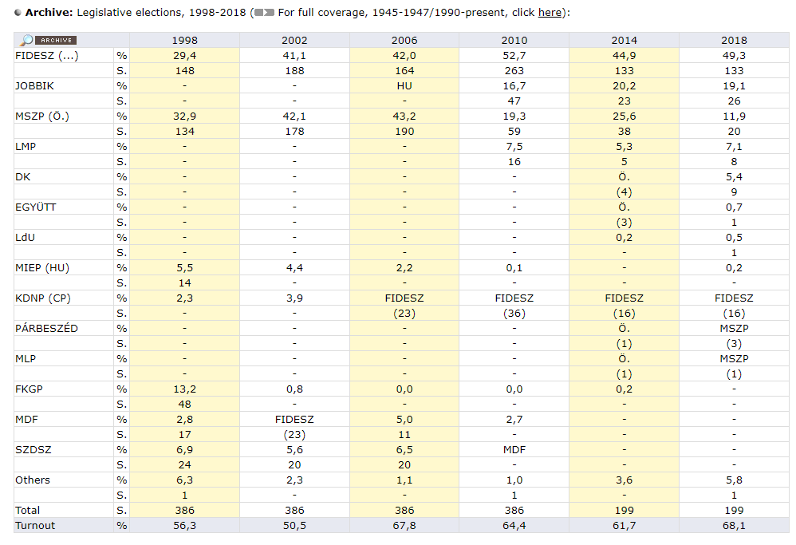

Slide 16
Hungarian Left
Transformation of Magyar Szocialista Munkáspárt (nodemocratic party)
Magyar Szocialista Párt – Hungarian Socialist party
Government role 1994 – 1998, 2002 – 2010
EU cooperation, redistribution, less post - Trianon claims
No other European country has done something as stupid as us", "We obviously lied in the last year and a half or two years", "Hungary managed to stay afloat only thanks to divine providence, a lot of money in the world economy and hundreds of scams.
Ferenc Gyurcsány 2006

Slide 17
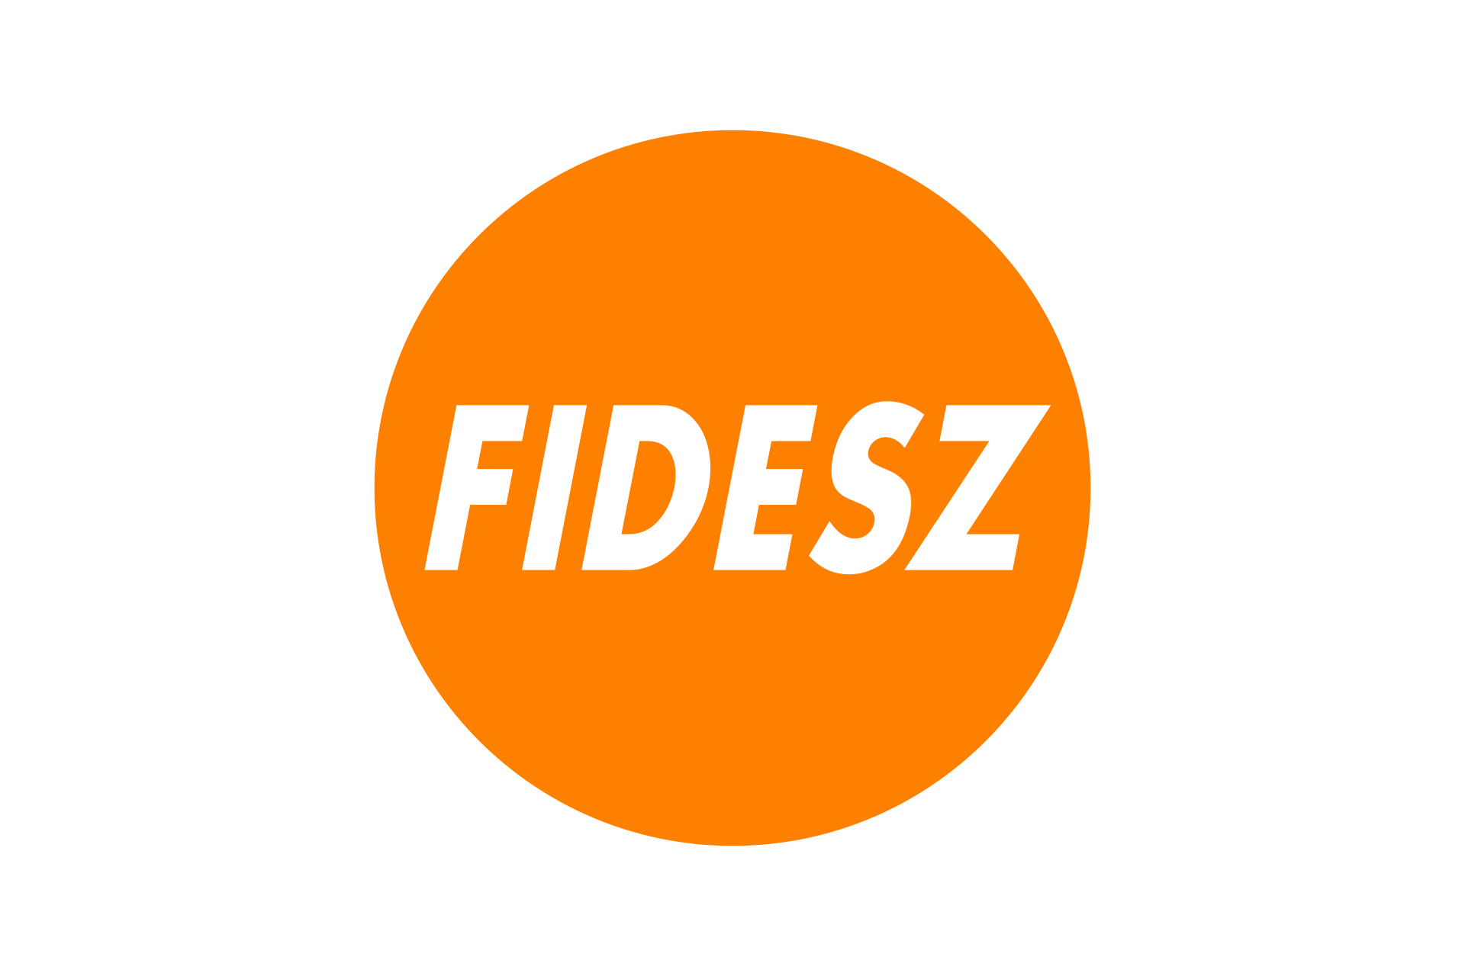
Hungarian right I. - Fidesz
1988 – Union of Young Democrats, max. 35 years
Opposition to the Communist Youth Organization
Governmental roles: 1998 – 2002 and since 2010
Viktor Orbán first an only one chairman of the party since 1993
1993 - spirit of liberal politics, but lost elections of 1994, 7.02%
1994 – 1998 transition from liberalism to a national-conservative position
1999 NATO and 2004 EU, 2001 - the Land Act, which gives Hungarians living outside the territory the same rights as citizens of the Republic of Hungary

Slide 18
Hungarian center/left?
Momentum – 2017, Budapest Olympics – referendum
LGBT support, decriminalization of cannabis, abortion rights etc.
Aim of the party: Hungary – let´s plan together by common goals
Green I. – Dialog for Hungary, cooperation with Socialist – local level
Green II. – Politics can be different, internal conflicts
Democratic coalition – center left project of exprime minister FD

Slide 19
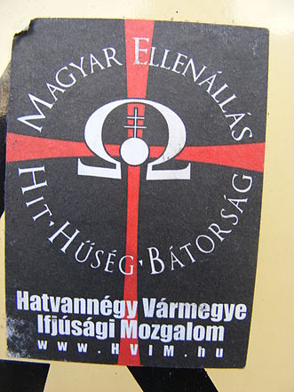
Hungarian right II.
Hungarian Justice and Life Party - István Csurka 1993 (MIÉP)
Jobbik – 2009 EP election
„Hungary belongs to the Hungarians“ – against the Constituion
Hungarian Guard Movement – own paramilitary organisation
No longer existence
Our Homeland Movement - Mi Hazánk Mozgalom, MHM
László Toroczkai - László Tóth, change the name Tóth/Slovac
Sixty-Four Counties Youth Movement

Slide 20
Conclusion
The radicalization process of political environment
Fidesz takes over the role of the moderate far/extreme right
The government gives space to the extreme right in the media
2015 – „normalisation“ of Jobbik
MHM – old trandition Hungarian interest
Social, liberal center left parties exist, but very fragmented and in minory

