Slide 1
Dynasties timeline

Slide 2
Timeline of dynasties
Xia (2000 BC – 1600 BC) – mythical, never proven
Shang (1600 BC – 1000 BC) – small bronze-age state in northern China, pagan religion and divinations

Slide 3
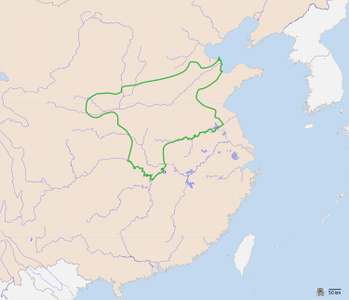

Slide 4
Timeline of dynasties
Zhou (1000 BC – 700 BC) – somewhat larger and more sophisticated

Slide 5
Timeline of dynasties
Zhou (1000 BC – 700 BC) – somewhat larger and more sophisticated
- disintegrated into several smaller kingdoms around 700 BC
> Spring and Autumn period, Warring States period > focus on increased production and population

Slide 6
Timeline of dynasties
Zhou (1000 BC – 700 BC) – somewhat larger and more sophisticated
- disintegrated into several smaller kingdoms around 700 BC
> Spring and Autumn period, Warring States period > focus on increased production and population
„Hundred Schools of Thought“ > Confucionism, Legalism, Taoism = search for legitimacy and unity in a turbulent age

Slide 7
Qin
„First Emperor“ – Qin Shi Huang – around 220 BC
Destroyed the other states, unified China, expanded into the south
Great Wall, terracota army, first great capital at Chang-an (Xian)
Megalomaniac and tyranical – high taxes, cruel punishments, purges of dissident scholars
Unpopular > overthrown around 200 BC
> „China“

Slide 8
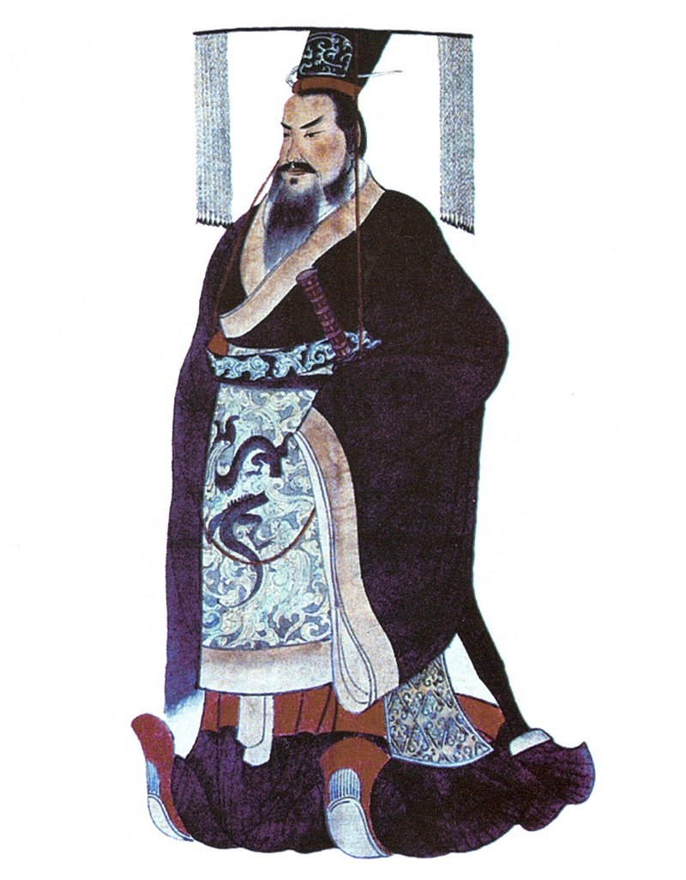

Slide 9
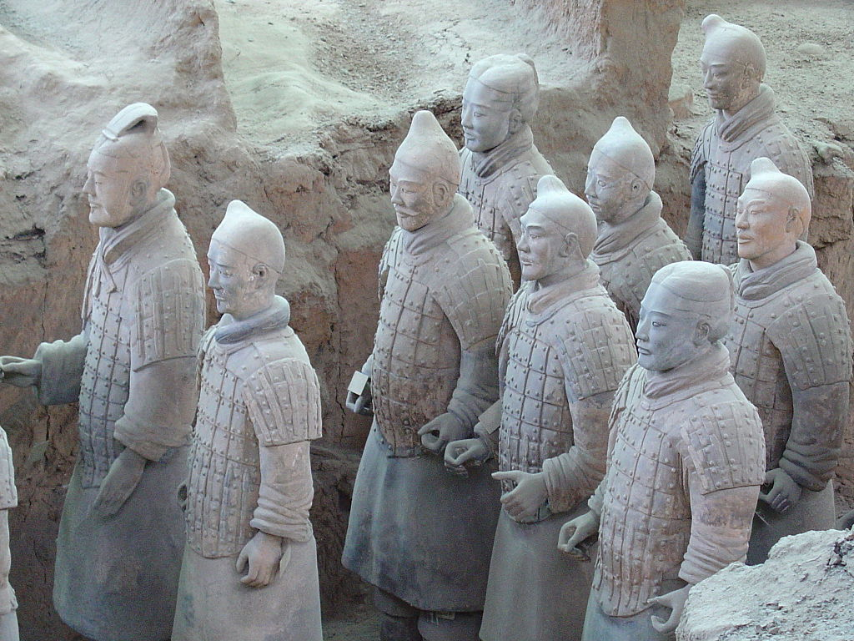

Slide 10
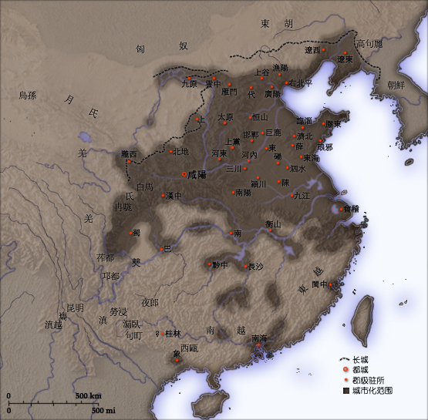

Slide 11
Han
200 BC – 200 AD
> „Han Chinese“, „Han characters“
More lenient, ruled on the basis of consent
Confucianism as the state ideology, first imperial examinations
Defeated the Xiongnu steppe tribes > Silk route

Slide 12
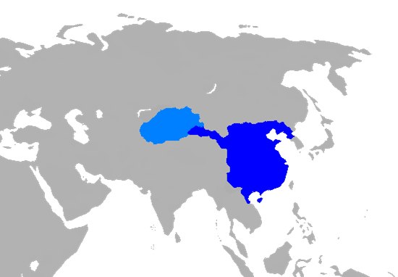

Slide 13
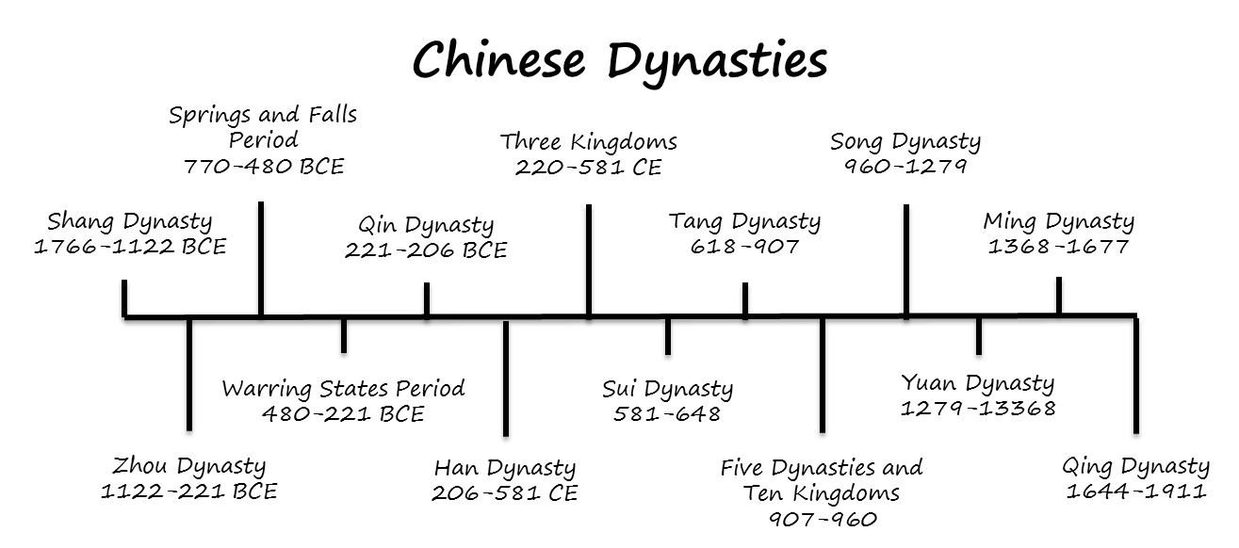

Slide 14
Sui and Tang
200 AD – 600 AD – „Three Kingdoms period“ – many short-lived regimes
Around 600 – Sui – unification, Grand Canal
Again too high taxes and too much cruelty > Tang dynasty (600-900)
Exposure to foreign cultures (Buddhism, Islam, Zoroastrianism, Christianity)
Imperial examinations!
„An Lushan rebellion“ – relatively worst civil war in human history?

Slide 15
Song
Song dynasty (900-1250)
Unknown and underrated
Better rice from Southeast Asia > doubling of population
Technological Innovation: paper money, printing of books, gunpowder, compass, pound lock

Slide 16
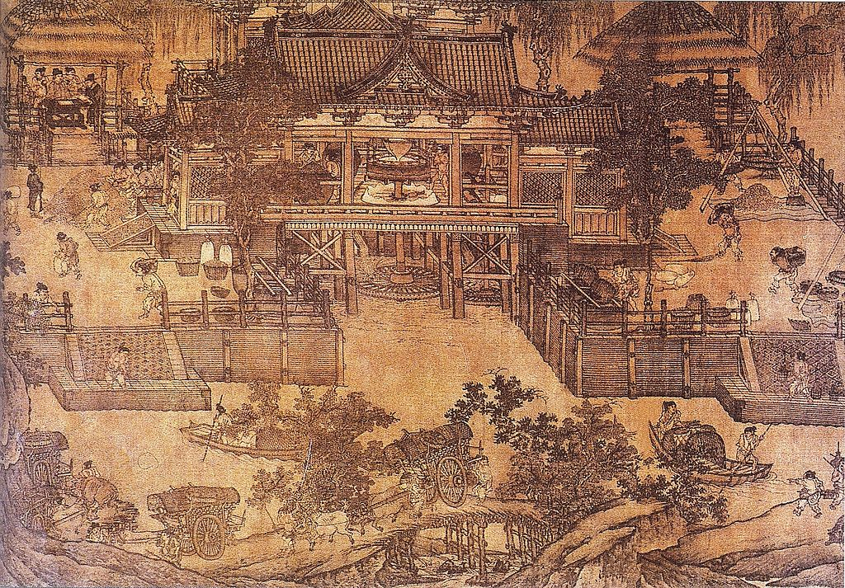

Slide 17
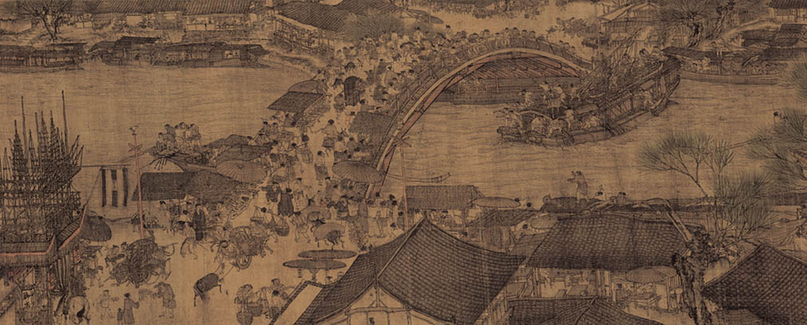

Slide 18
Mongols
1250-1350 – Mongols! (Genghis Khan)
Total conquest of China > Mongol Yüan dynasty

Slide 19
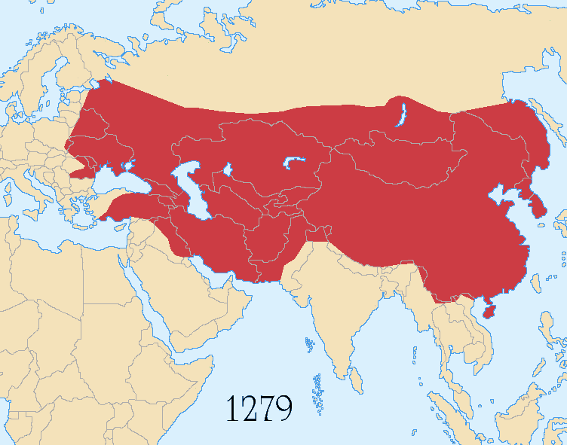

Slide 20
Mongols
1250-1350 – Mongols! (Genghis Khan)
Total conquest of China > Mongol Yüan dynasty
Kublai Khan – visited by Marco Polo
Attempts to conquer Korea, Japan, Vietnam and Indonesia (!)

Slide 21
Ming
1350-1650
Native Han Chinese rebellion against the Mongols („White Lotus movement“)

Slide 22
Ming
1350-1650
Native Han Chinese rebellion against the Mongols („White Lotus movement“)
Restoration of traditional culture and Confucianism

Slide 23
Ming
1350-1650
Native Han Chinese rebellion against the Mongols („White Lotus movement“)
Restoration of traditional culture and Confucianism
Ethnocentrism, xenophobia > end of naval exploration, isolationism and stagnation

Slide 24
Ming
1350-1650
Native Han Chinese rebellion against the Mongols („White Lotus movement“)
Restoration of traditional culture and Confucianism
Ethnocentrism, xenophobia > end of naval exploration, isolationism and stagnation
Nanking („Southern Capital“) and Beijing („Northern Capital“)

Slide 25
Zheng He‘s voyages
Early 1400s
Reached Southeast Asia, India, eastern Africa and Persia

Slide 26
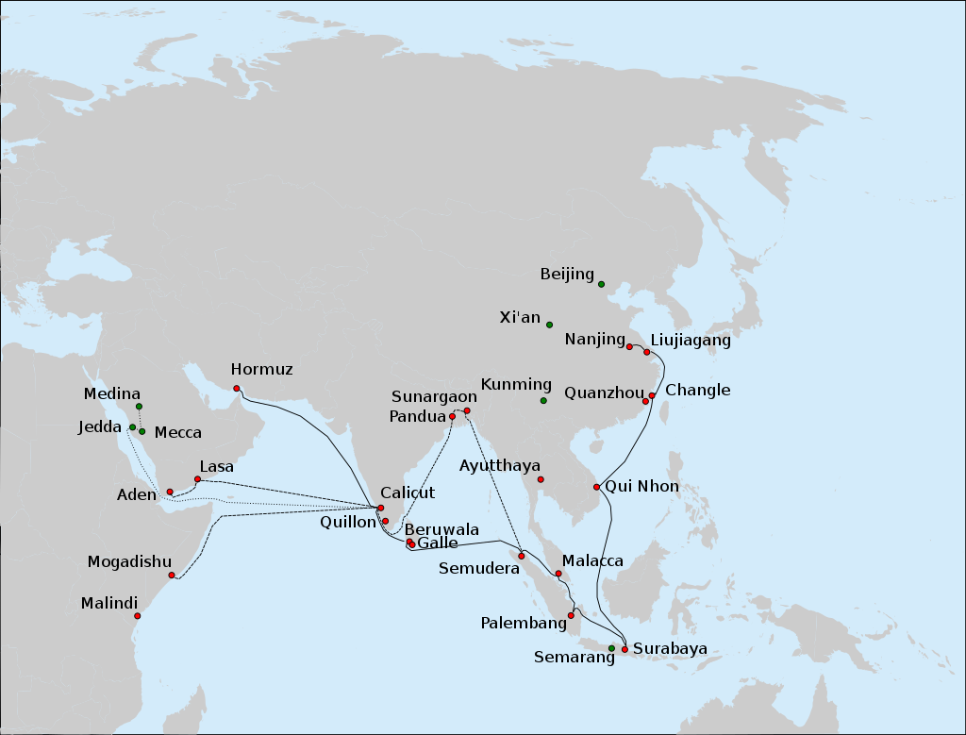

Slide 27
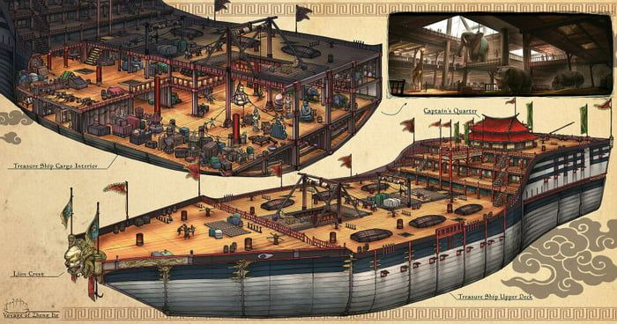

Slide 28
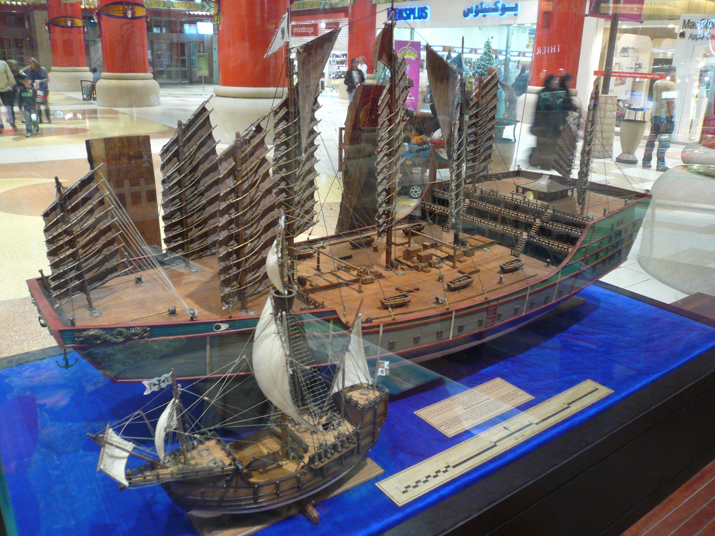

Slide 29
Zheng He‘s voyages
Early 1400s
Reached Southeast Asia, India, eastern Africa and Persia
Building of tributary relationships + some trade ties

Slide 30
Zheng He‘s voyages
Early 1400s
Reached Southeast Asia, India, eastern Africa and Persia
Building of tributary relationships + some trade ties
Cancelled – fear of foreigners + too expensive

Slide 31
Zheng He‘s voyages
Why was the Silk Road not cancelled?

Slide 32
Zheng He‘s voyages
Why was the Silk Road not cancelled?
No expenditures for the Chinese treasury
+ luxury trade – not subversive!

Slide 33
Qing
Last dynasty – 1650 - 1911
Manchus, steppe nomads similar to the Mongols - conquered China

Slide 34
„The transition from Ming to Qing, Ming–Qing transition, or Manchu conquest of China from 1618 to 1683 saw the transition between two major dynasties in Chinese history.“

Slide 35
Qing
Last dynasty – 1650 - 1911
Manchus, steppe nomads similar to the Mongols - conquered China
Militaristic and expansionist

Slide 36
Qing
Last dynasty – 1650 - 1911
Manchus, steppe nomads similar to the Mongols - conquered China
Militaristic and expansionist
> genocide of Dzungar Mongols, conquest of Tibet and Taiwan, tributary relations with Korea, Japan, Vietnam, Thailand

Slide 37
Qing
Last dynasty – 1650 - 1911
Manchus, steppe nomads similar to the Mongols - conquered China
Militaristic and expansionist
> genocide of Dzungar Mongols, conquest of Tibet and Taiwan, tributary relations with Korea, Japan, Vietnam, Thailand
Reached the limits of pre-industrial growth – highest yields and population possible without modern machinery

