Slide 1
Export-led growth
China in the World Economy, autumn 2024

Slide 2
Repetition from last time
1) How does a country finance its imports?

Slide 3
Repetition from last time
1) How does a country finance its imports?
2) What is the role of banks in an economy?

Slide 4
The role of China‘s banks
Banks – transfer people‘s savings into loans -> investment

Slide 5
The role of China‘s banks
Banks – transfer people‘s savings into loans -> investment
In China, banks (and other financial corporations) are overwhelmingly state-owned

Slide 6
The role of China‘s banks
Banks – transfer people‘s savings into loans -> investment
In China, banks (and other financial corporations) are overwhelmingly state-owned
= control over investment -> a tool of industrial and macroeconomic policy

Slide 7
The role of China‘s banks
Banks – transfer people‘s savings into loans -> investment
In China, banks (and other financial corporations) are overwhelmingly state-owned
= control over investment -> a tool of industrial and macroeconomic policy
= the government can order the banks to increase lending during a crisis, or to give „soft“ loans to a particular industry

Slide 8
The role of China‘s banks
Banks – transfer people‘s savings into loans -> investment
In the US – the stock market plays a similar role

Slide 9
The role of China‘s banks
Banks – transfer people‘s savings into loans -> investment
In the US – the stock market plays a similar role
China – financial speculation is heavily regulated -> the only avanue for investment is land and real estate -> extremely high costs of housing!

Slide 10
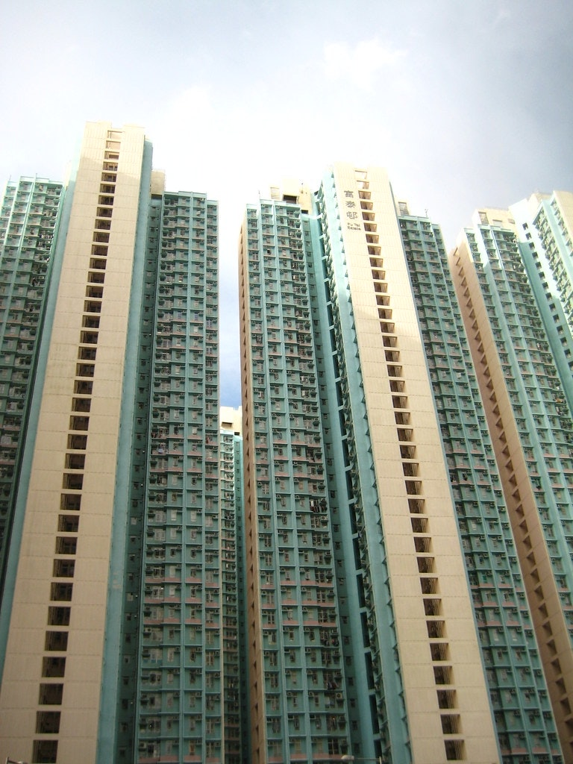

Slide 11
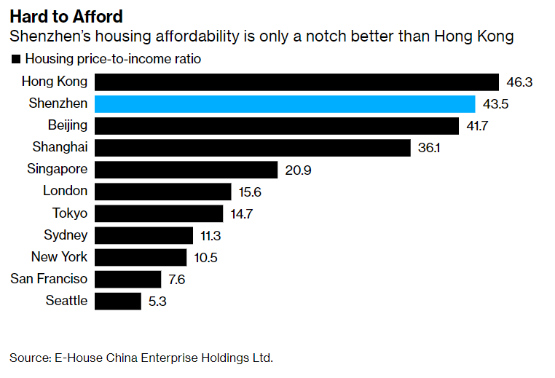

Slide 12
Repetition from last time
1) How does a country finance its imports?
2) What is the role of banks in an economy?
3) What happened with rural land during the 1980s?

Slide 13
Repetition from last time
1) How does a country finance its imports?
2) What is the role of banks in an economy?
3) What happened with rural land during the 1980s?
4) What was the system of „dual prices“?

Slide 14
Repetition from last time
1) How does a country finance its imports?
2) What is the role of banks in an economy?
3) What happened with rural land during the 1980s?
4) What was the system of „dual prices“?
5) Where did FDI come from in the 1980s? Which areas were opened to it?

Slide 15
Repetition from last time
1) How does a country finance its imports?
2) What is the role of banks in an economy?
3) What happened with rural land during the 1980s?
4) What was the system of „dual prices“?
5) Where did FDI come from in the 1980s? Which areas were opened to it?
6) Did China‘s private sector originate is a program of privatization?

Slide 16
Today
Continuing reforms in the 1990s and 2000s – export-led growth
Some macro-economic theory dealing with exchange rates

Slide 17
Return to reform and opening up
1992 – Deng‘s Southern Tour > push for reviving the reforms

Slide 18
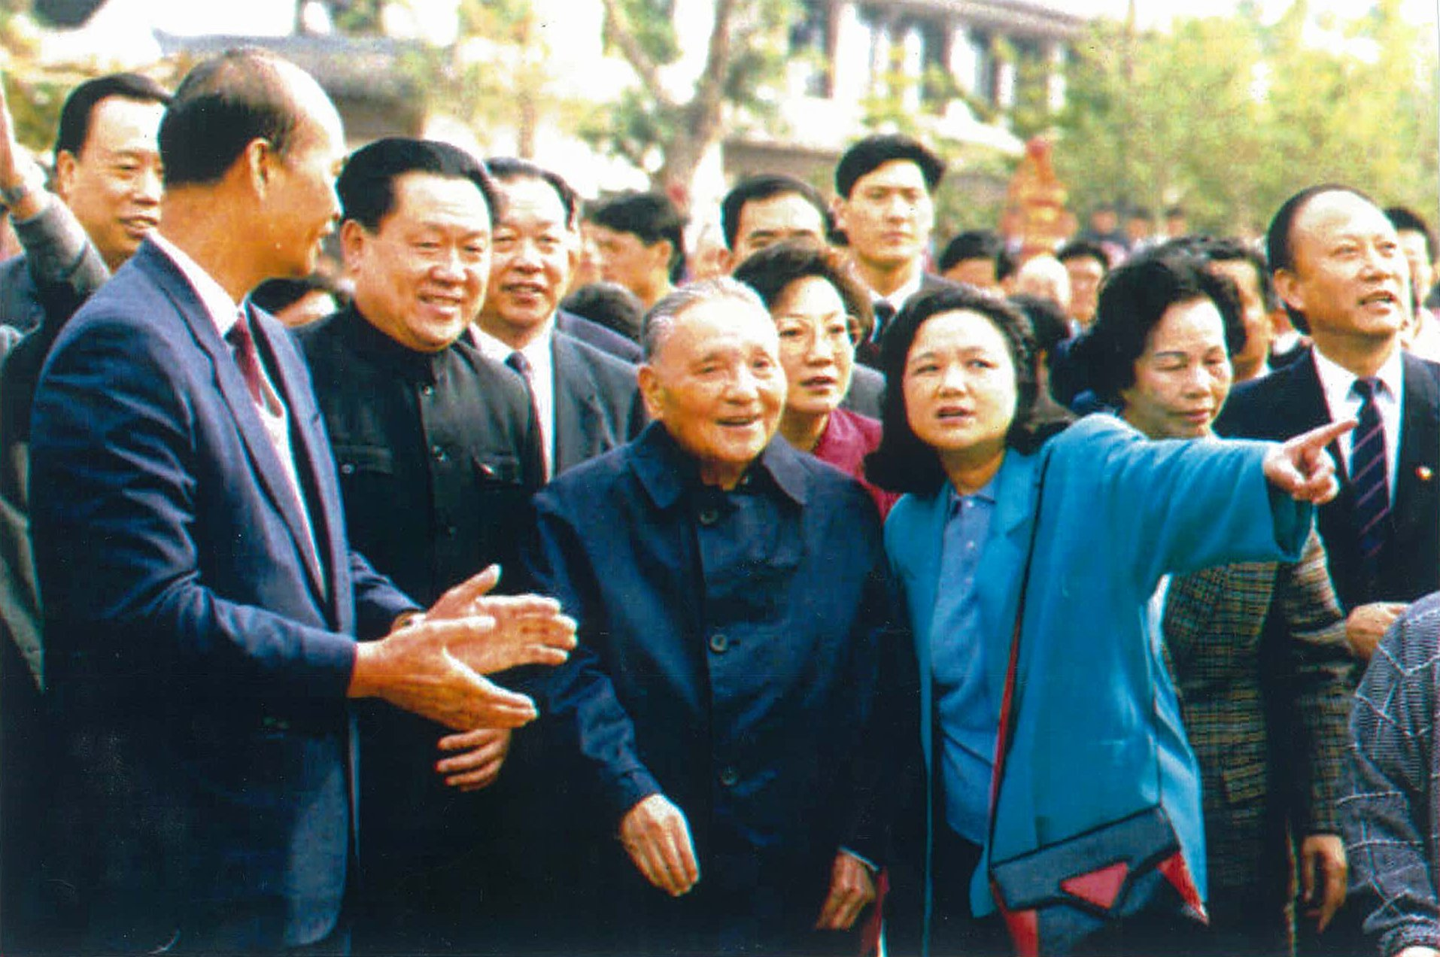

Slide 19
Return to reform and opening up
1992 – Deng‘s Southern Tour > push for reviving the reforms
New party leadership – Jiang Zenmin and Zhu Rongji – reliable party loyalists
Jiang and Zhu – from Shanghai – very conservative during the 1980s, almost no liberalization!

Slide 20
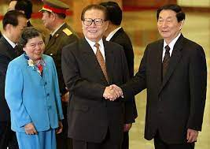

Slide 21
Return to reform and opening up
1992 – Deng‘s Southern Tour > push for reviving the reforms
New party leadership – Jiang Zenmin and Zhu Rongji – reliable party loyalists
Jiang and Zhu – from Shanghai – very conservative during the 1980s, almost no liberalization!
Return to a pro-market policy, but with more cautious approach than in the 1980s – fear of another Tiananmen

Slide 22
Return to reform and opening up
Focus on gradually reforming the urban economy – again at the expense of the countryside!

Slide 23
Return to reform and opening up
Focus on gradually reforming the urban economy – again at the expense of the countryside!
Higher taxes in for rural farmers and entrepreneurs > more inequality between cities and villages

Slide 24
Return to reform and opening up
Focus on gradually reforming the urban economy – again at the expense of the countryside!
Higher taxes in for rural farmers and entrepreneurs > more inequality between cities and villages
Increased rural illiteracy!
Resources invested in urban areas

Slide 25
Return to reform and opening up
Focus on advanced technologies + large projects + foreign investment + export

Slide 26
Return to reform and opening up
Focus on advanced technologies + large projects + foreign investment + export
This time, export and foreign investment really became the engine of growth

Slide 27
Return to reform and opening up
Sophisticated infrastructure – high speed trains connecting major cities

Slide 28
Return to reform and opening up
Sophisticated infrastructure – high speed trains connecting major cities
Some SOEs transformed into joint-stock companies, but the Party usually retains the controlling voting block
= mixed ownership – difficult to interpret who makes decisions

Slide 29
Return to reform and opening up
Industrial policy

Slide 30
„Industrial policy is defined as the strategic effort by the state to encourage economic transformation, i.e. the shift from lower to higher productivity activities, between or within sectors.“

Slide 31
„Industrial policy is defined as the strategic effort by the state to encourage economic transformation, i.e. the shift from lower to higher productivity activities, between or within sectors.“
x trade policy – attempts to influence import and export

Slide 32
Industrial policy - takes place within a country (subsidies, tax break, grants, privileged access to loans…)
Trade policy – takes place at the border – tariffs and non-tariff barriers to trade

Slide 33
Industrial policy - takes place within a country (subsidies, tax break, grants, privileged access to loans…)
Trade policy – takes place at the border – tariffs and non-tariff barriers to trade
> China is far more active in industrial policy!

Slide 34
Return to reform and opening up
Industrial policy –– „national champions“ – support of highly advanced companies such as Huawei – attempts to push them to the global cutting edge

Slide 35
Return to reform and opening up
„Letting go of the small“ – small companies can be privatized and left to their own devices
If they go bankrupt, who cares?

Slide 36
Return to reform and opening up
The state must nurture the big ones > economies of scale, export, prestige….

Slide 37
Return to reform and opening up
The state must nurture the big ones > economies of scale, export, prestige….
Largest firms – monopolistic construction companies (housing, infrastructure, electrical grid) - remained as SOEs

Slide 38
Return to reform and opening up
The state must nurture the big ones > economies of scale, export, prestige….
Largest firms – monopolistic construction companies (housing, infrastructure, electrical grid) - remained as SOEs
Financial sector (banks) – continues to be overwhelmingly state owned

Slide 39
Return to reform and opening up
The state must nurture the big ones > economies of scale, export, prestige….
Largest firms – monopolistic construction companies (housing, infrastructure, electrical grid) - remained as SOEs
Financial sector (banks) – continues to be overwhelmingly state owned
> Chinese foreign investment is based on state-owned capital!

Slide 40
> „state capitalism“

Slide 41
Return to reform and opening up
Problems – large rate of investment, relatively small growth of consumption

Slide 42
Return to reform and opening up
Problems – large rate of investment, relatively small growth of consumption
= huge growth, but you can‘t enjoy its fruit, new wealth is immediately reinvested

Slide 43
Special economic zones
New SEZ in Shanghai
More importantly – entire coastal region opened for „export-processing“

Slide 44
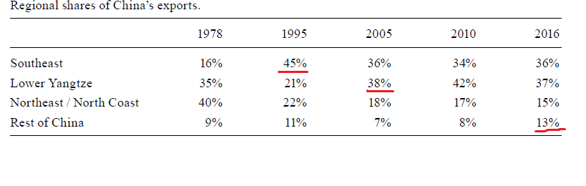

Slide 45
Special economic zones
New SEZ in Shanghai
More importantly – entire coastal region opened for „export-processing“
> due to proliferation of export processing + reforms to ordinary trade, SEZs gradually became relatively less special

Slide 46
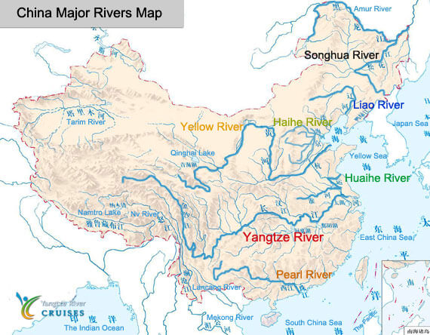

Slide 47
Foreign direct investment

Slide 48
Foreign direct investment
= a new firm or a large share in an existing one

Slide 49
Foreign direct investment
= a new firm or a large share in an existing one
vs. portfolio investment – smaller piecemall investment – no desire the control the company, only financial profit

Slide 50
Foreign direct investment
Focus on foreign direct investment (FDI) and export – integrating China into the world economy

Slide 51
Foreign direct investment
Focus on foreign direct investment (FDI) and export – integrating China into the world economy
x 1980s – mostly homegrown growth

Slide 52
Foreign direct investment
Focus on foreign direct investment (FDI) and export – integrating China into the world economy
x 1980s – mostly homegrown growth
FDI = source of foreign technologies
Push to attract investors – financial incentives, offer of access to China‘s already huge market

Slide 53
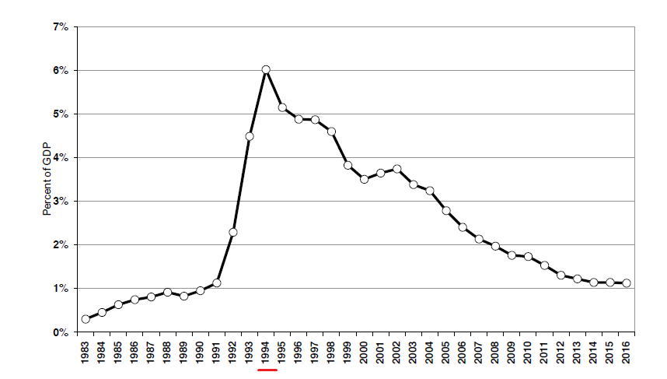
FDI as a percentage of GDP

Slide 54
Foreign direct investment
Focus on foreign direct investment (FDI) and export – integrating China into the world economy
x 1980s – mostly homegrown growth
FDI = source of foreign technologies
Push to attract investors – financial incentives, offer of access to China‘s already huge market
Sources of FDI – now not only Taiwan and Hong Kong, but the US and Europe as well

Slide 55
Foreign direct investment
Why is FDI good?

Slide 56
Foreign direct investment
Why is FDI good?
Source of foreign savings („money!“) -> but China has enough of its own savings, especially now

Slide 57
Foreign direct investment
Why is FDI good?
Source of foreign savings („money!“) -> but China has enough of its own savings, especially now
Foreign technologies, business know-how, connection to global markets

Slide 58
Foreign direct investment
Subcontractors, joint-ventures – investors need to commit themselves to transfer their know-how to Chinese counterparts

Slide 59
Foreign direct investment
Subcontractors, joint-ventures – investors need to commit themselves to transfer their know-how to Chinese counterparts
Sometimes outright IP theft

Slide 60
Foreign direct investment
Support for large state or semi-state companies + foreign capital; indifference to small businesses

Slide 61
Foreign direct investment
Support for large state or semi-state companies + foreign capital; indifference to small businesses
> best strategy for Chinese companies – get incorporated in Hong Kong, then do business in China as a foreign company

Slide 62
Reforms to the „ordinary“ foreign trade
Last time – special economic zones

Slide 63
Reforms to the „ordinary“ foreign trade
Last time – special economic zones
Now – reforms to the normal trade regime
= the rest of China
From 1980s onwards

Slide 64
Ordinary trade
Number of monopoly FTCs increased – from 12 to several thousands

Slide 65
Ordinary trade
Number of monopoly FTCs increased – from 12 to several thousands
But all of them were, at least officially, SOEs!

Slide 66
Ordinary trade
Number of monopoly FTCs increased – from 12 to several thousands
But all of them were, at least officially, SOEs!
The FTC system was only completely abolished in 2004, after entering the WTO!

Slide 67
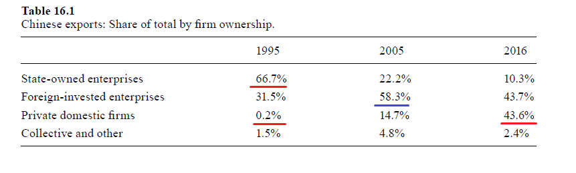

Slide 68
Ordinary trade
Liberalized prices – the foreign trade companies were encouraged to make money instead of fulfilling a plan

Slide 69
Ordinary trade
Liberalized prices – the foreign trade companies were encouraged to make money instead of fulfilling a plan
Before – artificial prices totally detached from the world market, trade guided by state direction
After reform – „export and import whatever is profitable in your business area“

Slide 70
Ordinary trade
Liberalized prices – the foreign trade companies were encouraged to make money instead of fulfilling a plan
Before – artificial prices totally detached from the world market, trade guided by state direction
After reform – „export and import whatever is profitable in your business area“
> give the central government a part of the foreign exchange, keep the rest as use it to do more business

Slide 71
Ordinary trade
„Canalization“ – if you wanted to import something and you did not have the license to do it, you had to persuade one of the monopoly SOEs to do it for you

Slide 72
Ordinary trade
„Canalization“ – if you wanted to import something and you did not have the license to do it, you had to persuade one of the monopoly SOEs to do it for you
> even TVEs and other small companies de facto could take part in trade, but a part of the profit went to the SOEs

Slide 73
Ordinary trade
„Canalization“ – if you wanted to import something and you did not have the license to do it, you had to persuade one of the monopoly SOEs to do it for you
> even TVEs and other small companies de facto could take part in trade, but a part of the profit went to the SOEs
> FTCs as middlemen

Slide 74
The exchange rate
Gradual devaluation of the RMB

Slide 75
The exchange rate
Floating exchange rate – the currency is a normal traded commodity, its value rises and falls in the market

Slide 76
The exchange rate
Floating exchange rate – the currency is a normal traded commodity, its value rises and falls in the market
Trade surplus -> currency appreciates (= gains value)

Slide 77
The exchange rate
Floating exchange rate – the currency is a normal traded commodity, its value rises and falls in the market
Trade surplus -> currency appreciates (= gains value)
Net inflow of capital > currency appreciates (= gains value)

Slide 78
The exchange rate
Floating exchange rate – the currency is a normal traded commodity, its value rises and falls in the market
Trade surplus -> currency appreciates (= gains value)
Net inflow of capital > currency appreciates (= gains value)
And vice versa

Slide 79
The exchange rate
Fixed exchange rate – fixed at some level by the state

Slide 80
The exchange rate
Fixed exchange rate – fixed at some level by the state
Kept there by currency interventions > the central bank buys or sells the currency

Slide 81
The exchange rate
Fixed exchange rate – fixed at some level by the state
Kept there by currency interventions > the central bank buys or sells the currency
It is always possible to devalue your currency

Slide 82
The exchange rate
Fixed exchange rate – fixed at some level by the state
Kept there by currency interventions > the central bank buys or sells the currency
It is always possible to devalue your currency
Revaluation is more difficult – you need foreign exchange to be able to buy your currency vs. you can always print more of your own money

Slide 83
The exchange rate
China – overvalued fixed exchange rate until 1994 – bad for export

Slide 84
The exchange rate
China – overvalued fixed exchange rate until 1994 – bad for export
Undervalued exchange rate until circa 2009 – good for export

Slide 85
The exchange rate
China – overvalued fixed exchange rate until 1994 – bad for export
Undervalued exchange rate until circa 2009 – good for export
Frequent adjusted fix since circa 2010 – still probably undervalued, but less

Slide 86
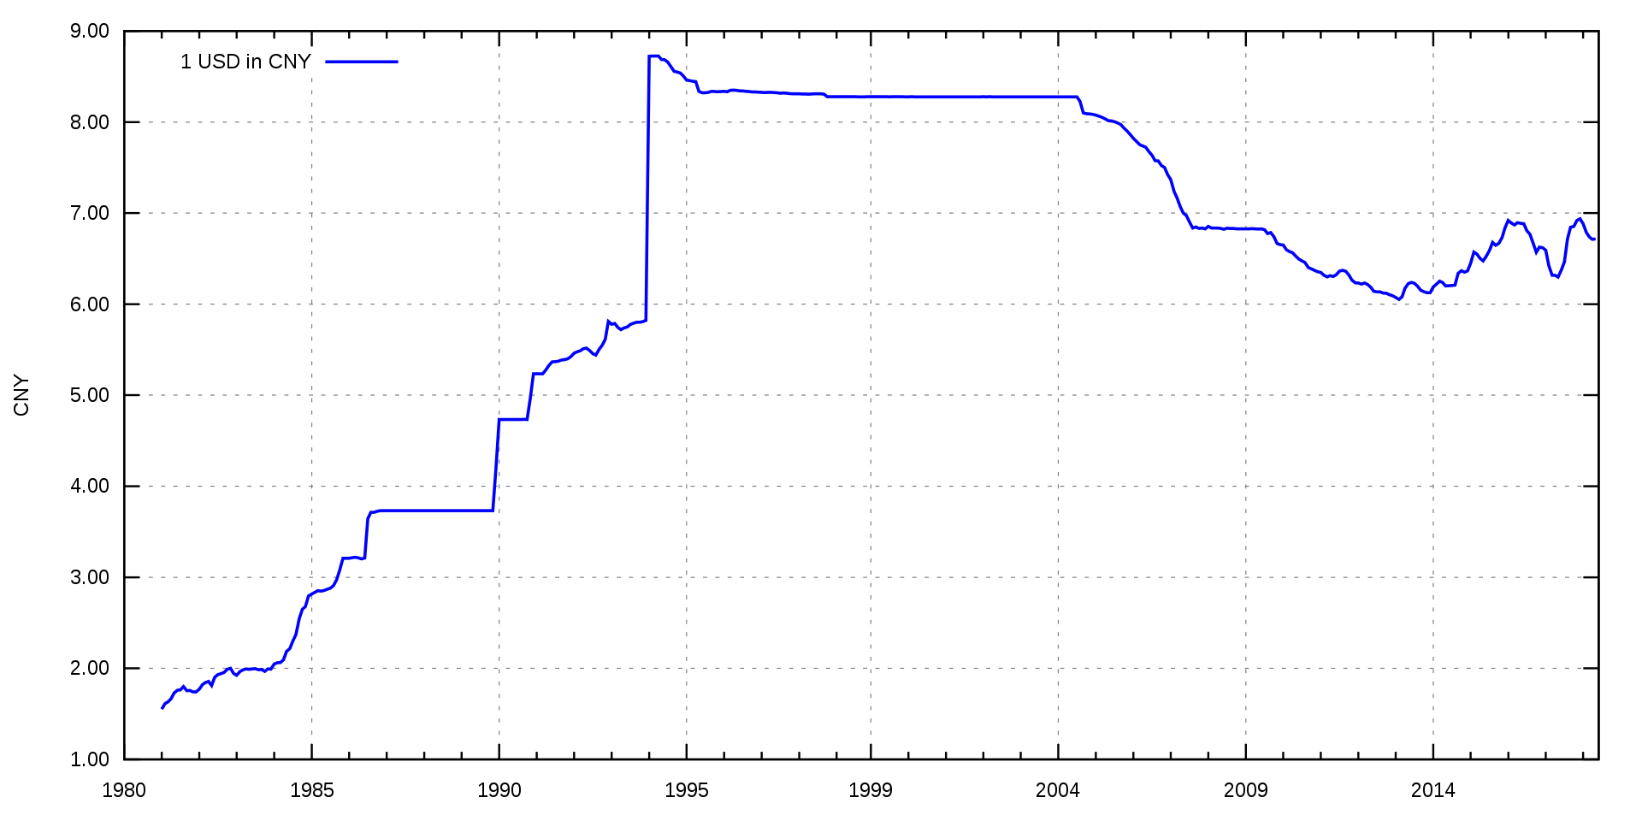
USD to RMB

Slide 87
The exchange rate
Gradual devaluation of the RMB
Separate foreign exchange market – foreign trade companies could exchange money and ignore the official rate

Slide 88
The exchange rate
Gradual devaluation of the RMB
Separate foreign exchange market – foreign trade companies could exchange money and ignore the official rate
> two exchange rates – the official one and the one used between the companies
Fix and floating at the same time (kind of)

Slide 89
The exchange rate
Gradual devaluation of the RMB
Separate foreign exchange market – foreign trade companies could exchange money and ignore the official rate
> two exchange rates – the official one and the one used between the companies
Fix and floating at the same time (kind of)
Which one was lower?

Slide 90
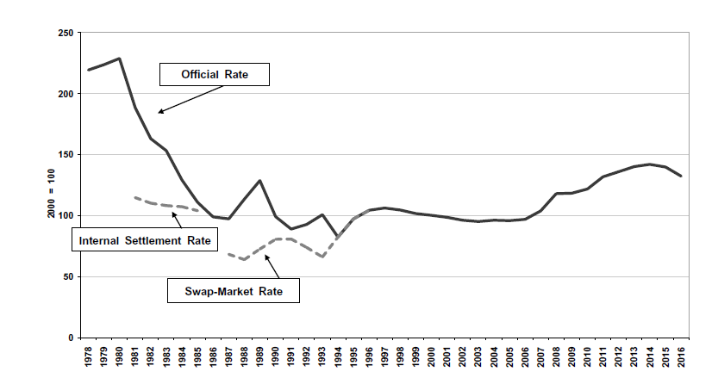
RMB to UDS

Slide 91
The exchange rate
Main devaluation – 1994 – official rate set and fixed at the previous unofficial rate

Slide 92
The exchange rate

Slide 93
USD to RMB

Slide 94
The exchange rate
Main devaluation – 1994 – official rate set and fixed at the previous unofficial rate
= „Let‘s respect the collective wisdom of the market“

Slide 95
The exchange rate
Main devaluation – 1994 – official rate set and fixed at the previous unofficial rate
= „Let‘s respect the collective wisdom of the market“
The rate was competitive and led to a more or less balanced trade

Slide 96
The exchange rate
Main devaluation – 1994 – official rate set and fixed at the previous unofficial rate
= „Let‘s respect the collective wisdom of the market“
The rate was competitive and led to a more or less balanced trade
Under floating, the rate would appreciate because of growing exports
= as China became more competitive, the rate should have gone up

Slide 97
The exchange rate
But China artificially kept the rate at the 1994 level all the way until 2005

Slide 98
USD to RMB

Slide 99
The exchange rate
But China artificially kept the rate at the 1994 level all the way until 2005
+ „real depreciation“
The price level in China rose more slowly than in the US and most other capitalist countries

Slide 100
The exchange rate
But China artificially kept the rate at the 1994 level all the way until 2005
+ „real depreciation“
The price level in China rose more slowly than in the US and most other capitalist countries
> Chinese goods became relatively cheaper

Slide 101
Real appreciation / depreciation
If your exchange rate is stable AND you have lower inflation than a partner country, your currency is undergoing a real depreciation

Slide 102
Real appreciation / depreciation
If your exchange rate is stable AND you have lower inflation than a partner country, your currency is undergoing a real depreciation
> your goods become more competitive > you export more
As if you devalued the currency

Slide 103
The exchange rate

Slide 104
USD to RMB

Slide 105
The exchange rate
But China artificially kept the rate at the 1994 level all the way until 2005
+ real depreciation
> undervaluation, huge trade surpluses!

Slide 106
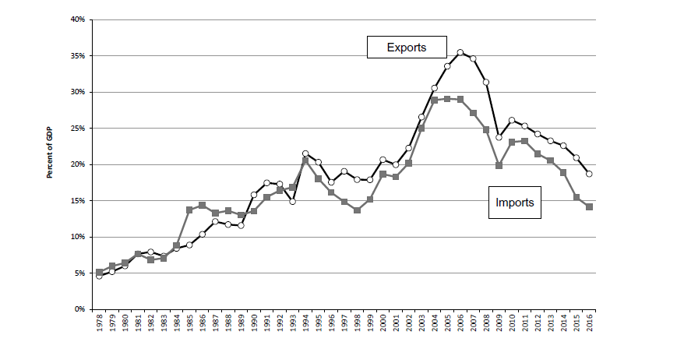

Slide 107
The exchange rate
The 1994 reform was connected with making the RMB convertible for current account transactions

Slide 108
The exchange rate
The 1994 reform was connected with making the RMB convertible for current account transactions
> every FTC could access foreign exchange whenever they wished, with no regulation – if it was for trade
= liberalization

Slide 109
The exchange rate
The 1994 reform was connected with making the RMB convertible for current account transactions
> every FTC could access foreign exchange whenever they wished, with no regulation – if it was for trade
= liberalization
Plans to also abolish capital controls = to make the RMB convertible for financial account transactions

Slide 110
The exchange rate
The 1994 reform was connected with making the RMB convertible for current account transactions
> every FTC could access foreign exchange whenever they wished, with no regulation – if it was for trade
= liberalization
Plans to also abolish capital controls = to make the RMB convertible for financial account transactions
Abandoned because of the 1997 Asian Financial crisis

Slide 111
The 2000s – continuing export-led growth

Slide 112
The 2000s – export-led growth
Progress from textile exports to electronics

Slide 113
The 2000s – export-led growth
Slow, gradual liberalization continued into the new millennium

Slide 114
The 2000s – export-led growth
Slow, gradual liberalization continued into the new millennium
China‘s most capitalist moment – after entering the WTO in 2001

Slide 115
The 2000s – export-led growth
Exports and imports – 5 % of GDP each in 1978
World average is about 20 % for each

Slide 116
The 2000s – export-led growth
Exports and imports – 5 % of GDP each in 1978
World average is about 20 % for each
China reached this level by 2001, its exports continued to soar after entering the WTO

Slide 117
The 2000s – export-led growth
Exports and imports – 5 % of GDP each in 1978
World average is about 20 % for each
China reached this level by 2001, its exports continued to soar after entering the WTO
2006 – exports stood at 35 % of GDP, imports at 30 % > 65 % together

Slide 118
The 2000s – export-led growth
Exports and imports – 5 % of GDP each in 1978
World average is about 20 % for each
China reached this level by 2001, its exports continued to soar after entering the WTO
2006 – exports stood at 35 % of GDP, imports at 30 % > 65 % together
In the United States, the sum is around 20 %!
= China was already far more opened than the world average or comparably large countries!

Slide 119
The 2000s – export-led growth
2009 – largest exporter in the world
2011 – largest manufacturer
2012 – largest GDP by purchasing power parity

Slide 120
The 2000s – export-led growth
Huge growth of export, current account surplus (5 % of GDP in 2006)

Slide 121
The 2000s – export-led growth
Huge growth of export, current account surplus (5 % of GDP in 2006) = China finally overcame its problem of financing imports

Slide 122
The 2000s – export-led growth
Huge growth of export, current account surplus (5 % of GDP in 2006) = China finally overcame its problem of financing imports
> accumulation of foreign exchange (mostly dollars)

Slide 123
The 2000s – export-led growth
What is China going to do with all this foreign exchange?

Slide 124
The 2000s – export-led growth
What is China going to do with all this foreign exchange?
Keep it as a reserve – a precaution against a monetary crisis

Slide 125
The 2000s – export-led growth
What is China going to do with all this foreign exchange?
Keep it as a reserve – a precaution against a monetary crisis
Anxiety after the Asian monetary crisis of 1997

Slide 126
Fixed exchange rates and monetary crises
A country has a fixed exchange rate

Slide 127
Fixed exchange rates and monetary crises
A country has a fixed exchange rate
- China does have a fixed exchange rate – the yuan was first tied to the US dollar, since 2005, it is pegged to a basket of currencies

Slide 128
USD to RMB

Slide 129
Fixed exchange rates and monetary crises
A country has a fixed exchange rate
Markets (banks etc.) think that the rate is overvalued and unsustainable > they start to sell the currency

Slide 130
Fixed exchange rates and monetary crises
A country has a fixed exchange rate
Markets (banks etc.) think that the rate is overvalued and unsustainable > they start to sell the currency
> pressure for devaluation

Slide 131
Fixed exchange rates and monetary crises
A country has a fixed exchange rate
Markets (banks etc.) think that the rate is overvalued and unsustainable > they start to sell the currency
> pressure for devaluation
The central bank needs to start buying the currency to keep the same rate – they need foreign currencies to do this!

Slide 132
Fixed exchange rates and monetary crises
A country has a fixed exchange rate
Markets (banks etc.) think that the rate is overvalued and unsustainable > they start to sell the currency
> pressure for devaluation
The central bank needs to start buying the currency to keep the same rate – they need foreign currencies to do this!
If they fail > increased interest rates to stop the capital flight > drop of domestic credit > domestic recession

Slide 133
Fixed exchange rates and monetary crises
= in the end, the central bank usually freezes the creation of money, which stops capital flight, but creates recession

Slide 134
How a monetary crisis works
China fears this scenario, so it keeps large reserves of foreign currency

Slide 135
How a monetary crisis works
China fears this scenario, so it keeps large reserves of foreign currency
> if you sit upon a huge pile of dollars, you can defeat a speculative attack
Actually, you can deter it

Slide 136
The 2000s – export-led growth
What else can you do with foreign exchange?
= you don‘t use it to buy imports, you don‘t want to keep it as reserves

Slide 137
The 2000s – export-led growth
What else can you do with foreign exchange?
= you don‘t use it to buy imports, you don‘t want to keep it as reserves
Foreign investment – purchases of Western companies; Belt and Road Initiative

Slide 138
The 2000s – export-led growth
Major exporter of advanced technology products already by 2005!
= laptops, mobile phones, scanners, cameras, medical equipment

Slide 139
The 2000s – export-led growth
2002 – change in Party leadership – Hu Jintao and Wen Jiabao
Only transfer of power without a purge in PRC‘s history!

Slide 140
The 2000s – export-led growth
2002 – change in Party leadership – Hu Jintao and Wen Jiabao
Only transfer of power without a purge in PRC‘s history!
Theoretically – generations of party leadership – change every 10 years (1992-2002-2012-2022)

Slide 141
The 2000s – export-led growth
2002 – change in Party leadership – Hu Jintao and Wen Jiabao
Only transfer of power without a purge in PRC‘s history!
Theoretically – generations of party leadership – change every 10 years (1992-2002-2012-2022)
Hu leadership – continuation of previous policies
More resources devoted to social spending – healthcare, education, alleviation of rural poverty

Slide 142
The 2000s – export-led growth
Major exporter of advanced technology products already by 2005!
= laptops, mobile phones, scanners, cameras, medical equipment
Growth continued at breakneck speed – over 10 % a year – even though the base was already quite large

Slide 143
The 2000s – export-led growth
Major exporter of advanced technology products already by 2005!
= laptops, mobile phones, scanners, cameras, medical equipment
Growth continued at breakneck speed – over 10 % a year – even though the base was already quite large
= biggest story of the decade; the West overlooked it

Slide 144
Next time:
The return of industrial policy
The fallout of the 2008 Financial crisis
The rise of Xi Jinping and the US-Chinese trade war

