Slide 1
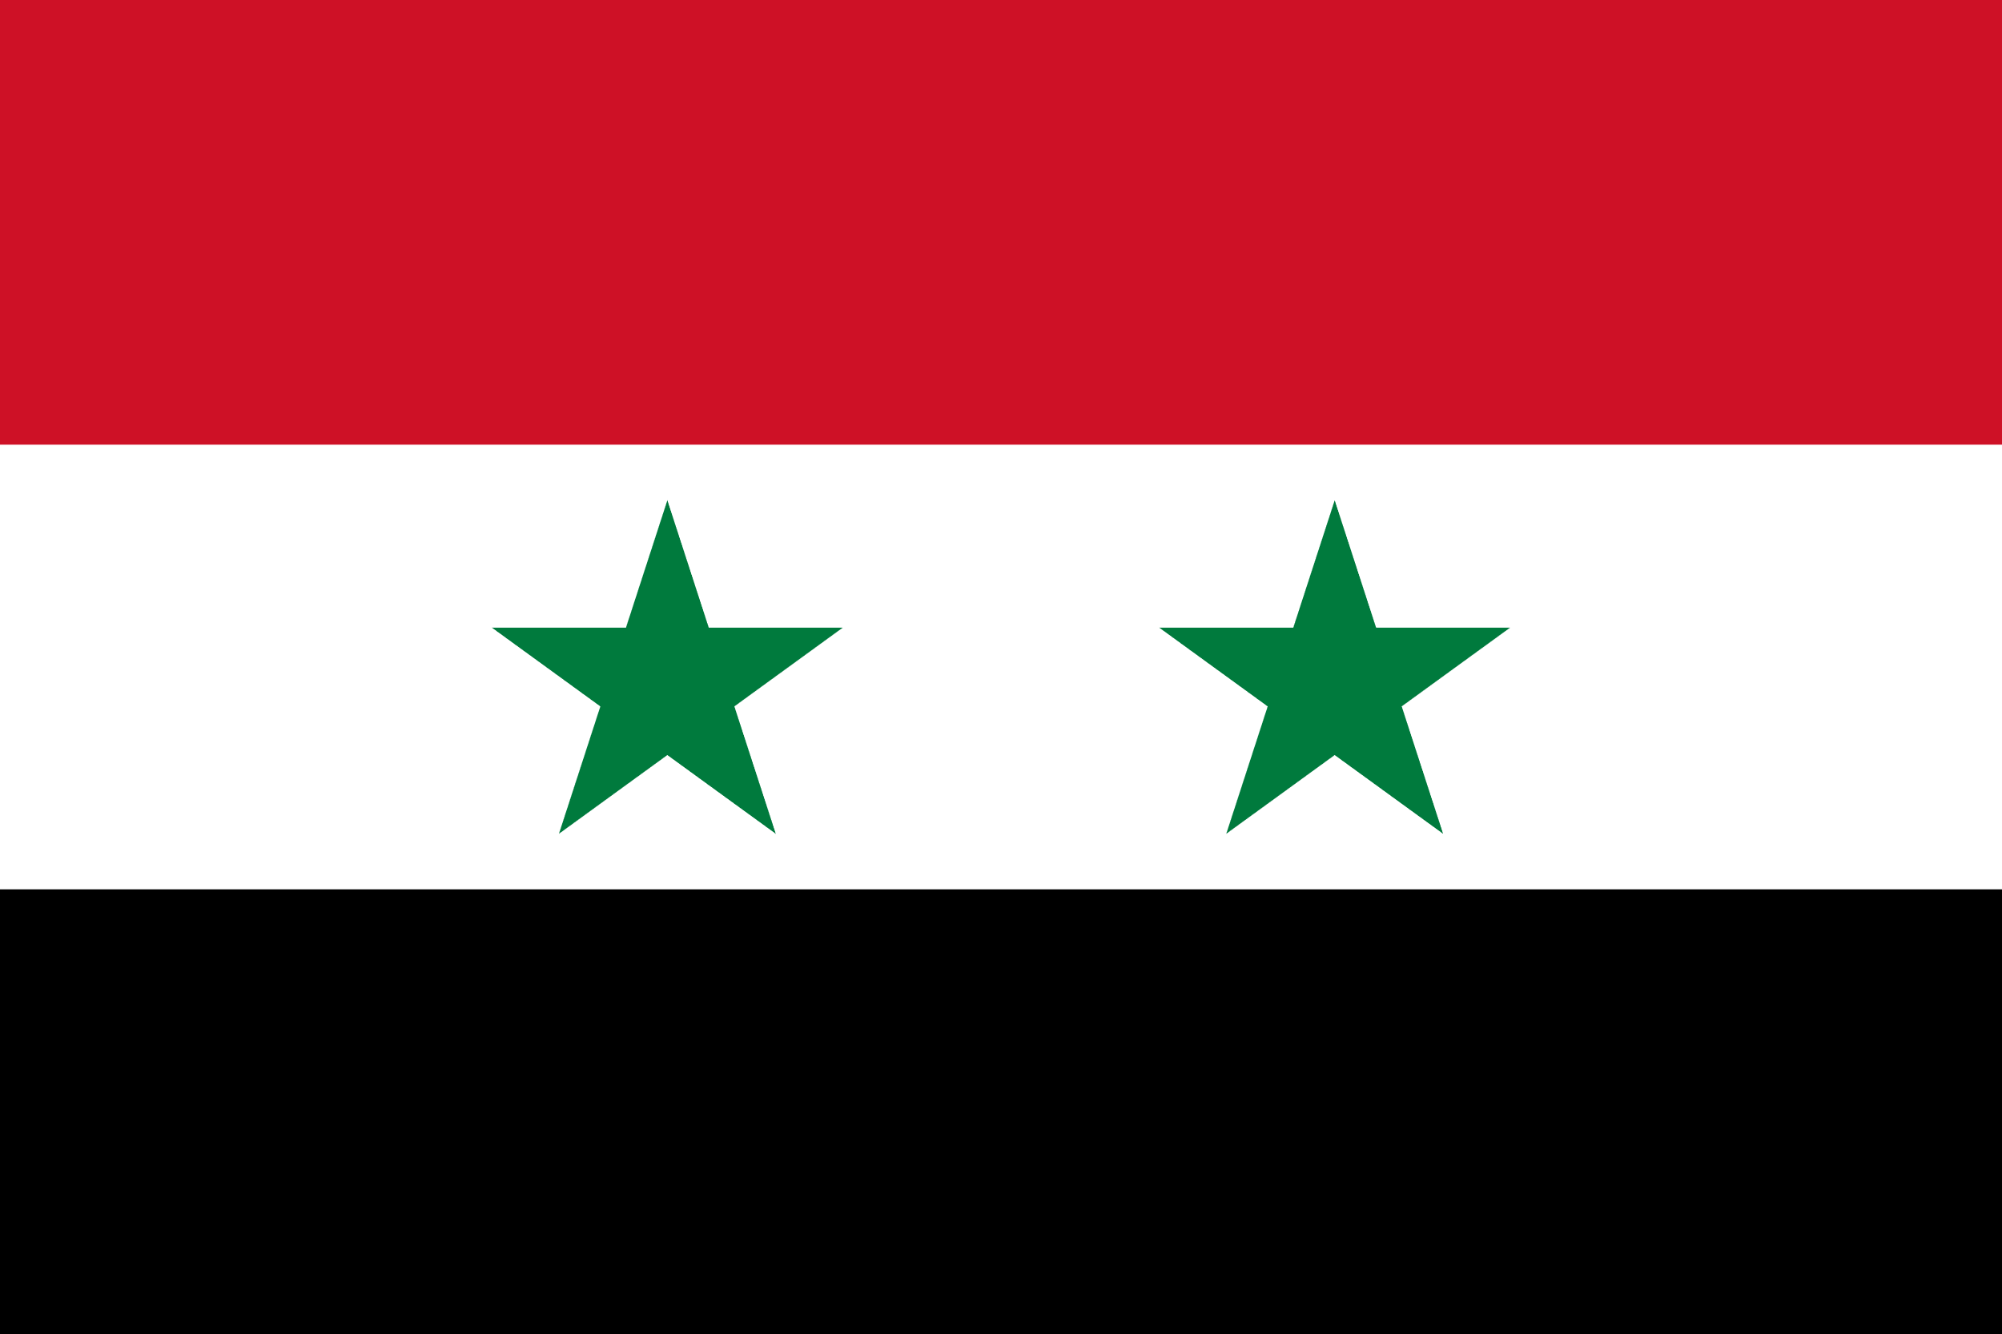
Syria
Mgr. Lenka Martínková
14. 11. 2023

Slide 2
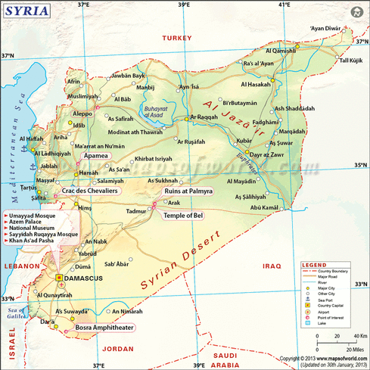
2023 data
187,437.00 km² (three times smaller than France)
22.66 million in January 2023

Slide 3
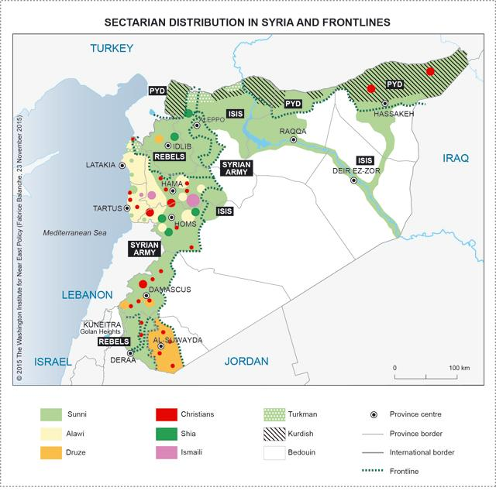
Minorities and distribution
Sunni 61%
Kurd 16%
Alawi 13%
Druze 4%
Christians 3%
Shia 1%
Ismaili 1%
Turkmen 1%

Slide 4
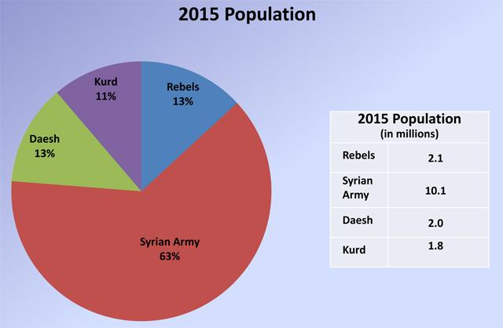

Slide 5
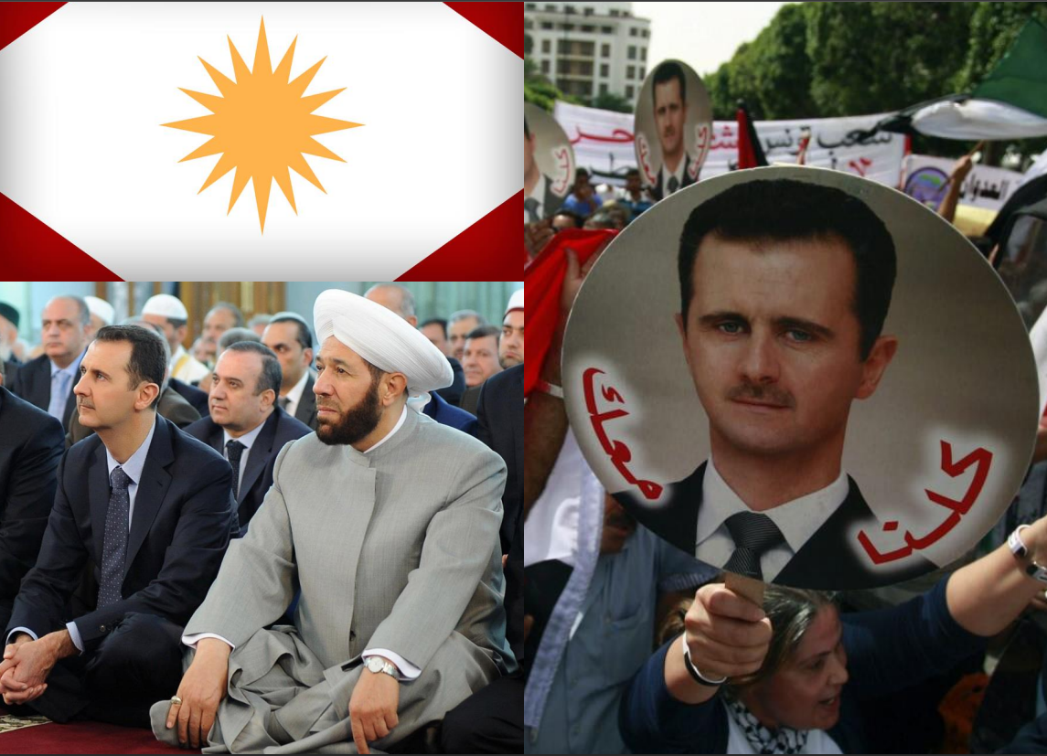
Alawites
(calawiyah / nusayriyah)
Alawites consider themselves followers of the 10th Imam al-Ali
al-Hadi and as part of the 12 Imams Shikah.
The founder is: Abu Shu'ayb Muhammad b. Nusayr (d. 873)
Heterodox Movements: Astral Cult (Man-Star), Primal sin and some Christian elements (Christmas, etc.).
Their dogmatics is based on the gradual revelation of truth:
Muhammad - name,
Alí – essence,
Salman al-Farisi - gate, knowledge
They currently live in Syria (where they form a military-political elite, (Hafiz and Bashar al-Assad) in Lebanon and Turkey

Slide 6
Druze (Daráziyún)
"the Unitarians" (al-muwahhibun)
A religion based on Ismailiyyah and especially from learning and the work of Caliph al-Hakim
Before he "disappeared" he sent his missionaries Muhammad ad-Darazi and Hamza from Zúzání to Lebanon, where they developed the foundations Druze teachings
Central to their teachings is hikma (wisdom)
there are books (kutub), houses (gift) and men (shuyuch) of wisdom
The emanations (hudud) of God's wisdom are manifested in history
who worked alongside the prophets, e.g.:
Muhammad - Salman al-Farisi
al-Hakim - Hamza az-Zuzani
The Druze are characterized by gender equality and community
are divided into the initiated cuqqál and the laic people juhhál.
Learning insiders is secret.
It is the beginning of the Druze era 1017, where al-Hakim claimed to be an emanation of God
Currently, the Druze live in Lebanon, Israel, Syria and Jordan

Slide 7
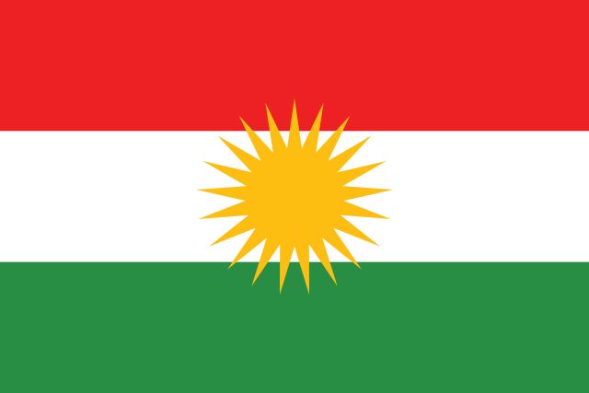
Kurds
Iran, Iraq, Turkey, and Syria sit in the north central area of the Middle East
mountains for sanctuary
survive as a distinct ethnic group
traditional nomadic lifestyle and the inhospitable mountain homeland provide a natural means to evade marauding armies that would subject indigenous people to rape, murder and genocide
Kurds have remained a separate ethnic group, they’ve always sought autonomy and independence
continuous conflict and a history of repression, resiliency and reinvention in the face of existential threats by the Turks, Arabs and Iranians
reinvented themselves as Muslims after the Arab invasion and conquest, as Sunni Muslims after the Ottoman Turks conquest, as Shiite Muslims after the Persian conquest, as Kurdish Nationalists in the aftermath of World War I and dissolution of the Ottoman Empire, as political revolutionaries (Kurdish Workers Party – PKK) in Turkey and Iraq (Kurdistan Democratic Party – KDP) in the 1970’s, as freedom fighters (Peshmerga) in the 1990’s and as a unified secular, democratic Kurdistan Regional Government (KRG) that provides all basic civil rights to its citizens including equal rights to women, all ethnic groups and religions
From 1990, the Kurds in Turkey, Iran, Iraq and Syria fought separate guerrilla campaigns to achieve autonomy
1990-1991 and the enforcement by the Americans of a no-fly zone in Iraqi Kurdistan region, the Iraqi Kurds had autonomy
1992, an alliance of political parties, the Iraqi Kurdistan Front, held parliamentary and presidential elections. As a result, the Iraqi Kurdistan Front established the Kurdistan Regional Government (KRG), a new autonomous Government of Kurdistan in Iraq
Notes:
At the end of the War, the Treaty of Sevres was drafted to deal with the dissolution and partition of the Ottoman Empire. The Treaty bolstered Kurdish nationalists’ aspirations by providing for a referendum to decide the issue of the Kurdistan homeland.
The Treaty of Sevres was rejected by the new Turkish Republic, and a new treaty (The Treaty of Lausanne) was negotiated and signed in 1923. The Treaty of Lausanne annulled the Treaty of Sevres, giving control of the entire Anatolian peninsula to the new Turkish Republic including the Kurdistan homeland in Turkey. There was no provision in the new treaty for a referendum for Kurdish independence or autonomy. Kurdistan’s hopes for an autonomous region and independent state were dashed.
The KRG is a secular government modeled along the lines of modern independent nation-state in a federation with the rest of Iraq. They have their own parliament, military (the “Peshmerga”), borders and foreign policy.
Kurdistan is a land-locked country dependent on its neighbors for access to markets for both supplies and to export oil – Kurdistan’s main economic resource. Given the history of the region and the geographic significance of Kurdistan as one of the crossroads of the Middle East, the potential for continued conflict is extremely high. If Kurdistan hopes to survive as an independent nation-state, it must prove to be strong enough to defend itself against the inevitable existential threats that will present itself and establish peaceful relationships with its neighbors despite a history of conflict, distrust and grievances.

Slide 8
Ancient History
date back to roughly 700,000 years ago
Ebla, a city in Syria that’s thought to have existed around 3,000 B.C
Syria was occupied and ruled by several empires, including the Egyptians, Hittites, Sumerians, Mitanni, Assyrians, Babylonians, Canaanites, Phoenicians, Arameans, Amorites, Persians, Greeks and Romans
Ancient Syria was a region referred to often in the Bible
Roman Empire fell, Syria became part of the Eastern or Byzantine Empire
637 A.D., Muslim armies defeated the Byzantine Empire and took control of Syria
Damascus eventually became the capital of the Islamic world
was replaced by Baghdad in Iraq around 750 A.D.
1516, the Ottoman Empire conquered Syria and remained in power until 1918

Slide 9
Modern History
During World War I, French and British diplomats secretly agreed to divide the Ottoman Empire into zones, as part of the Sykes-Picot Agreement of 1916
British and Arab troops captured Damascus and Aleppo in 1918, and the French took control of modern-day Syria and Lebanon in 1920
The French reign led to uprisings and revolts among the people in Syria. From 1925 to 1927, Syrians united against the French occupation in what’s now known as the Great Syrian Revolt
1936, France and Syria negotiated a treaty of independence, which allowed Syria to remain independent but gave France military and economic power
During World War II, British and Free French troops occupied Syria—but shortly after the war ended, Syria officially became an independent country in 1946
repeated government coups
Syria joined with Egypt and became the United Arab Republic in 1958, but the union split a few short years later in 1961
n 1963, the Arab Socialist Baath Party, which was active throughout the Middle East since the late 1940s, seized power of Syria in a coup known as the Baath Revolution.
1963 Emergency Law (until 2011) – no fundamental rights as Habeas Corpus or the right to assembly, great power to the president
In 1967, during the Six Day War, Israel seized the Golan Heights, a rocky plateau located in southwestern Syria
Notes:
Under the Sykes-Picot Agreement, most Arab lands under the rule of the Ottoman Empire were divided into British or French spheres of influence with the conclusion of World War I.

Slide 10
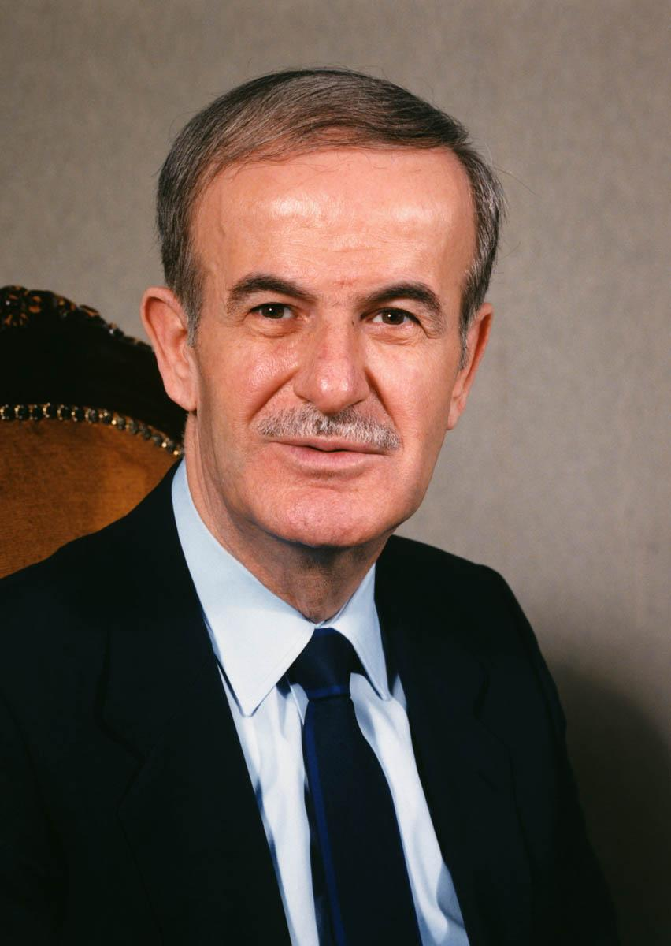
Assad’s Syria
1970, Hafez al-Assad, the Syrian minister of defense, overthrew the de facto leader of Syria, Salah Jadid
Syria and Egypt went to war with Israel in 1973
1982, the Muslim Brotherhood organized a rebellion against the Assad regime in the city of Hama, and Assad responded by arresting, torturing and executing political rebels. Estimates vary, but many experts believe the retaliation took the lives of about 20,000 civilians
Israel invaded Lebanon and attacked the Syrian army stationed there
1983, Israel and Lebanon announced that the hostility between the two countries was over
remained in power as president for 30 years, until his death in 2000

Slide 11
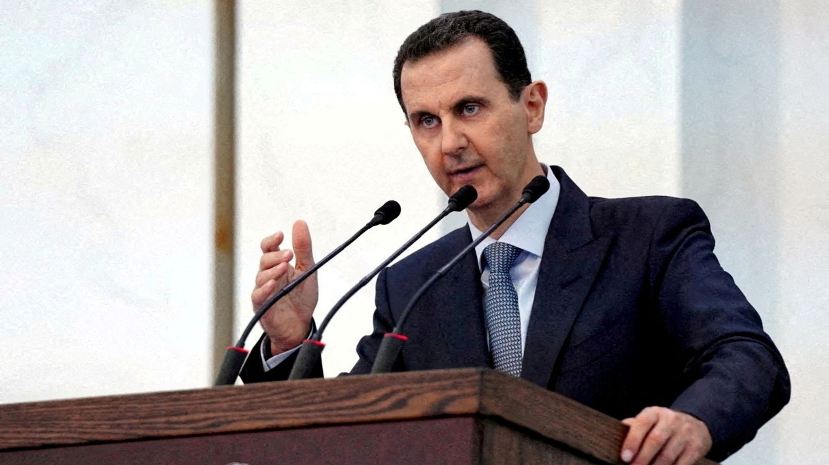
Bashar al-Assad
When Hafez al-Assad died in 2000, his son Bashar became president at age 34
After Bashar took power, the constitution was amended to reduce the minimum age of the president from 40 to 34
Bashar al-Assad released 600 political prisoners, and Syrians were hopeful that their new leader would grant more freedoms and impose less oppression than his father
2002, the United States accused Syria of acquiring weapons of mass destruction and listed the nation as a member of the so-called “axis of evil”
United States renewed sanctions against Syria in 2010
Notes:
A medical student, Bashar wasn’t the first choice for successor. His older brother, Bassel, was the next in line to take his father’s place, but he was killed in an automobile accident in 1994.

Slide 12
What was Syria like before the Uprising
Syria is not an electoral democracy
Executive branch hold all the power (president and inner circle)
Members of the ruling party Baath hold all to power and positions
High corruption (127 out of 178 according to the Transparency International)
State owned all broadcasting media and newspapers
Banned printed or recorded media in possession meant imprisonment
Internet access only via state servers (blockage of Facebook, Youtube and monitored mails)
Demonstration require state permission
Ban to any group of 5 or more to discuss politics
NGOs had to register with state
Supreme State Security Court operation outside or the constitution or the rights guaranteed
Security forces regularly use torture as an investigation method
Around 3000 political prisoners
Discrimination of 10% minority of Kurds, sanctions, ban on Kurdish language
Denial of the rights to travel
Monitoring of University classes and firing professors for opinions or mattes in dispute to the official Baath party position
2005 “Social market economy” transition from comand economy to the “free-market” – result combined the worst options of both systems
2006-2010 Drought of Biblical scope (devastated 60% of countryside, 75% farms failed, 85 percent of livestock died, rural-urban exodus of 1.5 million Syrians

Slide 13
Syrian Uprising 2011
15 March Syrian Revolution against Bashar Al-Assad
Beginning of March 2011 Syrian security forces arrested 10 children under 15 in Daraa for slogan on the wall “You are next doctor” (borrowed from Egypt “Down with the regime”)
Parents protested the imprisonment and torture – killed in open fire
20 000 people in the streets of Daraa (70 000 population)
Anti-government slogans, attacks on government buildings
Meanwhile in city Banias protests against secularisation of the schools (teachers with niqab were transferred to administrative jobs)
Protest spread to other cities
Brutal suppression from the regime, violent clashes, snipers
With she spread to Aleppo and Damascus the Uprising could not have been stopped
Notes:
Imprisoned and tortured

Slide 14
Characteristics of the Uprising
Spontaneous and leaderless
Had no 1 epicenter
Broke out in the provinces, towns with the nearby argicultural areas
No autonomous organisation or association
Army did not stand down, supported loyally the regime
Syrian Uprising differs very much from the other in the region based on three extremes: extents of militarization, secratianism, proxy war
Regime relied heavily on security forces to put down the uprising by any means necessary
Counterinsurgency measures, scorched-earth tactics
Firepower, tanks, helicopters, gunships, artillery, snipers, mortars, heavy machine guns, poison gas, barrel bombs

Slide 15
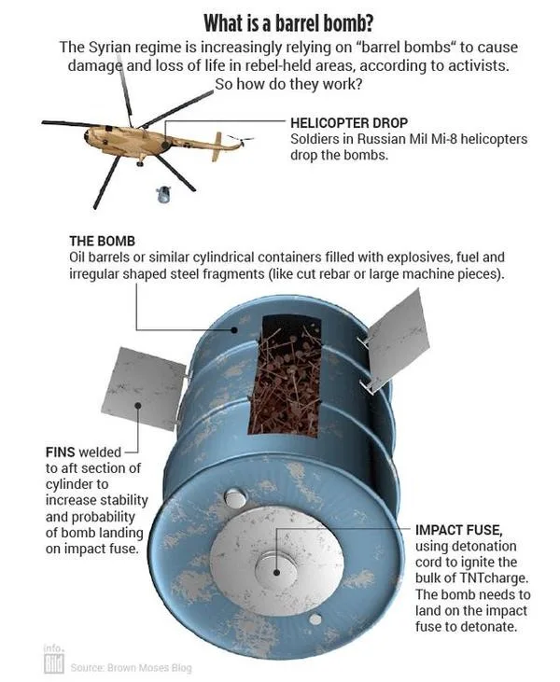

Slide 16
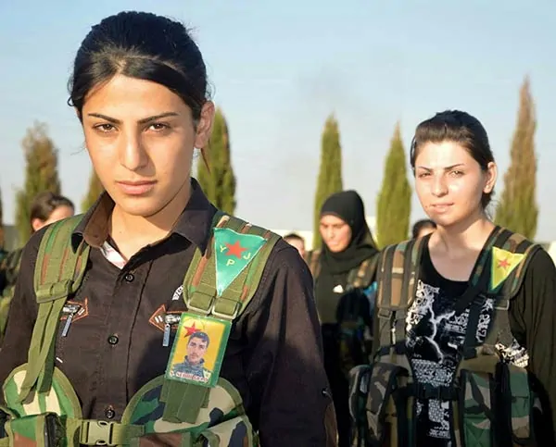
Kurdish groups - People’s Defense Units (YPG)
North-east Syria
YPG forms part of a wider coalition called the Syrian Democratic Forces (SDF), which has US backing
US, as well as UK and EU, consider the PKK a terrorist group
YPJ Women’s Protection Units, all-female brigade of the YPG, the armed forces of the Syrian region of Kurdistan, known as Rojava
they fight knowing that they must succeed in battle or become a suicide warrior to avoid being captured
The YPJ is also thought to be feared by ISIS, who believes that if a female kills them in battle, it will be a disgrace and dishonor, and will prohibit them from entering paradise
liberating Kobani in Syria
YPJ also played a big role in rescuing and providing security to the Yazidi community who were trapped on Mount Sinjar in Iraq in 2014

Slide 17
Syrian National Coalition
Supreme coordinating body
Based on the advice of UN “Friends of Syria” group of 114 states
Embodies “moderate” opposition
Participation in international negotiations
Little influence in Syria, mostly exiled politicians and activists

Slide 18
Al-Qaeda
Mainly against USA – the great puppet masters, not the puppets
Al-Qaeda has a weaker presence in Syria than HTS or Islamic State

Slide 19
Hay’at Tahrir al-Sham
primarily based in Idlib and is an offshoot from the terrorist group Al-Qaeda
ceasefire has been in place in Idlib since 2020
HTS has been involved in fighting with other groups and Assad forces
providing a haven for AlQaeda and Islamic State in Idlib

Slide 20
ISIL
ISIS, DAESH
2014/15, Islamic State controlled around a third of Syria
Raqqa was its nominal capital
2017, it had lost around 95% of its territory, including Raqqa
still capable of continuing attacks across much of Syria, limited sources and numbers, leaders mostly killed in air-strikes
10,000 Islamic State fighters remain in detention facilities in north-east Syria, and 56,000 of their family members are in humanitarian camps
Notes:
US has been encouraging countries to repatriate their nationals to reduce the risk of a resurgence. Many countries have sought to repatriate women and children, rather than Islamic State fighters

Slide 21
Peace for Syria
limited peace talks have taken place under UN Resolution 2254 (2015)
Russian-led talks in Sochi in 2018, however, did result in the formation of a group to negotiate a new constitution under the UN resolution

Slide 22
2023
Assad is back
War took 12 years
more than 350,000 casualties
displacement of half the Syrian population
stalemated conflict and the stalled peace talks
Syria’s frontlines have been largely frozen since 2020
Around 70% of the country is now controlled by Assad Government forces
Islamic State/Daesh no longer controls any territory
Kurdish forces continue to control substantial areas in north-eastern Syria

Slide 23
Syria back in Arab League
Arab League re-admitting Syria as a member in May 2023
recognizing that Assad will likely remain in power
wanting to reduce the influence of Iran
wanting to benefit from the economic gains of reconstruction in Syria
wanting to diversify their alliances beyond the US
return of Syrian refugees, many of whom are based in Jordan and Lebanon,
restrictions on the captagon drug trade from Syria, and containing non-state armed groups

Slide 24
Turkey and Kurdish question
PKK
SDF
Turkish military campaign against the Kurdistan Workers’ Party (PKK) in Turkey
Main goal is to prevent inception of Kurdish state in the Norther regions
first entered northern Syria in 2016
five military operations from 2016 to 2022, Turkey occupies a series of areas in northern Syria
Turkey pursues military action in Syria and Iraq. This is to restrict the Kurdish-led SDF in Syria and the Kurdistan Workers’ Party (PKK) in Turkey, which it lists as a terrorist group (as does the European Union and US).
2020 ceasefire agreement between Turkey and Russia froze the conflict in the north-west of the country, halting the attempts of Assad Government forces to capture the Idlib governorate
Turkey now expect Assad to remain in power

Slide 25
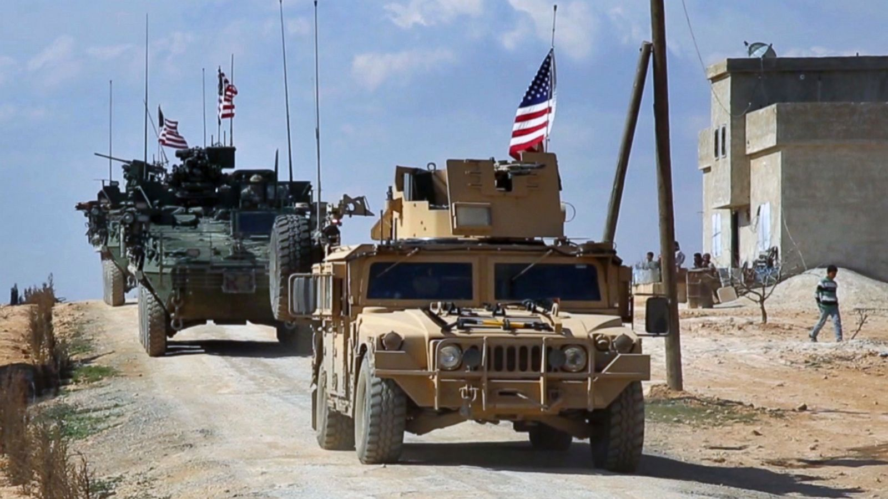
USA
Goal is to get rid of Assad
Lessons learnt from Iraq and Libya – no regime change via housecleaning
Prevent chaos
Negotiate the settlement and ensure stability
Keep parts of the regime
Destruction of ISIS
Support of Kurds

Slide 26
Saudi Arabia
Sunni supporter
Jaysh al-Islam
Ahrar al-Sham
Future Syria guided by the Islamic Law

Slide 27
Iran and Hizballah
Iran to have become Russia’s “top military backer”
Syria is a long-standing ally of Iran
Since the 1980s, Iran has also provided substantial support to Hezbollah in Lebanon
Iran’s presence is part of its wider strategy to consolidate the 1979 revolution
protect Shia Muslims abroad
limit the influence of Sunni states such as Saudi Arabia
counter the influence of Israel and the US
Iran has provided both economic (over US$105 billion) and military support to Assad and helped establish pro-Government and pro-Iran militias
Iran had around 10,000 troops in the early stages of the Syria conflict and cited claims that Iran-backed militias could mobilise up to 80,000 (IRGC and QUDS forces)
Hezbollah’s intervention in Syria from 2012 in support of Assad both supported Assad’s position and strengthened the military capabilities of Hezbollah more broadly. This has led to concerns about the threat it poses to Israel and pressure for the US and Israel to remain engaged in Syria to counter it

Slide 28
Russia
Old friends
2015, Russia militarily intervened to prevent the possible collapse of the Assad regime
Russian vetoes of multiple UN resolutions and sanctions
Russian military support has primarily been in the form of air and naval support and the mercenary Wagner Group, with Iranian and Assad forces conducting most ground operations
2022, Russia reduced its financial assistance to Syria, withdrawal of military forces
Notes:
Russian relationship with Assad remains strong: Assad has recognised Russian-seized areas of Ukraine as Russian, pledged a new economic cooperation agreement, and said he would welcome any new Russian bases in Syria

Slide 29
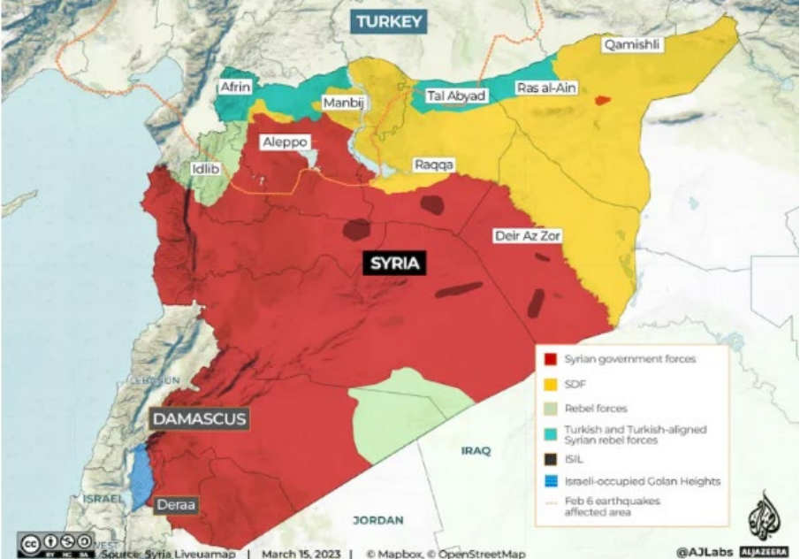

Slide 30
What is next…?
By the end of 2022
US, UK and EU continue to call for Assad to stand down as president and for negotiations on a new political settlement for Syria
sanctions against the Syrian regime (oil and products that could have military uses)
6 foreign powers are militarily active in Syria (US, Turkey, Russia, Iran, Hizballah, Israel)
2022 Russian withdrawal due to their military invasion of Ukraine
rebel infighting and actions by Islamic State and Hay’at Tahrir al-Sham
threat of Turkish action against Kurdish groups in the north
Notes:
UK Government says it remains committed to the principle of “do no harm” with its sanctions, which it says targets individuals and groups who have profited from the conflict.

Slide 31
Reconstruction
February 2023 earthquakes in Turkey and Syria also caused at least 4,400 deaths and 8,100 injuries in north-west Syria, and 9,000 homes were destroyed
high level of humanitarian need in the region, with 84% of the 4.1 million population already dependent on aid
60% of the country’s hospitals are functioning, and 7,000 schools have been destroyed during the conflict
World Bank estimated that one-third of Syria’s housing stock had been destroyed or damaged
substantial economic and budgetary challenges
World Bank reclassified Syria as a low-income country in 2018
the Assad Government also reduced funding for food subsidies by 40% for 2023
costs of reconstruction estimates range from US$250 million US$400 billion
Assad Government budget (US$9 billion in 2019)

Slide 32
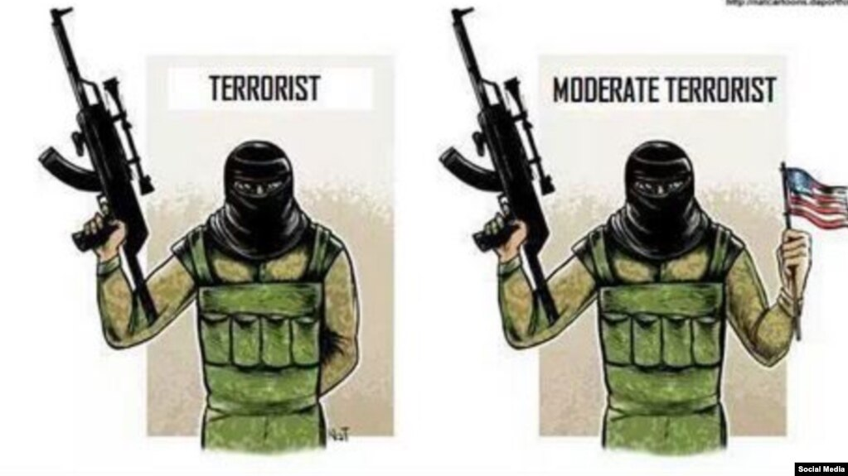
Questions?
Thank you for your attention!

