Slide 1
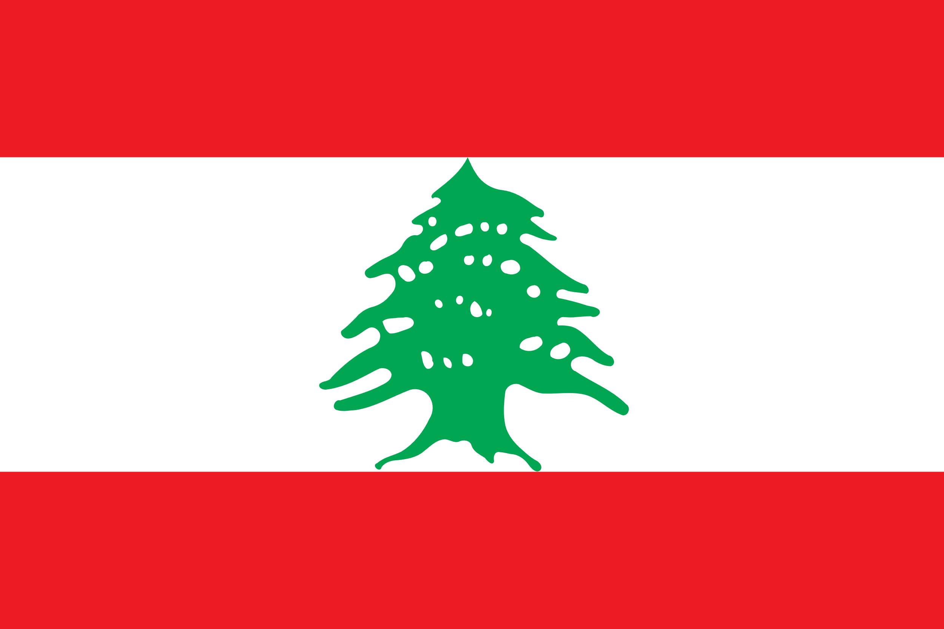
Lebanon
Mgr. Lenka Martínková
Notes:
Lebanon was heavily forested in ancient and medieval times, and its timber—particularly its famed cedar—was exported for building and shipbuilding. The natural vegetation, however, has been grazed, burned, and cut for so long that little of it is regenerated.

Slide 2
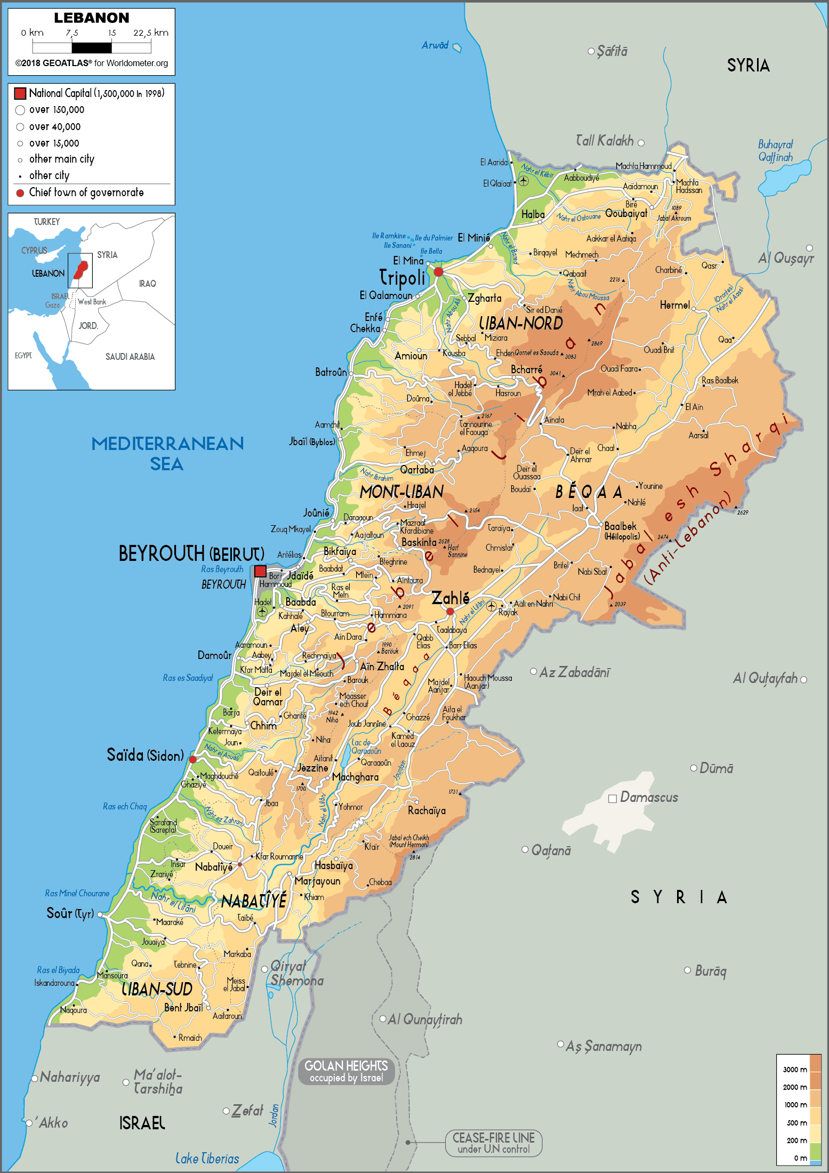
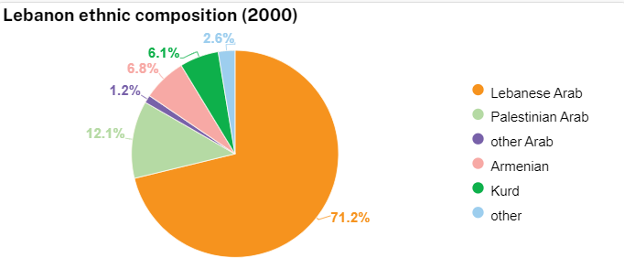
Geography
10,452 km²
5,296,814
$78.233 billion
88 % urban

Slide 3
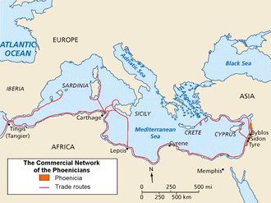
Ancient History
Ships, trade and ceramics
Byblos the first urban settlement is dated to about 3050–2850 BC Phoenicians untill 300 BC
Under Egypt rule
Under Assyrians
Greeks, Romans
634 AD
In 1516 the Ottomans take over

Slide 4
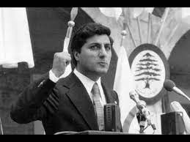
Modern History
From 1919 to the Waltz with Bashir
After WWI France took control over Lebanon, origins of sectarian system (president Maronite, prime minister Sunni)
Famine, demographic changes, 50% Maronites
WWII French forces in Lebanon and Syria
Indepence of Lebanon 1941, Free French Government
1943 election, new government abolished French mandate, was imprisoned, international pressure assured that new government was released and set in power
1948 wave of Palestinian refugees (100 000)
1958 insurrection, US troops called for help
1966 collapse of Yousef Beidas Intra Bank
1967 Six day war, Palestinian influx, PLO set up and operation in South Lebanon, attacks on Israel
1968 Israel attacked Beirut Airport as a retaliation of Lebanese support for PLO
1975-1990 CIVIL WAR
1980 Basher Gemayel, leader of Kataeb militia unites Christiall militias and creates Phallangas
1982 Siege of Beirut, Gemayel elected president
1982 Israel withdrawal from Beirut
1987 First Intifada
2000 Israel withdrew from Lebanon
2005 Cedar Revolution triggered by assassination of ex/prime minister Hariri
2005 Syrian withdrawal
2005 Hizballah attack on Israel borders, Lebanese war with Israel
2006 ceasefire
2012 Syrian Civil War
2013 Syrian refugees (over 677 000)

Slide 5
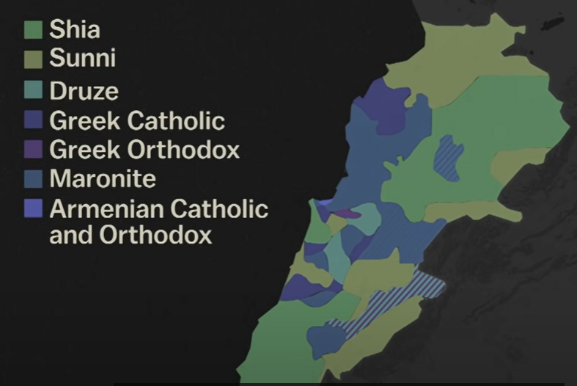
Religious fragmentation
Alawite 0.3%
Armenian catholic and Armenian orthodox 4 %
Assyrian church
Chaldean catholic
Copts
Druze 5.2 %
Greek orthodox 8 %
Isma’ili 0.3%
Jewish
Latin Catholic
Maronite Catholic 22 %
Melkite Greek Catholic 5%
Protestant 1 %
Sunni 28.7 %
Shia 28.4 %
Syriac Catholic
Syriac Orthodox

Slide 6
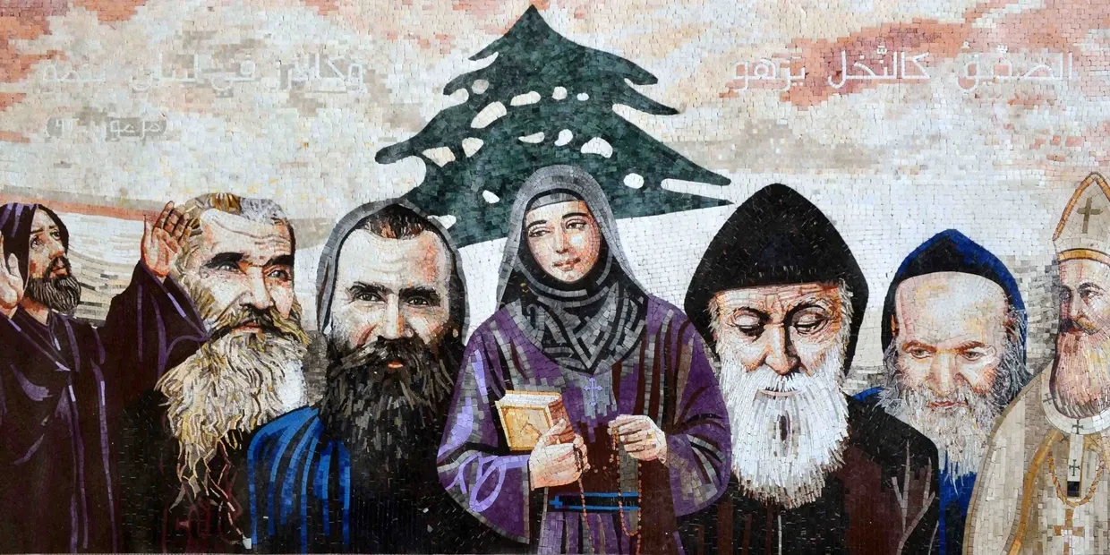
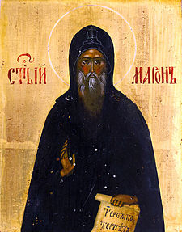
Maronites
Christian sect
Christian ethnoreligious group native to the Eastern Mediterranean and Levant region of West Asia
an Eastern Catholic Church
same fundamental theology as Roman Catholicism and submit leadership decisions to the pope
5th century when a monk named Maron founded a monastery in modern-day Lebanon
retained a much stronger flavor of Judaism than other Catholic denominations.
Their liturgical language is Aramaic, though many congregations have used Arabic due to cultural needs.
Maronite churches are patterned after ancient Jewish synagogues.
The flow of Maronite services follows a pattern markedly different from that of a Roman Catholic Mass
difference between Roman Catholic and Maronite practice regards celibacy. Maronites do not require their priests to remain unmarried

Slide 7
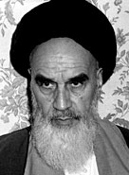
Hizballah
When the government fails
Political and military parts
Shia party in the parliament
The strongest force capable of protecting Lebanon itself
Stronger than Lebanese army
Obsessed with Israel
World’s most powerful non-state actor

Slide 8
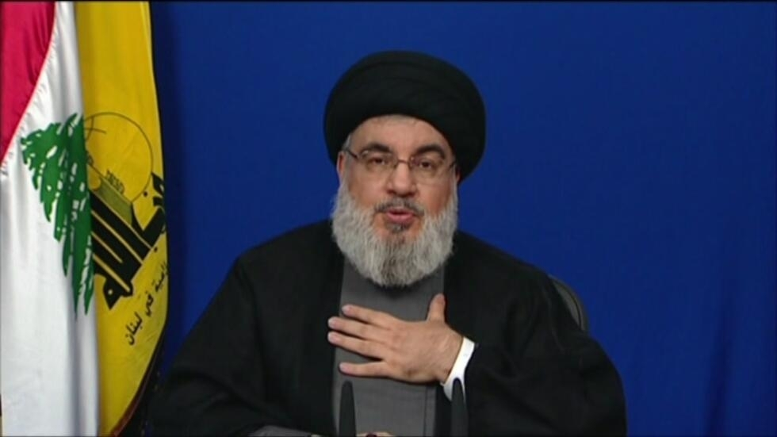
Origin of the Hizballah
Hassan Nasrallah since 1982, leader 1992
Long-term relationship with Iran, since the revolution
Origins in 1980ies, export of the Islamic revolution from Iran
Founder ayatollah Khomeini
Environment of civil war in Lebanon, PLO started to operate in the south, sectarian tension
Opportunity for Khomeini to make a deal with the PLO (sunni)
Training camps for Iranian fighters, support for Palestinian cause, foothold in Lebanon
Shia population in Lebanon was not thrilled with PLO and was interested in Islamic revolution and Iranian support
Khomeini invested in the case for long-neglected shia population in Lebanon and provided food, medicine, healthcare, infrastructure, social and religious institutions – gained loyal allies
1982 PLO attack on Israeli ambassador in UK – Israeli invasion in Lebanon
1982 from the trained fighters formed SHIA militia called Party of God “Hizballah”
Started to fight against Israel and US bases
In ten years Hizballah was dominant political and military force in Lebanon
Notes:
Israel and pre-revolutionary Iran were close allies
Will never recognize Israel, global reach,
Sleeping cells around the worlds
Individual attacks on Israelis, buildings, buses,…
Massive support from Iran
Tunnels to Israel, rockets, bombs,

Slide 9
Hizballah Manifesto
1985
Expel US, FR and allies from Lebanon
To bring the Fallangas to the justice
Permit all the sons of our people to determine their future and form the government they desire (Islamic government)
Destroy Israel

Slide 10
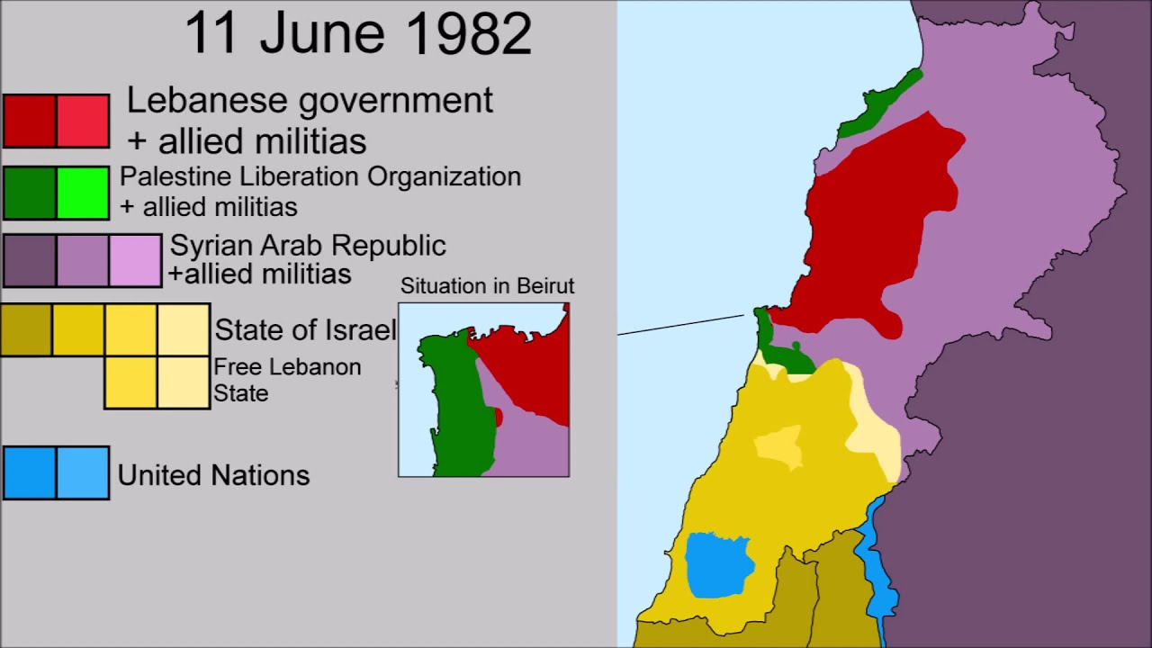
Lebanese Civil War
Waltz with Basheer
1975 Maronite and Muslim militias sparked a civil war
1976 Syria invaded Lebanon
1982 Israel invaded Lebanon
Beirut was divided between many militias
1982 Sabra and Shatila massacre
15 years, 120 000 casualties
1989 Taif Agreement – division among sects
All camps put down the weapons except Lebanese Army and Hizballah (a guerilla fighting force, founded and funded from Iran)
Notes:
Taif agreement were not supposed to set the final division of powers but transition period of 3 years
Conflict continued by other means in the parliament, leaders of militias became leaders of the political parties
The planned move to nonsectarian system
Over 24 ceasefires were agreed and broken

Slide 11
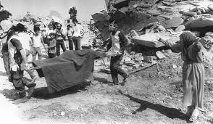
Sabra and Shatila Massacre
16th - 18th of September 1982
Lebanese Christian militia, the Phalangists
Sabra and Shatila are Palestinian refugee camps near Beirut,
under the political and military control of the State of Israel
forty hours of killing
question of Palestine and the Palestinian presence in Lebanon were major stakes on the regional and internal political arena
Notes:
The exact number of victims from the Sabra and Shatila massacre is not and will never be precisely known. Estimations have always varied widely between 700 to 3500
Palestinians have settled in Lebanon in the aftermath of the creation of the State of Israel. “During the summer of 1948, some 110,000 Palestinians were driven out of Galilee and crossed the border into Lebanon
Palestine Liberation Organization (PLO) set up its headquarters in Lebanon after its leaders and activists had been expelled from Jordan. The PLO was responsible for some 340,000 Palestinians. It provided social services and basic infrastructures and built institutions in various domains (economic, cultural, social and political). In the same time, Yasser Arafat, the PLO’s historic leader, developed a military apparatus to lead the armed struggle against Israel. Thousands of Palestinian fighters (the fedayin) were sheltered and trained in the refugee camps. The camps were under the sole control of the Palestinian military police, according to an agreement signed by Y. Arafat and the chief of the Lebanese army in 1969. In that context, refugee camps became symbols of Palestinian resistance.

Slide 12
Political system
Political parties are based on sectarian affiliations
Each sect/party has set number of seats but also agendas and ministries
Notes:
The division of powers and ministries, agendas lead to corruption and enrichment of the sects, jobs and offices, state offers, public procurements, were distributed based on sectarian affiliations
Politicians were using state money for they own needs, did not pay for the development, infrastructure and state basic services as garbage collection
Maronites – electricity (1 billion), but blackouts multiple times a day, undrinkable water – public fee
Sunni – Garbage,
Shia -

Slide 13
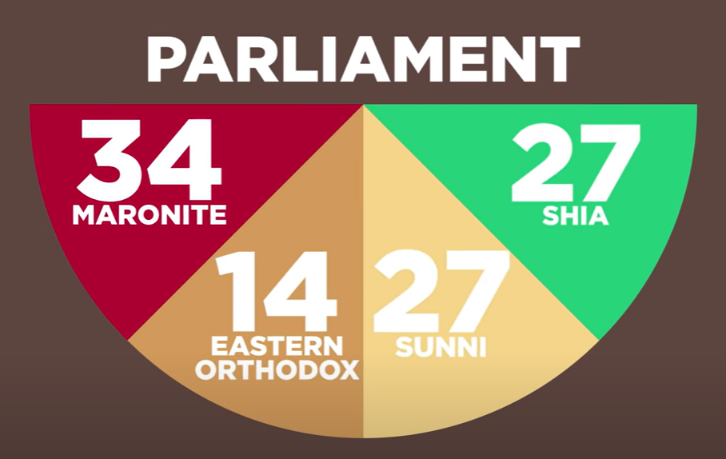
Parliament
Set number of seats
Citizens can only vote for candidates from a specific sects that are designated for their district
Leads to political stalemate
Political crisis
Notes:
Difficult to make any changes or reforms – can be seen as an attack on the community
2015 government owed nearly 70 billion, more thant its entire GDP (141percent)

Slide 14
Political paralysis
Failed state
No head of state for over a year and divided cabinet
Fragmented cabinet was not able to elect a president
Chronic mismanagement
Untrusworthy political representation

Slide 15
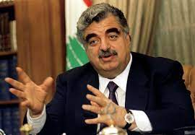
Rafik Hariri
Two terms as a premier
Sunni politician
Renewal of the economy after civil war
Moderate, reformist, millionaire and philanthropist
Funded the NGOs and Taif conference
Killed in the explosion attack on his convoy 2005
Suspected was Syrian regime due to Hariri effort to remove their soldiers from Lebanon

Slide 16
Special Tribunal for Lebanon
also referred to as the Lebanon Tribunal or the Hariri Tribunal
is a tribunal of international character applying Lebanese criminal law to carry out the investigation and prosecution of those responsible for 14 February 2005 assassination of Rafic Hariri, and the deaths of 21 others
opened on 1 March 2009 and has primacy over the national courts of Lebanon
The Tribunal has its seat in Leidschendam, on the outskirts of The Hague, Netherlands, and a field office in the Lebanese capital, Beirut

Slide 17
Economic crisis
Central Bank Scheme
Enemployment
Income inequality
Poverty
Continuous regular protests in the streets
Service based economy since 1990
Heavy importing country (food, raw material, goods…)
Corruption and clientelism
Foreign investments in the financial sector
Notes:
international transport and trade and to the position of Beirut as a centre of international banking and tourism

Slide 18
Trash Crisis 2015
Governmental failure to administrate the state basic services
Notes:
Lebanon was paying over 420 million a year for waste management
Landfill was used 5 times over its capacity
Pile up of garbage because the contract run off and government was not able to agree on new one
July 2015
Naameh landfill site – the largest one in the country – was closed and authorities failed to provide any alternative solutions for months

Slide 19
Landfill closure leads to the national protest
Notes:
Not the demands for the regime change but for the political change, resignation of the prime minister, management changes and reforms
Not violent, not religiously aimed, not liberal demands

Slide 20
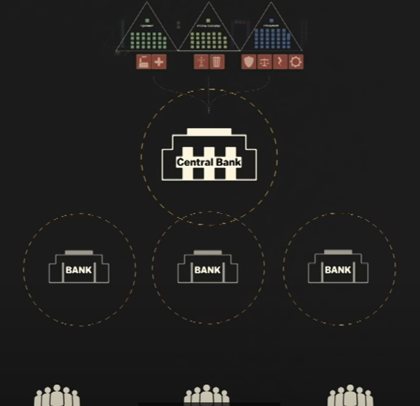
Bank Scheme
Central Bank
Banks offer high interest rates – global clients, important sector
Banks are owned by sectarian politicians
Scheme to get money from investors
Debts/Bankruptcy
New tax = revolution
Notes:
Ponzi scheme based on high interests offered to the foreign clients – private banks- central bank- government
Banks will not be able to pay the interests nor the money back to the clients
Attract more and more money
Syrian Civil war 2011 – investors started pulling their money back from Lebanon
2017 Lebanon’s prime minister Saad Hariri resigned via TV statement from KSA
Claims that Saudis forced him to do so = hostages after 10 days he returned and took back his office
Another damage to the investments – everyone rushed to pull their money off the banks
2019 Banks froze the accounts, run out of money, limiting withdrawals
Extreme increase in the goods prices – medicine, food, fuel,…
Daily tax of 20 USD cents on messaging apps such as Whatsapp

Slide 21
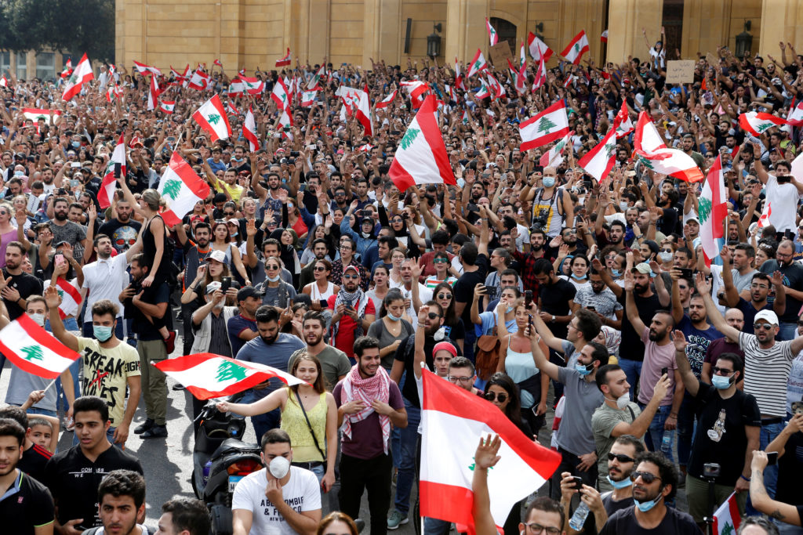
Lebanese protest 2019
Application tax
Corruption, bank collapse, shortages
Central Bank president on the run from International arrest warrant
Unified protest of all sects
Calls for the end of sectarian system
Prime minister Hariri final resignation
Political parties still in power
Economic Aid offering from IMF and USA in exchange for the governmental reform – politicians could not agree even on that
Notes:
In one year Lebanese currency (pound) lost over 90 percent of its value
80 percent of Lebanese population living in the poverty
Collapsed banking system

Slide 22
Beirut Explosion
4 August 2020
Warehouse caught fire in the Port of Beirut
2700 metric tons of ammonium nitrate
Explosion destroyed the port and the zone of destruction was 6 miles
200 casualties, thousands wounded
Close to the civil populated areas
Heave importing economy
Most of the imports via the Port of Beirut (major port) – shortages of the food, medicine, fuel
Notes:
Misfunction and misadministration of the system – ammonium nitrate was in the warehouse for over 7 years and none did anything about this highly dangerous content, it was intercepted by the customs but none got rid of it, could not have agree on who is responsible for that – CRIMINAL NEGLIGENCE
- people cleaning and restoring, not the governmental forces – Personal initiatives

Slide 23
Presidential election 2022-2023
May 2022
Shia Muslim Hezbollah movement and its allies lost their parliamentary majority. Hezbollah did not lose any of its seats, but its allies lost seats.
Hezbollah’s ally, President Michel Aoun's Free Patriotic Movement, was no longer the biggest Christian party after the election
Rival Christian party, led by Samir Geagea, with close ties to Saudi Arabia, the Lebanese Forces (LF), made gains.
Sunni Future Movement, led by former prime minister Saad Hariri, did not participate in the election, leaving a political vacuum to other Sunni politicians to fill
12 new independent MPs
DEEP STATE
Lebanon without president for 7 months, function government for a year
Notes:
2022–2023 Lebanese presidential election is an ongoing indirect election to elect the president of Lebanon following the expiration of term-limited incumbent Michel Aoun's mandate on 31 October 2022. The outgoing president has served since 31 October 2016, following the end of the 2-year presidential crisis.
Article 49 of the Lebanese Constitution, a qualified majority of two-thirds of the members of the Lebanese Parliament is required to elect the president in the first round. If no candidate reaches that threshold, further rounds of election are held where an absolute majority of the members legally constituting the parliament is sufficient to elect the president. The incumbent president is not eligible for reelection until six years has passed since the expiration of his mandate, as per article 49 of the Lebanese Constitution.

Slide 24
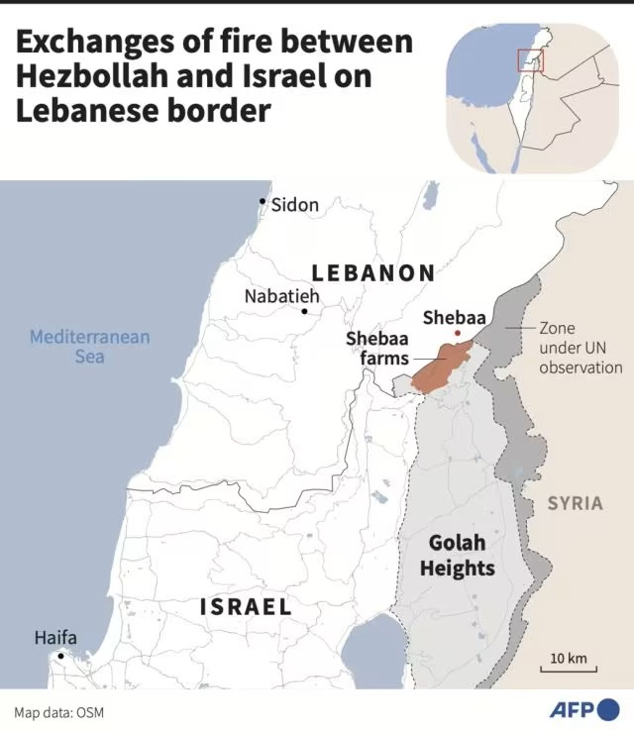

Slide 25
Israeli Invasion in Lebanon 2024
Cut the heads of the snake
1 October 2024, Israel invaded Southern Lebanon in an escalation of the ongoing Israel–Hezbollah conflict, a spillover of the Israel–Hamas war
In previous week air strike killed Hassan Nasrallah
weeks of aerial bombardment that Lebanese authorities say has killed more than 2,300 people and forced more than 1.2m to flee their homes
Israeli military said one army division — which typically numbers more than 10,000 soldiers — was conducting “limited, localized and targeted raids,” but it is unclear how many of those troops had already crossed the border.

Slide 26
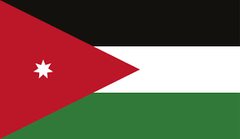
Hashemite Kingdom of Jordan

Slide 27
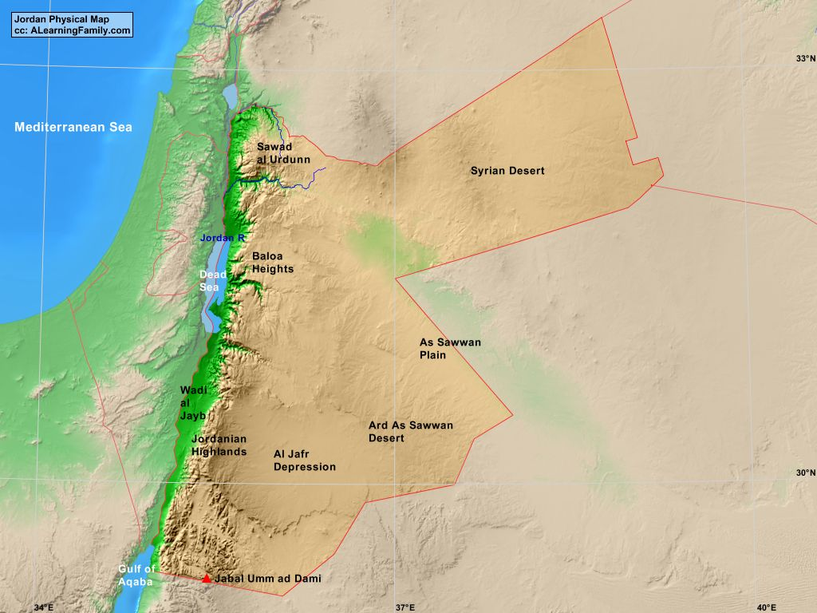
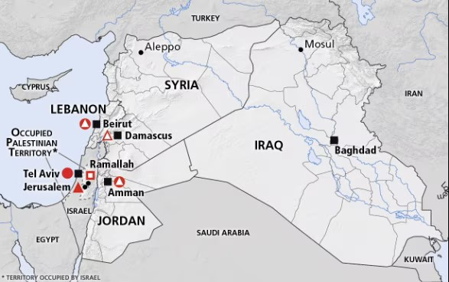
Geography and borderlands
89 342 km²
11,484,805 (2/3 pf the population were formerly Palestinians)
$132.092 billion

Slide 28
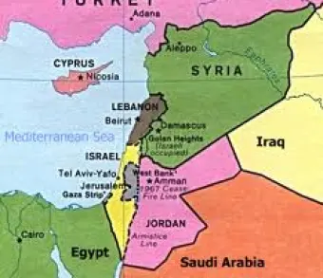
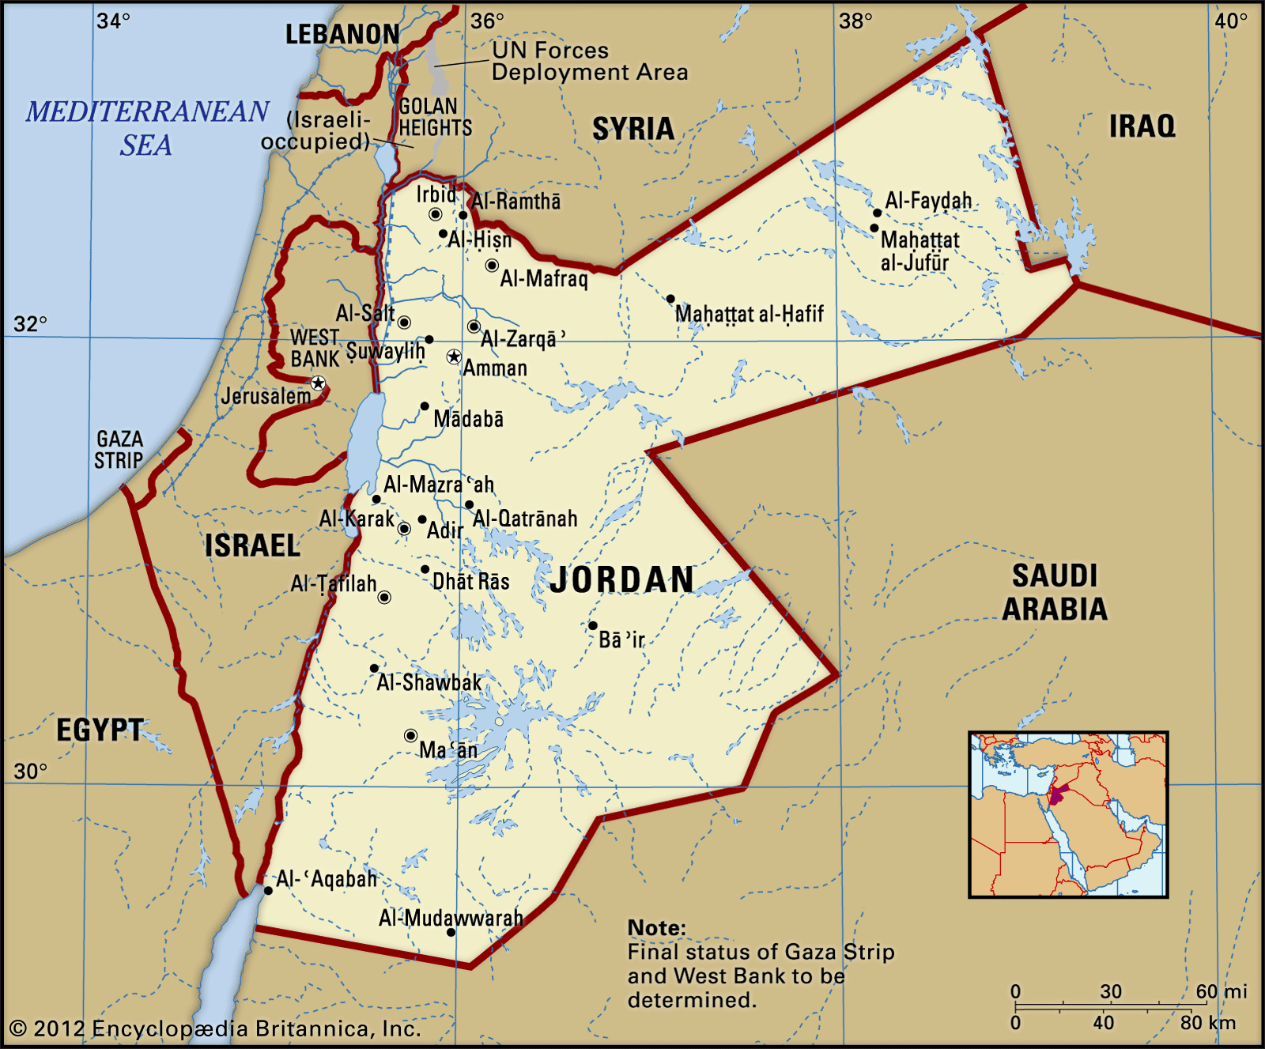
Notes:
One of the most stable Arab countries, liberal and moderate
Interconnected with Saudi royal family

Slide 29
Ancient History
Greek
Roman
Crusaders
Mostly connected to the Christianity, places referred to in the Bible

Slide 30
Modern History
1945 After WWII Jordan gained independence
Emir Abdullah king
1947 foundation of Israel, king Abdullah was close to the Zionist leaders
1951 king Abdullah assassinated in Jerusalem in Al-Aqsa mosque for his liberal approach to the Israel
1952 Jordanian constitution, king Talal abdication due to schizophrenia
King Hussein (17 years old)
Jordan is dragged in the Cold War as Gamal Nasir became president of Egypt, proposal to join the Cold war on the side of Britain
Public unrest to support Nasserism and oppose Britain influence, king Hussein did not enter the Baghdad Pact
Reduced the reliance on the Britain
Arabisation of the Jordanian Army and renamed to Jordanian Armed Forces
General election, democratically elected government – opposed king and caused public unrest
1957 government forced to resign
Alleged coup attempt from Nasirist army officers, avoided
United Arab Republic of Syria and Egypt, disbanded in 1961
Arab Federation Jordan and Iraq, Iraq Hashemite dynasty overthrown in July by army nassirist
Notes:
Palestinians turning into Jordanian, full right, unique in Arab countries
Building a nation
50s and 60s panarabism, nasirism
Arab- Israeli war Israel gained 60 percent more land 1949

Slide 31
Arab- Israeli conflict
1949 Jordan joined the coalition and declared war against Israel (Jordan took control of West Bank and East Jerusalem) renames itself to Jordan finally
1950 formal annexation of West Bank, country population tripled (1.3 million)
1967 Six-day war second Arab-Israeli conflict, defence pact with Egypt and Syria (Jordan lost West Bank and Jerusalem, Egypt lost Golan Heights, Gaza and Sinai)
Loss of West bank for Jordan was huge problem – population, economic centre, 300 000 displaced Palestinians to other Jordan cities
PLO (Palestinian resistance movement) settled in Jordan, launching attack to Israel from Jordanian soil
Israel attacked PLO on Jordanian territory, Jordan defeated Israeli forces and gained fame
PLO recruitment, powerful, funded, famous globally – violating local laws, shooting at Jordan forces (STATE in a STATE)
Threat to king’s authority
1970 Black September PLO were ousted from the Amman within 2 week with the use of army
1971 all PLO members were forced out of Jordan, moved to Lebanon
1973 Yom Kippur War
War Egypt and Syria attacked Israel, Jordan only supporting role to Syrian Golan Heights
1974 PLO recognized as a sole political representative of the Palestinian people – blow to the Jordan king, give up of speaking on behalf of Palestinian (refugees)
1988 I. Intifada – king Hussein renounced all legal and administrative ties with the West Bank (give the Palestinians a chance on Independence) – stripped of Jordanian citizenship
Protest in Jordan, 1989 parliamentary elections, introduction of National Charter (outline for democratization)
Notes:
46 years long official state of War between IS and JOR

Slide 32
Hashemite dynasty
King Hussein had close relations with Saddam Hussein, damage to his reputation
1994 Israel-Jordan Peace Treaty
King Hussein died in 1999
King Abdullah II. Since 2000
Notes:
One of the most stable Middle Eastern countries

Slide 33
Current issues
Migration
Limited sources of internal revenue
Externally oriented rentier economy
Resource impoverishment
Unemployment
Climbing prices
Corruption
Failed protests 2011
Tension in the society
Notes:
Tourism, trade, 1,000,000 barrels of proven oil reserves as of 2016
Jordan holds 0.21 trillion cubic feet (Tcf) of proven gas reserves as of 2017
Oil shale in Jordan represents a significant resource. Oil shale deposits in Jordan underlie more than 60% of Jordanian territory. The total resources amounts to 31 billion tonnes of oil shale.

Slide 34
Migration and refugee crisis in Jordan
https://www.youtube.com/watch?v=wcsqiNZAHg4
Jordan hosts the second largest number of refugees per capita worldwide, including 660,000 Syrians
unregistered, is estimated at around 1.3 million
Over 19,000 Palestinian refugees from Syria are also registered in Jordan
political, economic, and resource challenges in Jordan
restricted the number of Syrians who can enter the country, closed accessible border crossings, and attempted to confine more refugees to camps
Notes:
overstates the negative impacts of the Syrian refugee influx, while the positive impacts receive far less attention, highlighting the politicized nature of the refugee crisis in Jordan. Public sentiment toward Syrian refugees has a deleterious effect on the government’s ability to respond productively to the refugee influx.

Slide 35
Key points
Prioritize the integration of development and humanitarian aid
Maintain protection space for Syrian refugees
Formalize access to livelihoods
Empower local governance actors
Jordan Response Plan for the Syria Crisis, which is described as “the first nationally-led response of its kind, joining refugee and development responses in one comprehensive national plan.”
Notes:
The Syrian influx presents Jordan with a political problem. Syrians are highly concentrated in Jordan’s most vulnerable communities, and grievances brought to the fore by Syrian refugees have begun to mobilize marginalized Jordanians.

Slide 36
International obligations
Human rights protection
1951 convention “No Contracting State shall expel or return (‘refouler’) a refugee in any manner whatsoever to the frontiers of territories where his life or freedom would be threatened on account of his race, religion, nationality, membership of a particular social group or political opinion.”
Notes:
committed to not return persons through its ratification of the UN’s 1966 International Covenant on Civil and Political Rights

Slide 37
Jordanian approach to the refugees
Syrian children access to public education
until November 2014, facilitated Syrian access to subsidized medical care
rights to housing, employment, public education, freedom of movement, and public relief and assistance
restrict the protection space for Syrian refugees, terminating their healthcare provisions and limiting their freedom of movement
legally vulnerable = limited obligations under international law
repatriating refugees back to Syria, particularly unaccompanied men and Palestinians. Such actions amount to a violation of the principle of non-refoulement

Slide 38
Jordan’s Refugee Crisis
Stop the displacement
Egypt and Jordan refused to open borders for refugees in fear of Israeli policy of expulsion of Palestinions
has not signed any international conventions or protocols that govern the treatment of refugees, including the UN’s 1951 Convention Relating to the Status of Refugees and its additional 1967 protocol
Notes:
progressive stance on refugees and generally upholds international standards on their treatment. Its 1998 memorandum of understanding with the UNHCR outlines the extent of Jordan’s refugee policy for non-Palestinians

Slide 39
Impact on the Jordan
Public unrest and pressure on the government
Decreasing confidence in international support
a destabilizing security context
pressure on resources have only served to enhance this attitude
Pressure form the public to stop admitting and stop caring
Limitation of the movement and possibility to work
Negative attitude from the Jordanian society toward the refugees
stretched beyond its capacity to deliver essential services like healthcare, education, and waste management in the municipalities most affected by the Syrian refugee crisis
rental prices rose to six times their precrisis rates

