Slide 1
Varieties of Illiberal Backlash in Central Europe Petra Guasti, Associate Professor for Democratic Theory, Charles University
Guest lecture for the course:
PMCb1013 Citizens, media, opinion
9.12.2024
Notes:
Úvodní snímek

Slide 2
Motivation
“No civilization — the man-made artifact to house successive generations — would ever have been possible without a framework of stability, to provide the wherein for the flux of change. Foremost among the stabilizing factors, more enduring than customs, manners and traditions, are the legal systems that regulate our life in the world and our daily affairs with each other.”
Hannah Arendt, Crises of the Republic

Slide 3
WHAT EXPLAINS VARIETIES OF ILLIBERAL BACKLASH AGAINST REPRODUCTIVE AND LGBTQ RIGHTS IN CENTRAL EUROPE?
The extent of backlash reflects the strength of an alliance between socially conservative advocacy groups and political parties,
BUT illiberal politicians are constrained by two factors:
public opinion &
presence of a pluralistic moderate confessional political party
Notes:
In the past two decades, Czechia, Hungary, Poland, and Slovakia - the Visegrad Four countries (V4) - have experienced a dramatic increase in new forms of illiberalism associated with the contestation of reproductive and LGBTQ rights (cf. Grzebalska and Pető 2018; Lorenz and Anders 2020). 3 Illiberal parties with socially conservative leanings emerged to re-invent a paternalistic mixture of familialism and traditional values (Keskinen et al., 2016; Buzogany and Varga 2019; Cinpoes and Norocel 2020; Hanson and Kopstein 2021). Most importantly, they tapped into socially conservative groups that opposed the expansion of minority rights (Bustikova 2019, 2020; Guasti and Bustikova 2020; Guasti 2020a).

Slide 4
Structure
Illiberalism in Central Europe
Abortion and Same-Sex Rights in Central Europe
Confessional Parties
Radicalization of Mainstream Parties
Illiberal Policies
Illiberal Alliances
Conclusions

Slide 5
1. ILLIBERALISM IN CENTRAL EUROPE: DEFINITION
Definition:
a set of principles opposed to pluralism, minority accommodation and ideological heterogeneity.
calls for hetero-normative sexuality and ties of solidarity formed around a communitarian view of nationhood and sovereignty.
“[W]hat is happening today in Hungary can be interpreted as an attempt of the respective political leadership to harmonize the relationship between the interests and achievement of individuals – ... – with interests and achievements of the community, and the nation. Meaning, that the Hungarian nation is not a simple sum of individuals, but a community that needs to be organized, strengthened and developed, and in this sense, the new state that we are building is an illiberal state” (Orban, 2014).
Notes:
feeds of a nostalgia for “mechanical solidarity” that bonded traditional communities before the emergence of complex solidaristic ties in cities associated with a greater variety of lifestyles,

Slide 6
1. ILLIBERALISM IN CENTRAL EUROPE: STATE OF THE ART
parties that contest liberal norms also promote cultural conservativism and ethnic nationalism
the pushback against minority rights, traditionally associated with ethnicity, is a warning sign of nascent illiberalism
efforts to defend traditional values and to marginalize elites that promote progressive values and multiculturalism have been spearheaded by socially conservative groups and church organizations
over the last decade, socially conservative groups embraced “new” cultural issues linked to Christian values and associated with familialism, that oppose LGBTQ rights and gender equality
Could you name some examples of parties outside CEE contesting liberal norms?
Notes:
(Keskinen et al., 2016; Bustikova, 2019; Vachudova, 2019, 2021; Cinpoes and Norocel, 2020);
(Anders and Lorenz, 2020; Sadurski 2019);
(Pirro and van Kassel, 2017; Taggart, 2000; Greskovits 2020);
(Kotwas and Kubik, 2019; Guasti and Bustikova, 2020).
Alongside opposition to particularistic ethnicities, the old and the new forms of identity politics formed an amalgam of exclusionary populism (Mudde and Kaltwasser, 2013), ethnopopulism (Vachudova, 2021; Jenne, 2018), ethnonationalist populism (Bonikowski, 2017), and paternalist populism (Enyedi, 2020).

Slide 7
2. ABORTION AND SAME-SEX RIGHTS IN CENTRAL EUROPE: LGBTQ RIGHTS
Until | EU | HU | PL | SK | CZ
2010 | 14/27 registered partnership 4/27 same sex marriage | 2009 registered partnership | no registered partnership/no same sex marriage | no registered partnership/no same sex marriage failed constitutional referendum to declare marriage as between a man and a woman in 2014 | 2006 registered partnership
2021 | 22/27 registered partnership 14/27 same sex marriage | 2020 transgender people banned from legally changing gender at birth; constitutional ban on same-sex marriage domestic adoption of children by same sex couples not allowed | no registered partnership/no same sex marriage domestic adoption of children by same sex couples not allowed | no registered partnership/no same sex marriage domestic adoption of children by same sex couples not allowed | 2016 CC allows registered partners to adopt as individuals 2021 legislative proposal to legalize same sex marriage introduced domestic adoption of children by same sex couples not allowed

Slide 8
2. ABORTION AND SAME-SEX RIGHTS IN CENTRAL EUROPE: REPRODUCTIVE RIGHTS
Until | EU | HU | PL | SK | CZ
2010 | 24/27 | no legal restriction | abortion only in limited cases | no legal restriction | no legal restriction
2021 | 26/27 | no legal restrictions on abortion on request, but since 2012 protection of life since conception in Constitution | 2020 severe legal restriction introduced | no legal restrictions, but 2020 failed attempt at legal restriction abortion on request | no legal restrictions abortion on request

Slide 9
2. ABORTION AND SAME-SEX RIGHTS IN CENTRAL EUROPE: SUMMARY
WITHIN THE REGION:
Czechs tend to be most liberal on both reproductive rights and registered partnership,
Hungarians are liberal on reproductive rights but show limited support for LGBTQ rights,
Poles are divided on reproductive rights and rather conservative on LGBTQ rights, as are Slovaks, but to a lesser degree.
IN ALL COUNTRIES, THE ATTITUDES TOWARD ABORTION AND SAME-SEX MARRIAGE BECAME LESS LIBERAL OVER THE LAST DECADE.
Do you know what is the attitude towards LGBTQ rights in your country?
Take a few minutes to find out ;)
Notes:
https://www.pewresearch.org/global/2020/06/25/global-divide-on-homosexuality-persists/ Source: Pew Research 2020 (2019).

Slide 10
3. CONFESSIONAL PARTIES
confessional parties in Visegrad Four countries differ in their timing of formation, trajectories, and policy advocacy,
party systems in all four countries tilted towards issues of identity, regardless of their trajectory since the collapse of communism (Kitschelt et al. 1999),
continuous presence of Christian democratic parties that formed already in the very early 1990s’, survived, and actively participated in pro-European governments (CZ + SK), blocks the ability of illiberal parties to consolidate religiously infused conservatives under one umbrella.
issues of culture and national belonging continue to shape Polish and Hungarian politics.
➔ PRESENCE OF MODERATE CONFESSIONAL PARTIES DILUTES EFFORTS TO RESTRICT REPRODUCTIVE RIGHTS.

Slide 11
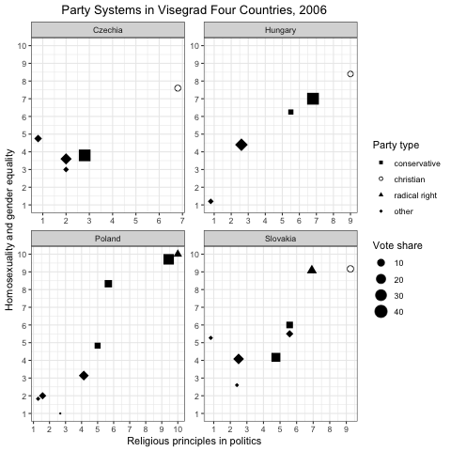
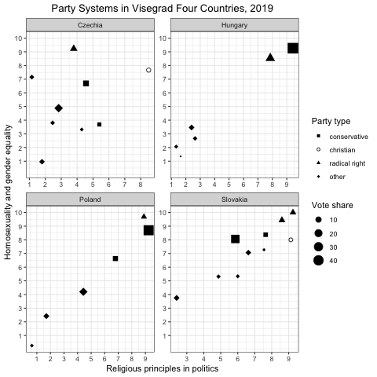
4. RADICALIZATION OF MAINSTREAM PARTIES

Slide 12
4. RADICALIZATION OF MAINSTREAM PARTIES: SUMMARY
RELIGION POLARIZES POLITICS IN HUNGARY, POLAND, AND SLOVAKIA, BUT NOT IN CZECHIA,
these patterns do not map onto the presence of moderate, well-established confessional parties,
both in Czechia and Slovakia, Christian democratic parties have served in governing coalitions with pro-Western, liberal parties that also implemented economic neo-liberal reforms & negotiated EU accession,
this limited the ability to ally with the Slovak Christian democratic party the way Fidesz allied with Hungarian Christian democrats.
FRAGMENTATION AND COMPETITION BETWEEN MODERATE AND RADICAL CONFESSIONAL PARTIES, UNDERCUTS THE ABILITY OF ONE ILLIBERAL PARTY TO CONSOLIDATE THE SOCIALLY CONSERVATIVE VOTE.

Slide 13
5. ILLIBERAL POLICIES: LEGAL CHANGES IN REPRODUCTIVE RIGHTS
THREE MAJOR ATTEMPTS TO LEGALLY RESTRICT REPRODUCTIVE RIGHTS BETWEEN 2012-2020
in Hungary, a Constitutional amendment in 2012 enshrined the protection of life since conception,
in 2020, the Polish Constitutional tribunal proposed a ban on abortion in case of foetal abnormality,
between 2020 and 2023, the Slovak parliament introduced multiple amendments that would restrict access to abortion, but they did not pass.

Slide 14
5. ILLIBERAL POLICIES: LEGAL CHANGES TO LGBTQ RIGHTS
by contrast, it is more politically expedient to curb the expansion of the small LGBTQ community’s rights, for it aligns with public opinion;
LGBTQ rights is a salient issue for social conservatives, who concentrate on introducing new regulatory barriers and restrictions,
while the domestic impetus for the expansion of LGBTQ rights is limited, the V4 countries face external pressures (cf. Ayoub and Paternotte 2014),
the only expansion of LGBTQ rights can be attributed to the legal framework of the European Union,

Slide 15
5. ILLIBERAL POLICIES: POLICY CHANGES TO REPRODUCTIVE AND LGBTQ RIGHTS
PARTIES IMPLEMENT POLICIES THAT ERODE REPRODUCTIVE RIGHTS AND CURB THE EXPANSION OF LGBTQ RIGHTS IN SUBTLER WAYS:
Poland is the only country that legally restricts abortion on request, but there are two effective alternatives to de iure restrictions - via policies, and the government to encourage non-enforcement of the existing legislation,
Hungary de facto restricts abortion access - on paper, abortion in Hungary is legal, but the government effectively limits women’s reproductive autonomy, even “loud” strategies have their “silent” counterparts - Hungary expanded the rights of ‘conscientious objectors’: medical professionals to perform abortion and to prescribe contraception,
THE ONLY PUSHBACK AVAILABLE TO CITIZENS IS TO CHALLENGE GOVERNMENTS VIA TRANSNATIONAL COURTS: BOTH ECJ AND ECTHR HAVE REPEATEDLY RULED AGAINST POLAND, HUNGARY, AND THE CZECH REPUBLIC ON LGBTQ RIGHTS

Slide 16
EXERCISE: SPOT THE TRENDS IN ILLIBERAL POLICIES
OBJECTIVE In a brief and interactive setting, students identify patterns and alliances driving illiberal policies in Central Europe, focusing on LGBTQ and reproductive rights.
Please Divide into 4 Groups: Czechia, Hungary, Poland, or Slovakia.
TASK
Each group identifies one example of an illiberal policy or action in their assigned country.
Brainstorm the actors involved (e.g., political parties, the Church, advocacy groups) and the alliances supporting or opposing these policies.
Discuss the broader implications for rights and democracy in the resepctive country.
Rapid Fire Presentation of your findings: 1. The policy/action you identified; 2. Key alliances or opposition involved; 3. A brief insight on how it reflects regional or national trends.

Slide 17
6. ILLIBERAL ALLIANCES: STRANGE BEDFELLOWS
radical socially conservative alliance is behind the illiberal backlash,
includes radicalized mainstream parties, radical confessional parties, the (Catholic) Church, and advocacy groups, such as Ordo Iuris (Poland),
BUT, socially conservative groups are useful allies, but bad masters for illiberal leaders like Orban or Kaczynski
IN THEIR RISE TO POWER, THEY INSTRUMENTALIZE CITIZEN GROUPS, BUT, ONCE IN POWER, THEY TRY TO KEEP FRINGE, EXTREME ELEMENTS AT ARM'S LENGTH.
Notes:
For example in 2011, the government launched a pro-life campaign, and in 2019 a Family Protection Action Plan. mber-states as legally equivalent to more traditional marriage for the purpose of residency permission (Guasti and Bustikova, 2020).

Slide 18
6. ILLIBERAL ALLIANCES: HOW TO EAT YOUR CAKE AND HAVE IT
Hungary illustrates our core argument on the intensity and limits of the illiberal backlash:
Viktor Orban turned previously liberal LGBTQ regime into one of the most restrictive ones, including constitutional changes (2012), far reaching legal and policy changes (2016, 2020, 2021), BUT, Orban never reversed the registered partnership introduced in 2009,
Similarly, on abortion Hungary did not legally restrict the widely popular reproductive rights, but implemented policy changes that made access to abortion more difficult and denial of care easier.
➔ ORBAN AVOIDED WIDE SPREAD MOBILIZATION ON AN ISSUE THAT WOULD UNITE THE OPPOSITION.

Slide 19
CONCLUSIONS
contestation of reproductive and LGBTQ rights in Central Europe in the past two decades has been one of the most politically salient issues, but the dynamics and the outcomes differ dramatically across the four countries;
we argue that a new alliance of conservative political parties and emboldened socially conservative groups have shaped this illiberal backlash,
socially conservative groups are not shy about forming a strategic alliance with confessional parties. Unlike liberal progressive groups who inherited a legacy of anti-partisanship from communism, this partnership does not diminish their credibility,
SOCIALLY CONSERVATIVE GROUPS PROVIDE ILLIBERAL POLITICIANS WITH VOTES, RESOURCES, LEGITIMACY, AND MOBILIZATION POWER, IN EXCHANGE, THEY DEMAND THAT PARTIES IN POWER CHANGE THE REGULATORY FRAMEWORK AROUND SEXUALITY AND RESTRICT (MINORITY) RIGHTS.

Slide 20
Thank you for your attention!

