Slide 1
Data sources

Slide 2
No visualization without data
Data:
already processed
Raw data

Slide 3
First steps
Try AI
Great development since last year
Knows the most general sources
Good for orientation in the field
Does not help with too narow or specific data
Important!!!
Check the sources
check the content
Check the „licence“
use google search for finding alternate/true location

Slide 4
Data sources
International organizations
National institutions
Academic groups
Data archives
News
Academic publications

Slide 5
Institutional data sources
General data about world
UN: https://unstats.un.org/unsd/demographic-social/products/
UNESCO: https://uis.unesco.org/ - education
ILO: https://ilostat.ilo.org/data / - labour
FAO: https://www.fao.org/faostat/en/#home - agriculture
WTO: https://stats.wto.org / - economy, trade
WB: https://databank.worldbank.org/ - economy, various indicators
IMF: https://www.imf.org/en/Data
WHO: https://www.who.int/data - health, healthcare
OECD: https://stats.oecd.org/ - various indicators
Useful links: ourworldindata.org, www.worldometers.info, www.statista.com

Slide 6
Politics
Freedomhouse: https://freedomhouse.org/report/freedom-world
Democracy index
Parlgov: https://www.parlgov.org/data-info/
Political parties – mostly Europe
Idea: https://www.idea.int/data-tools
Various issues
CHES: https://www.chesdata.eu/
Party positions in Europe and Latin America
Electoral manifesto: https://manifesto-project.wzb.eu/datasets

Slide 7
Electoral data
Electoral results:
https://electiondataarchive.org/data-and-documentation/
http://psephos.adam-carr.net/indexes/index_a.shtml
Integrity: https://www.electoralintegrityproject.com/data-1
Comparative surveys:
https://cses.org/data-download/download-data-documentation/election-studies/
https://u.osu.edu/cnep/surveys/surveys-through-2012/
Studies from various countries:
https://search.gesis.org/

Slide 8
Parliaments
IPU: https://data.ipu.org/content/parline-global-data-national-parliaments
EP: https://data.europarl.europa.eu/en/home
Czech: https://www.psp.cz/sqw/hp.sqw?k=1300
Almost any country

Slide 9
Public opinion
Political aspects
Trust, vote intentions, approval, sympathies, democracy, ideology,…
Social matters
Gender equality, identities, age roles, view on „others“, …
Economic evaluations
Inflation, taxes, economic left-right,….
Various other issues
Environment, values, customer behaviour, ad hoc issues

Slide 10
Barometer
Europe, Africa, Latin America, Asia
Comparative data
Various quality, timing and scope
Europe: https://www.gesis.org/en/eurobarometer-data-service/home
Africa: https://www.afrobarometer.org/data/data-sets/
Asia: https://www.asianbarometer.org/datar?page=d10
Latin America: https://www.latinobarometro.org/latContents.jsp

Slide 11
Comparative Projects
International Social Survey Programme
Role of Government, Social Networks and Inequality, Family, Gender Roles, Work, Religion, Environment, National Identity, Leisure Time, Health
https://issp.org/data-download/by-year/
World Values Survey
Wide set of countries, various issues
https://www.worldvaluessurvey.org/WVSContents.jsp
+ European Values Survey
European Social Study
https://ess-search.nsd.no/

Slide 12
Public Opinion Survey Data
World
https://ukdataservice.ac.uk/help/other-data-providers/data-archives/other-worldwide-data-archives/
https://www.pewresearch.org/tools-and-resources/
Europe
https://www.cessda.eu/About/Consortium
https://datacatalogue.cessda.eu/
Czech
http://nesstar.soc.cas.cz/webview/

Slide 13
Media
Media monitor (only Czech) https://ezdroje.muni.cz/prehled/hledej.php?dotaz=newton+media&lang=cs

Slide 14
Searching on google
"data about media" – exact combination of words
OR - logical or
"data about media" OR "data about culture" – pages containg first or second or both statements
And - Logical and
"data about media" AND "data about culture" – only pages containg both statements
- Minus "data about media" –culture – ony pages containing "data about media" without mentionining culture
* asteriks " data about * " – data about anything.
() – gives priority to certain word
"data about culture" 2016..2020 – two dots represents number line (2016, 2017, 2018, 2019, 2020), works in same sense as OR
filetype:xlsx (other options pdf, doc, xls, docx)
site:unstats.un.org - searching on given page site:unstats.un.org

Slide 15
Try to do same with AI

Slide 16
News articles

Slide 17
Data in acadamic articles and books

Slide 18
Real Data

Slide 19
Data linked to research articles
Processed data
Edited data
Original variables not used for article are deleted
Indication of source of data
data.mendeley.com
https://dataverse.harvard.edu/

Slide 20
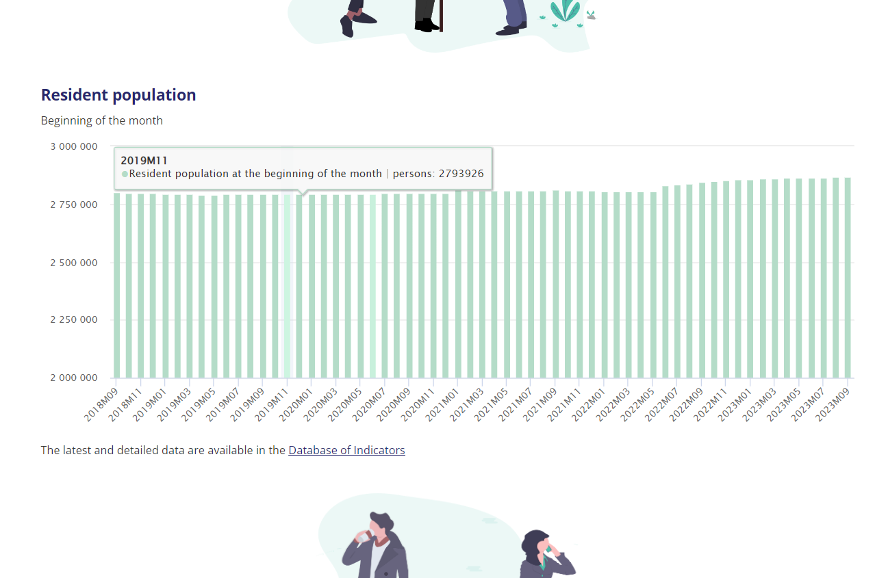
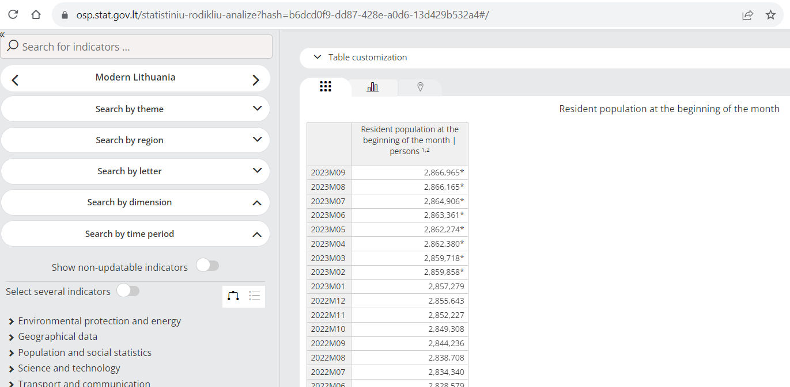
Information webpage using some data
https://osp.stat.gov.lt/en/lietuvos-ekonomikos-raida/gyventojai-ir-socialine-statistika
https://osp.stat.gov.lt/statistiniu-rodikliu-analize?hash=b6dcd0f9-dd87-428e-a0d6-13d429b532a4#/
Real Data

Slide 21
Open data repositories
https://datahub.brno.cz/

Slide 22
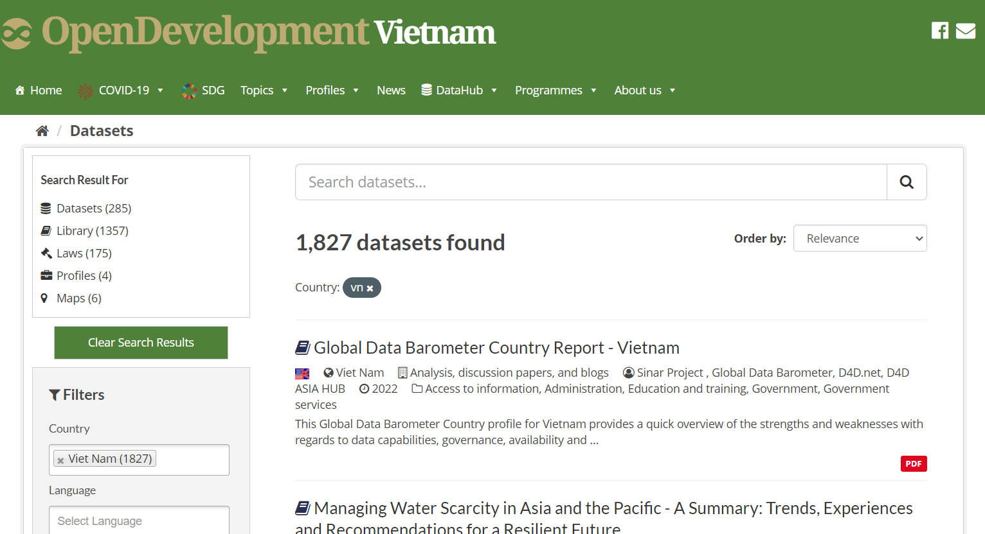
Vykopirovat vietnam

Slide 23
You can use AI !!!
Google search is obviously AI too
E.g. ChatGPT
https://chat.openai.com/
tell me about some sources about social and political data in Nigeria?
It is neccessary to check the results

Slide 24
Typical scenarios
Excel (xls, xlsx)
SPSS (sav), Stata (dta), R (rdata)
CSV, TXT
XML
JSON

Slide 25
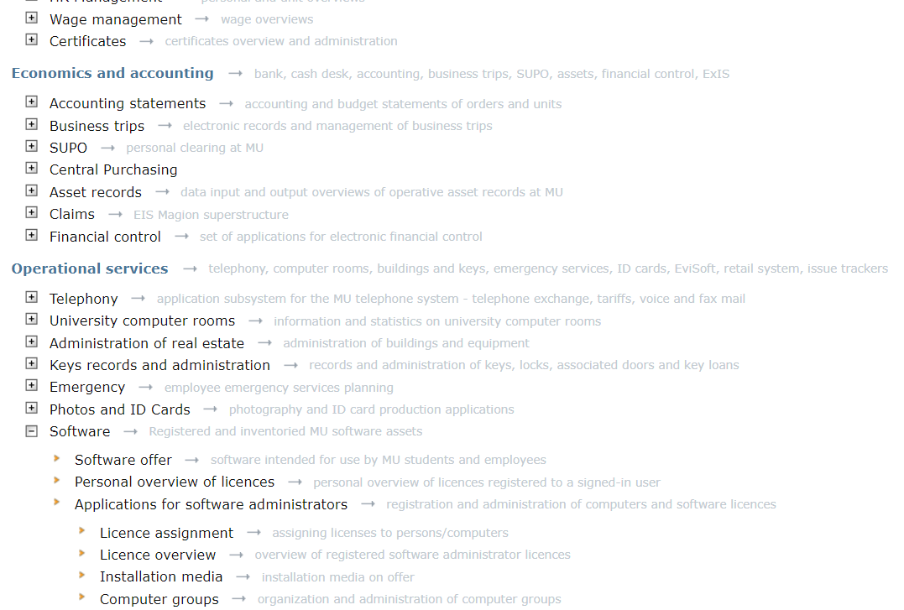
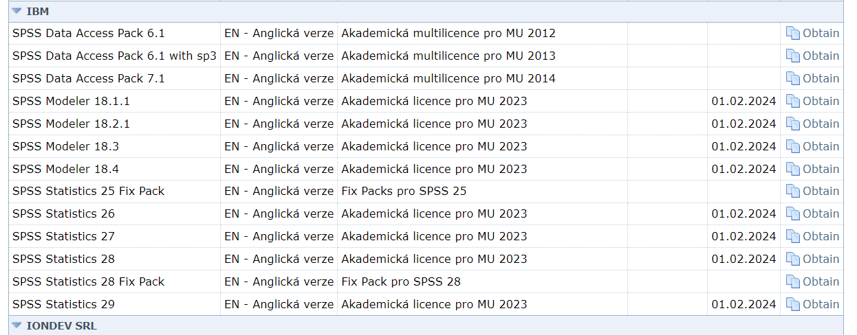
https://inet.muni.cz/?idr=ict.soft&pk=u&x=0&y=500

