Slide 1
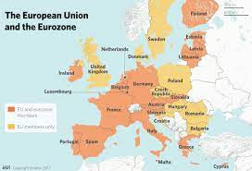
Influences on East European Politics: The European Union
Post-Communist Politics, PMCb1109
Doc. Marek Rybář, PhD.

Slide 2
How does the EU influence outside regimes?
EU is the most effective international organization in spreading democracy and the rule of law
the EU‘s leverage rests in motivating the outside countries by prospect of EU membership, AND in its political conditionality
active and passive leverage against the third countries

Slide 3
The framework for EU-CEE relations
conditionality as a key tool – “governance by enlargement”
conditionality spells an asymmetric relationship, in which the EU offered help and privileges after the candidate countries’ meeting the set criteria/conditions
first formulated in 1993

Slide 4
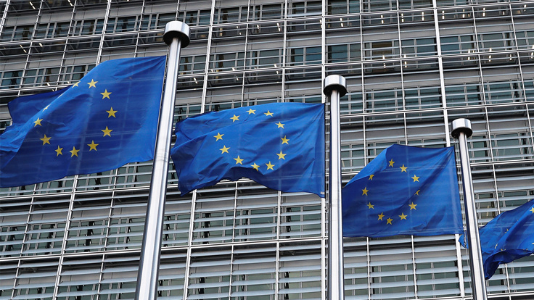
The Copenhagen Criteria (1993)
1) economic – a functioning market economy and the ability to cope with competitive pressure and market forces within the EU
2) political – stability of institutions guaranteeing democracy, the rule of law, human rights and respect for and protection of minorities
3) administrative – ability to take on the obligations of membership (implement the rules and adhere to the goals of the Union)

Slide 5
The Scope of EU Conditionality
impact on CEE stronger than on the domestic policies of the EU-15
conditionality included the acquis but also broadly conceived political and macroeconomic themes
political criteria included a judiciary and prisons reform (BUL), economic criteria involved pension and welfare state reforms (SLO)

Slide 6
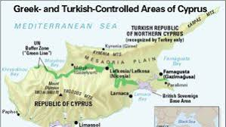
Conditionality and its limits
less effective in the countries with a history of (violent) ethnic conflicts
high political costs for the national governments
CRO and SER – (lack of) cooperation with the ICTY
Turkey‘s recognition of the Greek-Cypriot state
Status of ethnic minorities in LAT and EST

Slide 7
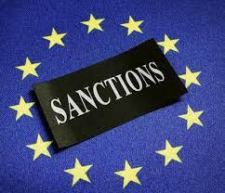
EU and democracy in the member states
the ability to sanction an EU member state is considerably weaker than an EU candidate country
autonomy of EU institutions in such sanctions is limited
if there is no compliance with the EU law, the Commission can turn to the CJEU
limited and complicated procedures to deal with democratic backsliding

Slide 8
Procedure 1:Sanctions
proposed by 1/3 of EU member states or the Commission
assent by 2/3 of MEPs (representing a simple majority in the EP)
unanimity in the European Council (excluding the country under consideration and the abstentions)
the Council by a qualified majority agrees on sanctions:
voting rights suspension in the Council

Slide 9
Procedure 2: Concern
“a preventive (political) procedure”: states the existence of a clear threat to liberal democratic norms in a member state:
Initiated by 1/3 of EU members, or by the Commission, or by the parliament
requires parliamentary assent and a 4/5 majority in the Council ((excluding the country under consideration and the abstentions)

Slide 10
Procedure 3:
A new rule of law mechanism
the argument that countries whose governments interfere with the rule of law do not deserve transfers from the EU budget; however:
the EU can only cut the funding to if there is a concrete Treaty-based procedure to do so
The only legal base is “the need to protect the financial interests of the Union”
the regulation states sanctions can only be imposed if there is a clear link to the financial interests of the Union

Slide 11
Other Possible Measures
a threat of sanctions
social pressures
issue linkages

Slide 12
Problems in Central Europe
Austria 2000: entry into government of the far right FPÖ
Hungary after 2010: new constitution and a series of constitutional laws – the central bank, media, NGOs, universities, electoral rules
Romania 2012: attacks on the Constitutional Court, limiting presidential powers
Poland 2015: weakening of the Constitutional Court and independence of judiciary, media, rights of the opposition

Slide 13
Why democratic backsliding?
how did the early frontrunners like HUN (and POL) become the most problematic EU members?
democratic consolidation understood as a process of adaptation of political elites
low levels of civic participation and weakly anchored political institutions were considered a minor problem

Slide 14
Why democratic backsliding?
they may represent the missing content of democratic political institutions, leading to the current wave of autocratization in CEE
adoption of institutions and EU legal templates (minority protection, antidiscrimination norms) were adopted without being backed by coalitions of politicians, civic groups and voters

Slide 15
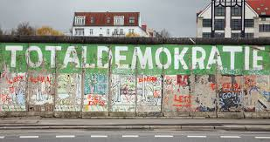
Missing Liberal Consensus?
Dawson&Hanley (2016): cohabitation of liberal and illiberal norms (the latter may even be stronger) led to corruption and a failure of EU conditionality) over time
BUL: economic & technocratic version of liberalism adapted to existing illiberal norms (nationalism and social conservativism)
CZE: an early coalition of liberal dissidents and economic technocrats was joined by economic elites of the old regime

Slide 16
The “Other” Democratic Deficit
Paradox: more democracy at the EU level (a stronger role of Parliament and parties, politicization of the Commission) may lead to authoritarianism at the lower (i.e. state) level
a parallel with other federations (India, USA before 1950, Brazil, etc.): in some democratic federations, a sub-national authoritarianism may prosper

Slide 17
Can an EU member state be an autocracy?
the importance of 1. party politics and 2. fiscal policies:
in federations, autocratic leaders at the sub-federal level may be an important part of governing coalitions at the federal level
consequently, democrats at the federal level may overlook authoritarian policies of their allies

Slide 18
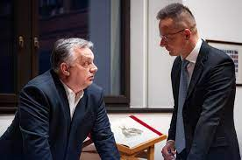
Can an EU member state be an autocracy?
fiscal policies: local autocrats may use federal financial transfers to support their clientelist networks to stay in power
Orbán’s Fidesz and Hungary as a model case
Fidesz was, until early 2021, an important part of the EPP group in the EP, protected and defended by its powerful allies

Slide 19
Hungary (and Poland) in the EU
EPP leaders rejected criticism from other political factions as politically motivated
(“a liberal-socialist conspiracy”)
Fidesz has misused the EU funds to sustain its clientelist networks – people close to Orbán are the major beneficiaries of EU subsidies in HUN
Orbán has also cultivated his own “clients” in other countries, e.g. Slovenia’s Janez Janša, Serbian leaders in Bosnia
a mutual cooperation HUN-POL

Slide 20
Recent development
Ukraine as an EU candidate country (2022)
a split in HUN-POL partnership, HUN as a Trojan horse?
NATO enlargement (HUN and TUR link it to EU politics)
2023: EU Commission proposed to freeze some €7.5 billion from the regular EU budget earmarked for Hungary + €5.8 billion in grants (Recovery plan) – some of it released in 2024

Slide 21
Official and Potential EU Candidate Countries
Albania (2014, negotiations since 2020)
Moldova (2022, referendum in 2024)
Republic of North Macedonia (2005, negotiations since 2020)
Montenegro (2010, neg. since 2018)
Serbia (2012, neg. since 2014, halted)
Turkey (1999, neg. since 2009, halted)
Ukraine (2022)
Georgia (U-turn in 2024), BiH, Kosovo

