Slide 1
Modes of Extrication from Communism
Post-Communist Politics POLb1141
Autumn 2024
Doc. M. Rybář, PhD.

Slide 2
Why Study the Ways Communism Collapsed
the past always impacts subsequent development, the question is how?
what past? → post-communist countries have several pasts
the pre-communist period: had shaped the extent to which their political and legal traditions were compatible with the model of “really-existing socialism”
the communist period: shaped the configurations of the communist incumbents and the forms (or absence) of anti-communist opposition, including the level of repressions, the character of economic relations, etc.
transition from communism: what decisions were made during the breakdown of communism and what legacies they produced for the subsequent period

Slide 3
Structure vs Agency
pre-communist times shaped the type of communism and its characteristics, which in turn shaped the ways communism ended
none of it was pre-determined: a considerable importance of individual decisions of political leaders
structure vs agency: people make decisions under conditions that they do not fully control
critical juncture and path dependence?
there may be moments/time points when decisions made by political elites have far-reaching consequences regardless of the context in which they take place (times of a greater autonomy of the elites)

Slide 4
Similarities and Differences across the Region
on the one hand, a large degree of diversity in terms of the degree of industrialization, urbanization, social distance from Russia/Soviet Union, or legal traditions at the time of the rise of communism
on the other hand, it is no coincidence that the communist regimes ended around the same time
the sharing of institutional, ideological economic and social elements (the 'legacy of communism')

Slide 5
Similarities and Differences across the Region
1) huge economic inefficiency
2) collapse of ideological legitimacy (regime legitimacy)
3) inability to adapt to changing conditions (lack of a mechanism to gather information about the moods and preferences)
the manifestations of these crises and the regime's response to them differed in each communist country

Slide 6
Collapse of Communism in Comparative Perspective
1) there was no counter-elite facing the communist governments that would act as a representative of the transitional interests (unlike many previous instances of regime change, across time and space)
2) agreements and decisions made in a short historical moment (when the regime change took place) may have a causal influence on the speed and direction of later policy choices
3) a unique consequence of transition was the breakup of several states (GDR, Czechoslovakia)

Slide 7
Variety of Post-Totalitarian Regimes
all communist regimes shared the common experience of totalitarianism, but entered the pre-transitional period already in the post-totalitarian phase
not a separate type of authoritarian regime, but derived from the previous existence of a totalitarian regime and representing its downgraded phase
in none of the basic dimensions (pluralism, ideology, mobilisation and leadership) did the regime meet the characteristics of totalitarianism

Slide 8
The Ends of Communism: Negotiation, Collapse and Control
similarities of the transition pathways:
negotiation between the regime and the opposition: Poland and Hungary
collapse of the regime: Czechoslovakia and East Germany
incumbent control over the regime demise: Romania and Bulgaria (Albania)

Slide 9
Negotiation: Poland and Hungary
All key conditions were met for a negotiated transition to begin:
Soft-liners within both the opposition and regime held significant influence.
Both groups of soft-liners believed that compromise was the most desirable outcome.
Soft-liners successfully dominated over hard-liners.
Unlike in Poland, the Hungarian roundtable talks directly led to free and fair parliamentary elections

Slide 10
Polish Communist Regime, 1947-1989
Linz and Stepan argue that the regime in Poland never met all the defining characteristics of totalitarianism
1. limited social pluralism
2. agriculture
3. fundamental transformation of the party leadership

Slide 11
Pacted Transition in Poland
1988: Mass protests against the regime were organized by the underground Solidarity movement.
Jaruzelski feared that Solidarity would boycott the elections planned for 1989.
He sought Solidarity’s support for urgently needed economic reforms.
Solidarity aimed to legalize its activities and end the regime’s repression of its activists.
Informal talks, mediated by the Catholic Church, began in the summer of 1988.

Slide 12
Results of the Roundtable Negotiations
Solidarity was legalized and allowed to participate in the 1989 elections, with 35% of parliamentary seats open for contestation.
A new presidential post, endowed with considerable powers, was created (to be elected by the parliament).
A second chamber, the Senate, was established, with all 100 seats open for free contestation.
The Communists believed they would control a parliamentary majority and the presidency; however, they lost nearly all contested seats and their majority in parliament.
In 1989, the first non-Communist administration in Central and Eastern Europe since 1945 was sworn in, led by Prime Minister Tadeusz Mazowiecki.
The first fully free elections were held only in 1991.

Slide 13
Hungary under the Communist Rule
After the suppression of the 1956 uprising, a period of "goulash communism" followed.
The Communist Party became increasingly heterogeneous, leading to the emergence of an intra-party alternative:
Moderate communist leaders with weaker ties to strict communist ideology (reformists, moderates, etc.).
A typical example was Miklós Németh, a trained economist who spent a year at Harvard in the 1980s and became Prime Minister of Hungary in 1988.
He resigned from the party in 1989, and after the free elections of 1990, he became a vice president at the European Bank for Reconstruction and Development.

Slide 14
Hungarian Roundtable Talks
Unlike its Polish counterpart, the Hungarian opposition was divided into several factions and proto-parties:
The Hungarian Democratic Forum: a moderatepopulist initiative by the rural intelligentsia with ties to reformist Communists.
Emerging traditional non-Communist parties, such as the Smallholders and Christian Democrats.
The Union of Free Democrats: an urban-based liberal party, and Fidesz: a radical liberal party of young students.
Together, these groups formed an opposition roundtable and accepted an invitation to join talks with the Communist Party in March 1989.

Slide 15
Hungarian Roundtable Talks
Motivated by a desire to avoid the bloodshed of 1956, there was a tacit agreement to transition to multiparty competition.
The Communists favored a directly elected, powerful presidency and a majoritarian electoral system, while the opposition preferred a weak president elected by parliament after the parliamentary elections and a proportional electoral system.
The outcome was a compromise: a mixed electoral system, a weak presidency, and a powerful constitutional court.
The liberal opposition rejected the agreement and initiated a referendum, which narrowly decided that the presidential election would take place only after the parliamentary elections.

Slide 16
Collapse: Czechoslovakia and East Germany
1989: The ruling elite was unable to negotiate the terms of its exit from power.
This was due to the rigidity and paralysis of the Communist Party, which was unable to make decisions or respond to rapidly evolving events.
Mid-level cadres in the coercive apparatus (militias, police, army) abandoned the regime, having lost belief in its legitimacy.
Czechoslovakia: A "frozen" post-totalitarian regime.
The regime collapsed after ten days of mass protests and negotiations between the newly emerging opposition initiatives and the Prime Minister (rather than the party leadership).
The Communist Party was paralyzed and unable to respond; no liberal wing existed due to the orthodoxy and party purges that followed 1968.

Slide 17
Czechoslovakia under Ice
Czechoslovakia: A "frozen" post-totalitarian regime.
Unlike Hungary, there was no negotiated transition in Czechoslovakia.
The regime collapsed after ten days of mass demonstrations.
State of the opposition: Following the 1968 invasion, many potential opponents chose an exit strategy through emigration.
A limited number of initiatives gradually emerged (e.g., VONS, Charter 77).
The main ethos of the opposition was “to live in truth” and exist in a parallel culture, without the capacity to negotiate with the regime.

Slide 18
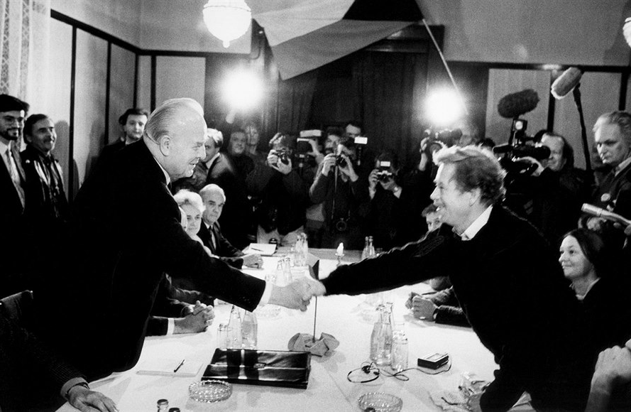

Slide 19
Collapse: East Germany
East Germany: in-built defect: a regime in a territory rather than an established nation-state
extreme dependence on external players (USSR, FRG)
after the regime abandoned the violent crackdown on the peaceful mass protests, political regime collapsed
the question of stateness became an immediate priority
dealing with the past and new political institutions supplied by the FRG
a key role of great powers, US/USSR, but also France

Slide 20
Control: Bulgaria
the Soviet leadership immediately installed a Communist government, which quickly liquidated the existing non-communist forces
after gaining power, the Stalinist leadership consolidated its position by purges in the party
Bulgaria was an agrarian country in which industrialisation and urbanisation came only after the Communists came to power
the few liberal bourgeois intellectuals were eliminated or persecuted after the communist takeover

Slide 21
Control: Bulgaria
Linz a Stepan: Bulgaria as an early post-totalitarian regime (from the mid-1980s)
the regime never lost control over the transition process
independent opposition groups (Ekoglasnost, Podkrepa) only emerged in the course of 1989
the broad party leadership forced its long-standing leader Zhivkov to resign, Petar Mladenov took over
roundtable talks initiated and controlled by the outgoing elites
the party rebranded itself as the Socialist party, convincingly won the first fully free elections of 1990

Slide 22
Zhivkov and Mladenov

Slide 23
Control: Romania
the most complicated transition path in the region (violence)
Romania was a latecomer to democratic transition
spontaneous demonstrations against the regime/Ceaucescu initiated by students and emerging urban-based opposition
clashes between Ceausescu-loyal secret service and the police/army
party leadership transformed itself into the National Salvation Front led by I. Iliescu
post-communist victory in the 1990 elections, Illiescu elected the president, Romanians accepted the change because the situation led to decline in terror

Slide 24
Posttotalitarian and Sultanistic Regime
Linz and Stepan describe the Romanian communist regime as a mixture of early post-totalitarian and sultanistic regimes
prior to 1989, Romania had the lowest level of organised anti-communist opposition activity among the CEE countries
N. Ceausescu was the supreme leader of the regime from 1965 until its end in December 1989
he came to power as an advocate of collective leadership, replacing the Stalinist Secretary-General Gheorghiu-Deu

Slide 25
Personalism and Nationalism
within a short period he became the de facto unlimited ruler of the country
appointments to positions of influence depended solely on his will
he placed his family members - his wife and brothers - in key positions in the state, counting his son as his successor
personalism and the manipulation of nationalism were key aspects of the communist regime in Romania
the role of ideology gradually declined, the enrichment of communist thought by the works of N. Ceausescu ('the genius of the Carpathians') was emphasised

Slide 26
Ceausescu and his successor Iliescu

Slide 27
Pre-emptive Democratization
a coup within the Communist Party, bloody clash between the secret service and the police/army
the arrest and swift execution of Ceausescu and his wife without due process
the transformation of the Communists into the National Salvation Front led by Ion Iliesco
public acceptance of the changes, the new regime meant a real improvement - the elimination of terror
in the May 1990 elections, the NSF won 66% of the vote and its presidential candidate Iliescu won 85% of the vote to become president

