Slide 1
Whither Central and Eastern Europe?
Post-Communist Politics PMCb1109
Autumn 2024
doc. Marek Rybář, PhD.

Slide 2
what is democracy? (an essentially contested concept)
Robert DAHL: Polyarchy/democracy
1. Control over governmental decisions about policy is constitutionally vested in elected officials
2. chosen and peacefully removed in relatively frequent, fair and free elections
3. all adults have the right to vote
4. most adults also have the right to run for the public offices
5. citizens have an enforced right to freedom of expression
6. have access to alternative sources of information
7. have an enforced right to form political parties and interest groups

Slide 3
Preconditions of democracy?
A) explanations that emphasize deep-seated factors
economic factors ▶︎ modernization ▶︎ political progress (democracy)
S.M. Lipset (1959): GDP per capita leads to democratization and strengthens democracy
criticized by: Przeworski et al.: the birth of democracy is independent of the GDP per capita
however, the likelihood that democracy survives increases with sustained economic growth

Slide 4
Preconditions of democracy?
Boix a Stokes: it is a mistake to study only cases of democratization after 1950: Countries that were economically developed by 1950 were already democratic by that time
democratization 1850-1940: a strong correlation between GDP per capita and democracy
development causes dictatorships to fall to democracy, and causes democracy to last

Slide 5
Preconditions of democracy?

Slide 6
Preconditions of democracy?
B) actor-centered explanations of democratic transitions:
D. Rustow: a dynamic model of transition
you do not need democrats for democracy to emerge
A prolonged and inconclusive political struggle between competing groups of elites may lead to a situation that they decide to compromise and adopt democratic forms of rule
democracy is a result of a conscious decision on the part of elites to adopt impartial rules to resolve their conflicts (POL, HUN?)

Slide 7
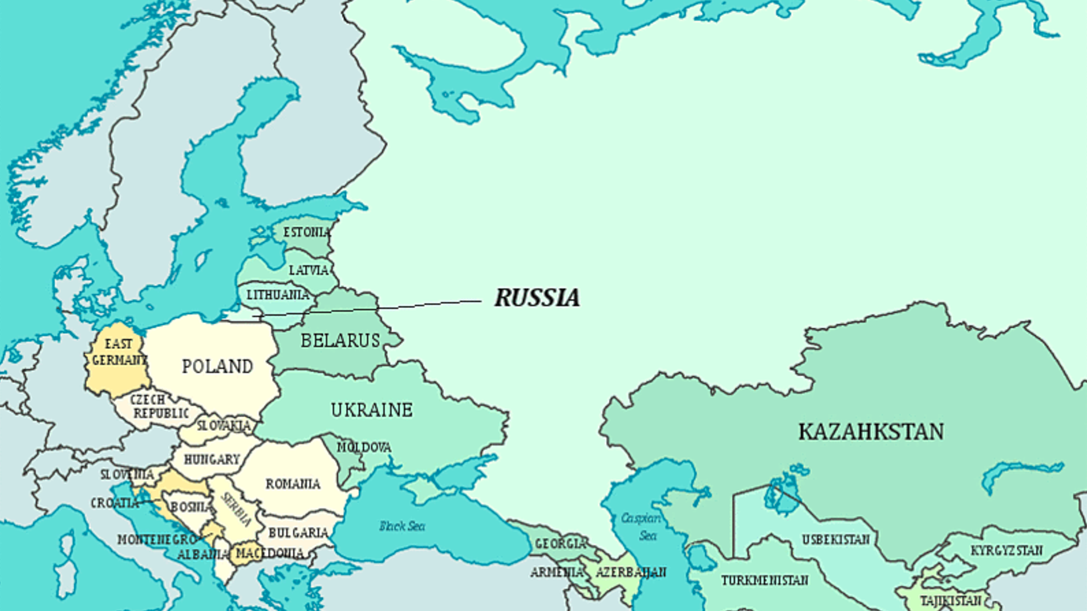

Slide 8
political regimes in cee 15 years after the end of communism (2005)
freedom house DATA
Democracies: Bulgaria, Croatia, Czech Republic, Estonia, Hungary, Latvia, Lithuania, Poland, Romania, Slovakia, Slovenia
Autocracies: Armenia, Azerbaijan, Belarus, Kazakhstan, Kyrgyzstan, Russia, Tajikistan, Turkmenistan, Uzbekistan
Defective Democracies: Albania, Georgia, Macedonia, Moldova, Mongolia, Ukraine
a link between character of the regime and geographical location of the countries
WHY?

Slide 9
deep (structural) explanatory variables
1. Political legacies:
Based on the status on the two pre-communist attributes of bureaucratic state legacies and the balance of power between communists and their challengers at the introduction of communist rule:
bureaucratic-authoritarian (Czechoslovakia) and national-accommodative (Hungary) vs. patrimonial communism (Bulgaria) and colonial periphery (Kazakhstan)
2. Modernization:
the first GDP figures after the breakdown of communism

Slide 10
deep (structural) explanatory variables
3. geography (Vicinity to Western Europe)
closeness is positively associated with democracy – indicates density of cross-border interactions
4. The Resource Curse:
governments are naturally induced to use their revenues from natural resources, (oil), to undermine democratization
The money can be used to relieve social pressures on government through the provision of patronage and public goods

Slide 11
questions
what other deep-seated structural factors could we examine?
how would we operationalize them?

Slide 12
proximate (actor-centered) explanatory variables
1. Displacement of communist incumbents at the first elections?
an oppositional win over the communist incumbents at the first elections favoured democratization
2. Economic reform
economic liberalization has had a positive effect on democratization in the longer term
the distinction between reformers and non-reformers (shock therapy vs. gradual reforms)
3. Strong Legislatures / weak presidency
a high degree of parliamentary power makes for democracy whereas a low degree of parliamentary power makes for autocracy

Slide 13
questions
what other actor-centered (i.e. short-term) factors could have played a role?
how to operationalize them?

Slide 14
assessing the role of structural variables in shaping political regimes
in 2005, favorable political legacy & modernization & no resource curse & favorable geography --- met by 9 out of 11 cases of democracies, only Romania & Bulgaria had less favorable political legacy
poor political legacy, low level of modernization & distance from the West is typical of all autocracies (only Russia crossed a minimal level of modernization/GDP per capita)
defective democracies: none of the six defective democracies either had or lacked all the structural attributes
when considering all four structural variables, 19 out of 26 countries are classified as anticipated theoretically

Slide 15
assessing the role of actor-centered variables in shaping political regimes
Where all three attributes are present, democracy is the expected political outcome: communist displacement, economic reform and strong legislature – met by 9 democratic countries (not in Rom and Bul)
communist elite continuity, slow reforms and strong presidents – met by 6 autocratic regimes (and three other cases – ARM, KGZ and RUS only met the first criterion)
Of the six defective democracies, four have the expected mixed combinations of attributes whereas two (Macedonia and Ukraine) exhibit the respective presence and absence of all attributes
when considering all actor-centered variables, 19 out of the 26 countries are classified as anticipated theoretically

Slide 16
combining structural and actor-centered variables
all 7 favorable conditions met by CRO, CZE, EST, HUN, LAT, LIT, POL, SVK, SLO; 5 out of 7 met by additional three states (ROM, BUL, MAC)
no favorable condition existed in 4 cases: AZE, KAZ, TURK, UZB,
One favorable condition met by TJK, two favorable conditions met by BEL, RUS, ARM, GEO and KIR
In ROM and BUL, EU political conditionality had played a decisive role (external influence)
defective democracies characterized by a great internal diversity and heterogeneity

Slide 17
What has changed since?

Slide 18
What has changed since?

Slide 19
conclusion
among the countries that were considered stable consolidated democracies, Hungary and Poland stand out as textbook examples of democratic backsliding
deep structural factors seem to be as important as the actor-centered variables – at least in a short-term perspective
while Hungary and Poland constitute prominent cases, we also need to examine more subtle defects of CEE democracies but also see the region’s development in a broader (long term) perspective

Slide 20
THANKS!
Thank you for your attention!
Please keep this slide for attribution.

