Slide 1
Qualitative methods
Andrew Roberts

Slide 2
Favorite qualitative papers
What are some of your favorite qualitative papers?
What method do they use?
How do they persuade you?

Slide 3
Qualitative research
Small-N: often 1-10 cases
Usually nominal or ordinal level data
Focus on time sequences, controlled comparisons, smoking guns
Sources: historical archives, interviews, observation

Slide 4
Qualitative methods in political science
Qualitative methods are still the dominant form in comparative politics
  >60% of articles in a recent survey of CPS, CP, and WP
  Though trend towards quantitative
However standards are changing
  Harder to publish single-country qualitative studies
  Reviewers more demanding on methods

Slide 5
Characteristics
Explain individual cases: why WWI, why revolution in France, China & Russia
  Typically causes of effects
Often deterministic causation
Often distinct pathways, equifinality
Focus on crucial cases
Focus on creating concepts

Slide 7
Benefits of fewer cases
Less worry about causal heterogeneity: Do X & Y have same relation in all cases
  Does oil have same effect on politics in Venezuela and Norway?
Easier to see pathways, sequences
Key outcomes are often rare: revolutions, wars
  They would get lost with random selection or buried in negative cases

Slide 8
Kinds of evidence
Historical archives – events, meetings, news reports
Unstructured or semi-structured interviews with policy-makers, protesters, etc.
Participant observation

Slide 9
Quantitative versus Qualitative Templates

Slide 10
Two cultures?
Do qualitative and quantitative methods have different logics?
  KKV: single logic for all inference
  Mahoney and Goertz: two different logics

Slide 11
Approaches and concepts
Quantitative | Qualitative
Large # of cases Usually continuous measures | Small # of cases Often ordinal or cardinal measures
Goal = estimate size of average effects of independent variables on dependent variable, often effects of causes | Goal = fully explain causes of individual cases, typically causes of effects
Probabilistic conception of cause | Deterministic conception of cause: necessary and sufficient conditions Equifinality: multiple discrete causal paths

Slide 12
More qualitative specificities
Case selection focused on specific, positive cases
  Negative cases don’t tell us as much
  Some cases more important than others (eg, WWII)
Each case should be explained correctly
  Because causation is deterministic
Few cases => avoid causal heterogeneity
Sequences and pathways are important
More attention to concepts, revision of concepts

Slide 13
Issues with qualitative template
Is social world deterministic or probabilistic?
  How many phenomena where cause is necessary or sufficient for outcome?
  “No bourgeoisie, no democracy”
Often simply historical or descriptive
Can it predict?
  Small scope conditions mean that inferences don’t apply outside of particular cases
Is it useful for making interventions?
  Can it tell us what we should do?

Slide 14
Main types
Case study
Process tracing
  Path dependence & critical junctures
Structured, focused comparison
Qualitative comparative analysis
Conceptual/typological analysis
Ethnographic methods
Mixed methods & case selection

Slide 15
1. Case study

Slide 16
Small-n problem
Statistical techniques work best when number of cases is large
Don’t work at all if number of cases is too small
  If number of cases is less than or equal to number of independent variables, we can fit an infinite number of different regression lines

Slide 17
Small-n problem

Slide 18
Small-n problem

Slide 19
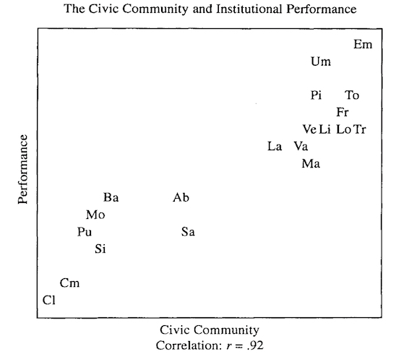
Larger-n

Slide 20
Solutions to small-n problem
Case study to generate hypotheses or concepts
  Then test it with more cases
Case study relative to previous knowledge
Turn one case into multiple cases
  Evolution of case over time: process tracing
  Break case into more cases: subnational
Small-n comparisons: structured

Slide 21
Hypothesis generating case study: Japan’s developmental state
Chalmers Johnson studies Japan’s incredible period of growth
Singles out government agency – Ministry of International Trade & Industry – which selectively encourages particular industries
  Highly meritocratic agency not captured by special interests
  Provides subsidies, loans, trade protection

Slide 22
Can we prove that these actions cause growth?
Firms supported by MITI prosper
Plausible mechanism: infant industry argument
Try to rule out alternatives
  Unique national culture: but why only now?
  Distinctive institutions like lifetime employment, shopfloor management: they predate period of growth

Slide 23
Problem of case selection
How do we know that if this case reflects a general trend or is unique?
  Problem of cherry-picking
Probably want to confirm hypothesis in other cases
  South Korea, Taiwan seem to show similar trends
  But what about developmental state in Brazil, Nigeria?

Slide 24
2. Process tracing

Slide 25

Process tracing
The main form of qualitative analysis
Focus on sequences and mechanisms
  Do events and processes fit those predicted by alternative theories?
  Similar to detective solving a crime or doctor diagnosing an illness

Slide 26
Causal process observations (CPOs)
CPOs are key form of evidence
  Versus dataset observations: spreadsheet
“An insight or piece of data that provides information about context, process, or mechanism and that contributes distinctive leverage in causal inference”

Slide 27
Examples
Nuclear taboo: Is there cultural aversion to using nuclear weapons?
  Documentary evidence that key leaders thought about & discussed taboo
Why do leftist Latin American leaders switch to neoliberalism?
  Documentary evidence that leaders like Fujimori or Menem spoke with international investors and got scared

Slide 28
Theory testing with CPOs
Independent variable CPOs: is cause actually present?
  Theory may imply that cause should be present at certain time and place
Mechanism CPOs: presence of intervening event posited by theory
Auxiliary outcome CPOs: presence of events that should occur if theory is true

Slide 29
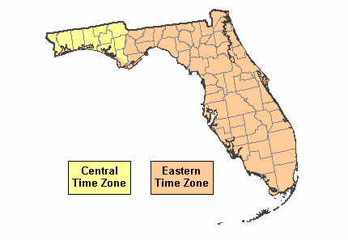
Brady on 2000 election
Lott does a regression analysis showing that Bush lost votes in western time zone of Florida because media report that race is over
Brady shows this is highly unlikely
  # of potential voters from 7-8 PM
  % of those who would vote for Bush
  % of those who heard the media reports
  % of those who decided not to vote

Slide 30

Types of tests
Hoop test: necessary conditions
  Is suspect in state on day of crime?
  Good for eliminating hypos
  But passing test doesn’t help much
Smoking gun: sufficient conditions
  Is suspect holding a recently fired gun?
  Good for confirming hypos
  But failing test doesn’t help much

Slide 32
Pension privatization in CZ and PL
I hypothesized that privatization is due to responsive policy making
If this is true, we should see…
  Public opinion differences between privatizers and non-privatizers
  High sign-up rates in privatizers
  Consultation with and support from interest groups
  Reform only where all parties support
  Reform passed just before elections

Slide 33
Equifinality
Multiple pathways to the same outcome
Moore: How do countries become modern?
  Democratic: bourgeois revolution
  Fascist: revolution from above
  Communist: peasant revolution
Quantitative analysis doesn’t discover pathways – only influence of individual variables and interactions

Slide 34
My advice
Specify the theory very clearly
  Try to outline the steps: X=>X1=>X2=>X3=>Y
  Microfoundations: individual actions lead to outcome
Think of as many observable implications as possible
  If X1=>X2, then we should see…
Show evidence that implications actually occurred
BEWARE: Not just a narrative or description

Slide 35
More information
Check Lindsay Mayka’s video on process tracing on youtube

Slide 36
3. Path dependence & critical junctures

Slide 37
Path dependence
History matters – arbitrary past decisions determine present outcomes
Small initial advantages lead to lock-in and large later advantages
Consequences
  Suboptimal outcomes may win
  Multiple outcomes possible

Slide 38
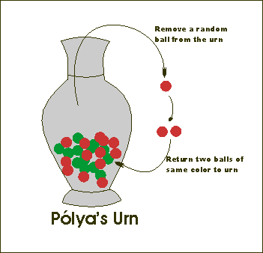
Polya urn
Urn with one red and one black ball
Pull one out and return with another ball of same color
Do this 100 times
What happens?
  Many outcomes possible
  Ultimately reach an equilibrium
  Sequence & initial draws matter a lot

Slide 39

Qwerty keyboard
Initially chosen so that keys don’t jam
But once people get used to it and companies start manufacturing typewriters, no one wants to change

Slide 40
Mechanisms of path dependence
Large set-up costs but then returns to scale: need to be the first
Learning effects: get better at technology more that you use it
Coordination effects: technology more popular if more people using it
Adaptive expectations: picking the wrong horse has big costs

Slide 41
Welfare state
Once we set up a state welfare program, it can get locked in
  Interest groups grow up around the policy
  Private actors (firms, charities) stop providing
  People come to expect benefits
“Don’t take away my medicare!”

Slide 42
Critical junctures
If path dependence important, we can isolate critical points where path gets locked-in
Key moments of openness, when different paths are possible
But due to contingencies, a certain path gets chosen and locks in

Slide 43
Path dependence
State Building and Agricultural Policy in 19th Century
Political Regimes in 20th Century
Military
Authoritarianism
Traditional
Authoritarianism
Progressive Democracy
Source: Mahoney 2001, p. 230

Slide 44
How to do it?
Identify critical juncture where many choices are possible
Show the lock-in effects of this choice
  How does it lead actors to coordinate on this outcome or increase costs of switching

Slide 45
4. Structured, focused comparison

Slide 46
Structured, focused comparison
Comparison of small number of cases
Structure: general question and systematic gathering of equivalent data across cases
Focused: only certain aspects of cases

Slide 47
Mill’s methods
Similarity
  Very similar cases with different outcomes
  Isolate what makes them different
Difference
  Very different cases with similar outcomes
  Isolate what they have in common

Slide 48
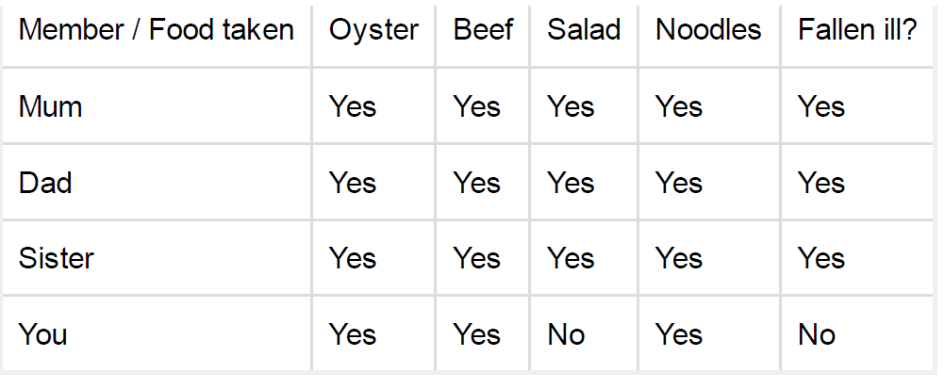
Most similar analysis

Slide 49
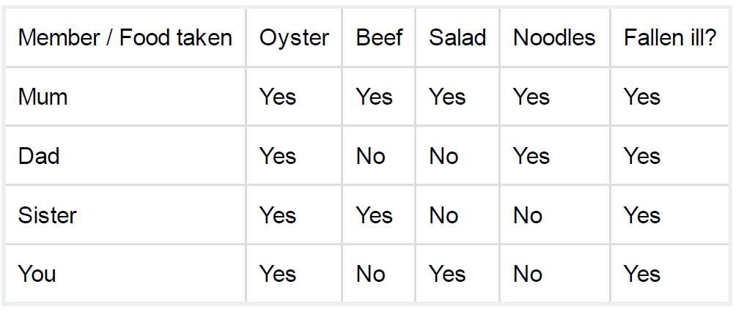
Most different analysis

Slide 50
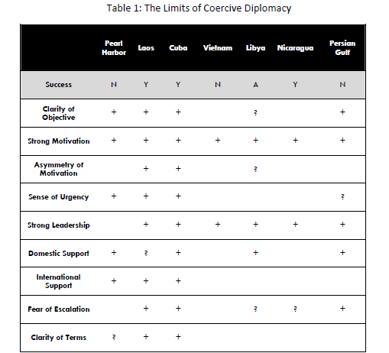

Slide 51
How to do it?
Typically use most similar analysis
  Similar cases with different outcomes
  Helps to reduce potential causes
Try to identify key causal difference
Often combine with process tracing to show how cause leads to outcome

Slide 52
My take
Still the workhorse of qualitative methods
Becoming less popular
  Depends a lot on case selection
  Worries about generalizability
  Quantitative methods are approaching: matching
Probably best to combine with process tracing or quantitative methods
Or use to generate & eliminate hypotheses

Slide 53
5. Qualitative comparative analysis

Slide 54
QCA
Use of set theory and Boolean logic to show that certain conditions are necessary and sufficient for an outcome
Explaining outcomes in specific cases rather than average effects of particular causes

Slide 55
Increasing popularity of QCA

Slide 56
Truth tables

Slide 57
Some deterministic relations in PS
No bourgeoisie, no democracy
No famine in democracies
No wealthy democracies transition to authoritarianism
Every suicidal campaign has as its goal coercing a foreign state to leave its territory
Note: Are these causal claims?

Slide 58
Fuzzy set analysis
Worry that QCA depends on dichotomous variables and deterministic causation
Fuzzy set analysis as a solution
  Calibration of variables between 0 & 1: Degree of membership
  Non-deterministic causation: eg, cause is 90% necessary

Slide 59
Usefulness
Helps in identifying deterministic causation – necessary & sufficient conditions
Helps when many interactions between variables

Slide 60
Some bad news
Recent tests of QCA with simulated data
  QCA has difficulty recovering the correct pathways
  Regressions do better
For larger-N fuzzy set, not clear what is added to regression-style analysis
Maybe useful because of closer attention to cases, concepts, and measures

Slide 61
6. Concepts and typologies

Slide 62
Useful typologies & concepts
Typologies & concepts aren’t right or wrong, but useful and not useful
  Don’t contradict common usage
  Offer enough detail to differentiate cases
  Avoid unnecessary detail
  Help us understand world and causality
  Can be measured easily

Slide 63
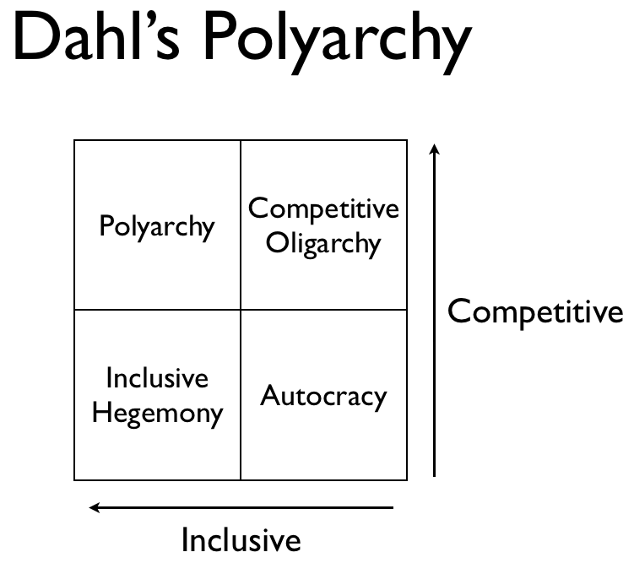
Typologies
Often useful to create typologies
Typically 2X2 tables but can be larger

Slide 64
Basics
Overarching concept
Row and column variables
Matrix (2x2 or different size)
Types – give each meaningful labels
  Nominal: no scale
  Partially ordered: A > B & C > D
  Ordinal: A > B = C > D

Slide 65
Issues
Typology should be mutually exclusive and collectively exhaustive
  Categories don’t overlap
  Categories cover all possibilities (though only in reference to particular cases)
Typologies can be outcomes or explanatory factors

Slide 66
Three-level concepts
Basic level: Democracy
Secondary level: political rights & civil liberties
Indicator level: voter turnout, bans on political parties, restrictions on free speech, etc.

Slide 67
Clear indicators and rules of aggregation

Slide 68
Aggregation
Do you need all characteristics: necessary conditions, AND
  Must have inclusiveness and competitiveness to be democratic
Or characteristics substitute for each other: sufficient conditions, OR
  Need any 3 of 4 to be a welfare state
  Pensions, healthcare, unemployment insurance, housing

Slide 69
What is an ethnic group?
Family resemblance structure: not all characteristics need to be present
  Membership reckoned mainly by descent
  Members are conscious of group membership
  Members share cultural features
  These features held as valuable by most members of group
  Group has homeland or remembers one
  Group has shared history

Slide 70
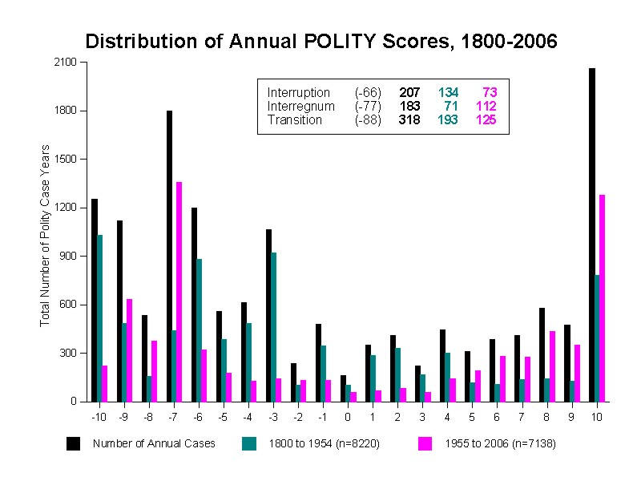
Spikes at extremes
Necessity of extending the scale

Slide 71
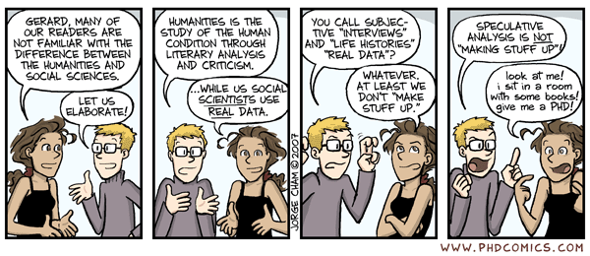

Slide 72
7. Ethnographic methods

Slide 73
Participant observation
Researcher spends time with subjects, gets to know them well, watches them at work
  Fenno refers to “soaking and poking” & “just hanging around”
New insights and concepts but hard to show causality and generality

Slide 74
Fenno – Home style
Fenno attaches himself to Congresspeople in their home districts
Findings
  Different constituencies: Geographic, reelection, primary, and intimates
  Different types: Homefolks, issue-articulating activist, errand boy, local leader
  Not just concerned with reelection
  Give same account of themselves to different groups

Slide 75
8. Mixed methods

Slide 76
Integration versus Triangulation
Triangulation: ask same question with 2 different methods
  Is the question really the same? How to confirm a regression estimate of 0.21 with a case study?
Better: Integration
  Use each method for what it is good at it
  One method to produce final inference
  Other method to design, test, or refine analysis

Slide 77
Varieties of combinations
Start with regression and choose cases
  Outliers to probe other possible causes
  Typical cases to probe mechanism
Start with case studies to develop theory
  Then use results to conduct larger test
Small-N comparison combined with subnational regressions
Iteration between cases and large-N

Slide 78
How can case study add to statistical analysis
Test measurement quality
Evaluate plausibility of causal pathways
Search for evidence of omitted variables
Causal process observations may show that large effect likely or unlikely

Slide 79
Types of case selection
Method | Use
Typical: fits relationship between X & Y | Help discover mechanisms that may confirm or disconfirm theory
Diverse: exemplifies diverse values of X, Y, or X/Y | Explore new causes or confirm theory
Extreme: extreme values of X or Y | Explore new hypotheses
Deviant: deviates from relationship between X & Y – outliers | Probe new explanations

Slide 80
How does statistics add to case studies
Test generalizability of finding
  What is proper domain?
Quantify effect sizes
Add evidence about steps in process tracing
  Survey evidence, embedded experiment

Slide 81
9. Final issues

Slide 82
Replicability
Increasing belief that qualitative work should be replicable
You should archive field notes, oral interviews
Codebook that describes measurement of all variables

Slide 83
When to choose qualitative template?
Good place to start your exploration – not sure what matters
  Immerse yourself in some important cases and develop hypotheses
You care a lot about some very important cases
Unsure about how to conceptualize outcomes or causes

Slide 84
Advantages of qualitative research
Focus on particular cases and explaining them correctly
  Avoid causal heterogeneity
Necessary & sufficient conditions and multiple discrete paths (equifinality)
Better development of concepts and use of data to revise concepts
Lots of evidence about causal process can’t be reduced to spreadsheet

Slide 85
Disadvantages
Weaker generalizability
Quantitative judgments (where data exists) beat qualitative ones
Often deteriorates into history and description
How deterministic is social world?
Prediction and interventions?

Slide 86
Exercises
Pick one of the following:
  Choose one article from Collier’s piece on process tracing and answer questions
  Choose several questions from Goertz’s long list on concepts
  Something else? Paper on a specific method? Analysis of a particular qualitative article?

Slide 87
Discussion questions

Slide 88
Small-n comparisons
Can we learn much from small-N (structured, focused) comparisons?
What can we conclude from a comparison of the Czech Republic, Hungary, and Poland?
Yes, they are similar enough, but can we really identify causality or produce general knowledge?
Can you name any papers that use structured, focused comparisons to produce strong conclusions?

Slide 89
Process tracing
Just about any qualitative paper that traces a case over time gets called “process tracing”. Is there really a distinctive method here?
In the lectures I struggled to say exactly what you should do (except for tests of necessary &
sufficient conditions). What are the key steps?
Again, are any of your favorite qualitative papers
examples of process tracing? How do they do it?

Slide 90
Concepts and typologies
Does political science already have too many concepts and typologies? In what areas, do we need more concepts/typologies?
Should we focus more on measures and new data than on new conceptions of, say, democracy/regime or the welfare state?
Where might we find new conceptions?

Slide 91
When and where?
When are qualitative methods most useful and what can they provide?
When should we avoid them?
Should we usually combine them with quantitative methods? How should we do this?
Is qualitative data always necessary to supplement quantitative work?

