Slide 1
SOCn5010 Analýza sociálních sítí
Přednáška 11: Bi-modální sítě a ekvivalence

Slide 2
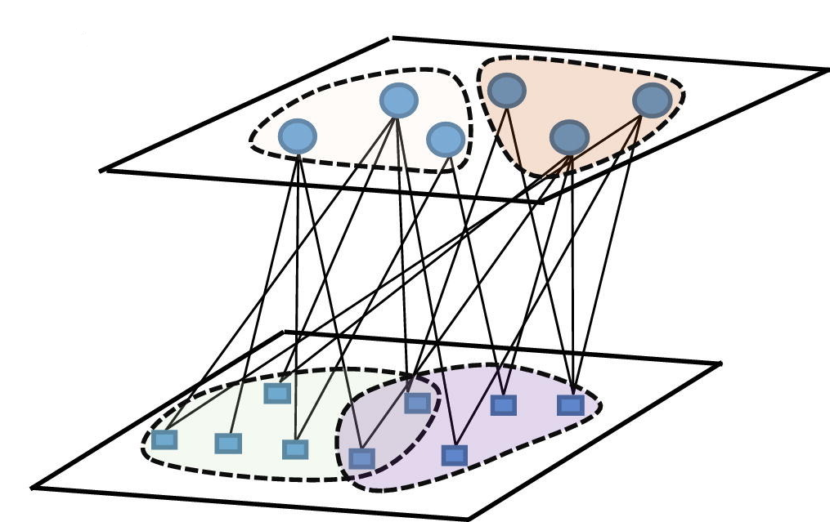
Dualita osob a skupin (Breiger)
Uvažujme množinu jedinců a množinu skupin tak, že hodnota vazby mezi libovolnými dvěma jedinci je definována jako počet skupin, jichž jsou oba členy
Hodnota vazby mezi dvěma skupinami je definována naopak jako počet osob, které patří do obou skupin

Slide 3
Dualita osob a skupin (Breiger)

Slide 4
Dualita osob a skupin (Breiger)

Slide 5
Dualita osob a skupin (Breiger)

Slide 6
Idea of equivalence
Concept of social roles & positions
Similar attitudes, behaviour, etc.
social role is determined over a number of different relations (criminal – victim, criminal – police, etc.)
Different types of equivalence – less ad more relaxed
Structural vs. Automorphic vs. Regular equivalence

Slide 7
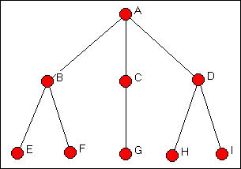
Structural equivalence
„Two actors are structurally equivalent if they send ties to the same third parties, and receive ties from the same third parties“
They do not need to have a direct tie to each other to be equivalent
Similarity: similar social environments provoke similar responses
Directed, undirected and self-loops network data
Grouping of structurally similar data: blockmodel

Slide 8
Structural equivalence
Profile similarity
Direct method - optimatization

Slide 9
Automorphic equivalence
identifies actors that have the same position, or who are completely substitutable
sets of actors can be equivalent by being embedded in local structures that have the same patterns of ties -- "parallel" structures
If exchanged - all of the distances among all the actors in the graph would be exactly identical

Slide 10
Regular equivalence
the same profile of ties with members of other sets of actors that are also regularly equivalent
actors can be structurally similar in ways that do not involve being connected to the same actors
similar patterns:
structural equivalence - two teachers are structurally equivalent if they teach the same students
regular equivalence - teachers have to teach at least one student each

Slide 11
Core - periphery
partition of the nodes into two groups: the core and the periphery
The core block contains the core-to-core interactions, and the peripheral block contains the periphery-to-periphery interactions, with the two off-diagonal blocks containing the core-to-periphery and the periphery-to-core interactions
In a core–periphery structure, we expect core nodes to be well connected to other core nodes + peripheral nodes not to be connected to other peripheral nodes
ideal structure the core block would be a 1-block and the peripheral block would be a 0-block
cannot be directly applied to valued data

Slide 12
Literatura
Simmel, Georg. 1964. „The Web of Group-Affiliations.“ Pp. 127-185 in Conflict and The Web of Group-Affiliations. New York: The Free Press.
Breiger, Ronald. 1974. “The Duality of Persons and Groups,” Social Forces 53: 181-190.
CROSSLEY, Nick. 2010. Towards Relational Sociology. Abingdon: Routledge.
PRELL, Christine. 2012. Social Network Analysis: History, Theory & Methodology. Los Angeles: Sage.
KNOKE, David, and Song YANG. 2008. Social network analysis. Thousand Oaks: Sage.

