Slide 1
Inequality of conditions, inequality of opportunity, and segregation:
How to measure them?

Slide 2
Inequality, segregation, diversity
Inequality, segregation, diversity are tightly coupled concepts
  diversity indicates mostly variety or quantity of groups in population
  inequality and segregation indicate precise differences among groups
Inequality refers to the uneven distribution of resources, opportunities, outcomes across groups
  distribution of a variables in population
  differences in one population from one criterion
  vertical differences
Segregation refers to the uneven distribution of groups across separate places, occupations or institutions
  differences between two and more groups
  differences between populations in specific areas (educational system, labor market)
  horizontal differences
2
Notes:
Historically speaking, there are three major types of systems of social stratification: slavery, caste, and class. Let me briefly describe each type.
1. In slave systems, some peoples are considered less than human and are owned as property. Their legal rights are limited, certain relationships are prohibited, and as you might imagine, and social power is essentially nonexistent.
2. In caste systems, societal groupings are based on deeply held cultural ideals and boundaries. The Indian caste system exemplifies this societal form of stratification, having both cultural and economic impacts. Caste systems are rigidly based. They are characterized by hereditary status, endogamy, and social barriers and are sanctioned by custom, law, and religion.
3. Class systems are the stratification system we are familiar with. People are divided according to economic markers such as income, wealth, ownership, and so on. There are many different characterizations of what constitutes class, and we will be talking about these characterizations today.

Slide 3
Two concepts of inequality
Inequality of (economic) conditions
  unequal distribution of income to people
  vertical differences in wealth and material conditions
  different incomes means different chances to get different goods
  indicated by Lorenz curve or GINI (economic theme)
  useful as explanatory variable for sociology
Inequality of opportunity
  unequal start positions
  vertical differences in start positions means different chances to get different levels of education, jobs and incomes
  indicated by levels of social mobility (sociological theme)
  levels of societal openness
3
Notes:
Historically speaking, there are three major types of systems of social stratification: slavery, caste, and class. Let me briefly describe each type.
1. In slave systems, some peoples are considered less than human and are owned as property. Their legal rights are limited, certain relationships are prohibited, and as you might imagine, and social power is essentially nonexistent.
2. In caste systems, societal groupings are based on deeply held cultural ideals and boundaries. The Indian caste system exemplifies this societal form of stratification, having both cultural and economic impacts. Caste systems are rigidly based. They are characterized by hereditary status, endogamy, and social barriers and are sanctioned by custom, law, and religion.
3. Class systems are the stratification system we are familiar with. People are divided according to economic markers such as income, wealth, ownership, and so on. There are many different characterizations of what constitutes class, and we will be talking about these characterizations today.

Slide 4
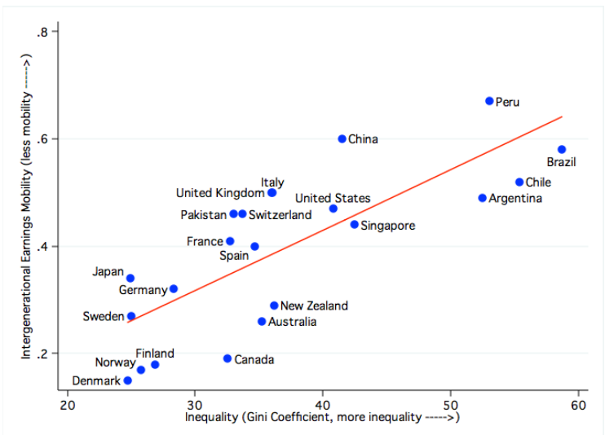
Inequality of conditions vs. inequality of opportunity
Inequality of conditions and inequality of opportunity are connected in empirical reality
Analytically they are two concepts that describe differences among people
Inequality of conditions result from social classes in empirical reality
Inequality of opportunity result from social movements/social mobility
GGC: Great Gatsby Curve
  inequality generates
  less opportunities
  low social mobility

Slide 5
Inequality of economic conditions
Economic inequality is a huge social and political challenges of our time
President Obama calls inequality the defining issue of our time
World Economic Forum 2014 meeting at Davos pointed to inequality as the most pressing problem of the coming decade
In April 2014 Pope Francis tweeted: Inequality is the root of social evil
Statistics:
  In Germany top 1% earns more than 150,000 EUR per year
  In UK top 1% earns more than £150,000, top 5% earns more than £70,000 per year
  In USA top 1% earns the annual income of $422,000
These data are not comparable from inequality point of view

Slide 6
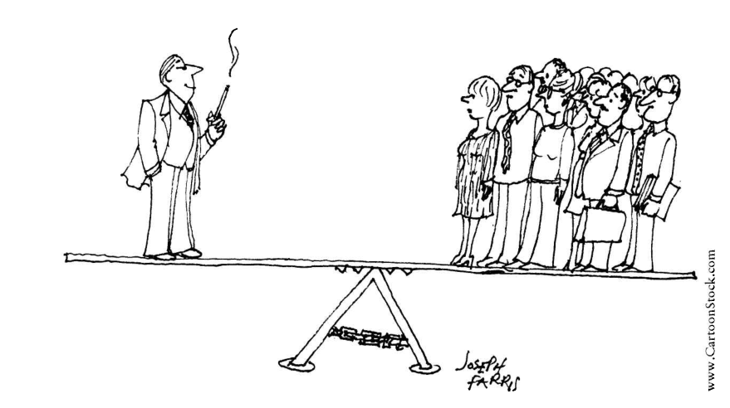
Inequality of economic conditions
indicated by Lorenz curve in empirical reality
  curve not number, it shows the shape of material inequality not the size
the size of material inequality is indicated by GINI coefficient
  it is number, it shows the size of material inequality
CURVE vs. NUMBER

Slide 7
Lorenz curve I
Max O. Lorenz (1876-1959), American economist
description of concentration of incomes/wealth in societies
graphical presentation of inequality of conditions
  it is cumulative distribution function
Lorenz curve is utilized in social sciences as:
  economy
  sociology
  demography
  statistics

Slide 8
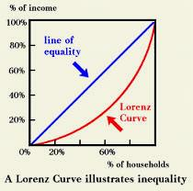
Lorenz curve II
it is based on the comparison of cumulative distribution of incomes to cumulative distribution of population
higher distance between hypothetical and real Lorenz curve means higher inequality in incomes in society

Slide 9
Trends in Lorenz curve in the CR

Slide 10
Gini index I
Corrado Gini (1884-1965), Italian sociologist, statistician and demograph
the Gini coefficient is also known as the Gini index or Gini ratio
a measure of the income inequality
it is one number that represents the income distribution in society
the coefficient varies between 0, which reflects complete equality and 1, which indicates complete inequality (one person has all the income or consumption, all others have none).

Slide 11
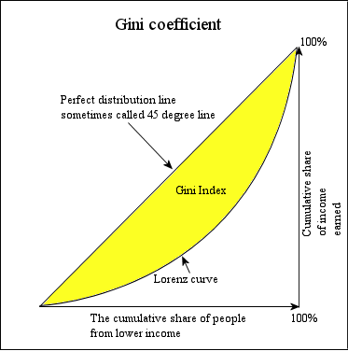
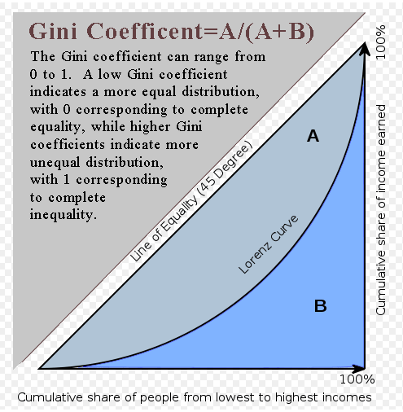
Gini index II
GI is derived from Lorenz curve
  it shows the relationship between the Lorenz curve area and the total area under ideal Lorenz curve area

Slide 12
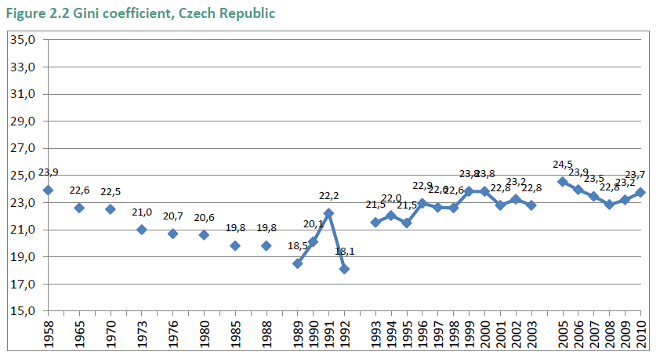
Trend in GINI in the Czech Republic

Slide 13
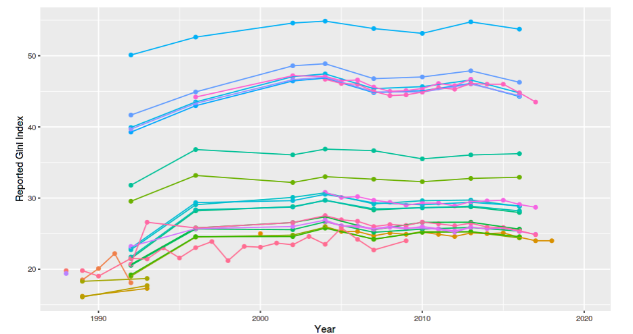
Trend in GINI in the Czech Republic
Differences in: 1) type of income; 2) unit of analysis; 3) type of database
market income households - LIS
market income per capita - LIS
gross income households - LIS
disposable income households - LIS
gross income households - OECD
disposable income - EUROSTAT
The Standardized World Income Inequality Database: The SWIID’s income inequality estimates are based on thousands of reported Gini indices from hundreds of published sources.

Slide 14
Cross-country comparision of GINI
Inequality in selected countries, based on equalized household disposable income (after taxes and transfers). Source: https://ourworldindata.org/grapher/gini-disposable-household-income-lis
Notes:
Inequality in selected countries, 2010
Based on equalized household disposable income (after taxes and transfes).

Slide 15
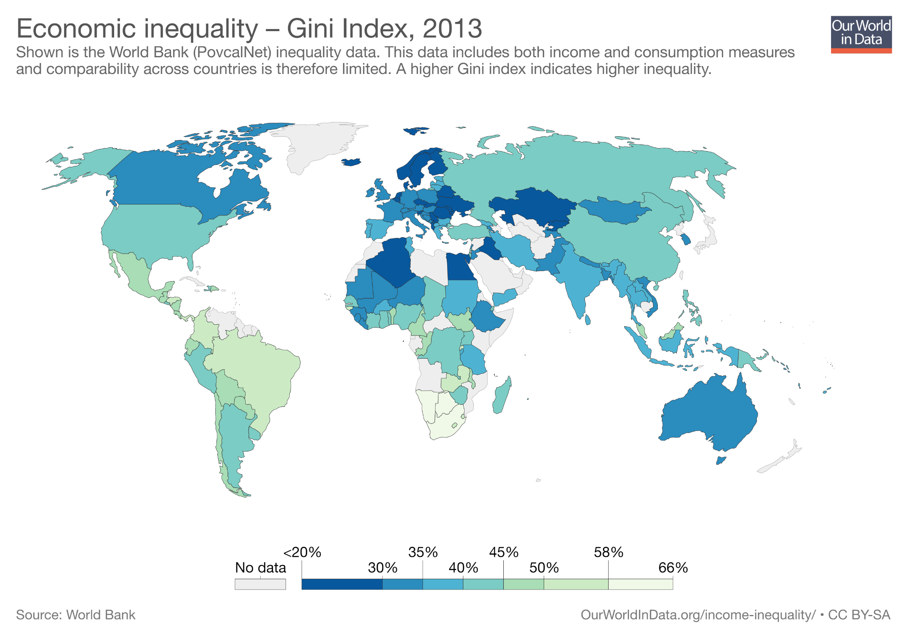

Slide 16
Advantages and disadvantages of Lorenz curve and GINI coefficient
advantages of GINI
  it is a number suitable for comparison of many historical periods or countries
disadvantages of GINI
  it does not show the shape of inequality, different shapes but one GINI coefficient
advantages of Lorenz curve
  it shows the shape of inequality, it means that it makes differences among various types of inequalities
disadvantages of Lorenz curve
  but Lorenz curve is not very suitable for huge comparisons, many curves means chaos

Slide 17
Some other measures of inequality
Share of income (top 10%, 1%, .1%, .01%)
20:20 Ratio (or decile ratio can be used)
  Compares how much richer the top 20% of populations are to the bottom 20% (SE=4,UK=7,US=8)
the Robin Hood index, the Atkinson index and Theil's entropy measure.
Palma ratio (the ratio of the income share of the top 10% to that of the bottom 40%).

Slide 18

How economic inequality harms societies
Video YT: Richard Wilkinson
https://youtu.be/cZ7LzE3u7Bw
Richard Gerald Wilkinson is British social epidemiologist
Best known for his book (with Kate Pickett) The Spirit Level,
He argues that equal distribution of incomes:
  improves population health
  decreases social problems (violence, drug abuse, teenage births, mental illness, obesity)
  improves social cohesion

Slide 19
Measures of inequality of opportunity
social mobility
  SM is the movement of people up or down the stratification system
retrospective vs. prospective measurement
structural social mobility vs. net social mobility
absolute vs. relative social mobility
percent/proportions vs. odds ratios
opportunity structure for specific behaviour vs. effort, motivation, real behaviour
19
Notes:
An important characteristic of class systems, as opposed to slave or caste systems, is that in class-based systems of stratification, there is the opportunity for social mobility. This means that people and groups can, potentially, move up or down in the rankings, and this is seen by many as a significant benefit of class systems.
In reality, however, such mobility is less common than our national mythology suggests. Typically, those who arrive at high positions have families who either had high positions themselves or the resources to provide the appropriate education for advancement. Achieving upward mobility is very difficult, and the wonderful stories we’ve all heard and seen (think, for example, of the movie The Pursuit of Happyness) are so very moving because they are the exception, not the norm. If such stories were common, they would not get our attention in nearly the same way.

Slide 20
Measures of segregation
Entropy, Theil Index, Information Theory Index, Dissimilarity Index, Divergence Index
  Most measures are „entropy-based“
  Dissimilarity index is not „entropy-based“
Entropy a Theil Index indicate the level of diversity between groups
  if all are members of one group, there is no diversity in population
Entropy measure is offered for discrete variables (proportion)
Theil Index is offered for continuous variables (distribution)

Slide 21
Dissimilarity index I
DI, D, or Δ, the most popular empirical measure of segregation
DI indicates the absolute difference between relative distributions two groups according to categories of next variable
example: what is gender segregation in tertiary education?
  compute proportion of students by gender in selected study fields (social science, natural science, law, medicine, pedagogy)
  subtract these proportions (negative results multiply by -1)
  sum up all differences and divide the results by 2
DI is computed as sum of positive differences between two percent distributions divided by number 2:

Slide 22
Dissimilarity index II
advantages
  intuitive and easy interpretation
  identification of categories where the differences are high
  multiply by 100 indicates what proportion is needed for equality between groups
disadvantages
  numbers of categories influence the size of DI
  more categories means higher probability in differences between groups
  two DI can be compared only for groups with the same number of categories

Slide 23
Entropy (E)
Theil (1967, 1971, 1972) introduced the concept of entropy to SS as a measure of population diversity
  E is commonly used in physics to measure the randomness of a system
E is the amount of information needed to describe a probability distribution
High E, high uncertainty = two outcomes are equally likely
  high probability of one outcome, less uncertainty about it and low E
E measures the probability of an outcome (m) occurring (e.g. race group), weighted by its probability occurrence (π) (proportion of race group in population)
overall E (interpreted as a measure of diversity) is:
if all are in the same group = no diversity in population, E=0
If all are evenly distributed in two or more groups =, max diversity in population, E=1

Slide 24
Theil index (TI)
Theil (1971, 1972) derived several indexes using the logic of entropy
Theil index (TI) can be calculated for continuous distribution (income)
  It measures the difference between the observed distribution and the mean
if all incomes are equal = no inequality, TI=0
if all are evenly distributed in two or more groups =, max diversity in population, TI=1

Slide 25

Segregation – why it happens?
Video YT: Segregation in US | Stanford Center on Poverty and Inequality
https://youtu.be/zxICQqDPD4g

