Slide 1

Self-directed violence: Suicide and Self-harm
Lecture 5
Susantha Rasnayake

Slide 2
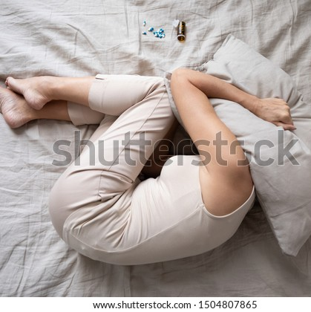
Brainstorming questions
Have you ever felt that life is not worth living?
Have you ever met a person with a suicidal mind?
If yes, what was your response?
‘‘All healthy men have thought of their suicide’’(Camus, 1955, p.5)
Approximately 70% of people with suicidal ideation do not convert thoughts into suicide attempts.
At the same time, some people suffer from suicidal ideation throughout their life

Slide 3

Related terms
Suicide
Suicidality
Suicidal ideation
Suicidal behaviour
Suicide attempt
Deliberate self-harm
Suicidal threats
Suicidal gestures

Slide 4
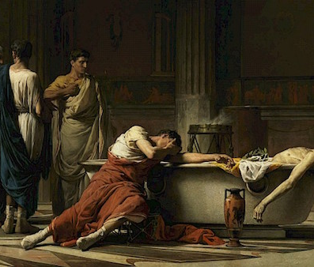
Historical accounts
Historically suicide has been condemned by various human societies except for a few occasions.
For instance, Sati puja (India), Hara-kiri (Japan), as a way of saving one’s honour
Ancient Greece allowed convicted criminals to take their own lives
Many religions including Islam, Judaism, Christianity, and Buddhism condemned suicide
Many societies interpreted suicide as a punishable offence

Slide 5
Today
Committing suicide is not socially and morally approved in human society
Except for euthanasia for the terminally ill in some societies.
However, suicide is a major global public health issue
Over one million commit suicide annually.
According to WHO (2019) records, over the last 45 years, suicide rates have surprisingly increased by 60% across the world.
Suicide is more central in Asia, reporting 60% of death by suicide (Beautrais et al., 2006)

Slide 6
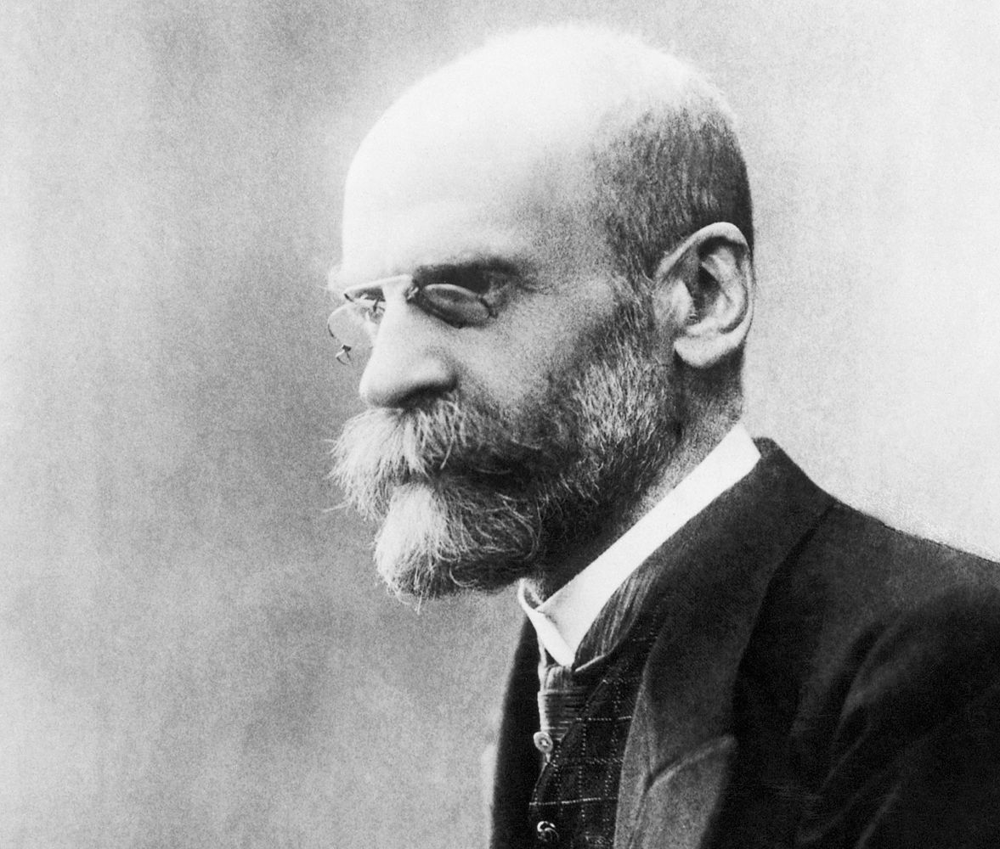
Definitions
“the act of intentionally taking own life” or “killing oneself”.
Emil Durkheim’s definition, provided in his remarkable work on suicide (1857, 1951)
Durkheim’s classification of suicide
  Egoistic
  Altruistic
  Anomic
  Fatalistic

Slide 7
Most risk groups
More frequent in older age
But it is the second cause of death in late childhood and adolescence (15–29) along with road injury and interpersonal violence,
Statistical evidence indicates an elderly person commits suicide every 1 hour 37 minutes, and a young person commits suicide every 2 hours and 7 minutes (Barker, 2011, p.613).
Deaths by suicide contribute to 8.5% of all deaths worldwide among adolescents and young adults (15–29 years) (WHO, 2017).
Why do youth become risk
biological, psychological, and social changes that take place during this period

Slide 8
Where is the risk mostly available?
Out of the total, 73% is reported from developing countries
WHO (2015), out of 800,000 global deaths by suicide, 78% of all completed suicides occurred in low and middle-income countries
But in the recent past, youth suicide rates have increased unexpectedly in developed countries For example, in the United States, between 2007 and 2017, the suicide rate aged 10-24 group increased by 56%.
Finland, New Zealand, Lithuania, Japan, and Latvia are the other countries that report the highest youth suicide rate (Standley, 2020).
Therefore, some research recognizes youth suicide epidemiology as a problem in economically more advanced societies (Cha et al., 2018; Doran & Kinchin; 2020).

Slide 9
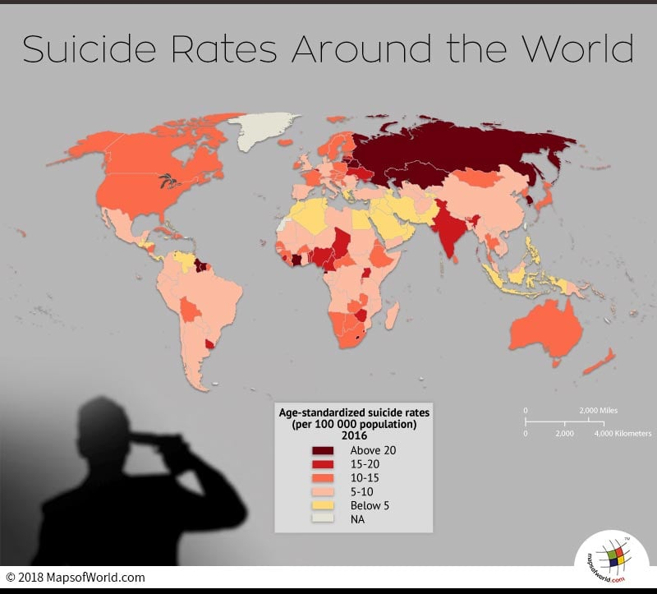

Slide 10
Youth Suicide rate per 100,000 persons in selected countries by age
Country | Year | 5-14 years | 15-19 years
Lithuania | 2015 | 1.3 | 24.3
New Zealand | 2012 | 1.4 | 20.7
Finland | 2014 | 0.2 | 17.7
Japan | 2014 | 0.8 | 15.8
Latvia | 2014 | 0.3 | 14.5
Uzbekistan | 2014 | 2.8 | 13.3
Sweden | 2015 | 0.8 | 13.1
Iceland | 2015 | - | 13.0
United States of America | 2014 | 1.0 | 13.0
Ireland | 2013 | 0.3 | 12.9
Republic of Korea | 2013 | 0.8 | 12.7
Trinidad and Tobago | 2010 | 1.1 | 12.6
Mauritius | 2014 | 1.6 | 12.4
Belgium | 2013 | 0.4 | 12.6
Estonia | 2014 | 1.5 | 11.3
Canada | 2012 | 0.8 | 10.3
Chile | 2014 | 1.1 | 10.2
Australia | 2014 | 0.7 | 9.6
Colombia | 2013 | 1.1 | 9.3
Costa Rica | 2014 | 1.0 | 9.2
Austria | 2014 | 0.4 | 9.2
Norway | 2014 | 0.3 | 9.0
Hungary | 2014 | 0.2 | 9.0
Czech Republic | 2015 | 0.7 | 8.8
Slovenia | 2015 | 0.5 | 8.6
Switzerland | 2013 | 0.4 | 8.1
Republic of Moldova | 2015 | 0.7 | 7.6
Romania | 2015 | 0.7 | 7.6
The Netherlands | 2015 | 0.4 | 7.3
Slovakia | 2014 | 0.1 | 7.2
Kyrgyzstan | 2015 | 2.3 | 7.2
Mexico | 2014 | 0.9 | 7.1
Croatia | 2015 | 0.7 | 6.9
Germany | 2014 | 0.3 | 6.7
Cuba | 2014 | 0.8 | 6.1
United Kingdom | 2014 | 0.2 | 6.0
St Vincent & the Grenadines | 2014 | 1.2 | 4.9
Denmark | 2015 | 0.2 | 4.8
Israel | 2014 | 0.4 | 4.3
Italy | 2012 | 0.1 | 3.8
Luxembourg | 2014 | 0.8 | 3.8
Spain | 2014 | 0.2 | 3.8
Sri Lanka* | 2018 | - | 11.6
Macedonia | 2013 | 0.3 | 3.6
Malta | 2014 | 1.7 | 3.2
Brunei Darussalam | 2014 | - | 1.7
Bahamas | 2013 | - | 1.6

Slide 11
Gender Paradox of Youth Suicidality
Suicide is considered a more male-focused problem
in 2016, the global age-standardized suicide rate was 13.7 per 100 000 for males while it was 7.5 per 100 000 for females.
At the same time, in the highest suicide-rated countries, the male suicide rate was 45 per 100 000 and the rate for females was 30 per 100, 000 (WHO, 2019)
Why do more men commit suicide than women?
this gender difference is influenced by multiple risk factors including biological, psychological, and socio-cultural

Slide 12
Why gender paradox???
Masculine values influence male suicide
Independence, aggressiveness, risk-taking behaviour, the pursuit of power, and dominance are used to describe male gender role
Female gender role is described by opposite meanings of these characteristics
At the same time anxiety or depression come out through various life stressors is not acknowledged by the male gender role
Men – committing suicide as a way of showing the braveness of their personality
Females use less lethal or soft methods while males use more lethal methods in suicide
Help-seeking behaviours is low among male than female

Slide 13
Risk factors of Suicide
Psychological theories - mental disorders
Sociological theories- social factors
Bio-psycho-social model- combination of biological, individual, social and environmental

Slide 14
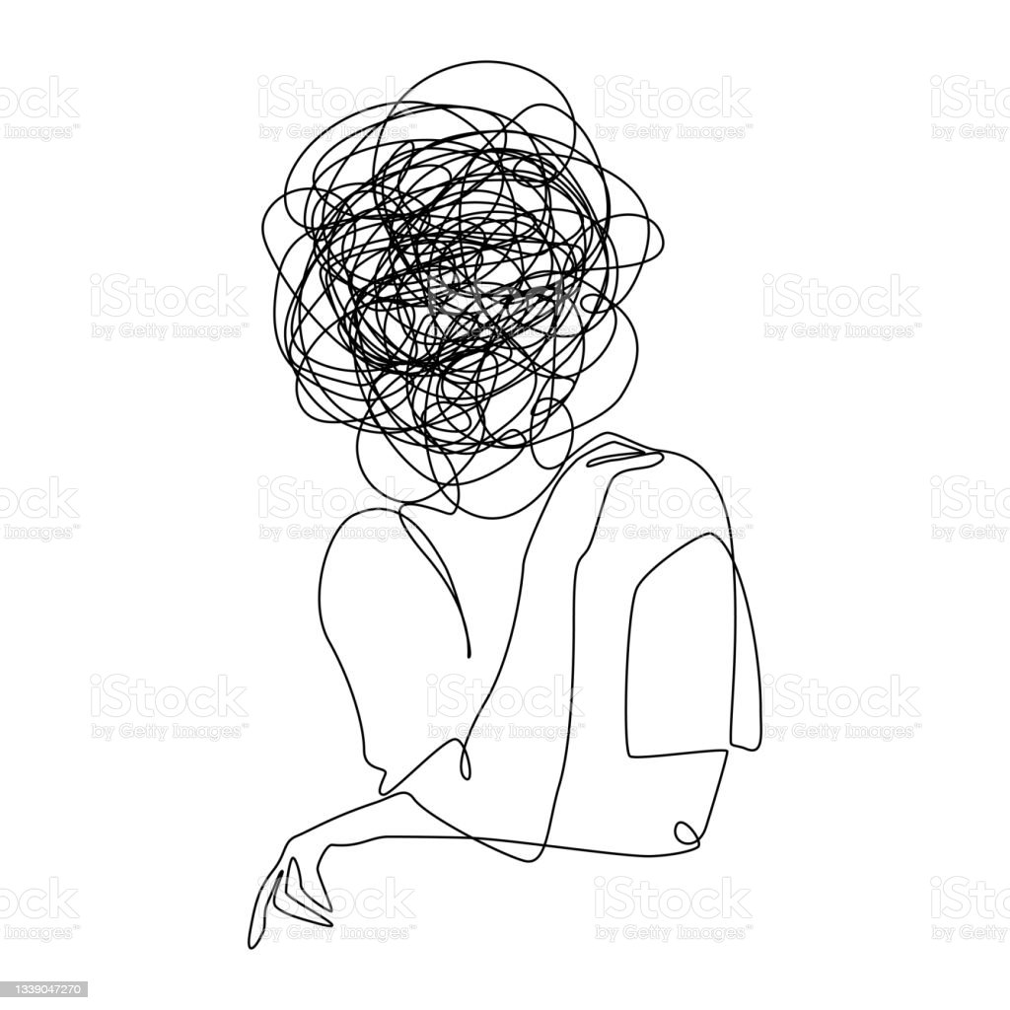
Individual level
  Previous suicide attempt
  Mental illness, such as depression
  Social isolation
  Criminal problems
  Financial problems
  Impulsive or aggressive tendencies
  Job problems or loss
  Serious illness
  Substance use disorder

Slide 15

Relationship Level
Adverse childhood experiences such as child abuse and neglect
Bullying
Family history of suicide
Relationship problems such as a break-up, violence, or loss
Sexual violence

Slide 16

Community level
Barriers to healthcare
  Lack of mental healthcare facilities
  Social stigma associated with mental disorders including suicidality
Cultural and religious beliefs such as a belief that suicide is a noble resolution of a personal problem
Suicide cluster in the community
Violence culture

Slide 17
Activity
Identify individual, relationship-level and community-level risk factors

Slide 18

Protective Factors
Coping and problem-solving skills
Promotion of cultural and religious beliefs that discourage suicide
‘Befriending’-Connections to friends, family, and community support
Supportive relationships with care providers (help-seeking)
Availability of physical and mental health care
Limit access to lethal means among people at risk
Identification of early warning signs

Slide 19
Activity:
1. Read the following two suicide narratives and identify early warnings
2. What are the clues that indicate low supportive response of family members
We did not expect that he would make this type of decision. Usually, he is a very aggressive person. Since aggressiveness is natural in old age, we did not worry about such behaviors. A few days before his death, he quarreled with my elder son and me. At that time, he aggressively told us that he no longer wanted to live. But now we understand that perhaps we could have saved his life if we had referred him to a doctor (interview data)
We noticed that my mother’s behavior had changed from earlier. But we never thought that she would commit suicide. Religiously, she was a devotee. Usually, she likes to stay alone and speaks very little. Two to three months before the incident, she often worried about her physical difficulties and dependence on someone else. She thought she had become a burden to everyone and said that further living was meaningless. But we thought she was just saying these types of things (interview data).

Slide 20
“People who commit suicide don’t want to die but to end their pain,” says Rainey (2020).
THANK YOU

