Slide 1
Law of Domain names
Supervisor: JUDr. Radim Polčák, Ph.D.
Teacher: Mgr. Michal Koščík

Slide 3
Time and location
Wednesdays– 18:15 – 19:35
Room 131

Slide 4
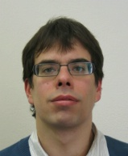
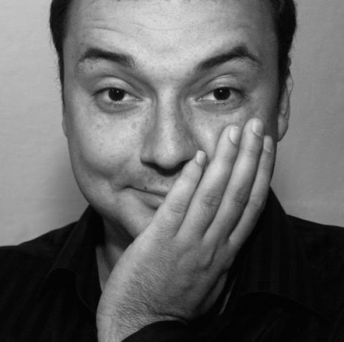
Potential Teachers
Mgr. Matěj Myška JUDr. Radim Polčák, Ph.D.

Slide 5
Consultations
On request –
michalkoscik@gmail.com
koscik@law.muni.cz
76882@mail.muni.cz

Slide 6
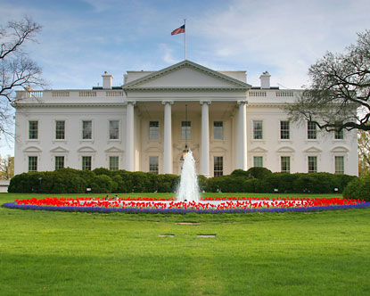
www.whitehouse.com

Slide 7
www.oskar.cz

Slide 8
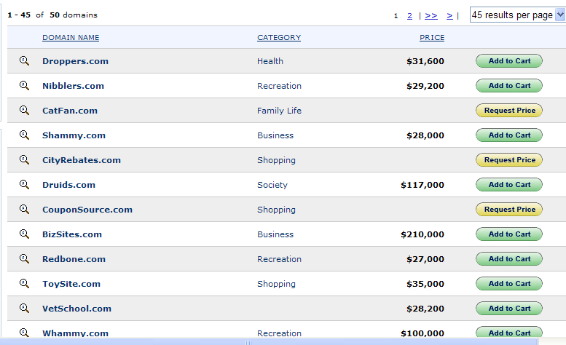
Vytvořený výřez obrazovky: 15.2.2012 14:21

Slide 9
Typos(quatting)
vikipedia.org
wikipedia.com
wiki.cz
gooogle.com

Slide 10
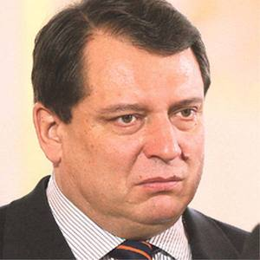
Personal rights
Paroubeknamars.cz
foto: Iveta Komendová, Nový Čas
juliaroberts.com
britney-spears.com
love-britney.com
nude-britney.com

Slide 11
Scope of the subject
Practical application of:
„Soft skills“
Intellectual property law
Competition law
Consumer protection
EC/EU Law
Rules of „soft law“
Arbitration procedures
Terms and conditions governing the use and transfers of domain names
Legal English
Legal Writing:
Submission to arbitration
Decision making and writing
Contracting techniques (optional)

Slide 12
Objective
Detailed knowledge of related issues of IP, Arbitration, Competition law, Civil law
Practical skills in transferring of web domains and buying/selling “web sites”
Experience in enforcing rights via alternative dispute resolution (arbitration)

Slide 13
Language
This course is opened for foreign students
Language – English

Slide 14
Central motive - CYBERSQUATTING
Use of the domain name in bad faith
The intent to:
Prevent your competitors to use the domain name
Confuse consumers
“Blackmail” the trademark owners

Slide 15
Date | Topic
29.2.2012 | Domain name, System of domain names, Abusive use of domain names, Cybersquatting (optional for those who have attended the lectures of „úvod do práva ICT I in 2009)
7.3.2012 | Contract excercise - transferring domain name, buying a website (optional)
14.3.2012 | Domain names and IP - Introduction to IP in general
21.3.2012 | Cybersquatting and violation of intellectual property
28.3.2012 | Unfair competition, privacy and alternative dispute resolution procedures RECOMMENDED
3.4. 2012 | Alternative dispute resolution in generic TLD
10.4. 2012 | EU domain, ADR in .eu domain
17.5. 2012 | Micro moot-court – attendance compulsory
24.5. 2012 | Micro moot-court – Attendance compulsory
2.5. 2012 | Micro moot-court – Attendance compulsory
9.5. 2012 | Colloquia

Slide 16
Colloquia criteria
Attendance
22.2.2012 – 3.4.2010 – Min 4 lectures/ Max 4 absences
18.4.2009 – 9.5.2009 – Compulsory 3 lectures
Total: 11 lectures / Max 4 absences
Sumission/decision in the simulated arbitration
Teams of cca. 3 people
Cca 4 pages
Oral presentation 20 minutes

Slide 17
Moot court system
2-3 cases
Each case shall have two/three teams
Complainant
Respondent
Arbitrator – actual panelist

Slide 18
Study materials
Interactive syllabi –
Information system of the Masaryk university
Guide to WIPO Domain Name Dispute Resolution
http://www.wipo.int/freepublications/en/arbitration/892/wipo_pub_892.pdf

Slide 19
Good luck in your new semester
See you next week!!!!

