Slide 1
I. INTRODUCTION
PRESENTED BY:
JUDGE MARK A. SPEISER

Slide 2
A. PERSONAL AND PROFESSIONAL BACKGROUND OF LECTURER

Slide 3
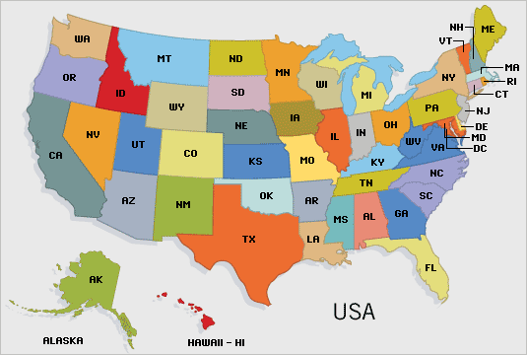

Slide 4
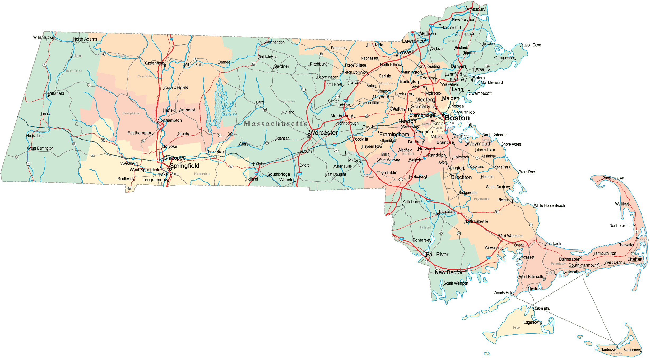

Slide 5
