Slide 1
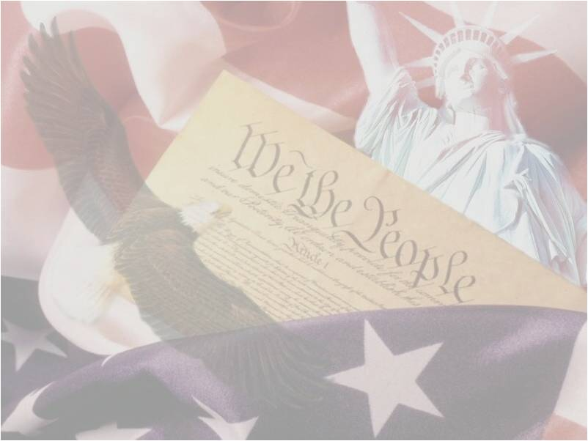
II. STRUCTURE OF U.S. GOVERNMENT
PRESENTED BY:
JUDGE MARK A. SPEISER

Slide 3
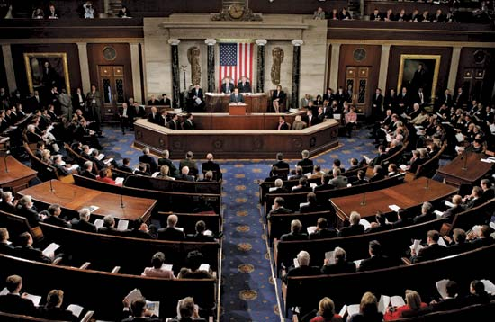
I. LEGISLATURE (ARTICLE 1)
A. 2 BRANCHES KNOWN AS CONGRESS
SENATE
HOUSE OF REPRESENTATIVES (HOUSE)
PRIMARY RESPONSIBILITY
ENACT FEDERAL STATUTES

Slide 4
B. SENATE (ARTICLE 1 SECTION 3)
100 MEMBERS
2 ELECTED FROM ALL VOTERS IN EACH STATE
MUST BE US CITIZEN AT LEAST 9 YEARS
AT LEAST 30 YEARS OLD
CAN SERVE UNLIMITED NUMBER OF 6 YEAR TERMS

Slide 5
EACH SENATOR HAS 1 VOTE
VICE-PRESIDENT OF U.S. SERVES AS PRESIDENT OF SENATE, BUT HAS NO VOTE UNLESS SENATE VOTE IS EQUALLY DIVIDED
HAS POWER TO IMPEACH THE PRESIDENT
SALARY $174,000

Slide 6
C. HOUSE (ARTICLE 1 SECTION 2)
CURRENTLY 435 MEMBERS
TOTAL NUMBER MAY CHANGE EVERY 10 YEARS AFTER U.S. CENSUS TO ENSURE NUMBER OF MEMBERS EACH STATE HAS REFLECTS THE RELATIVE SIZE OF EACH STATE’S POPULATION COMPARED WITH OTHER STATES

Slide 7
EACH CONGRESSMAN ELECTED BY ALL VOTERS WITHIN A CONGRESSIONAL DISTRICT
EACH CONGRESSIONAL DISTRICT IS WITHIN ONE STATE, THOUGH MOST STATES HAVE MULTIPLE CONGRESSIONAL DISTRICTS
IN STATES WITH MULTIPLE CONGRESSIONAL DISTRICTS, EACH ONE IS EQUAL IN POPULATION TO ALL OTHER CONGRESSIONAL DISTRICTS WITHIN THE SAME STATE
A CONGRESSIONAL CANDIDATE MUST BE US CITIZEN AT LEAST 7 YEARS

Slide 8
AT LEAST 25 YEARS OLD
CAN SERVE UNLIMITED NUMBER OF 2 YEAR TERMS
SPEAKER OF HOUSE IS LEADER OF REPRESENTATIVES

Slide 9
5 NONVOTING DELEGATES FROM:
DISTRICT OF COLUMBIA
US VIRGIN ISLANDS
AMERICAN SAMOA
NORTH MARIANA ISLANDS
GUAM
PUERTO RICO REPRESENTED BY NON-VOTING RESIDENT COMMISSIONER
SALARY $174,000

Slide 10
D. GENERAL POWERS OF CONGRESS (ART.1 SECTIONS 8)
TAXING POWER TO RAISE REVENUES AND PAY DEBTS
PROVIDE FOR THE WELFARE AND HEALTH OF CITIZENS
REGULATE FOREIGN AND DOMESTIC INTERSTATE COMMERCE
TO DECLARE WAR, PROVIDE A DEFENSE AND ARM THE MILITARY

Slide 11
TO PRINT AND REGULATE THE U.S. CURRENCY
ENACT LAWS
POSTAL POWER
PROMOTE SCIENCE AND ARTS
COPYRIGHT AND TRADEMARK POWER
BANKRUPTCY POWER
IMMIGRATION AND NATURALIZATION POWERS

Slide 12
E. HOW LEGISLATION BECOMES LAW (ART. 1 SECTION 7)
EVERY BILL (PROPOSED LEGISLATION) MUST PASS BOTH CHAMBERS OF CONGRESS BY A MAJORITY VOTE
IF PRESIDENT SIGNS BILL IT BECOMES LAW
IF PRESIDENT TAKES NO ACTION ON BILL AT ALL AFTER 10 DAYS, BILL AUTOMATICALLY BECOMES LAW

Slide 13
IF BILL TIMELY REJECTED BY PRESIDENT (“VETO”), BILL RETURNS WITH THE PRESIDENT’S NOTED OBJECTIONS TO CONGRESS WHERE IT IS VOTED ON AGAIN. IF AFTER RECONSIDERATION, 2/3RDS OF BOTH CHAMBERS APPROVE (“OVERRIDING A VETO”) THE BILL BECOMES LAW WITHOUT THE PRESIDENT’S SIGNATURE
OTHERWISE THE BILL FAILS
AND DOES NOT BECOME LAW
A BILL CAN ORIGINATE IN EITHER CHAMBER BY A
MEMBER OF THAT CHAMBER
(EXCEPT BILLS TO RAISE REVENUE,
“TAXES” THAT MUST ORIGINATE IN
THE HOUSE)

Slide 14
II. EXECUTIVE BRANCH (ART. 2 SECTION 1)
PRESIDENT MAY SERVE 2 TERMS, EACH TERM IS 4 YEARS
MUST BE A NATURAL BORN U.S. CITIZEN
AT LEAST 35 YEARS OLD AND 14 YEAR RESIDENT OF U.S.
SALARY IS $400,000

Slide 15
A. PRESIDENTIAL POWERS (ART.2 SECTION 2)
COMMANDER-IN-CHIEF-MILITARY
GRANT PARDONS FOR CRIMES AGAINST U.S.
ENTER INTO TREATIES WITH ADVICE AND CONSENT OF 2/3RDS OF SENATE
APPOINT AMBASSADORS, CABINET MEMBERS, FEDERAL JUDGES WITH CONSENT OF MAJORITY OF SENATE
VETO POWER OVER PROPOSED CONGRESSIONAL LEGISLATION

Slide 16
B. PRESIDENTIAL CABINET (ART. 2 SECTION 2)
SECRETARY OF STATE
SECRETARY OF TREASURY
SECRETARY OF DEFENSE
ATTORNEY GENERAL (DEPARTMENT OF JUSTICE)
SECRETARY OF INTERIOR

Slide 17
SECRETARY OF AGRICULTURE
SECRETARY OF COMMERCE
SECRETARY OF LABOR
SECRETARY OF HEALTH AND HUMAN SERVICES
SECRETARY OF HOUSING AND URBAN DEVELOPMENT

Slide 18
SECRETARY OF TRANSPORTATION
SECRETARY OF ENERGY
SECRETARY OF EDUCATION
SECRETARY OF VETERAN AFFAIRS
SECRETARY OF HOMELAND SECURITY

Slide 19
C. CABINET MEMBERS
ANNUAL SALARY $199,700
SERVE AT WILL OF PRESIDENT BUT MUST BE APPROVED BY A MAJORITY VOTE OF SENATE AND ONLY PRESIDENT CAN FIRE THEM
COLLECTIVELY MEET WEEKLY WITH THE PRESIDENT

Slide 20
D. FEDERAL LAW ENFORCEMENT AGENCIES
DEPARTMENT OF JUSTICE
FEDERAL BUREAU OF INVESTIGATION(FBI)
DRUG ENFORCEMENT ADMINISTRATION (DEA)
BUREAU OF ALCOHOL, TOBACCO AND FIREARMS (ATF)
U.S. MARSHALS SERVICE
FEDERAL BUREAU OF PRISONS

Slide 21
DEPARTMENT OF HOMELAND SECURITY (DHS)
BORDER PATROL (USBP)
IMMIGRATION AND CUSTOMS ENFORCEMENT (ICE)
SECRET SERVICE (USSS)
WHITE HOUSE POLICE FORCE
FEDERAL AIR MARSHALS

Slide 22
E. JURISDICTION OF FEDERAL LAW ENFORCEMENT
ENFORCE NATIONWIDE FEDERAL LAWS WITHIN SCOPE OF THEIR AGENCY’S STATUTORY AUTHORITY AS SET FORTH IN U.S. CODE
WITH PASSAGE OF U.S. PATRIOT ACT ON OCTOBER 26, 2001, FEDERAL OFFICERS’ POWER EXPANDED TO STATE, COUNTY AND LOCAL LEVELS

Slide 23
III JUDICIARY (ART. 3)
U.S. SUPREME COURT
9 JUSTICES NOMINATED BY PRESIDENT AND CONFIRMED BY MAJORITY OF SENATE
LIFETIME TENURE
SALARY
CHIEF JUDGE (1)
$223,500
ASSOCIATE JUSTICES (8)
$213,900

Slide 24
HIGHEST JUDICIAL BODY IN U.S.
JURISDICTION OVER TWO TYPES OF CASES
ORIGINAL JURISDICTION
VERY FEW HANDLED EACH TERM
CASES AFFECTING AMBASSADORS
DISPUTES BETWEEN STATES

Slide 25
APPELLATE JURISDICTION
GRANTED BY FEDERAL STATUTES OR ART. III, SECTION 2 OF CONSTITUTION
PETITION FOR WRIT OF CERTIORARI FILED BY LOSING PARTY TO A CASE DECIDED BY A U.S.COURT OF APPEALS
WRIT OF CERTIORARI FROM A STATE SUPREME COURT WHERE AN ISSUE OF CONSTITUTIONAL OR U.S. STATUTORY LAW IS IN QUESTION
CERTIFIED QUESTION FROM A U.S. COURT OF APPEALS REQUESTING DIRECTION AS TO HOW TO DECIDE A CASE (RARE)
TO RESOLVE CONFLICT IN DECISIONS ON A PARTICULAR LEGAL ISSUE BETWEEN U.S. COURTS OF APPEALS IN TWO DIFFERENT CIRCUITS

Slide 26
IV SEPARATION OF POWERS
GOVERNMENT CONSISTS OF 3 EQUAL BRANCHES THAT ARE KEPT DISTINCT TO PREVENT ABUSE AND STACKING OF POWER

Slide 27
EXAMPLES
A. LEGISLATIVE POWERS (ART I)
ARE SINGULARLY VESTED IN CONGRESS
POSSESSES EXCLUSIVE POWER TO ENACT LAWS, INCIDENTAL TO WHICH IS THE RIGHT TO CONDUCT INVESTIGATIONS AND HEARINGS UPON WHICH LEGISLATION MAY BE ENACTED
CLINTON V. CITY OF NEW YORK
524.U.S.417(1998) US SUPREME COURT STATED
LINE ITEM VETO ACT OF 1996 ENACTED BY CONGRESS VIOLATED “THE
PRESENTMENT CLAUSE” OF ART 1,
SECTION 7 OF CONSTITUTION BY GIVING
PRESIDENT AUTHORITY TO SELECTIVELY
NULLIFY AND CANCEL CERTAIN PROVISIONS
OF APPROPRIATION BILLS BEFORE SIGNING IT INTO
LAW.

Slide 28
IT IS IMPERMISSIBLE FOR CONGRESS TO EXTEND TO THE PRESIDENT POWER TO UNILATERALLY AMEND PARTS OF STATUTES DULY PASSED BY CONGRESS
CLINTON DECISION HELD ALTHOUGH PRESIDENT HAS POWER TO INITIATE AND INFLUENCE THE LEGISLATIVE PROCESS, AS WELL AS THE POWER TO RETURN TO CONGRESS AN ENTIRE BILL WITHIN 10 DAYS AFTER IT IS PRESENTED TO HIM (“PRESIDENTIAL VETO”), PRESIDENT HAS NO POWER TO ENACT, AMEND, APPEAL OR CANCEL PORTIONS OF A STATUTE

Slide 29
CONGRESS HAS PLENARY “POWER TO REGULATE COMMERCE” AMONG THE SEVERAL STATES UNDER THE INTERSTATE COMMERCE CLAUSE (ART. 1 SECTION 8)
U.S. V. LOPEZ
514 U.S. 549 (1995) HELD A FEDERAL LAW
(“THE GUN-FREE SCHOOL ZONES ACT OF
1990) ENACTED BY CONGRESS MAKING IT
A CRIME FOR ANYBODY TO KNOWINGLY
POSSESS A FIREARM IN A SCHOOL ZONE
IS BEYOND SCOPE OF INTERSTATE
COMMERCE CLAUSE OF U.S.
CONSTITUTION AND THEREFORE
UNCONSTITUTIONAL

Slide 30
REASONING:
GUN POSSESION NEAR SCHOOL IS NOT A COMMERCIAL ACTIVITY
NOT AN ACTIVITY THAT SUBSTANTIALLY AFFECTS INTERSTATE COMMERCE

Slide 31
NO “JURISDICTIONAL NEXUS” CONNECTING GUN POSSESSION TO INTERSTATE COMMERCE EXPRESSED IN STATUTE
CONGRESS SUBSEQUENTLY AMENDED STATUTE TO SATISFY THE “JURISDICTION NEXUS” BY PROVIDING THE LAW APPLIED ONLY TO A FIREARM “THAT HAS MOVED IN OR OTHERWISE AFFECTED INTERSTATE OR FOREIGN COMMERCE”

Slide 32
B. EXECUTIVE POWERS (ART 2 SECTION 1)
PRESIDENT HAS NO POWER TO ENACT LAWS BUT HAS POWER TO IMPLEMENT LAWS PASSED BY CONGRESS
FEW POWERS EXPRESSLY CONFERRED UNDER ARTICLE 2 OF U.S. CONSTITUTION TO THE PRESIDENT
SUPREME COURT INTERPRETS CONSTITUTION TO IMPLY MOST OF PRESIDENT’S DOMESTIC AND FOREIGN POWERS

Slide 33
BUCKLEY V. VALEO 424 U.S. 1 (1976)
DECISION ANALYZES THE APPOINTMENT CLAUSE OF ART. 2 (THE EXECUTIVE BRANCH), SECT. 2, CLAUSE 2
ALTHOUGH CONGRESS HAS THE INHERENT AUTHORITY TO APPOINT ITS OWN INFERIOR OFFICERS TO PERFORM FUNCTIONS FOR ITS LEGISLATIVE STAFF COMMITTEES IT IS WITHOUT POWER TO APPOINT UNDER ART. 2, SECTION 2, CLAUSE 2 ITS OWN MEMBERS TO ANY FEDERAL GOVERNMENT AGENCY OR COMMISSION UNDER THE EXECUTIVE BRANCH (FEDERAL ELECTIONS COMMISSION) WITH ADMINISTRATIVE POWERS
LEADERS OF ADMINISTRATIVE AGENCIES UNDER THE EXECUTIVE BRANCH ARE SELECTED BY THE PRESIDENT SUBJECT TO THE ADVICE AND CONSENT OF THE SENATE

Slide 34
BOWSHER V. SYNAR 478 U.S. 714(1968)
CONGRESS HAS NO POWER TO RESERVE THE AUTHORITY TO SUMMARILY REMOVE AN OFFICER IN THE EXECUTIVE BRANCH GIVEN THE RESPONSIBILITY TO EXECUTE THE LAWS AND HAVING FIXED TERMS, OR OFFICERS PERFORMING JUDICIAL OR QUASI-JUDICIAL FUNCTIONS (FEDERAL TRADE COMMISSIONER OR AN ADMINISTRATIVE LAW JUDGE)
OTHERWISE PERSONS CHARGED WITH EXECUTING THE LAWS WOULD BE ANSWERABLE TO CONGRESS WHEN IN FACT THE CONSTITIUTION PROVIDES THIS IS AN EXECUTIVE BRANCH FUNCTION OVERSEEN BY THE PRESIDENT

Slide 35
V. INTERBRANCH CHECKS UPON EXERCISE OF FEDERAL POWER
SEPARATION OF POWERS BETWEEN THREE BRANCHES IS NOT ABSOLUTE
IT IS QUALIFIED BY DOCTRINE OF “CHECKS AND BALANCES”
EACH BRANCH HAS CONSTITUTIONAL CONTROL OVER EACH OTHER
SYSTEM ALLOWS EACH BRANCH TO RESTRAIN ABUSE BY ANOTHER BRANCH

Slide 36
CONGRESSIONAL LIMITS ON THE EXECUTIVE
HAS AUTHORITY TO IMPEACH PRESIDENT AND VICE PRESIDENT
APPROPIATIONS POWER TO PREVENT PRESIDENT FROM IMPOUNDING FUNDS EXPLICITLY SET ASIDE FOR EXECUTIVE FUNCTIONS
LEGISLATIVE VETO

Slide 37
EXECUTIVE CHECK ON CONGRESS
PRESIDENT (ART. 1 SECTION 7) HAS POWER TO VETO ACTS OF CONGRESS TO PREVENT THEM FROM BECOMING LAW

Slide 38
JUDICIAL RESTRAINTS ON PRESIDENT AND CONGRESS (ART. 3 SECT. 2)
LOWER FEDERAL COURTS AND ULTIMATELY THE U.S. SUPREME COURT HAS FINAL AUTHORITY OVER CASES INVOLVING INTERPRETATION OF THE CONSTITUTION, ENACTMENTS OF CONGRESS, OR A FEDERAL TREATY

Slide 39
INS V. CHADHA 462 U.S. 919 (1983)
FEDERAL LAW (CONGRESSIONAL ENACTMENT) STATED I.N.S. WAS TO SUSPEND DEPORTATION PROCEEDINGS AGAINST ALIEN IF ALIEN IN U.S. FOR 7 YEARS AND DEPORTATION WOULD BE AN EXTREME HARDSHIP

Slide 40
COURT HELD CONGRESS WHEN APPRISED OF SUSPENSION OF DEPORTATION PROCEEDINGS, LACKED AUTHORITY TO OVERRULE DECISION OF I.N.S. TO STOP DEPORTATION ACTION
COURT STATED ACTION OF CONGRESS WAS TANTAMOUNT TO A “LEGISLATIVE VETO” (OVER AN AGENCY WITHIN EXECUTIVE BRANCH) WHICH WAS NOT AN EXERCISE OF POWER CONFERRED BY THE CONSTITUTION

Slide 41
THE END

