Slide 1
III. JUDICAL SYSTEMS
PRESENTED BY:
JUDGE MARK A. SPEISER

Slide 2
I. FEDERAL SPECIALTY COURTS WITH ORIGINAL JURISDICTION OVER SPECIFIC SUBJECT MATTERS
A. U.S. BANKRUPTCY COURTS
  CREATED BY ART. I SECTION 8, SALARY $150,00
  CONSIDERED A UNIT OF U.S. DISTRICT COURTS
  JUDGES APPOINTED BY U.S. COURT OF APPEALS FOR 14 YEARS
  DECISIONS APPEALED TO U.S. DISTRICT COURT
  HANDLE CASES FOR INDIVIDUALS OR BUSINESSES THAT CAN NO LONGER PAY THEIR CREDITORS AND SEEK A COURT SUPERVISED LIQUIDATION OF THEIR ASSETS OR A REORGANIZATION OF THEIR FINANCIAL AFFAIRS SO A PLAN CAN BE ARRANGED TO PAY OFF THEIR DEBTS

Slide 3

B. U.S TAX COURT
  CREATED BY ART. I SECTION 8; SALARY $169,300
  LOCATED IN WASHINGTON, D.C.
  JUDGES APPOINTED FOR 15 YEARS BY PRESIDENT
  COMPRISED OF 19 JUDGES
  ONLY FORUM FOR TAXPAYERS TO LITIGATE FEDERAL INCOME TAX DISPUTES WITHOUT HAVING TO FIRST PAY THE DISPUTED TAX IN FULL
  DECISIONS APPEALED TO U.S. COURT OF APPEALS

Slide 4
C. U.S. COURT OF INTERNATIONAL TRADE
    CREATED BY ART III SECTION 2, SALARY $169,300
    LOCATED IN N.Y.C.
    CASES INVOLVE INTERNATIONAL TRADE AND CUSTOMS LAW ISSUES
    APPEALS TAKEN TO U.S COURT OF APPEALS
    9 JUDGES SIT ON COURT FOR LIFE TERMS
    MOST CASES HEARD BY SINGLE JUDGE

Slide 5
D. U.S. COURT OF FEDERAL CLAIMS
    HANDLES NON-TORT MONETARY CLAIMS (CONTRACT MATTERS) AGAINST U.S.
    16 JUDGES APOINTED BY PRESIDENT FOR 15 YEAR TERMS
    CREATED UNDER ART I; SALARY $169,300
    LOCATED IN WASHINGTON, D.C.

Slide 6
E. U.S. FOREIGN INTELLIGENCE SUREILLANCE COURT
  CREATED BY FEDERAL STATUTE
  CONSISTS OF 11 U.S. DISTRICT COURT JUDGES SELECTED BY CHIEF JUSTICE OF U.S. SUPREME COURT TO SERVE A 7 YEAR TERM

Slide 7
  ENTERTAINS REQUESTS BY FEDERAL POLICE AGENCIES FOR WIRETAP WARRANTS AGAINST SUSPECTED FOREIGN INTELLIGENCE AGENTS LOCATED WITHIN U.S.
  NOT AN ADVERSARIAL COURT AS ONLY PARTY IS U.S GOVERNMENT
  BETWEEN 1978-2004 ONLY 5 WARRANT REQUSTS DENIED AND 18,761 GRANTED
  RARE APPEALS TAKEN TO U.S. FOREIGN INTELLIGENCE SURVEILLANCE COURT OF REVIEW

Slide 8
ADMINISTRATIVE LAW JUDGES (“ALJ”)
  FEDERAL A.L.J.’S APPOINTMENT BASED UPON 4 HOUR WRITTEN TEST SCORE AND ORAL EXAM
  ONLY MERIT BASED FEDERAL JUDICIAL APPOINTMENT IN U.S.
  THEY ARE ART. I NOT ART.3 CONSTITUTIONAL JUDGES AND THEREFORE NOT CONFIRMED BY SENATE AND NOT LIFETIME APPOINTEES
  ASSIGNED TO FEDERAL ADMINISTRATIVE AGENCIES UNDER THE EXECUTIVE BRANCH

Slide 9
  THEY EXERCISE THEIR INDEPENDENT JUDGEMENT ON EVIDENCE BEFORE THEM FREE FROM PRESSURE FROM PARTIES OR THEIR AGENCY OFFICIALS
  EACH AGENCY HAS AN INDEPENDENT APPELLATE BODY;
    IN SOME INSTANCES THE CABINET SECRETARY DECIDES THE FINAL INTERNAL APPEAL BEFORE AN APPEAL CAN BE TAKEN TO US DISTRICT COURT
  31 FEDERAL AGENCIES HAVE A.L.J.’S
  THEY SERVE AS FACT FINDER AND DECISION MAKER; THEY ADMINISTER OATHS, TAKE TESTIMONEY, AND RULE ON EVIDENTIARY ISSUES
  APPROX. 20 STATES ALSO HAVE A.L.J.’S AS WELL

Slide 10
II. FEDERAL COURTS WITH GENERAL JURISDICTION
A. THEY ARE ART.III CONSTITUTIONAL COURTS WITH MUCH GREATER POWER AND JURISDICTION THAN ART.I SPECIALIZED COURTS
    JUDICIAL BRANCH HAS MORE INDEPENDENCE THAN CONGRESS AND THE PRESIDENT
B. U.S. DISTRICT COURTS
  94 FEDERAL JUDICIAL DISTRICTS WITH AT LEAST 1 DISTRICT IN EACH STATE AND THE DISTRICT OF COLUMBIA AND PUERTO RICO AND 1 IN EACH OF 3 US TERRITORIES
  CONGRESS SETS THE NUMBER OF FEDERAL JUDGES IN EACH OF THE 92 JUDICIAL CIRCUITS

Slide 11
  NOMINATED BY 2 U.S SENATORS IN STATE WHERE JUDICIAL CIRCUIT LOCATED
  APPOINTED FOR LIFE BY PRESIDENT, SUBJECT TO CONSENT OF SENATE
  700 U.S. DISTRICT COURT JUDGES, EACH WITH A SALARY OF $169,300

Slide 12
  PRESIDE OVER CRIMINAL AND CIVIL JURY AND NON-JURY TRIALS
  AUTHORIZED TO APPOINT U.S. MAGISTRATES (SALARY $143,800) TO SERVE AS HEARING OFFICERS TO PRESIDE OVER PRELIMINARY MATTERS AND EXPEDITE DISPOSITION OF CASES DURING THEIR 8 YEAR TERM
  APPROXIMATELY 475 U.S. MAGISTRATES

Slide 13
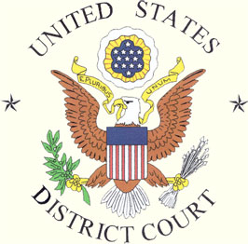
B. JURISDICTION OF U.S. DISTRICT COURTS
  THE GENERAL JURISDICTION, ENTRY LEVEL FEDERAL TRIAL COURTS EXCEPT FOR THOSE INSTANCES WHERE CONGRESS HAS ENACTED STATUTES DIVERTING JURISDICITON FROM U.S. DISTRICT COURTS TO SPECIALIZED COURTS PREVIOUSLY IDENTIFIED OR TO ADMINISTRATIVE LAW JUDGES
  CIVIL ACTIONS ARISING UNDER U.S. CONSTITUTION, U.S. STATUTES AND U.S. TREATIES
  CERTAIN CIVIL ACTIONS BETWEEN CITIZENS OF DIFFERENT STATES OR U.S. CITIZEN AND CITIZEN OF
          ANOTHER COUNTRY

Slide 14
  CERTAIN CIVIL ACTIONS INVOLVING ADMIRALITY AND MARITIME JURISDICTION OF U.S.
  ALL CIVIL ACTIONS WHERE U.S. IS A PARTY
    ALL CRIMINAL PROSECUTIONS BROUGHT BY U.S. GOVERNMENT
    IN GENERAL TWO TYPES OF CIVIL CASES HAVE JURISDICTION IN U.S. DISTRICT COURTS:
      DIVERSITY OF CITIZENSHIP OF THE LITIGANTS
        CASE MUST INVOLVE MORE THAN $75,000 IN POTENTIAL DAMAGES
      FEDERAL QUESTIONS
        CLAIM FOR ENTITLEMENT TO MONEY UNDER A FEDERAL COURT PROGRAM (SOCIAL SECURITY)

Slide 15
    CRIMINAL PROSECUTIONS CAN BE INITIATED IN EITHER FEDERAL OR STATE COURT; THE DECISION ON WHERE TO PROSECUTE IS BASED ON WHETHER CRIMINAL INVESTIGATION CONDUCTED BY FEDERAL OR LOCAL LAW ENFORCEMENT AGENCY
    IN CIVIL CASES A DEFENDANT CAN CHOOSE TO REMOVE THE CASE FROM STATE TO FEDERAL COURT
    HANDLE APPEALS FROM DECISIONS OF CERTAIN SPECIALIZED COURTS OR JUDGMENTS ENTERED BY ADMINISTRATIVE LAW JUDGES

Slide 16
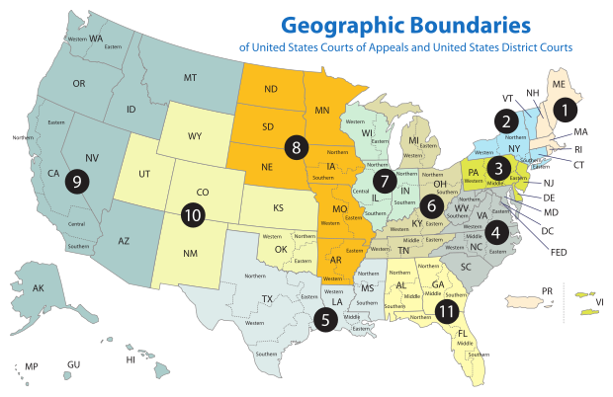
C. U.S. COURT OF APPEALS
  179 JUDGES SIT IN 12 JUDICIAL CIRCUITS
  GEOGRAPHICAL BOUNDRY OF A U.S. COURT OF APPEALS CONSIST OF 2-7 STATES
  PRESIDENT SELECTS JUDGES WHO MUST BE CONFIRMED BY THE SENATE
  NO JURY TRIALS; ONLY HEAR APPELLATE ORAL ARGUMENT
  IT IS THE FEDERAL INTERMEDIATE APPELLATE COURT

Slide 17
  SALARY=$180,00
  PRIMARILY REVIEW DECISIONS FROM U.S. DISTRICT COURTS AND LIMITED NUMBER OF OTHER FEDERAL COURTS WITH JURISDICTION OVER SPECIFIC SUBJECT MATTERS
  DECISIONS SET SIGNIFICANT LEGAL PRECEDENT AND HAVE A STRONG POLICY IMPACT ON U.S. LAW

Slide 18
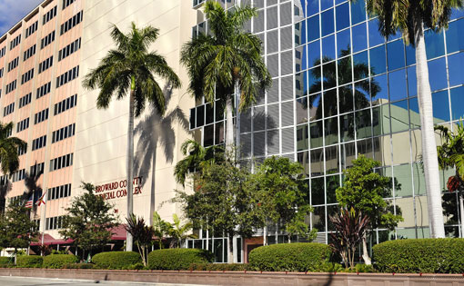
III STATE OF FLORIDA
A. COUNTY COURT JUDGES
  AT LEAST 1 IN EACH OF FLORIDA’S 67 COUNTIES
  COUNTY RESIDENT
  MEMBER OF FLORIDA BAR MINIMUM OF 5 YEARS
  6 YEAR TERM (ELECTED OR APPOINTED)
  SALARY=$ 132,000
  HANDLE JURY AND NON-JURY TRIALS

Slide 19
  JURISDICTION
    MISDEMEANORS
    TRAFFIC OFFENSES
    CIVIL CASES; AMOUNT IN DISPUTE LESS THAN $15,000
    SMALL CIVIL CLAIMS UP TO $5,000
    LANDLORD-TENANT ISSUES

Slide 20
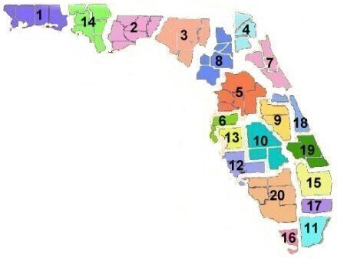
B. CIRCUIT COURT JUDGES
  20 JUDICIAL CIRCUITS
  6 YEAR TERM (ELECTED OR APPOINTED)
  5 YEAR MEMBER OF FLORIDA BAR
  MUST RESIDE IN JUDICIALCIRCUIT WHICH MAY COMPRISE ONE OR SEVERAL COUNTIES
  SALARY= $142,00
  HANDLE JURY AND NON-JURY TRIALS

Slide 21
  JURISDICTION
    ALL FELONIES
    CIVIL DISPUTES OVER$15,000
    FAMILY LAW MATTERS
      DIVORCE
      DEPENDENCY
      ADOPTIONS
      DOMESTIC VIOLENCE
    JUVENILE DELINQUENCY
    PROBATE , GUARDIANSHIP AND MENTAL HEALTH
    APPEALS FROM COUNTY COURT

Slide 22
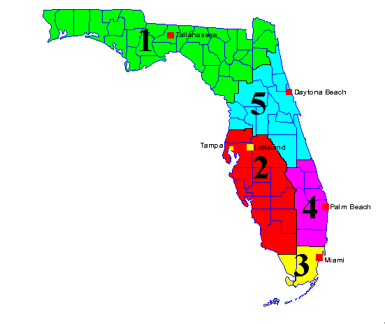
C. DISTRICT COURTS OF APPEAL
  5 JUDICIAL DISTRICTS EACH COMPRISING FROM 2-32 COUNTIES
  FLORIDA BAR MEMBER FOR 5 YEARS
  6 YEAR TERMS (APPOINTED AND MERIT RETENTION)
  RESIDENT OF AREA WITHIN DISTRICT
  SALARY=$152,00
  THE STATE INTERMEDIATE COURT OF APPEAL

Slide 23
  JURISDICTION
    APPEALS OF FINAL ORDERS AND JUDGEMENTS FROM COURTS NOT DIRECTLY REVIEWABLE BY FLORIDA SUPREME COURT OR A CIRCUIT COURT
    APPEALS OF CERTAIN NON-FINAL ORDERS FROM CIRCUIT COURTS
    APPEALS FROM FINAL ACTIONS OF FLORIDA STATE AGENCIES

Slide 24
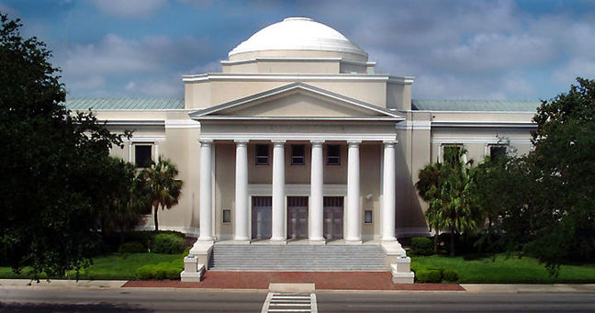
D. SUPREME COURT
  7 JUSTICES
  FLORIDA BAR MEMBER FOR 10 YEARS
  6 YEAR TERM (APPOINTED AND MERIT RETENTION)
  SALARY=$162,000
  ONE JUSTICE SELECTED FROM EACH OF THE AREAS COVERED BY THE 5 DISTRICT COURTS OF APPEALS AND TWO- AT LARGE JUSTICES

Slide 25
  JURISDICTION
    MANDATORY
      DEATH PENALTY CASES
      DECISION DECLARING A STATE STATUTE OR CONSTITUTIONAL PROVISION UNCONSTITUTIONAL

Slide 26
    DISCRETIONARY
      DECISION FROM A DCA THAT CONFLICTS WITH A DECISION OF ANOTHER DCA OR THE SUPREME COURT
      DECISION CERTIFIED BY A DCA TO BE ONE OF GREAT PUBLIC IMPORTANCE
      LEGAL QUESTIONS CERTIFIED BY A U.S. COURT OF APPEALS AS DETERMINATIVE OF A PENDING CAUSE OF ACTION FOR WHICH THERE IS NO CONTROLLING PRECEDENT FROM THE FLORIDA SUPREME COURT

Slide 27
    EXCLUSIVE
      REGULATING FLORIDA BAR
      FINAL DISCIPLINARY ACTION OVER FLORIDA STATE JUDGES AND LAWYERS FOR ETHICAL BREACHES
      ENACT PROCEDURAL RULES FOR THE COURT SYSTEM

Slide 28
IV PREREQUISITES TO BECOMING A JUDGE
  A. EDUCATION
    HIGH SCHOOL
    COLLEGE
    LAW DEGREE (A.B.A. APPROVED LAW SCHOOL)
      J.D.
      L.L.M.
  B. BAR EXAM
    LICENSE TO PRACTICE LAW
  C. OATH OF ATTORNEY
  D. LEGAL PRACTICE

Slide 29
  E. ELECTION V. APPOINTMENT
    POLITICAL CONSIDERATIONS
    COST AND TIME REQUIRED
    JUDICIAL NOMINATION PROCESS
    NON PARTISAN V. PARTISAN
    FUNDRAISING AND EXPENDITURES
  F. CONTINUING EDUCATION REQUIRMENTS
  G. JUDICIAL LECTURING

Slide 30
V. DAY TO DAY JUDICIAL RESPONSIBILITIES
  ADHERE TO JUDICIAL CODE OF CONDUCT AND ETHICS
  MAINTAIN DIGNITY AND DECORUM IN COURTROOM
  TREAT LAWYERS AND LITIGANTS WITH RESPECT
  JUDGES ARE PUBLIC SERVANTS
  CONTROL YOUR CASE DOCKET

Slide 31
  AVOID DELAY IN PRONOUNCING DECISIONS
  WORK EVERY DAY AT BEING FAIR
  CHOOSE FRIENDS CAREFULLY
  KEEP CURRENT WITH NEW APPELLATE DECISIONS AND CHANGES IN RELEVANT RULES AND LAW
  REPORT UNETHICAL OR IMPROPER CONDUCT OF LAWYERS TO THE BAR ASSOCIATION
  INSPIRE PROFESSIONALISM AMONG LAWYERS

Slide 32
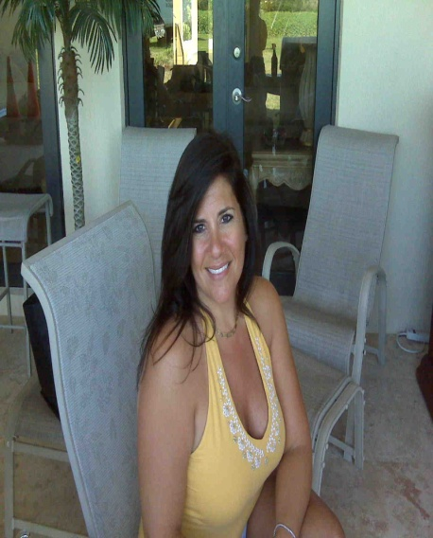
VI. OTHER COURT PERSONNEL
  MAGISTRATES
  COURT BAILIFF
  COURT CLERK
  COURT ADMINISTRATOR
  PROBATION OFFICERS
  JURY COORDINATOR
  COURT PSYCHOLOGISTS
  COURT TRANSLATORS
  COURT MEDIATORS
  LAW CLERKS
  SHERIFF
  JUDICIAL ASSISTANT

Slide 33
THE END

