Slide 1
VI. CRIMINAL PROCESS FROM ARREST TO CONCLUSION
PRESENTED BY:
JUDGE MARK A. SPEISER

Slide 2
I. POLICE INVESTIGATIVE TOOLS
A. ARREST WITHOUT WARRANT
WHEN A FELONY, MISDEMEANOR OR ORDINANCE VIOLATION IS COMMITTED OR IS BEING COMMITTED IN PRESENCE OF OFFICER

Slide 3
B. INVESTIGATIVE MEASURES AVAILABLE TO DETECT CRIME WHEN CRIMINAL ACTIVITY IS NOT READILY ASCERTAINABLE, VISIBLE AND APPARENT
1. UNDERCOVER POLICE
SELLING DRUGS, COUNTERFEIT CURRENCY, ALCOHOL, STOLEN PROPERTY
POSING AS PROSTITUTE, ORGANIZED CRIME HITMAN
MUST BE CONCERNED WITH DEFENSE OF ENTRAPMENT

Slide 4
2. USE OF INFORMANTS
MUST BE RELIABLE AND CREDIBLE
DOES INFORMANT HAVE PENDING CRIMINAL CHARGES OR IS INFORMANT MERELY A CO-OPERATING CITIZEN?
IS INFORMANT “WIRED” TO RECORD CONVERSATIONS?
IS INFORMANT UNDER SURVEILLANCE BY POLICE AT TIME CRIMINAL ACTIVITY IS OCCURRING?
DISCLOSURE OF INFORMANT’S IDENTITY NORMALLY NOT REQUIRED TO JUDGE ISSUING SEARCH WARRANT
AT TRIAL, JUDGE HAS DISCRETION TO DISCLOSE OR WITHHOLD IDENTITY OF INFORMANT

Slide 5
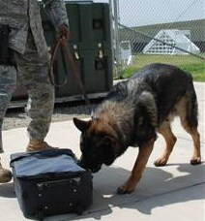
3. NARCOTICS SNIFFING DOGS
DOG HANDLER NEEDS TO ESTABLISH IN SEARCH WARRANT AFFIDAVIT EVIDENCE OF DOG’S HISTORY OF TRAINING AND SUCCESS OF PRIOR IDENTIFICATIONS
NO SEARCH WARRANT REQUIRED TO
USE DOG TO IDENTIFY
CONAINERS OR PACKAGES
CONTAINING DRUGS
POSITIVE ALERT BY DOG CAN
BE USED AS BASIS FOR
PROBABLE CAUSE TO SECURE A SEARCH WARRANT
OFTENTIMES USED BY LAW ENFORCEMENT AT TRANSPORATION HUBS

Slide 6
4. “BIRD DOG” MOBILE
TRACKING DEVICE
NO SEARCH WARRANT REQUIRED
IT IS NOT IMPERMISSIBLY INTRUSIVE UPON PRIVATE AFFAIRS OF TARGET

Slide 7
5. “PEN REGISTER” AND “TRAP AND TRACE” DEVICES
PEN REGISTER IS AN ELECTRONIC DEVICE THAT RECORDS NUMBERS YOU DIAL ON YOUR PHONE
TRAP AND TRACE DEVICES RECORD THE NUMBERS THAT CALL YOU
NOT AN ILLEGAL SEARCH NOR VIOLATION OF 4TH AMENDMENT SINCE THERE IS NO REASONABLE EXPECTATON OF PRIVACY IN THE NUMBERS DIALED OR RECEIVED SINCE TELEPHONE OWNER VOLUNTARILY CONVEYED NUMBERS TO TELEPHONE COMPANY TO FACILITATE THE CONNECTION OF THE CALLS
SMALL V. MARYLAND 442US 735(1979)

Slide 8
NO PRIVACY INTEREST SINCE YOU KNOWINGLY EXPOSE NUMBERS TO PHONE COMPANY FOR BILLING PURPOSES WHEN YOU DIAL OR RECEIVE THEM
EXPECTATION OF PRIVACY EXISTS WITH RESPECT TO WORDS UTTERED ON PHONE AND THUS CONTENTS OF A CONVERSATION ARE PROTECTED UNDER 4TH AMENDMENT BUT NOT DIALING INFORMATION
A COURT ORDER VALID UP TO 60 DAYS IS REQUIRED

Slide 9
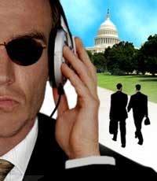
6. WIRETAPPING OR ELECTRONIC EAVES DROPPING SECTION 934.07
THE ACT OF SECRETLY LISTENING TO THE PRIVATE CONVERSATIONS OF OTHERS WITHOUT THEIR KNOWLEDGE OR CONSENT
AFFIDAVIT OF LAW ENFORCEMENT OFFICER IS REQUIRED TO SECURE COURT AUTHORIZATION
COURT ORDER IS GOOD FOR 30 DAYS, BUT MAY BE EXTENDED WITH COURT APPROVAL

Slide 10
BEFORE WIRETAP WARRANT WILL BE JUDICIALLY APPROVED, POLICE MUST ESTABLISH ALL OTHER INVESTIGATIVE TECHNIQUES HAVE EITHER FAILED, ARE LIKELY TO FAIL, OR ARE TO DANGEROUS TO UNDERTAKE
MUST SPECIFY IN DETAIL SUBJECT MATTER OF COMMUNICATIONS SOUGHT TO BE INTERCEPTED, IDENTITY OF PERSONS WHO HAVE OR ARE ABOUT TO COMMIT AN OFFENSE TO BE INTERCEPTED, AND LOCATION(S) WHERE INTERCEPTIONS WILL OCCUR

Slide 11
NO STATE MAY ENACT A WIRETAP STATUTE THAT IS LESS RESTRICTIVE ON LAW ENFORCEMENT THAN THE FEDERAL WIRETAP LAW; STATE WIRETAP LEGISLATION HOWEVER MAY BE MORE RESTRICTIVE THAN THE FEDERAL WIRETAP LAW
STATE WIRETAP STATUTE CAN ONLY BE USED FOR CRIMES ENUMERATED IN THE FEDERAL WIRETAP STATUTE THAT ARE FELONIES DANGEROUS TO LIFE, LIMB OR PROPERTY
NOT PROSTITUTION OR ANY OTHER MISDEMEANOR
PROBABLE CAUSE MUST BE SHOWN THAT A CRIME HAS BEEN OR IS BEING COMMITTED

Slide 12
CAN’T BE USED TO INVESTIGATE NONVIOLENT CRIMES
EVIDENCE OF OTHER CRIMES UNCOVERED AS A RESULT OF AN INVALID WIRETAP CAN NOT AFTER THE FACT VALIDATE AN OTHERWISE INVALID AUTHORIZATION
CAN EITHER BE FOR A “PHONE TAP”OR FOR A “HIDDEN AUDIO AND VIDEO DEVICE” PLACED IN A RESIDENCE OR OFFICE

Slide 13
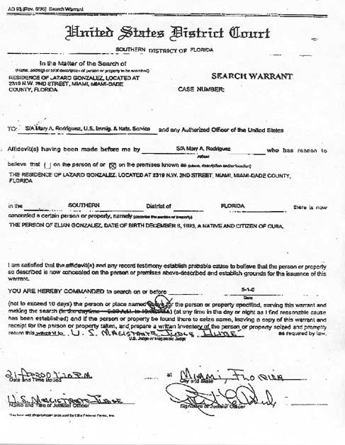
7. SEARCH WARRANTS
PROBABLE CAUSE REQUIREMENT
UNDER OATH BY POLICE OFFICER
APPLICATION MUST BE TO A JUDGE BY AFFIDAVIT OF LAW ENFORCEMENT OFFICER
DETAILED DESCRIPTION REQUIREMENT
PLACE TO BE SEARCHED
THINGS TO BE SEIZED
EVIDENCE TO BE OBTAINED

Slide 14
FREQUENT ISSUES RAISED BY MOTIONS TO SUPPRESS EVIDENCE SEIZED PURSUANT TO SEARCH WARRANT (A/K/A “EXCLUSIONARY RULE”)
OFFICER LACKS JURISDICTION
FALSE STATEMENTS OR OMMISIONS IN AFFIDAVIT
INCORRECT ADDRESS IN AFFIDAVIT
INFORMATON PROVIDED BY AN INFORMANT IS NOT CREDIBLE, RELIABLE OR LACKS POLICE CORROBORATION
MERE CONCLUSIONS IN AFFIDAVIT
(LACK OF SPECIFICITY)

Slide 15
FAILURE TO EXECUTE WARRANT PROPERLY BY NOT COMPLYING WITH “KNOCK AND ANNOUNCE RULE”
EXCEEDING SCOPE OF SEARCH AUTHORIZED BY WARRANT
FAILURE TO LEAVE AN “INVENTORY OF ITEMS SEIZED
DID DEFENDANT HAVE STANDING TO CHALLENGE SEARCH WARRANT
DID DEFENDANT HAVE AN EXPECTATION OF PRIVACY

Slide 16
THE END

