Slide 1
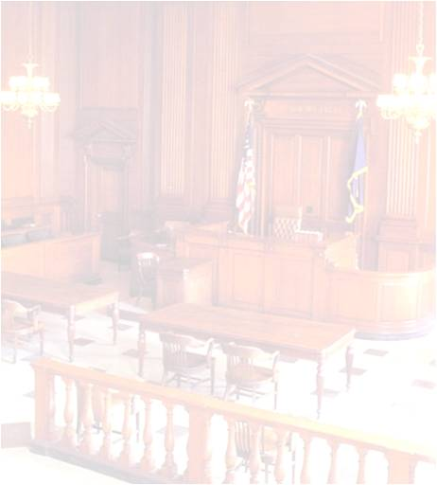
VII. IMPORTANT TRIAL CONSIDERATIONS
PRESENTED BY:
JUDGE MARK A. SPEISER

Slide 2
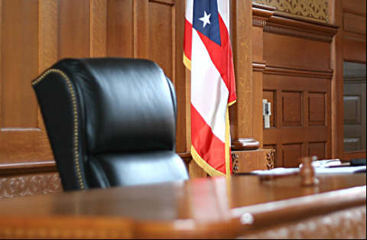
I. ROLE OF JUDGE
CONTROL MEDIA
COURTROOM PRESENCE
ACCESS TO WITNESSES, JURORS AND JUDGE
“GAG ORDERS”
MAINTAIN ORDER IN COURTROOM REMEMBER: RESPECT IS EARNED NOT BESTOWED
CONTEMPT: POWER OF COURT
PROJECT IMAGE OF IMPARTIALITY
SEQUESTRATION OF WITNESSES
CHANGE OF VENUE MOTION DUE TO PRETRIAL PUBLICITY

Slide 3
EXCLUDE PUBLIC FROM COURTROOM DURING TESTIMONY BY CHILD VICTIM OF SEXUAL OFFENSE
RULE ON ADMISSIBILITY OF EXHIBITS INTO EVIDENCE
DETERMINE WHETHER WITNESS QUALIFIES TO TESTIFY AS AN EXPERT WITNESS
RESOLVE UNIQUE EVIDENTIARY ISSUES
RULE ON OBJECTIONS TO TESTIMONIAL EVIDENCE
JUDGE MUST REFRAIN FROM:
FACIAL REACTIONS,
BODY LANGUAGE,
VERBAL COMMENTARY,
CONCERNING AN ATTONEY’S STATEMENTS, WITNESS TESTIMONY OR AN EXHIBIT INTRODUCED INTO EVIDENCE THAT COULD BE CONSTRUED AS A COMMENT OR OPINION BY
THE COURT ON AN ISSUE IN
THE CASE

Slide 4
INSURE JURY COMFORT AND THEIR COMPLIANCE WITH COURT DIRECTIVES
RULE ON OBJECTIONS TO JURY CHALLENGES
RULE ON JUROR NOTETAKING AND JURORS QUESTIONING OF WITNESSES
PREVENT MISBEHAVIOR BY ATTORNEYS OR DEFENDANT
EXCLUDING DEFENDANT
FROM TRIAL DUE TO DISRPUTVE COURTROOM BEHAVIOR IS PERMISSIBLE DESPITE CONSTITUTIONAL RIGHT UNDER 6TH AMMENDMENT TO BE PRESENT AT TRIAL AND CONFRONT THE WITNESSES TESTIFYING AGAINST THE DEFENDANT

Slide 5
RULE ON REQUESTS FOR JURY VIEW OF CRIME SCENE
DETERMINE WHETHER CASE SHOULD BE SUBMITTED TO JURY FOR DECISION
RULE ON MOTION FOR DIRECTED VERDICT OF ACQUITTAL

Slide 6
DETERMINE LAW TO BE FURNISHED TO JURY, THAT IS, THE “ JURY INSTRUCTIONS”
RULE ON DEFENDANT’S CUSTODY STATUS IF CONVICTED
REVIEW PRESENTENCE INVESTIGATION REPORT AND PRONOUNCE SENTENCE

Slide 7
RULE ON POST-TRIAL MOTIONS
INSURE COURT REPORTER RECORDS ENTIRE PROCEEDING TO DEVELOP AN ACCURATE RECORD FOR APPEAL
ARRANGE FOR TRANSLATOR, IF NEEDED

Slide 8
II. JURY ISSUES
DEFENDANT HAS 6TH AMENDMENT CONSTITUTIONAL RIGHT TO JURY TRIAL IF DEFENDANT FACES POSSIBILITY OF A SENTENCE MORE THAN 6 MONTHS
SERIOUS V. PETTY CRIME
DEFENDANT CAN WAIVE RIGHT TO JURY TRIAL IF DONE INTELLIGENTLY AND KNOWINGLY; PROSECUTOR MUST ALSO CONSENT TO WAIVER OF TRIAL BY JURY IF THE JURY TRIAL WAIVER IS INITIATED BY DEFENDANT

Slide 9
JUROR ELIGIBILITY
U.S. CITIZEN
COUNTY RESIDENT
AGE 18-70
NOT A CONVICTED FELON
NOT A SWORN LAW ENFORCEMENT OFFICER
SOURCE OF JURY POOL
VOTER REGISTRY
TAXPAYER ROLL
DRIVERS LICENSE LIST

Slide 10
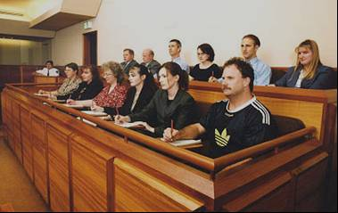
SIZE OF JURY PANEL
FEDERAL-12
STATE OF FLORIDA
DEATH PENALTY -12
ALL OTHER CRIMES-6
FLORIDA IS 1 OF 2 STATES
ALLOWING 6 INSTEAD OF 12
JURORS TO DECIDE A CRIMINAL CASE WHERE A LIFE SENTENCE CAN BE IMPOSED IF DEFENDANT IS CONVICTED
ALTERNATE JURORS
ROLE AND NUMBER
USE OF JUROR QUESTIONAIRES IN CAPITAL OR COMPLEX TRIALS
VOIR DIRE
FEDERAL
STATE

Slide 11
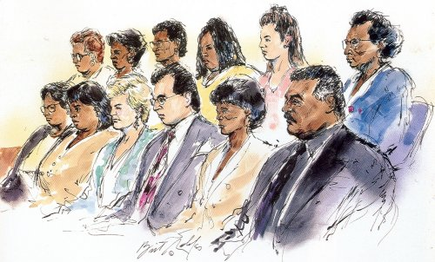
FOCUS OF JUROR INTERVIEWS
UNCOVER BIAS OR PREJUDICE
IDENTIFY PRECONCEIVED IDEAS
ASCERTAIN FAMILIARITY WITH:
CASE
WITNESSES
DEFENDANT
ATTORNEYS
JUDGE
ABILITY TO BE FAIR
CAPABILITY TO REACH A VERDICT
LEARN JUROR’S PERSONAL BACKGROUND

Slide 12
STRIKING ENTIRE JURY PANEL
JUROR CHALLENGES
CHALLENGES FOR CAUSE
UNLIMITED NUMBER
PEREMPTORY CHALLENGES
10- DEATH PENALTY OR LIFE IN PRISON
6- ALL OTHER FELONIES
3- MISDEMEANORS
1- FOR EVERY TWO ALTERNATE JURORS BEING SEATED

Slide 13
STATE AND DEFENSE ALWAYS ALLOWED EQUAL NUMBER OF JUROR CHALLENGES
DISCRIMINATION IN JUROR STRIKING BASED UPON RACE, GENDER, ETHNICITY OR RELIGION ABSOLUTELY PROHIBITED BASED UPON EQUAL PROTECTION CLAUSE OF CONSTITUTION
DEFENDANT HAS STANDING EVEN IF NOT A MEMBER OF EXCLUDED CLASS

Slide 14
MANNER OF STRIKING JURORS
CONDUCTED OUTSIDE OF EARSHOT OF JURORS
MAYBE ORAL OR WRITTEN
DEFENDANT HAS TO APPROVE THEIR COUNSEL’S JUROR CHALLENGES
SWEARING IN THE JURY PANEL

Slide 15
DOUBLE JEOPARDY CLAUSE OF 5TH AMENDMENT TO CONSTITUTION ATTACHES ONCE JURY IMPANELED AND SWORN IN
DEFENDANT CAN NOT BE TRIED TWICE FOR SAME OFFENSE
REPROSECUTION AFTER ACQUITAL PROHIBITED
REPROSECUTION AFTER MISTRIAL ONLY IF BASED UPON DEFENDANT’S CONSENT OR MISCONDUCT; A HUNG JURY; OR ILLNESS DURING TRIAL OF JUDGE, JUROR OR DEFENDANT

Slide 16
JUROR MISCONDUCT
RECEIVING, ACCESSING OR SOLICITING INFORMATION OUTSIDE THE COURTROOM
MISREPRESENTATIONS OR OMMISSIONS DURING JURY SELECTION
SLEEPING JUROR
JUROR HOSTILITY DURING DELIBERATIONS

Slide 17
JUROR SEQUESTRATION
JUROR VERDICTS
UNANIMOUS
HUNG JURY (JUROR DEADLOCK)
GUILTY AS CHARGED
GUILTY OF LESSER INCLUDED OFFENSE
NOT GUILTY
NOT GUILTY BY REASON OF INSANITY
JUROR DISCHARGE

Slide 18
THE END

