Slide 1
Rights of citizens
Táňa Krutilkova
UČO:405472

Slide 2
Citizen
A native or naturalized member of a state or
nation who owes allegiance to its government and is entitled to its protection.
Citizenship
The status of a citizen with its attendant duties, rights and privileges.

Slide 3
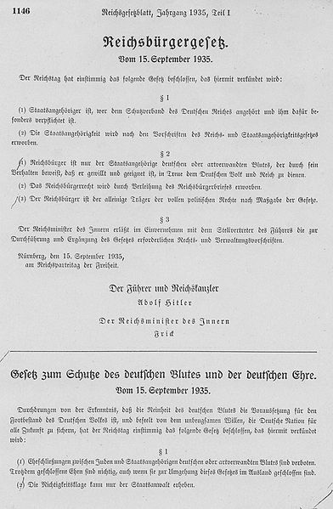

Slide 4
Rights of Citizens
Right to vote
Right to participate in the administration of public affairs
Right to material security in an old age and during incapacitation for work
Right of free education
Right to form political parties and political movements
Right to resistance
Rights of minorities

Slide 5
Right to vote
Election
A formal expression of preference for a candidate for office or for a proposed resolution of an issue.
universal, equal, direct, secret

Slide 6
Right to vote
Austria-Hungary
Election curia
4 types of curia, vote wasn´t equal
1907
equal, secret, universal for man (24, 30)
1920
equal, direct, secret, universal for everybody
(21,30)
Communism
Right to vote - but actually only one political party

Slide 7
Right to participate in the administration of public affairs
Right to participate in meeting of local authority
Chance to express your opinion there
Possibility to aprove or reject an act of the legislature = referendum
Freely choose representatives by election

Slide 8
Material security in old age and during incapacitation for work
Article 30
(1) Citizens are entitled to material security in old age and during incapacitation for work, as well as in the case of loss of their provider.
(2) Everybody who suffers from material need is entitled to such assistance as is essential for securing his or her basic living conditions.
(3) Detailed provisions in this respect shall be set by law.

Slide 9
Right of free education
Education in the Czech Republic is free and compulsory from ages 6 to 15.
Habsburg emperor Maria Theresa of Austria passed the law that every child between ages 6 – 12 is required to attend school.
Universities were shut down at the time of Nazi´s occupation

Slide 10
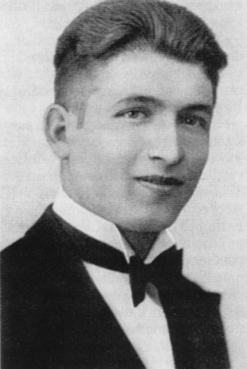

Slide 11
Right to form political parties and political movements
Possibility to express your opinion by form political parties
You need:
Signature of 1000 citizens
Statutes and regulations
3 citizens to form political party

Slide 12
Right to resistance
Citizens have right to resist if human and fundamental rights established by the Charter are violated and there are no legal means lefted.
II. World war call up
1968 invasion

Slide 13
Rights of minorities
Citizens have right to communicate with authority in their language, have education in their language, participate in issues related to minorities.
Right to develope their culture

Slide 14
Cvičení
Status
Privileges
Right to vote
Certain duties
Duty to serve
Multiple
stateless
Amend
Ballot
Polling station
Censorship
Sovereignty
Resident
Fundamental rights
Franchise
Corrupt practices
Pre election

Slide 15
References
http://en.wikipedia.org/wiki/Suffrage
http://legal-dictionary.thefreedictionary.com/
http://dictionary.law.com/
Presentation of Mr Smejkal
SCHELLE. Právní dějiny. Plzeň: Vydavatelství a nakladatelství Aleš Čeněk, 2007, 1134 s. ISBN 978-807-3800-437
http://www.zakonyprolidi.cz/cs/1993-2

Slide 16
Thank you

